Slide 1
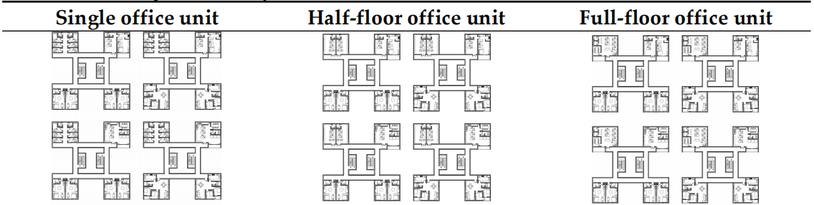
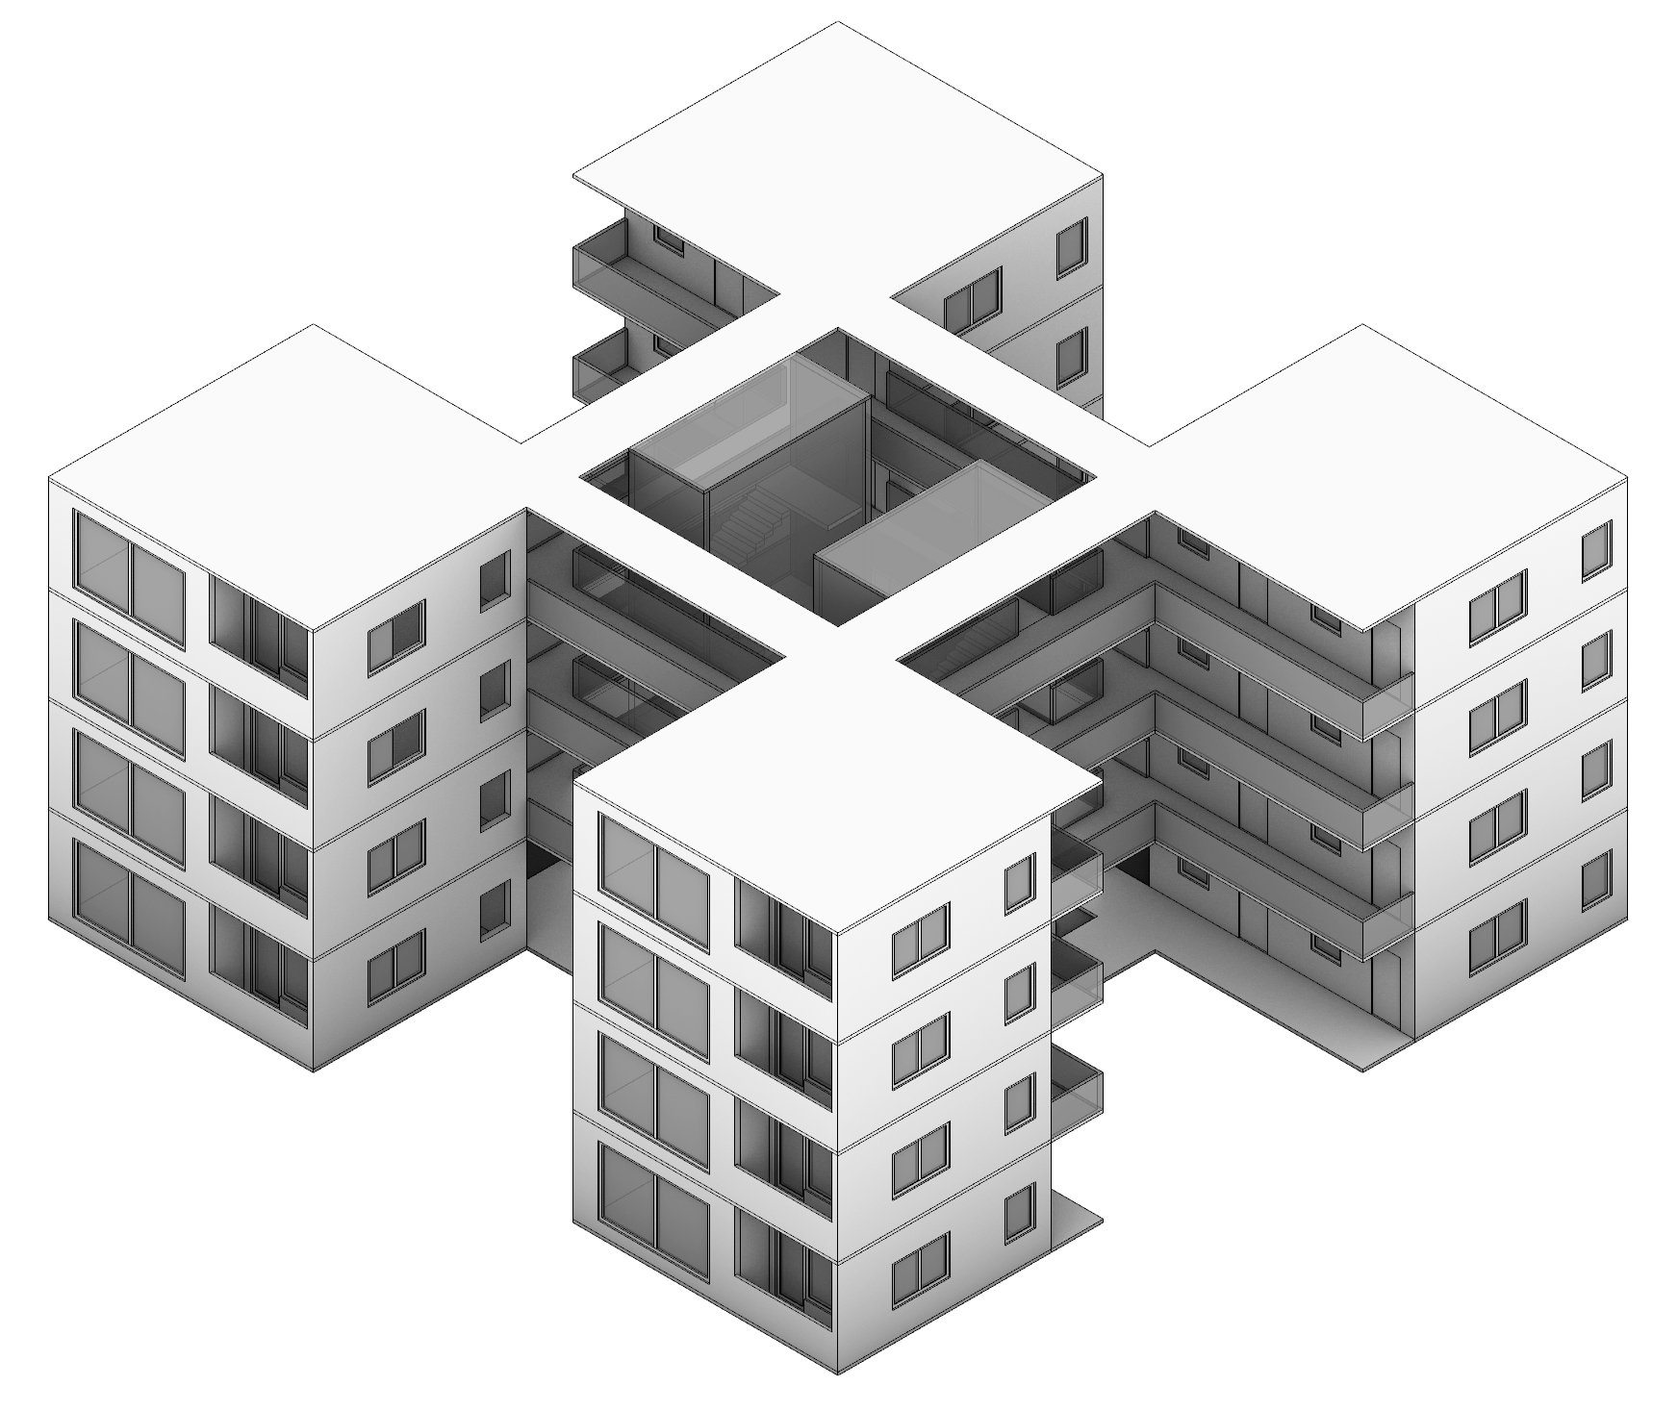
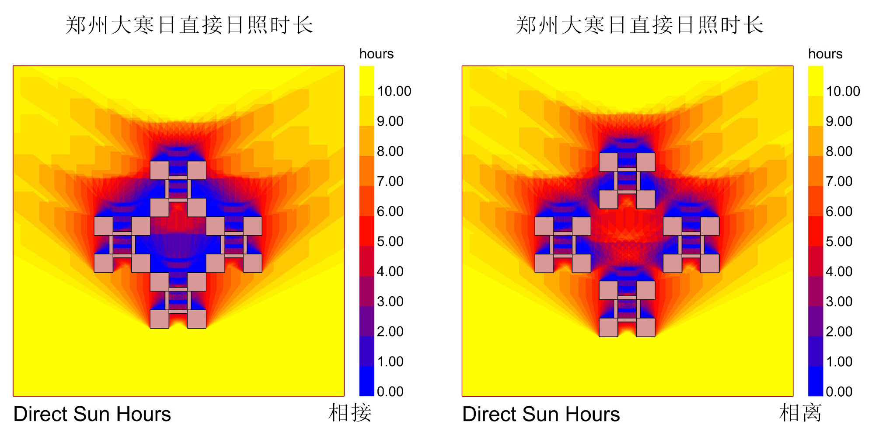
Research On The Design Of Prefabricated Industrial Park In Zhengzhou Based On The Concept Of "Interest-based Relationships"
Yilin Wang1, Meiwei Wu 2,*
1 Nanjing Tech University; 2 Zhengzhou University
INTRODUCTION & AIM
RESULTS & DISCUSSION
Industrial parks are crucial for China's development, attracting investments, fostering innovation, and driving local economies. However, the conventional industrial park model faces challenges like centralized layouts, single functions, and urban-industrial separation due to the evolving Chinese economy. This outdated model results in issues like poor industrial convergence, suboptimal land use, and inefficiencies in value chain establishment. Moreover, the rapid expansion of industrial parks has outpaced planning and research efforts, rendering traditional approaches obsolete. Therefore, there's a pressing need to optimize the construction model for industrial parks to align with modern demands.
In recent years, modular construction has gained traction in the construction industry due to its numerous advantages over traditional methods. Modular construction, with its speed, safety, and environmental benefits, has gained popularity in recent years. It aligns well with the industrial park model, offering standardized designs and factory-based production. This study assesses its suitability in Zhengzhou's industrial park development, aiming to provide insights for its advancement.
1 Basic functional module
According to the "Design code for residential buildings" (GB 50096-2011), residential spaces must include at least the basic functional areas, such as bedrooms, living rooms (or halls), kitchens, and bathrooms. Additionally, bedrooms and living rooms can be combined for dual-use, referred to as a combined bedroom and living room.In this paper, each functional space is discussed in detail.
2 Functional Module Combinations
The above-mentioned functional modules are combined into residential modules, mixed modules, and office modules.
Residential module has total four different layout options according to different living structures. Mixed modules are categorized into half-floor, single-floor, and double-floor layouts based on the company's varying scale requirements. Office modules are divided into single-room, half-floor, and full-floor layouts based on different office space size requirements.
3 Basic units
Three functional modules are combined based on specific circumstances to create units of different types tailored to the diverse needs of different populations. For companies of varying sizes, different office and residential modules are arranged and combined according to distinct organizational requirements, resulting in a variety of unit combinations.
4 Basic cluster
Four basic units are arranged to form a basic cluster, creating an open courtyard space at the cluster's center.
Interest-driven clustering, centered around a particular industry, extends to related industries and continues to grow with related industries at the core. Through this approach, it enhances communication and vitality among various industries.
Figure 1. Unit floor plan summary
……
METHOD
1 Extraction
This article primarily identifies four modular types: Residential Module (residential functionality), Office Module (office functionality), Mixed Module (combined work and living spaces).
2 Combination
According to the industry standard, the ratio of office to residential area is 1:7, and the functional area is allocated according to this ratio.In addition, the blocks are arranged according to the sunshine conditions.
3 Connectivity
Combining the four units into an interest-industry cluster point (Figure 1) forms a cluster. Within the cluster level, connections are established through corridors, and these corridor spaces serve as interest-industry spaces. Taking into account the lighting and ventilation of the four modules, vertical transportation is arranged on the inside of the corridors. When combining units at the cluster level, According to the sunshine analysis, the connection mode of phase separation is selected.(Figure 2)
Figure 1. Unit module axonometric Figure 2. Direct sunlight analysis
4 Growth
The interest-based growth model facilitates closer cluster connections, expanding as needed. New clusters connect through corridors, forming interest-based industry hubs. Residents can select clusters based on hobbies, but diverse interests require more options.
CONCLUSION
This study explores "Interest-based" work-residence relationships at Zhengzhou Accelerator Industrial Park. It utilizes a modular approach with a 9000mm * 9000mm basic module size, defining three core unit types: residential, office, and mixed modules. These units are combined into diverse clusters, with four units forming interest-based industry hubs that expand and aggregate between clusters. The study also offers detailed module designs, creating a library for designers to expedite designs while maintaining flexibility and creativity. By leveraging modern modular design and prefabricated construction, this study establishes a scalable model, providing guidance for similar projects. Its goal is to foster standardized industrial park production, fueling the construction industry's expansion.
https://iocbd2023.sciforum.net/

