Slide 1
THE 10TH INTERNATIONAL CONFERENCE ON SENSOR AND APPLICATION
DEVELOPMENT OF A COMPACT IOT-ENABLED DEVICE TO MONITOR AIR POLLUTION FOR ENVIRONMENTAL
SUSTAINABILITY
AUTHORS:
Dr. L VIJAYARAJA, DEEE, SRI SAIRAM INSTITUTE OF TECHNOLOGY
Dr. R DHANASEKAR, DEEE, SRI SAIRAM INSTITUTE OF TECHNOLOGY
VIDHYA D, DEEE, SRI SAIRAM INSTITUTE OF TECHNOLOGY
UMA MAGESHWARI K, DEEE, SRI SAIRAM INSTITUTE OF TECHNOLOGY
Mrs. RUPA KESAVAN, DCSE, SRI VENKATESHWARA COLLEGE OF ENGINEERING

Slide 2
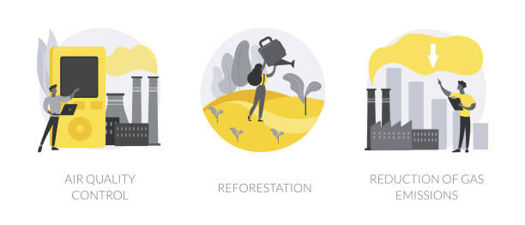
OBJECTIVE
Assess air quality
Protect human health and the environment
Identify pollution sources
Issue alerts when pollution levels exceed safe limits
Collect data for research and policy development
Raise public awareness
Ensure compliance with emissions regulations.

Slide 3
ABSTRACT
An IoT-based Air Pollution Surveillance System (APSS) has been developed to combat worsening air quality worldwide. Deploying IoT sensors in urban and industrial areas, it monitors pollutants like PM2.5, NO2, CO, and more. It predicts air quality using regression models considering weather and traffic, categorizes it, and triggers alarms for poor air quality. The system employs an MQ-135 gas sensor, shares data via the internet, and alerts authorities and the public if pollution exceeds safe levels. User-friendly web and mobile interfaces provide real-time air quality data. Field trials validate its effectiveness in promoting environmental sustainability and citizen engagement.

Slide 4
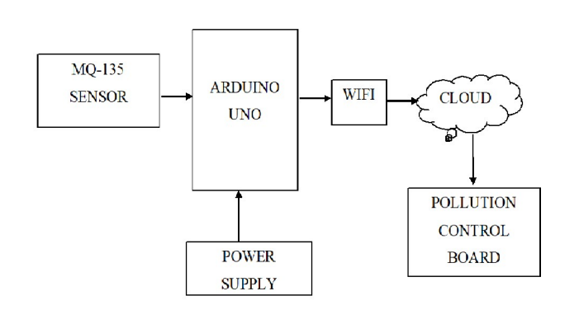
PROPOSED SOLUTION
The proposed air pollution surveillance system shown in Fig. 1. The power supply is given to the Arduino UNO. The MQ-135 sensor detects ammonia, sulfur, benzene, carbon dioxide, smoke, and other similar harmful gases and sends them to the Arduino UNO. It is connected with the wi-fi module, as shown in Fig. 1, which sends data when the pollution rate received from the gas sensor is high. Then the data is sent to the pollution control board through a hybrid cloud that combines both public and private cloud resources, which takes steps and takes action towards reducing pollution in the air.
5
MQ-135 SENSOR
ARDUNO UNO
WI-FI
CLOUD
3
POLLUTION CONTROL BOARD
POWER SUPPLY
1
Fig.1.Air pollution surveillance system

Slide 5
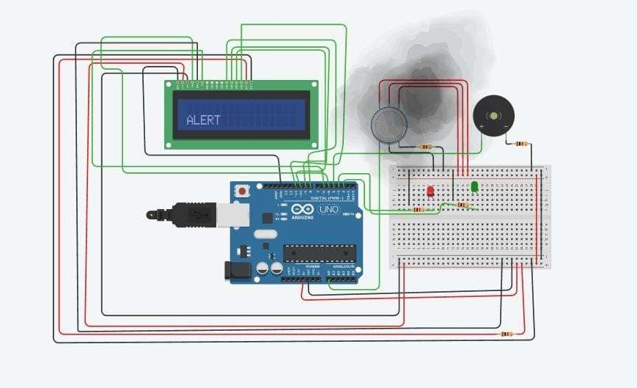
SIMULATION
MODELING OF AIR POLLUTION SURVEILLANCESYSTEM
As shown in Fig. 2, Connections are provided in accordance with the circuit. Data is sent from the MQ-135 to alarm system sounds and the alert message is shown on the LCD when the level of smoke or pollution is excessive. The pollution control board receives the data on a continuous basis along with its PPM value. The LCD shows a safe message when the pollution level is below the set threshold. When the circuit is closed, the safe green LED illuminates.
Fig.2. APSS-Simulation

Slide 6
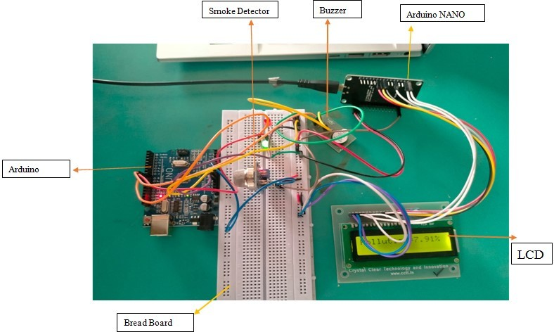
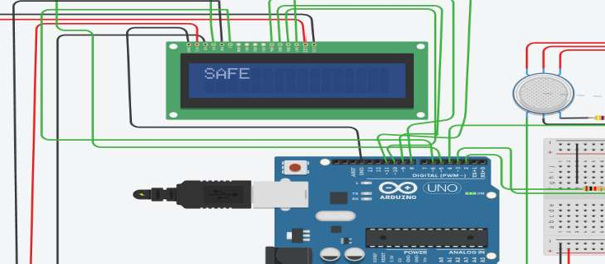
HARDWARE MODEL
Fig.4. Result of APSS for LCD
Fig.3. Result of APSS
The proposed Air Pollution Surveillance System (APSS) employs components including the MQ-135 gas sensor, Arduino UNO, Wi-Fi Module, LCD display, alert system, and LED lights. It detects gases like CO2, smoke, alcohol, benzene, and NH3, monitoring air quality in PPM. When PPM exceeds 1000, the LCD displays an alert message with a red LED indicator; otherwise, it shows a safe message with a green LED as shown in Fig 4. Data is sent via Wi-Fi to the pollution control board, indicating PPM levels, and triggering an audible alert and message when the levels are dangerous. This system enables prompt pollution control actions as shown in Fig 3.

Slide 7
THANK YOU

