Slide 1
ECSA 2023 Conference
“Devising IoT Based Healthcare Medical Container for Transportation of Organs and Healthcare Products using Unmanned Aerial Vehicle“
Authors: S Vijayalakshmi, A Paramasivam, E Balasubramanian, Jaesung Choi, Mohamed Thoufeek K S, Pittu Pavan Sai Kiran Reddy

Slide 2
Introduction
Every second counts when a patient who requires an organ transplant is finally matched with a donor.
The organ's post-transplant performance declines with increasing time between the organ's removal and transplantation into the recipient.
Organs must be transported from point A to B as quickly and safely as possible to improve the chances of success or delivering medical goods or vaccines to hard-to-reach places, current drone technology can help us to save lives across the world.
The medical cargo drones carry containers which will be subjected to many external disturbances such as temperature, pressure, humidity etc.
Further, the drones carrying medical containers flying at different altitudes, time period and climate result in change in temperature.
It is evident that while seeing literatures/previous works related to healthcare products transportation, there is a need for new technology to address and eliminate issues in which one of them is maintaining and monitoring the temperature of container.

Slide 3
Methodology
To tackle the difficulties which have been discussed in problem statement, a novel Medical Container Box is designed and developed. Further, the container is embedded with Peltier module (Thermoelectric cooler), a temperature sensor (LM35 sensor), ESP8266 WIFI Microcontroller (MCU), relay board and battery power banks to maintain & monitor the temperature thereby providing safety for healthcare products such as vaccines, blood units, biopsy samples, human organs etc.
Also, the Internet of Things (IoT) framework has been developed using Blynk application and the ESP8266 WIFI Microcontroller (MCU) enables the developed device to send live data (temperature of the container) to the cloud platform, allowing the user to monitor and control the temperature remotely.
The developed device ensures the high level safety for transportation of healthcare products.

Slide 4
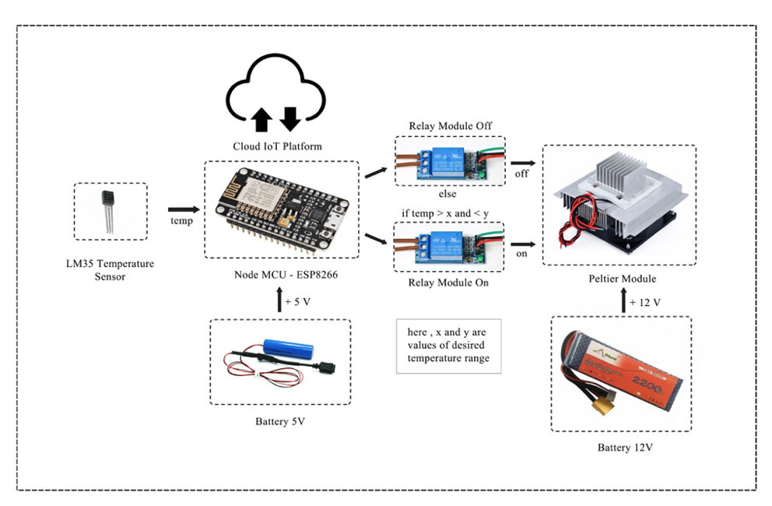
Fig. 1.Overall block diagram of IoT based smart healthcare medical box

Slide 5
Fig.2. Flowchart for working of smart healthcare medical box

Slide 6
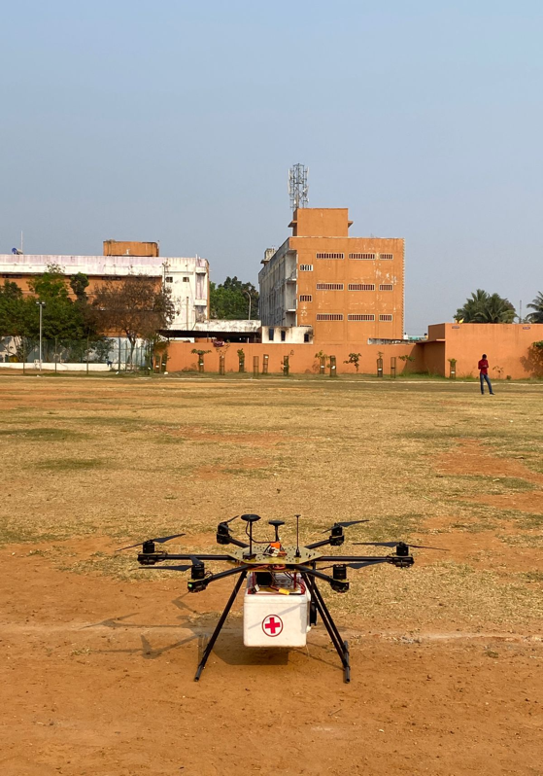
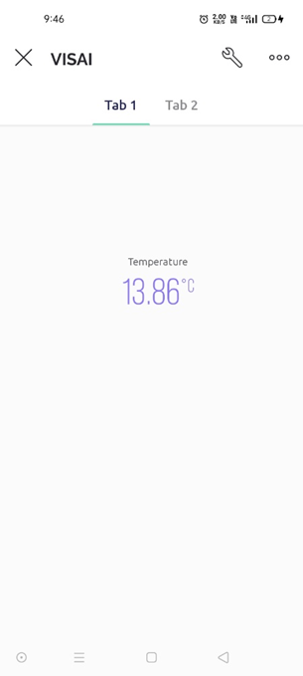

Results and discussions
(a)
(b)
(c)
Fig. 3 (a) Smart medical box integrated with an Unmanned Aerial Vehicle (b) User page of Blynk IoT platform (c) Twilio Messenger Service

Slide 7
Results and discussions
The container box which is attached to a drone, and trial tests were conducted at high altitudes to simulate the actual delivery conditions is shown in the figure 3 (a). Figure 3 (b) shows the custom designed user page of Blynk IoT platform.
The proof of concept is evaluated and it is evident that by using the Peltier module, the temperature of the medical compartment can be maintained at the set values.
The Peltier module is used to maintain a constant temperature within the container during delivery. Also, the trial tests were conducted to assess the efficiency of our container.
The temperature inside the container were recorded continuously with the help of the Blynk IOT platform.
The trial tests showed that the container with the Peltier module successfully maintained the temperature range for 6 to 8 hours. This indicates that the container is suitable for transporting medical goods that require a constant temperature during delivery.

Slide 8
Results and discussions
The proposed system is integrated with Twilio API. The Twilio API sends a message to notify the user that the package has been successfully delivered at the destination.
The container with the Peltier module proved to be efficient in maintaining a constant temperature during delivery, which is crucial for medical goods that require specific temperature conditions.
The integration of the Twilio API allows us to notify the user of successful delivery, which adds an extra layer of convenience and security to the system which is shown in the figure 3 (c).

Slide 9
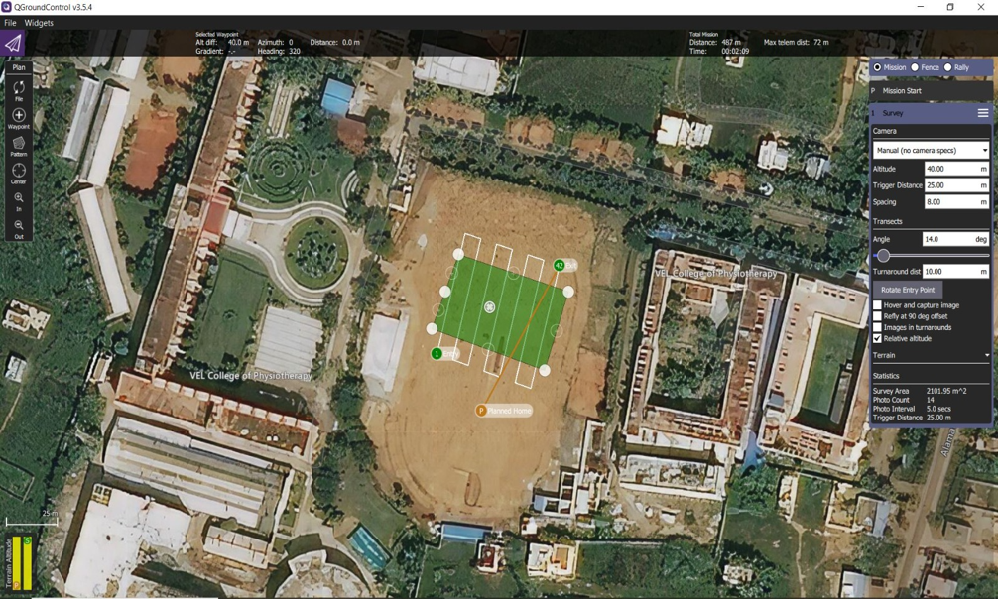
Results and discussions
Fig. 4. QGround Control User Interface

Slide 10
Results and discussions
Also, the figure 4 shows the QGround Control user interface which was used to monitor the drone parameters and control the drone.
Further, it is demonstrated that the altitude, target distance and spacing of the drone can be fixed using QGround Control user interface. Also, it is clearly observed that the path of the drone can be configured using the same user interface whereas the drone will travel through the specified path as shown in the figure 4.
Hence, the QGround Control provides an efficient solution for path planning, mission planning and monitoring of drone. The future work includes conducting trials in different environmental conditions to assess the container's efficiency and further improvements to the system, such as adding Humidity sensor.

Slide 11
Conclusions
A novel medical container box embedded with a Peltier module, temperature sensor, ESP8266 WIFI Microcontroller, relay board, and battery power banks to maintain and monitor the temperature is devised.
The integrated IoT framework to the medical container allows the user to monitor and control the temperature remotely. The entire module is incorporated into a UAV and field testing is performed at various altitude levels and range of 2km.
The developed module is able to maintain the desired temperature and same being transmitted via IoT platform. The developed device ensures high-level safety for transportation of healthcare products, including organs, medical goods, and vaccines. With the assistance of drones, the proposed solution can quickly and safely deliver medical products to hard-to-reach places, saving lives across the world.
Additionally, the proposed solution does not require cryogenic systems, which can be expensive and challenging to maintain. This helps to reduce the risk of product damage, spoilage, or loss during transportation.

Slide 12
References
Sathyan, Asulabha et al. “An advanced approach for an efficient mode of organ transportation.” Materials Today: Proceedings (2021): n. pag.
Stehlik J, Edwards LB, Kucheryavaya AY, Benden C, Christie JD, Dipchand AI, et al. The Registry of the International Society for Heart and Lung Transplantation: 29th official adult heart transplant report--2012. J Heart Lung Transplant. 2012; 31: 1052-64.
Minasian SM, Galagudza MM, Dmitriev YV, Karpov AA, Vlasov TD. Preservation of the donor heart: from basic science to clinical studies. Interactive cardiovascular and thoracic surgery. 2015; 20: 510-9.
Peltier, J., Iriart, X., Mouton, E., & Benoit, G. (2020). Best practices in organ preservation for transplantation. Journal of visceral surgery, 157(1), S37-S43.
Liao, J., Ma, S., Lv, Z., Li, D., & Li, Y. (2021). Advances in blood preservation during storage and transportation. Blood transfusion = Trasfusione del sangue, 19(4), 257-265.
Michel SG, LaMuraglia II GM, Madariaga MLL, Anderson LM. Innovative cold storage of donor organs using the Paragonix Sherpa PakTM devices. Heart, Lung and Vessels. 2015. In press.
Jing, Lei, et al. "Organ preservation: from the past to the future." Acta Pharmacologica Sinica 39.5 (2018): 845-857.
Beutel, G., & Goyal, R. K. (2021). Temperature control in vaccine storage and distribution. Journal of pharmaceutical policy and practice, 14(1), 1-14.

Slide 13
Fahy, G. M., and A. Hirsch. "Prospects for organ preservation by vitrification." Organ Preservation: Basic and Applied Aspects A Symposium of the Transplantation Society. Springer Netherlands, 1982.
de Vries, Reinier J., Martin Yarmush, and Korkut Uygun. "Systems engineering the organ preservation process for transplantation." Current opinion in biotechnology 58 (2019): 192-201.
Remeli, Muhammad Fairuz, et al. "Experimental study of a mini cooler by using Peltier thermoelectric cell." IOP Conference Series: Materials Science and Engineering. Vol. 788. No. 1. IOP Publishing, 2020.
Afshari, Farzad & Afshari, Faraz & Ceylan, Murat & Ceviz, Mehmet. (2020). A REVIEW STUDY ON PELTIER COOLING DE.
Chang Y W, Chang C C, Ke M T, Chen S L (2009). “Thermoelectric air-cooling module for electronic devices”. Applied Thermal Engineering, 29(13), 2731-2737.
Nyemba, W. R., et al. (2019). “Evaluation and feasibility assessment of the sustainability of refrigeration systems devoid of harmful refrigerants for storage of vaccines”. Procedia Manufacturing, 35, 291-297.
Mirmanto, M., Syahrul, S., Wirdan, Y. (2019). “Experimental performances of a thermoelectric cooler box with thermoelectric position variations”. Engineering Science and Technology, 22(1), 177-184.
Zeng, Y., Wang, M., Zhang, H., & Qian, L. (2020). Theoretical analysis of temperature control for a thermal insulation box. Journal of thermal analysis and calorimetry, 139(3), 1503-1509.
Patil, Veerandra, et al. "Fabrication of Solar operated Thermoelectric Refrigeration System." Int. J. Sci. Technol. Res 8.9 (2019).
Schubert, C., Hagedorn, P., & Langer, G. (2019). Sensor technologies for monitoring the cold chain. Current opinion in food science, 30, 1-8.

Slide 14
THANK YOU

