Slide 1



Measurement of Soil Moisture Using Microwave Sensors Based on BSF coupled lines
W. Karasaeng
J. Nualkham
C. Summatta
S. Sonasang
Department of Electronic Technology, Faculty of Industrial Technology,
Nakhon Phanom University, Nakhon Phanom, Thailand 48000
Notes:
Today, I presents the concept Measurement of soil moisture using a microwave sensor based on BSF (Band Stop Filter) coupled lines. next

Slide 2
OUTLINES
INTRODUCTION
DESIGN AND ANALYSIS OF MICROWAVE SENSOR
RESULT AND DISCUSSIONS
CONCLUSION
Notes:
the OUTLINES is divided into 4 topics as follows first INTRODUCTION second DESIGN AND ANALYSIS OF MICROWAVE SENSOR third RESULTS AND DISCUSSIONS forth CONCLUSION next

Slide 3
INTRODUCTION
- Microstrip complementary split-ring resonator ( CSRR)
- Sensor short-range radar
- Passive microwave sensors
- Open-end coaxial cable
- Microwave sensors based on BSF coupled lines
Notes:
the introduction is divided into 4 topics as follows first second third forth fifth next

Slide 4
OBJECTIVE
Design and Analysis of Microwave Sensors Based on BSF coupled lines for Measurement of Soil Moisture
Figure 1
Notes:
The objective Figure 1

Slide 5
DESIGN AND ANALYSIS OF MICROWAVE SENSOR

Slide 6
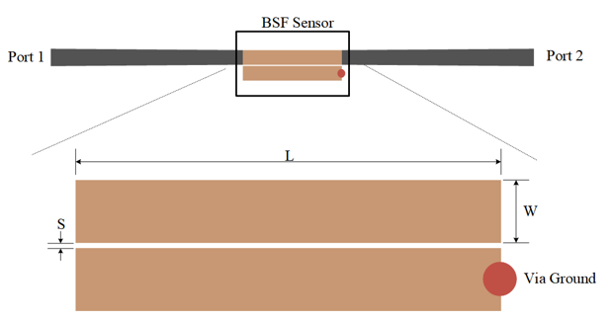
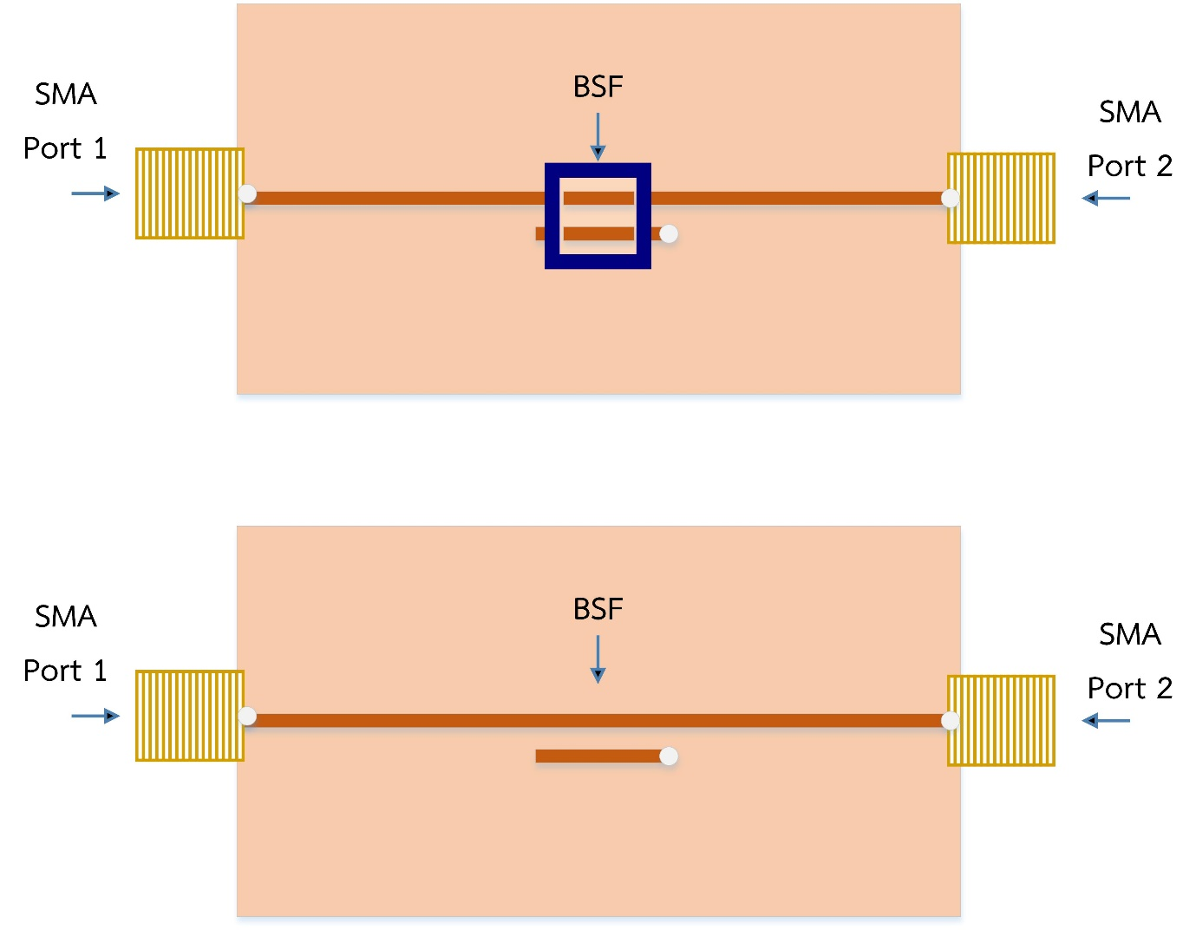
Microwave microstrip line sensor
Fig. (a) The physical of the proposed band stop filter and (b) the prototype band stop filter.

Slide 7
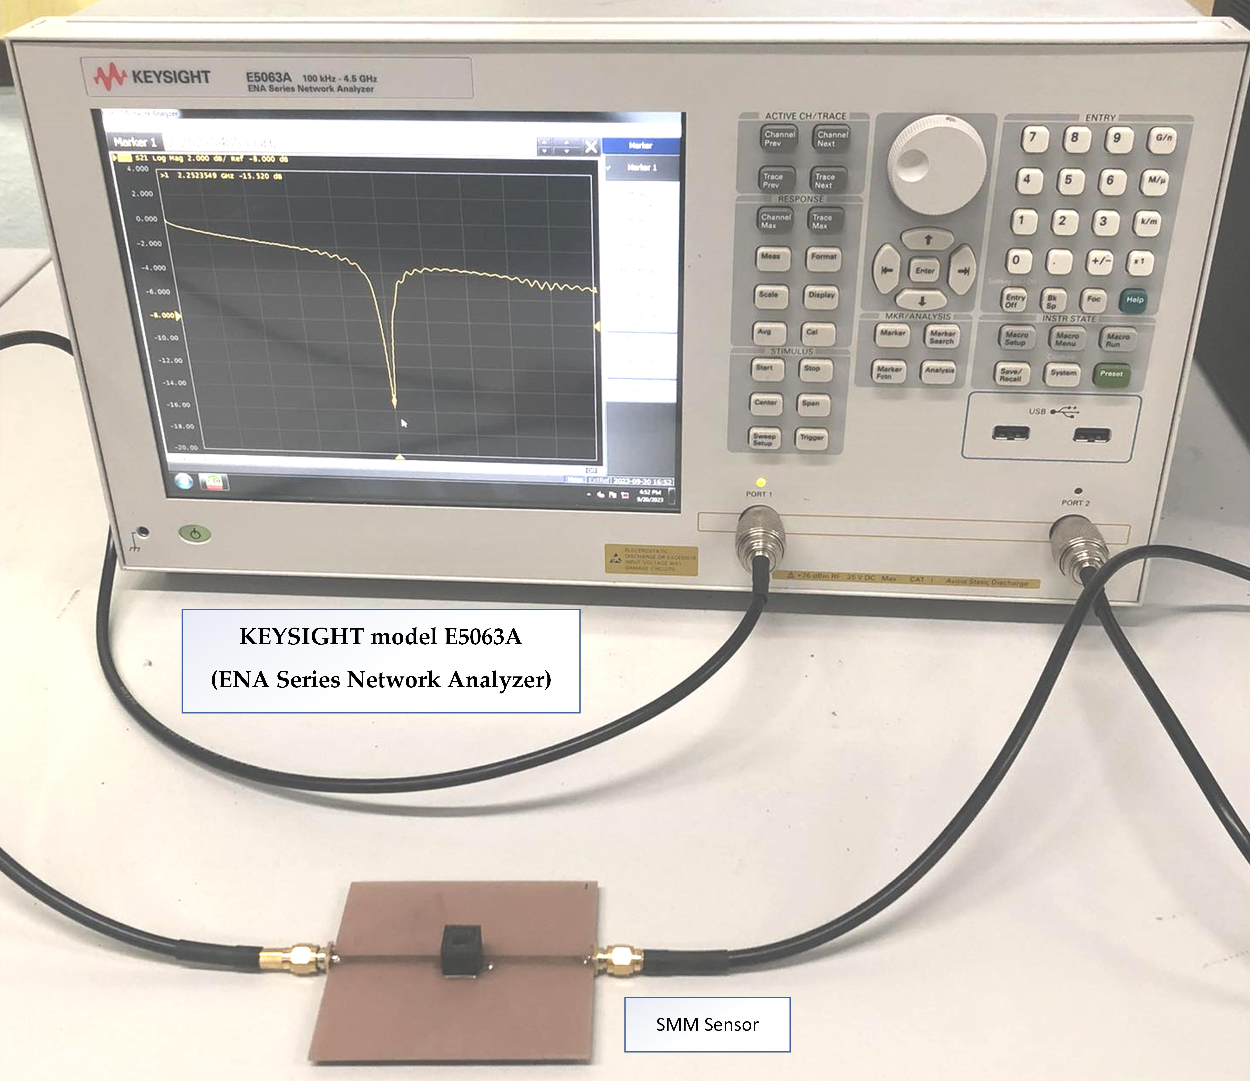
The meter soil Moisture concentrations level
To measurement soil moisture intensity are presented on a scale ranging from 0% to 100% in 20% increments
To measurement of the frequency response of S₂₁, the sample was tested using the KEYSIGHT model E5063A (ENA Series Network Analyzer) network analyzer, which operates in the frequency range of 100 kHz to 4.5 GHz.
Notes:
next

Slide 8
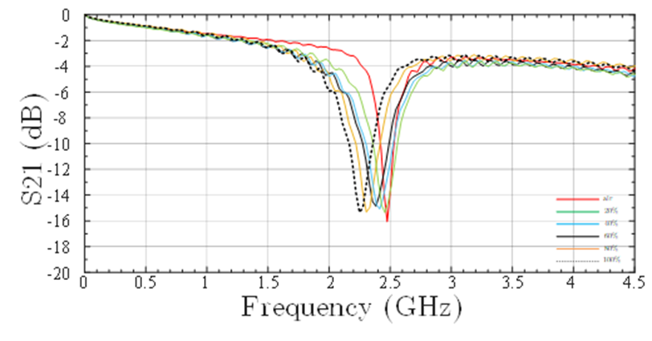
RESULT AND DISCUSSIONS
Notes:
The measurement result of the 0%(air), 20%, 40%, 60%, 80%,and finally 100% the measurement result for the insertion loss
S₂₁ are equal to -15.12 dB, -14.92 dB, -14.85 dB, -15.01 dB, -15.02 dB, and -15.01 dB, at the frequency are 2.45 GHz, 2.432 GHz, 2.390 GHz, 2.361 GHz, 2.305 GHz, 2.250 GHz Works in the signal range from 2.3 to 2.5 GHz next

Slide 9
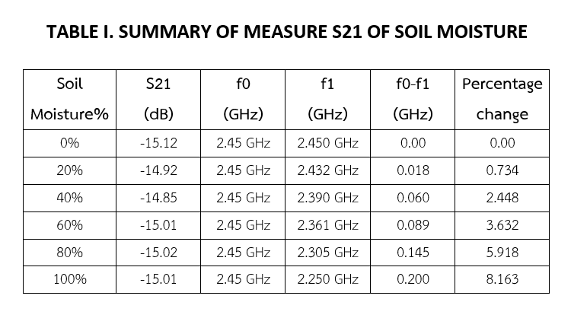

Slide 10
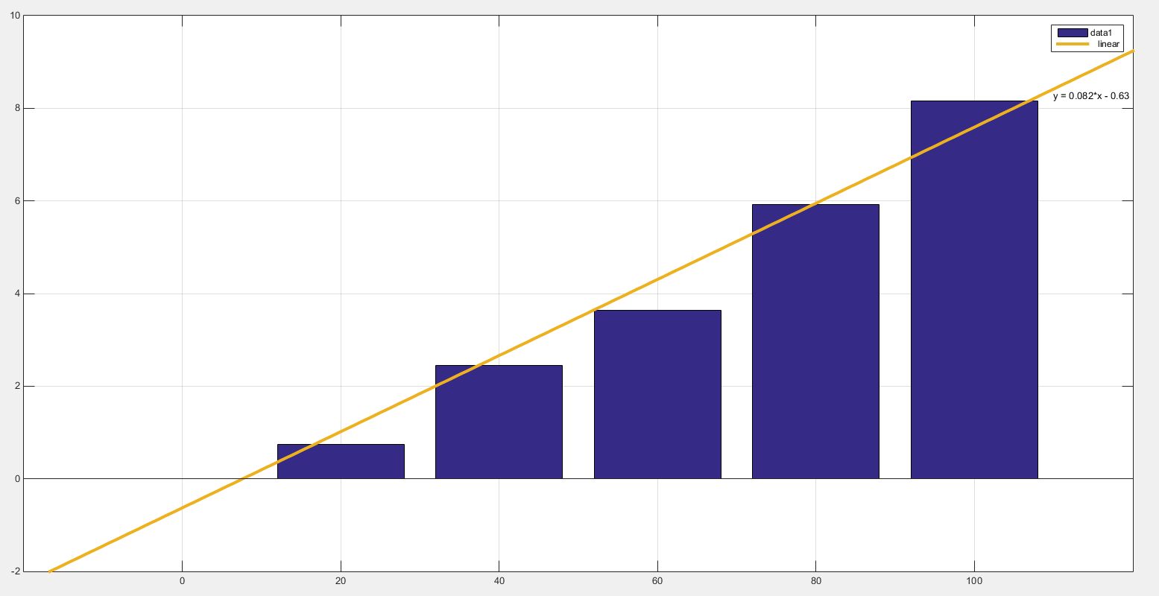
Notes:
The percentage difference was0%, 20%, 40%, 60%, 80%, and 100% between frequency increases with the soil moisture concentration level. next

Slide 11
CONCLUSION
The microwave sensor prototype was measured using a KEYSIGHT network analyzer, specifically the E5063A model, across a 100 kHz to 4.5 GHz frequency range. The measurement involved capturing the frequency response of the transmission coefficient, S₂₁. experiment was performed on samples with varying soil moisture levels, ranging from 0% to 100%. were evaluated, and the resulting frequencies exhibited shifts (f0-f1) with the percentage relationship of the frequency shift of the transmission coefficient was compared, revealing am clear correlation for soil moisture, 0%(air), 20%, 40%, 60%, 80%, and 100%. However, the range of the test samples was shifted.

Slide 12
Acknowledgement

