Slide 1

Low-cost environmental monitoring station to acquire health quality factors
Ioannis Christakis, Vasilios A. Orfanos, Pavlos Chalkiadakis, Dimitrios Rimpas.
Department of Electrical and Electronic Engineering, University of West Attica, Greece

Slide 2
Introduction
In general, the term of health, is referenced to terms like the wellness of the body and the effects on human life, however, mental health also proved equally severe.
The air quality has shown an impact on human health.
There are other forms of environmental pollution,
- Noise pollution
- Light pollution (UV)
The rapid development and construction of electronic circuits has resulted in the creation of reliable microcontrollers and low-cost sensors.
This aspect offers feasibility to build affordable environmental monitoring systems of environmental conditions , giving citizens precious information for their residential area.

Slide 3
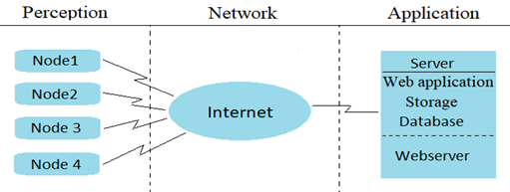
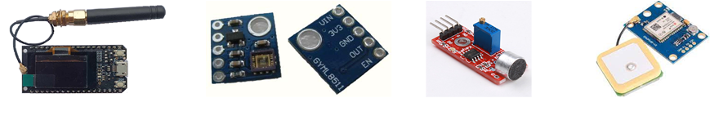
Materials and methods
Three sections compose the IoT architecture, the low-cost environmental monitoring station constitutes the Perception part,
TTGO@ESP32
GYML8511 UV sensor
Sound sensor module
GPS module
Data transfer has been done using "The Things Network (TTN)" LoRaWAN network.

Slide 4
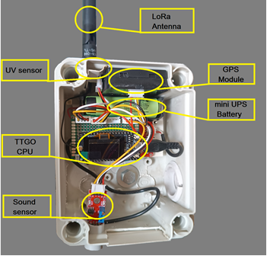
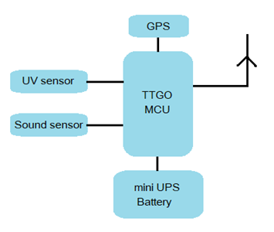
Materials and methods
The diagram of implementation and the final construction of environmental conditions monitoring station
The total cost of the station is approximately 80 €. Every ten minutes a measurement is conducted and transferred over the LoRa network through the internet to the Application server.

Slide 5

Results
On the evaluation of the UV low-cost sensor the UV index calculation took place.
According to the datasheet of the sensor, (output voltage – UV intensity) characteristics extracted the slope of the sensor response.
The proposed UV index derived at equation
$UVI= \frac{\left( calculate output \left(\frac{mW}{{cm}^{2}}\right) ∙ slope \left(\frac{{cm}^{2}}{mW}\right) \right)}{A}$ (1)
The reference data are received by the official monitoring station in cooperation with the National Observatory of Athens.
The distance between the low cost station and reference station are 3 km.

Slide 6
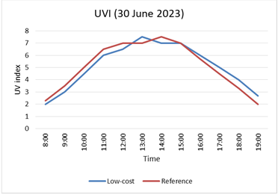
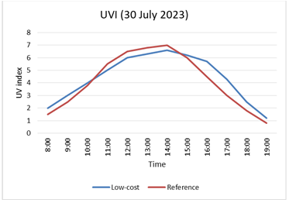
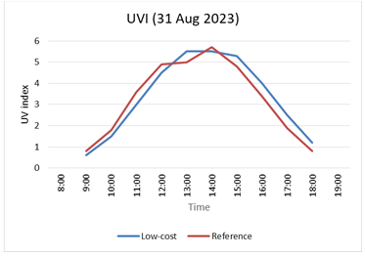
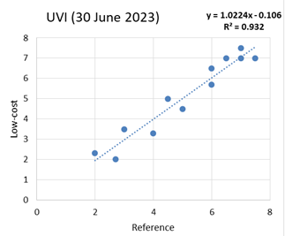
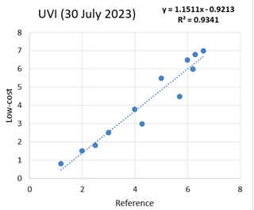
Results
Time series measurements and the correlation of UV index of the low cost sensor and the reference

Slide 7
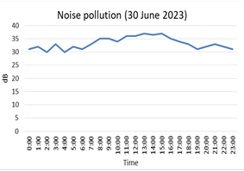
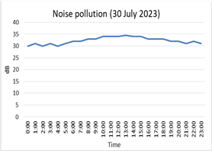
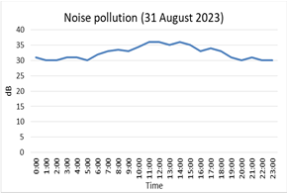
Results
Time-series measurements of noise pollution.
The calibration of the microphone module was performed in a laboratory where the noise level decibel (dB) was known by official instruments.

Slide 8
Conclusion
In the environment, apart from atmospheric, there are other forms of pollution, such as light and noise, which affect human health and wellness. In this article, a low-cost UV radiation and noise pollution monitoring station has been presented. The data transfer has been done through the LoRa network.
The measurements have been retrieved in-vivo and the measured values have been corrected using a proposed equation to extract the UV index for the UV sensor and the sound output in decibels (dB) from the sound sensor. The results are encouraging as the low-cost UV sensor shows a correlation coefficient R² greater than 90% with respect to the reference data, while the noise value accuracy shows satisfactory results as the station was installed in a quiet neighborhood of northeast Attica.
The use of low-cost sensors and their utilization with micro-controllers of new technology, can satisfy a wide range of detection for environmental conditions. The aim is to attract more and more people to actively participate in actions such as public health monitoring which is a common good for all. However, it is a good and affordable solution for the general public to be informed about the environmental conditions where they live and work.

Slide 9
Thank you for your attention

