Slide 1

LoRa radius coverage map on urban and rural areas: Case study of Athens northern suburbs and Tinos Island, Greece.
Spyridon Mitropoulos ^{1,}*, Vasilios Α. Orfanos ², Dimitrios Rimpas ², Ioannis Christakis ²
¹Department of Surveying and Geoinformatics Engineering, University of West Attica, Greece
²Department of Electrical and Electronic Engineering, University of West Attica, Greece.

Slide 2
Introduction
The development of IoT devices in recent years is mainly focused in LoRa protocol for data transmission.
IoT architecture consists of three parts: perception, network and application. A LoRa network include three different types of nodes, i.e., a LoRa server, a LoRa gateway (GW), and the end devices.
One LoRa GW can cover the area of a city. However, coverage directly depends on an area's environmental factors and ground obstacles
In this work an extensive study of the LoRa network coverage is presented, using SNR and RSSI measurements that are received at the LoRa gateway.

Slide 3
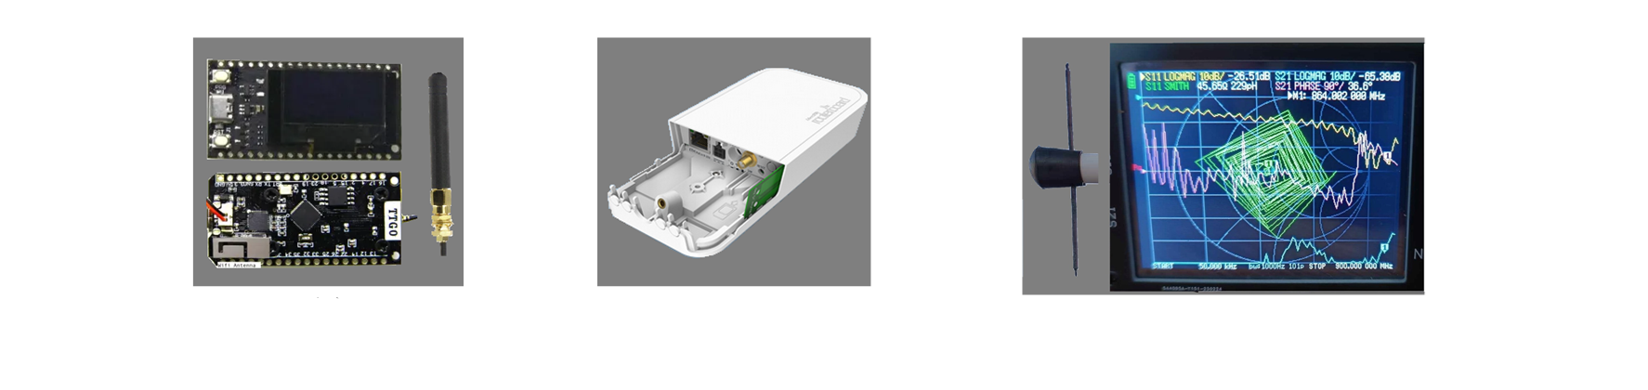
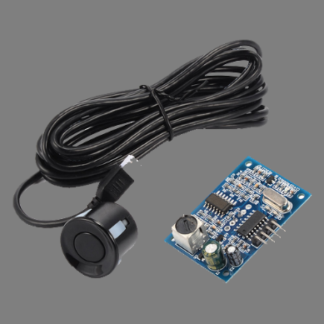
Materials and methods
This study is focused on the perception and network layer because the measurements analysis concerns the radio radius coverage of an area, between the LoRa node and LoRa gateway.
Devices used: TTGO@ESP32 (868Mhz) (station), Mikrotik wAP LR8 (gateway)
Custom dipole antennas were used both as nodes and gateway and antenna performance measurements are shown.
Water depth measured using ultrasonic JSN-SR04T sensor.

Slide 4
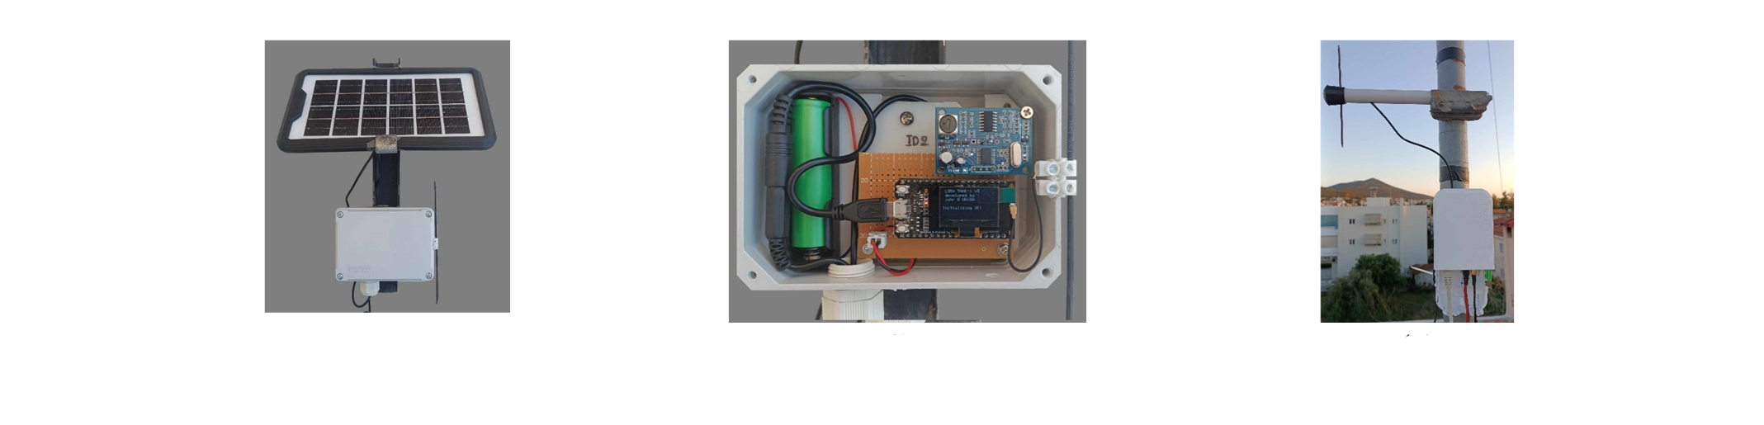
Materials and methods
Portability purpose of the node a small solar panel with a lithium battery. The TTGO@ESP32 based on ESP32, offers high processing performance and low power consumption.
Charging circuit is implemented.
This setup, exploits the 868 Mhz frequency band, spread factor 8, bandwidth 125Khz and code rate 4/5. Measurements are obtained via the web interface of the LoRa gateway.

Slide 5
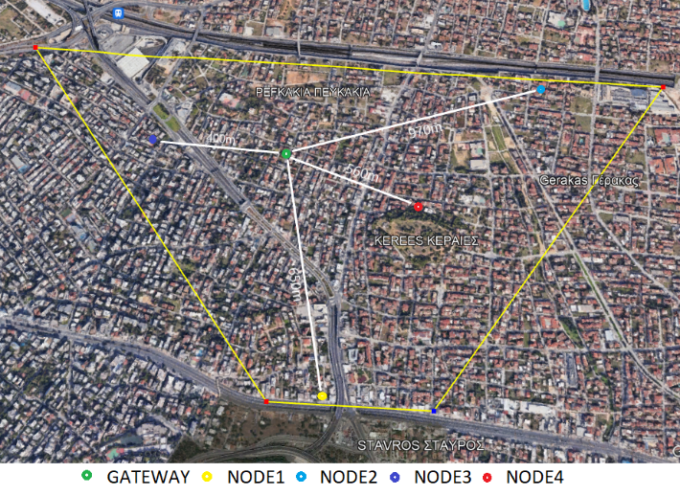
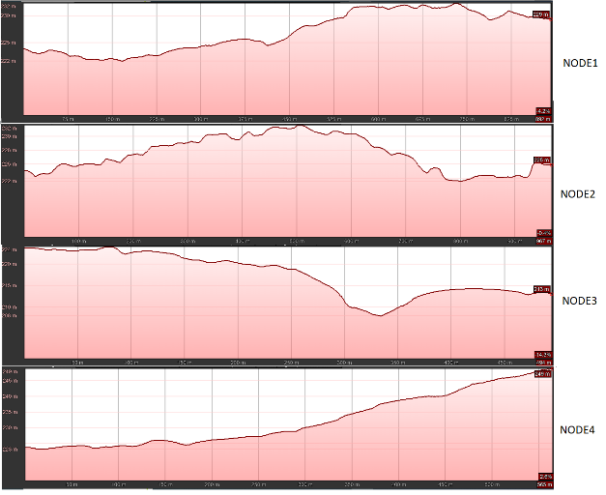
Results
The experiment was concluded at two phases. The LoRa nodes and LoRa gateway were firstly installed within an urban area at the northeast Athens at the municipality of Agia Paraskevi, Attica, Greece. The measurements between the nodes and the gateway are summarized at Table. The measurements were obtained at the two first weeks of the June 2023.
Table. SNR and RSSI measurements from nodes (urban area)
 | GW dist. (m) | Roof (dB) |  | 2nd floor (dB) |  | 1^{rst} floor (dB) |  | Ground (dB)
Node |  | SNR | RSSI | SNR | RSSI | SNR | RSSI | SNR | RSSI
1 | 892 | 0 ~ 2.5 | -110 ~ -113 | -5.5 ~ -7.5 | -112 ~ -114 | N/A | N/A | N/A | N/A
2 | 967 | -7.5 ~ -9.5 | -113 ~ -115 | N/A | N/A | N/A | N/A | N/A | N/A
3 | 494 | -7.0 ~ -10.0 | -114 ~ -117 | N/A | N/A | N/A | N/A | N/A | N/A
4 | 565 | 3~6 | -103 ~ -107 | -2.0 ~ -1.0 | -108 ~ -111 | -7.0 ~ -10.0 | -115 ~ -118 | N/A | N/A

Slide 6
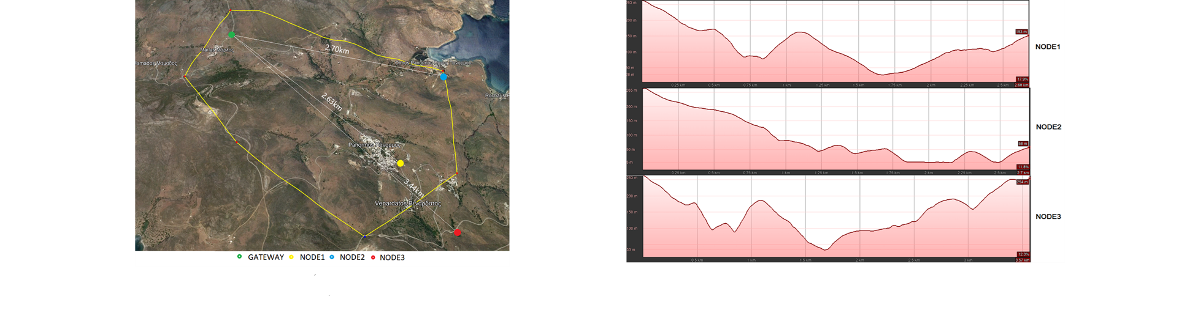
Results
The installation points of the LoRa gateway and LoRa nodes at rural area projected in the figures bellow, while the surface elevation between gateway and nodes. Measurements were obtained at the first two weeks of the July 2023.

Slide 7
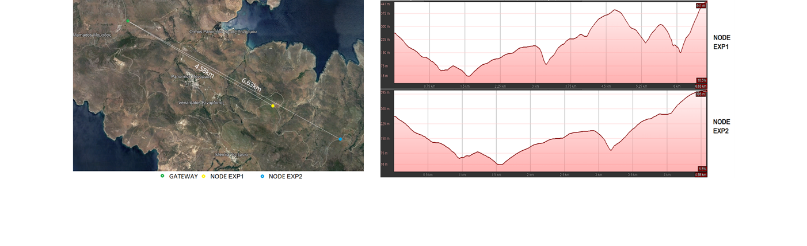
Results
For the research purpose the radio coverage distance extension presented at figures bellow, The table shows the measurements between the nodes and the gateway.
Table. SNR and RSSI measurements from nodes (rural area)
 | Gateway distance (Km) | SNR (dB) | RSSI (dB)
Node 1 | 2.68 | 5.5 ~ 5.7 | -108 ~ -109
Node 2 | 2.70 | 4.5 ~ 5.1 | -109 ~ -110
Node 3 | 3.57 | 3.9 ~ 4.78 | -108 ~ -110
Node EXP1 | 4.58 | 9.5 ~ 10.5 | -95 ~ -91
Node EXP2 | 6.63 | -3.75 ~ 5.5 | -116 ~ -102

Slide 8
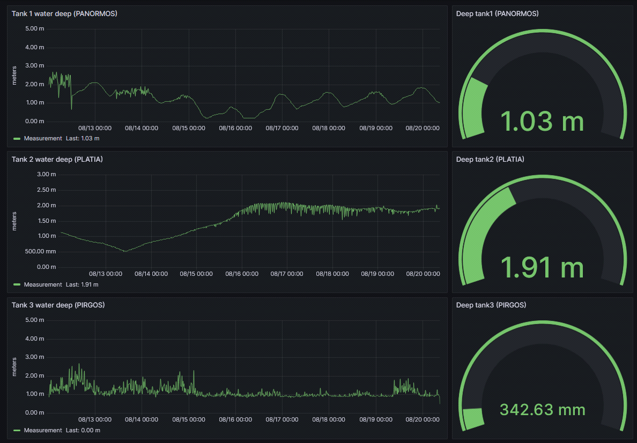
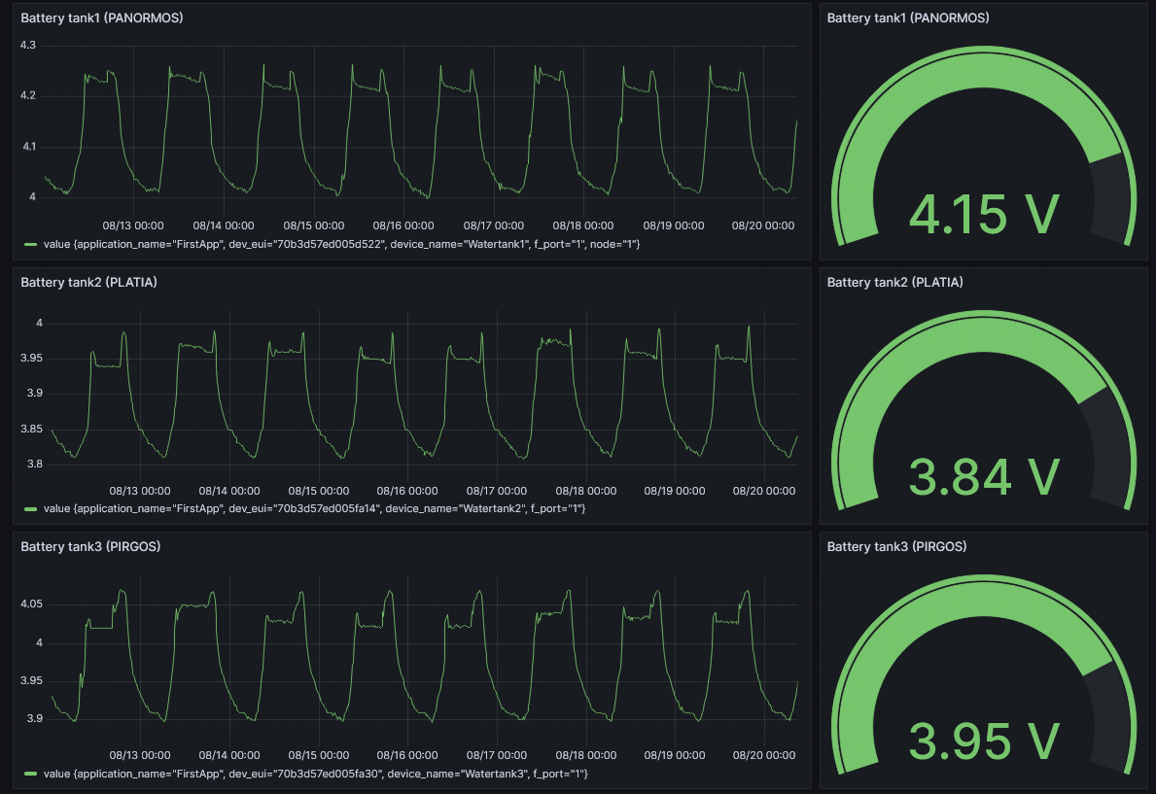
Results
The visualization of the deep of water tank presented dynamically under the Grafana lab environment. Figure bellow, shows the water tanks depth measurements and the battery voltage of the node.

Slide 9
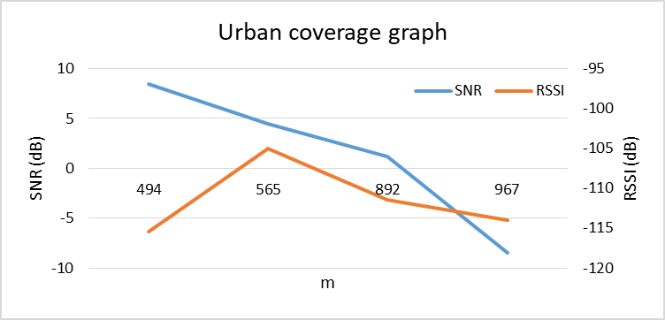
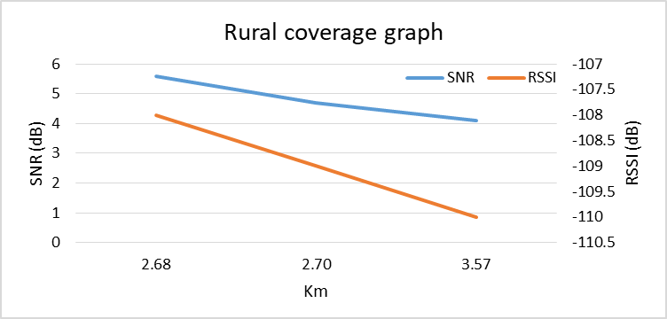
Results
SNR, RSSI measurements show the difference between urban and rural area coverage

Slide 10
Conclusion
In order to improve the life quality, especially in rural areas, automated monitoring systems can offer better living conditions for citizens.
In this work, an autonomous energy water tank measuring system through a LoRa network was presented. The radio coverage measurements were gathered, both in urban and rural areas in a similar terrain.
On the radio coverage, the maximum distance in the urban area was 1 km, while in rural area it worked up to 6.5 km. The measurements in the city were also done for each floor, where in many cases, especially on the ground floor and first floor, the system could not operate properly. In summary, it was confirmed that in non-line of site cases, the LoRa network does not work, plus in an urban area where there is radio noise from different sources (television or radio broadcast, mobile networks, different LoRa networks) the radio coverage decreases while in provinces with no radio frequency noise, this system showed excellent radio coverage.
On the other hand, the operation of monitoring systems, such as the water tanks in a village, especially in rural areas, improves the lifestyle of the citizens, hence directly addressing needs with simple, low-cost but highly important ways in terms of people's quality of life and livelihood.

Slide 11
Thank you for your attention

