Slide 1
Electrical and Optical Properties of Controlled Reduced Graphene Oxide Prepared by a Green and Facile Route†
Parsa Hooshyar ¹, Atieh Zamani ^{1,2,*}, Deniz Rezapour Kiani¹, Shayan Fakhraeelotfabadi ¹, and Mehdi Fardmanesh ^{1,*}
¹SERL, Electrical Engineering department, Sharif University of Technology, Tehran 14588-89694, Iran;
²Department of converging technologies, Khatam University, Tehran 19916-33357, Iran;
*Correspondence: fardmanesh@sharif.edu; atieh.zamani.mail@gmail.com
†Presented at the 10th International Electronic Conference on Sensors and Applications
Notes:
https://www.lasernanofab.com/index.php/8-products/11-additive-micro-manufacturing

Slide 2
Introduction
Graphene: monolayer of carbon atoms held together by sp² covalent bonds in a honeycomb-resembling lattice
Graphene Oxide (GO): the oxidized form of graphene
reduced Graphene Oxide (rGO): fewer oxygen-containing groups than GO
Extraordinary features and applications
When arranged in a stacked configuration, they would form many other derivatives including monolayer, few-layer, and multilayer graphene-based materials, each exhibiting distinct characteristics and properties [1].
[1] Parvin, N., et al., Recent Advances in the Characterized Identification of Mono-to-Multi-Layer Graphene and Its Biomedical Applications: A Review. Electronics, 2022. 11(20): p. 3345.
Notes:
https://www.lasernanofab.com/index.php/8-products/11-additive-micro-manufacturing

Slide 3
Introduction
Most graphene synthesis methods involve the utilization of complex and costly techniques, as well as the need for three-dimensional crystal [2].
We have developed a green and facile route towards the synthesis of free-standing rGO samples. This eco-friendly route is based on the modified Hummer’s method, which uses the least possible chemicals.
[2] Dato, A., et al., Substrate-free gas-phase synthesis of graphene sheets. Nano letters, 2008. 8(7): p. 2012-2016.
Notes:
https://www.lasernanofab.com/index.php/8-products/11-additive-micro-manufacturing

Slide 4
Materials
Synthesis method: Aqueous GO solution has been initially prepared by a modified Hummers method. Pre-treatment of graphite powder favored a lower amount of reactants during synthesis. Also, the reaction time was prolonged to 34 h, which provides a good GO exfoliation without compromising the quality of the dispersion [3-6]. The concentration of the solution was 12 mg/mL, which was then air dried overnight. This was followed by thermal reduction processes to obtain rGO free-standing layers [7].
[3] Paulchamy, B., G. Arthi, and B. Lignesh, A simple approach to stepwise synthesis of graphene oxide nanomaterial. J Nanomed Nanotechnol, 2015. 6(1): p. 1.
[4] Segal, M., Selling graphene by the ton. Nature nanotechnology, 2009. 4(10): p. 612-614.
[5] Sharma, N., et al. Synthesis and characterization of graphene oxide (GO) and reduced graphene oxide (rGO) for gas sensing application. in Macromolecular Symposia. 2017. Wiley Online Library.
[6] Chen, X., Z. Qu, Z. Liu, and G. Ren, Mechanism of oxidization of graphite to graphene oxide by the hummers method. ACS omega, 2022. 7(27): p. 23503-23510.
[7] Roy Chowdhury, S. and T. Maiyalagan, CuCo2S4@ B, N-doped reduced graphene oxide hybrid as a bifunctional electrocatalyst for oxygen reduction and evolution reactions. ACS omega, 2022. 7(23): p. 19183-19192.
Notes:
https://www.lasernanofab.com/index.php/8-products/11-additive-micro-manufacturing

Slide 5
Samples
We produced three distinct rGO samples, designated rGO1, rGO2, and rGO3, using the described method. Notably,
No use of any mechanical or shear force.
Three rGO samples were fine-tuned by adjusting the initial reactant concentration and annealing temperature.
Notes:
https://www.lasernanofab.com/index.php/8-products/11-additive-micro-manufacturing

Slide 6
Structural Properties
The multi-stacked layer architectures of the rGO free-standing thin films are immediately apparent from their FESEM cross-sectional views.
Each stacked layer is about between 2 to 3 µm thick and is made up of multiple rGO planes.
While looking at the surface morphology of the samples, it can be seen that they have a relatively smooth sheet-like surface with few wrinkles.
rGO1
rGO2
rGO3
Notes:
https://www.lasernanofab.com/index.php/8-products/11-additive-micro-manufacturing

Slide 7
Structural Properties
All materials derived from graphene exhibit a G peak in their Raman spectra, and in GO and rGO, a D band is also detected.
The Raman spectra obtained from our rGO samples confirm these findings.
Also disclose a shift of the G bands towards lower wavenumbers when compared to the G bands of the GO, which is indicative of a lower oxygen content in the rGOs.
The intensity ratio between the D band and the G band (ID/IG) shows that the number of surface defects is small [8].
[8] Palaniselvam, T., H.B. Aiyappa, and S. Kurungot, An efficient oxygen reduction electrocatalyst from graphene by simultaneously generating pores and nitrogen doped active sites. Journal of Materials Chemistry, 2012. 22(45): p. 23799-23805.
Notes:
https://www.lasernanofab.com/index.php/8-products/11-additive-micro-manufacturing

Slide 8
Electrical Properties
We first measured the rGO samples’ resistance value in various directions at room temperature using the four-point probe technique. The values measured in different directions for each sample differ just slightly.
The recorded measurements exhibit an average value of approximately 19.38, 294.25, and 5849.7 Ω for rGO1, rGO2, and rGO3, respectively.
Different days
In AC measurements, no phase change was observed between voltage and current passing through them. As a result, these free-standing homogeneous thin-films are laterally pure-resistive.
homogeneity
versatility and tunability
No change
Thermally stable
Notes:
https://www.lasernanofab.com/index.php/8-products/11-additive-micro-manufacturing

Slide 9
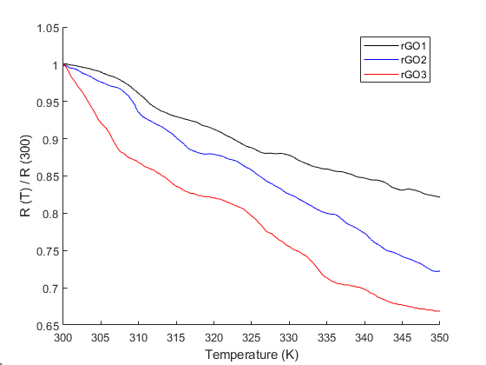
Electrical Properties
The electrical resistance versus temperature (RT) curves of the samples show that with an increase in temperature, the resistance of rGO1, rGO2, and rGO3 decreases at a rate of 0.35, 0.55, and 0.65 %/K, in turn, implying semiconducting behavior in the rGOs.
Sample with higher conductivity and therefore higher reduction degree, suggesting a lower C/O ratio, has a lower temperature coefficient of resistance (TCR), implying a decrease in its semiconducting energy gap [9].
RT curves of rGO1, rGO2, and rGO3
[9] Jung, I., D.A. Dikin, R.D. Piner, and R.S. Ruoff, Tunable electrical conductivity of individual graphene oxide sheets reduced at “low” temperatures. Nano letters, 2008. 8(12): p. 4283-4287.
Notes:
https://www.lasernanofab.com/index.php/8-products/11-additive-micro-manufacturing

Slide 10
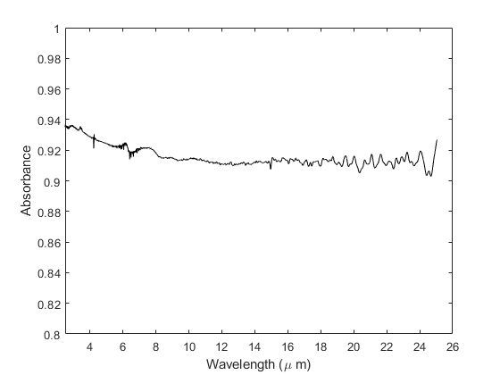
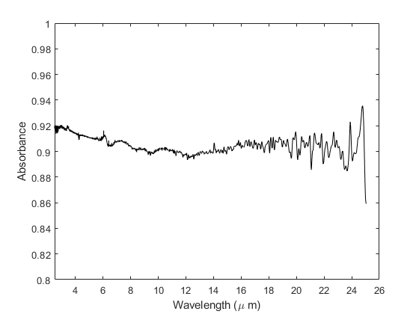
Optical Properties
rGO1 and rGO2 were measured and analyzed by FTIR spectroscopy, within the wavelength range of 2.5 to 25 µm.
Their absorbance spectra highlight the significant absorption values of the samples exceeding 90% across the entire spectrum, indicating their potential use as spectrally wide absorbers.
FTIR spectra of rGO1 (up) and rGO2 (down)
Notes:
https://www.lasernanofab.com/index.php/8-products/11-additive-micro-manufacturing

Slide 11
Conclusions
By using a modified version of Hummer's method, which is a facile, versatile, and eco-friendly approach, three self-standing rGO samples were successfully synthesized.
Despite the absence of shear stress in the production process, their cross-sectional FESEM images validate the attainment of a well-organized stacking arrangement. Also all samples displayed minor surface defects and a smooth sheet-like structure with few wrinkles.
According to our electrical and optical investigations, the samples showcased semiconducting behavior and substantial absorption values exceeding 90% in a wide infrared range.
Different features exhibited by each sample indicate that it is possible to fine-tune their properties, thereby enhancing their potential for a variety of applications, including electronics, thermoelectric, and optoelectronics devices.
For instance, the mentioned green synthesis route, coupled with high optical absorption of samples even in electrically conductive ranges, makes them a clean and favorable option for many biomedical applications.
Notes:
https://www.lasernanofab.com/index.php/8-products/11-additive-micro-manufacturing

Slide 12
Thanks!
for your attention

