Slide 1
Developing a Cross-Platform Application for Integrating
Real-time Time-series Data from Multiple Wearable Sensors
ECSA-10
10th International Electronic Conference on Sensors and Applications
2023
Pataranit Sirithummarak
Zilu Liang Ubiquitous and Personal Computing Lab
Kyoto University of Advanced Science (KUAS)

Slide 2
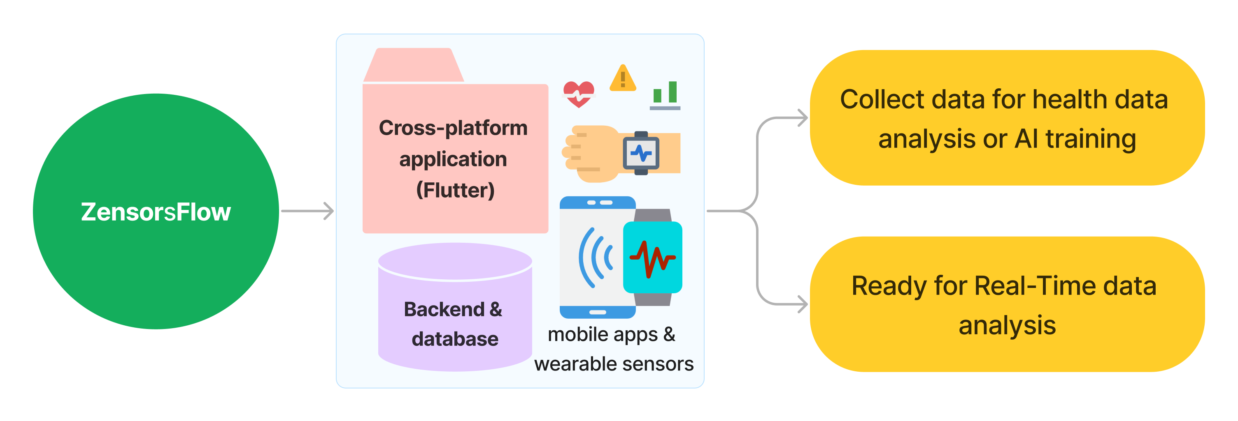
Overview
ZensorsFlow
Developing a Cross-Platform Application for Integrating Real-time Time-series Data from Multiple Wearable Sensors
KUAS | ubicomp-lab.org | ZensorsFlow Developing a Cross-Platform Application for Integrating Real-time Time-series Data from Multiple Wearable Sensors

Slide 3
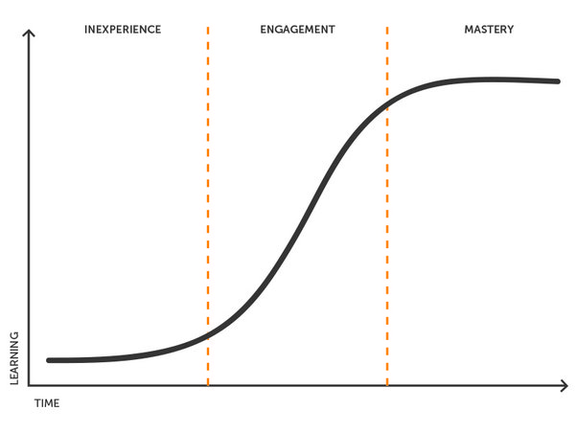
Background & Motivation
Problems Statements
Wearable data research for mHealth is popular recently, however collecting quality and quantity data is not an easy step
Developing mobile application especially with wearable sensors is complex and learning curve is high for non-expert
For data science researchers, it may cost much time and effort or money, in case they need to get custom app dealing with wearable sensors while they should be focusing on their tasks
Due to technical barriers, data researcher may encounter the loss of data or quality cannot be controlled
Software development learning curve
Source: https://www.quora.com/Why-is-there-such-a-steep-learning-curve-to-programming
KUAS | ubicomp-lab.org | ZensorsFlow Developing a Cross-Platform Application for Integrating Real-time Time-series Data from Multiple Wearable Sensors

Slide 4
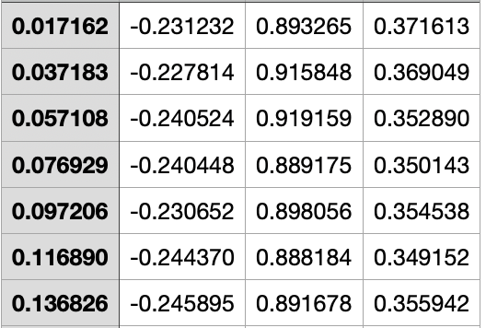
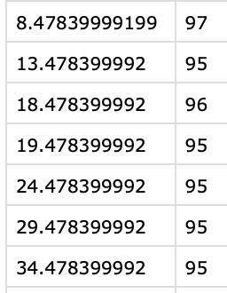
Background & Motivation
Review of Traditional Wearable Data Research Methods
Create iOS and Apple Watch app for data collection
Data will be transmited manually from participants
Raw Acceleration: [time (sec), x, y, z]
Clean and sync the data -> build features
Heart Rate: [time (sec), bpm]
Motion in g (time, x, y, z) sampling rate : 50 Hz
Heart rate (time, bpm) sampling rate ~ 5-second
Steps Count: [time (sec), steps]
(Raw acceleration data)
(Raw heart rate data)
Source: Motion and heart rate from a wrist-worn wearable and labeled sleep from polysomnography https://www.physionet.org/content/sleep-accel/1.0.0/
KUAS | ubicomp-lab.org | ZensorsFlow Developing a Cross-Platform Application for Integrating Real-time Time-series Data from Multiple Wearable Sensors

Slide 5
Background & Motivation
Research Questions
1
What is the minimal method for developing mHealth apps that connect with wearable sensor devices?
Does Flutter serve as a feasible cross-platform framework for mHealth apps and wearable sensor devices?
Which time-series database is optimal for efficiently storing and real-time tracking of wearable sensor data in the domain of mHealth?
2
3
KUAS | ubicomp-lab.org | ZensorsFlow Developing a Cross-Platform Application for Integrating Real-time Time-series Data from Multiple Wearable Sensors

Slide 6
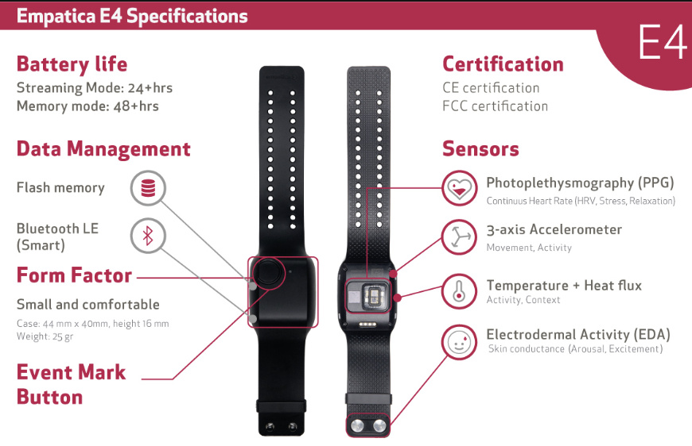
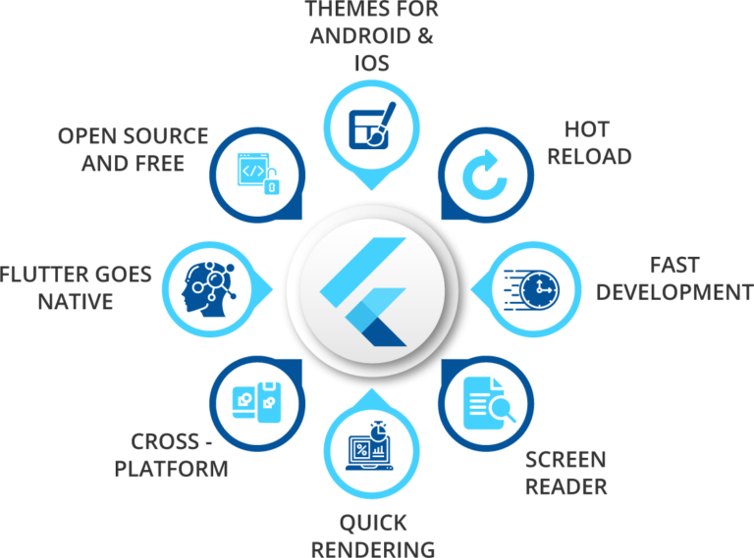
Methodology
Development Design and Frameworks
Empatica E4
Raw Acceleration: [time (sec), x, y, z]
Apple Watch
&
Android Wear
Heart Rate: [time (sec), bpm]
Flutter
Steps Count: [time (sec), steps]
KUAS | ubicomp-lab.org | ZensorsFlow Developing a Cross-Platform Application for Integrating Real-time Time-series Data from Multiple Wearable Sensors

Slide 7
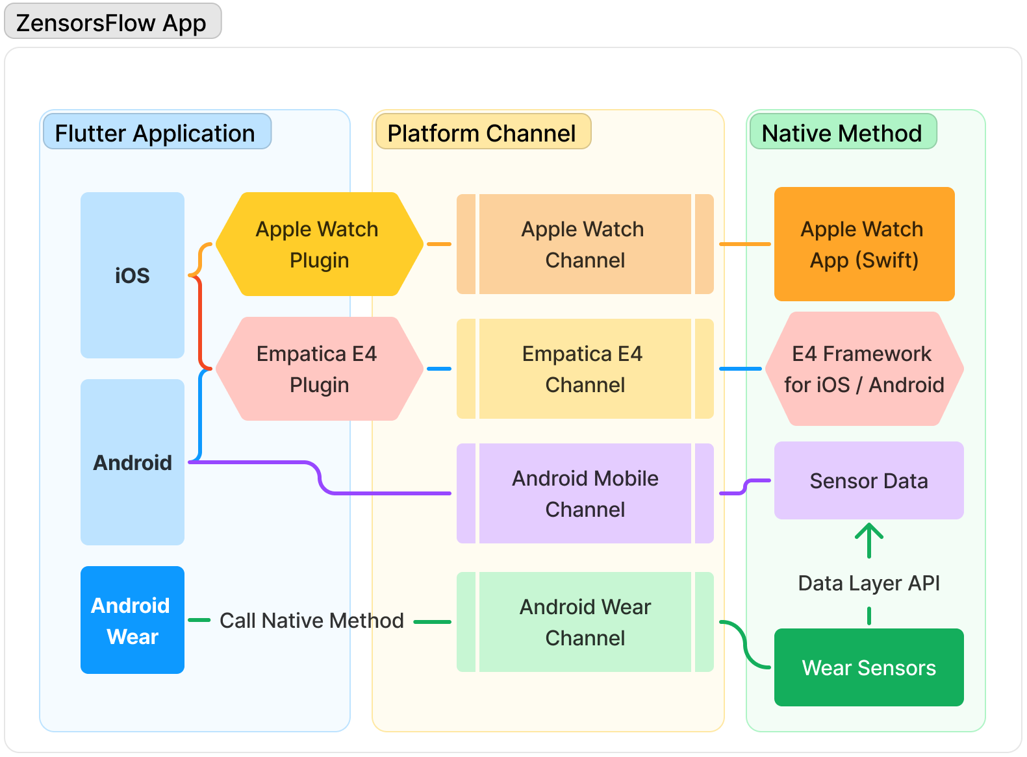
Methodology
Development of ZensorsFlow App and Wearable Sensors Connectivity
KUAS | ubicomp-lab.org | ZensorsFlow Developing a Cross-Platform Application for Integrating Real-time Time-series Data from Multiple Wearable Sensors

Slide 8
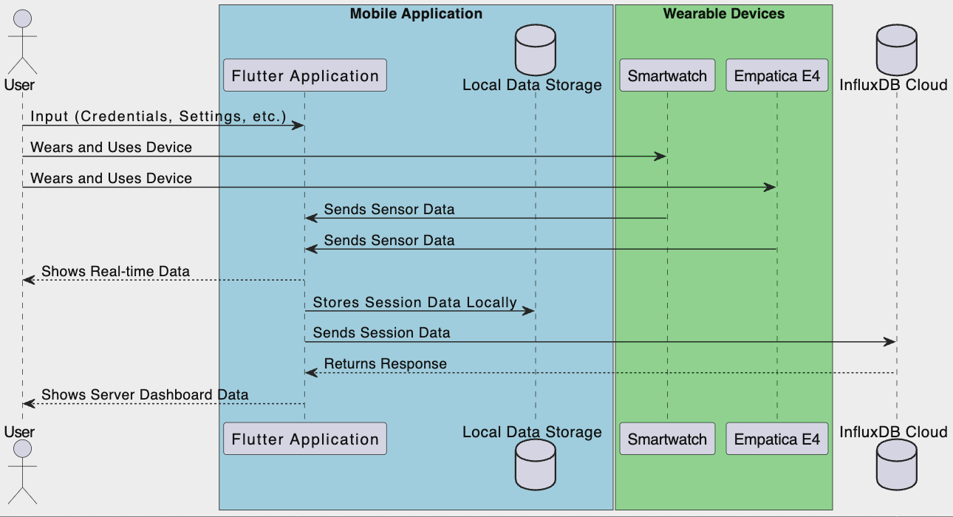
Methodology
ZensorsFlow Program Flow
KUAS | ubicomp-lab.org | ZensorsFlow Developing a Cross-Platform Application for Integrating Real-time Time-series Data from Multiple Wearable Sensors

Slide 9
Methodology
Time-Series Database System
From previous studies [1][2] and technical reviews of time-series database choices including InfluxDB, TimescaleDB, Druid and OpenTSDB, ClickHouse , PostgreSQL, CrateDB, and KairosDB.
InfluxDB stands out among Time-Series Databases due to impressive performance and extensive library support.
Wide range of language support including Dart, Swift, Kotlin, Java for mobile, and Javascript, Node.js, Python for backend development.
Monitoring tool support plugins, e.g., Telegraf, Grafana.
InfluxDB is chosen for its versatility and compatibility with ZensorFlow App requirements
References
[1] Hao, Yuanzhe, et al. "Ts-benchmark: A benchmark for time series databases." 2021 IEEE 37th International Conference on Data Engineering (ICDE). IEEE, 2021.
[2] Mostafa, Jalal, et al. "SciTS: A Benchmark for Time-Series Databases in Scientific Experiments and Industrial Internet of Things." Proceedings of the 34th International Conference on Scientific and Statistical Database Management. 2022.
KUAS | ubicomp-lab.org | ZensorsFlow Developing a Cross-Platform Application for Integrating Real-time Time-series Data from Multiple Wearable Sensors

Slide 10
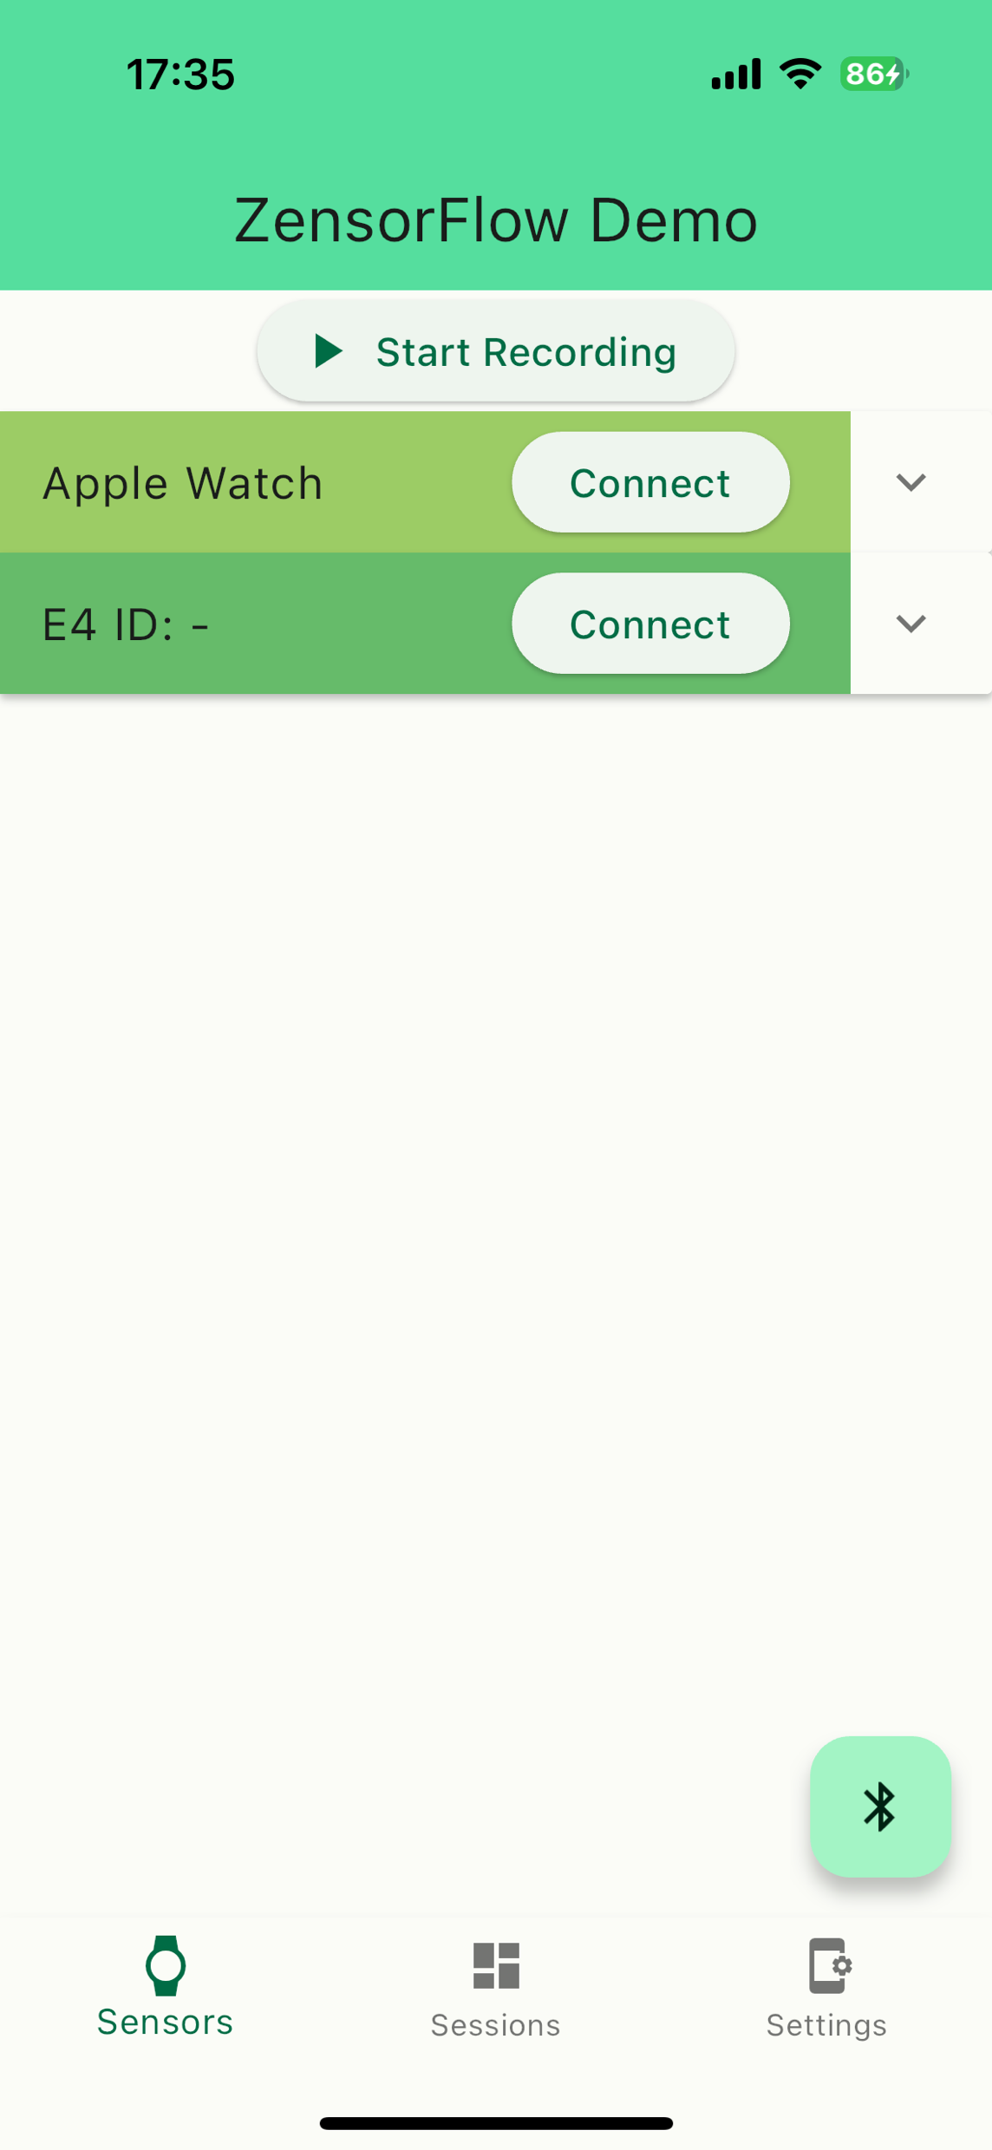
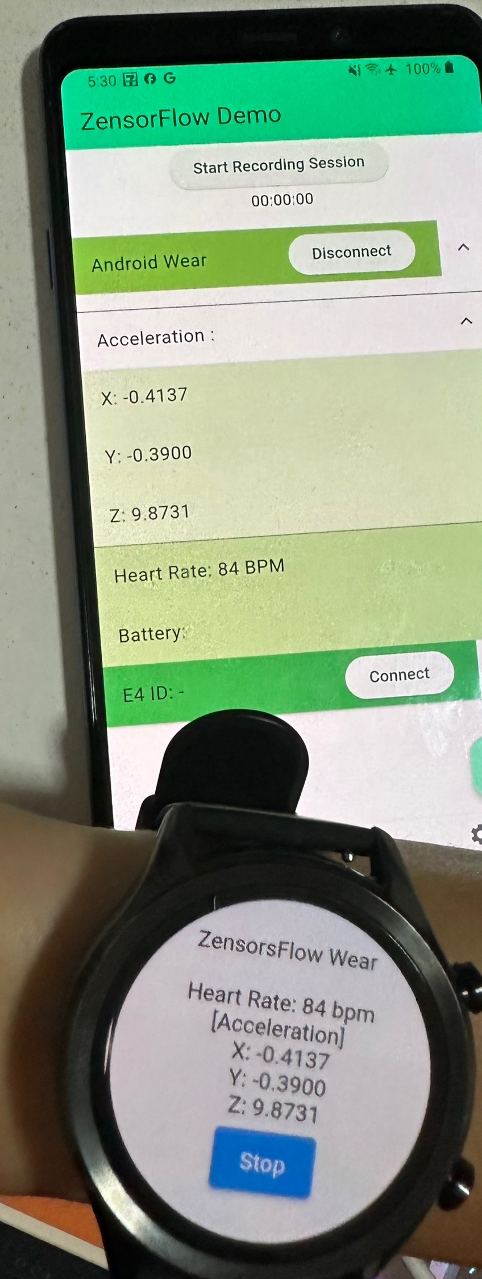
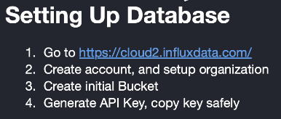
Results & Discussion
Application Demo
DEMO
KUAS | ubicomp-lab.org | ZensorsFlow Developing a Cross-Platform Application for Integrating Real-time Time-series Data from Multiple Wearable Sensors

Slide 11
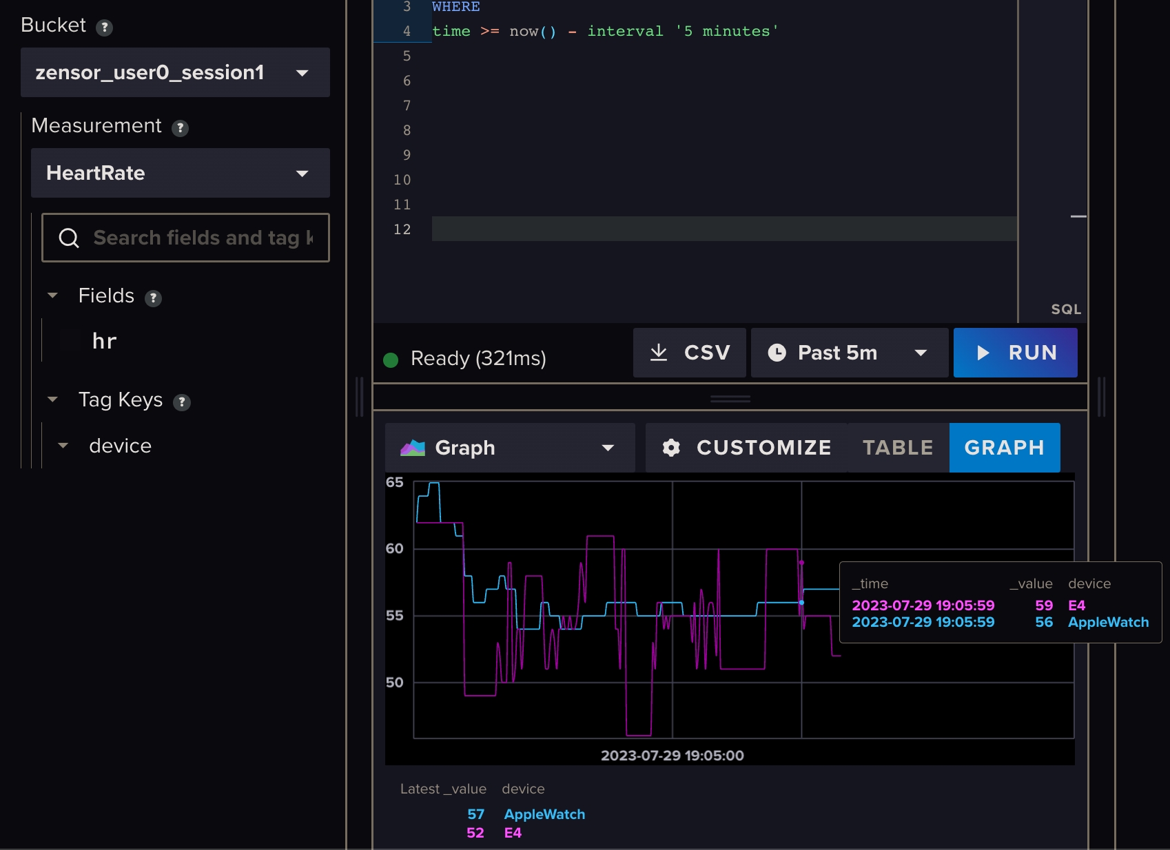
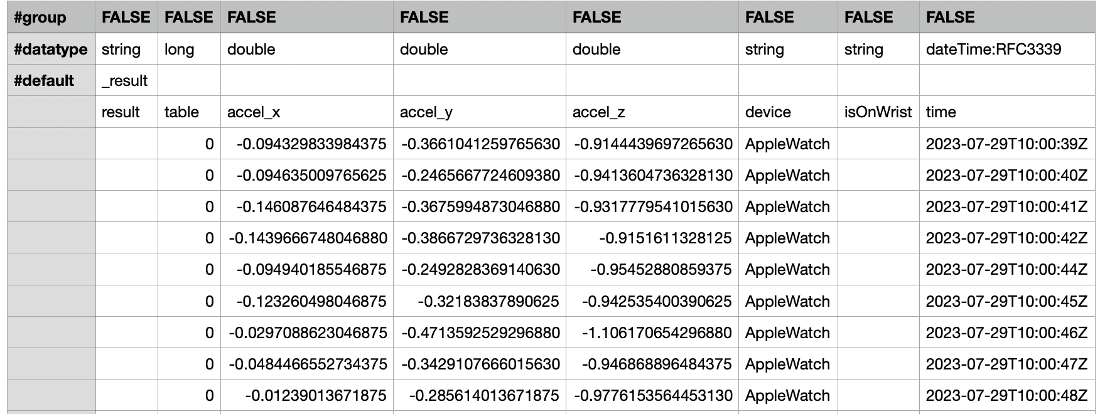
Results & Discussion
Datastore in Database Server (InfluxDB)
Time-Series Database and Real-time Data Ready
InfluxDB Dashboard
File exported to CSV
KUAS | ubicomp-lab.org | ZensorsFlow Developing a Cross-Platform Application for Integrating Real-time Time-series Data from Multiple Wearable Sensors

Slide 12
Results & Discussion
Limitations
Comparison of advantages and disadvantages of using Flutter in ZensorsFlow app development
Advantage | Disadvantage
Cross-Platform Compatibility: Write once, deploy on both iOS and Android, saving time and development resources | Limited Wearable Connectivity Support: Requires native code expertise for wearable connectivity
Hot Reload: Immediate visual feedback during development, aiding in efficient debugging | Slow Compilation Time: Slow builds and occasional confusing errors that extend development time
These disadvantage points suggest potential limitations when using Flutter for extensive native platform interfacing such as wearable connectivity.
These issues present promising areas for future exploration and solution development.
KUAS | ubicomp-lab.org | ZensorsFlow Developing a Cross-Platform Application for Integrating Real-time Time-series Data from Multiple Wearable Sensors

Slide 13
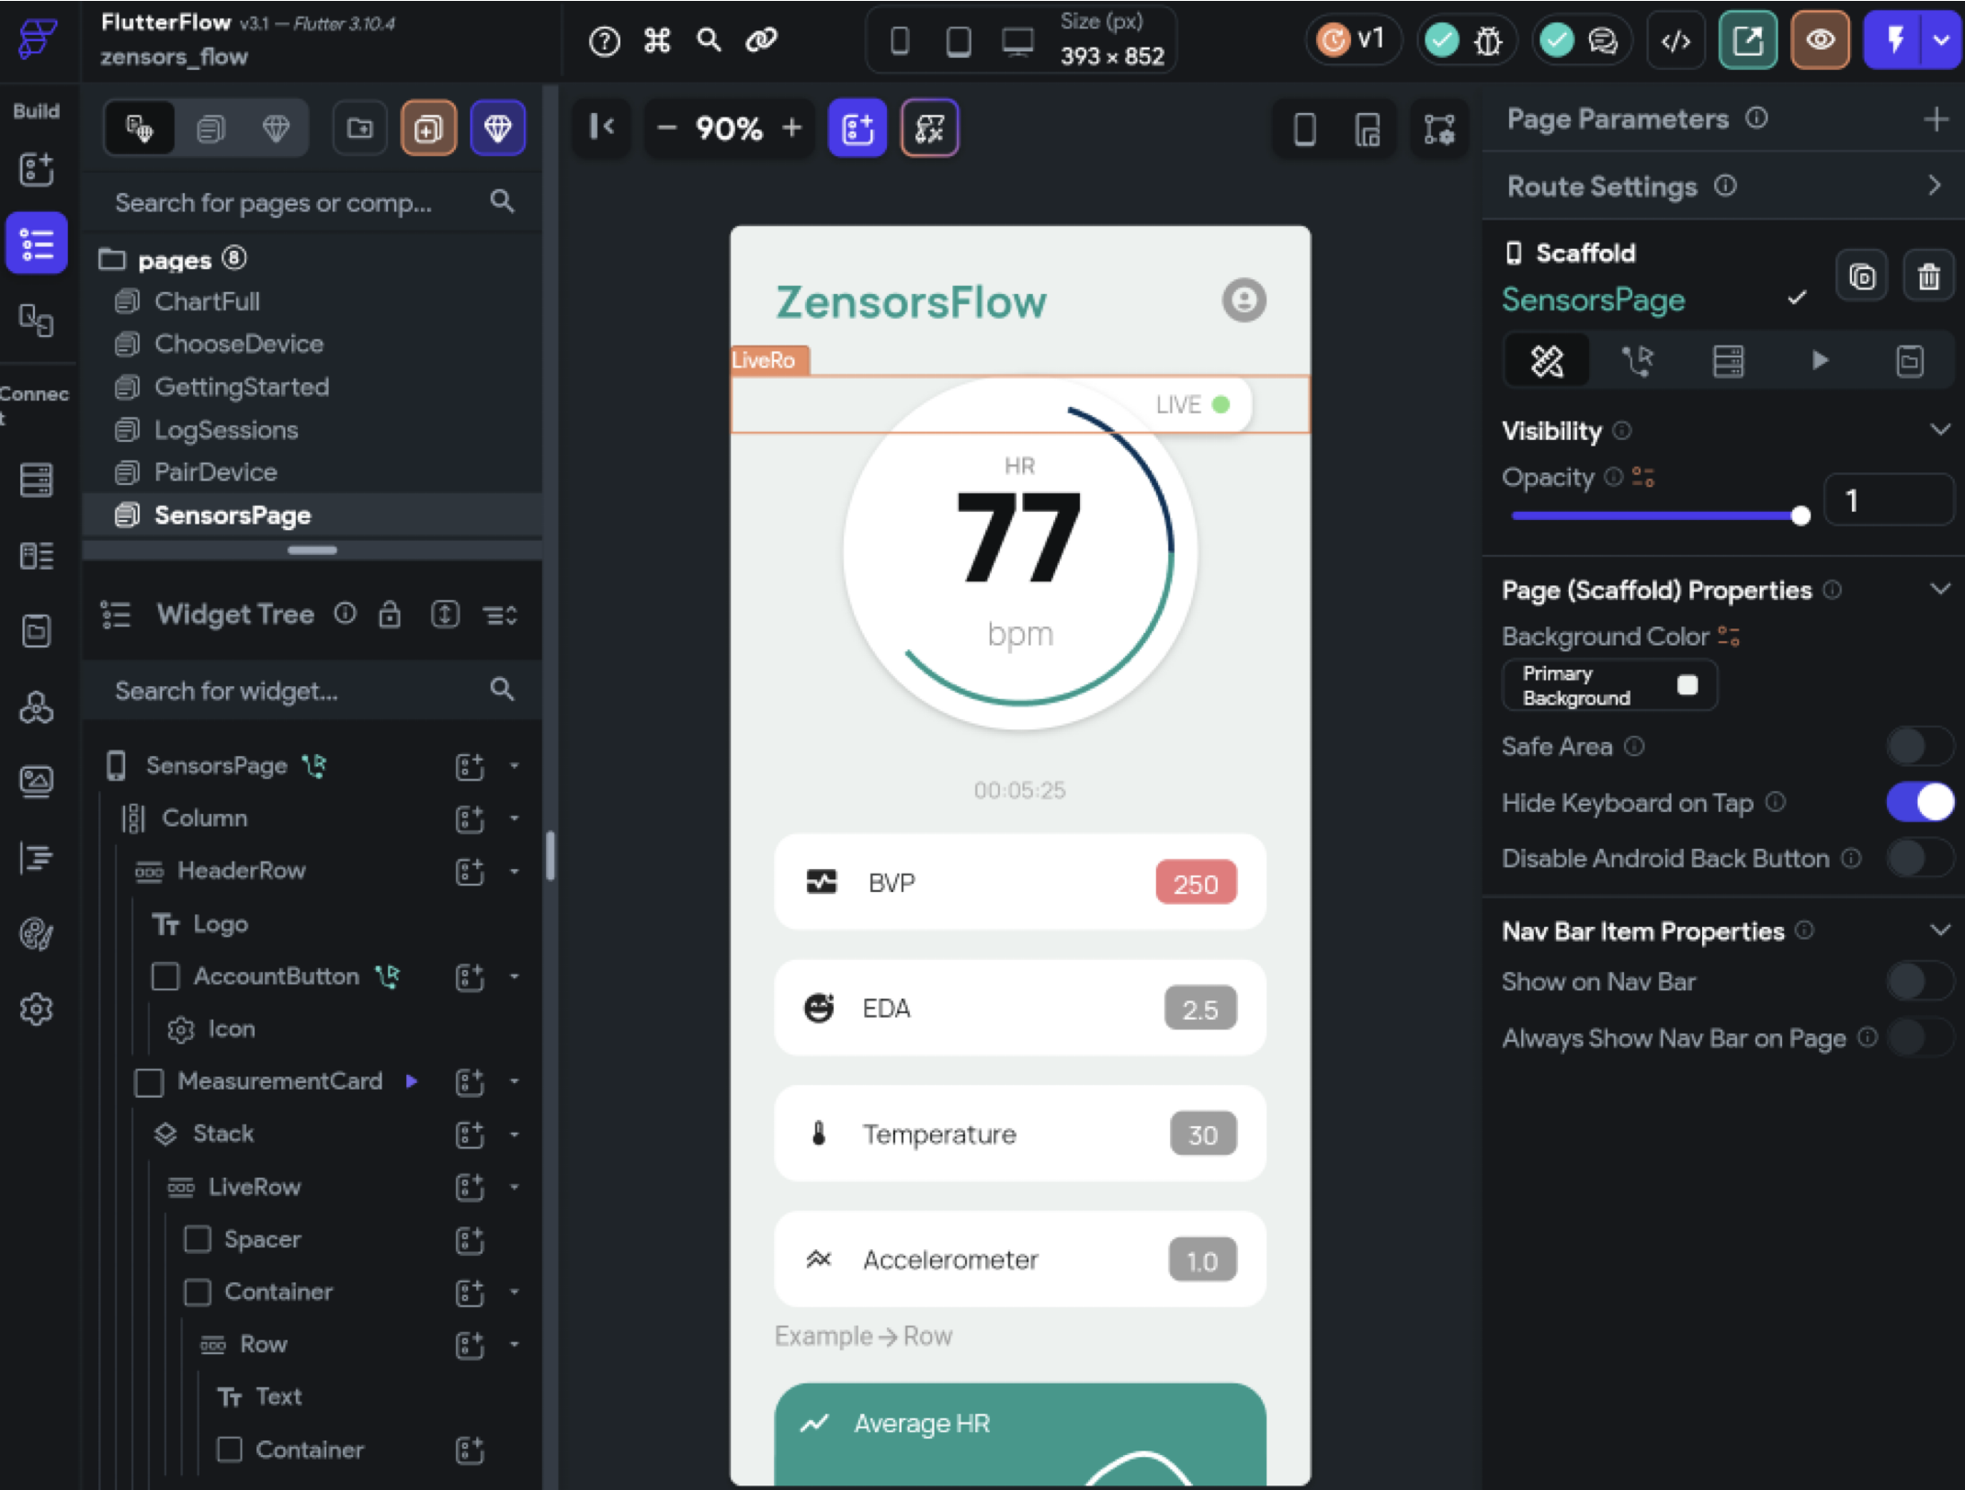
Results & Discussion
Future Works
Migrate to low-code platform like FlutterFlow for more minimal solution
Expand device support, including Android Wear, and enhance the app's utility, security, and performance
KUAS | ubicomp-lab.org | ZensorsFlow Developing a Cross-Platform Application for Integrating Real-time Time-series Data from Multiple Wearable Sensors

Slide 14
Conclusion
Cross-Platform Mobile Application Streamlined Data Integration
We successfully developed a Flutter app for real-time health monitoring, integrating data from Empatica E4, Android Wear, and Apple Watch on both iOS and Android.
Effective mHealth App Implementation with Flutter and Wearable Sensors
Flutter is an effective and minimal cross-platform tool for creating mHealth apps that interface with wearable sensors, setting a best practice for future development.
Comprehensive System with Efficient Real-time Data Management
The ZensorsFlow App uses InfluxDB for superior performance in managing and monitoring real-time mHealth wearable sensor data.
KUAS | ubicomp-lab.org | ZensorsFlow Developing a Cross-Platform Application for Integrating Real-time Time-series Data from Multiple Wearable Sensors

Slide 15
Q & A
ZensorsFlow
Developing a Cross-Platform Application for Integrating Real-time Time-series Data from Multiple Wearable Sensors
More Information
Contact our lab: https://www.ubicomp-lab.org
Email: liang.zilu@kuas.ac.jp
Ubiquitous and Personal Computing Lab, KUAS, Kyoto
Contact developer: http://nothing2say.dev
Email: nothing2say.develop@gmail.com
KUAS | ubicomp-lab.org | ZensorsFlow Developing a Cross-Platform Application for Integrating Real-time Time-series Data from Multiple Wearable Sensors

