Slide 1


Aptamer-Based Biosensor Design for Simultaneous Detection of Cervical Cancer-Related MicroRNAs
ICSI Analytics, National Institute for Research and Development
for Cryogenic and Isotopic Technologies – ICSI Rm. Vâlcea
Radu TAMAIAN
radu.tamaian@icsi.ro

Slide 2



Introduction (1/3)
Cervical cancer is a significant global health burden with a high prevalence in many regions, being the fourth most common cancer among women and accounting for 90% of new cases and fatalities in low- and middle-income countries.
To address this challenge, there is an urgent need for innovative diagnostic tools that can enable early detection and personalized therapeutic interventions.
One such promising approach involves the design and development of aptamer-based biosensors (aptasensors).
Aptamers ("chemical antibodies") are single-stranded DNA or RNA molecules that can bind specifically to target molecules with high affinity.

Slide 3
Introduction (2/3)
This paper refers to a design study for the further development of an aptasensor for the detection of circulating microRNAs (miRNAs) associated with cervical cancer development.
In the context of cancer, including cervical cancer, altered expression levels of specific miRNAs have been identified in the bloodstream, known as circulating miRNAs.
These circulating miRNAs can serve as potential biomarkers for early cancer detection and monitoring disease progression.

Slide 4
Introduction (3/3)
Aptasensors offer several advantages over traditional diagnostic methods.
  They are highly specific and sensitive, allowing for the detection of very small quantities of target molecules in complex biological samples.
  Aptasensors can be engineered to detect multiple miRNA targets simultaneously, providing a comprehensive profile of miRNA expression patterns associated with cervical cancer.
  Aptasensors offer a non-invasive and cost-effective diagnostic approach.
  Blood samples, which are easy to obtain, can be used for miRNA detection.
  Aptasensors, when used in place of more intrusive procedures such as biopsies, reduce patient discomfort and the risk of complications.

Slide 5
Materials and Methods (1/2)
An extended panel of circulating miRNAs known to play crucial roles in the pathogenesis of cervical cancer (regulating processes such as cellular proliferation, migration, invasion, angiogenesis, apoptosis, inflammatory responses, and metastasis) was chosen for the design of the aptasensor.
The RNA sequences of the circulating miRNAs were extracted from the RNAcentral database (v22).
All the aptamer sequences corresponding to the circulating miRNA panel were predicted with the help of the web-based software tool NHLBI-AbDesigner.
The best-ranked sequences were selected with the help of the Immunogenicity Score (it help assess the likelihood that the chosen peptide sequence will be specifically recognized).

Slide 6
Materials and Methods (2/2)
The RNA Folding Form from the mfold web server was used for modeling, displaying, and analyzing the secondary structure of designed aptamers.
The preset folding temperature of software is fixed at 37°; meanwhile, the ionic conditions were set to 1.0M NaCl and no divalent ions.
The Gibbs free energy (ΔG) was utilized to predict the stability of RNA aptamer secondary structures.
A positive value for ΔG means that the folding process is not spontaneous and requires an input of energy. This could be due to an unfavorable change in enthalpy (ΔH) or a decrease in entropy (ΔS) that is not compensated by a favorable change in enthalpy. In other words, the RNA molecule is more stable in its unfolded state than in its folded state under these conditions.

Slide 7


Results and Discussion (1/15)
The Immunogenicity Score ranking of NHLBI-AbDesigner was used to select the most immunogenic aptamers (RNA sequence).
The RNA Folding Form was used to predict the most stable RNA aptamer secondary structures.

Slide 8
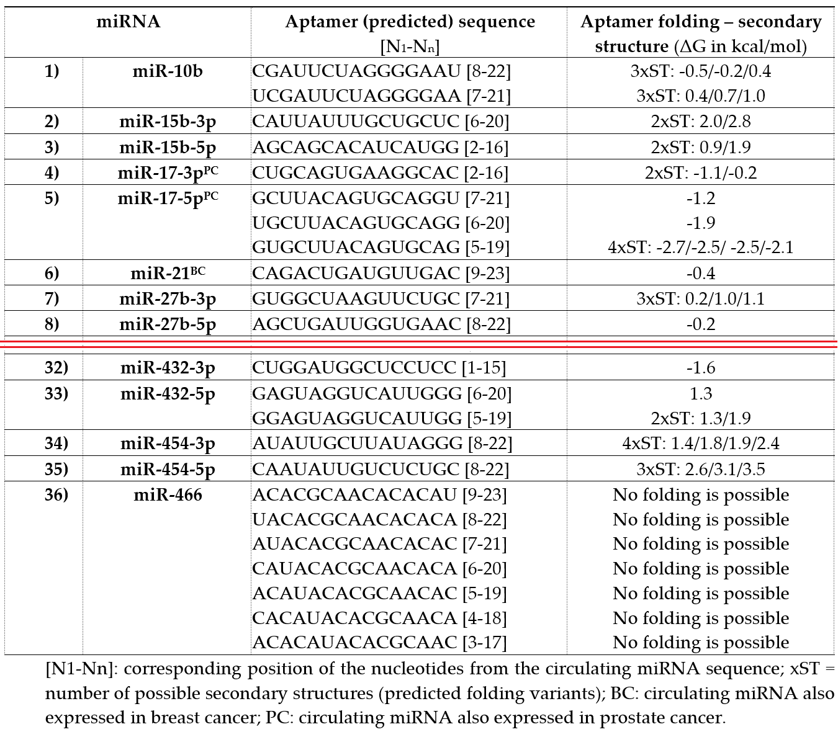
Results and Discussion (2/15)

Slide 9
Results and Discussion (3/15)
19 of the selected circulating miRNAs, a single aptamer sequence was predicted, while for the rest of the 17 circulating miRNAs, up to seven possible variants of sequence were predicted, with all the presented sequences having an Immunogenicity Score rank equal to 1.
  This suggests that the 19 miRNAs may have relatively straightforward binding requirements, and a single aptamer sequence is sufficient for specific interaction.
However, for the remaining 17 circulating miRNAs, the prediction process has led to the identification of multiple possible variants of aptamer sequences.
  This indicates that these particular miRNAs may have more complex structural features or binding requirements that necessitate multiple candidate aptamers to achieve the desired specificity.

Slide 10
Results and Discussion (4/15)
Regardless of whether a single sequence or multiple variants were predicted, all the presented aptamer sequences have an Immunogenicity Score rank equal to 1.
  This implies that these aptamers are unlikely to trigger an immune response when used in practical applications (a favorable characteristic for diagnostic or therapeutic purposes).
For the 19 circulating miRNAs with only one aptamer sequence predicted, there was also a single secondary structure predicted for 5 of them:
  miR-21 (negative ΔG, also expressed in breast cancer);
  miR-27b-3p (negative ΔG);
  miR-143-5p (negative ΔG, also expressed in prostate cancer);
  miR-218-5p (positive ΔG);
  miR-432-3p (negative ΔG).

Slide 11
Results and Discussion (5/15)
In terms of the Gibbs free energy (ΔG), utilized to predict the stability of aptamer secondary structures, it can be observed the following outcome:
  At least one valid secondary structure (folding variant) with negative ΔG for ap-tamers corresponding to 14 circulating miRNAs.
    Negative ΔG values suggest that these aptamers are likely to form stable secondary structures; the folding process of RNA aptamers is spontaneous and thermodynamically favored.
  At least one folding variant with positive ΔG for 19 circulating miRNAs and no folding secondary structure variants with negative ΔG.
    This indicates that for these miRNAs, the secondary structures of the aptamers might not be as thermo-dynamically stable, which could influence their binding kinetics and specificity.

Slide 12
Results and Discussion (6/15)
In terms of the Gibbs free energy (ΔG), utilized to predict the stability of aptamer secondary structures, it can be observed the following outcome (continued):
  In the case of three aptamers, the folding process wasn’t possible, and prediction of secondary structure failed, namely the corresponding aptamers for miR-138-1-3p (a single aptamer sequence predicted), miR-328-5p (two aptamer sequences predicted), and miR-466 (seven aptamer sequences predicted).
    This suggests that these particular miRNAs might pose challenges in terms of aptamer design due to their structural complexity or other factors.

Slide 13
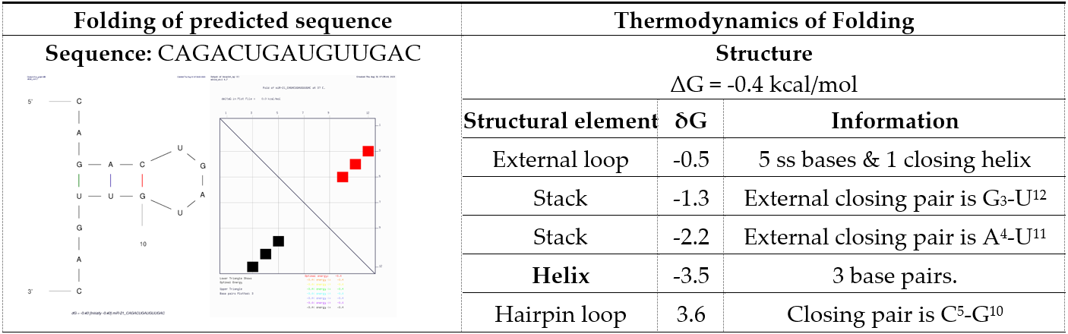
Results and Discussion (7/15)
Case study I: Aptamer for miR-21 (one predicted aptamer sequence and a single secondary structure variant with negative ΔG)

Slide 14
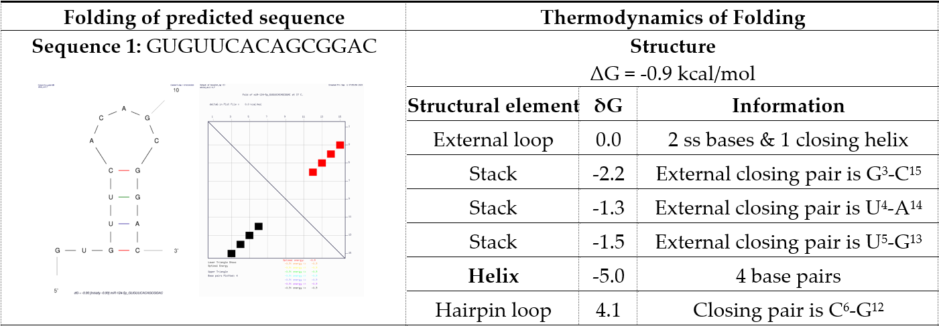
Results and Discussion (8/15)
Case study II (1/2): Aptamers for miR-124-5p (two predicted aptamer sequences and multiple secondary structure variants, all with negative ΔG)

Slide 15
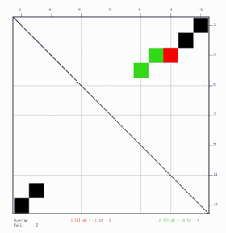
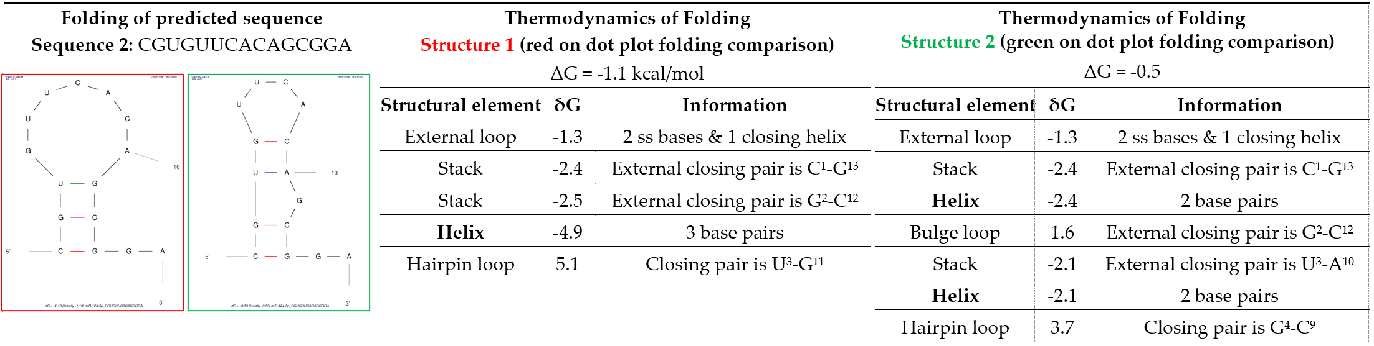
Results and Discussion (9/15)
Case study II (2/2): Aptamers for miR-124-5p (two predicted aptamer sequences and multiple secondary structure variants, all with
negative ΔG)

Slide 16

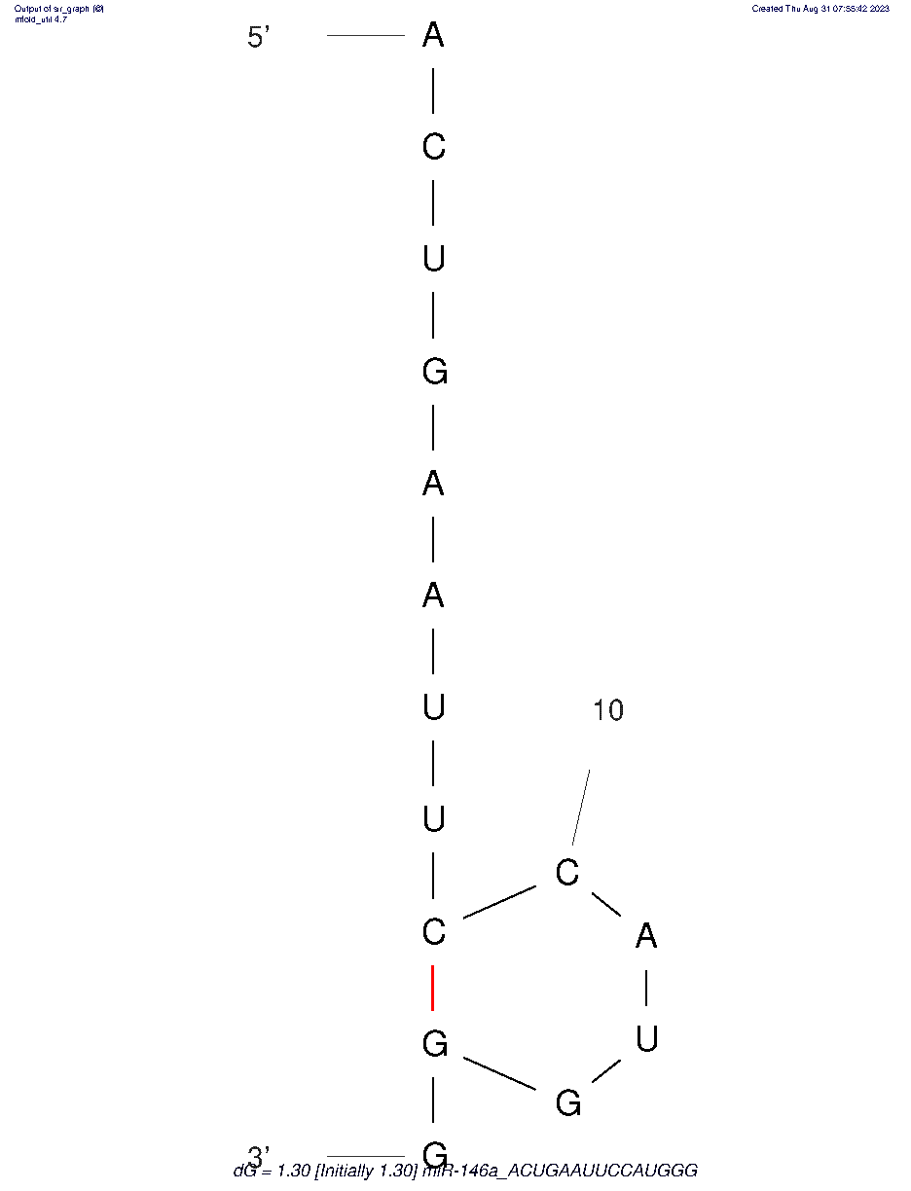
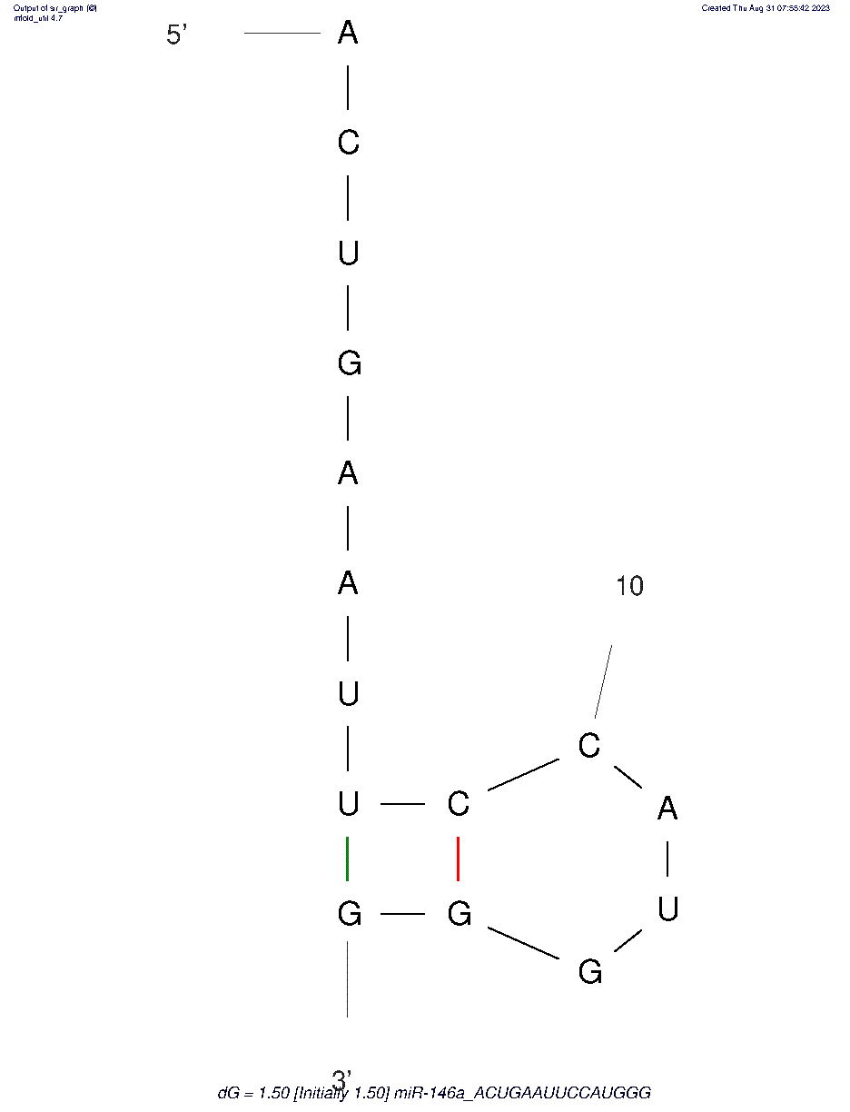
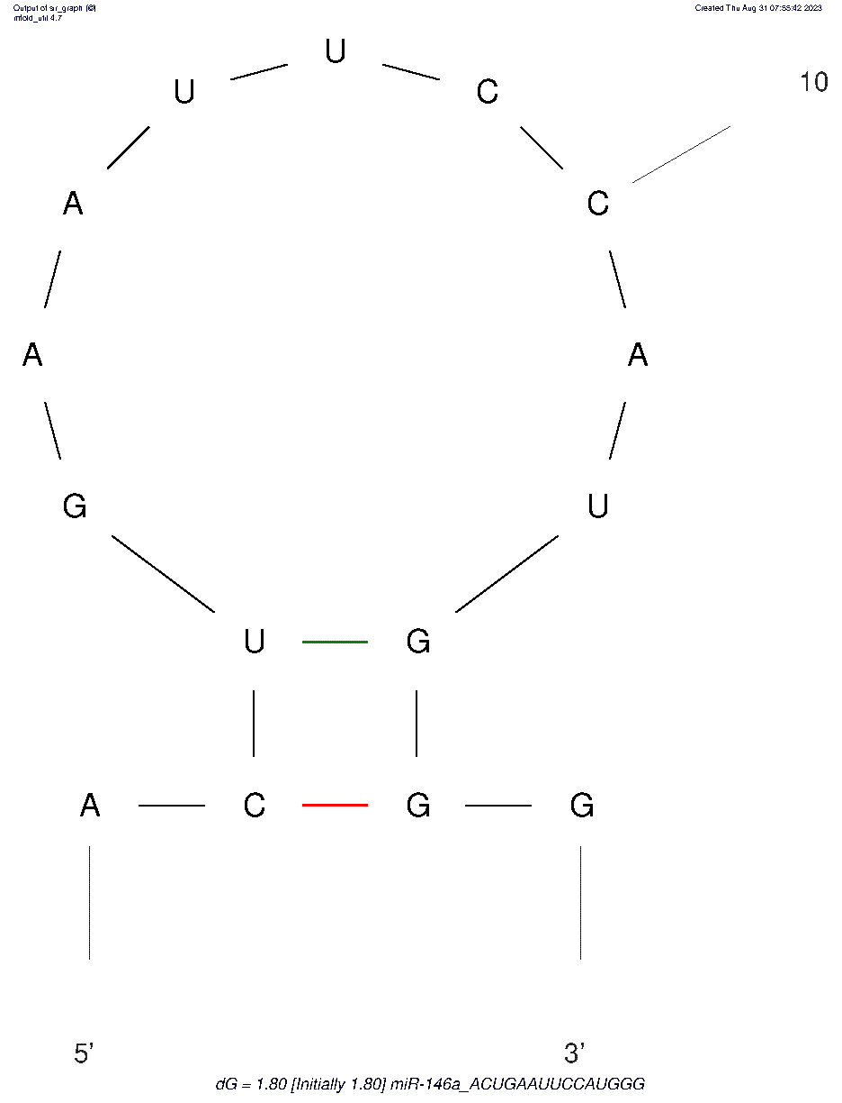
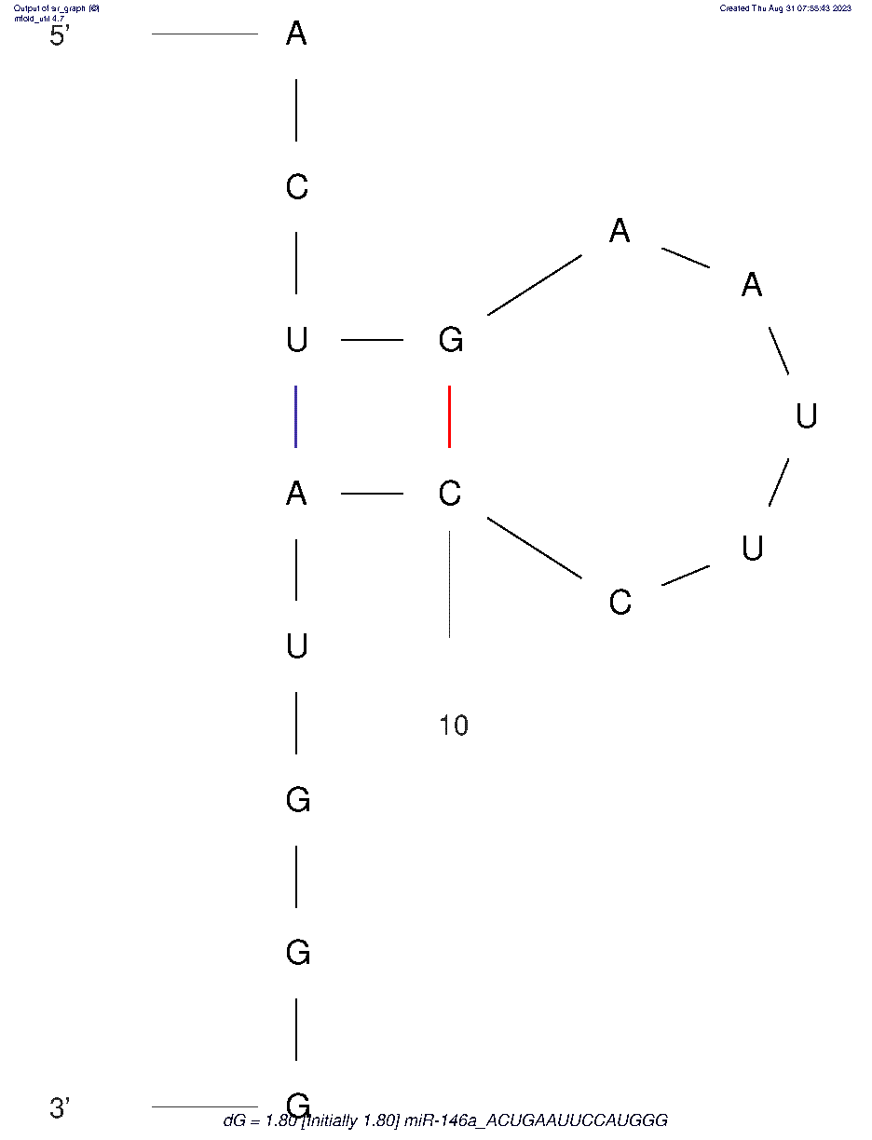
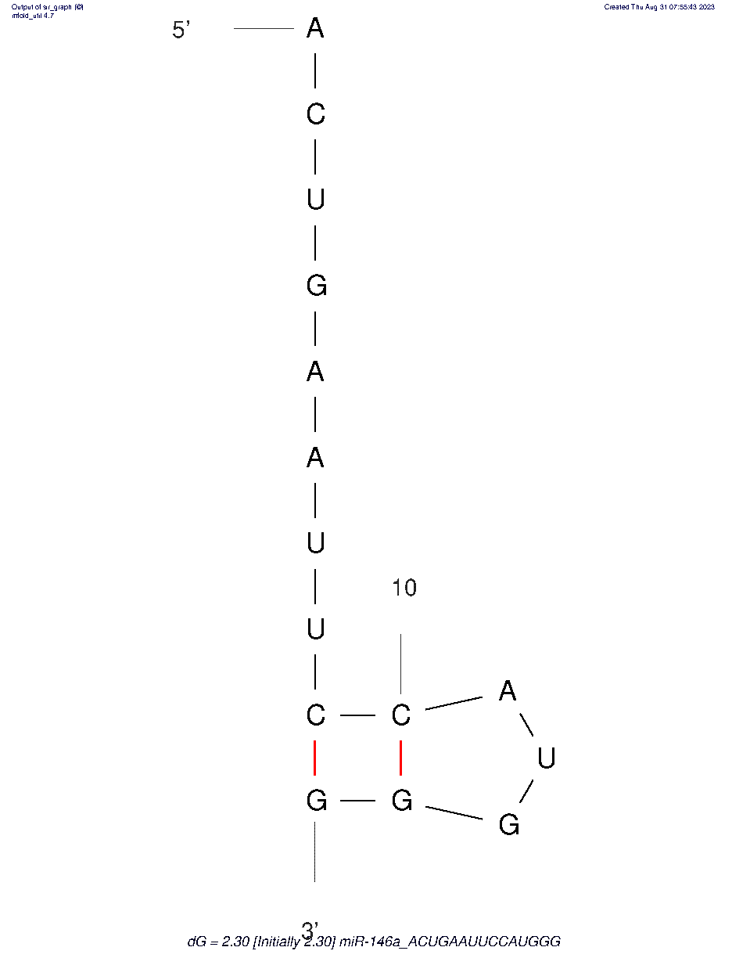
Results and Discussion (10/15)
Case study III (1/2): Aptamers for miR-146a (one predicted aptamer sequence and five secondary structure variants, all with positive ΔG)

Slide 17
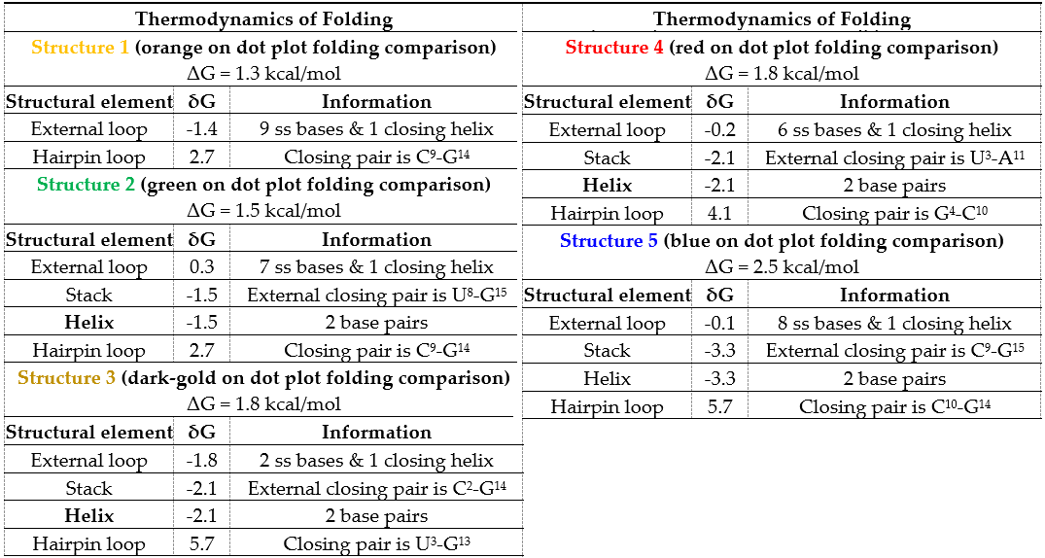
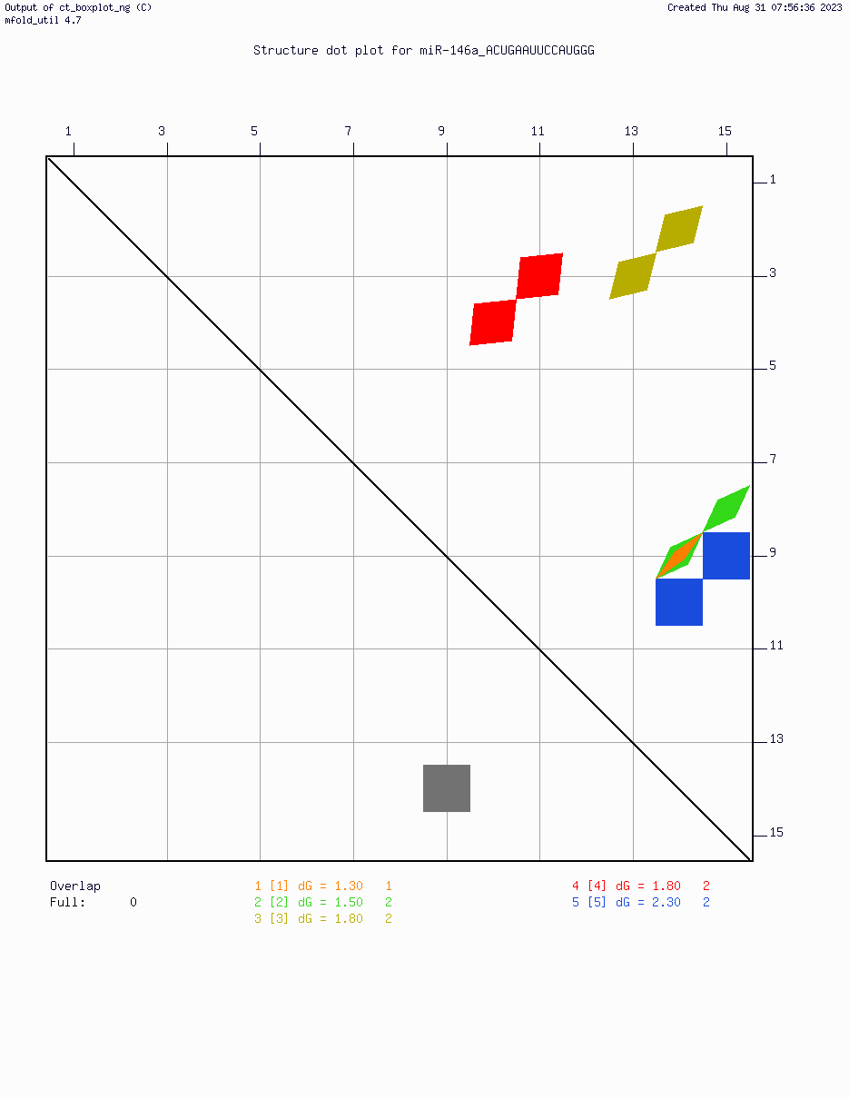
Results and Discussion (11/15)
Case study III (2/2): Aptamers for miR-146a (one predicted aptamer sequence and five secondary structure variants, all with positive ΔG)

Slide 18
Results and Discussion (12/15)
The miR-21 aptamer exhibits a single structure with a negative ΔG (-0.4 kcal/mol), indicating favorable stability and binding potential.
Moreover, as a single structure was predicted for the miR-21 aptamer, the folding process is straightforward.
Two sequences were predicted for miR-124-5p, each with a single structure variant, indicating some structural diversity but not as complex as in miR-146a.
Both miR-124-5p aptamers have negative ΔG values (-0.9 kcal/mol, respectively -1.1 kcal/mol), suggesting favorable folding and stability.
In contrast, all structures for the miR-146a aptamer have positive ΔG values, ranging from 1.3 kcal/mol to 2.5 kcal/mol, indicating unfavorable folding and instability.

Slide 19
Results and Discussion (13/15)
Hairpin loops are significant as they often form the functional binding sites of ap-tamers. In all case studies, hairpin loops are present, but their thermodynamic contributions vary:
hairpin loops contribute positively to the stability of the miR-21 aptamers and miR-124-5p aptamers;
for the miR-146a aptamers, hairpin loops contribution is detrimental (positive ΔG values dominate).

Slide 20
Results and Discussion (14/15)
The ΔG values play a critical role in aptamer design because they reflect the stability of the interactions.
Aptamers with negative ΔG values are generally preferred as they are more likely to form stable complexes with their target molecules.
A negative ΔG value indicates that the aptamer-miRNA binding is thermodynamically driven and spontaneous, which is advantageous for applications such as biosensors, diagnostics, or targeted therapies. These aptamers are more likely to function effectively.
The positive ΔG values indicate that these structures may struggle to form stable conformations, which could affect their binding affinity and specificity.

Slide 21
Results and Discussion (15/15)
Accurate understanding and prediction of these values are crucial for the successful design and application of aptamers, especially in the context of cervical cancer-related miRNA detection.
The structural complexity of miRNAs can pose serious challenges, and some miRNAs have intricated secondary and tertiary structures that may not be accurately captured in silico or even impossible to predict by certain computational tools in preset conditions (e.g., aptamers for miR-21, miR-124-5p, and miR-146a).
This complexity can lead to difficulties in predicting ΔG values, especially if multiple conformations are possible.

Slide 22
Conclusions
The existence of multiple aptamer variants for some miRNAs indicates the need for careful selection and testing to determine which aptamers provide the best performance in terms of specificity and sensitivity.
The design of an innovative aptamer-based biosensor for the detection of circulating miRNAs associated with cervical cancer development holds great promise in the fight against this global health burden.
By enabling early detection and personalized therapeutic interventions, this technology has the potential to improve patient outcomes and reduce the impact of cervical cancer on women's health worldwide.
Continued research, validation, and collaboration are essential to realizing the full potential of this diagnostic tool and its translation into clinical practice.

Slide 23

Funding:
This research was funded by the Ministry of Research, Innovation and Digitization through Program 1 – Development of the na-tional research and development system, Subprogram 1.2 – Institutional performance – Projects for financing excellence in R&D, Contract no. 19PFE/2021.
THANK YOU FOR YOUR ATTENTION!
ICSI Analytics, National Institute for Research and Development
for Cryogenic and Isotopic Technologies – ICSI Rm. Vâlcea

