Slide 1
Deep Learning Enabled Pest Detection System Using Sound Analytics in the Internet of Agricultural Things
Presented By: Md. Akkas Ali
Article ID: sciforum-078035
Dr. Rajesh Kumar Dhanaraj
Professor, Symbiosis Institute of Computer Studies and Research, Symbiosis International (Deemed University), Pune, India.
Md. Akkas Ali
Ph.D Scholar, School of Computing Science and Engineering, Galgotias University, Greater Noida, U.P, India & Assistant Professor, Dept. of CSE, Bangabandhu Sheikh Mujibur Rahman Science and Technology University, Gopalganj, Bangladesh

Slide 2
Outlines
Introduction
Literature Review
Research Gaps
Objectives and Specific aims
Proposed Methodology
Results Analysis- Comparison
Conclusion & Future Recommendation
References

Slide 3
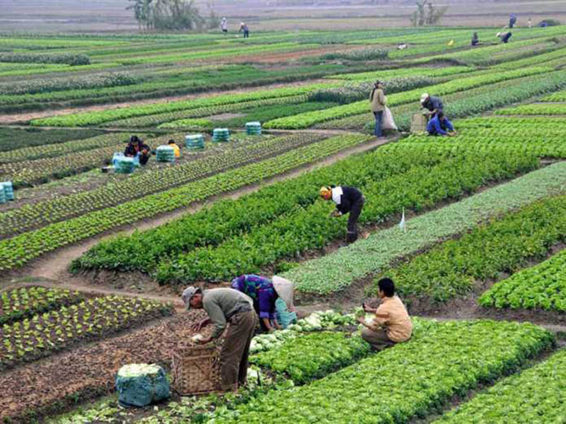
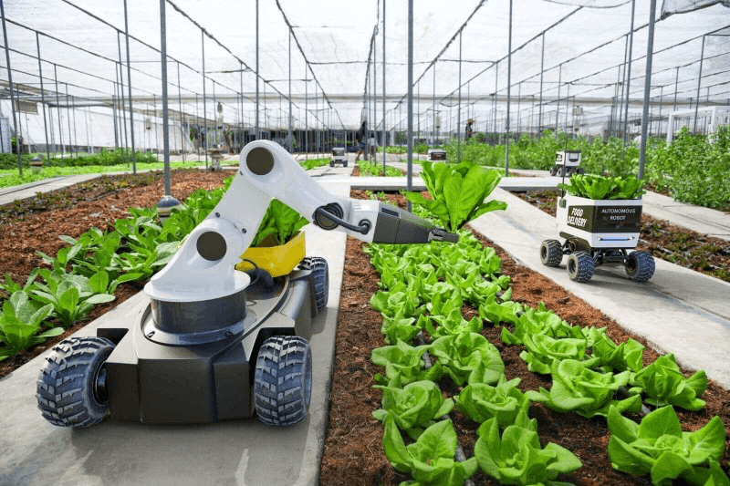
Introduction
The agricultural industry has:
Enormous potential to meet the world's growing
Need for nutritive and healthy food
Necessary for human existence globally
etc.
Modern agriculture is more:
Scientific
Analytical
Technological
etc.

Slide 4
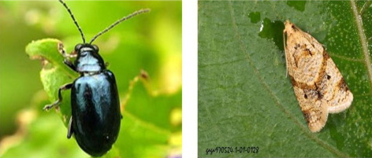
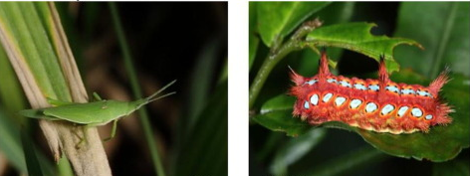
Introduction….
Crop production affected due to the presence of pests.
Injury to crops
Slow the growth of crops
Pests destroy a significant portion of the harvest and reduce quality.
etc.
Farmers struggle to discover pests on their farms

Slide 5
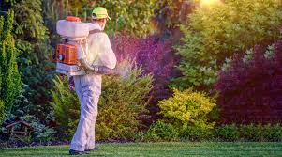
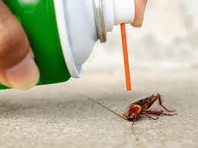
Introduction….
Traditional pest identification and Control methods:
Visual Inspection, Sticky Traps, Pheromone traps, Light Traps, Manual Sampling, Harm thresholds, Manual Counting, etc.
Their Limitations:
Require scientists with extensive field experience correctly identify pests based on their physical characteristics.
Pesticides harm food and agriculture.
Labor-intensive, dangerous, and require a lot of physical labor.
Limited Accuracy, Labor-intensive, Species-specific, Minimal Sensitivity, Absence of Real-Time Data, Non-Scalability, Environmental Impact, Complex Ecosystems
etc.

Slide 6
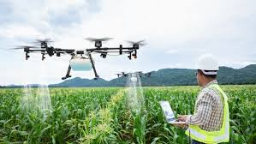
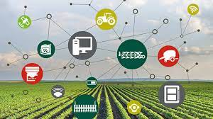
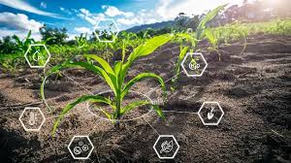
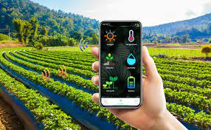
Introduction….
IoT technology and Machine learning models:
Use many affordable sensor devices to collect real-time data on pest-related agricultural development characteristics.
Deep Learning Enabled Pest Detection System Using Sound Analytics in the Internet of Agricultural Things

Slide 7
Literature Survey
Author’s Name | Publisher & Year | Training Methods | Dataset | Sample Size | Accuracy rate (%)
Liu et al. [23] | Springer, 2022 | CNN | Images | 27.8K | 71
Jiao et al. [24] | Computers and Electronics in Agriculture, 2022 | RCNN | AgriPest21 | - | 77
Feng et al. [27] | IEEE Access, 2022 | SRCNN | IP-102 | - | 74.61
Ai et al. [29] | IEEE Access, 2020 | Inception-ResNet-v2 | Images | - | 86.1
Kalpana et al. [33] | Springer, 2021 | KNN | Images | - | 85
Kasinathan et al. [39] | Scopus, 2020 | CNN | Wang and Xie[62] | - | 91.5
Lyu et al. [61] | IEEE Access, 2021 | SSD | Images | 9.99K | 96.89

Slide 8
Literature Survey….
Author’s Name | Publisher & Year | Training Methods | Dataset | Sample Size | Accuracy rate (%)
..........................................
Garg et al. [63] | Springer, 2022 | DNA | DNA Barcode | - | -
Moussian et al. [64] | Springer, 2022 | RNA | RNA | - | -
Le-Qing et al. [65] | IEEE Access, 2022 | PNN | IP-102 | 50 | 96
Santiago et al. [66] | IEEE, 2017 | ANN | USDA ARS | - | 95.10
Bilgi et al. [67] | IEEE, 2016 | KNN | Own | - | 93.6

Slide 9
Research Gap
Few studies had been done so far on pest detection by pest sound analytics produced by pests.
A research gap exists in that additional work must be done to achieve the highest possible accuracy in detecting pests in large agricultural fields through pest sound analytics and deploying IoT and ML-based networks.

Slide 10
Research Objectives
To study the previous research works to find out the gap in the IoT-based intelligent agricultural field.
To design real-time IoT and AI-enabled networks for pest sounds collecting from and providing to the IoT-based sizeable agricultural field.
To denoise the pest sounds and remove the spectral leakage without affecting the signal during data preprocessing through optimized ways.
To train, validate, and test the GPA-Net model with fewer distractions that will lead to better overall results.
To get the best accuracy in detecting the pest for increasing agricultural productivity.

Slide 11
Proposed Methodology
(Dataset description)
United States Department of Agriculture (USDA), the Agricultural Research Service (ARS) called USDA ARS dataset.
https://data.nal.usda.gov/dataset/bug-bytes-sound-library-stored-product-insect-pest-sounds/resource/ff1b1ed6-5597-4494-be21-7205122dae63 [19].

Slide 12
Proposed Methodology….
(Data Pre-processing)
Chebyshev filter : denoising the pest sound
Welch approach: removing the spectral leakage
Non-overlap-add method : converting overlapping to non-overlapping frames
Linear Prediction Coefficients (LPC): computing the feature matrix from the pest sound signal
No. of pest sounds | Extracted values
0 | [-218.3128, 35.2941, -5.9360, 8.8495, -...
1 | [-218.3128, 35.2941, -5.9360, 8.8495, -...
2 | [-218.3128, 35.2941, -5.9360, 8.8495, -...
3 | [-218.3128, 35.2941, -5.9360, 8.8495, -...
 | …
796 | [-148.7184, 78.4729, -11.6938, 42.9273, ...
797 | [-148.7184, 78.4729, -11.6938, 42.9273, ...
798 | [-148.7184, 78.4729, -11.6938, 42.9273, ...
799 | [-148.7184, 78.4729, -11.6938, 42.9273, ...
Input
Preemphasis
Framing
Windowing
LPC
LPC Analysis
Autocorrelation
Statistical measurements of each sound: Mean, Median, Variance, Standard Deviation

Slide 13
Proposed Methodology….
(System Models)
Multilayer Perceptron (MLP) System Model:
Input Layer First hidden layer Second hidden layer Output layer
A₁
B₁
C₁
D₁
Matrix [M]
Output
A₂
B₂
C₂
D₂
.
.
.
.
.
.
.
.
A₂₀
B₄₀
C₄₀
D₁₆

Slide 14
Proposed Methodology….
(Architecture)
Large Agricultural Field
Downloaded
pest sounds
Database
Acoustic Sensor
Recorded
PID Sensor
Microprocessor
MLP Model
Feature extraction
Pre-processing

Slide 15
Experimental Setup
PC with Windows 10,
Processor (a 2.40 GHz Intel(R)Core (T.M.) i5-9300H)
64 GB of RAM
2 GB Nvidia GeForce GTX 970M
Python 3.8.10
PyTorch 1.9.0
Jupyter notebook
CUDA 10.2 for GPU acceleration
Buzzer (Tweeter)
Power Supply
Arduino UNO R3
LCD Display
Temperature Sensor
Motor on/off
Humidity Sensor
ZigBee module
Soil Moisture Sensor
Sound Emitor
……………………………...
……………………………...
Pest Sound Receiver
Infrared Sensor
Water Level Sensor
Figure: Block diagram of hardware connection

Slide 16
Result Analysis
(Performance Parameters)
Accuracy = $\frac{\left(TrueN+TrueP\right)}{\left(TrueN+TrueP+FalseN+FalseP\right)}$
Sensitivity = $\frac{TrueP}{TrueP+FalseN}$
Specificity = $\frac{TrueN}{TrueN+FalseP}$
Recall = $\frac{TrueP}{\left(FalseN+TrueP\right)}$
Precision = $\frac{TrueP}{TrueP+FalseP}$
F1-score = $\frac{Two∗ precision∗recall}{precision+recall}$ (8)
Mean Square Error = (1/n) * Σ (actual – forecast)²
Percentage Error = (actual – forecast) * 100

Slide 17
Result Analysis….
(Performance Parameters Measurement)

Slide 18
Result Analysis….
(Accuracy and Loss of the Training, Validation, and Testing)

Slide 19
Result Analysis….
(Performance comparison of proposed system with state-of-the-art techniques)

Slide 20
Conclusion and Future Scope
This research will be continued to attain 100% detection accuracy with minimum 100 pests.
If the government or another development corporation is willing to assist with project financing.
We are excited about expanding our study to incorporate real-time applications in natural settings within large agricultural areas of a given country.

Slide 21
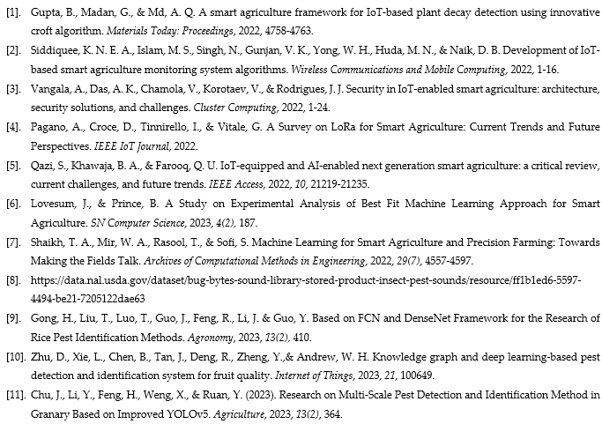
References

Slide 22
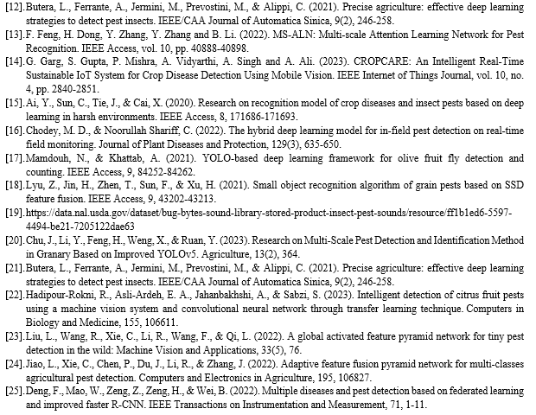
References….

Slide 23
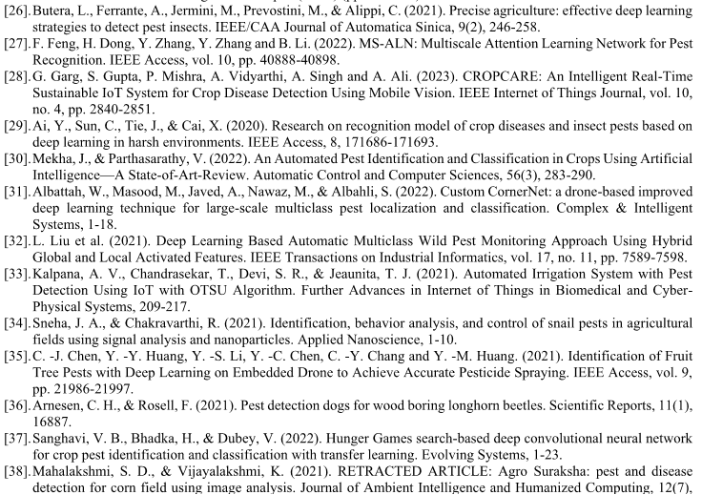
References….

Slide 24
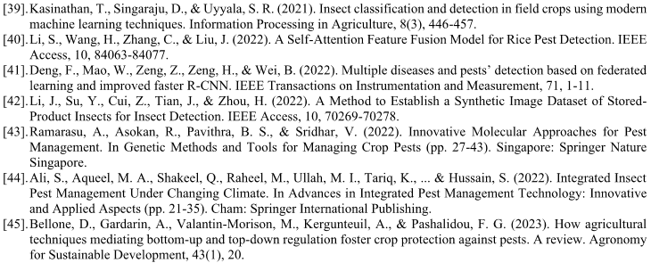
References….

Slide 25
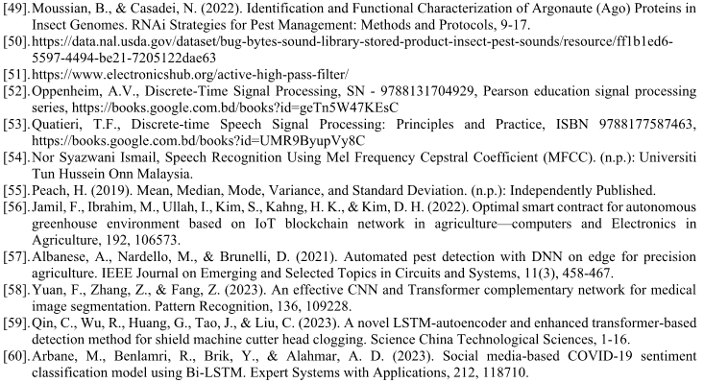
References….

Slide 26
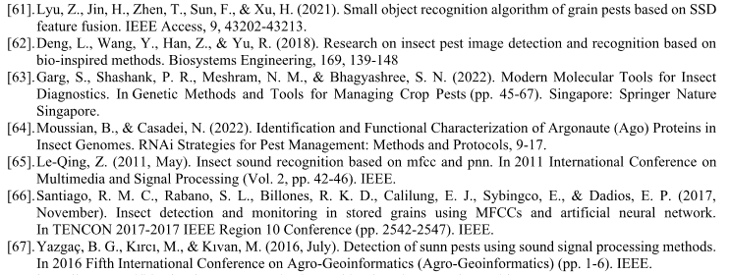
References….

Slide 27
Thanks to All

