Slide 1
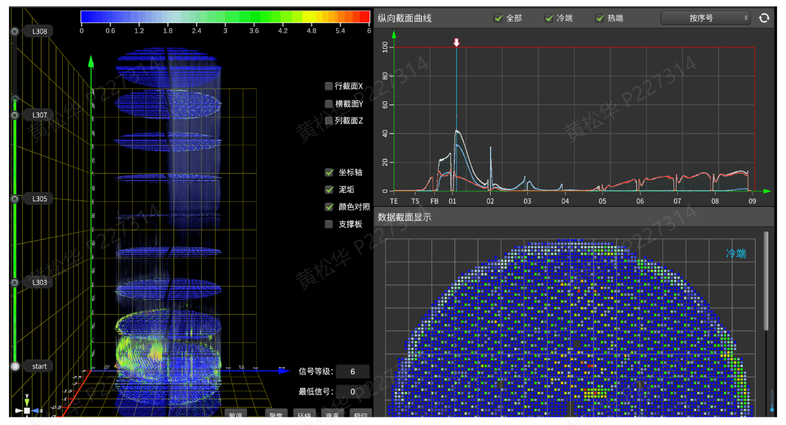
Nuclear power plant sludge deposition detection: automatic collection, automatic sludge measurement and analysis, etc

