Slide 1
Early Results on GNSS Receiver Antenna Calibration System Development
Antonio Tupek ^{1,*}, Mladen Zrinjski ¹, Marko Švaco ², Đuro Barković ¹
¹ University of Zagreb, Faculty of Geodesy, Croatia
² University of Zagreb, Faculty of Mechanical Engineering and Naval Architecture, Croatia
* Correspondence: antonio.tupek@geof.unizg.hr
10th International Electronic Conference on Sensors and Applications
15–30 November 2023
ECSA-10

Slide 2
PRESENTATION OUTLINE
Introduction
GNSS receiver antenna calibration
Definitions
Antenna Calibration Methods
Antenna Calibration System @ LMMT
System components
Data processing and PCC estimation
Preliminary Results
Conclusion & Outlook
ECSA-10 | 15 – 30 November 2023
2

Slide 3
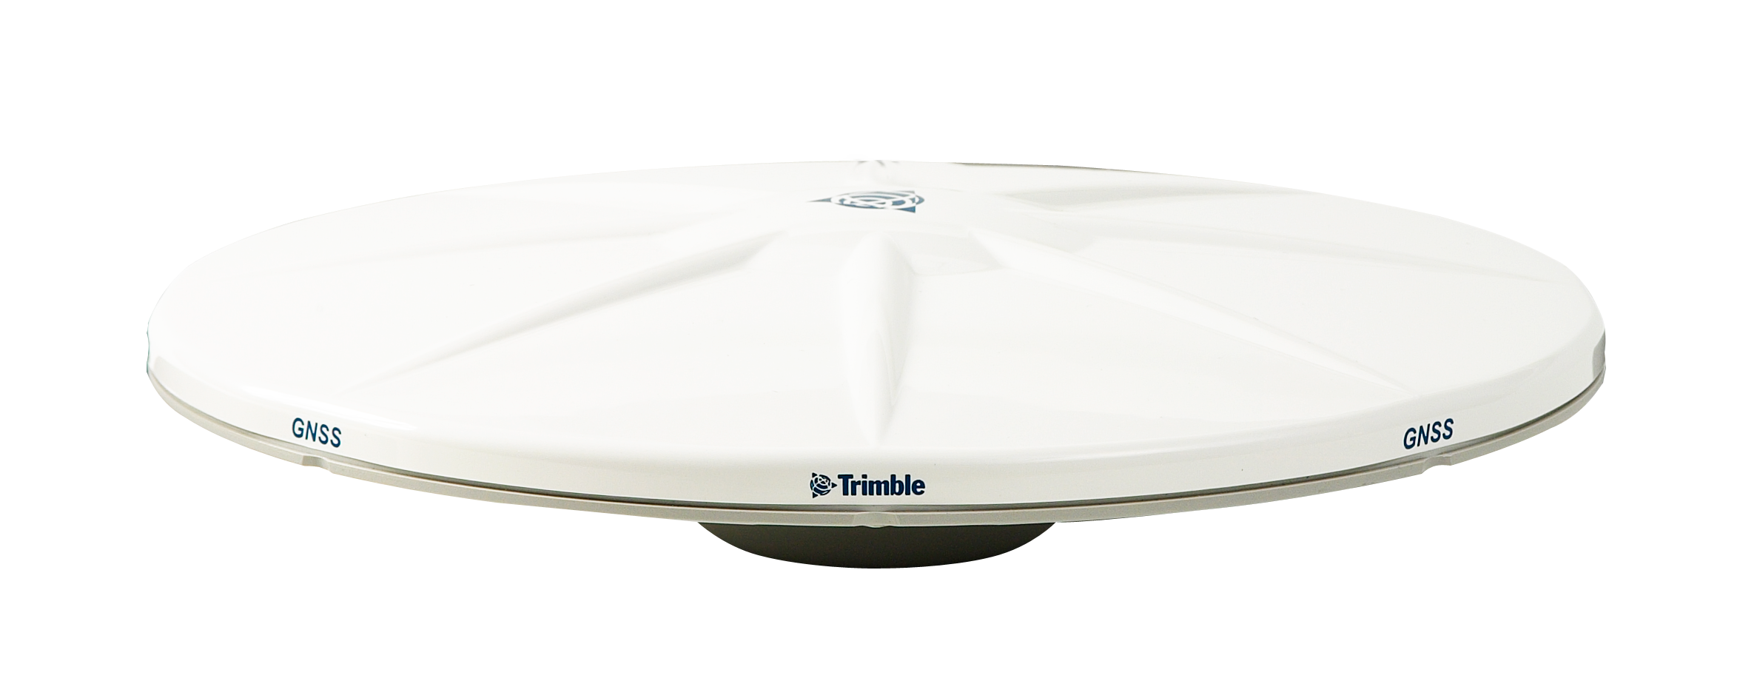
INTRODUCTION (1)
Global Navigation Satellite Systems (GNSS) positioning – 3D trilateration
GNSS satellite signals – L-band (1 – 2 GHz)
Geodetic GNSS positioning – carrier phase observations
GNSS receiver antenna electrical phase centre – PC
Antenna Reference Point – ARP
PC
Correction!
ARP
ECSA-10 | 15 – 30 November 2023
3

Slide 4
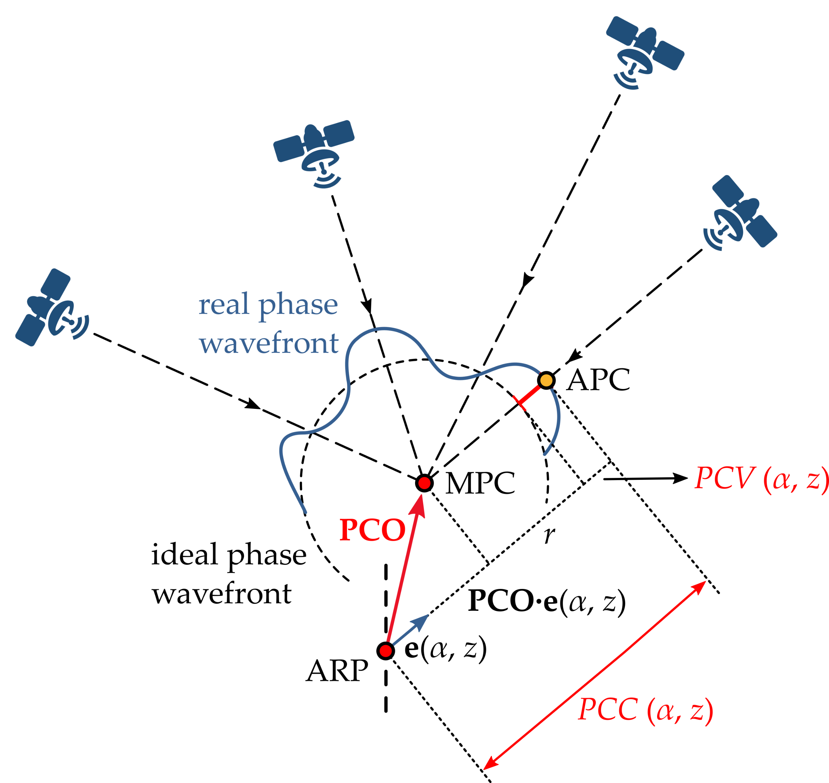
INTRODUCTION (2)
Phase Center Correction – PCC
Phase Center Offset – PCO
Phase Center Variation – PCV
GNSS Antenna Calibration
Individual and type-mean PCC models
ANTEX (ANTenna EXchange)
IGS → igs20.atx
Definition and geometrical interpretation of the adopted GNSS receiver antenna phase center correction (PCC) model; ARP — Antenna Reference Point; MPC — Mean Phase Center; APC — Actual Phase Center; PCO — Phase Center Offset; PCV — Phase Center Variation.
ECSA-10 | 15 – 30 November 2023
4

Slide 5
INTRODUCTION (3)
CALIBRATION METHODS
RELATIVE FIELD CALIBRATION
Rothacher et al. (1995), Mader i MacKay (1996), Mader (1999)
ABSOLUTE FIELD CALIBRATION
Wübbena et al. (1997), Wübbena et al. (2000)
CHAMBER CALIBRATION
Zeimetz (2010)
ECSA-10 | 15 – 30 November 2023
5

Slide 6
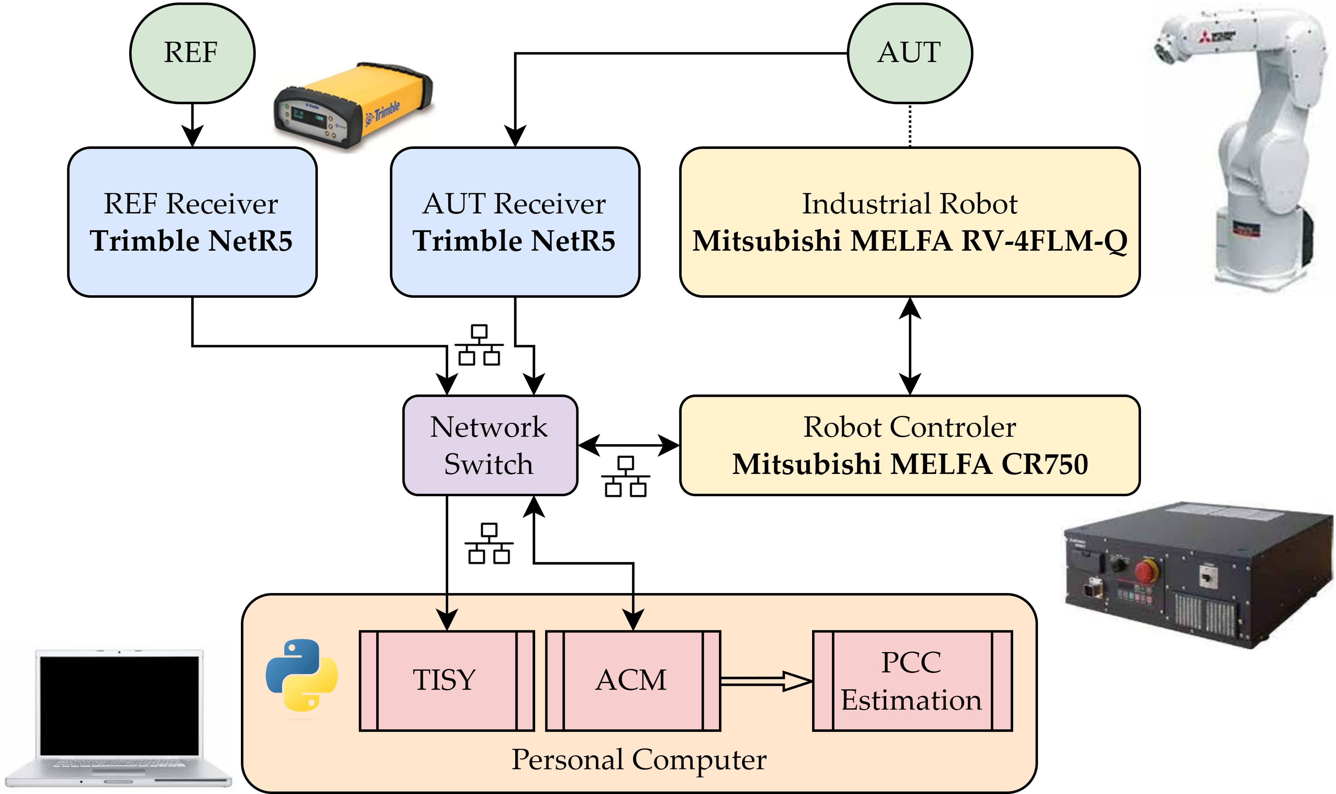
ANTENNA CALIBRATION @ LMMT (1)
Calibration System Hardware Components:
Industrial robot – Mitsubishi MELFA RV-4FLM-Q
GNSS antennas – REF and AUT
GNSS receivers – REF and AUT
Personal computer
Network switch, required wiring, ...
Software:
Antenna calibration module (ACM)
Time Synchronization module (TISY)
PCC estimation module
ECSA-10 | 15 – 30 November 2023
6

Slide 7
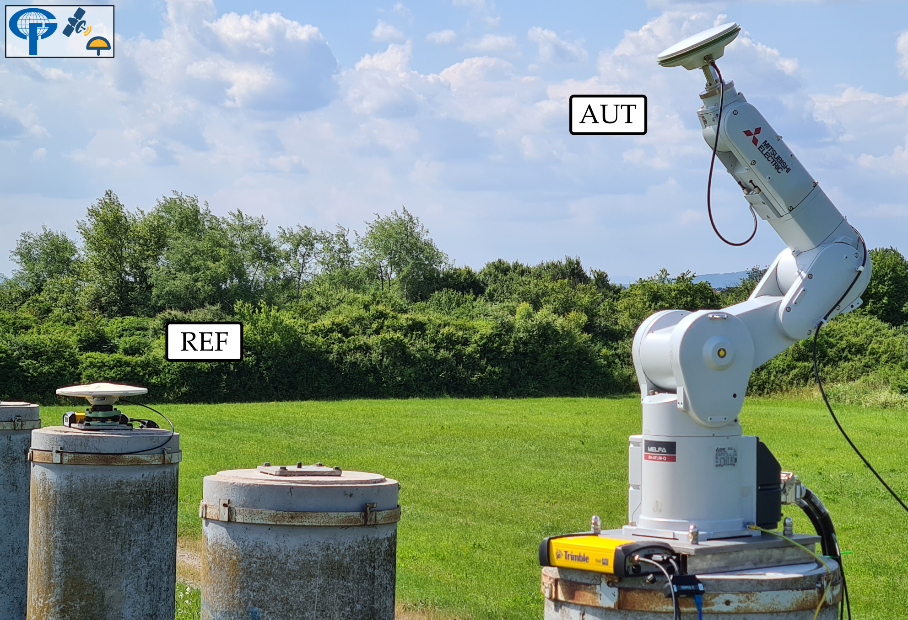
ANTENNA CALIBRATION @ LMMT (2)
REF
MELFA RV-4FLM-Q
Robot controller
ECSA-10 | 15 – 30 November 2023
7

Slide 8
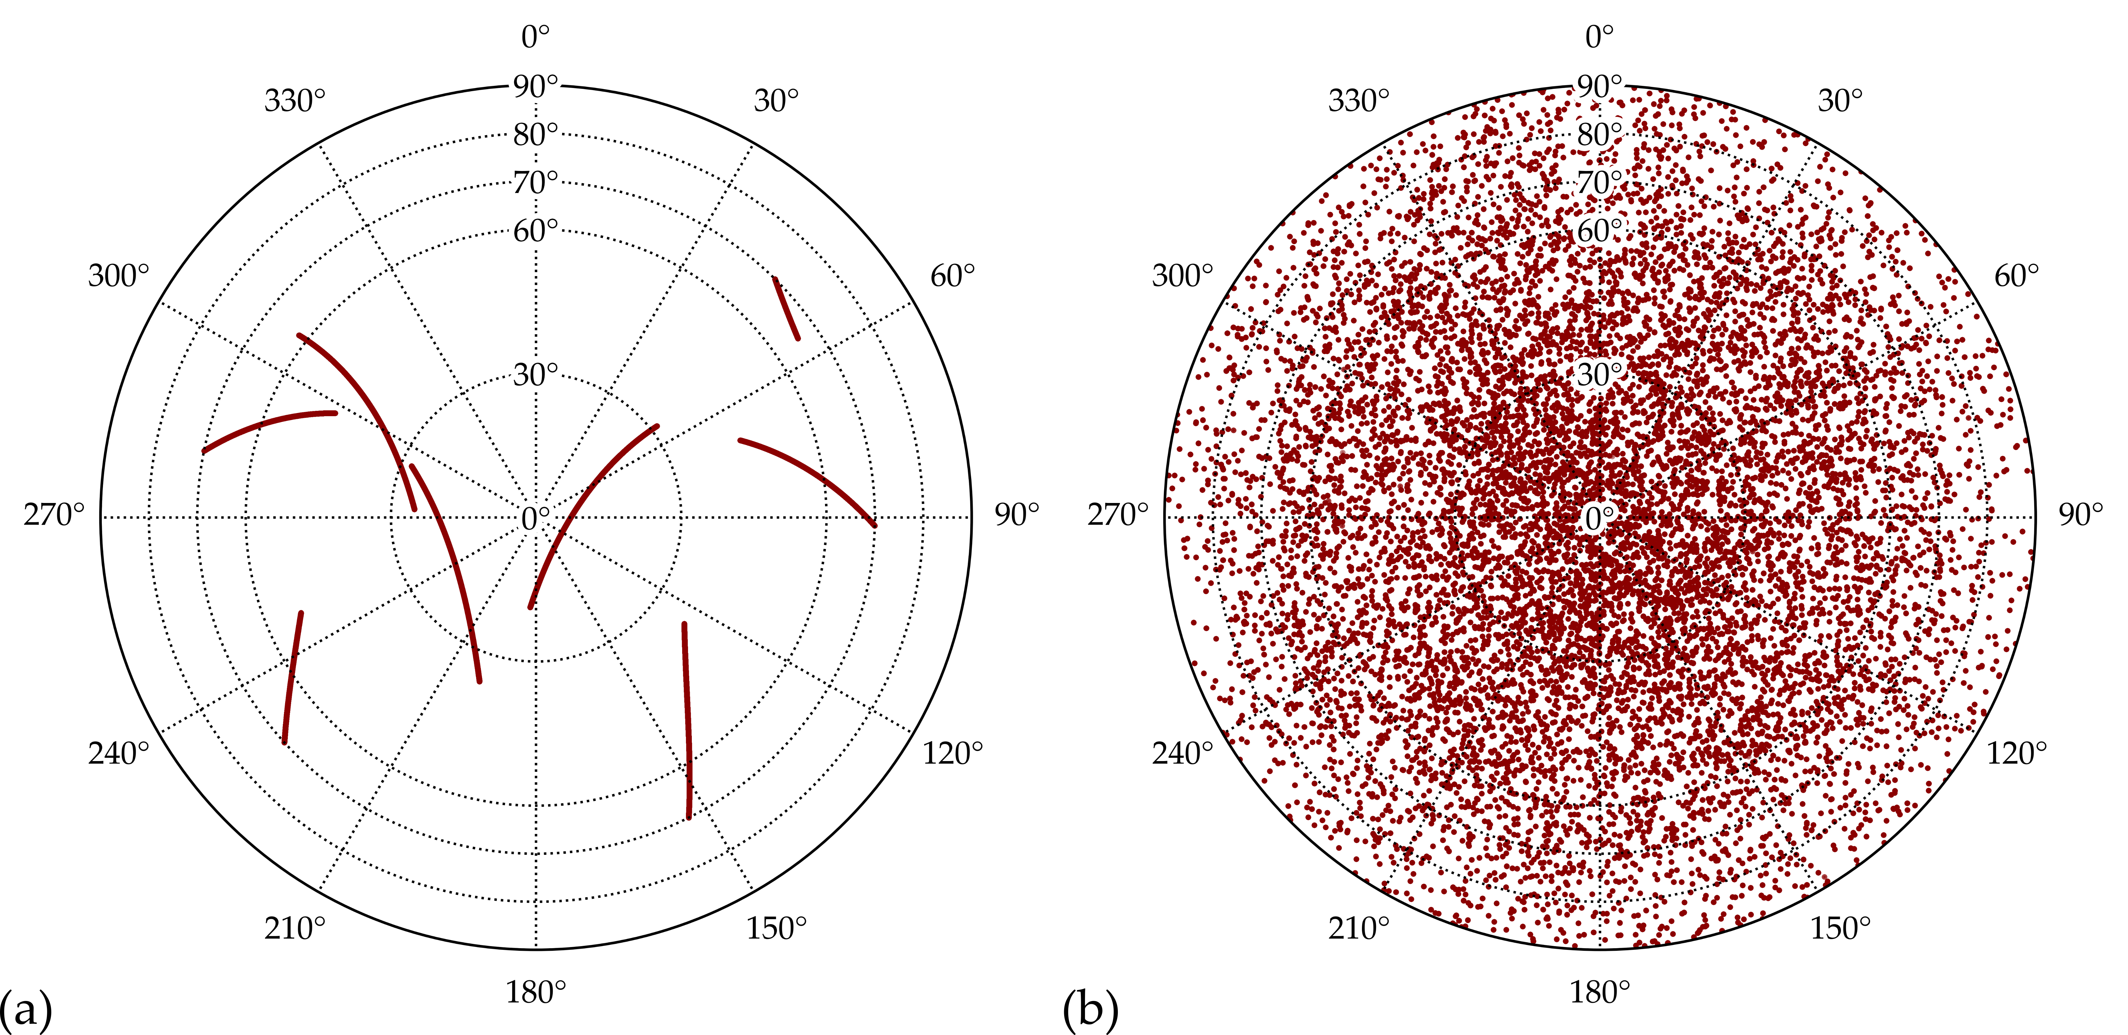
ANTENNA CALIBRATION @ LMMT (3)
Calibration setup:
5 m baseline
2088 different antenna orientations (rotation and tilting)
Robot stationary for 2.5 s at every antenna orientation
10 Hz GNSS observations
Full antenna calibration ≈ 2 h
Antenna orientations timestamped with GPS time (TISY)
Satellite azimuth and zenith angle plot (sky-plot) during antenna calibration at LMMT; (a) topocentric frame (TF); (b) antenna frame (AF).
ECSA-10 | 15 – 30 November 2023
8

Slide 9
ANTENNA CALIBRATION @ LMMT (4)
Triple-difference (TD) approach:
Single (station) differences (SD)
Double (satellite) differences (DD)
Triple (time) differences (TD)
Spherical Harmonics (SH) parametrisation:
ANTEX output
ECSA-10 | 15 – 30 November 2023
9

Slide 10
PRELIMINARY RESULTS (1)
4 calibration campaigns (April – June 2023)
Trimble Zephyr 2 Geodetic (TRM57971.00 NONE, S/N:30739001)
Global Positioning System (GPS) L1 frequency (G01)
Validation with Geo++ GmbH
ECSA-10 | 15 – 30 November 2023
10

Slide 11
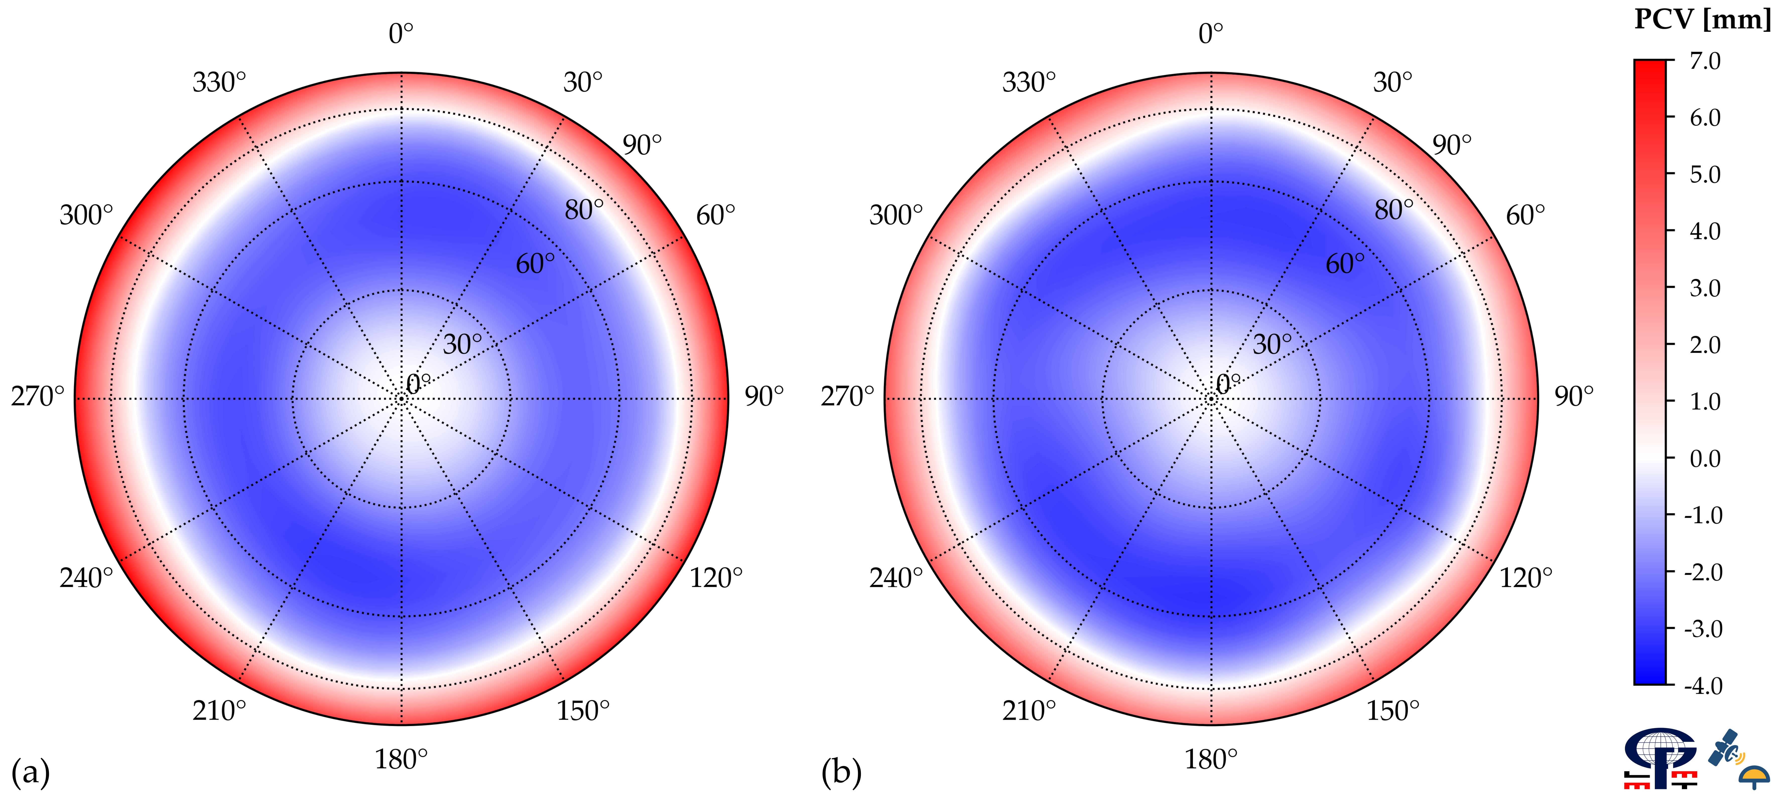
PRELIMINARY RESULTS (2)
PCO vector components of antenna TRM57971.00 NONE (S/N: 30739001) of GPS L1 (G01) frequency per calibration institution. All values are in millimeters (mm).
Calibration Institution | Phase Center Offset (PCO)
 | North | East | Up
Geo++ GmbH | 0.79 | 0.32 | 66.96
LMMT | 1.24 | 0.11 | 67.24
(a) Geo++ GmbH and (b) LMMT phase center variations (PCVs) of antenna TRM57971.00 NONE (S/N: 30739001) for GPS L1 (G01) frequency.
ECSA-10 | 15 – 30 November 2023
11

Slide 12
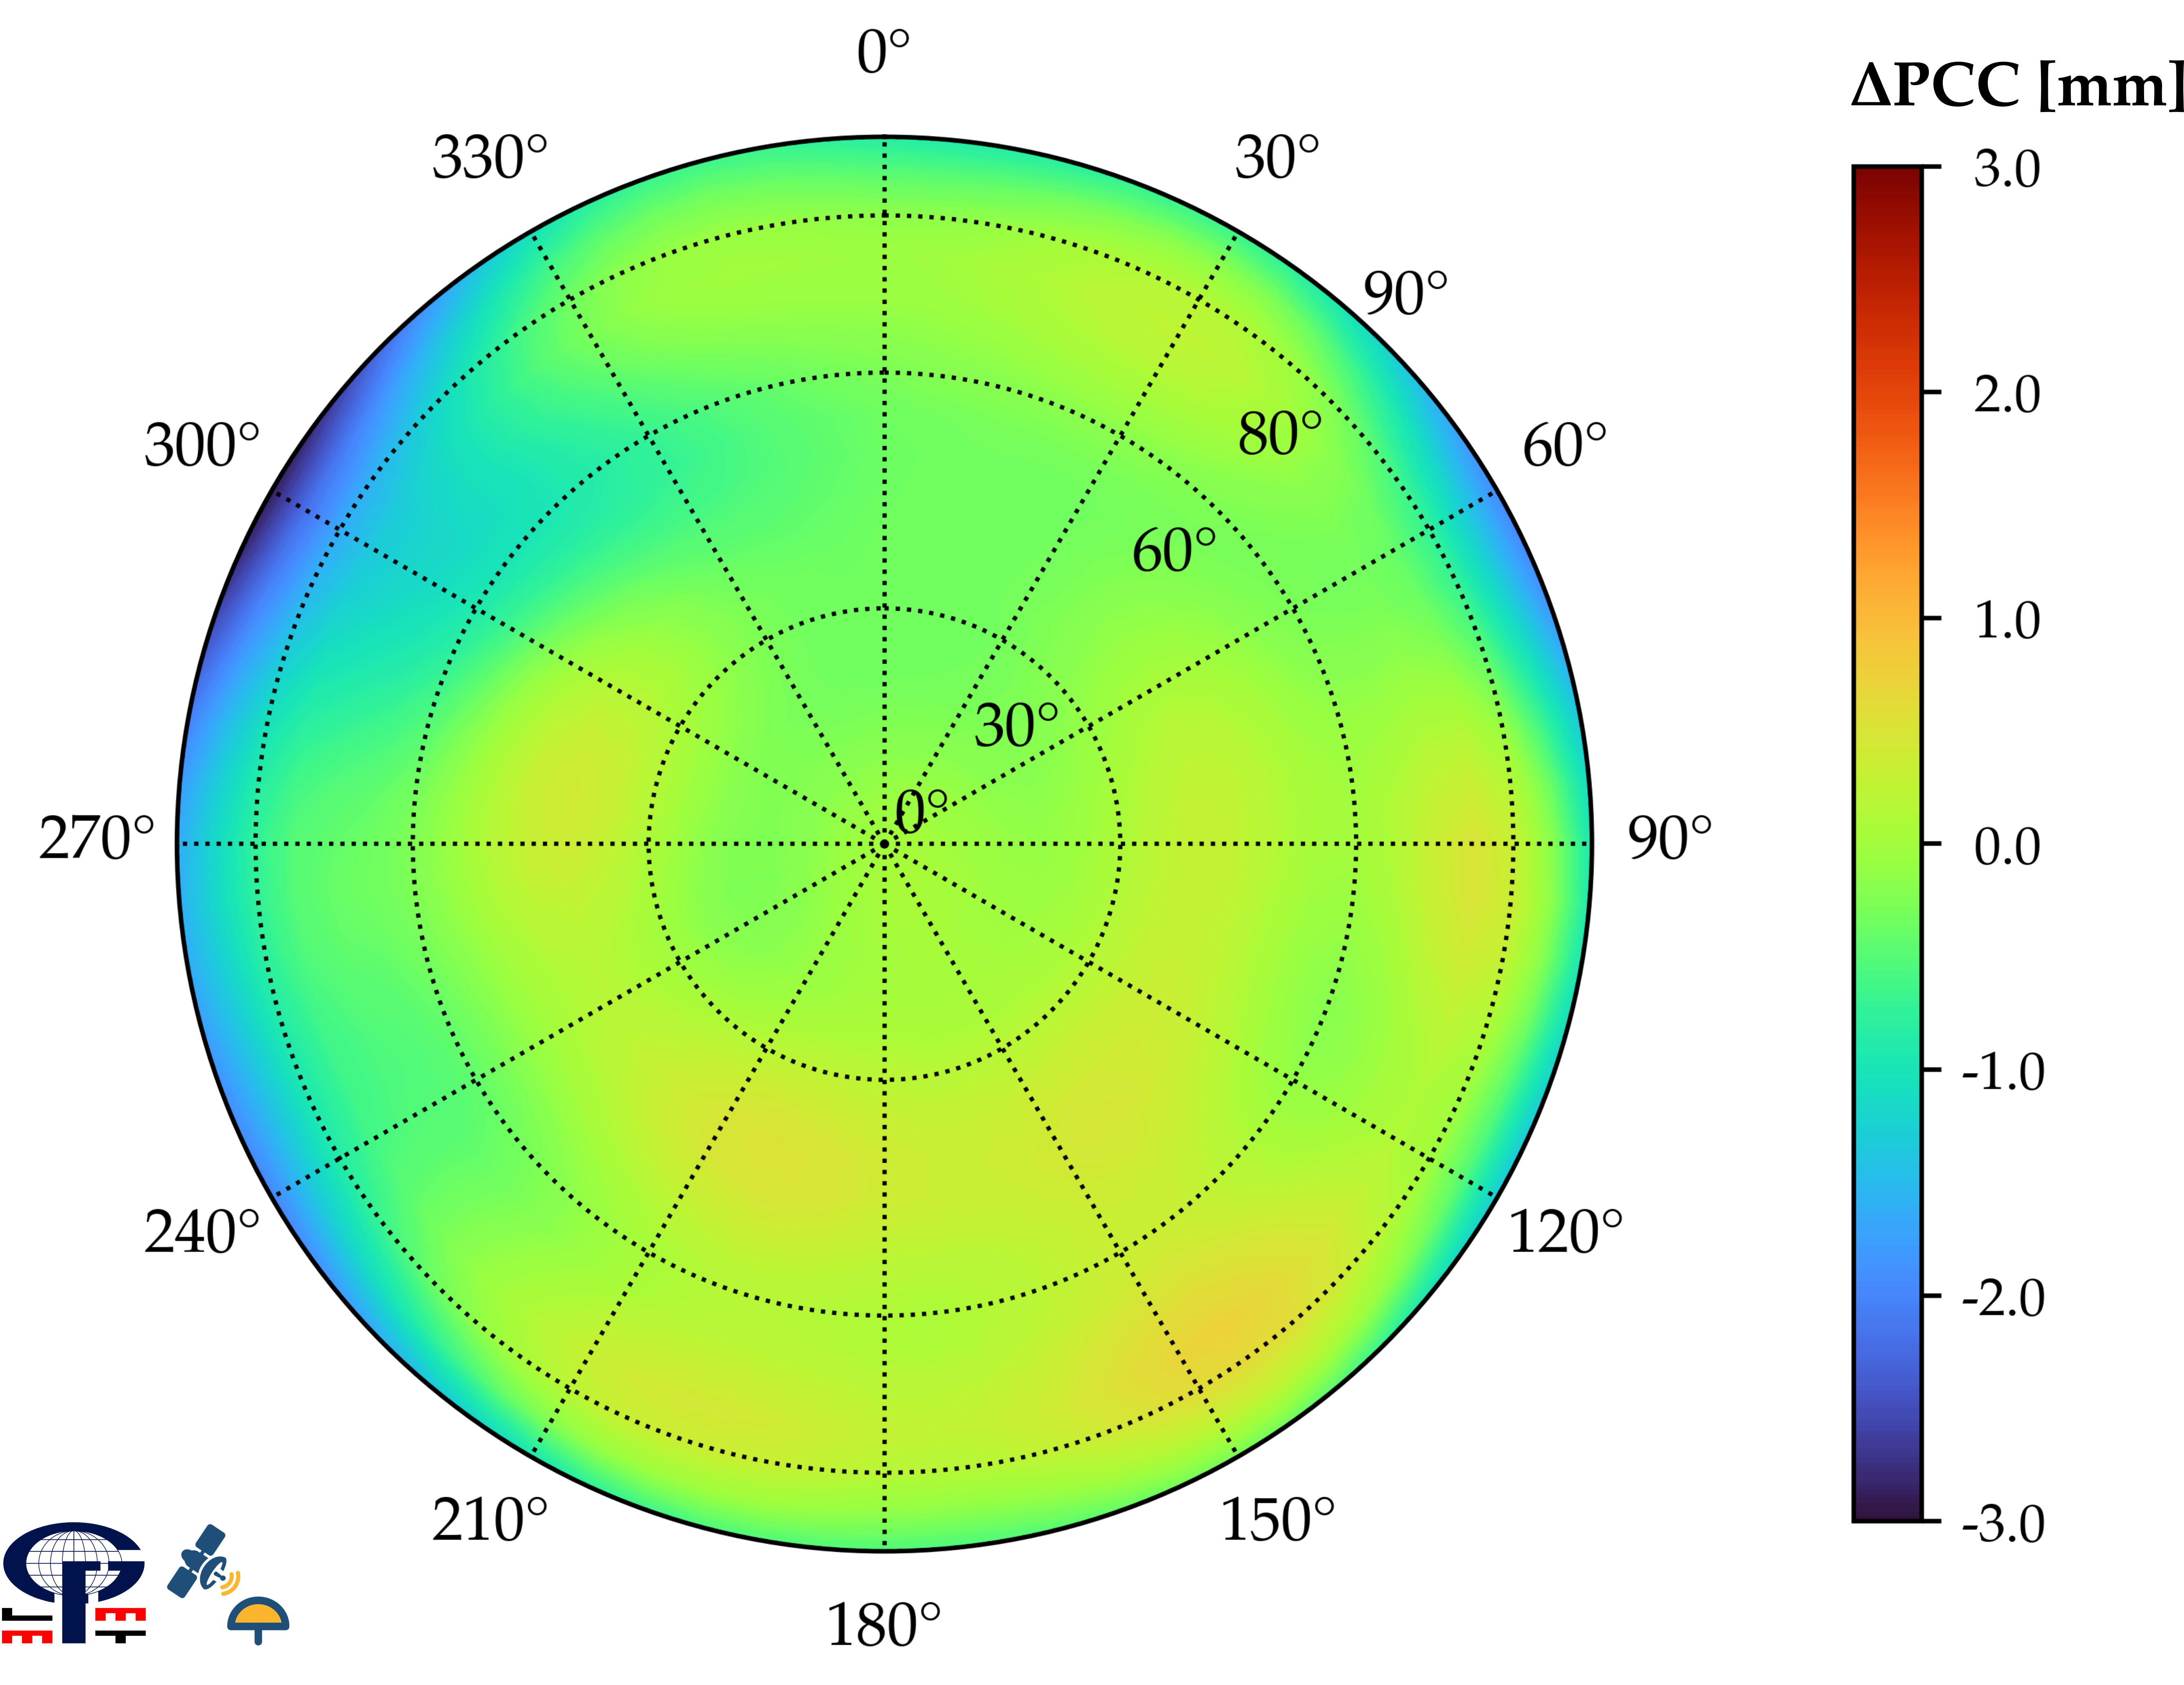
PRELIMINARY RESULTS (3)
Quantitative measures of the difference between Geo++ GmbH and LMMT individual absolute calibrations. All values are in millimetres (mm).
Full antenna hemisphere (0° elevation cut-off) |  |  |  |  | Reduced antenna hemisphere (10° elevation cut-off)
Min. | Max. | RMS | Range | IQR | Min. | Max. | RMS | Range | IQR
–2.92 | 0.72 | 0.52 | 3.64 | 0.44 | –1.64 | 0.72 | 0.34 | 2.36 | 0.41
Geo++ GmbH and LMMT PCC differences (ΔPCC) of antenna TRM57971.00 NONE (S/N: 30739001) for GPS L1 (G01) frequency after transformation to common PCO and datum.
ECSA-10 | 15 – 30 November 2023
12

Slide 13
CONCLUSION & OUTLOOK
Antenna Calibration System is operational and provides meaningful receiver antenna calibration results for GPS L1 frequency
Submillimeter accuracy achieved
Validation with Geo++ GmbH to within 0.52 mm
Robot control software and time synchronization – successful
Outlook: calibration sequence optimization, further system development with the end goal of providing multi-GNSS calibrations
ECSA-10 | 15 – 30 November 2023
13

Slide 14
REFERENCES
Mader, G.L. GPS Antenna Calibration at the National Geodetic Survey. GPS Solut. 1999, 3, 50–58. https://doi.org/10.1007/PL00012780.
Rothacher, M., Schaer, S., Mervart, L., Beutler, G. (1995): Determination of Antenna Phase Center Variations using GPS Data, in Proceedings of the IGS Workshop – Special Topics and New Directions, May 15–18, Potsdam, Germany, 205–220.
Wübbena, G.; Schmitz, M.; Menge, F.; Seeber, G.; Völksen, C. A New Approach for Field Calibration of Absolute GPS Antenna Phase Center Variations. Navigation 1997, 44, 247–255. https://doi.org/10.1002/j.2161-4296.1997.tb02346.x.
Wübbena, G.; Schmitz, M.; Menge, F.; Böder, V.; Seeber, G. Automated Absolute Field Calibration of GPS Antennas in Real-Time. In Proceedings of the 13th International Technical Meeting of the Satellite Division of The Institute of Navigation (ION GPS 2000), Salt Lake City, Utah, USA, 19–22 September 2000; The Institute of Navigation: Manassas, VA, USA, 2000; pp. 2512–2522.
Zeimetz, P. Zur Entwicklung Und Bewertung Der Absoluten GNSS-Antennenkalibrierung Im HF-Labor. Ph.D. Thesis, University Bonn, Bonn, Germany, 2010.
ECSA-10 | 15 – 30 November 2023
14

Slide 15
Thank you for your attention!
Antonio Tupek, MSc
Research and teaching assistant
Faculty of Geodesy, University of Zagreb
Zagreb, Croatia
antonio.tupek@geof.unizg.hr

