Slide 1
01/10/2023
Nicky Andre Prabatama
ESYCOM Laboratory
Advisor:
Pierre Hornych
Stefano Mariani
Jean-Marc Laheurte
Development of a Zigbee-based wireless sensor network of MEMS Accelerometers for Pavement Monitoring

Slide 2
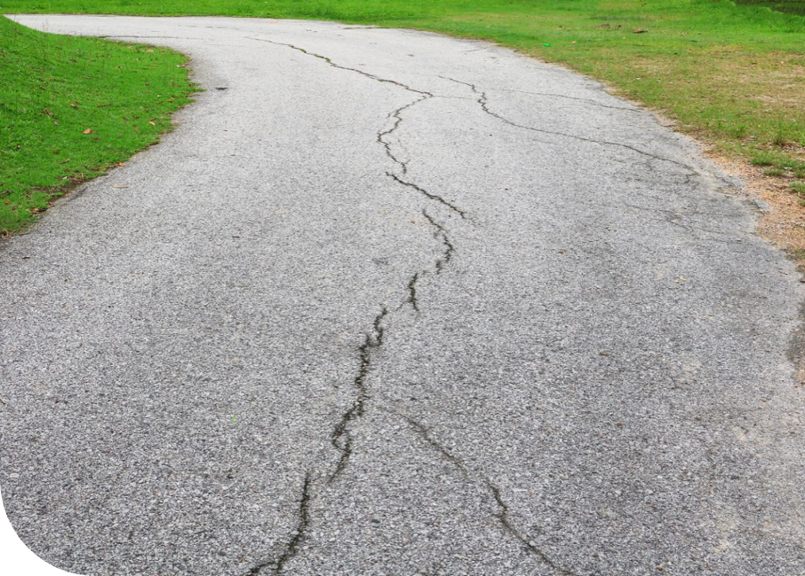
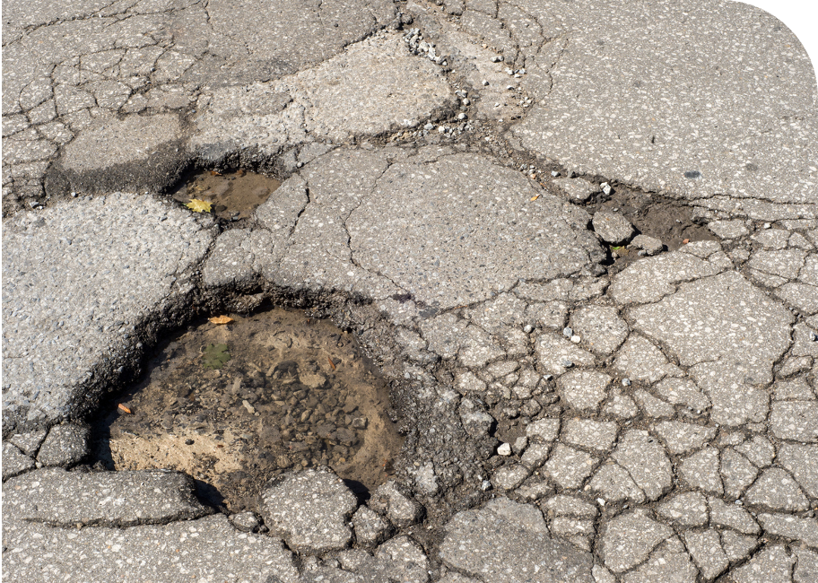
Topic Introduction
Parameters Affecting Pavement health
Traffic factors (Truck Loads)
Climatic Condition
Pavement Age
Initial design and construction
Typical displacement when truck passing is 0.1 - 1mm with 5 mg to 200 mg acceleration expected, with low frequency vibration 0.5 Hz to 20 Hz
Problem to address
Safety related to the roads become a major issue.
Difficult to detect the degradation of roads.
Main objective of the thesis
Predict, localize, and quantify the severity and propagation before the pavement is damaged.
1

Slide 3
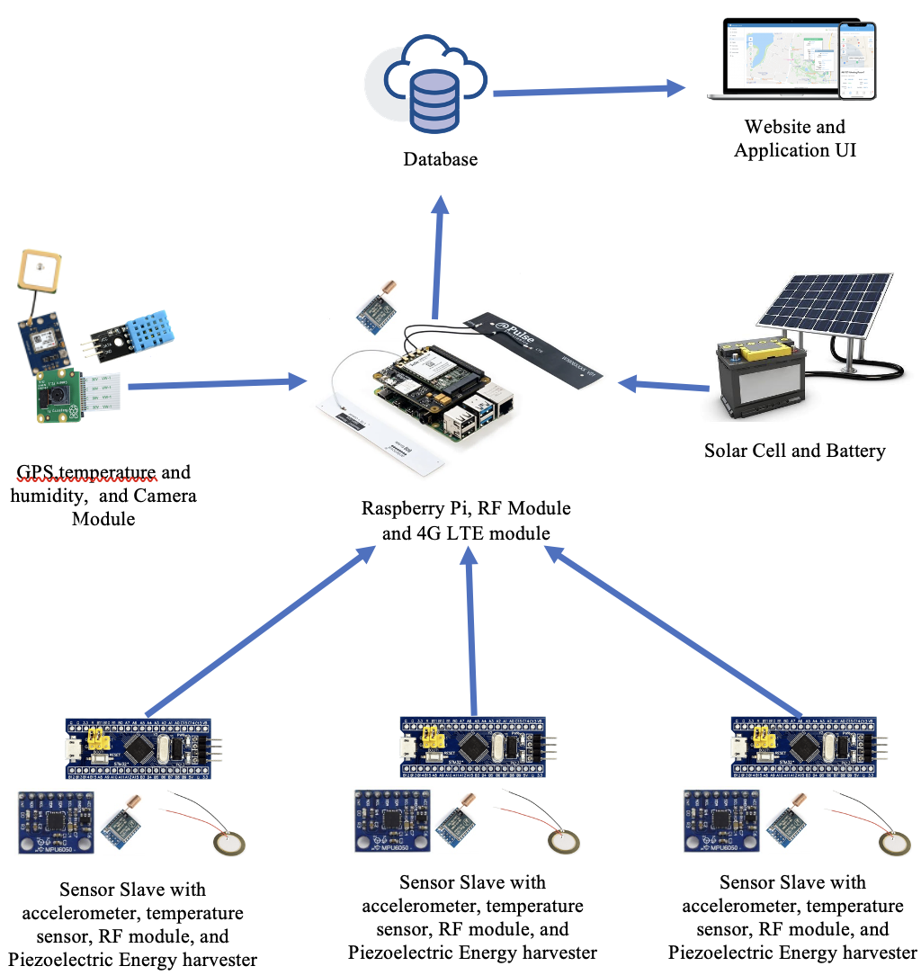
Proposed System Architecture
Website and Application UI
Database
Roadside System
Road side System = Placed next to the road
GPS, Temperature and Humidity, and Camera Module
Battery charged by Solar Cell
Raspberry Pi with RF, and 4G module
Embedded Unit
Embedded Unit = Embedded into the pavement
Sensor slaves with accelerometer, RF Module, and Piezoelectric Energy Harvester
6

Slide 4
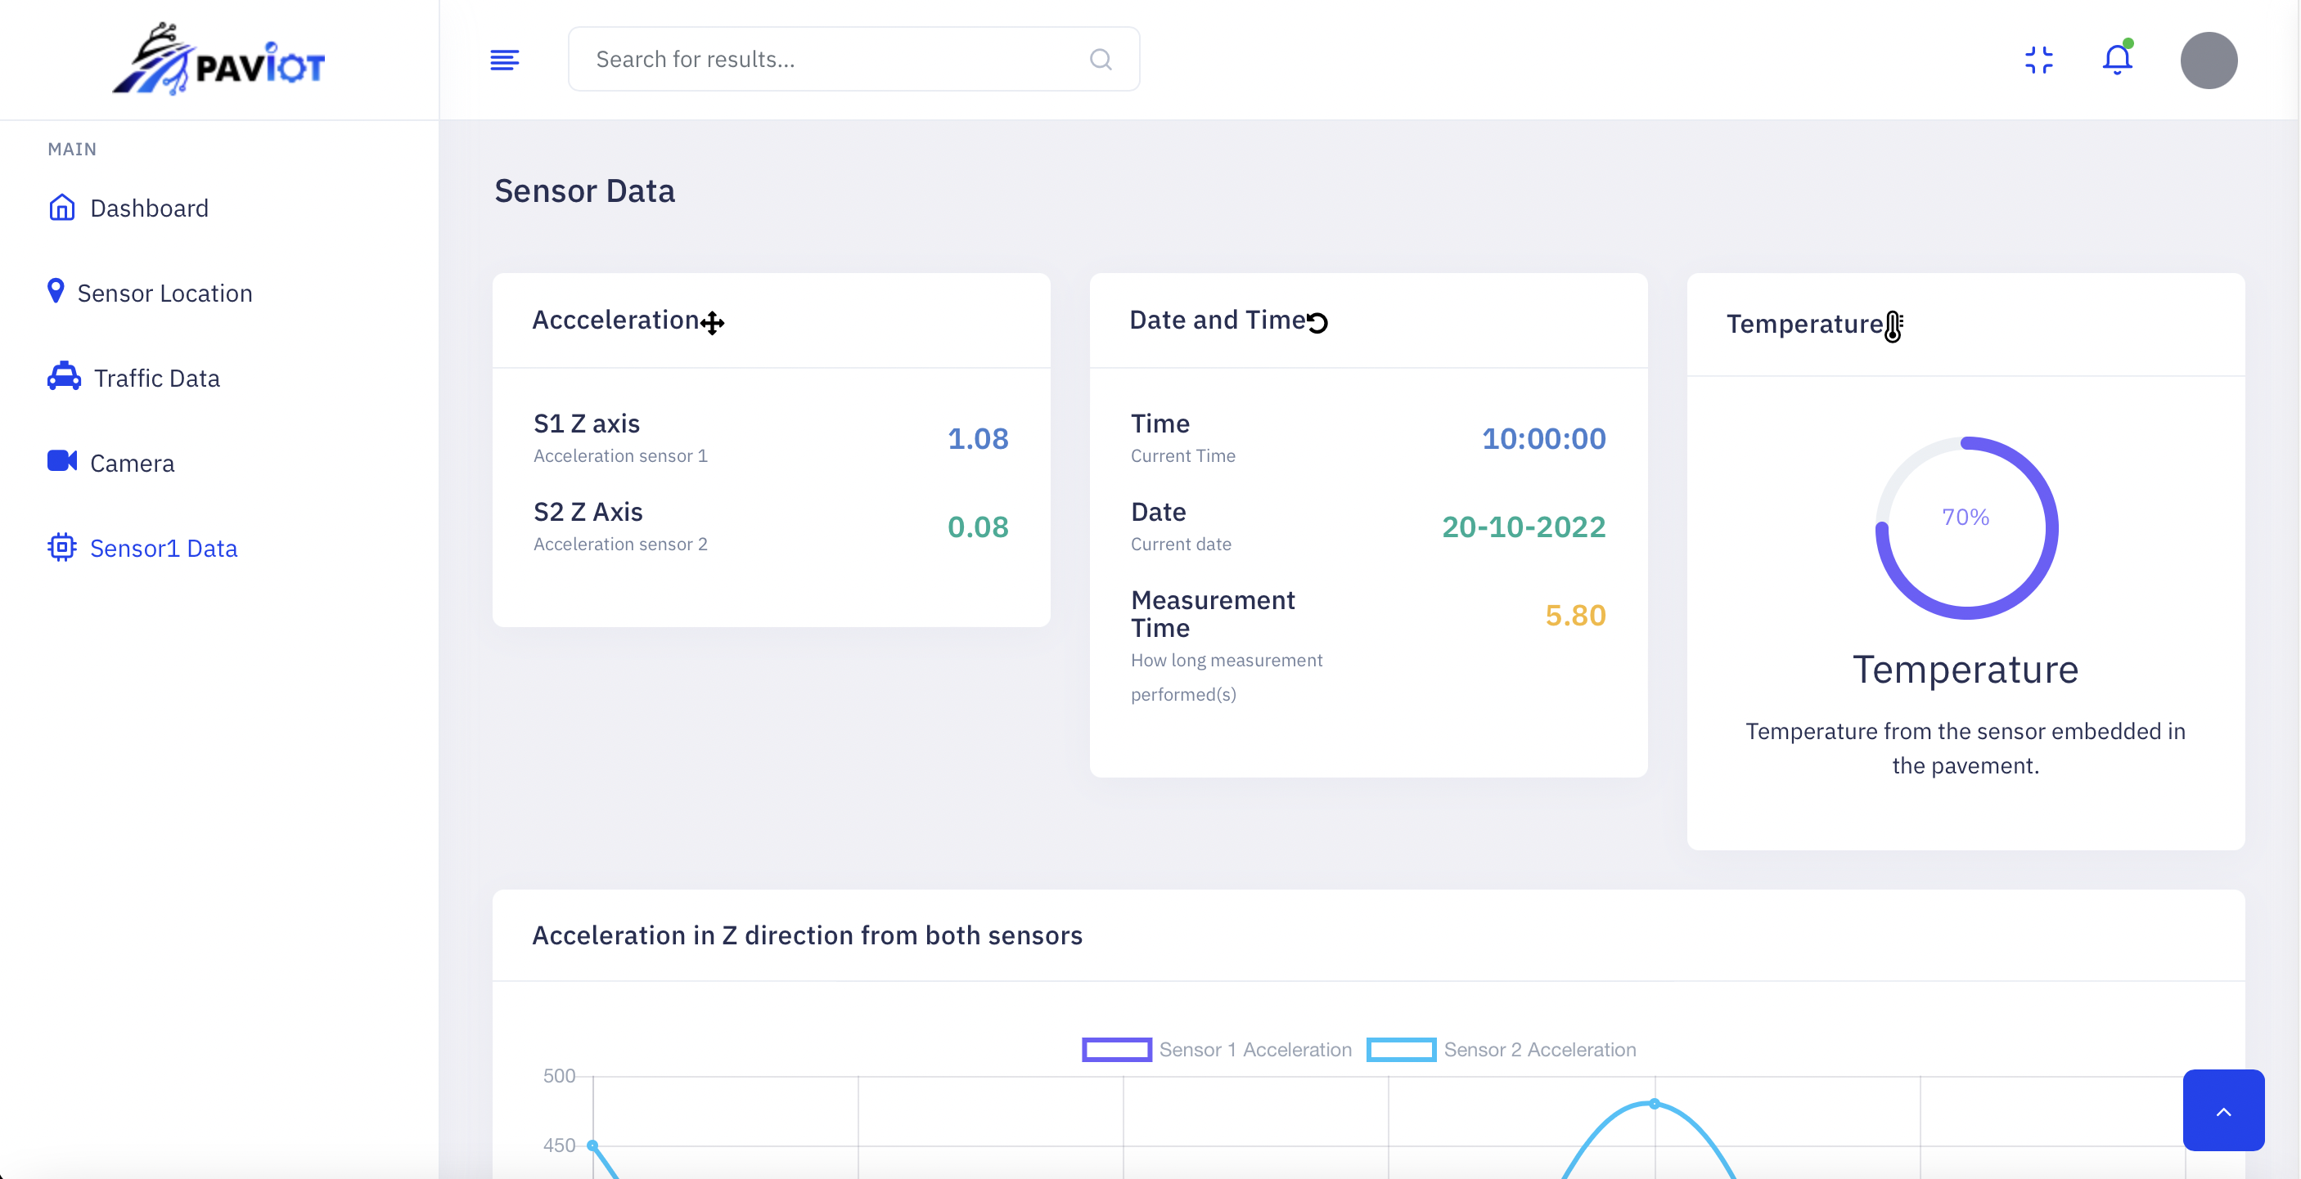
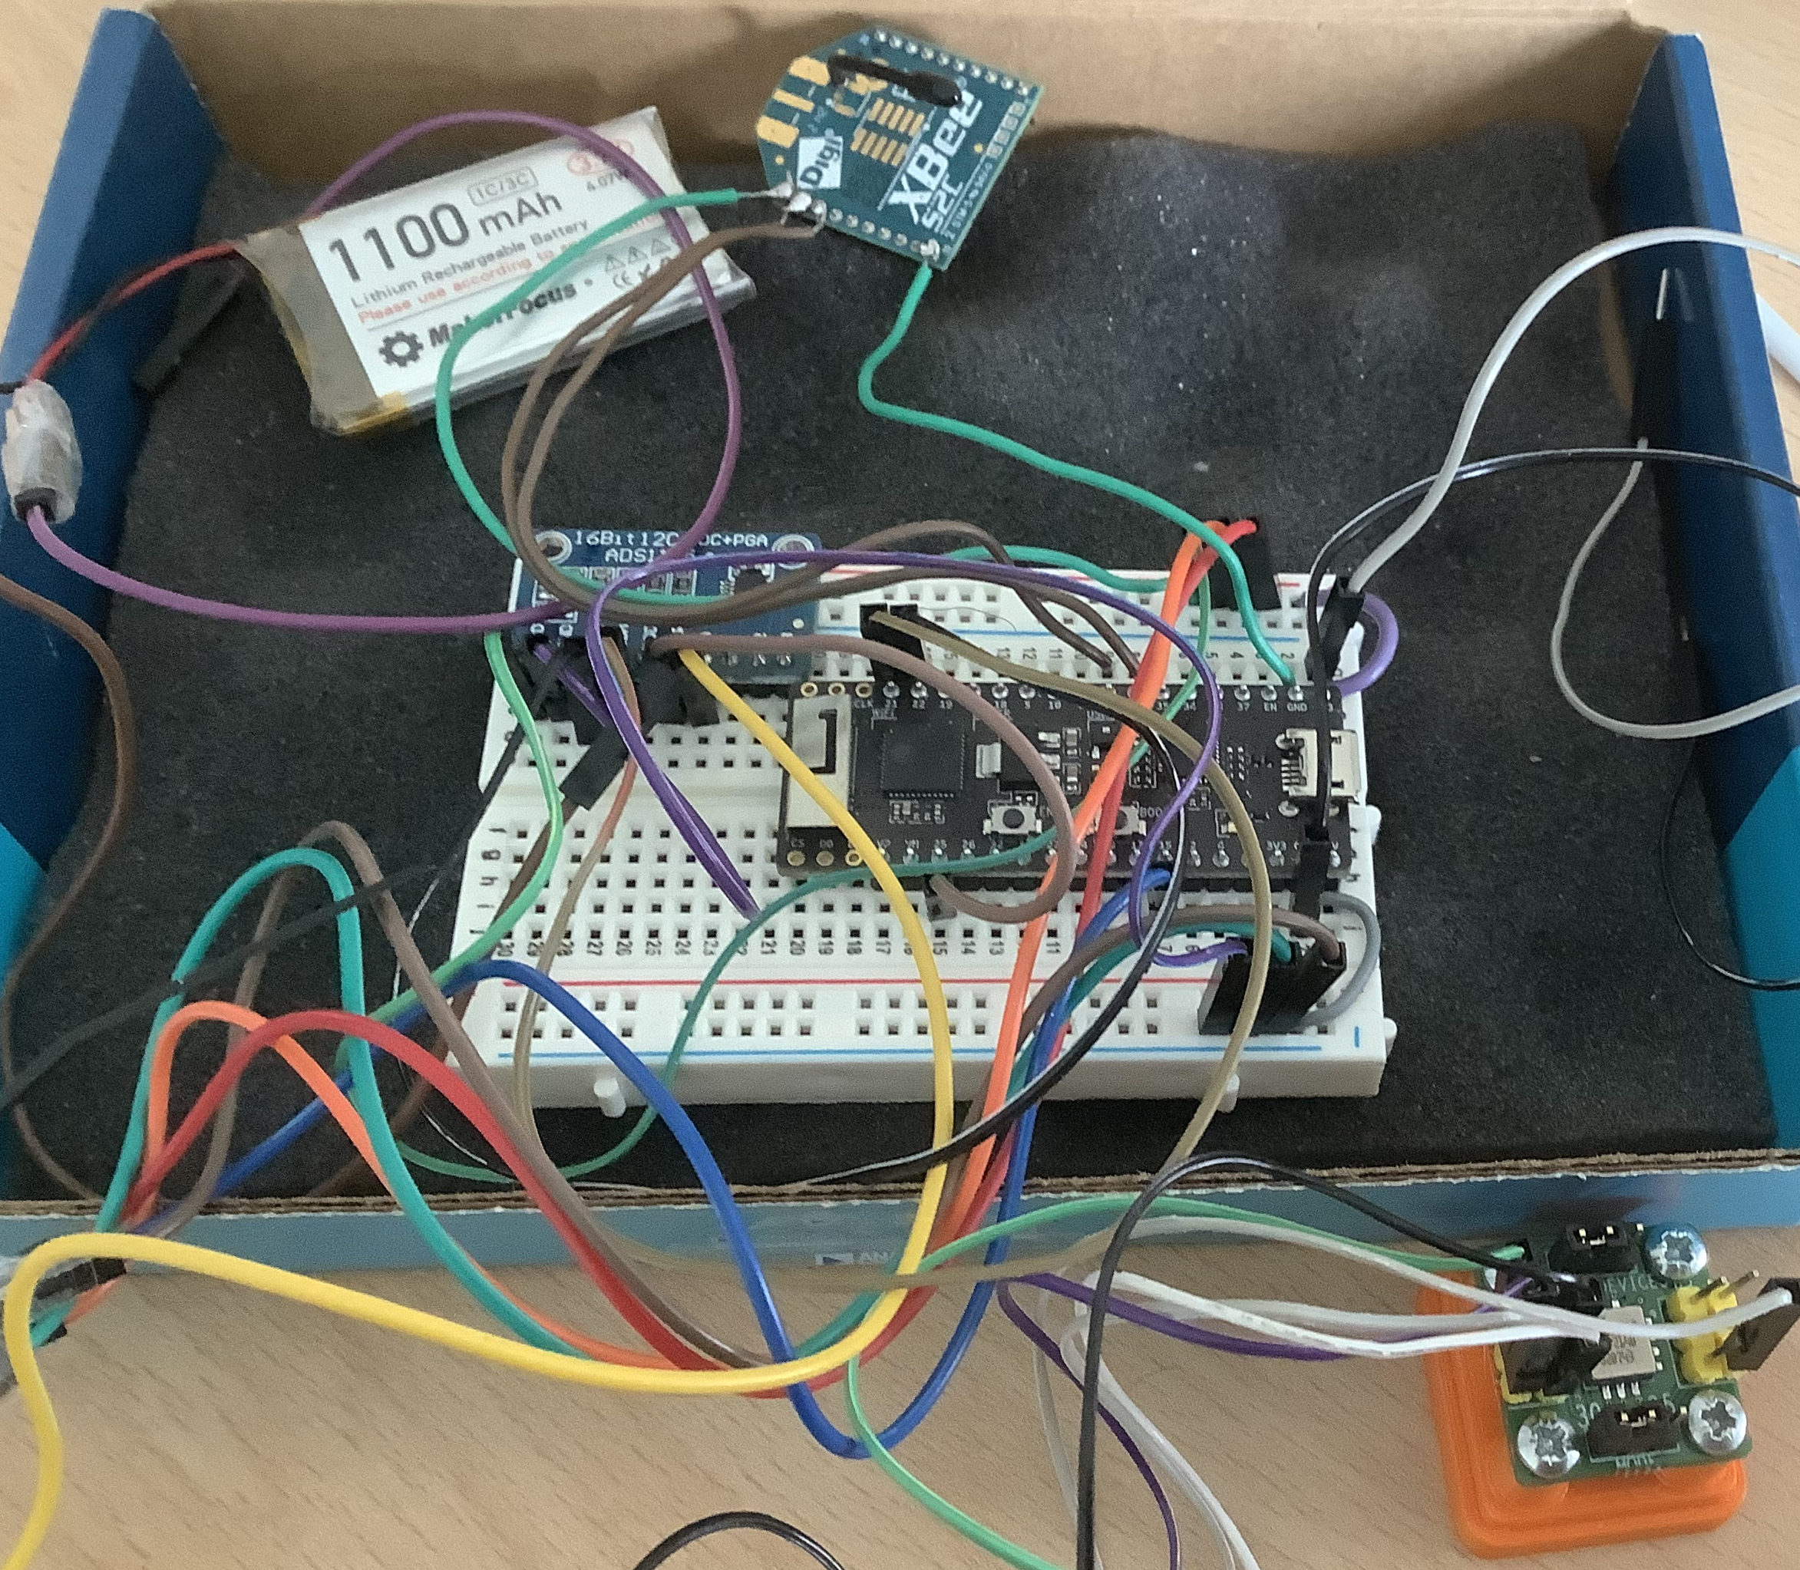
Developped system
Embedded Unit
Road side System
Singleboard Computer, Zigbee
Signal Processing and Integration using Python or Matlab
Microcontroller, Accelerometer, and Zigbee powered by battery
7

Slide 5
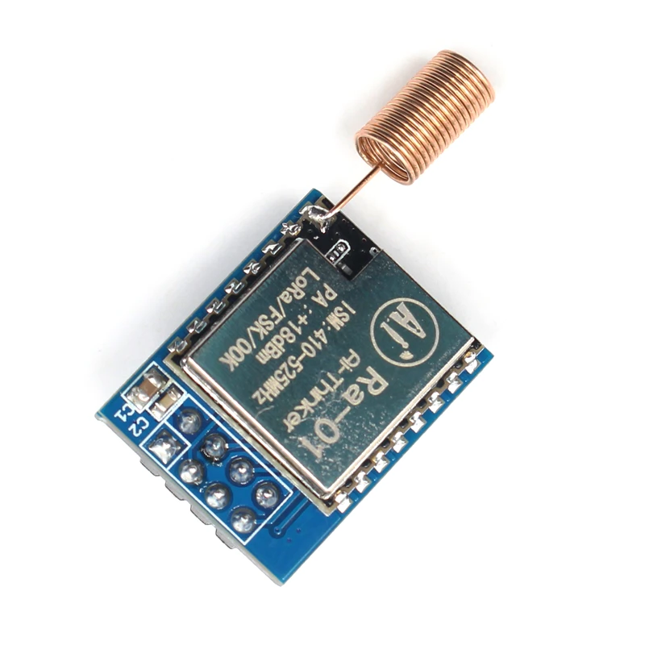
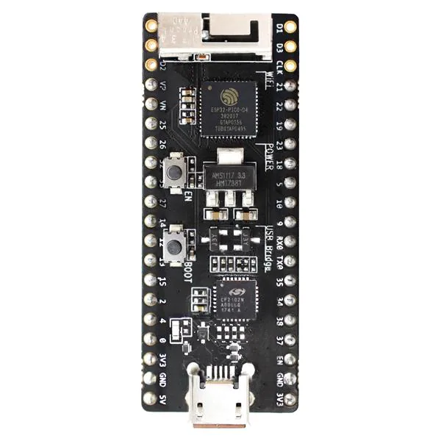
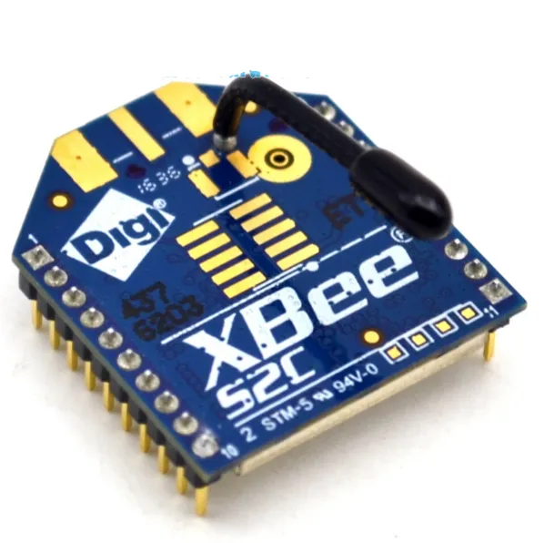
Wireless Communication
Rx
Tx
12.46 mA
85.5 mA
Sleep
0.7 uA
Long Range (up to 15km), Low Power Consumption, and Low Data rate 30 data/s
Rx
Standby
1.72 mA
Tx
86.63 mA
152.3 mA
Sleep
Rx
10 .5uA
Tx
29.28 mA
Standby
29.60 mA
Sleep
0.8 uA
20.6 mA
Standby
28.90 mA
Wireless Communication used should be Low Power Consumption with Sufficient Data rate
Low Power Consumption, Medium Data Rate 110 data/s,
Medium distance (up to 150m)
High Power Consumption, and High Data Rate 200 data/s,
Medium distance (up to 200 m)
8

Slide 6
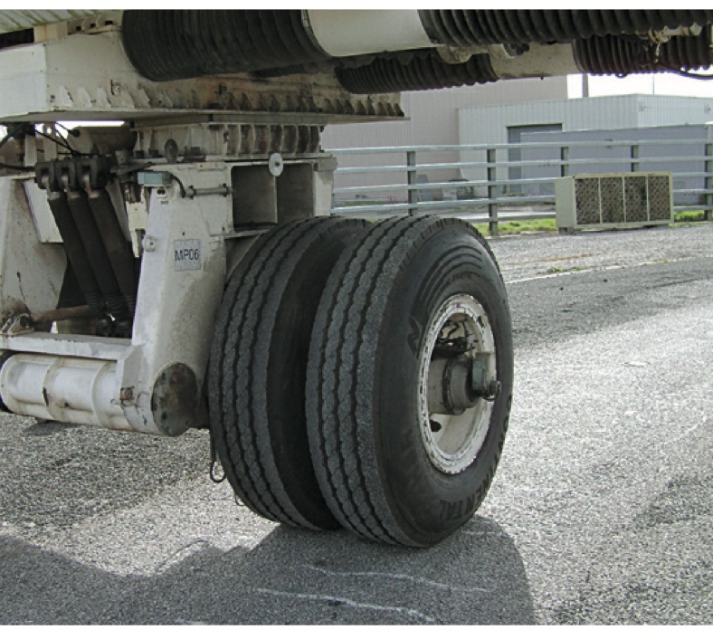
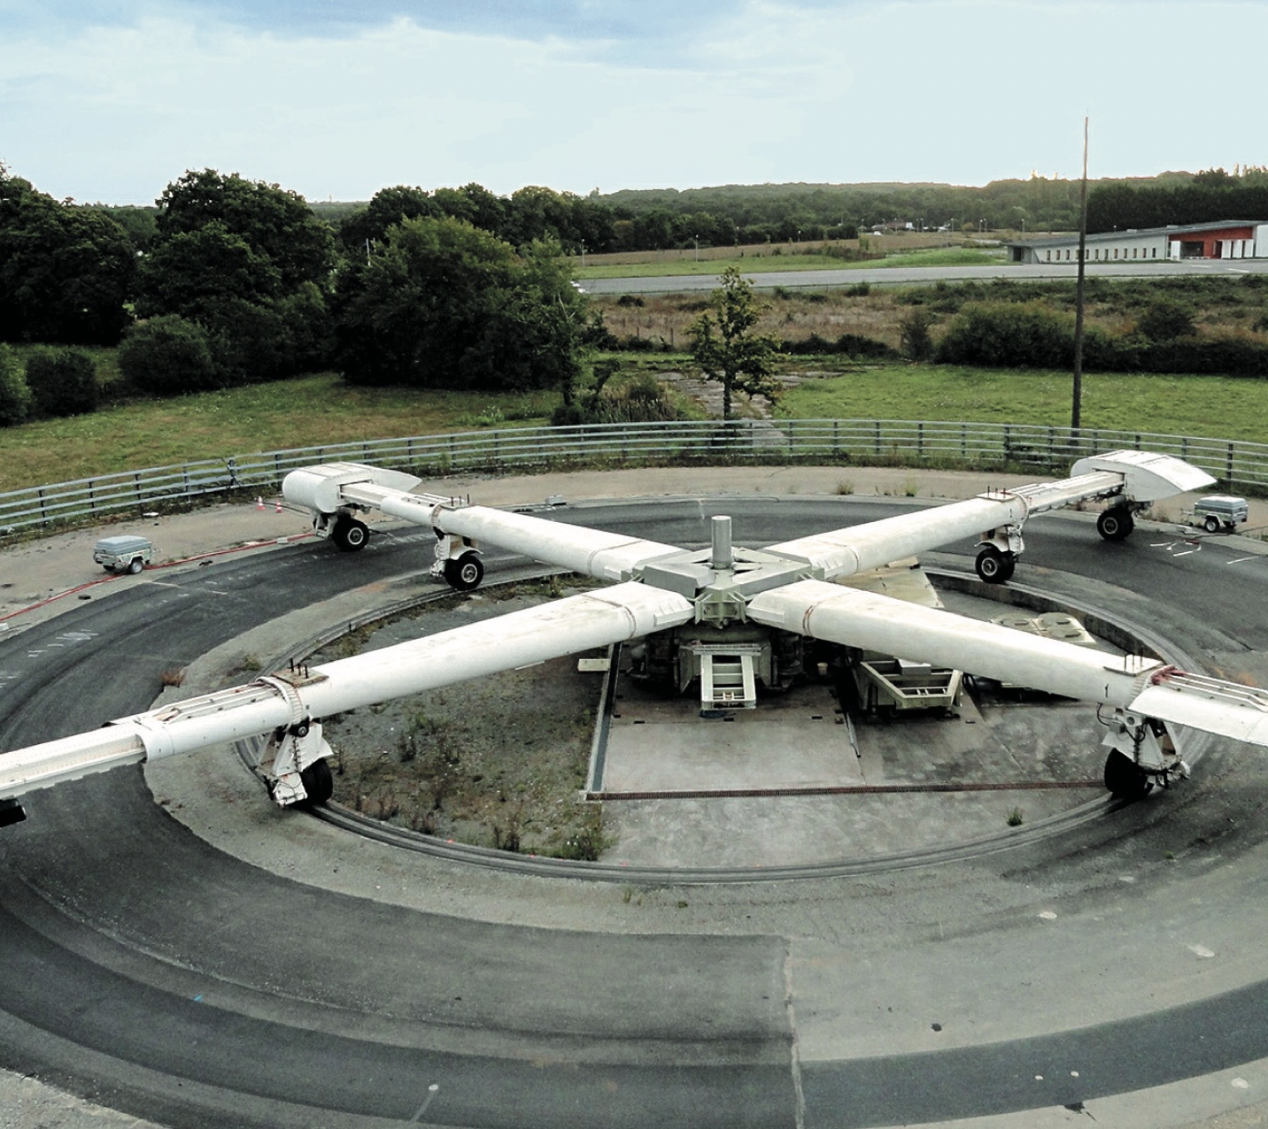
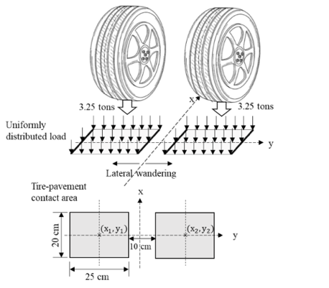
Fatigue Caroussel available in Universite Gustave Eiffel
Fatigue Caroussel in Nantes : Accelerated pavement testing facility to test new pavement materials, or instrumentation for pavement.
Finite Element modeling performed in ABAQUS for the Fatigue Caroussel Pavement.

Slide 7
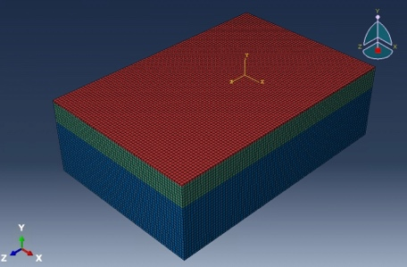
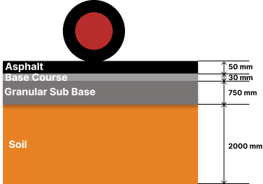
FEM model for the Fatigue Caroussel Pavement
Fatigue Caroussel pavement comprised of 4 different layers : modeled in ABAQUS
FEM for dynamic simulation.
Layer | Young’s Modulus E(MPa) | Poisson’s ratio | Density (kg/m3) | Thickness(mm)
Pavement | 31,468 | 0.35 | 2400 | 50
Base Course | 37,554 | 0.35 | 2400 | 30
Granular Sub Base | 160 | 0.35 | 2400 | 750
Soil | 95 | 0.35 | 2400 | 2000

Slide 8
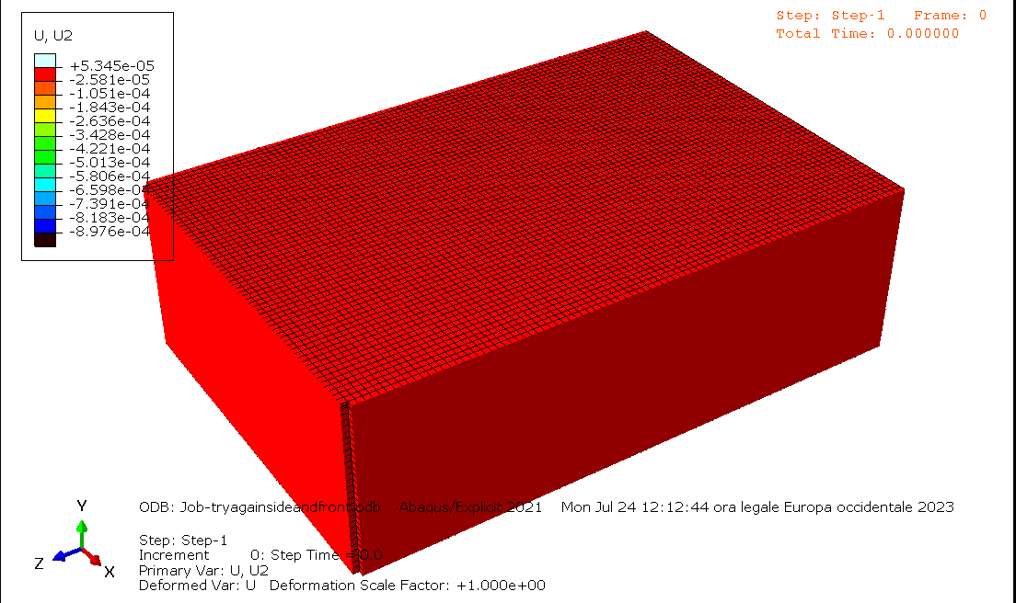
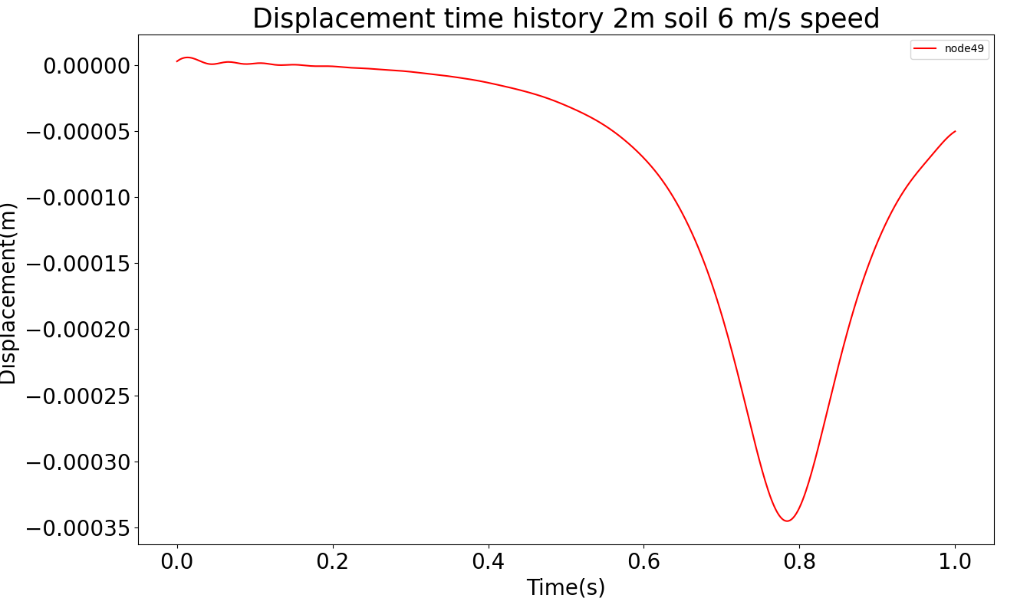
Results from FEM
-0.3491 mm

Slide 9
Laboratory Test performed using the prototype
Vibrating Table Test
Vibrating Pot Test
Typical Truck Displacement Signal
Dynamic calibration
ADXL354
Silicon Design Accelerometer
Accelerometer from Bruel and Kjaer
ADXL355 (Digital out)
ADXL355
ADXL354
( Analog Out)
MS1002
Built in displacement sensor in the vibrating table
9
MS1002.A
(Differential Analog out)
9

Slide 10
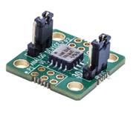
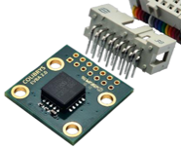
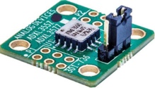
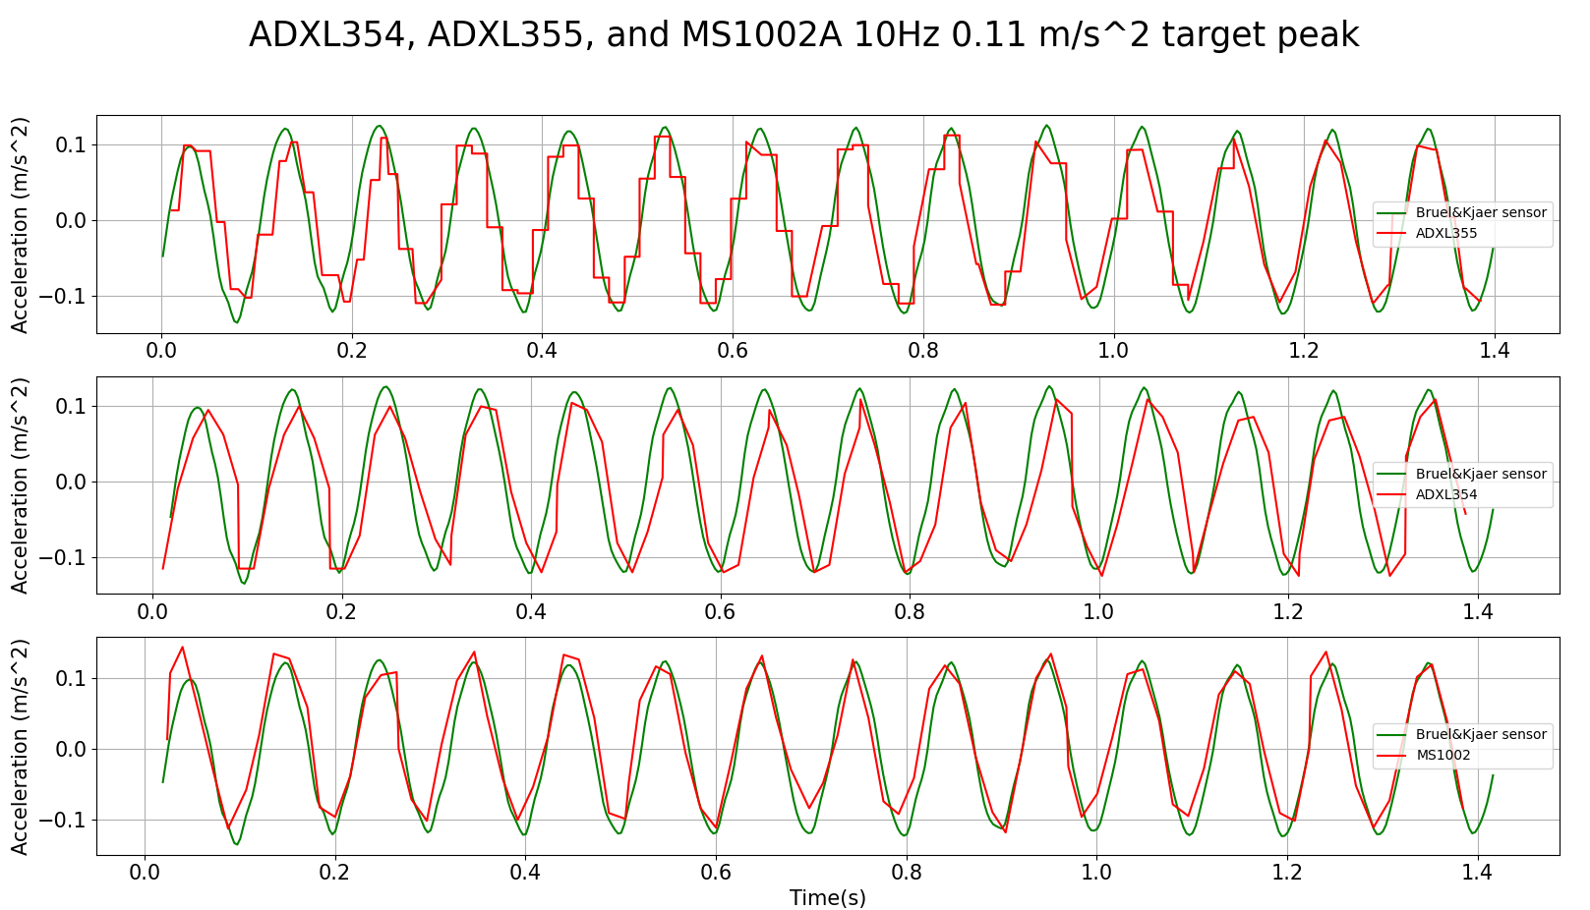
10 Hz
Accelerometer Type | ADXL355 | ADXL354 | MS1002
Sensitivity |  | 384 mV/g | 1340 mV/g
Power Consumption | 201.0 uA | 155.2 uA | 12.11 mA
Noise (mg) | 0.254 mg | 0.230 mg | 0.781 mg
10

Slide 11
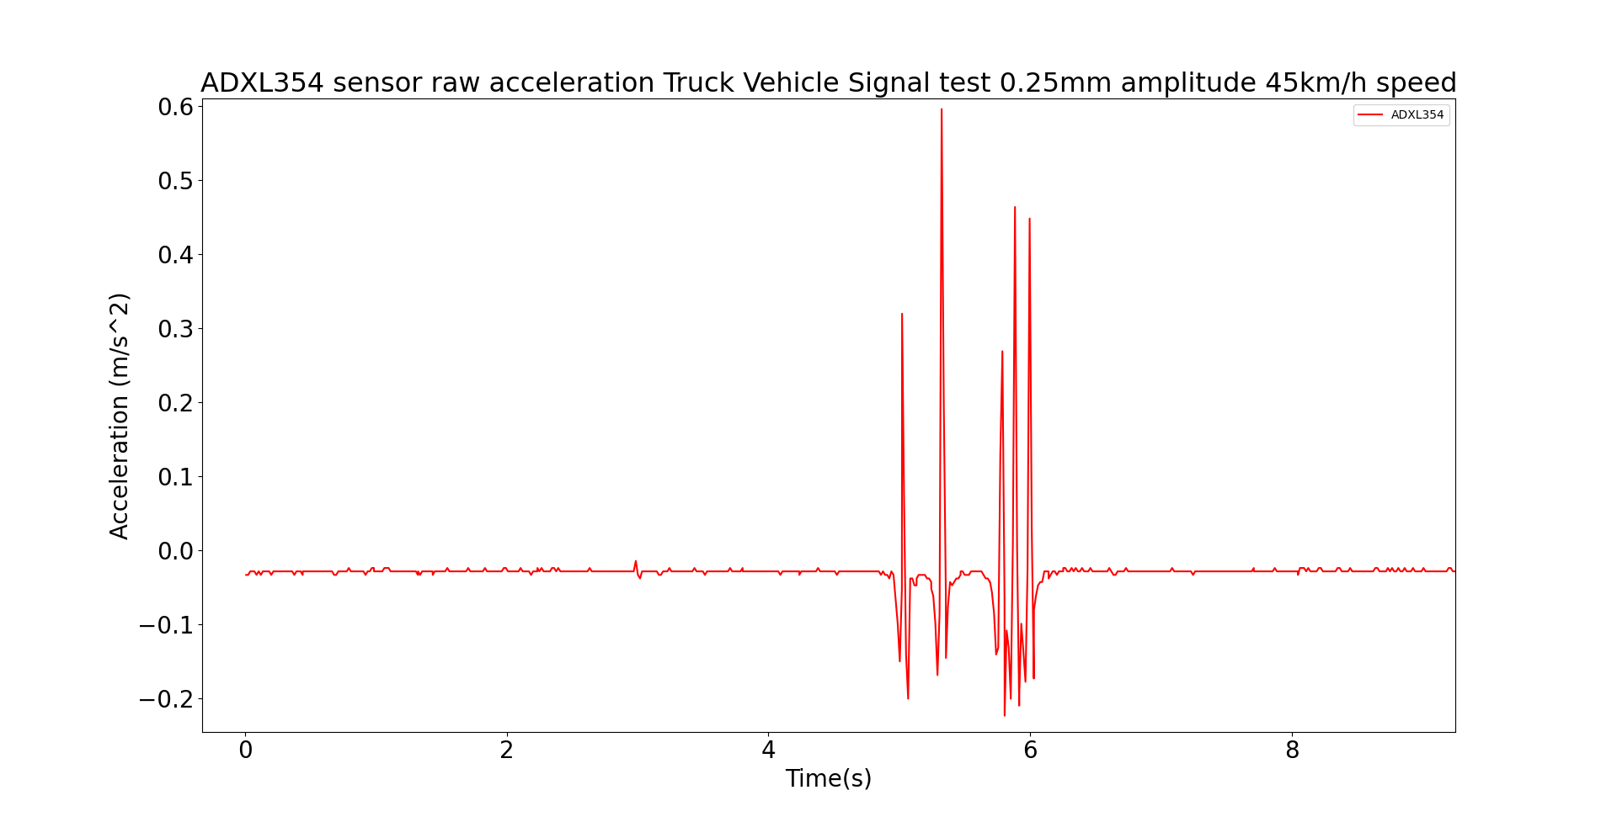
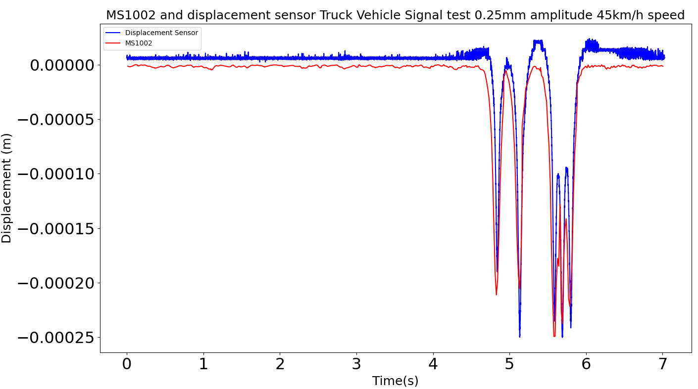
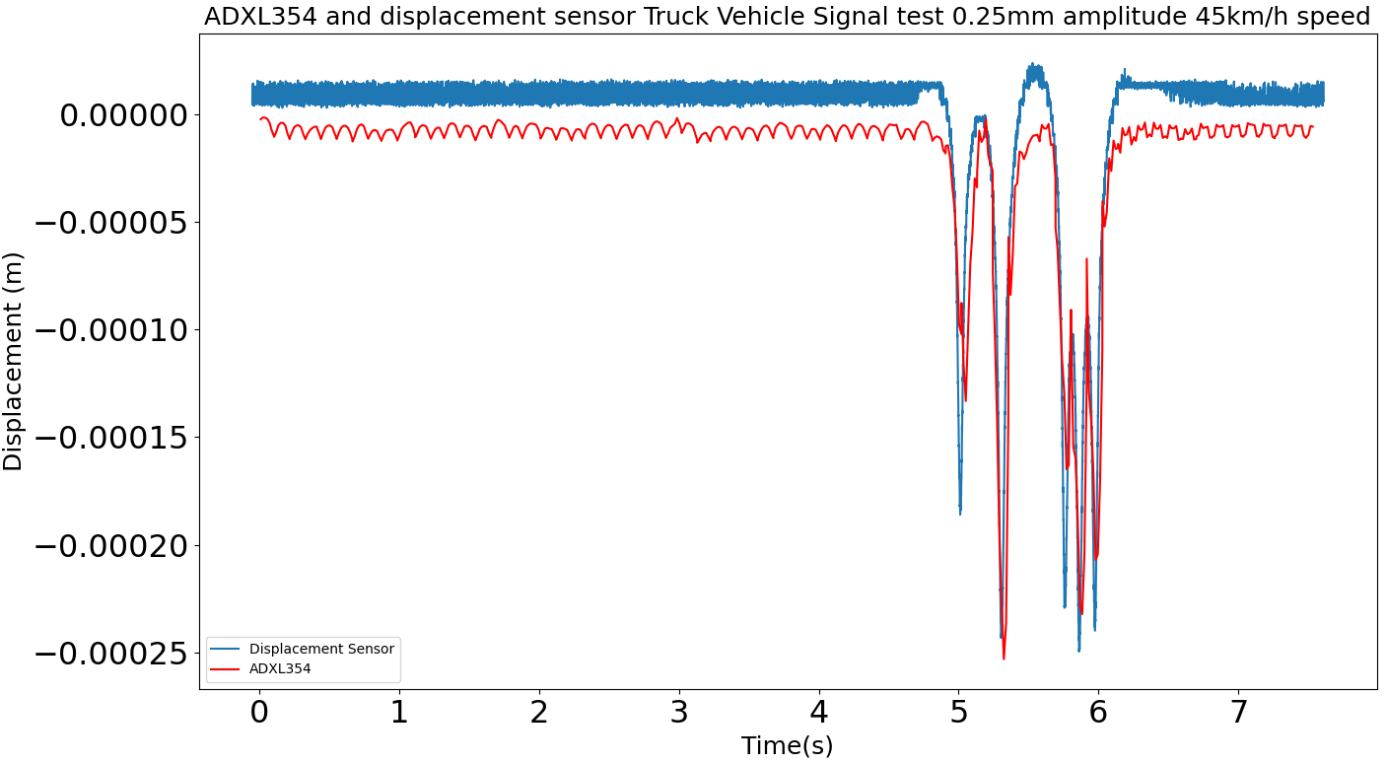
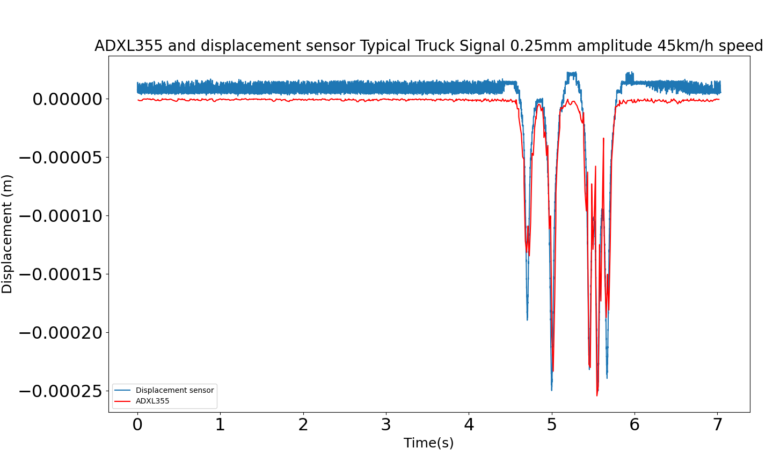
45 km/h speed with 0.25 mm displacement amplitude
11

Slide 12
Conclusion
ADXL354 used in the project as it has the lowest power consumption and good accuracy
Finite Element modeling carried out to access pavement deflection expected under the moving load induced in fatigue test.
Signal processing converts acceleration into displacement.
Prototyped wireless sensor network capable of monitoring pavement displacement.

Slide 13
Nicky Andre Prabatama
Nicky-andre.prabatama@univ-eiffel.fr

Slide 14
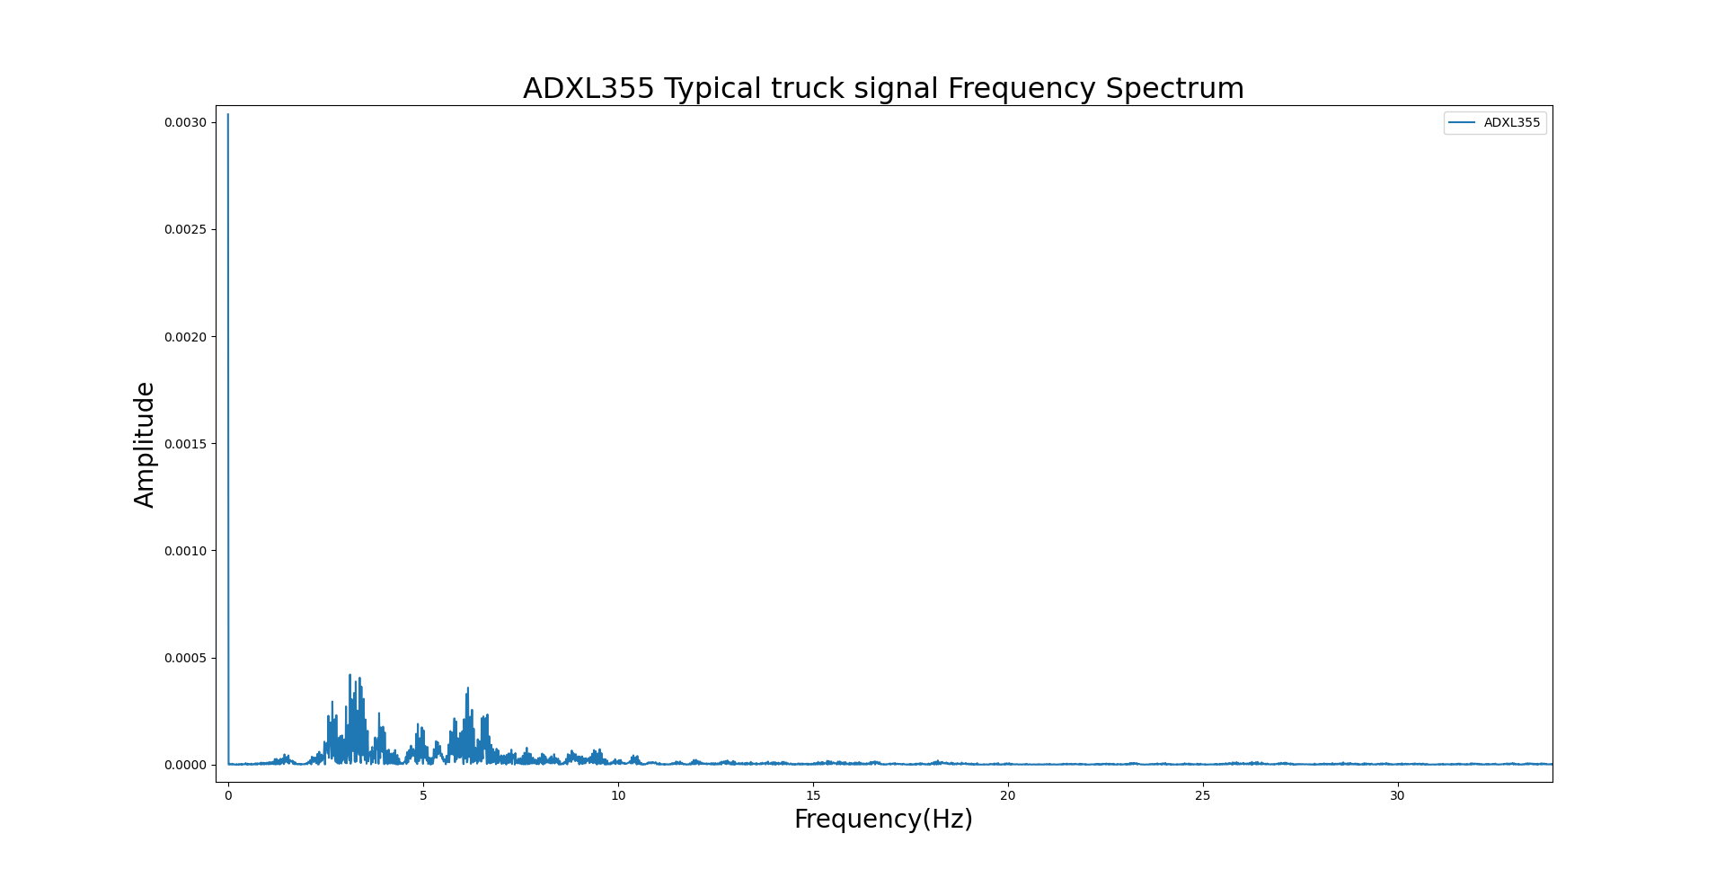
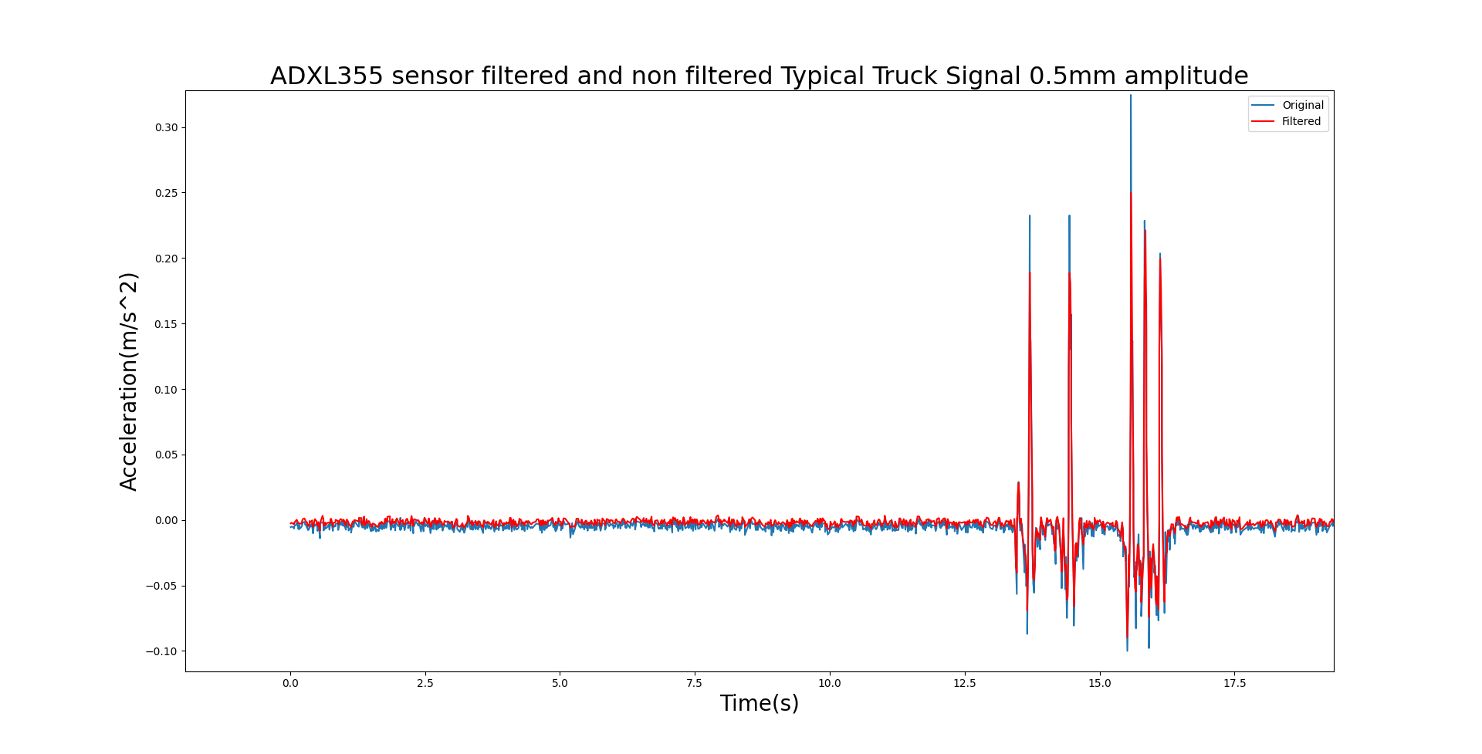
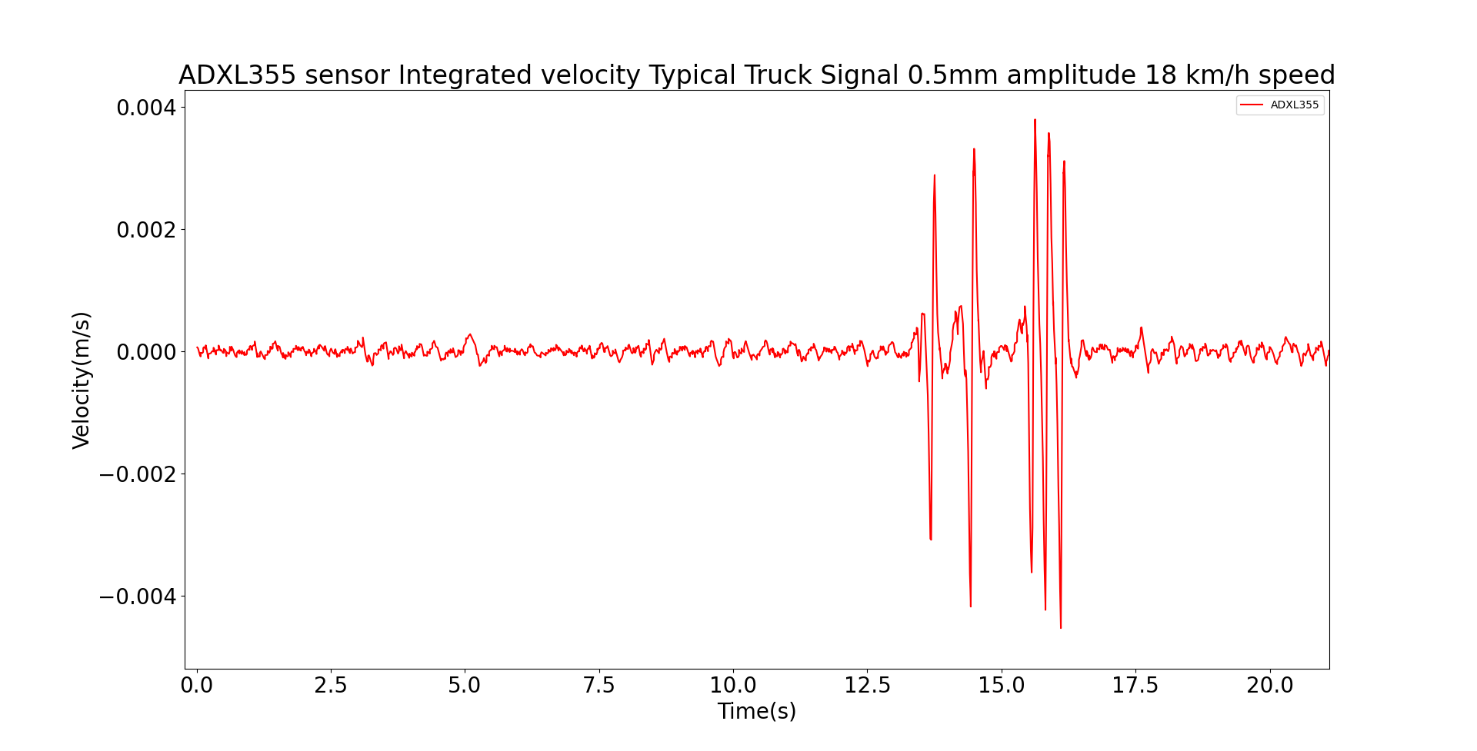
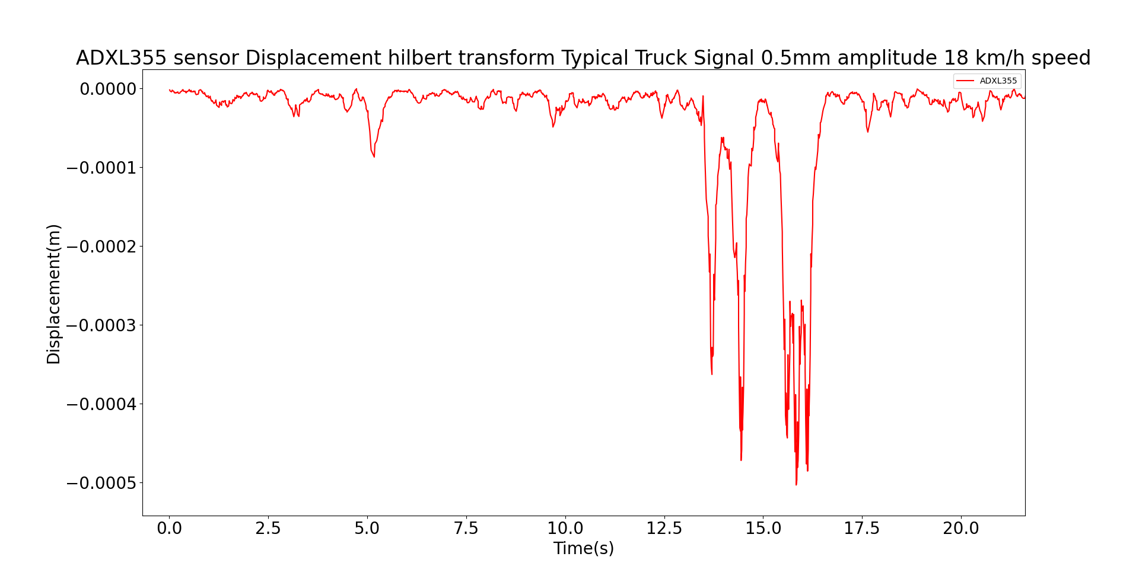
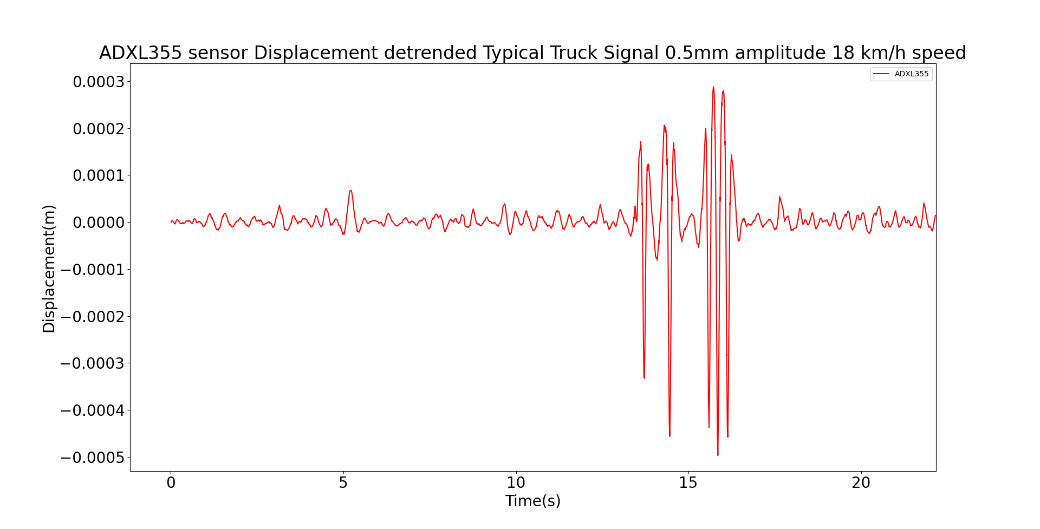
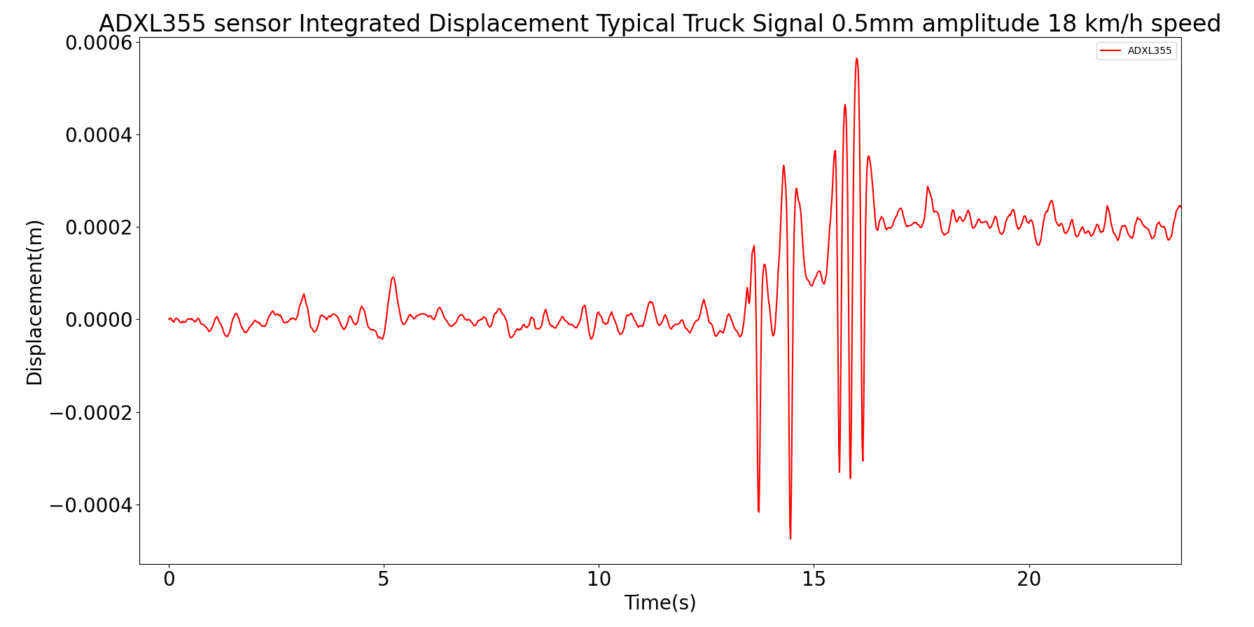
Signal processing Applied to the raw acceleration
FFT, and
Filtering
Integration to obtain Velocity
Hilbert Transform
Integration to obtain Displacement
Detrending and Amplification
7

