Slide 1
YOLO-NPK: A Light Deep Network for Lettuce Nutrients Deficiency Classification Based on Improved YOLOv8 Nano
Jordane Sikati and Joseph Christian Nouaze*, 2023

Slide 2
Outline
Introduction
Related Work and the Proposed Model
Results and Discussion
Conclusions
J. Sikati and J.C. Nouaze . 2023 10th International Electronic Conference on Sensors and Applications 2/11

Slide 3
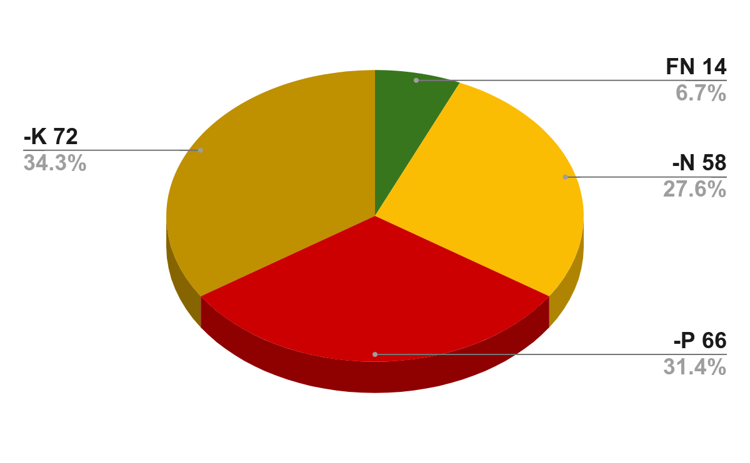
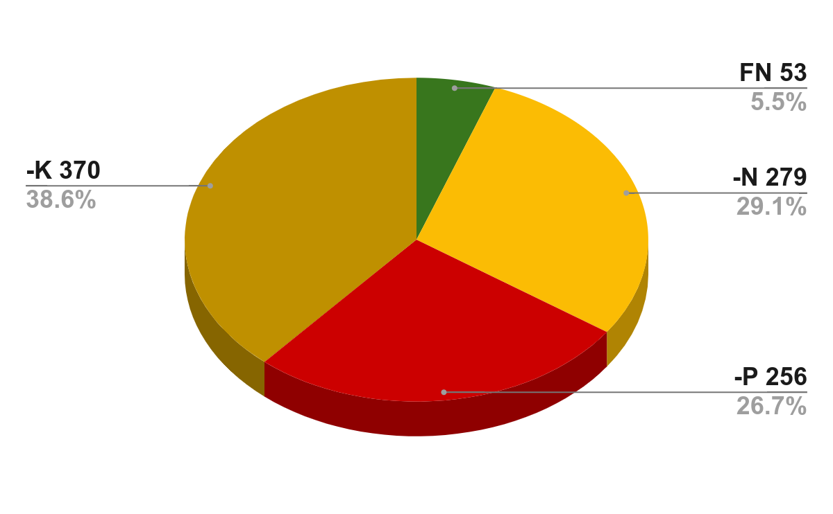
Introduction
Dataset Augmentation
Figure 1. The dataset samples. (a)Fully Nutritional lettuce (FN); (b) Nitrogen Deficiency (-N); (c) Phosphorus Deficiency (-P); (d) Potassium Deficiency (-K). With Dataset augmentation percentage (right picture)
J. Sikati and J.C. Nouaze . 2023 10th International Electronic Conference on Sensors and Applications 3/11

Slide 4
Overview of YOLO-NPK
Figure 2. The architecture of YOLO-NPK. Conv, DW, MP, and nc respectively stand for convolution, depthwise convolution, max-pooling layer, and number of classes. The original backbone of YOLOv8n-cls has been replaced with the proposed feature extractor, and the classification head remains unchanged.
J. Sikati and J.C. Nouaze . 2023 10th International Electronic Conference on Sensors and Applications 4/11

Slide 5
Ablation Study
Table 1. Ablation study on different modifications of YOLO-NPK.
VGG16 | Depthwise Convolution | Top-1 Accuracy (%) | FLOPs (G) | CPU Latency (ms)
 |  | 93 | 3.3 | 19.8
✓ |  | 97.5 | 14.5 | 68.3
 | ✓ | 95.2 | 2.4 | 18.2
✓ | ✓ | 99 | 9.2 | 64.1
J. Sikati and J.C. Nouaze . 2023 10th International Electronic Conference on Sensors and Applications 5/11

Slide 6
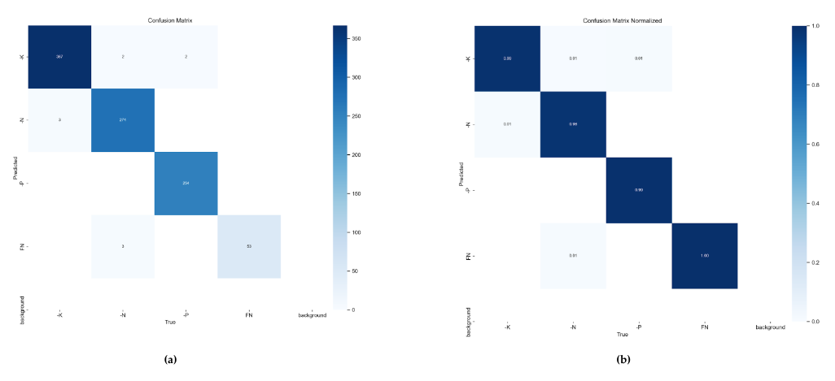
Performance of the Proposed Model
Figure 3. Confusion Matrix of YOLO-NPK.(a) confusion matrix. (b) confusion matrix FN, -N, -P, and, -K respectively represent Full Nutritional, Nitrogen deficiency, Phosphorus deficiency, and Potassium deficiency. True represents the ground truth in the dataset, predict is the classification result, and the background is the images that were missed by the model
J. Sikati and J.C. Nouaze . 2023 10th International Electronic Conference on Sensors and Applications 6/11

Slide 7
Performance of the Proposed Model
Table 2. Classification performance of YOLO-NPK. FN, -N, -P, and, -K respectively represent Full Nutritional, Nitrogen deficiency, Phosphorus deficiency, and Potassium deficiency
Classe | Images | Correctly Classified |  | Falsely Classified |  | Missed
 |  | Count | Rate | Count | Rate | Count | Rate
FN | 53 | 53 | 100 % | 0 | 0 % | 0 | 0 %
-N | 279 | 274 | 98.21 % | 5 | 1.79 % | 0 | 0 %
-P | 256 | 254 | 99.22 % | 2 | 0.78 % | 0 | 0 %
-K | 370 | 367 | 99.19 % | 3 | 0.81 % | 0 | 0 %
J. Sikati and J.C. Nouaze . 2023 10th International Electronic Conference on Sensors and Applications 7/11

Slide 8
Performance of the Proposed Model
Figure 4. The classification output of YOLO-NPK. (a)Fully Nutritional lettuce (FN); (b) Phosphorus Deficiency (-P); (c) Nitrogen Deficiency (-N); (d) Potassium Deficiency (-K).
J. Sikati and J.C. Nouaze . 2023 10th International Electronic Conference on Sensors and Applications 8/11

Slide 9
Comparison of State-of-the-art Method
Table 2. Comparison of the state-of-the-art method.
.
Methods | Images Size | Top-1 Accuracy (%) | FLOPs (G) | CPU Latency (ms)
SVM | 640 | 85.3 | 12 | 141.6
VGG16 | 640 | 87.9 | 15.2 | 170.3
MobileNetV2 | 640 | 82.5 | 3.4 | 41.6
ShuffleNetv2 | 640 | 81 | 2.1 | 30.8
YOLOV8n-cls | 640 | 93 | 3.3 | 19.8
YOLO-NPK | 640 | 99 | 9.2 | 64.1
J. Sikati and J.C. Nouaze . 2023 10th International Electronic Conference on Sensors and Applications 9/11

Slide 10
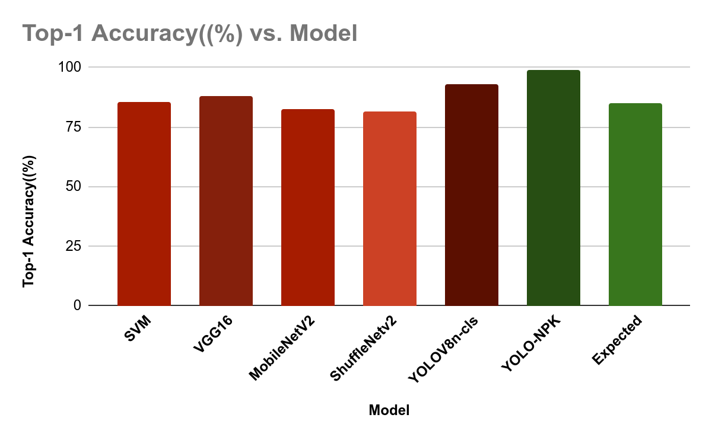
Conclusions
.
✓
Top-1 Accuracy > 85% ; FLOPs < 10 G CPU; Latency < 170 ms
J. Sikati and J.C. Nouaze . 2023 10th International Electronic Conference on Sensors and Applications 10/11

Slide 11
References
1. Muñoz-Huerta, R.F.; Guevara-Gonzalez, R.G.; Contreras-Medina, L.M.; Torres-Pacheco, I.; Prado-Olivarez, J.; Ocampo-Velazquez, R.V. A Review of Methods for Sensing the Nitrogen Status in Plants: Advantages, Disadvantages and Recent Advances. Sensors 2013, 13, 10823–10843, doi:10.3390/s130810823.
2. Khan, F.; Siddique, A.B.; Shabala, S.; Zhou, M.; Zhao, C. Phosphorus Plays Key Roles in Regulating Plants’ Physiological Responses to Abiotic Stresses. Plants 2023, 12, 2861, doi:10.3390/plants12152861.
3. Nouaze, J.C.; Kim, J.H.; Jeon, G.R.; Kim, J.H. Monitoring of Indoor Farming of Lettuce Leaves for 16 Hours Using Electrical Impedance Spectroscopy (EIS) and Double-Shell Model (DSM). Sensors 2022, 22, 9671, doi:10.3390/s22249671.
4. Davis, J.L.; Armengaud, P.; Larson, T.R.; Graham, I.A.; White, P.J.; Newton, A.C.; Amtmann, A. Contrasting Nutrient-Disease Relationships: Potassium Gradients in Barley Leaves Have Opposite Effects on Two Fungal Pathogens with Different Sensitivities to Jasmonic Acid. Plant Cell Environ 2018, 41, 2357–2372, doi:10.1111/pce.13350.
5. Watchareeruetai, U.; Noinongyao, P.; Wattanapaiboonsuk, C.; Khantiviriya, P.; Duangsrisai, S. Identification of Plant Nutrient Deficiencies Using Convolutional Neural Networks. 2018 International Electrical Engineering Congress (iEECON) 2018, 1–4, doi:10.1109/IEECON.2018.8712217.
6. Taha, M.F.; Abdalla, A.; ElMasry, G.; Gouda, M.; Zhou, L.; Zhao, N.; Liang, N.; Niu, Z.; Hassanein, A.; Al-Rejaie, S.; et al. Using Deep Convolutional Neural Network for Image-Based Diagnosis of Nutrient Deficiencies in Plants Grown in Aquaponics. Chemosensors 2022, 10, 45, doi:10.3390/chemosensors10020045.
7. Lu, J.; Peng, K.; Wang, Q.; Sun, C. Lettuce Plant Trace-Element-Deficiency Symptom Identification via Machine Vision Methods. Agriculture 2023, 13, 1614, doi:10.3390/agriculture13081614.
8. Jocher, G.; Chaurasia, A.; Qiu, J. YOLO by Ultralytics 2023.
9. Ultralytics Home Available online: https://docs.ultralytics.com/ (accessed on 5 September 2023).
10. Lettuce NPK Dataset Available online: https://www.kaggle.com/datasets/baronn/lettuce-npk-dataset (accessed on 5 September 2023).
11. Simonyan, K.; Zisserman, A. Very Deep Convolutional Networks for Large-Scale Image Recognition 2015.
12. Chollet, F. Xception: Deep Learning with Depthwise Separable Convolutions. In Proceedings of the 2017 IEEE Conference on Computer Vision and Pattern Recognition (CVPR); July 2017; pp. 1800–1807.
13. Redmon, J.; Divvala, S.; Girshick, R.; Farhadi, A. You Only Look Once: Unified, Real-Time Object Detection.; IEEE Computer Society, June 1 2016; pp. 779–788.
14. Redmon, J.; Farhadi, A. YOLO9000: Better, Faster, Stronger. In Proceedings of the 2017 IEEE Conference on Computer Vision and Pattern Recognition (CVPR); July 2017; pp. 6517–6525.
15. Redmon, J.; Farhadi, A. YOLOv3: An Incremental Improvement 2018.
16. Jocher, G.; Stoken, A.; Borovec, J.; ChristopherSTAN; Changyu, L.; Hogan, A.; Laughing; NanoCode012; yxNONG; Diaconu, L.; et al. Ultralytics/Yolov5: V2.0 2020.
17. Li, C.; Li, L.; Jiang, H.; Weng, K.; Geng, Y.; Li, L.; Ke, Z.; Li, Q.; Cheng, M.; Nie, W.; et al. YOLOv6: A Single-Stage Object Detection Framework for Industrial Applications 2022.
18. Wang, C.-Y.; Bochkovskiy, A.; Liao, H.-Y.M. YOLOv7: Trainable Bag-of-Freebies Sets New State-of-the-Art for Real-Time Object Detectors 2022.
J. Sikati and J.C. Nouaze . 2023 10th International Electronic Conference on Sensors and Applications 11/11

