Slide 1


Multipurpose Smart Shoe for Various Communities
10th International Electronic Conference on Sensors and Applications
AUTHORS:
Dr. L VIJAYARAJA
Dr. R DHANASEKAR
K GOKUL RAJ
S SARATH
M THEERTHAVASAN
RUPA KESAVAN

Slide 2

OBJECTIVE
To design an intelligent shoe. The proposed intelligent shoe consists of a controller connected with an ultrasonic sensor, voice alert system (VAS), vibration patterns, GPS navigation, connectivity with a smart-phone or smart-watch, voice assistance, feedback on gait and posture, and emergency features that are embedded with each other to communicate the presence of obstacles in the directions of the path of the blind. The features of the shoe includes:
Vibration sense
Voice alert system (VAS)
GPS navigation
Connectivity

Slide 3


ABSTRACT
The proposal for an intelligent shoe. The proposed intelligent shoe consists of a controller connected with an ultrasonic sensor, voice alert system (VAS), vibration patterns, GPS navigation and connectivity.
03
The evolutions of obstacle detectors for blind people have been from the usage of people, sticks, smart glasses, and smart shoes. Among the above, the major problem faced by all blind people is to walk independently to every place, so to make them feel independent while they walk
01
02
The sensor identifies an obstacle in the direction present then it passes the signal to the controller that activates the voice alert system and the vibration patterns present in that direction.

Slide 4






PROPOSED SOLUTION
5
The shoe has a GPS module for transmitting the blind’s location with the care-taker.
The shoe produces vibrational effect to make the deaf people to feel on detection of obstacle.
4
3
The proposed shoe has connectivity with phone and watches for ease of use.
It produces voice alert system for blind people to identify the presence and type of the obstacle.
2
1
The proposed shoe uses CNN embedded camera for communicating the type of the obstacle to the blind person.

Slide 5
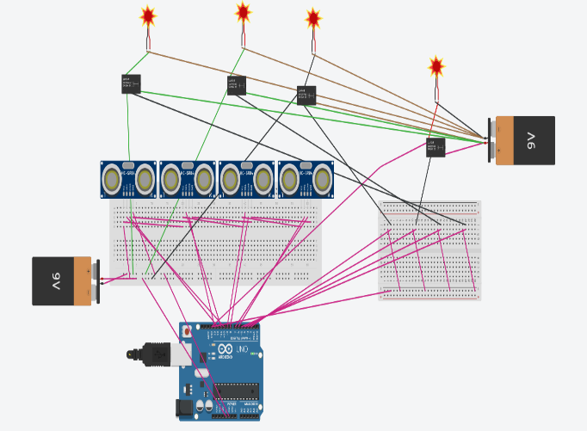
SIMULATION DIAGRAM
The simulation model in on state as the distance of the ultrasonic is more than the fixed range the light source is turned ON to indicate the presence of obstacle, in on state the ultrasonic sensors work based on the order:
i) If the obstacle is identified in the 1st ultrasonic sensor, then the vibrational motor on the right-side glows up (turns on) and the vice-versa.
ii) If the obstacle is identified in the 2nd ultrasonic sensor, then the vibrational motor present at the 2nd position from the right-side glows up (turns on).
iii) If the obstacle is detected in the 3rd ultrasonic sensor, then the vibrational motor present at the 2nd position from the left side glows up (turns on).
iv) Finally, if a obstacle is detected at the 4th ultrasonic sensor then the vibrational motor present at the left side glows on (turns on).

Slide 6
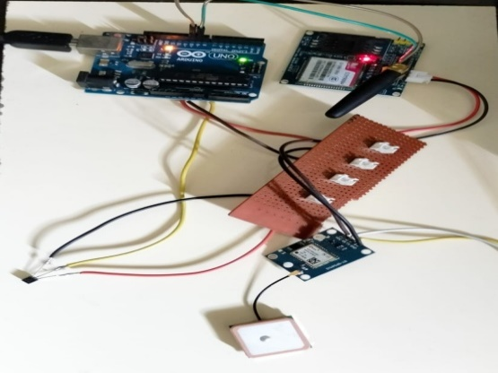
HARWARE MODEL
FIG 2 GPS MODULE
FIG 1 HARDWARE MODEL
.
The proposed smart shoe classifies based on the presence of an obstacle in either direction mentioned can be can convey the message to the visually impaired. As shown in identified and based on the vibration caused by the vibrational motor and the alert from the VAS the Fig 2, the prototype model is embedded with the GPS module in-order to pass the location of the blind on emergency conditions.

Slide 7
Conclusion
In the olden days the blind people were suffering from the problem to walk independently in roads, so there was an invention termed as blind stick which is used for detection of object but as it can’t sense the presence of obstacle in before there was an invention where there was an addition of ultrasonic sensor to detect the presence of object but this wasn’t effective as taught because the stick can’t be used in every locations where the blind travel so in order to solve this here is a IOT technology used in the shoe of a blind will help to them to walk independently in roads and which makes them to feel independent without depending on the help of others to walk. This helps the blind effectively as there are nearly 4 ultrasonic sensors combined with the vibrators and VAS which can predetermine the presence of object in all the directions when a blind walks in the road. Here there is a usage of both VAS and vibrators, because if the blind is also having earing-impairment then the vibrator’s vibration is enough for him to detect the location of obstacle present. By the usage of GPS module, the blind can be protected from emergency situations.

Slide 8
THANK YOU

