Slide 1
MAPPING AND NAVIGATION OF AUTONOMOUS ROBOT WITH LiDAR FOR INDOOR APPLICATIONS
Dr . N. Dinesh Kumar
Mr. K.Yashwanth Raj
Mr. T.J.S.S.Phanindra
Mr. T.Sheelanand Vidhik
1

Slide 2
CONTENTS :-
ABSTRACT
Problem Statement
LIDAR
BLOCK DIAGRAM
CIRCUIT DIAGRAM
RESULT
REAL WORLD APPLICATIONS
FUTURE SCOPE
CONCLUSION
2

Slide 3
ABSTRACT:-
This is a project that utilizes LIDAR (Light Detection and Ranging) technology along with Arduino, a LIDAR sensor, Bluetooth connectivity, and Python Flask framework to create an autonomous robot capable of scanning and mapping rooms in real time. The robot is equipped with a LIDAR sensor that emits laser beams and measures the time it takes for the beams to bounce back from objects, allowing for precise distance measurements. By combining the data from the LIDAR sensor with Arduino's control capabilities and Bluetooth connectivity, the robot can navigate and explore rooms while generating detailed 2D or 3D maps. The collected data is transmitted to a remote server via Python Flask, providing real-time visualization and analysis of the room layout.
3

Slide 4
Challenge -1
The following problem areas are the focus of this work:
Limited perception capabilities:
Traditional autonomous robots often rely on limited sensors like cameras or proximity sensors, which have limitations in accurately perceiving the environment. This can lead to incomplete or unreliable information about the surroundings, hindering the robot's ability to navigate and make informed decisions. The work aims to overcome this limitation by integrating LiDAR technology, which provides precise 2D mapping and detailed perception of the environment.
4

Slide 5
Challenge -2
Mapping of unknown environments:
Navigating and mapping unknown environments pose significant challenges for autonomous robots. Without prior knowledge or pre-existing maps, robots may struggle to create accurate representations of their surroundings. The work seeks to develop algorithms and techniques that leverage LiDAR data to create detailed and reliable maps in real time, enabling robots to explore and understand unknown environments more effectively.
4

Slide 6
Challenge -3
Real-time operation and robustness:
Autonomous robots operating in real-world scenarios require real-time decision-making and robustness. Delays in data processing or inaccuracies in perception can lead to safety issues or inefficient operations. The work aims to optimize the system to handle large amounts of LiDAR data in real time, ensuring fast and responsive decision-making while maintaining robustness in various environmental conditions.
4

Slide 7
Proposed Method
The proposed system consists of a mobile robot powered by an Arduino board and equipped with a LIDAR sensor for room scanning.
The LIDAR sensor emits laser beams and measures the time-of-flight of the reflected beams, providing accurate distance measurements.
Arduino is responsible for controlling the robot's movements and acquiring data from the LIDAR sensor.
Bluetooth connectivity is used to establish a wireless communication link between the robot and a remote server.
The robot scans the room by systematically moving and rotating, capturing LIDAR data at different angles.
The collected data is processed, and a detailed 2D map of the room is generated.
The map data is transmitted to a remote server via Python Flask, enabling real-time visualization and analysis.
4

Slide 8
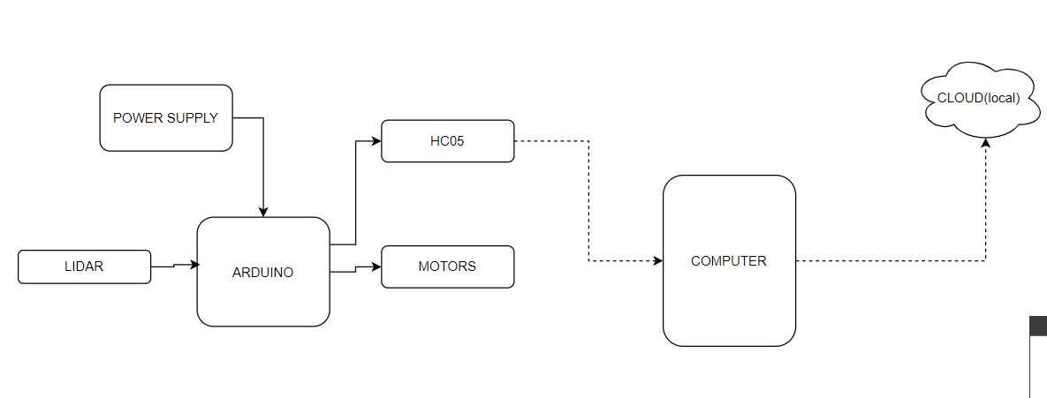
BLOCK DIAGRAM :-
Figure 3 :- Block Diagram
13

Slide 9
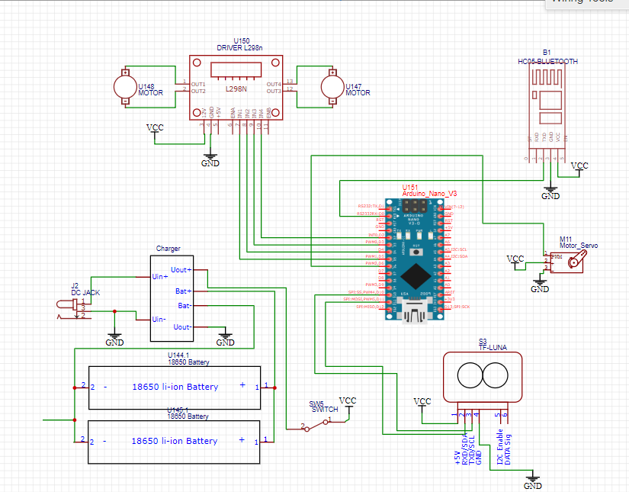
CIRCUIT DIAGRAM :-
Figure 4 :- Circuit Diagram
13

Slide 10
FLOW CHART
Start the Robot
Deploy the Robot
Read LiDAR data
Receive and Store the data
Run the code
Send the data
Open the webpage
Display the plot and data
End
13

Slide 11
Sample Code
from flask import Flask, render_template, request, Response, redirect, flash import cv2
import serial import base64
from time import sleep import pandas as pd
from datetime import datetime as dt
import numpy as np
tm = dt.now().timestamp()
def _map(x, in_min, in_max, out_min, out_max): //mapping data points onto figure return int((x - in_min) * (out_max - out_min) / (in_max - in_min) + out_min)
app = Flask( name )
@app.template_filter('b64encode')
def b64encode_filter(s): //converting everything to the base64 standard return base64.b64encode(s).decode('utf-8')
@app.route('/', methods=["get", "post"])
def server_app(): //this function opens up the web page if request.method == "GET":
return render_template("main.html")
13

Slide 12
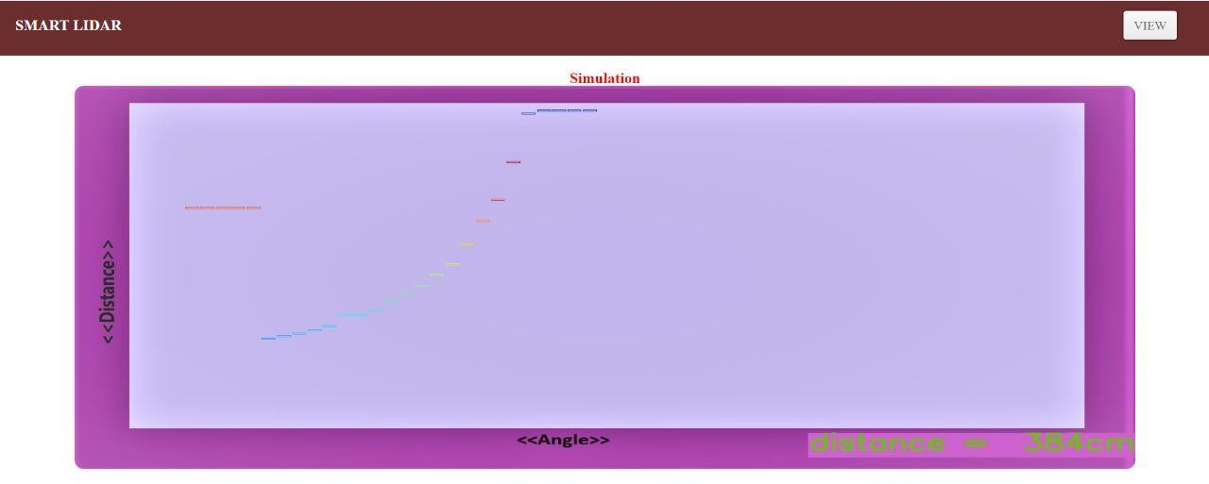
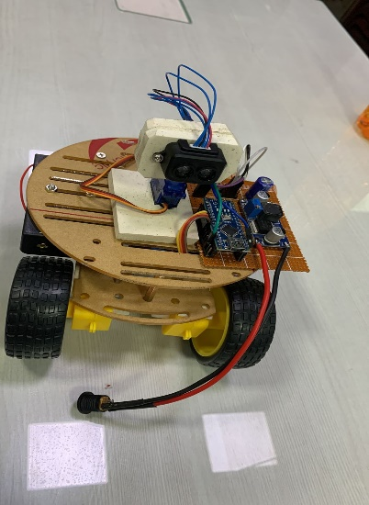
RESULT :-
Figure 5 :- Robot Integrated with LiDAR
Plotting of Data points
13

Slide 13
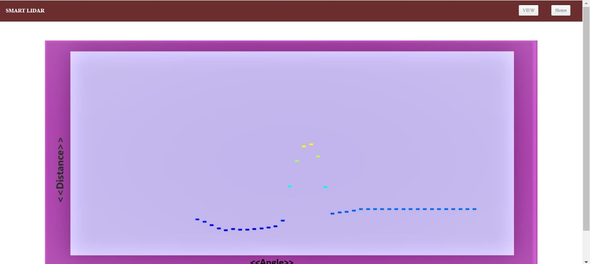
RESULT :-
Figure 7:- Plotting of Data points
13

Slide 14
REAL WORLD APPLICATIONS :-
This project has a number of real-world applications:
Indoor Delivery Robots
Caves and Hard-to-Reach Environments
Robot Vacuums
Order Fulfillment
Factories
14

Slide 15
FUTURE SCOPE :-
This work offers several possibilities for future expansion and improvement. Some potential areas for future development include implementing SLAM (Simultaneous Localization and Mapping) algorithms for simultaneous mapping and localization, integrating additional sensors for environmental data collection (e.g., temperature, humidity), incorporating machine learning techniques for advanced map analysis and object recognition, and enhancing the robot's autonomy by incorporating path planning algorithms. Furthermore, the project can be extended to include multi-robot collaboration and the creation of a centralized mapping system for large-scale applications.
13

Slide 16
CONCLUSION :-
This project presents a novel and efficient approach for room scanning and mapping. By utilizing LIDAR technology, Arduino control, Bluetooth connectivity, and Python Flask integration, the project enables real-time generation, visualization, and analysis of room maps. The system offers the potential for a wide range of applications, including robotics, smart home automation, and indoor navigation. The implementation demonstrates the feasibility and effectiveness of using LIDAR for accurate room scanning and lays the foundation for further research and development in this field.
13

Slide 17
THANK YOU
15

Slide 18
REFERENCES
Fragapane, G.; de Koster, R.; Sgarbossa, F.; Strandhagen, J.O. Planning and control of autonomous mobile robots for intralogistics: Literature review and research agenda. Eur. J. Oper. Res. 2021, 292, 405–426.
Sindermann, C.; Sha, P.; Zhou, M.; Wernicke, J.; Schmitt, H.S.; Sariyska, R.; Stavrou, M.; Becker, B.; Montag, C. Assessing the attitude towards artificial intelligence: Introduction of a short measure in German, Chinese, and English language. KI—Künstliche Intell. 2021, 35, 109–118.
Lalic, B., Majstorovic, V., Marjanovic, U., von Cieminski, G., Romero, D., Eds.; IFIP Advances in Information and Communication Technology; Springer International Publishing: Cham, Switzerland, 2020; pp. 661–669.
Shimmura, T.; Ichikari, R.; Okuma, T.; Ito, H.; Okada, K.; Nonaka, T. Service robot introduction to a restaurant enhances both labor productivity and service quality. Procedia CIRP 2020, 88, 589–594. [C
Cheong, A.; Lau, M.; Foo, E.; Hedley, J.; Bo, J.W. Development of a Robotic Waiter System. IFAC-PapersOnLine 2016, 49, 681–686.
Blöcher, K.; Alt, R. AI and robotics in the European restaurant sector: Assessing potentials for process innovation in a high-contact service industry. Electron. Mark. 2021, 31, 529–551.
Jeong, M.; Kim, K.; Ma, F.; DiPietro, R. Key factors driving customers’ restaurant dining behavior during the COVID-19 pandemic. Int. J. Contemp. Hosp. Manag. 2022, 34, 836– 858.
Yu, Q.; Yuan, C.; Fu, Z.; Zhao, Y. An autonomous restaurant service robot with high positioning accuracy. Ind. Robot. 2012, 39, 271–281.
Ma, E.; Bao, Y.; Huang, L.; Wang, D.; Kim, M.S. When a Robot Makes Your Dinner: A Comparative Analysis of Product Level and Customer Experience between the U.S. and Chinese Robotic Restaurants. Cornell Hosp. Q. 2021.
Yang, J.; Gope, P.; Cheng, Y.; Sun, L. Design, analysis and implementation of a smart next-generation secure shipping infrastructure using autonomous robot. Comput. Netw. 2021, 187, 107779.

Slide 19
REFERENCES
Pudu. Smart Delivery Robot-Pudu Robotics. 2021.
Chitta, S.; Marder-Eppstein, E.; Meeussen, W.; Pradeep, V.; Rodríguez Tsouroukdissian, A.; Bohren, J.; Coleman, D.; Magyar, B.; Raiola, G.; Lüdtke, M.; et al. ros_control: A generic and simple control framework for ROS. J. Open Source Softw. 2017, 2, 456.
Ladosz, P.; Coombes, M.; Smith, J.; Hutchinson, M. A Generic ROS Based System for Rapid Development and Testing of Algorithms for Autonomous Ground and Aerial Vehicles. In Robot Operating System (ROS): The Complete Reference; Studies in Computational Intelligence; Springer International Publishing: Cham, Switzerland, 2019; Volume 3, pp. 113–153.
Chivarov, S.; Kopacek, P.; Chivarov, N. Cost oriented humanoid robot communication with iot devices via mqtt and interaction with a smart home hub connected devices. IFAC- PapersOnLine 2019, 52, 104–109.
Tkáˇcik, M.; Bˇrezina, A.; Jadlovská, S. Design of a Prototype for a Modular Mobile Robotic Platform. IFAC-PapersOnLine 2019, 52, 192–197.
Noh, S.; Park, J.; Park, J. Autonomous Mobile Robot Navigation in Indoor Environments: Mapping, Localization, and Planning. In Proceedings of the 2020 International Conference on Information and Communication Technology Convergence (ICTC), Jeju Island, Korea, 21–23 October 2020; pp. 908–913.
Belanche, D.; Casaló, L.V.; Flavián, C.; Schepers, J. Service robot implementation: A theoretical framework and research agenda. Serv. Ind. J. 2020, 40, 203–225.

