Slide 1
Ferro-to-antiferromagnetic transition in Gd(Fe,Ni)Si
Roman Mukhachev email: r.d.mukhachev@imp.uran.ru
Alexey Lukoyanov, Anatoly Kuchin, Sergey Platonov, Aleksey Volegov, Vasilii Gaviko, Mari Yakovleva
M.N. Mikheev Institute of Metal Physics of Ural Branch of Russian Academy of Sciences, Yekaterinburg, Russia
Ural Federal University named after the first President of Russia B.N. Yeltsin, Yekaterinburg, Russia
The 4th International Electronic Conference on Applied Sciences,
27 Oct–10 Nov 2023

Slide 2
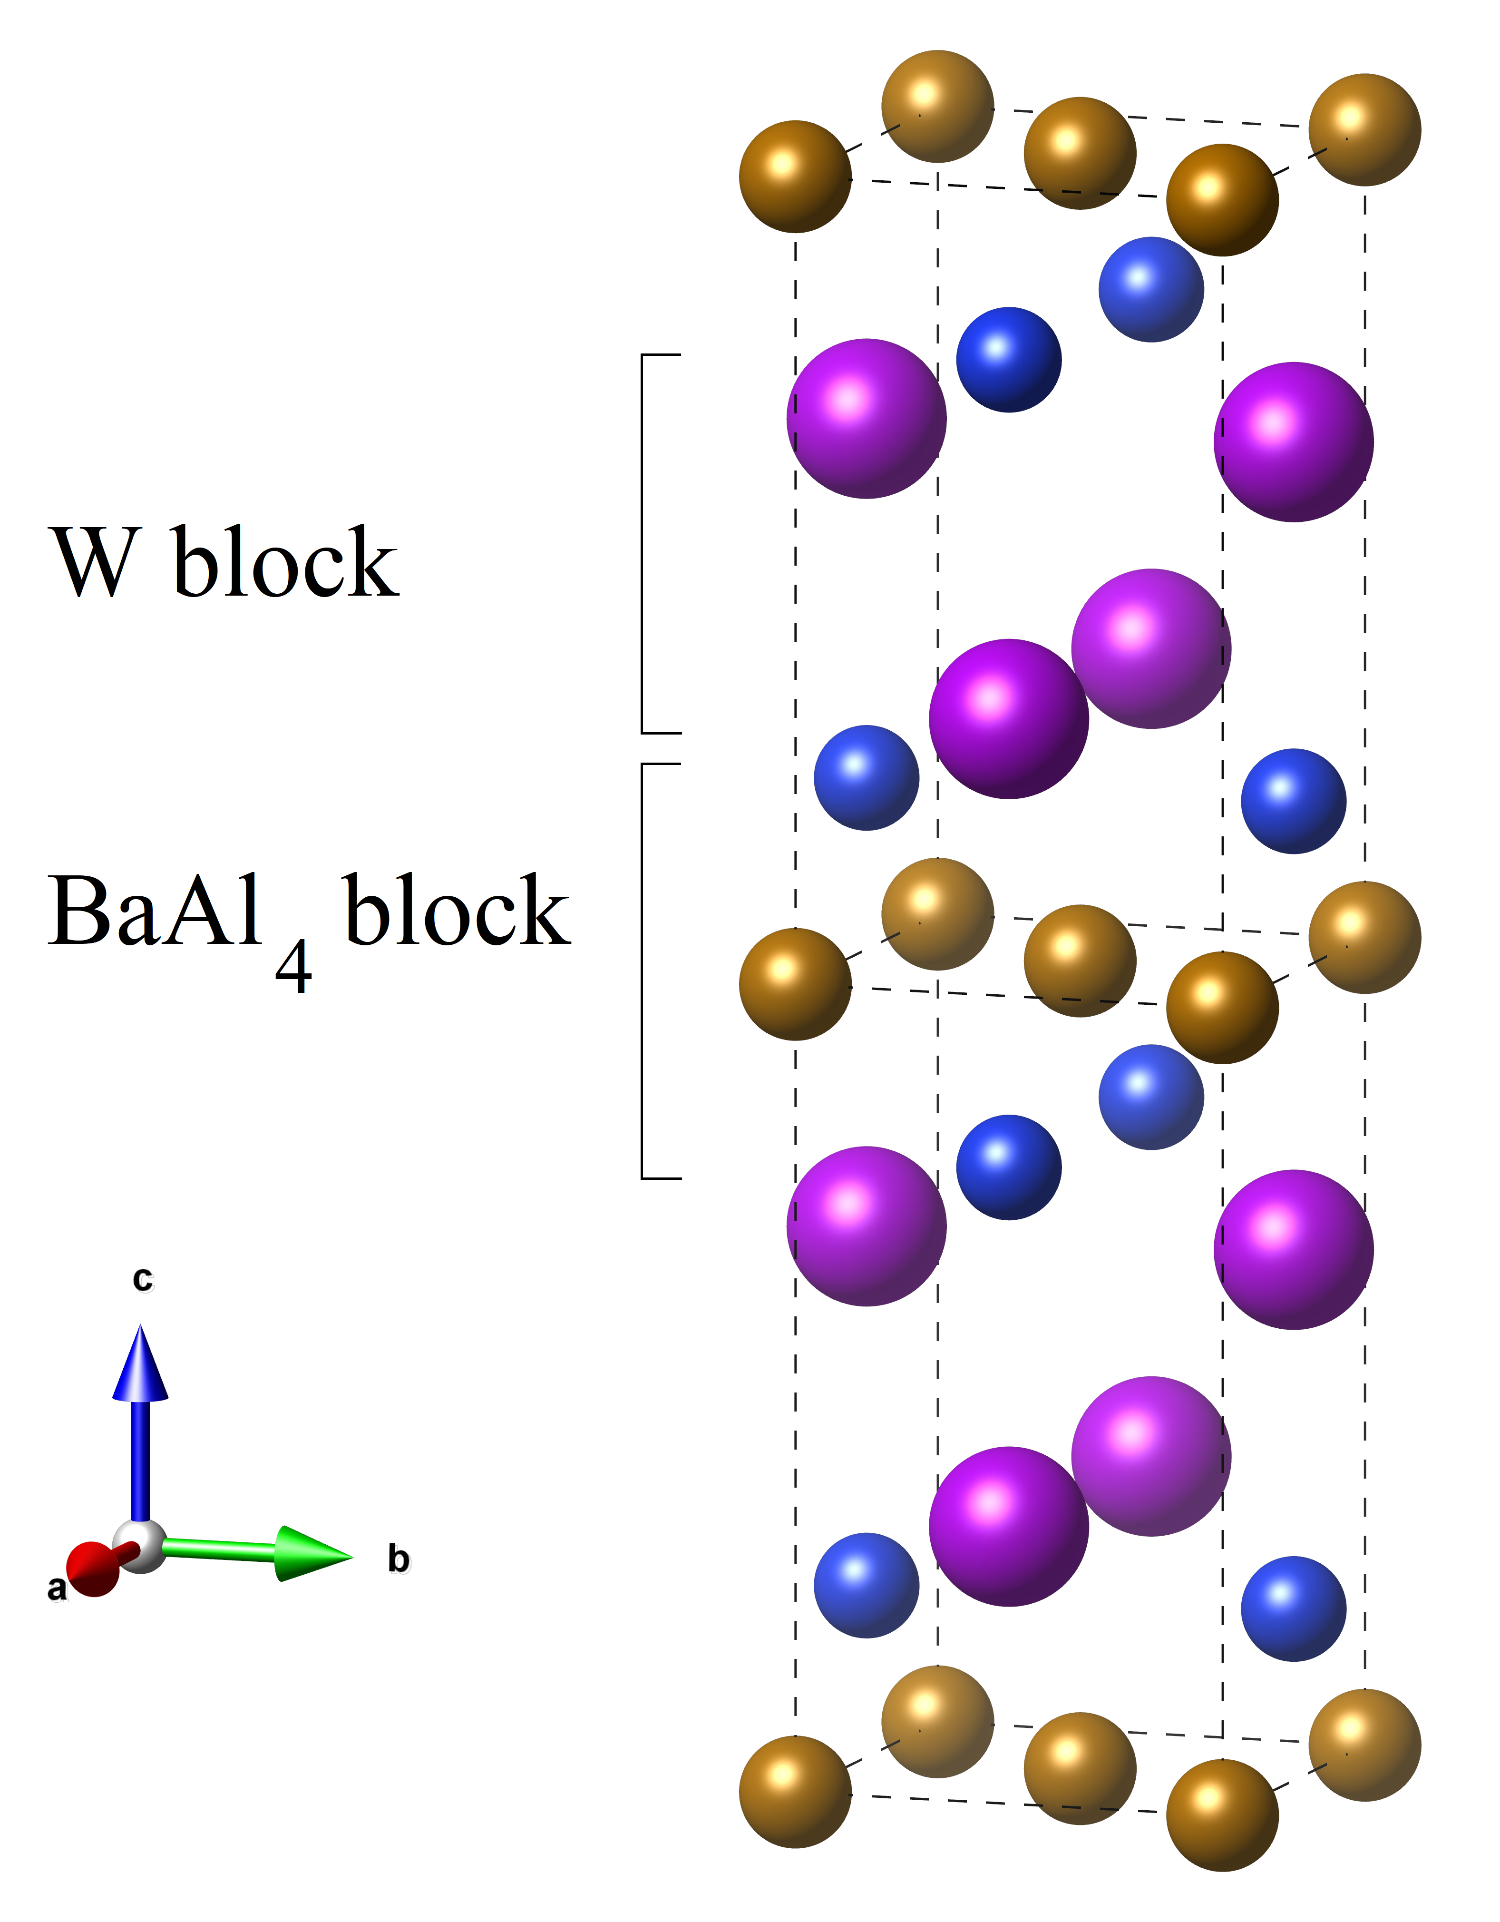
Crystal structure of GdFe_{1-x}Ni_{x}Si
Compound | Phases | Lattice parameters |  | Content
(x) |  | a (Ǻ) | c (Ǻ) | (%)
0.1 | CeFeSi | 4.001 | 6.765 | 97.7
 | Gd₅Si₃ |  |  | 2.3
0.2 | CeFeSi | 4.015 | 6.747 | 97
 | Phases not identified |  |  | < 3
0.3 | CeFeSi | 4.019 | 6.708 | 96
 | Phases not identified |  |  | < 4
0.4 | CeFeSi | 4.019 | 6.707 | 72
 | Gd(Ni,Fe)Si₂ |  |  | 23
 | Gd₂(Ni,Fe)₁₇ |  |  | 5
Error |  | ±0.002 | ±0.002 | ±2
Gd
Si
Fe/Ni
Diverse local environments in the blocks forming this unit cell: the ‘‘W block’’ and the ‘‘BaAl4 block’’
Space Group | P4/nmm
Crystal System | Tetragonal

Slide 3
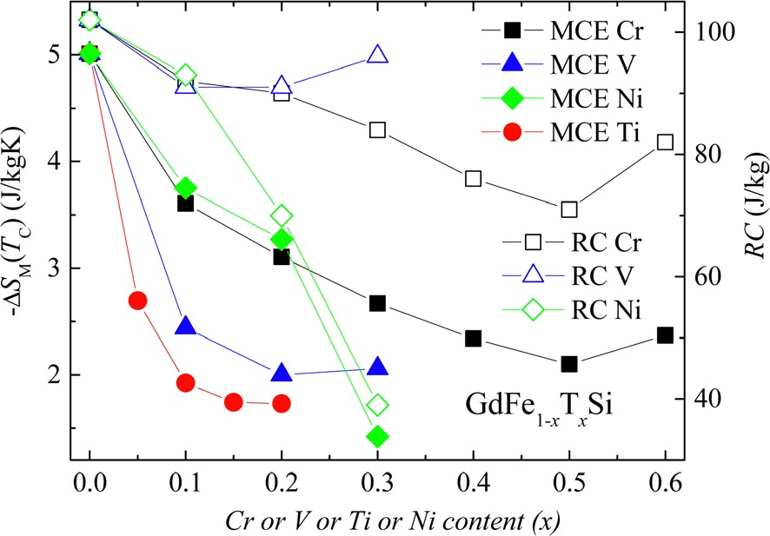
Experimental data
In GdFe_{1—x}Ni_{x}Si, the Curie temperature T_{C} varies between 104 and 130 K. Magnetocaloric effect (MCE) was found for all GdFe_{1—x}Ni_{x}Si samples.
Concentration dependences of the peak value of the change in magnetic entropy - ∆ S_{M}(T_{C}) (solid symbols) and the refrigerant capacity RC (open symbols) in a field changing to 17 kOe.
Concentration dependences of the lattice parameters.

Slide 4
Ferro- to antiferro-magnetic transition
In GdFe_{1—x}Ni_{x}Si, a transition from the ferro- (FM) to antiferromagnetic (AFM) ordering of the Gd moments occurs for x = 0.25 – 0.3.
FM
AFM
Total energy difference ∆ E = |E_{FM} – E_{AFM}| in meV f.u.^{—1} relative to the lowest magnetic ordering of the Gd moments. The magnetic structure of GdFe_{1—x}Ni_{x}Si changes from the ferromagnetic for x = 0 – 0.25 to the antiferromagnetic one for x > 0.25. These results are in good agreement with the experimental magnetic measurements. Similarly, for x = 0.75 (appr. from the Pnma structure [J. Solid State Chem. 235, 58 (2016)]), AFM is also found lower than FM in the total energy.

Slide 5
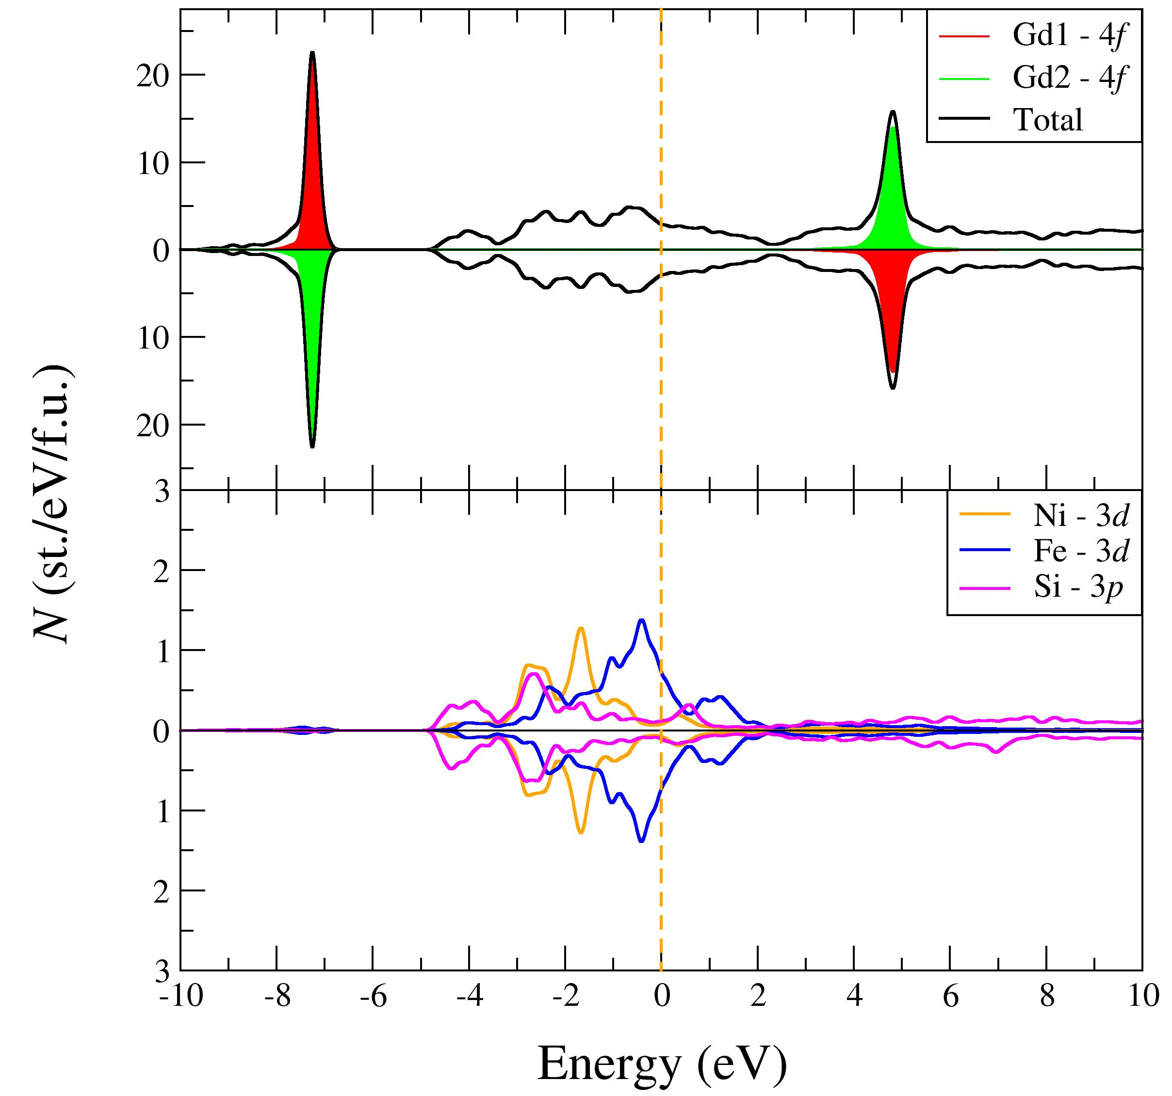
Densities of electronic states
Total and partial densities of electronic states N of GdFe_{0.75}Ni_{0.25}Si with the ferromagnetic ordering (left) and GdFe_{0.6}Ni_{0.4}Si with the antiferromagnetic ordering (right). The Fermi energy E_{F} is shown at zero energy.

Slide 6
Conclusions
Ternary intermetallic GdT Si compounds with T – transition metals are proposed to have a wide range of possible applications, such as magnetocaloric cooling, gas liquefaction and others. The electronic structure and magnetic properties are investigated using the DFT+U method taking into account strong electron correlations in the 4f Gd shell. In this work, for the GdFe_{1—x}Ni_{x}Si series, the transition from a ferromagnetic (low Ni content) to an antiferromagnetic ordering (x > 0.25) was identified using our first-principles calculations. The results are well supported by the experimental magnetic data. The results indicate promising prospects of GdT Si which will motivate further research.
The study is supported by Russian Science Foundation proj. 18-72-10098.
Thank you for your attention!

