Slide 1
Turning waste into soil conditioner with a sustainable innovative approach: Biochar
Hakan Çelebi, Tolga Bahadır, İsmail Şimşek, Şevket Tulun
Department of Environmental Engineering, Aksaray University, 68100, Aksaray, Turkey; hakancelebi@aksaray.edu.tr

Slide 2
Abstract:
Globally, the increase in population density, various epidemics (COVID-19, SARS, and MERS etc.), climate change, global warming, and the reduction of arable land have caused dam-age to the ecosystem. Quality soil is the most important factor that has a direct impact on safe food and a clean environment. Different pollutant loads, microbiological activities, climatic and topographic conditions and current land use can change the properties of the soil. In recent years, fertile agricultural lands have been used in the construction industry. This situation ex-plains the inadequacy between population growth and food supply. Both polluting parameters and non-purpose uses affect soil quality negatively, and alternative solutions are sought for this. One of these solutions is the application of various additives to the soil. Among these substances, biochar is a widely used additive in agricultural production, soil quality improvement, and pollutant treatment in water and soil environments. Among these substances, biochar has been widely used in agricultural production, soil quality improvement, and pollutant treatment in water and soil environments. It is a carbon-rich product formed by pyrolysis method of biochar, food and agricultural wastes in an oxygen-free environment at ≥250 °C. In this study, current re-search is examined to explain the interaction of soil quality with biochar. The biochar materials used, the production conditions, the 3-step reaction in the soil were examined. It summarizes the recent developments on soil quality of biochar with porous structure and high specific surface area.
Keywords: biochar; food waste; soil quality; soil conditioner

Slide 3
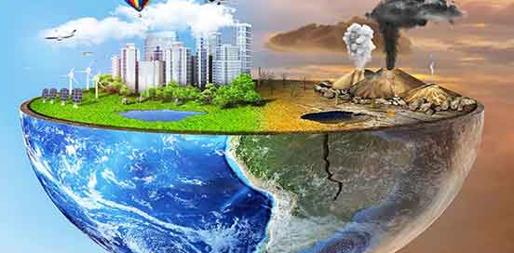
Introduction:
In recent years, all countries of the world think that the ecosystem is under a heavy pollution load. In particular, the increase in population, sectoral developments, and the change in the waste structure with epidemics have provided a dynamic increase in environmental pollution. The ecosystem is dealing with numerous environmental pressures, including increased food and clean water supply, inadequacies in the supply chain, climate change, water scarcity, and soil degradation [1, 2]. As a result of anthropogenic activities, constant changes in the environment and epidemics adversely affect the health of living things [3]. In particular, the increasing population and climate change have reduced agricultural areas and caused negativities in agricultural production and soil quality.

Slide 4
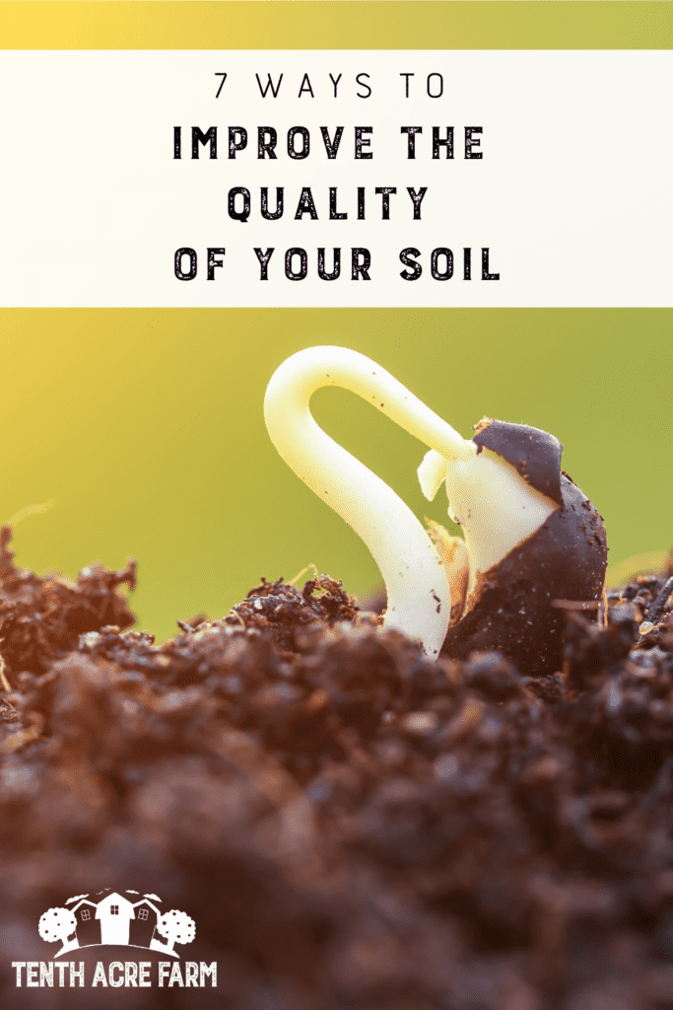
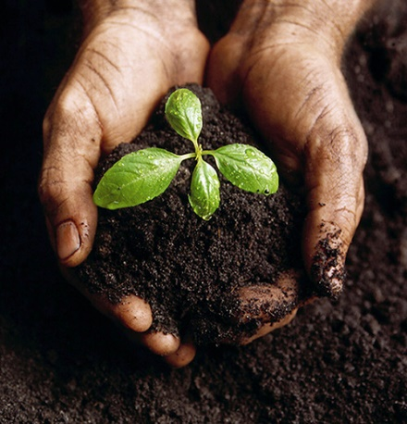
Soil quality is integrated with the food chain and a clean ecosystem. Quality soil is the most important factor that has a direct impact on safe food and a clean environment. Different pollutant (heavy metal, paint, pesticide, etc.) loads, microbiological activities, climatic and topographic conditions, and current land use can change the properties of the soil. In recent years, fertile agricultural lands have been used in the construction sector. This situation explains the inadequacy between population growth and food supply. Both polluting parameters and non-purpose uses affect soil quality negatively, and alternative solutions are sought for this.

Slide 5
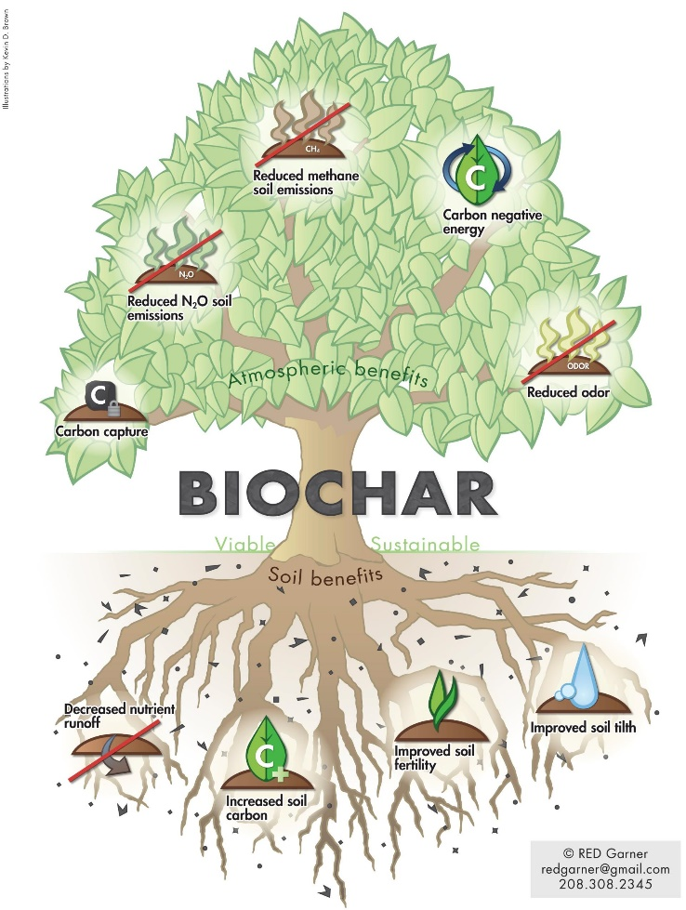
Biochar
One of these solutions is the application of various additives to the soil. Biochar, which is defined as "black gold", finds a wide place among these additives [4, 5]. Recently, it is a widely used additive in agricultural production, soil quality improvement, and treatment of different pollutants in water and soil environments [6, 7]. Biochar is based on the preparation of different organic raw materials by various techniques at ≥250 °C and anoxic conditions [8]. In particular, the application of biochar is important in terms of the management and evaluation of food and agricultural wastes. Because, with the industrial symbiosis approach and zero waste planning, incorporating waste as a raw material into the circular environmental process will eliminate waste minimization and waste-related pollution [9, 10]. The main objective of the review is to perform a comprehensive review of current studies on biochar. The main criteria of this study are (i) the production process of biochar; (ii) the composition of the biochar; (iii) the effects of biochar on soil quality; and (iv) the environmental pros and cons of biochar.

Slide 6
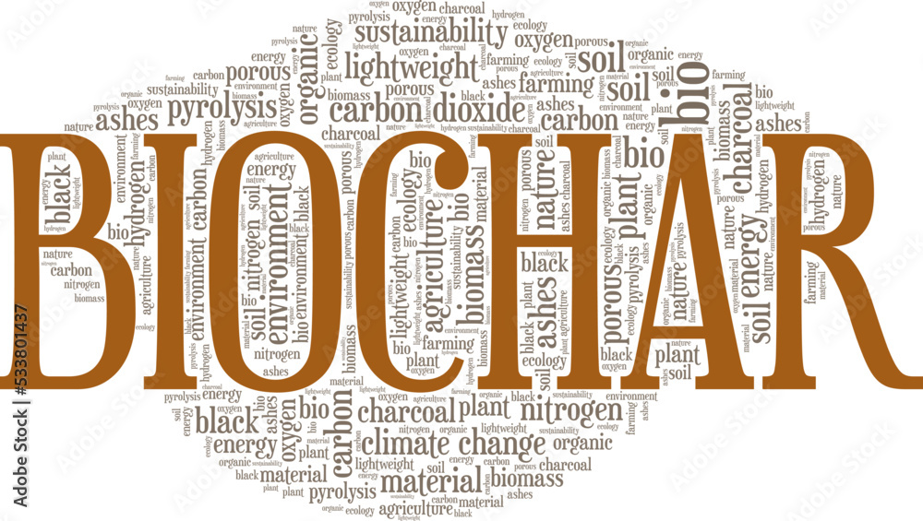
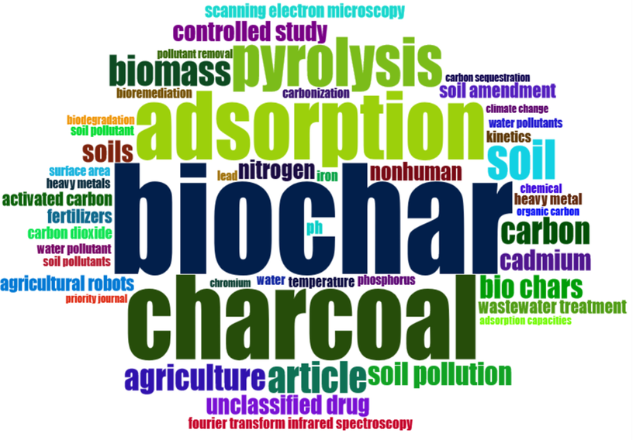
Methodology
While examining the studies made for the compilation study, different databases (Science Direct, Springer, Wiley, Taylor & Francois, Scopus, PubMed etc.) in the “Web of Science Core Collection” (Clarivate Analytics®, Boston, USA) “Google Scholar” (Googleplex, Mountain View, California, United States) was scanned. For the study, 41 articles made especially in the last 5 years were tried to be evaluated.

Slide 7
Biochar's building blocks
 | Ultimate Analysis (%) |  |  | Proximate Analysis (%)
Raw Material | C | H | N | Ash content | Moisture
Sugar cane | 73 | 0.9 | 1.1 | 49 | 1.5
Pine nut shell | 79 | 3.76 | 0.89 | 2.51 | 5.20
Peanut shell | 84 | 1.75 | 1.14 | 3.46 | 9.75
Soybean Stover | 82 | 4.29 | 1.88 | 2.64 | 5.86
Banana peel | 36 | 0.25 | 1.94 | 9.28 | 12
Corn cob | 62 | 7.5 | 1.02 | 2.30 | 12.8
Herb Tea waste | 45 | 5.91 | 2.61 | 13.4 | 7.26
Macadamia husk | 52 | 5.77 | 0.33 | 1.53 | 6.90
Mango seed | 46 | 5.54 | 0.89 | 1.38 | 4.97
Passion shell | 42 | 5.47 | 0.62 | 1.46 | 3.15
Pistachio husk | 48 | 5.32 | 0.34 | 5.61 | 7.83
Rice husk | 42 | 6.34 | 1.85 | 15.1 | 10.9
Walnut shell | 47 | 7.90 | 0.86 | 0.80 | 4.50
Tea waste | 52 | 6.31 | 2.46 | 4.36 | 2.24
Spent coffee | 57 | 7.70 | 2.74 | 2.06 | 36.2
The majority of studies on biochar are carried out with agricultural (corn cob, rice straw, wheat straw, etc.) and food waste (walnut and peanut shells, fruit shells, tea waste, etc.). From a physicochemical point of view, the structure of biochar is related to the raw materials used and the preparation processes. Specific quality biochars are obtained from different food and agricultural wastes. These differences are revealed by the proximate and ultimate analyzes in Table 1.
Table 1. Physical and chemical properties of different biochar materials [4, 10].

Slide 8
C, H, O, and N contents reveal the chemical effectiveness of biochar. In addition, biochar production methods and geochemical cycles affect these contents [15]. The C content of biochar consists of inorganic and organic forms, and the H consists of aromatic and functional hydrogen.
Compared to previous regions, the surface area of biochar was determined as 1.5–500 m²/g [16].
The functional groups on the surface of biochar obtained from raw agricultural and food wastes consist of –OH, –COOH, –COOR, –C=O [17, 18]. These determine whether the biochar is hydrophilic or hydrophobic in different applications. In addition, the production temperature changes the increase (500–700 ⁰C) and decrease (250–350 ⁰C) of functional groups on the biochar surface [4].
The chemical composition of biochar is obtained with the raw material; it varies depending on the production conditions such as temperature, heating rate, residence time, and reactor type. For this reason, it is not possible to clearly define the chemical composition of biochar [19].
Cation exchange capacity affects the retention of soil nutrients and fertilizer circulation of biochar. The pure CE value of biochar created with raw materials ranges from 14 to 17 cmol/kg [20].

Slide 9
Synthesis of biochar
Biochar; It is a carbon-rich and dissolution-resistant material obtained as a result of the thermal decomposition of organic material under anaerobic or low oxygen conditions and generally at low temperatures (200-900°C). The conversion of agricultural and food wastes into biochar is possible with traditional (slow and fast pyrolysis) and innovative (hydrothermal carbonization, vacuum-sand/microwave radiation) thermochemical approaches [22, 23]. The success of the chosen technique is affected by the type of waste and operating conditions [24]. Thermo-chemical conversion processes can be examined in two main parts dry and wet. Dry processes are among themselves; they can be divided into four sections: fast pyrolysis, slow pyrolysis (carbonization), gasification, and partial pyrolysis (torrefaction). Hydrothermal carbonization can be given as an example of the wet thermochemical conversion process. The general characteristics of thermochemical conversion processes are given in Table 2 [19]. The pyrolysis temperature used in thermochemical reactions in biochar production affects biochar quality and natural soil physical properties. In general, biochar produced at high temperatures has more moisture retention than that produced at low temperatures [19]. Modern methods of producing biochar are hydrothermal carbonization and roasting [27]. Studies show that biochar production techniques are of great importance in terms of both properties and level of influence. The type and conditions of the biochar production process affect the quality of the product.

Slide 10
Table 2. Biochar production processes and standard conditions [19].
Parameter | FP¹ | SP¹ | G¹ | PP¹ | HC¹
Heat | ˜ 500 ⁰C | <400 ⁰C | 600-1800 ⁰C | <300 ⁰C | 180-260 ⁰C
Heating Rate | 1000 ⁰C/min | <80⁰C | - | - | 5-10⁰C
Reaction Time | A few seconds | A few hours or days | - | <2 h | 5-720 min
Pressure | 101.325 Pa | 101.325 Pa or 1MPa | 101.325 Pa/8 MPa | 101.325 Pa | 1-4.7 MPa
Environment | no oxygen | limited oxygen | limited oxygen | No oxygen | PW¹
Bio-Oil | 75% | 30% | 5% | 5% | 5-25%
Synthesis Gas | 13% | 35% | 85% | 15% | 2-5%
Biochar | 12% | 35% | 10% | 80% | 45-70%
¹FP: Fast Pyrolysis, SP: Slow Pyrolysis, G. Gasification, PP: Partial Pyrolysis, HC: Hydrothermal Carbonization, PW. Pressure water.

Slide 11
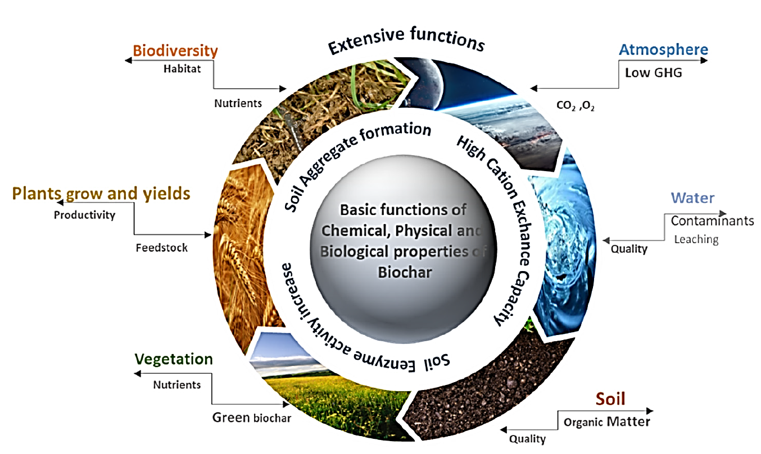
Biochar as a soil ameliorator and conditioner
The power of biochar manifests itself in the water and soil ecosystem. In particular, interactions in the soil ecosystem are described in this study. Biochar is a practical soil amendment that can positively change agricultural activities, soil health and development in terms of sustainability (see Figure 1) [28, 29]. Microorganisms in the structure of the soil, which are the basic parts of the ecosystem, have a key role in the development of the soil [30, 31]. Biochar provides population change in the soil biota to which it is added. In particular, the elemental composition and morphological functions (porosity, surface area) of biochar offer advantages for the growth of bacteria, fungi, and other microorganisms. Biochar, which is effective in water treatment, has an important position in the treatment of pollutants entering the soil ecosystem with its adsorbent feature. Biochar added in terms of soil pollution and soil health positively affects the physiochemical and microbiological properties of the soil [32]. It can also be a nutrient source for agricultural and other plant activities. Their content mainly depends on the raw materials used and the conditions of the pyrolysis process.
Figure 1. Biochar as a soil ameliorator and conditioner [41].

Slide 12
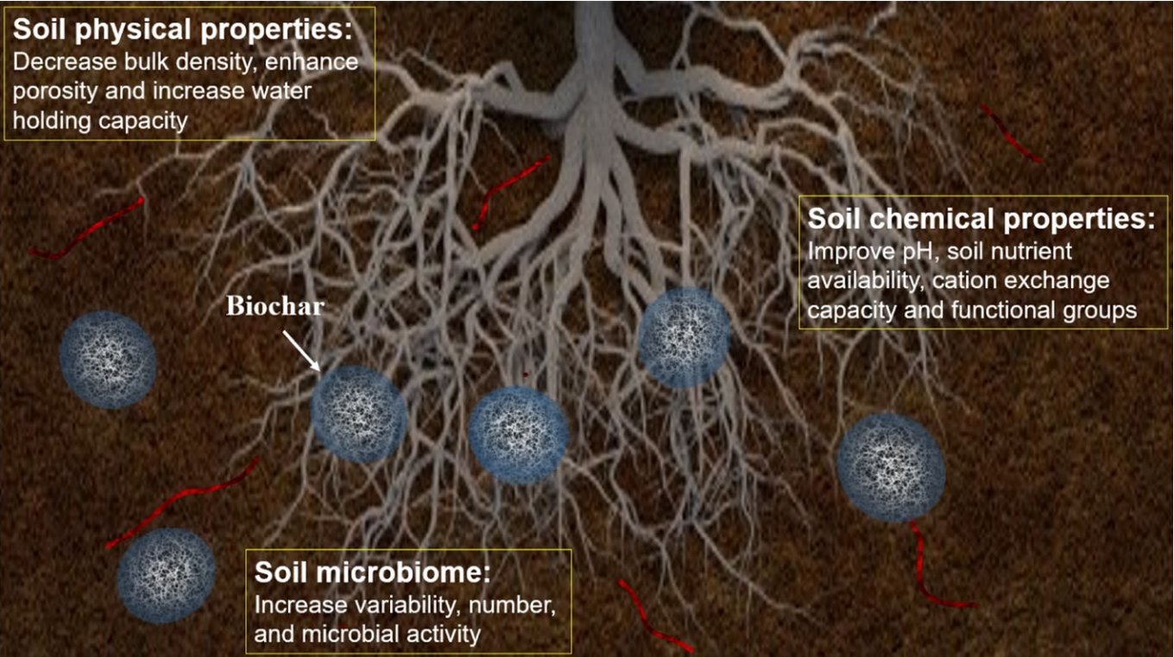
Biochar has a significant role in improving the chemical, physical, and microbiological properties of soil. Among the chemical properties of soil that can be improved are pH, nutrient availability, cation-exchange capacity and functional groups. Additionally, soil physical properties such as bulk density, porosity, and water holding capacity properties can be improved. Moreover, soil biological properties are enhanced by the addition of a significant amount of bioavailable nutrients, which improve the variety, number, and activity of soil microorganisms

Slide 13
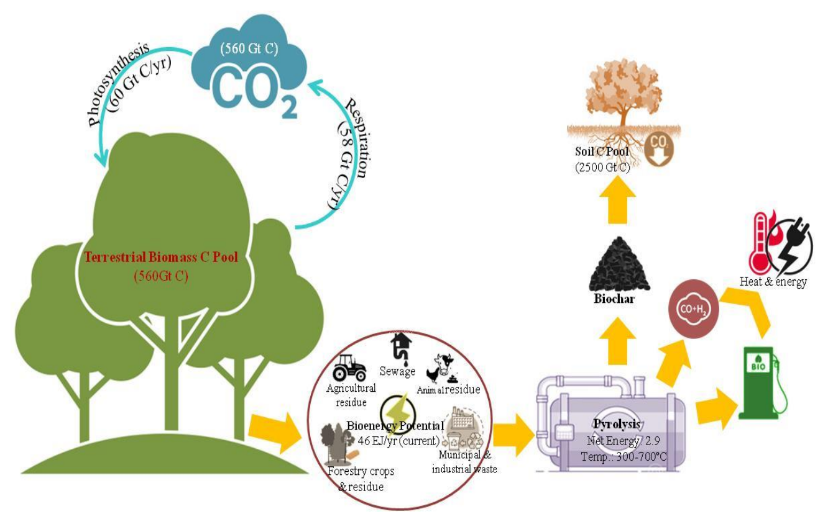
Schematic diagram of biochar-induced carbon sequestration. Biochar can be applied to rehabilitate contaminated soils and mitigate climate change [10]. What makes biochar indispensable for soil is its relatively easy preparation and low cost [33]. One of the methods used for minimizing greenhouse gas (GHG) emissions is the addition of biochar to soil, which is designed to capture and store carbon in the soil [34, 39, 40]. Biochar, where the C cycle is slow, provides carbon sequestration and CO2 reduction. When biochar is added, soil structure, aeration, water holding capacity, and pore size can be positively affected and soil improvement is achieved [35, 36]. Biochar can improve soil main structure in three stages (water holding capacity, pore size, microbial activity) [37, 38].

Slide 14
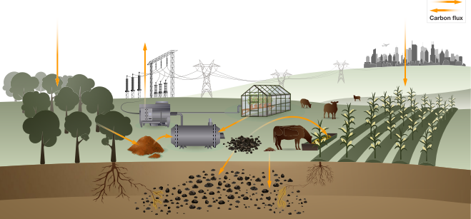
Results
Biochar systems utilize organic residues, including forest, crop, and horticultural residues, to produce biochar that is used as a soil amendment directly, and indirectly via feeding to livestock. Pyrolysis gases and process heat, co-products of biochar production, can be used to supply renewable energy
Biochar has been described as environmentally friendly by researchers. However, some of its features and surface structure may adversely affect the soil ecosystem and other environmental environments. The functional groups and some elemental components of biochar can be transformed into harmful components by chemical reactions in the soil and release. The investigations revealed that biochar can take an active role in soil improvement due to factors such as active pore distribution, organic functional groups, adsorbing capacity, and high stability ability. One of the most important advantages of adding biochar is to minimize the effect of pollutants by affecting the soil biota. Biochar's long carbon sink capacity is expected to increase carbon storage in the soil structure and thus reduce greenhouse gas emissions.

Slide 15
Turning waste into soil conditioner with a sustainable innovative approach: Biochar
Hakan Çelebi, Tolga Bahadır, İsmail Şimşek, Şevket Tulun
Department of Environmental Engineering, Aksaray University, 68100, Aksaray, Turkey; hakancelebi@aksaray.edu.tr

