Slide 1
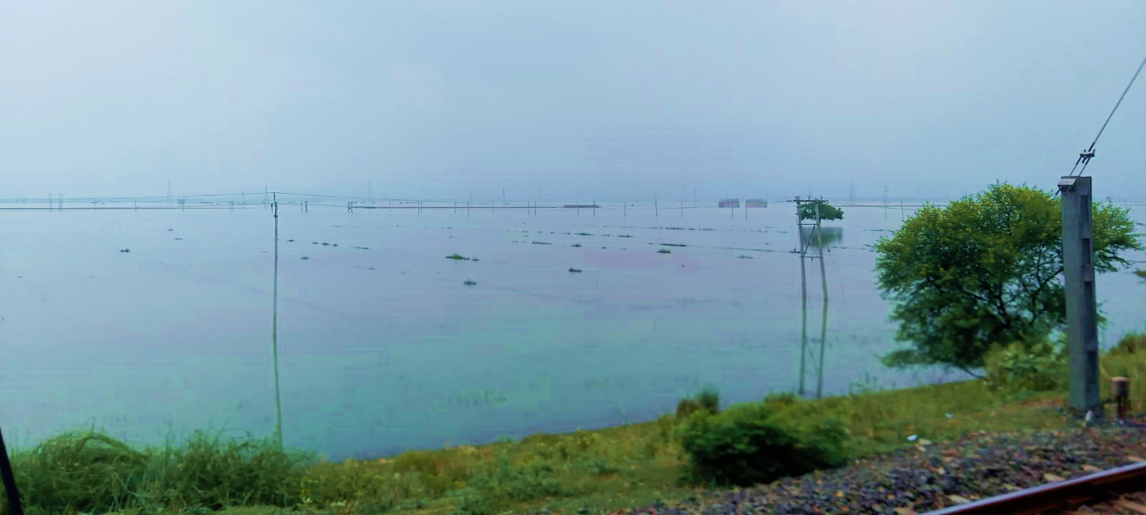



5th International Electronic Conference on Remote Sensing
07th-21st November 2023
SAR-Data-Based Flood Mapping and Regional Precipitation Trend Analysis
Kavita Kaushik and A C Pandey*
Department of Geoinformatics, Central University of Jharkhand, Ranchi
Presenting Author: Kavita Kaushik; Email ID: Kavita.20260201001@cuj.ac.in

Slide 2
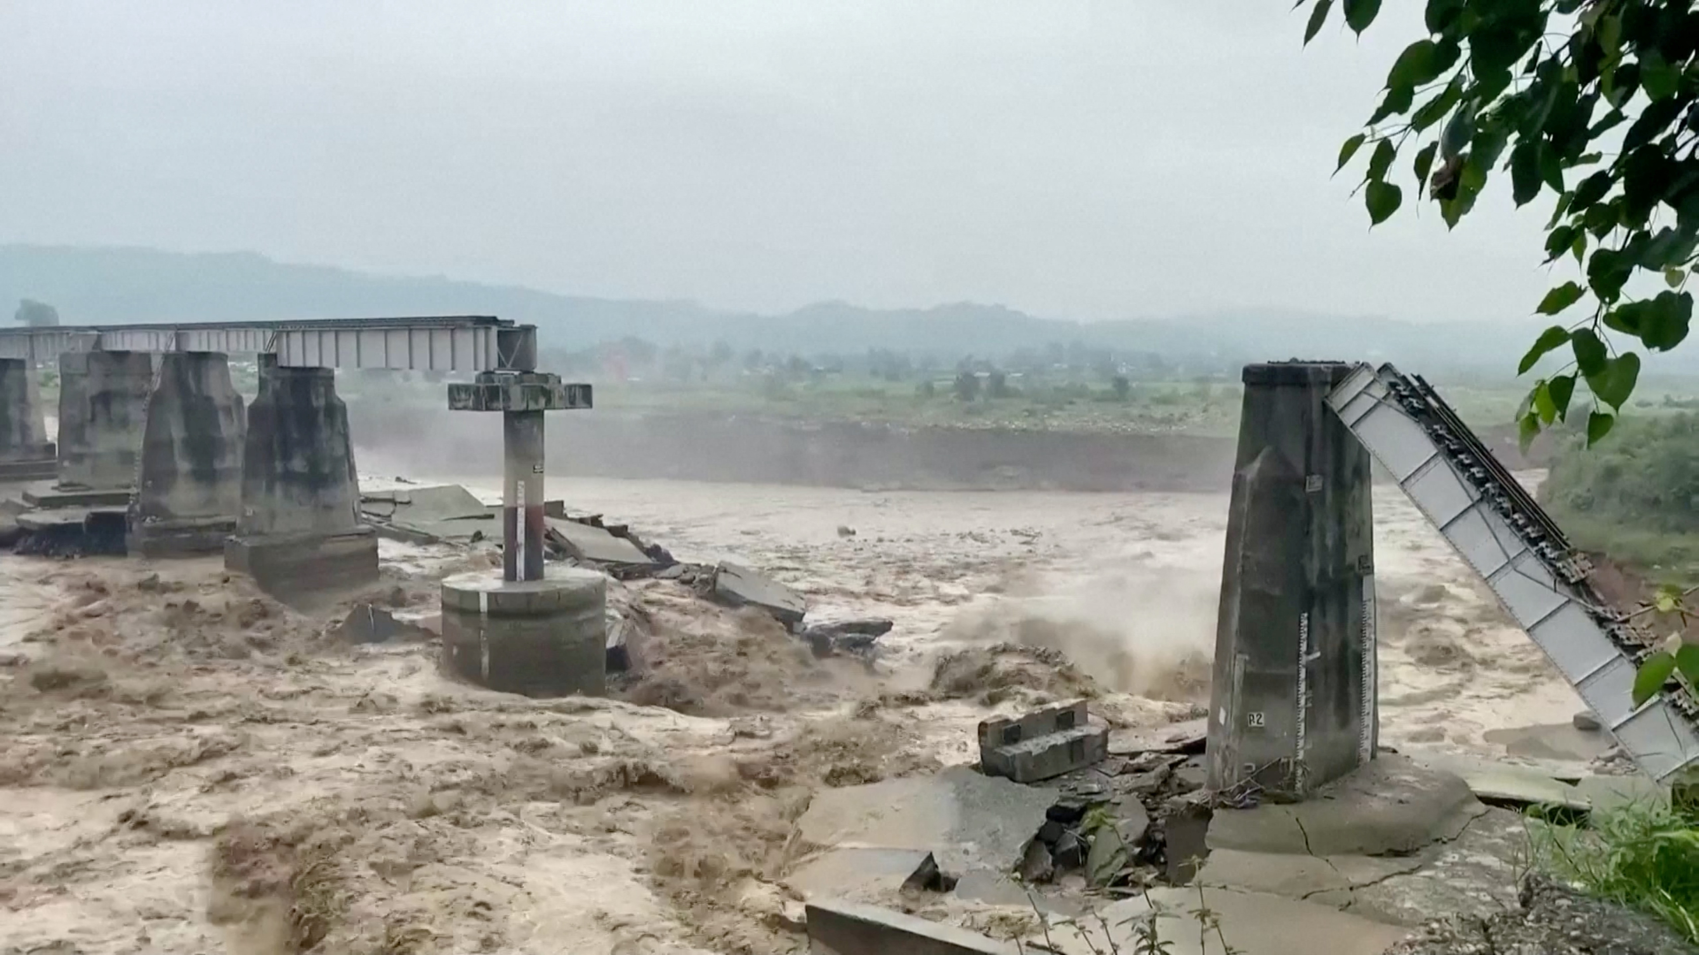
INTRODUCTION
The variability in the river flow in relation to rainfall changes plays a pivotal role in understanding the occurrences of disaster in the Ganga-Brahmaputra basin. In the recent decade, findings are indicating towards an increase in flash floods and droughts due to the impacts of climate change.
As the frequency of flood events (Mirza, 2011) and their severity has increased, the global concerns are also increasing for lessening the fatalities because of the flood and other economic losses (Kuldeep et al., 2016).
The flood inundation extent analysis and its information is necessary for understanding variables like the exposure of society, infrastructure, flood storage volumes, attenuation of flood waves and the future flood hazards and are the first steps for the formulation of any flood management strategy (Sahoo & Sreeja, 2017).

Slide 3
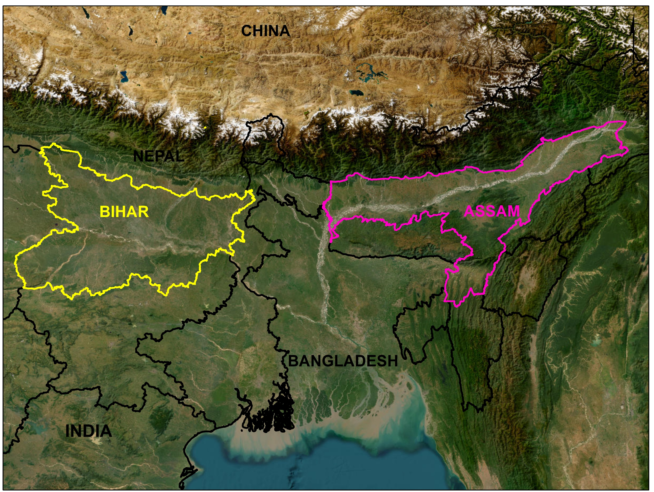
STUDY AREA
The study area comprises of two major states (Bihar and Assam) in the Ganga-Brahmaputra basin, which are facing recurrent flood disasters over the years.
The study area receives a maximum of precipitation during the monsoon season from July to September.
Bihar has most of its geographical area under cultivation and is one of the highest population densities in the country.
In Assam, the population residing in the valley region are adversely affected by the high flow of the Brahmaputra River.

Slide 4
DATASET USED
Dataset used | Spatial resolution | Acquisition date | source | purpose
MODIS LULC | 500m | 2019 | Earthdata | Agriculture Land Extraction
CHIRPS | 25 km | July’ 2022 August’ 2022 September 2022 October 2022 | NRT GSFC | Rainfall anomaly
Sentinel 1 | 10m | July’ 2022 August’ 2022 September 2022 October 2022 | GEE | Flood Extent estimation
Global Human Settlement Population data | 9 arcsec | 2015 | GHSL | Population density

Slide 5
METHODOLOGY
SENTINEL-1
MODIS LULC
GHSL POPULATION
CHIRPS RAINFALL
Pre-processing: Thermal noise removal, radiometric calibration, Speckle filter, Terrain Correction.
Thresholding
Flood/Non-flood
FAO-based LULC classification
Extract Built-up and Cropland
Population count per pixel
Monthly precipitation dataset
Anomaly
FLOOD INUNDATION PATTERN AND IMPACT ASSESSMENT

Slide 6
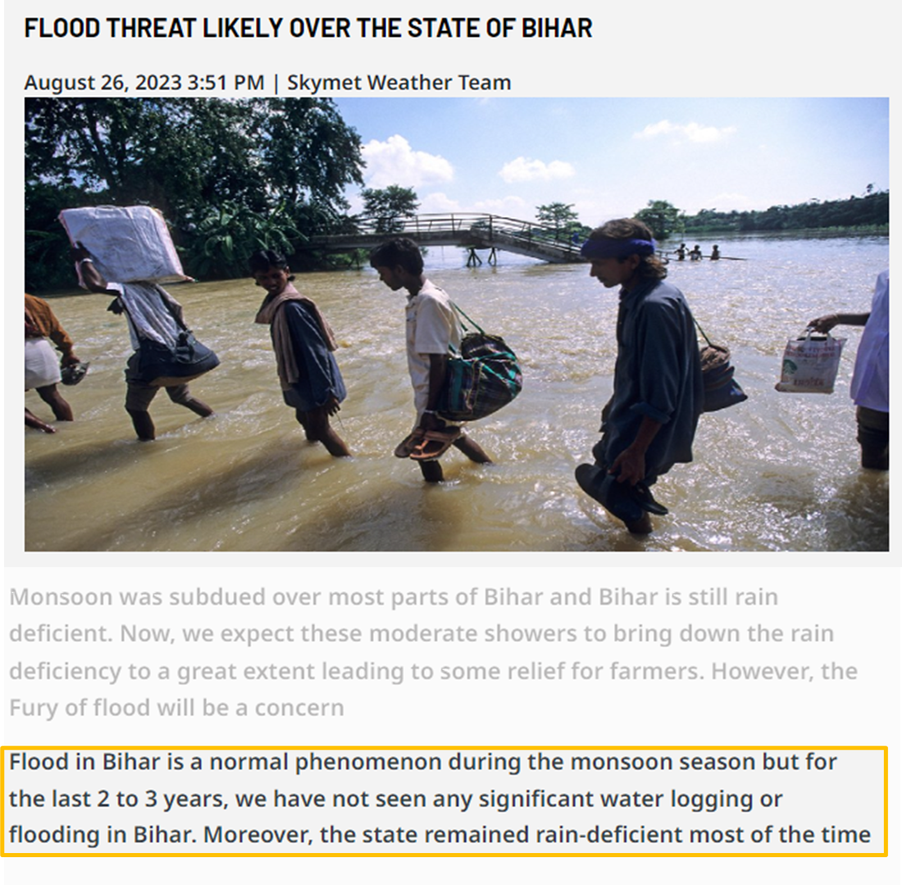
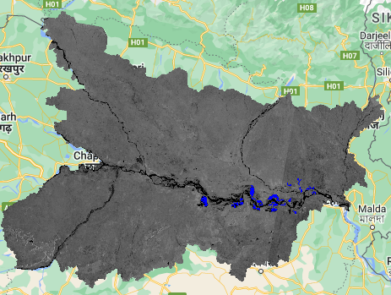
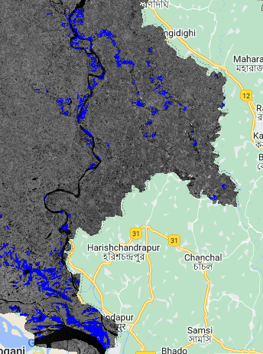
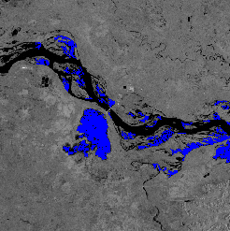
Flood extent in Bihar during the monsoon period (2022)
The composite area from July to October (2022) under flood was estimated to be 4362.71 km² for Bihar.
However, the flood inundation extent reduced in subsequent months like August and September, indicating flood regression
1
2
1
2
Fig 2: Flood extent (Composite) in Bihar

Slide 7
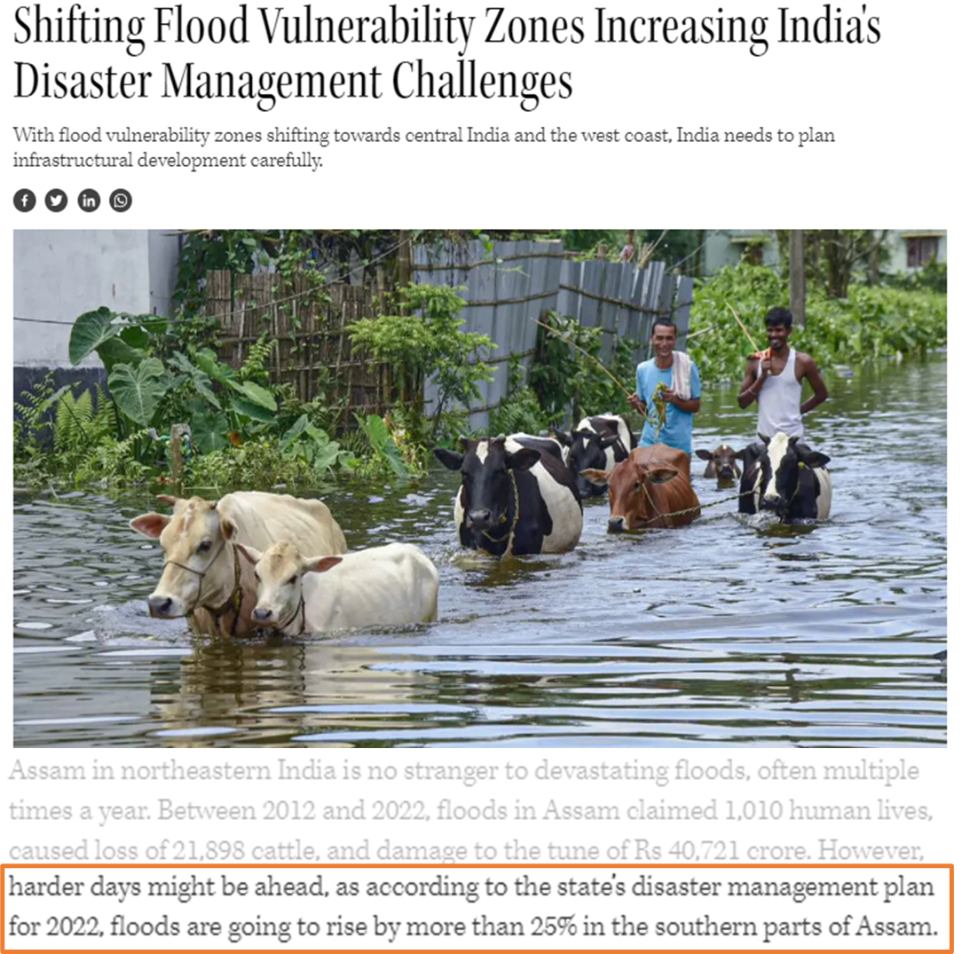
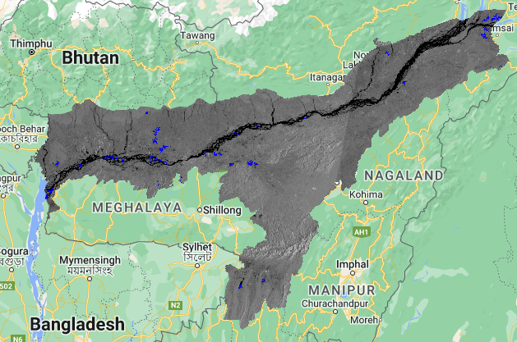
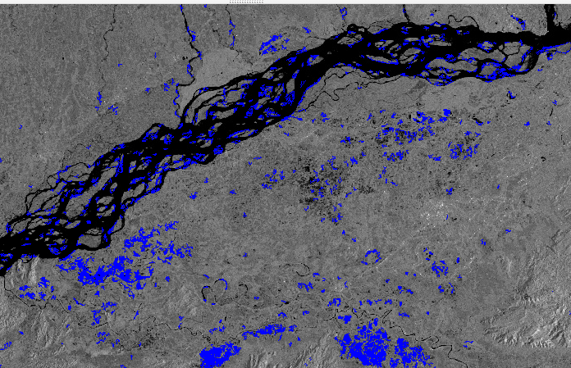
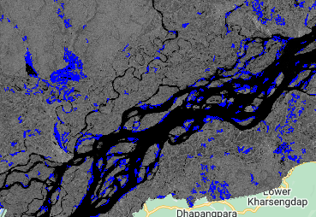
Flood extent in Assam during the monsoon period (2022)
The composite area for July to October under flood was estimated to be 11048.52 km² for Assam.
In Assam the flood extent is largely confined to the proximity areas of Brahmaputra River
1
1
2
2
Fig 3: Flood extent (Composite) in Assam

Slide 8
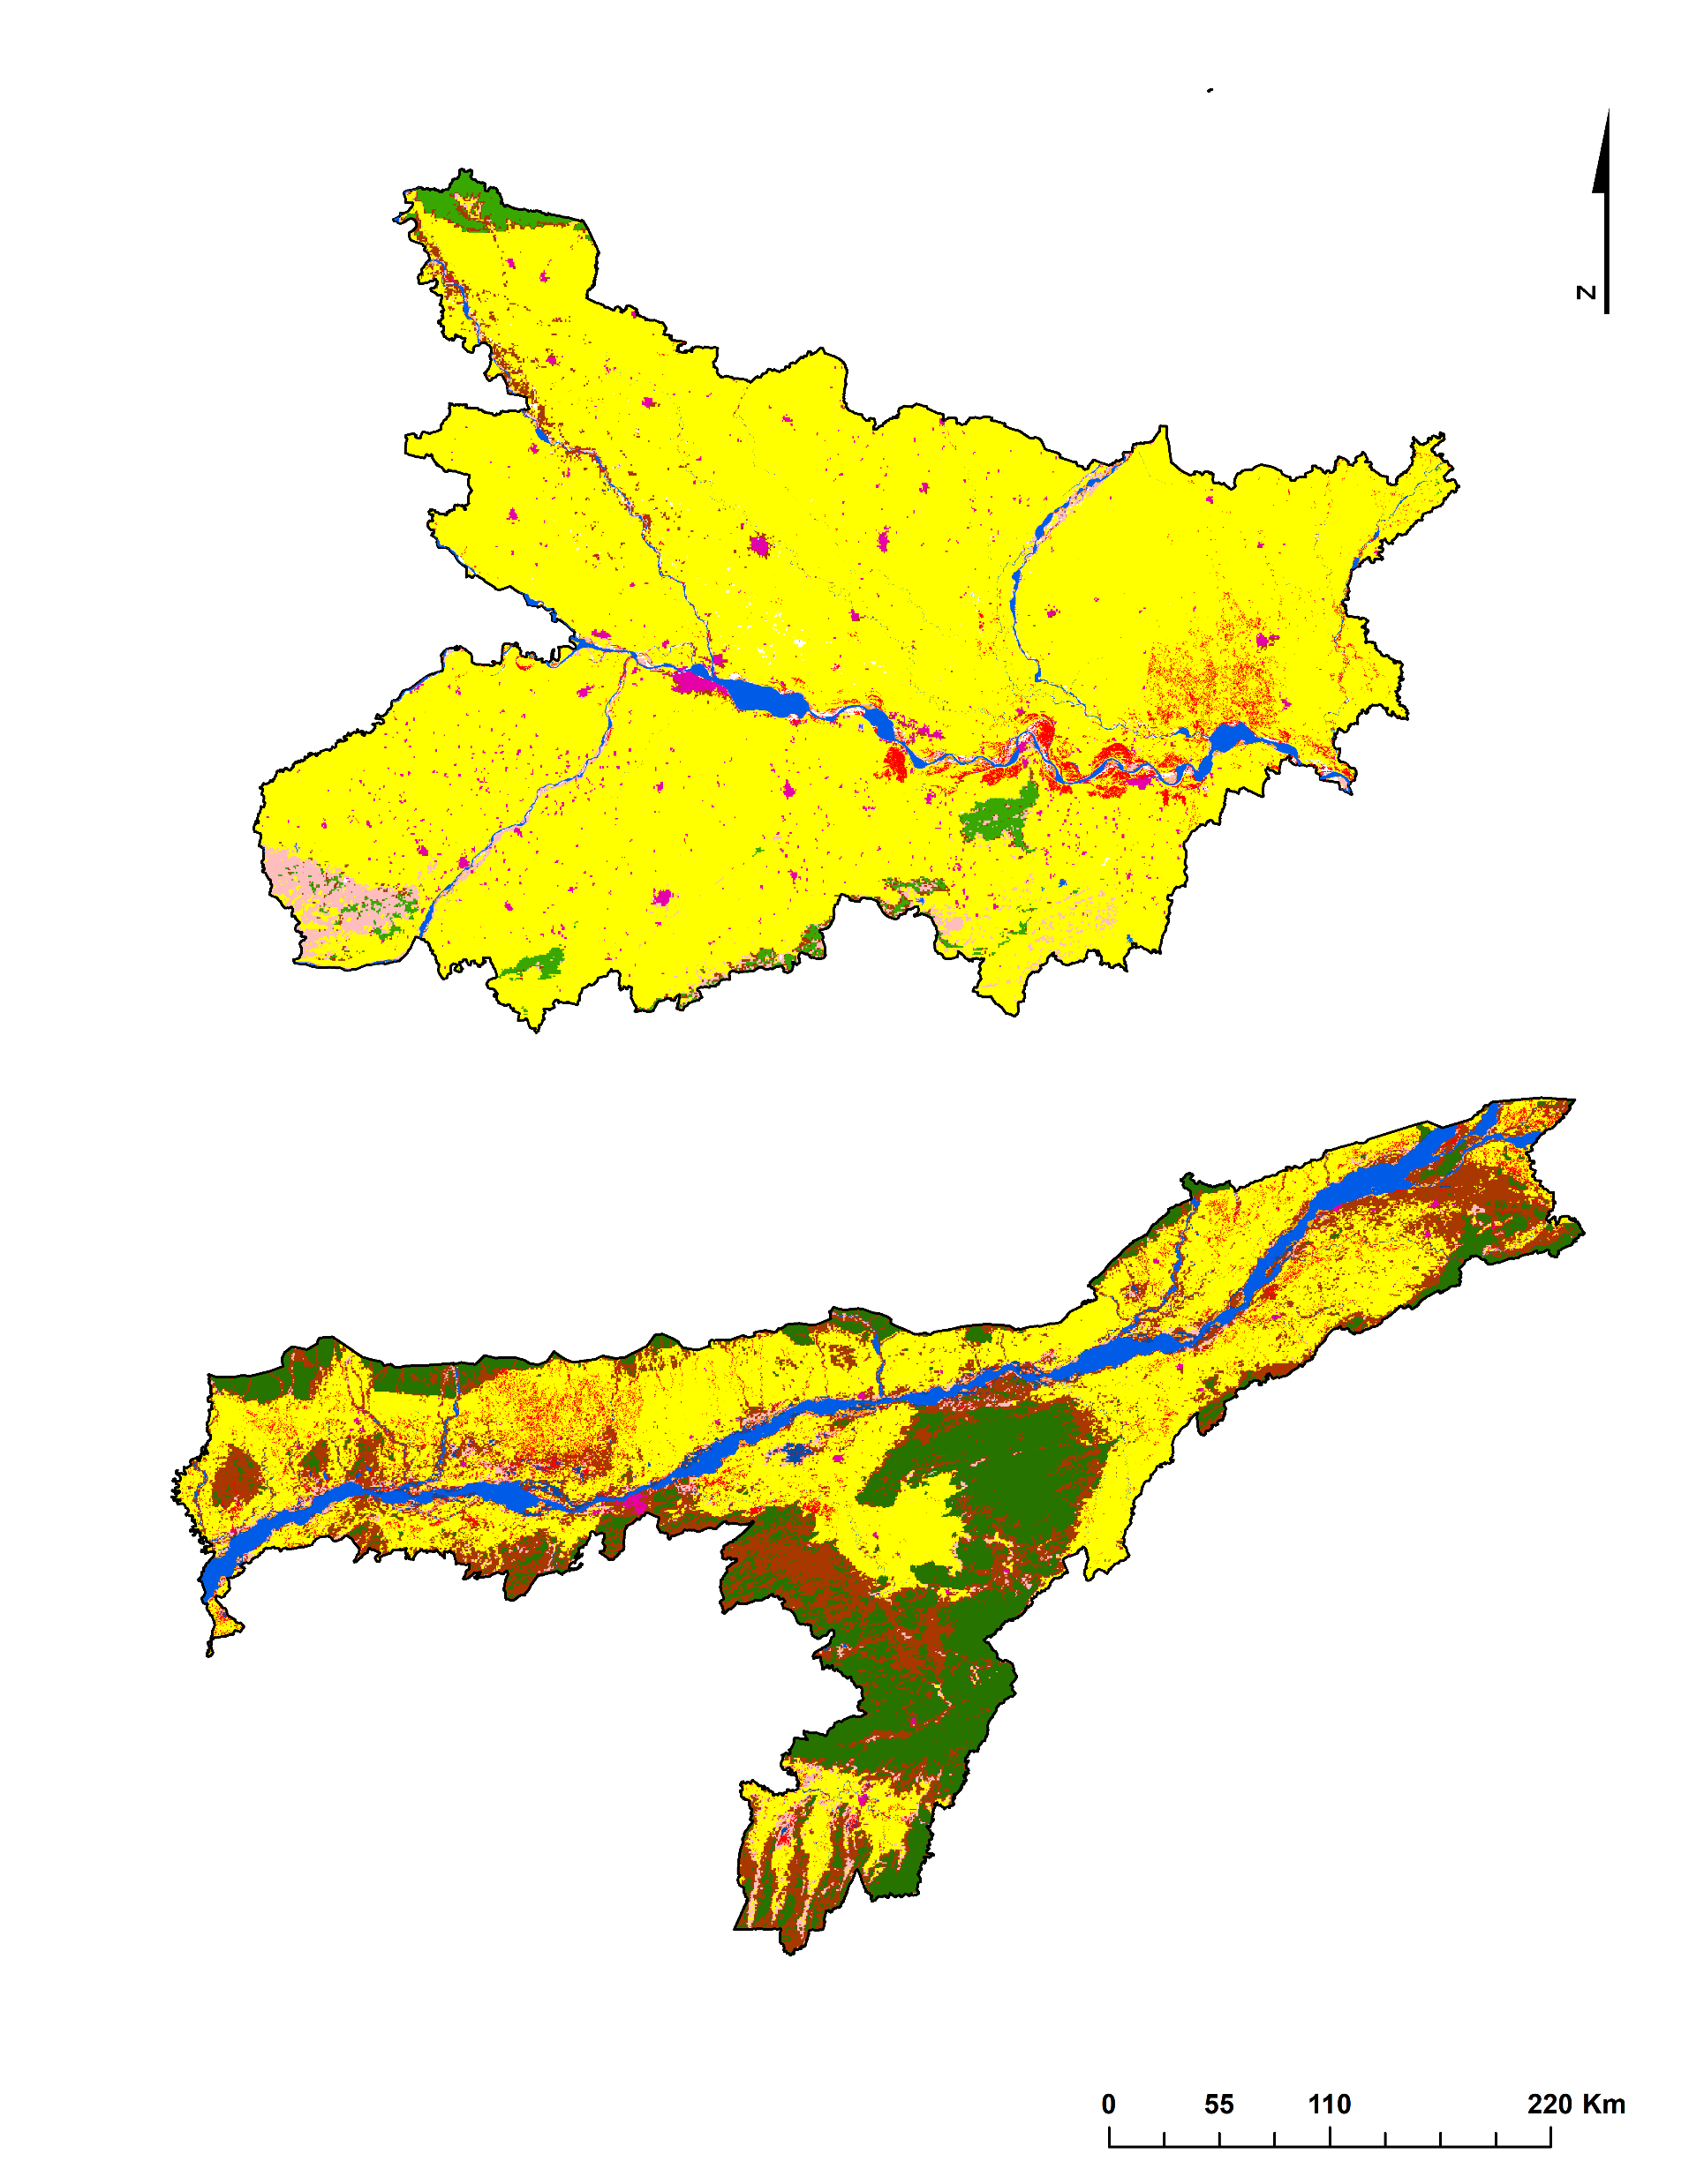

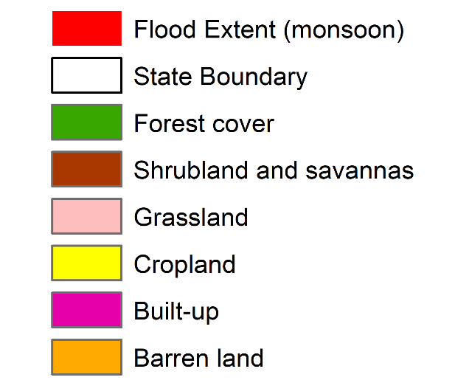

Affected Cropland and Built-up during the floods of monsoon 2022
MODIS Land Cover Type Yearly Global dataset was used to calculate the impact of flood on agricultural area and urban areas which revealed that the highest impact was on Bihar with an area of 1563.14 km², 463.81 km² respectively, and Assam (161.19 km², 51.91 km²).

Slide 9
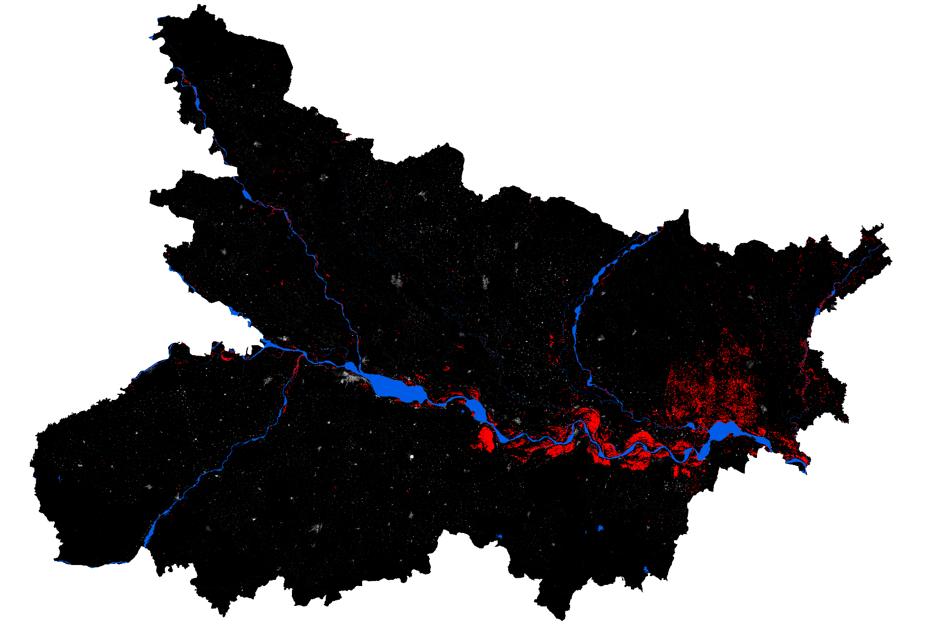
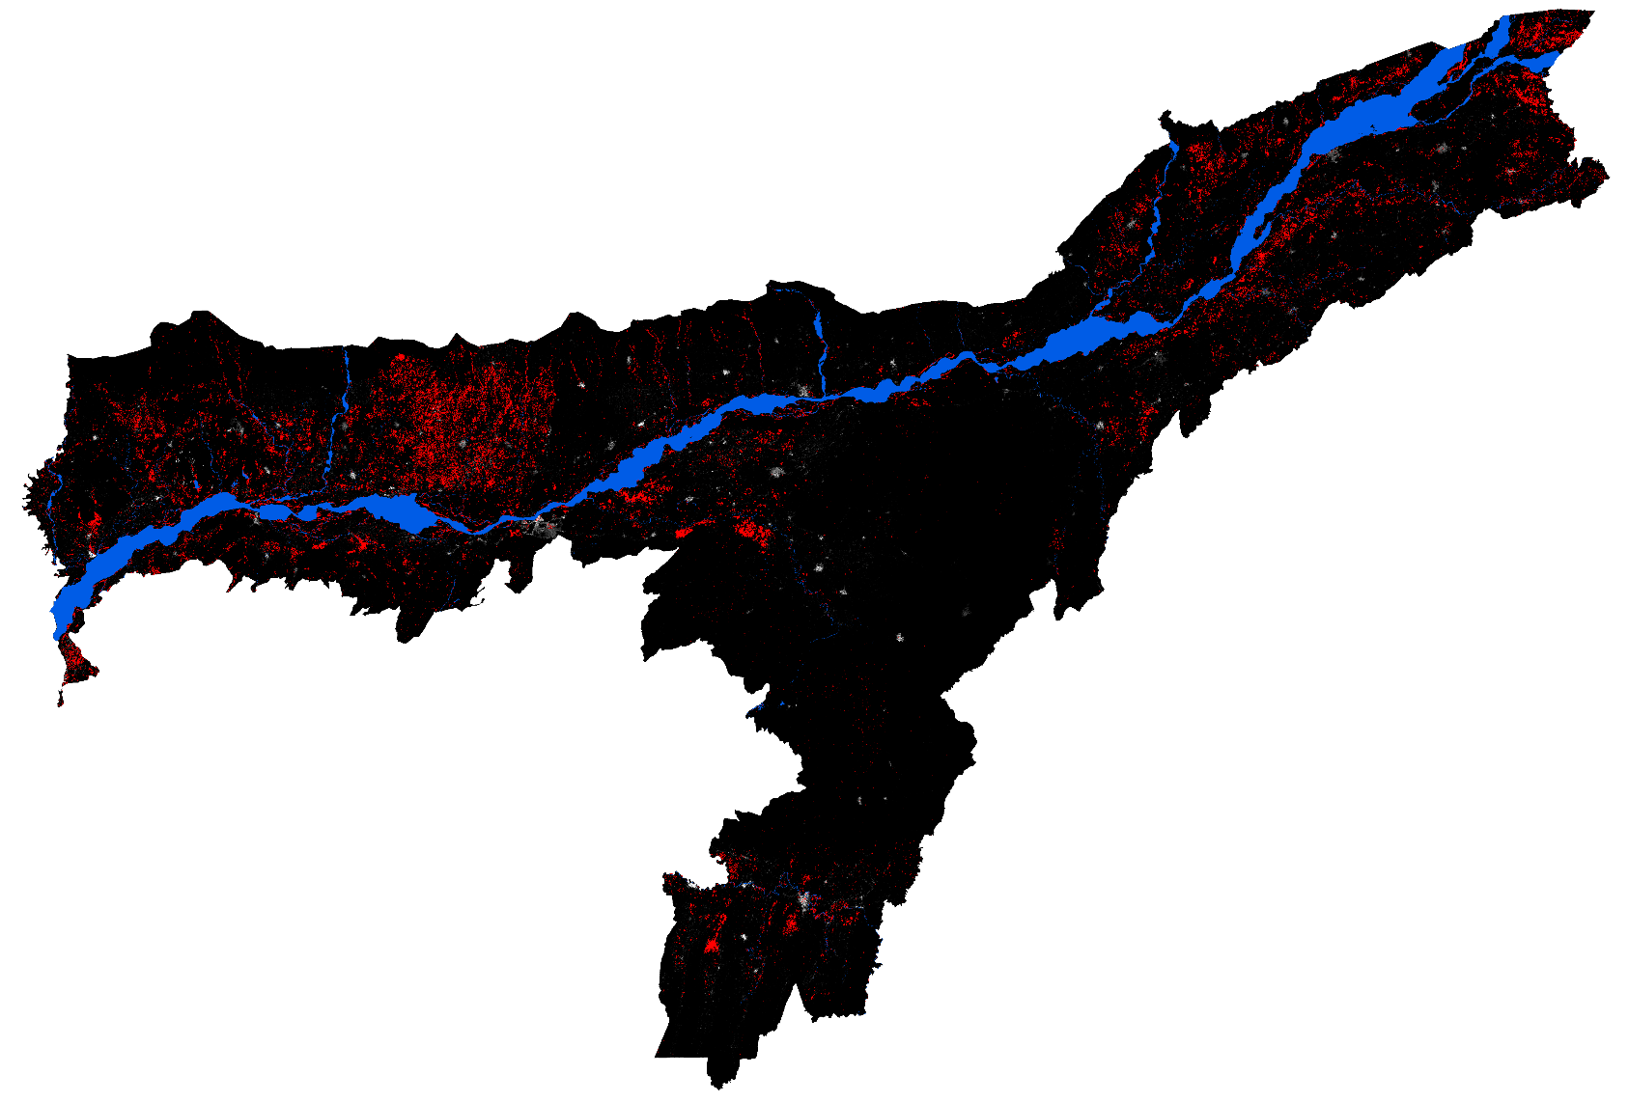
Affected Population during the floods of monsoon 2022
JRC Global Human Settlement Population Density layer was employed to evaluate the flood impacts which revealed that a total of 3.7 million of the population was affected.

Slide 10
Assam
Assam
Bihar
Bihar
Assam
Assam
Bihar
Bihar

Slide 11
Major flood events in Bihar and Assam (1950-2022)
Bihar is highly influenced by the various stream system and the flow of river water from the Himalayan region creating havoc for the state in every monsoon season. Whereas for Assam being in low-lying zone has been the reason of most impact during the flood event.
As per the composite flood maps during 2020 flood events, it inundated 19.48% (77493.1 km²) of areas in the Ganga-Brahmaputra basin with maximum inundation in Bihar (22.11% (20837 km²)) followed by Assam (17.16% (13460.1 km²)) (Pandey et al., 2022). However in our analysis it was observed that the impact was higher in Assam as compared to Bihar.
States/ Country | Flood events | Source
Assam | 1954, 1962, 1972, 1977, 1984, 1988, 1998, 2002, 2004, 2012, 2013, 2015, 2016, 2017, 2018, 2019, 2020. | (Govt. of Assam, 2023), (Pandey et al., 2022)
Bihar | 1987, 1995, 1998, 2000, 2001, 2003, 2004, 2008, 2010, 2013, 2016, 2017, 2018, 2019, 2020, 2021. | (Tripathi et al., 2020), (Tripathi, Pandey, Parida, & Shakya, 2020)

Slide 12
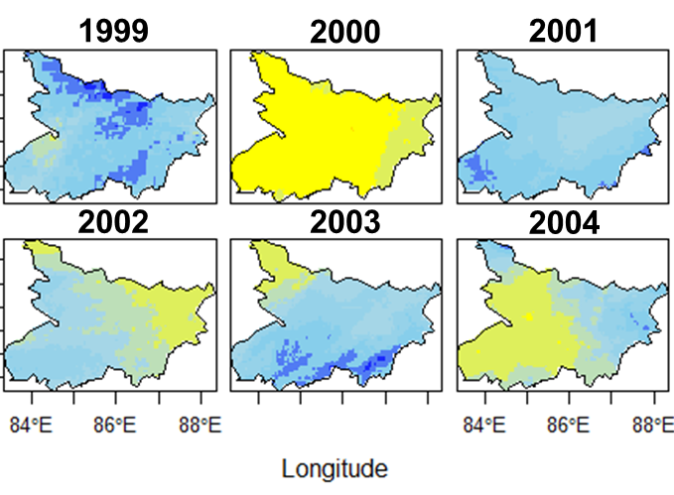
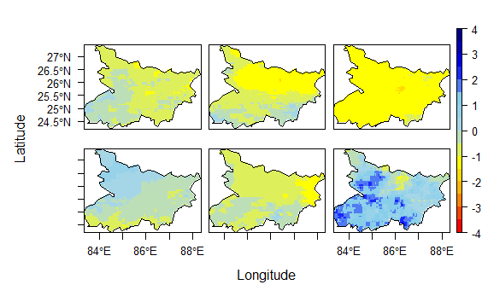
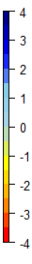
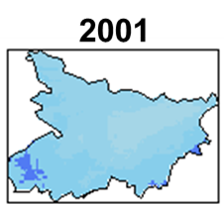
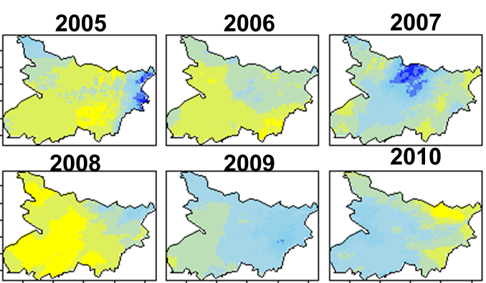
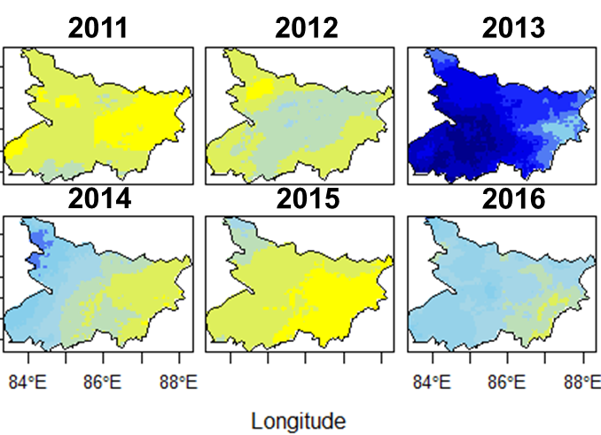
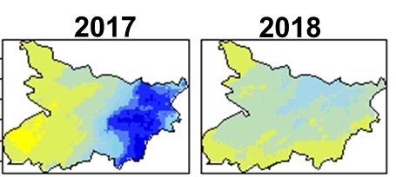
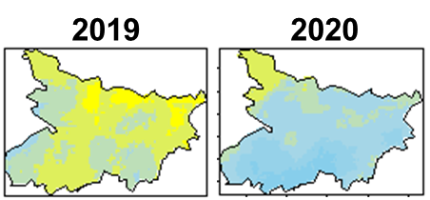
Rainfall Anomaly for the period 1993-2022 in Bihar
1993
1994
1995
1996
1997
1998

Slide 13
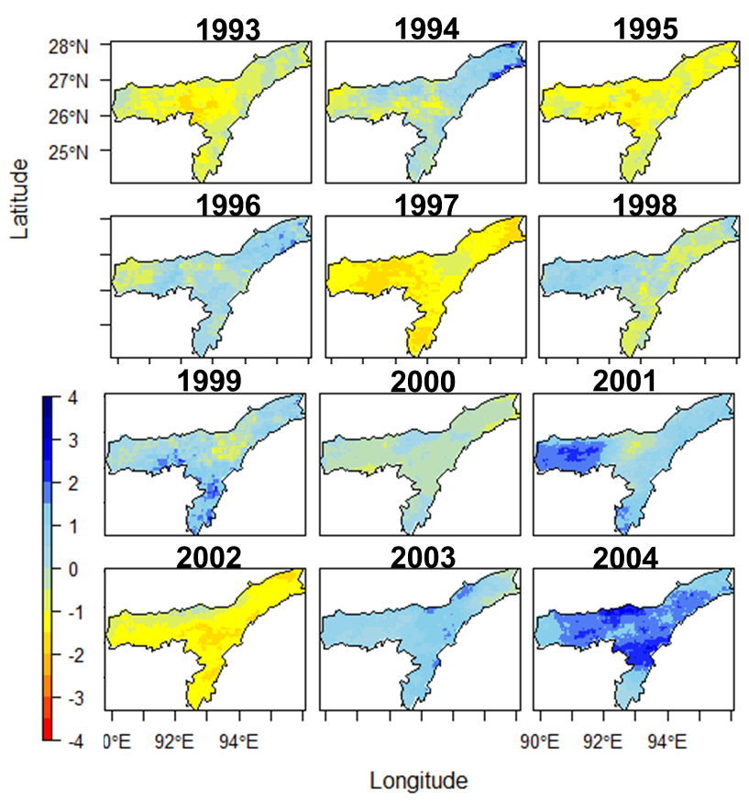
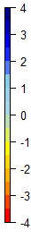
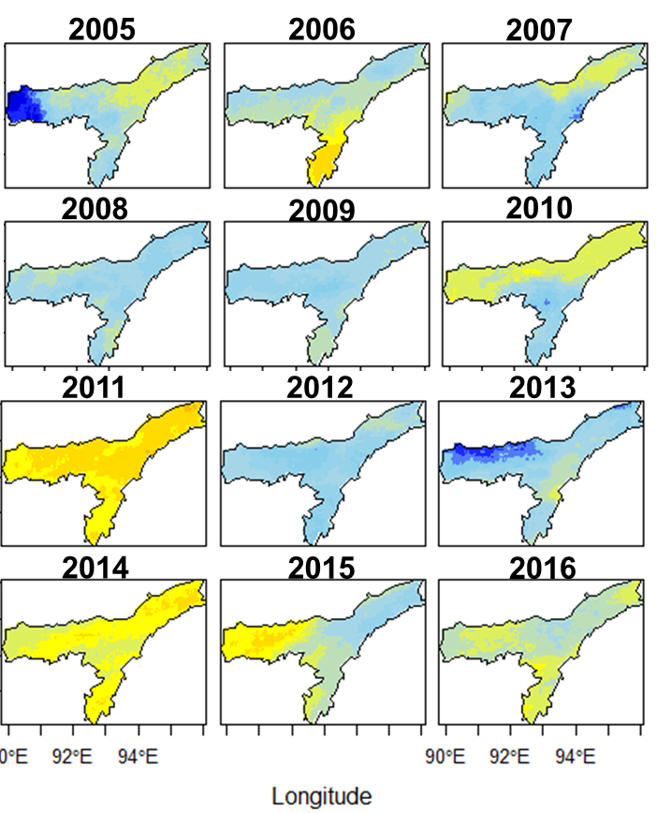
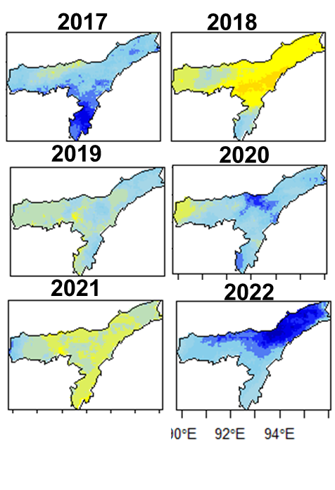
Rainfall Anomaly for the period 1993-2022 in Assam

Slide 14
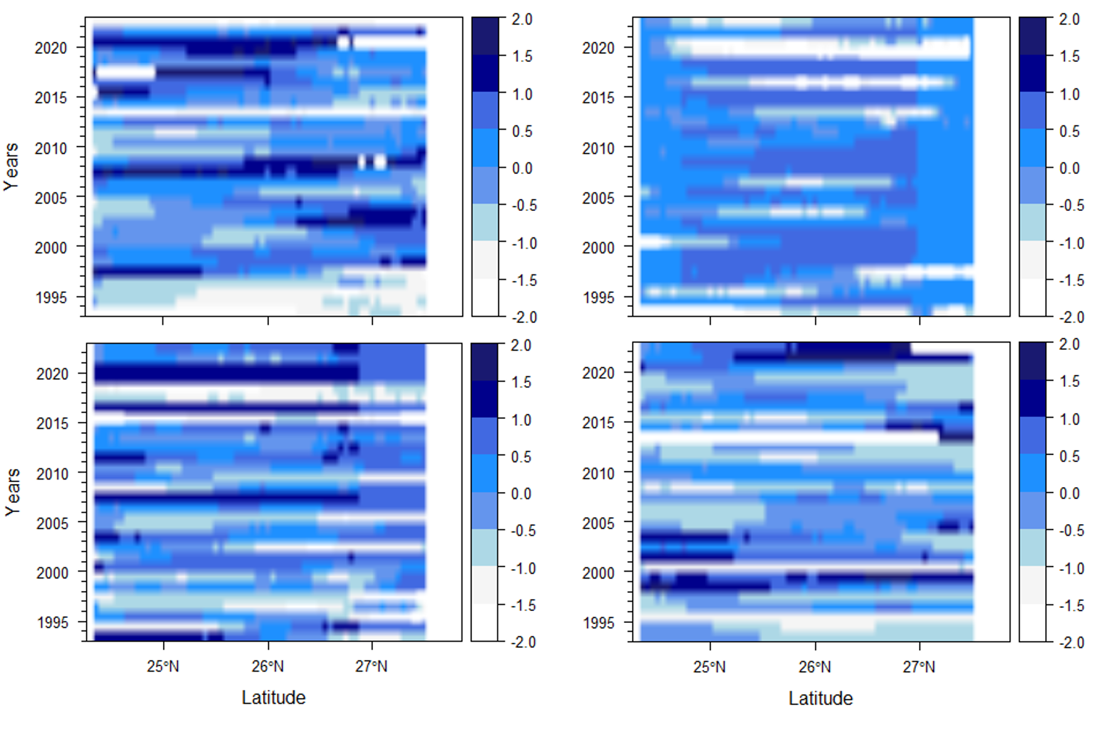
Rainfall Anomaly for the period 1993-2022 in Bihar
July
August
September
October

Slide 15
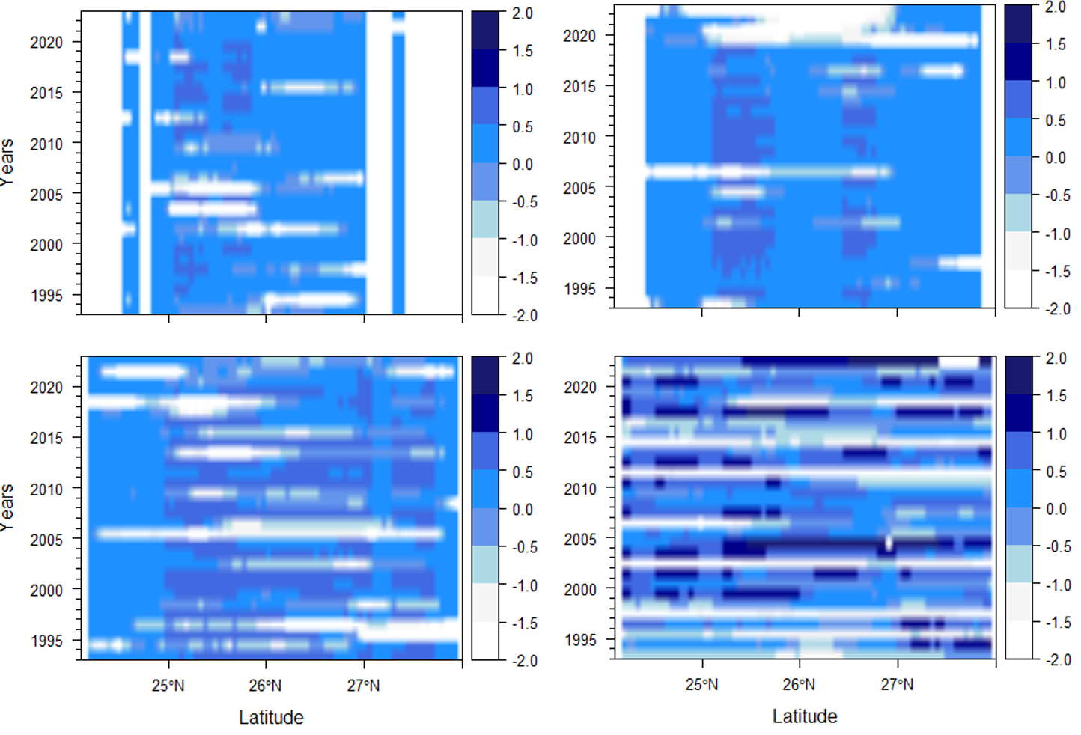
Rainfall Anomaly for the period 1993-2022 in Assam
July
August
September
October

Slide 16
CONCLUSION
The present study is focused on the recent flood disaster in the Ganga-Brahmaputra basin mainly affecting the states of Bihar, and Assam in India during the months of July, August, September, and October 2022.
The composite area for July to October under flood was estimated to be 11048.52 km² for Assam and 4362.71 km² for Bihar. Extensive area was inundated in Assam due to increased rainfall intensity during the monsoon season with values ranging from 384.92 to 476.07mm as compared to Bihar with 272.56 to 386mm.
Bihar recorded the least precipitation variation in the month of August with major values ranging between 0.5 to -0.5mm year⁻¹ however the month of October presents the highest variability over the past 30 years with an increase of more than 1.5mm year⁻¹ after 2020 which has previously been non-significant.
However, in Assam, the monsoon period has not recorded significant change in the anomaly from July to September with values falling between -0.5 to 1.0mm year⁻¹.
The near real time flood inundation mapping together with the possible impact over the cropland and settlements and population would provide relevant information to the disaster management authority for quick damage assessment and effective relief operation during flood impacts.

Slide 17
REFERENCES
Govt. of Assam. (2023). Water Resources. Government of Assam. https://waterresources.assam.gov.in/portlet-innerpage/brahmaputra-river-system.
Kuldeep, Garg, P. K., & Garg, R. D. (2016). Geospatial techniques for flood inundation mapping. 2016 IEEE International Geoscience and Remote Sensing Symposium (IGARSS), 4387–4390. https://doi.org/10.1109/IGARSS.2016.7730143.
Mirza, M. M. Q. (2011). Climate change, flooding in South Asia and implications. Regional Environmental Change, 11(S1), 95–107. https://doi.org/10.1007/s10113-010-0184-7.
Pandey, A., Kaushik, K., & Parida, B. (2022). Google Earth Engine for Large-Scale Flood Mapping Using SAR Data and Impact Assessment on Agriculture and Population of Ganga-Brahmaputra Basin. Sustainability, 14, 4210. https://doi.org/10.3390/su14074210.
Sahoo, S. N., & Sreeja, P. (2017). Development of Flood Inundation Maps and Quantification of Flood Risk in an Urban Catchment of Brahmaputra River. ASCE-ASME Journal of Risk and Uncertainty in Engineering Systems, Part A: Civil Engineering, 3(1). https://doi.org/10.1061/AJRUA6.0000822.
Tripathi, G., Pandey, A. C., Parida, B. R., & Kumar, A. (2020). Flood Inundation Mapping and Impact Assessment Using Multi-Temporal Optical and SAR Satellite Data: A Case Study of 2017 Flood in Darbhanga District, Bihar, India. Water Resources Management: An International Journal, Published for the European Water Resources Association (EWRA), 34(6), 1871–1892.
Tripathi, G., Pandey, A. C., Parida, B. R., & Shakya, A. (2020). Comparative Flood Inundation Mapping Utilizing Multi-Temporal Optical and SAR Satellite Data Over North Bihar Region: A Case Study of 2019 Flooding Event Over North Bihar. In Spatial Information science for natural resource management. (pp. 149–168). IGI Global. 10.4018/978-1-7998-5027-4.ch008.

Slide 18
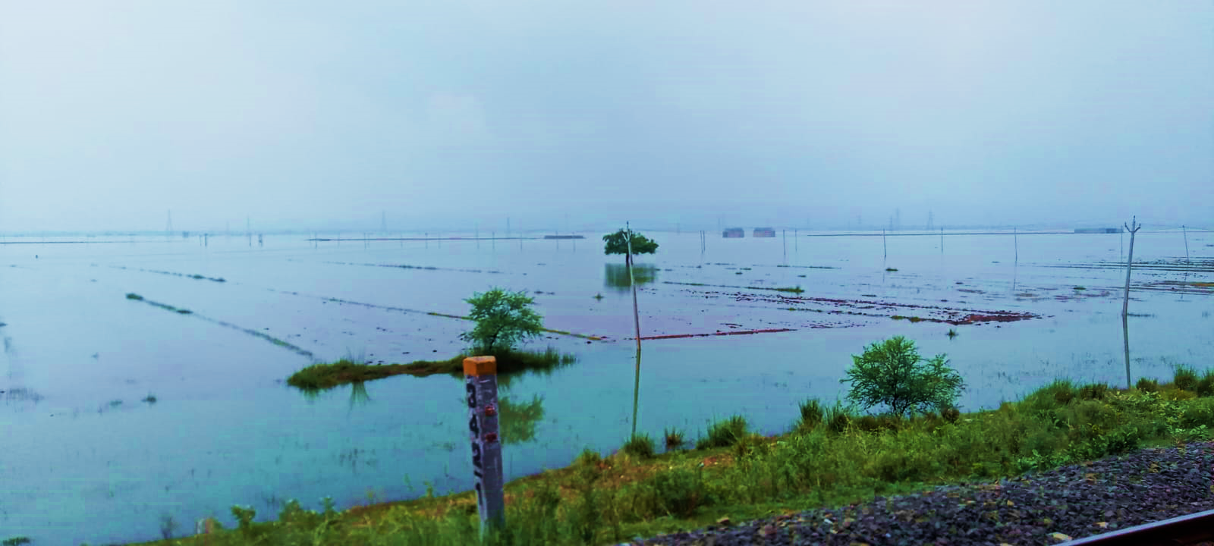
THANK YOU
Email Id: Kavita.20260201001@cuj.ac.in

