Slide 1
Biotransformation of Beta-lactam Antibiotics pollutants into nontoxic form
The 3rd International Electronic Conference on Antibiotics
Presented by:
Asmita N. Bambole
Research Fellow
Department of Chemistry
Savitribai Phule Pune University,
Pune-411007, India
Research Supervisor:
Prof. Kisan M. Kodam
Biochemistry Division
Department of Chemistry
Savitribai Phule Pune University,
Pune-411007, India

Slide 2
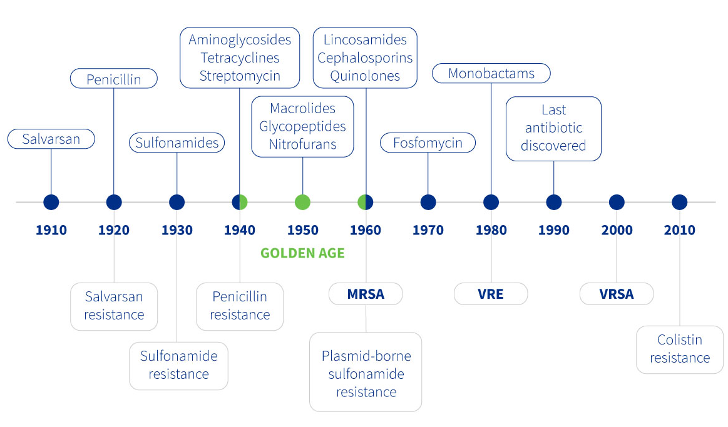
Why resistance is a concern?
In his Nobel Prize lecture, Fleming warned of danger of resistance –
“It is not difficult to make microbes resistant to penicillin in laboratory by exposing them to concentrations not sufficient to kill them, and same thing has occasionally happened in body and by exposing microbes to non-lethal quantities of drug make them resistant.
Treatment failure
Increased mortality
Burden on healthcare costs
Back to pre-antibiotic era
Because resistant organisms lead to
Resistance to Colistin
(only last resort for life-threatening infections)
Over 56,000 new born deaths occur every year due to sepsis in India
Discovery void + increasing resistance =
‘ticking time bomb’ of the 21st century
Fig. no. 1: Brief history of antibiotics resistance development
Ref: https://aboutsmallruminants.com/history-development-antibiotics-chronology/

Slide 3
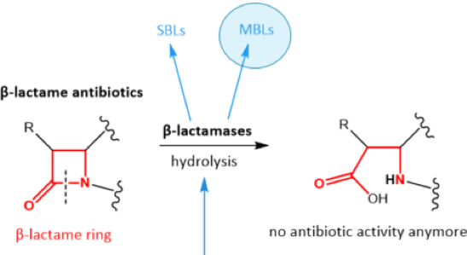
Beta-lactams overuse and dump in environment
Development of resistance
Inactivation of Beta-lactams by beta-lactamase
Lower the load of antibiotics in environment
Restoration of susceptibility to antibiotics
Clinical threat
Why Beta-lactams ?
Broadly and commonly used antibiotics.
Need to restore the broad spectrum antibiotics resistance.
Resistance to beta-lactams is through beta-lactamase production.
Why β-lactamases
Though beta-lactamase cause resistance but also can be useful.
β-lactamases hydrolytically cleave the β-lactam ring of β-lactams through the action of an active Site Ser nucleophile (Ser-β-lactamases) or through activation of water via a Zn2+ centre (metallo-β-lactamases).
Fig 2. Simplified mode of action of beta-lactamases

Slide 4
Objectives (Work flow)
Sample collection
Enrichment and isolation
Identification and characterisation
Beta-lactam degradation
Byproducts characterisation
Future work
Enzyme identification
Pharmaceutical waste water effluent
On minimal media with penicillin 100 mg/ml
24 resistant isolates
PCR amplification, sequencing and blast analysis
Antibiotics susceptibility testing
By phenotypic double disc diffusion method
Beta-lactam (Cefotaxime) timepoint degradation
TLC and spectrophotometric confirmation
Optimisation of degradation efficiency and applications
LCMS, HPLC, GCMS
Antimicrobial activity and toxicity
Notes:
S

Slide 5
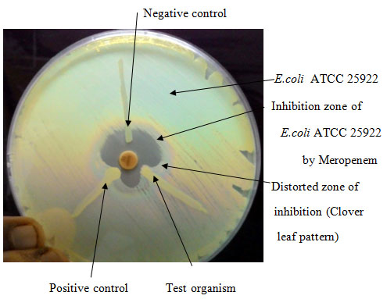
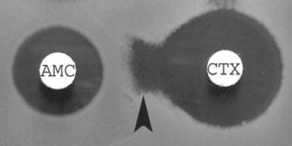
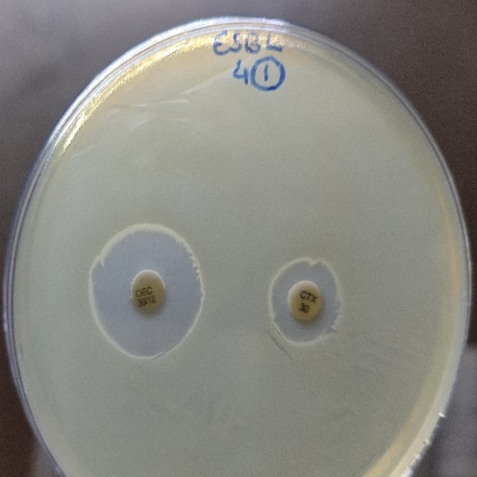
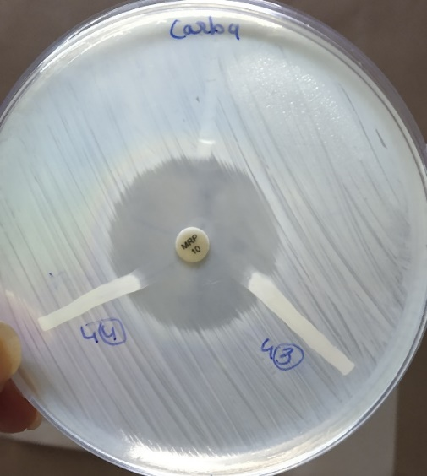
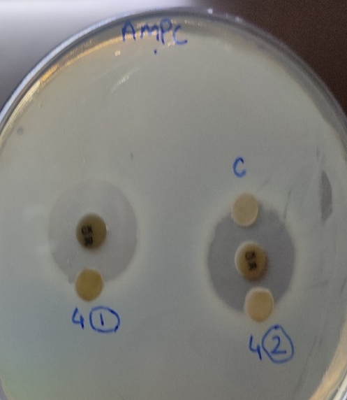
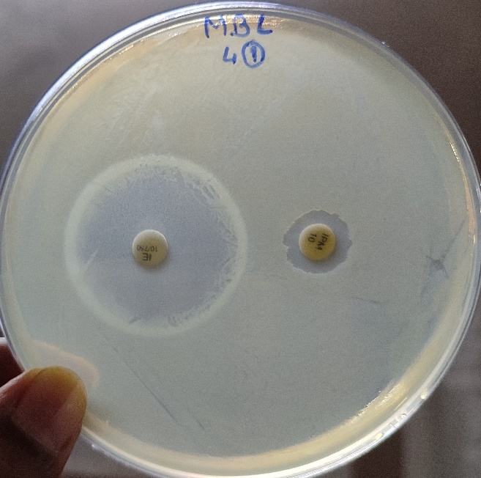
Phenotypic detection of beta-lactamase by double disc diffusion method
Test for ESBL by Double-disk Synergy test
Carbapenemase test by Hodge test/ Clover leaf test
AmpC disc test
MBL detection by Imipenem
and EDTA

Slide 6
Types of beta-lactamase produced by isolates
 | Isolate | Name of isolates | Screening assay | Beta-lactamase detection by phenotypic method
 |  |  | Iodometric method | ESBL | AmpC | Carbapenemase | MBL
Sample 1 | AB13 | Brucella intermedia | + | - | + | - | -
 | AB14 | Not identified | + | - | + | - | -
 | AB15 | Not identified | - | + | - | - | -
Sample 2 | AB21 | Brucella intermedia | + | + | + | - | -
 | AB23 | Pseudomonas lalkuanensis | - | - | - | NA | +
 | AB24 | Not identified | - | - | - | + | +
 | AB27 | Brucella intermedia | - | NA | - | - | +
 | AB28 | Brucella intermedia | + | - | - | - | +
Sample 3 | AB31 | Brucella intermedia | - | - | + | - | +
 | AB33 | Stenotrophomonas acidaminiphila | + | + | - | - | +
 | AB34 | Brucella cytisi | + | - | + | - | NA
 | AB35 | Brucella vulpis | + | NA | + | NA | +
Sample 4 | AB41 | Stenotrophomonas acidaminiphila | + | - | - | - | +
 | AB42 | Pseudomonas guariconensis | - | - | - | - | -
 | AB43 | Not identified | + | - | - | - | +
 | AB44 | Not identified | + | - | NA | - | +
Isolates are beta-lactamase producers, some of them are positive for multiple types of beta-lactamase production

Slide 7
Antibiotics susceptibility testing results of 16 isolates
Isolates shows resistance to multiple antibiotics, all of them resistant to beta-lactam class of antibiotics and some of them are resistant to colistin which is last lost resort of antibiotics

Slide 8
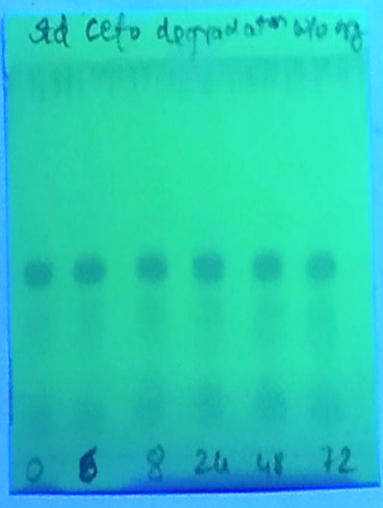
TLC detection of Cefotaxime degradation
Results: No degradation of cefotaxime observed in control w/o organism (A)
whereas shift in band shows degradation of cefotaxime after 24hrs of incubation in presence of beta-lactamase producing organisms (B & C).
A
B
C
Spectrophotometric detection of Cefotaxime degradation
Results: Decrease in peak intensity at 260 nm shows degradation of cefotaxime

Slide 9
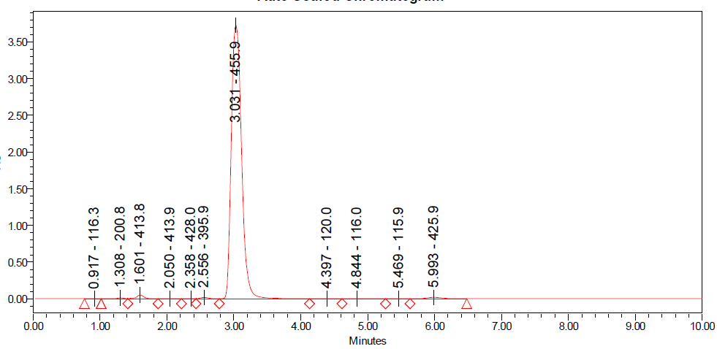
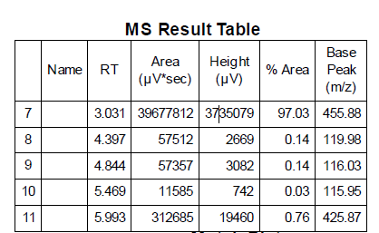
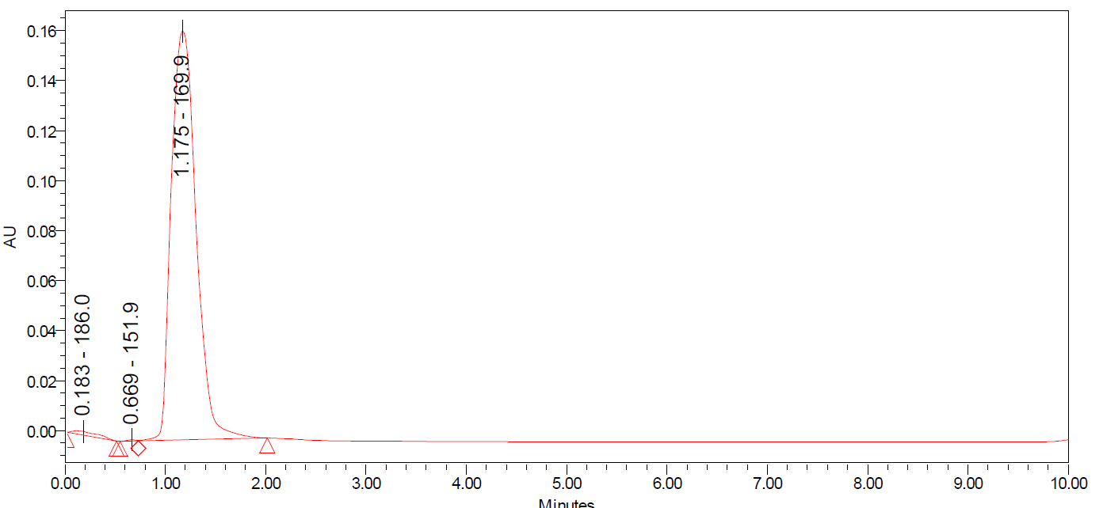
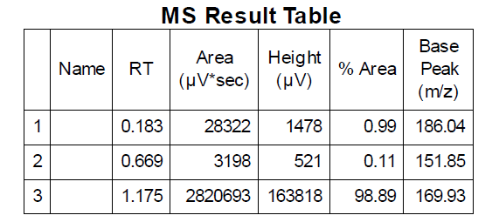
LCMS of Cefotaxime
A. Standard cefotaxime without any treatment
B. Cefotaxime after 48 hours in presence of beta-lactamase producing isolate

Slide 10
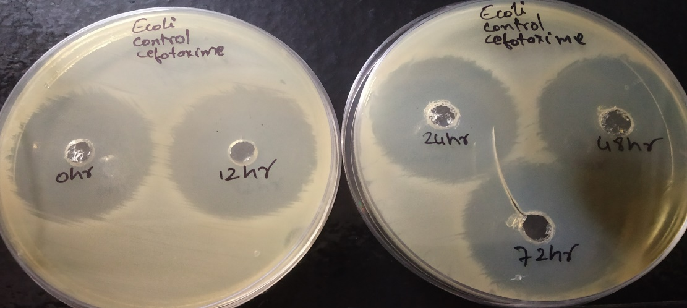
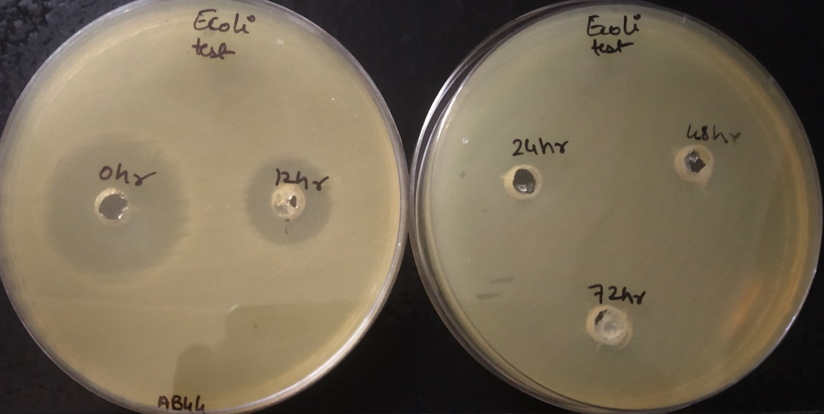
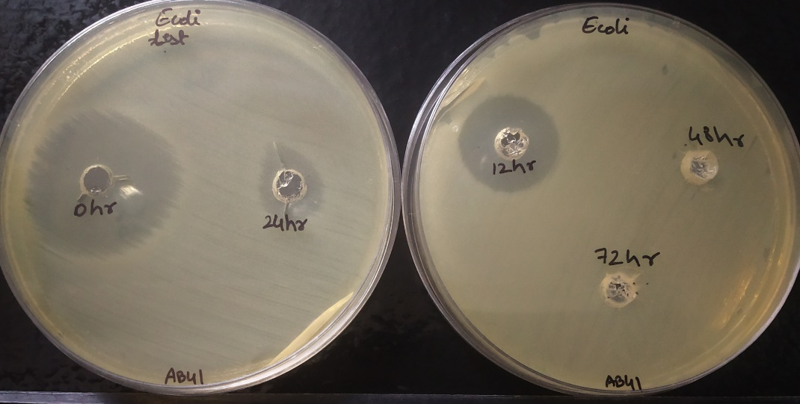
Loss of antimicrobial activity of cefotaxime after degradation
Control cefotaxime w/o test organism
Cefotaxime with test organism losses its antimicrobial activity indicates hydrolysis of beta-lactam ring
Conclusion: Beta-lactamase producing organisms are potent to degrade and inactivate the beta-lactam antibiotics. Hence, are useful in decreasing the load of antimicrobial load in the environment as well as lowering the development of resistance to antibiotics.

Slide 11
Key References
Willyard, Cassandra. "Drug-resistant bacteria ranked." Nature 543, no. 7643 (2017): 15.
Sykes, R. B., and K. Nordström. "Microiodometric determination of β-lactamase activity." Antimicrobial agents and chemotherapy 1, no. 2 (1972): 94-99.
Doern, G. V., and T. A. Tubert. "Detection of beta-lactamase activity among clinical isolates of Branhamella catarrhalis with six different beta-lactamase assays." Journal of clinical microbiology 25, no. 8 (1987): 1380-1383.
Page, Michael I., and Adriana Badarau. "The mechanisms of catalysis by metallo β-lactamases." Bioinorganic chemistry and applications 2008 (2008).
Mogasale, Vijayalaxmi V., Prakash Saldanha, Vidya Pai, P. D. Rekha, and Vittal Mogasale. "A descriptive analysis of antimicrobial resistance patterns of WHO priority pathogens isolated in children from a tertiary care hospital in India." Scientific reports 11, no. 1 (2021): 5116.
Drieux, L., F. Brossier, W. Sougakoff, and V. Jarlier. "Phenotypic detection of extended‐spectrum β‐lactamase production in Enterobacteriaceae: review and bench guide." Clinical Microbiology and Infection 14 (2008): 90-103.
Hancu, Gabriel, Brigitta Simon, Hajnal Kelemen, Aura Rusu, Eleonora Mircia, and Árpád Gyéresi. "Thin layer chromatographic analysis of Beta-lactam antibiotics." Advanced pharmaceutical bulletin 3, no. 2 (2013): 367.
Kumar, Vundavilli Jagadeesh, Peruri Badarinadh Gupta, K. S. R. P. Kumar, K. V. V. P. Rao, S. John Prasanna, G. S. Kumar, Hemant Kumar Sharma, and K. Mukkanti. "Identification and characterization of new impurity in cefotaxime sodium drug substance." Der Pharma Chemica 2 (2010): 230-241.

