Slide 1
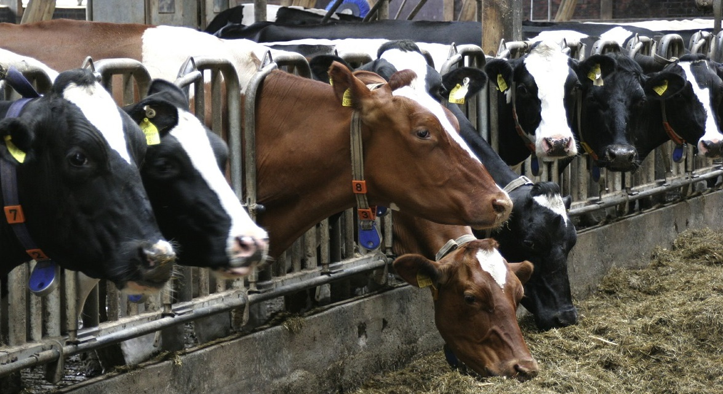
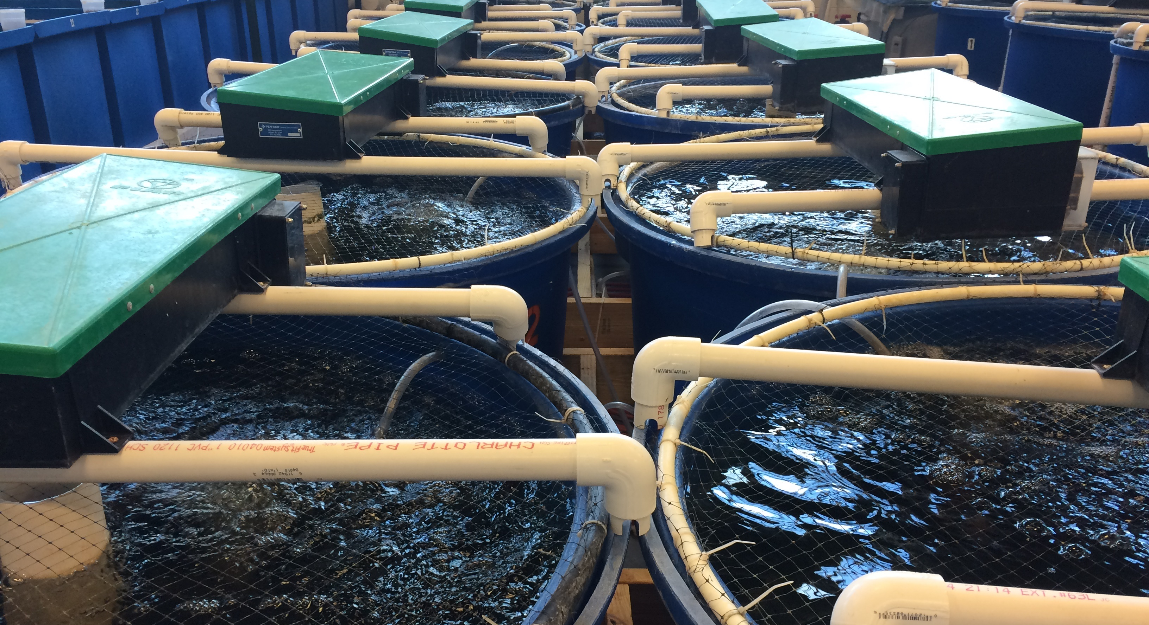

O
H
F
Cl
S
H
N
Cl
O
O
O
Antibiotic Florfenicol
Enzymatic Inactivation of Antibiotics to Combat Antimicrobial Resistances
Marik M. Müller, Katja M. Arndt
Molecular Biotechnology
University of Potsdam, Germany
University of Potsdam

Slide 2
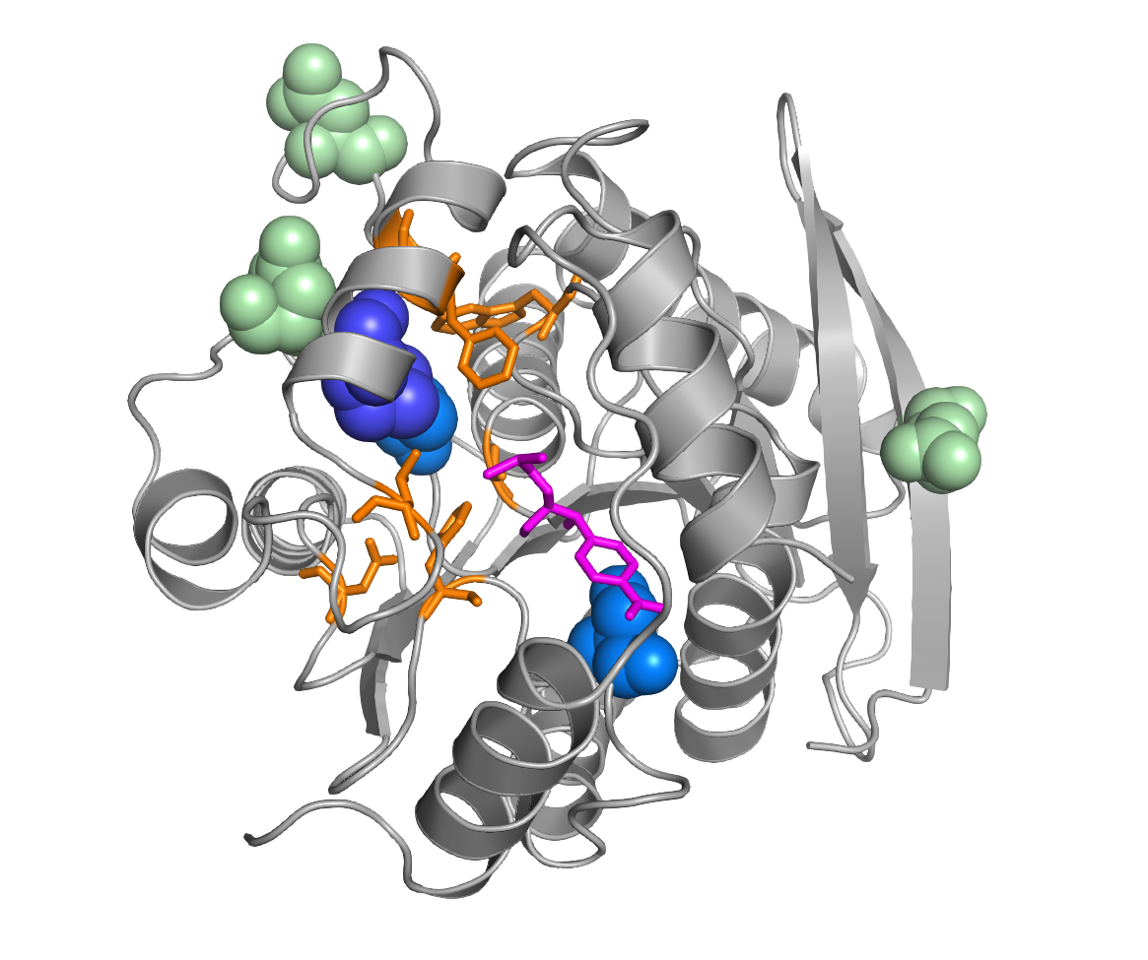
Optimisation of the Hydrolase for Florfenicol Cleavage
Problem: Wild type hydrolase shows only insufficient florfenicol cleavage
Solution: Optimization of the enzyme by error-prone PCR, selection in florfenicol containing media, sequencing of enriched mutants
Location of mutation in the hydolase
Asn226Asp
Asn189Ile
Asn51Asp
Met211Leu
Overview of the obtained mutations
Val186Ala
Amino acid position | Location in the protein | Wild-type hydrolase | Selected mutants
 |  |  | 33P5 | 36P4 (2x) | 36P5 (2x)
51 | Surface | Asn (AAT) |  |  | Asp (GAT)
186 | Near active centre | Val (GTA) | Ala (GCA) | Ala (GCA) | Ala (GCA)
189 | Surface | Asn (AAT) |  | Ile (ATT)
211 | Near active centre | Met (ATG) | Leu (TTG) |  | Leu (TTG)
226 | Surface | Asn (AAT) |  |  | Asp (GAT)
286 | Near active centre | Ser (AGC) |  | Gly (GGC)
Pink = Substrate (Cm)
Orange = active
centre, substrate binding
Ser286Gly
(PDB: 6IEY)
Growth assay of selected mutants
Identical clones were found multiple times
Mutations more frequent in the active center
Selected hydrolase mutants grow faster than the wild-type hydrolase

Slide 3
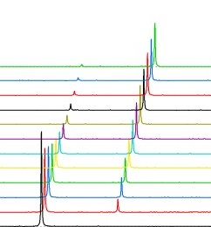
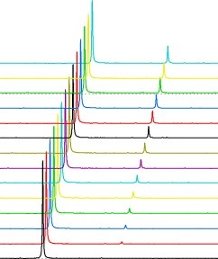
Analysis of Florfenicol Cleavage by NMR Spectroscopy
Expression and purification of wild-type and optimized mutant hydrolase 36P5
Mixing of hydrolase (0.25 µM) with florfenicol (0.66 mM), measurement of ¹H-NMR spectra every 4 min
Blue = Florfenicol
Red = Cleavage products
(Numbers indicate assignment of NMR signals to protons)
O
H
F
O
H
F
2
1
2
1
Cl
Hydrolase
4
Cl
4
+ H
O
2
N
H
2
H
O
3
S
2
H
N
3
Cl
2
S
1
Cl
O
O
1
O
O
O
O
Florfenicol
Florfenicolamine
+
Dichloroacetic acid
Spectra before and after cleavage
Analysis of reaction rate
4
[1e6]
Mutant hydrolase
Wild-type hydrolase
1.5
3
3
3
3
1.0
1
1
3
1
2
0.5
3
0.0
0
0
8
6
4
2
Chemical shift [ppm]
6.2
6.0
5.8
[ppm]
6.2
6.0
5.8
[ppm]
Florfenicol and cleavage products show different NMR signals
Optimized mutant cleaves florfenicol significantly faster

Slide 4
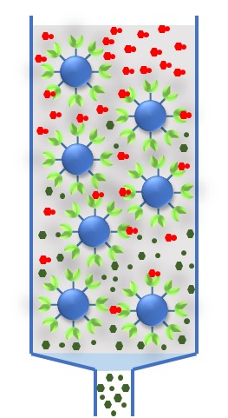
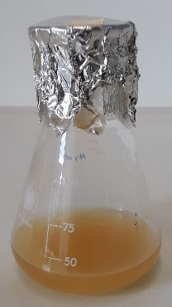
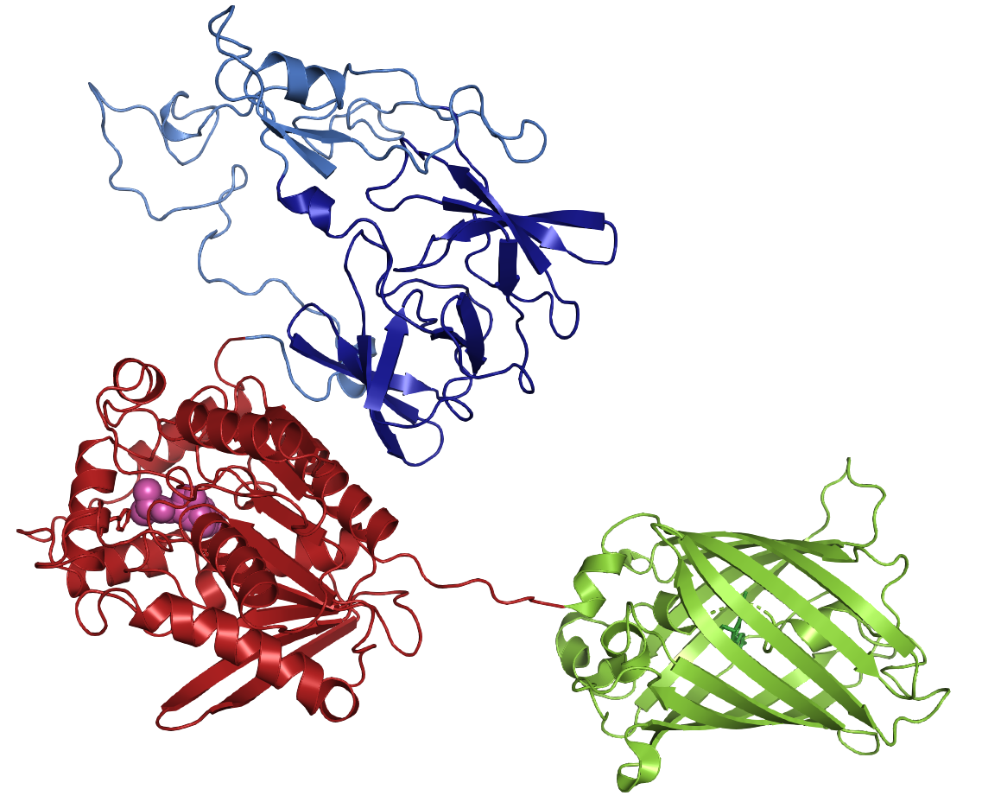



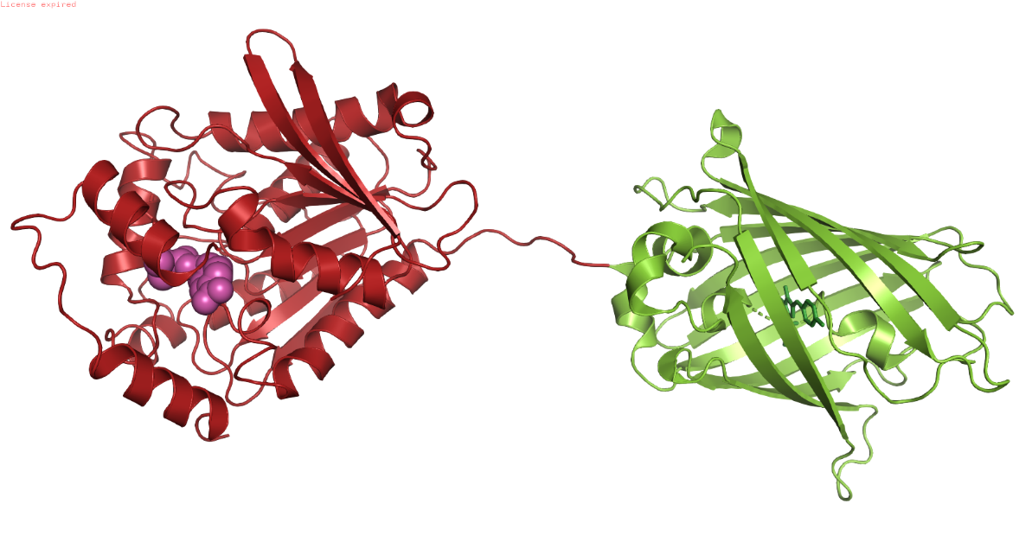



Immobilization of the Hydrolase Enzyme
Cloning and expression of optimized hydrolase fused to immobilization tag (His₆- and Silica_{L2}) and green fluorescence protein (GFP)
Immobilization of hydrolase to Ni-NTA, silica, and sand
Immobilization
Expression
active Florfenicol
Florfenicol-Inactivation
Hydrolase
Matrix with immobilized hydrolase
LacI
GFP
tag
Amp^{R}
lac
Transformation
in E. coli
Immobilization
Plasmid pAR2000_His-Hydrolase-GFP
Visualisation
Florfenicol cleavage product
C
Fusion protein with His-tag
Microscopy of the immobilized hydrolase
Fusion protein with Silica-tag
Hydrolase (PDB: 6IEY)
Ni-NTA
Silica
Sand
Silica_{L2}-tag (PDB: 5J8A)
200 µm
Bright field
GFP (PDB: 2Y0G)
column matrix
with Ni-NTA (nitrilotriacetic acid)
His₆-tag
Fluorescence
GFP (green fluorescent protein); PDB: 2Y0G
overlay
Hydrolase (PDB: 6IEY)
Successful immobilization of hydrolase; different immobilization strategies are possible

Slide 5
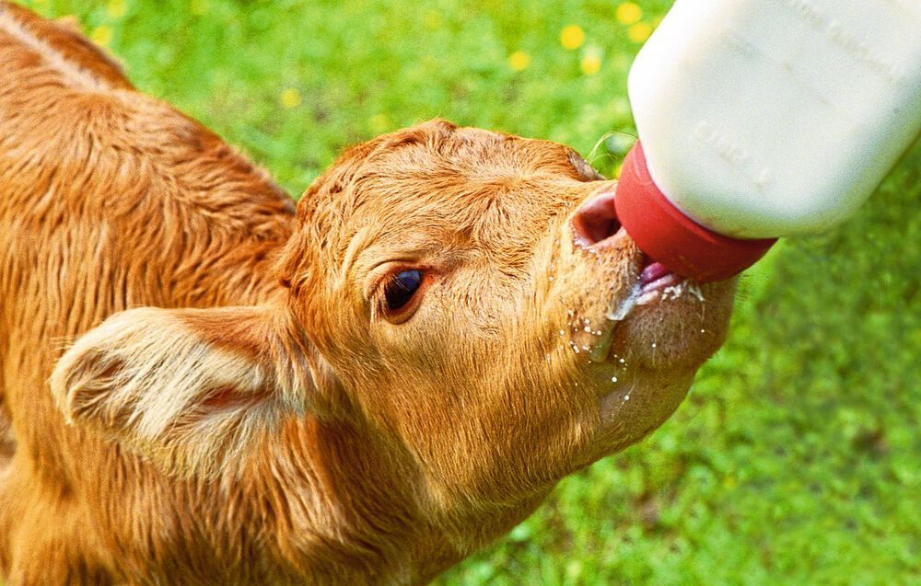
Products for Florfenicol Inactivation
Incubation of florfenicol-containing media with immobilized hydrolase
Bacterial growth assay to detect remaining florfenicol
Problem: Antibiotic treatment of dairy cattle leads to waste milk
Solution: Use of hydrolase for florfenicol inactivation in milk
(public domain, indigoblues38 / Pixabay)
Different materials, repeated use
Application: Florfenicol inactivation in milk
after treatment
before treatment
Immobilized hydrolase can successfully inactivate florfenicol, is stable and can be used repeatedly
New procedure for florfenicol inactivation in milk
Safe use of waste milk after decontamination

Slide 6

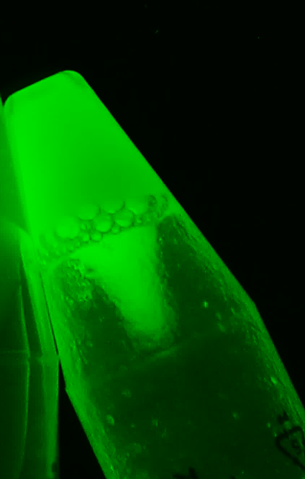
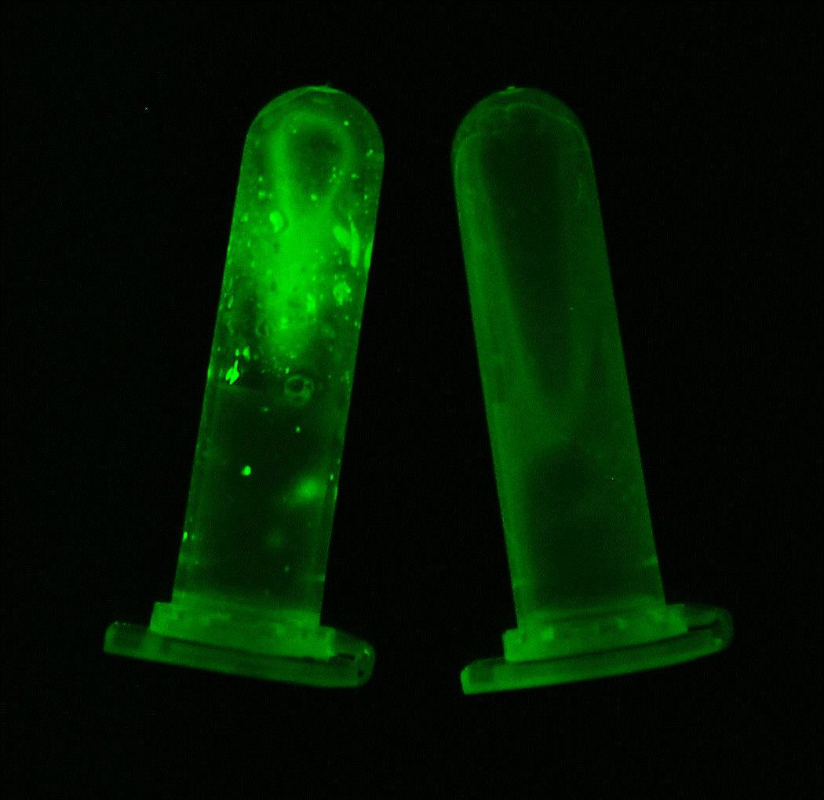
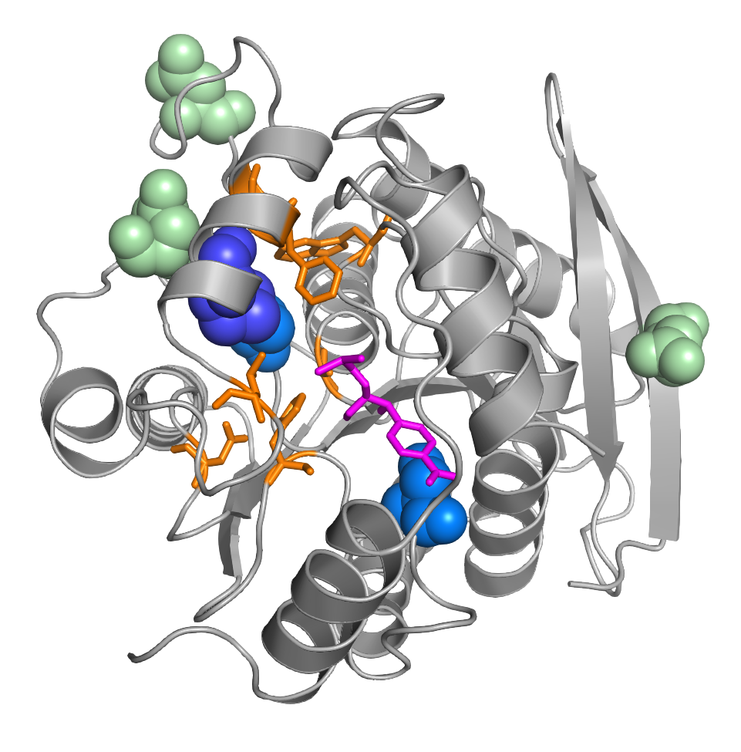


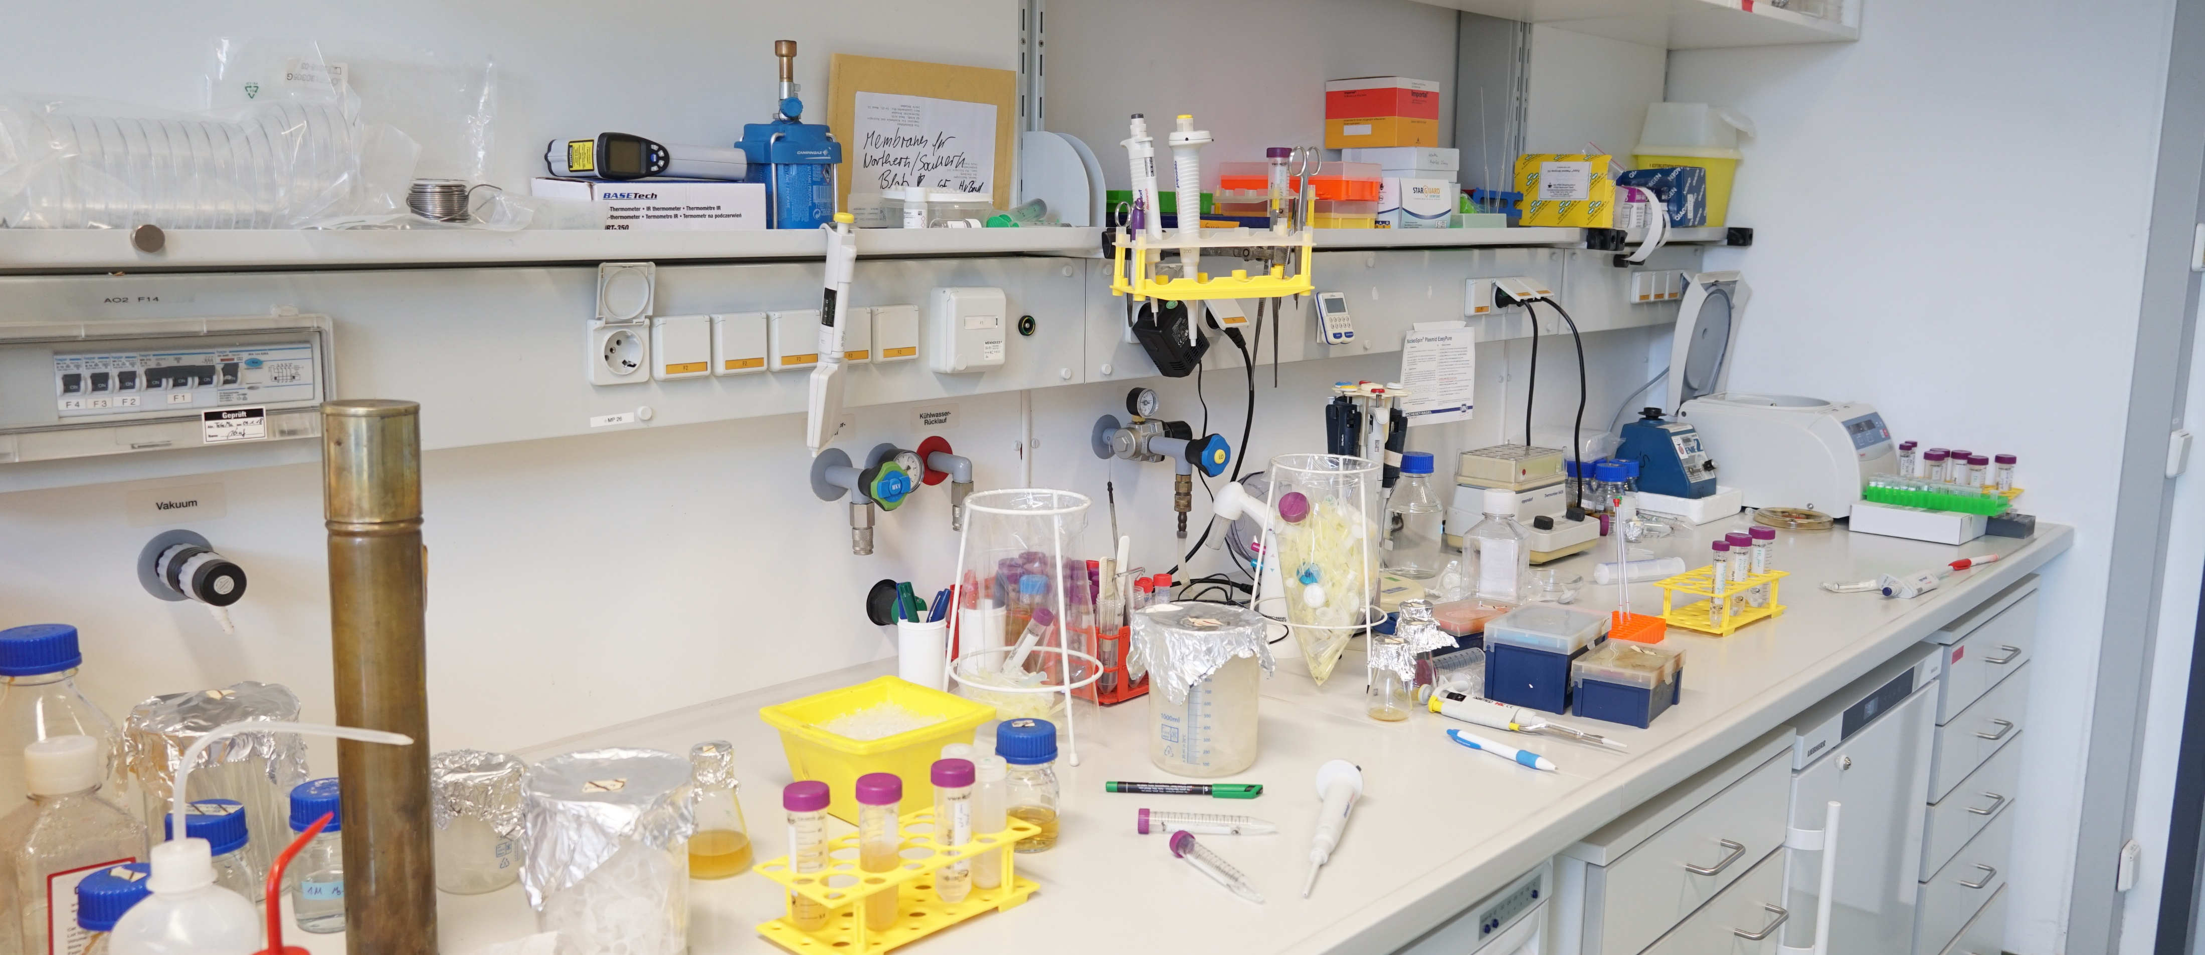



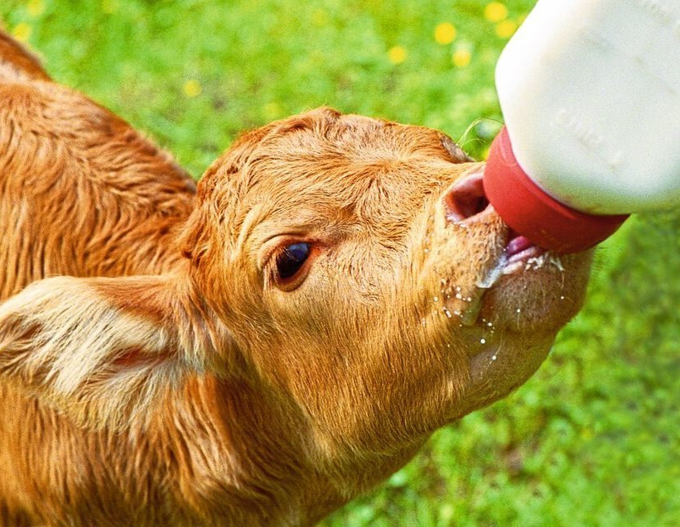
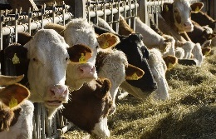



Enzymatic Inactivation of Antibiotics to Combat Antimicrobial Resistances
Marik M. Müller, Katja M. Arndt – Molecular Biotechnology, University of Potsdam, Germany
PROBLEM
Florfenicol
in aqua culture
OPTIMISATION
Mutating hydrolase
enzyme to efficiently
inactivate florfenicol
APPLICATION 1
New material for
florfenicol inactivation
after treatment
Asn226Asp
MOTIVATION
Development of
products to inactivate
the antibiotic florfenicol
Asn189Ile
Asn51Asp
PRODUCT
Matrix with
immobilized hydrolase
before treatment
Met211Leu
Val186Ala
(Bild: gemeinfrei, Narek75 / Wikimedia commons)
can promote antibiotic resistances
Pink = Substrate
Orange = active
center, Substrate binding
Ser286Gly
(PDB: 6IEY)
Material is reusable
active antibiotic florfenicol
PROBLEM
Florfenicol
in animal farming
CONTROL
Microscopy of
immobilized hydrolase
Matrix with immobilized hydrolase
APPLICATION 2
Florfenicol in milk
can be inactivated
Ni-NTA
Silica
Sand
inactive florfenicol cleavage products
Bright
field
after treatment
200 µm
Fluores-cence
before treatment
(Bild: gemeinfrei, franzl34 / Pixabay)
(public domain, indigoblues38 / Pixabay)
can promote antibiotic resistances
Decontamination of
waste milk
overlay
Notes:
https://upload.wikimedia.org/wikipedia/commons/9/95/Recirculating_Aquaculture_System_7.jpg
https://pixabay.com/de/photos/k%C3%BChe-futter-fressen-bauernhof-552946/

