Slide 1
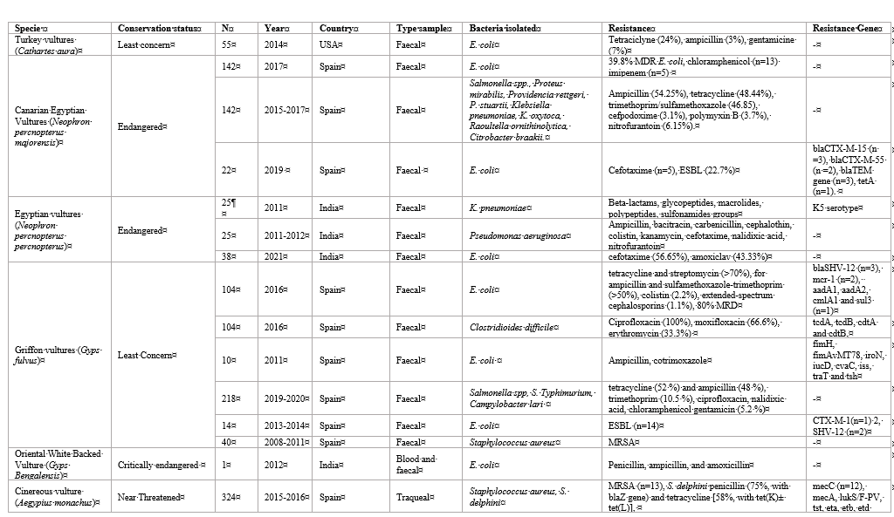
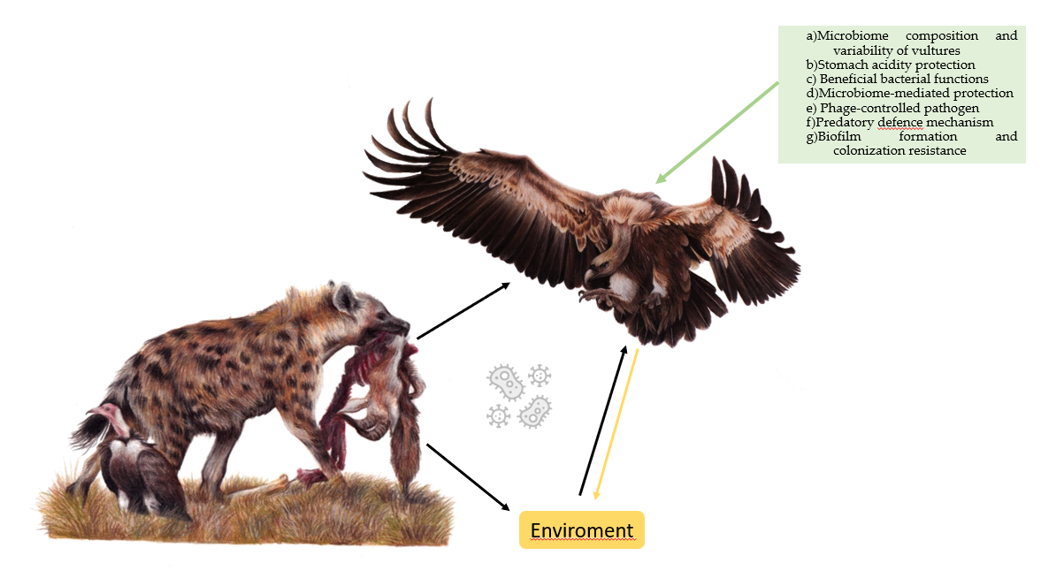
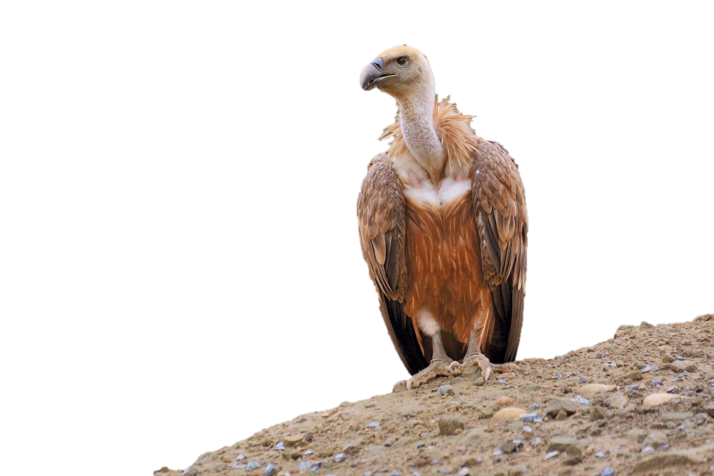
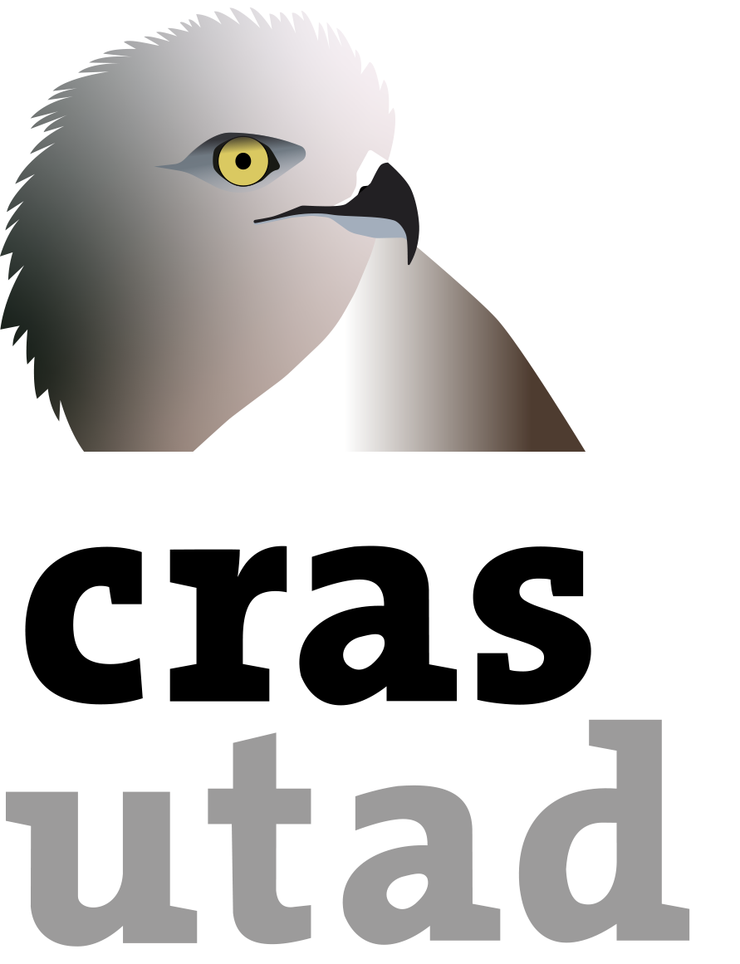
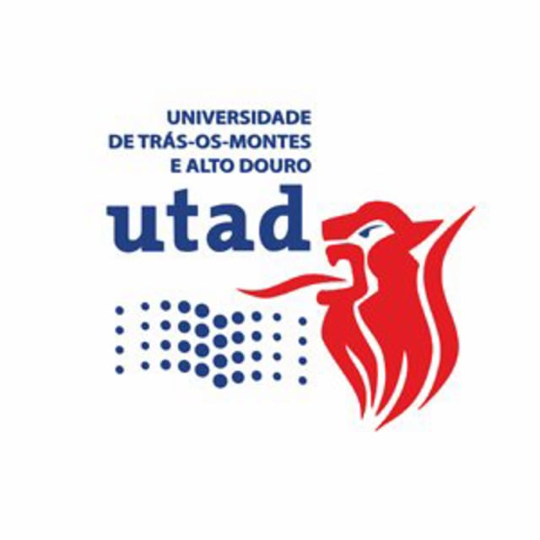
Antibiotic-Resistant in Scavenger birds: a One Health Problem
Andreia Garcês^{1,2,*}
¹Wildlife Rehabilitation Center (CRAS) University of Trás-os-Montes e Alto Douro, Vila Real, Portugal; ²Centre for the Research and Technology of Agro-Environmental and Biological Sciences (CITAB), University of Trás-os-Montes e Alto Douro, Vila Real, Portugal
Introduction
Vultures are composed of two great groups the New World vultures (Cathartidae) and Old-World vultures (Accipitridae). Vulture populations are in decline worldwide. Collisions with wind-energy turbines, electrocution, poisoning, and ingestion of lead from carcasses or gunshots are some of the causes associated to this decline. According to the IUCN Red List species such as Sarcogyps calvus, Gyps africanus, Trigonoceps occipitalis or Gyps rueppelli are Critically Endangered. On the other hand, through the conservation efforts of many ONG and governmental entities, populations of Coragyps atratus and Gymnogyps californianus have been increasing in recent years.
Vultures have a fundamental role in the ecosystem. They are known as “nature’s cleanup crew” because they feed on animal carcasses that have died from old age, malnutrition, accidents, predation, or diseases. These carcasses left in the environment could have become an important health risk for animals and humans. Vultures help to remove the organic material from the environment, and therefore help to reduce the spread of pathogenic microorganisms in the ecosystem. However, despite the serious health effects of consuming these carcasses, vultures have developed important adaptations to deal with these agents.
If the vultures disappeared, the uneaten carcasses would remain in the environment for longer periods, and facultative scavenger species such as dogs and rats would take advantage of this food source. These opportunistic species, some considered pests, would increase in abundance and associated zoonotic diseases (e.g., Leptospira, rabies, plague). Furthermore, the longer the carcass remains in the environment, the greater the likelihood of contact with humans and spread of pathogens. The conversion of wild territories to agriculture has been associated with shifts in food resources available to avian scavengers. Some populations have increased dependence on domestic animal carrion and farm waste. Regular consumption of livestock remains can expose scavenging birds to veterinary drug residues. Studies carried out in India and in other countries have shown the presence of diclofenac residues in vulture tissues associated with the consumption of carcasses contaminated with this drug. Consumption of this compound led to the death of several vultures.
The aim of this study is to compiled some of the most recent studies on antibiotic resistance reported on vulture species.
Results
Overall, we analysed a total of 20 works, between the years 2011 to 2021. The studies were performed on Cathartes aura (n=1), Gyps Bengalensis (n=1) Neophron percnopterus majorensis (n=3), Neophron percnopterus percnopterus (n=3), Gyps fulvus (n=5), Aegypius monachus (n=4). Two studies were performed simultaneous forseveral species.
The predominant sample type was faecal material in almost all paper, except one.
The countries with the highest number of studiesin descending order as follows: Spain (n=11), India (n=3), the USA, Germany, Mongolia, and Portugal (n=1).
Since most studies were performed on faecal samples, the isolated bacteria were mostly microbiota faecal flora microbiota, with Escherichia coli one of most studied microorganisms (n=12). Extended Spectrum Beta-Lactamase was detected in 5 different studies. The main resistance present in E.coli were ampicillin, tetracycline and sulfamethoxazole-trimethoprim.
Conclusions
Antimicrobial resistance is a “One Health” issue. The problem of multidrug-resistant bacteria is associated with human and veterinary medicine. Consequently, the detection of multidrug resistant bacteria important, due to the continuous interaction between domestic animals, humans, ecosystem and wild animals.
Regarding antimicrobial resistance, vultures can be important as sentinels, reservoirs, spreaders, and sources of infection for humans, other animals, and the ecosystem. Although vultures play an important role in the ecosystem as cleaners for the environment and therefore limiting the spread of pathogenic microorganisms, they can acquire AMR bacteria and spread them. Furthermore, they can act as an asymptomatic reservoir for zoonotic bacteria (e.g., Salmonella) and other agents. These microorganisms can represent a potential threat to the conservation of vulture populations, since they can produce disease in individuals. More survey studies on AMR and pathogens are needed in these populations, some of them so threatened.
Table 1. Studies describing the presence of AMR in different vultures regarding the specie, conservation status, number, year, country, agent isolated, resistances and genes.
References
1. Zepeda Mendoza ML, Roggenbuck M, Manzano Vargas K, Hansen LH, Brunak S, Gilbert MTP, et al. Protective role of the vulture facial skin and gut microbiomes aid adaptation to scavenging. Acta Veterinaria Scandinavica. 2018 Oct 11;60(1):61.
2. Angelov I, Hashim I, Oppel S. Persistent electrocution mortality of Egyptian Vultures Neophron percnopterus over 28 years in East Africa. Bird Conservation International. 2013 Mar;23(1):1–6.
3. Blanco G, Junza A, Segarra D, Barbosa J, Barrón D. Wildlife contamination with fluoroquinolones from livestock: Widespread occurrence of enrofloxacin and marbofloxacin in vultures. Chemosphere. 2016 Feb 1;144:1536–43.
4. International) BI (BirdLife. IUCN Red List of Threatened Species: Sarcogyps calvus. IUCN Red List of Threatened Species [Internet]. 2021 Jul 15 [cited 2023 Jan 31]; Available from: https://www.iucnredlist.org/en
5. International) BI (BirdLife. IUCN Red List of Threatened Species: Gyps africanus. IUCN Red List of Threatened Species [Internet]. 2021 Jul 6 [cited 2023 Jan 31]; Available from: https://www.iucnredlist.org/en
6. International) BI (BirdLife. IUCN Red List of Threatened Species: Trigonoceps occipitalis. IUCN Red List of Threatened Species [Internet]. 2021 Jul 22 [cited 2023 Jan 31]; Available from: https://www.iucnredlist.org/en
7. International) BI (BirdLife. IUCN Red List of Threatened Species: Gyps rueppelli. IUCN Red List of Threatened Species [Internet]. 2021 Jul 9 [cited 2023 Jan 31]; Available from: https://www.iucnredlist.org/en
8. International) BI (BirdLife. IUCN Red List of Threatened Species: Coragyps atratus. IUCN Red List of Threatened Species [Internet]. 2016 Oct 1 [cited 2023 Jan 31]; Available from: https://www.iucnredlist.org/en
9. International) BI (BirdLife. IUCN Red List of Threatened Species: Gymnogyps californianus. IUCN Red List of Threatened Species [Internet]. 2020 Aug 28 [cited 2023 Jan 31]; Available from: https://www.iucnredlist.org/en
10. Plaza P. Vultures and condors may help to prevent the spread of infectious diseases [Internet]. British Ornithologists’ Union. 2020 [cited 2022 Nov 29]. Available from: https://bou.org.uk/blog-plaza-vultures-and-condors-infectious-diseases/
11. Plaza PI, Martínez-López E, Lambertucci SA. The perfect threat: Pesticides and vultures. Science of The Total Environment. 2019 Oct;687:1207–18.
12. Sulzner K, Kelly T, Smith W, Johnson CK. Enteric pathogens and antimicrobial resistance in turkey vultures (Cathartes aura) feeding at the wildlife–livestock interface. zamd. 2014 Dec;45(4):931–4.
13. Swan GE, Cuthbert R, Quevedo M, Green RE, Pain DJ, Bartels P, et al. Toxicity of diclofenac to Gyps vultures. Biology Letters. 2006 Jun 6;2(2):279.
14. Becker R. Cattle drug threatens thousands of vultures [Internet]. Nature. Nature Publishing Group; 2016 [cited 2023 Feb 1]. Available from: https://www.nature.com/articles/nature.2016.19839
15. Wiemeyer GM, Plaza PI, Bustos CP, Muñoz AJ, Lambertucci SA. Exposure to Anthropogenic Areas May Influence Colonization by Zoonotic Microorganisms in Scavenging Birds. International Journal of Environmental Research and Public Health. 2021 Jan;18(10):5231.
16. McCoy KA, Peralta AL. Pesticides Could Alter Amphibian Skin Microbiomes and the Effects of Batrachochytrium dendrobatidis. Frontiers in Microbiology [Internet]. 2018 [cited 2022 Sep 27];9. Available from: https://www.frontiersin.org/articles/10.3389/fmicb.2018.00748
17. Blanco G, Bautista LM. Avian Scavengers as Bioindicators of Antibiotic Resistance Due to Livestock Farming Intensification. International Journal of Environmental Research and Public Health. 2020 Jan;17(10):3620.
18. Bonnedahl J, Järhult JD. Antibiotic resistance in wild birds. Upsala Journal of Medical Sciences. 2014 May;119(2):113–6.
19. Cláudio VC, Gonzalez I, Barbosa G, Rocha V, Moratelli R, Rassy F. Bacteria richness and antibiotic-resistance in bats from a protected area in the Atlantic Forest of Southeastern Brazil. Cloeckaert A, editor. PLoS ONE. 2018 Sep 14;13(9):e0203411.
20. Suárez-Pérez A, Corbera JA, González-Martín M, Tejedor-Junco MT. Multidrug-Resistant Phenotypes of Escherichia coli Isolates in Wild Canarian Egyptian Vultures (Neophron percnopterus majorensis). Animals. 2021 Jun;11(6):1692.
21. Ramey AM, Ahlstrom CA. Antibiotic resistant bacteria in wildlife: perspectives on trends, acquisition and dissemination, data gaps, and future directions. Journal of Wildlife Diseases. 2019 Sep 30;56(1):1–15.
22. Ruiz-Suárez N, Boada LD, Henríquez-Hernández LA, González-Moreo F, Suárez-Pérez A, Camacho M, et al. Continued implication of the banned pesticides carbofuran and aldicarb in the poisoning of domestic and wild animals of the Canary Islands (Spain). Science of The Total Environment. 2015 Feb;505:1093–9.
23. Jobbins SE, Alexander KA. From whence they came--antibiotic-resistant escherichia coli in african wildlife. J Wildl Dis. 2015 Oct;51(4):811–20.
24. Suárez-Pérez A, Corbera JA, González-Martín M, Donázar JA, Rosales RS, Morales M, et al. Microorganisms Resistant to Antimicrobials in Wild Canarian Egyptian Vultures (Neophron percnopterus majorensis). Animals. 2020 Jun;10(6):970.
25. Sharma SK, Sharma P, Shringi BN. Phenotypic and genotypic characterization of Klebsiella pneumoniae obtained from Egyptian vultures and steppes eagles from India. Israel Journal of Veterinary Medicine. 2014;69(3):123–9.
26. Sharma P, Tripathi S, Patel SK, Dhama K, Chandra R. SARS-CoV-2 / COVID-19 and its Transmission, Prevention, Treatment and Control - An Update. J Pure Appl Microbiol. 2020 May 30;14(suppl 1):945–56.
c

