Slide 1
Essential oil-loaded coaxial wet-spun fibers for potential wound therapies
Catarina S. Miranda¹, Elina Marinho¹, Susana P. G. Costa², Natália C. Homem³ and Helena P. Felgueiras^{1,}*
¹Centre for Textile Science and Technology (2C2T), University of Minho, Guimarães, Portugal;
²Centre of Chemistry (CQ), University of Minho, Braga, Portugal;
³ Simoldes Plastics S.A., Oliveira de Azeméis, Portugal.
* Corresponding author: helena.felgueiras@2c2t.uminho.pt

Slide 2
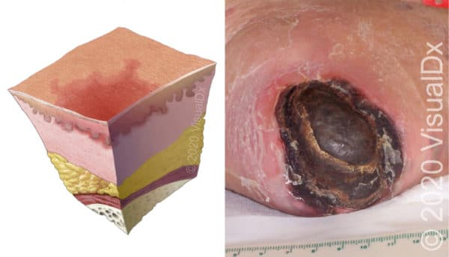
Essential oil-loaded coaxial wet-spun fibers for potential wound therapies
Motivation
Chronic wounds (CWs)
Inserir Imagem
Wounds that have failed to progress by an appropriate period of time of repair.
Increased resistance
to antibiotics
High
prevalence
Great impact on patients’ health and quality of life
It is estimated that 1% of the developed countries population will experience a CW during their lifetime, related with bacterial infections.
Järbrink, K. et al. (2016) Car Syst. Rev. 5, 1–6

Slide 3
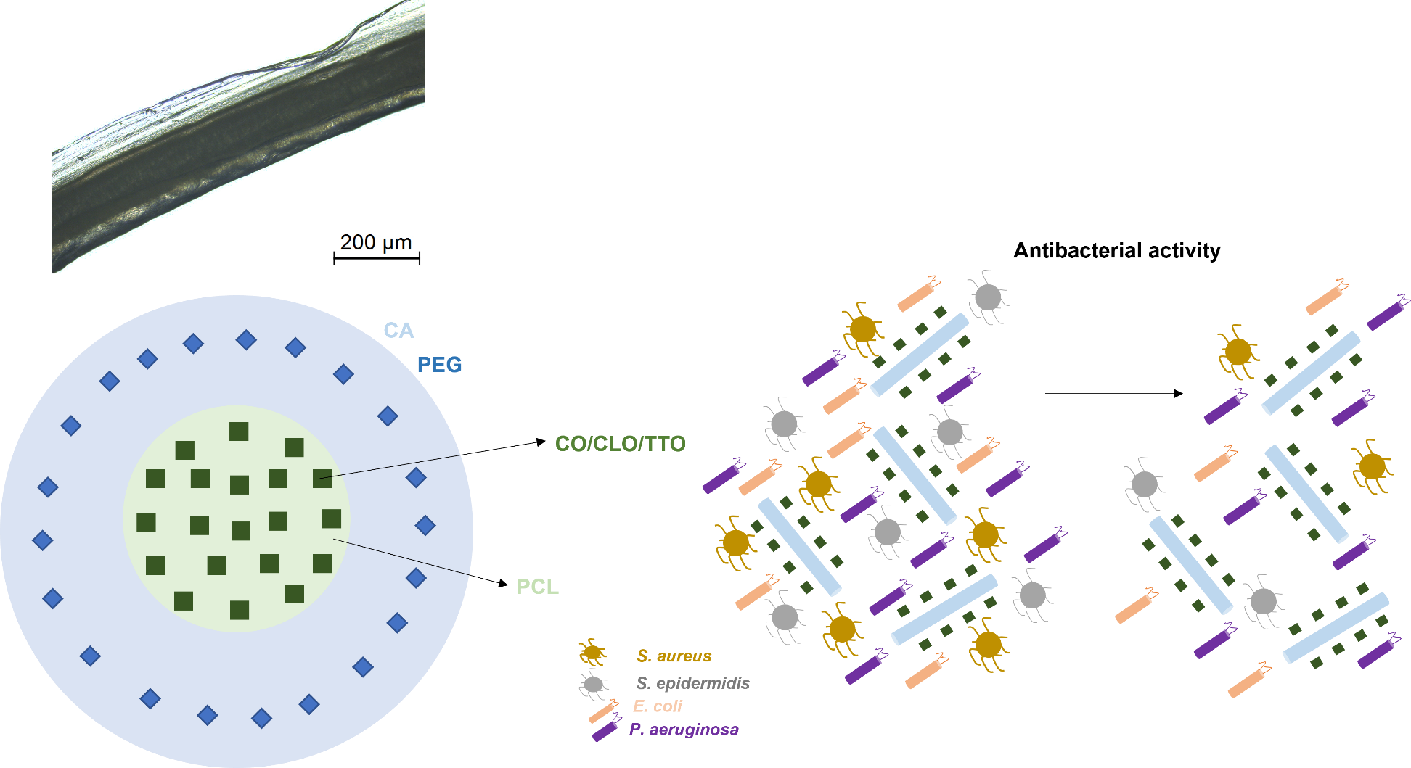
Essential oil-loaded coaxial wet-spun fibers for potential wound therapies

Slide 4
Wet-spinning
Technique based on a non-solvent-induced phase inversion process, in which a polymeric solution is extruded into a coagulation bath composed of a poor solvent or a non-solvent, giving rise to a continuous polymeric fiber, with a diameter of tens to hundreds of micrometers.
Miranda, C. et al. Pharmaceutics, 2022, 14. 164

Slide 5
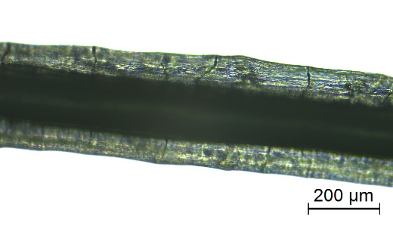
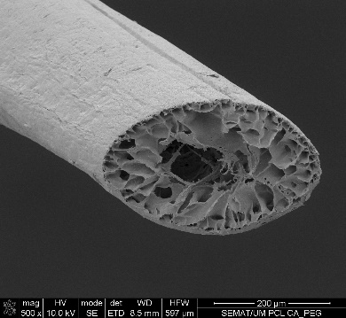
Essential oil-loaded coaxial wet-spun fibers for potential wound therapies
Coaxial fibers
Cellulose acetate
CA
Clove oil/Cinnamon leaf oil/
Tea Tree Oil
CO/CLO/TTO
Produced fibers:
CA hollow (core: coagulation bath; shell: CA);
CA-PEG hollow (core: coagulation bath; shell: CA combined
with PEG);
PCL (core: PCL; shell: coagulation bath);
PCL-CO/CLO/TTO (core: PCL combined with CO/CLO/TTO; shell: coagulation
bath);
PCL-CA (core: PCL; shell: CA);
PCL-CO/CLO/TTO-CA (core: PCL combined with CO/CLO/TTO; shell: CA);
PCL-CA-PEG (core: PCL; shell: CA combined with PEG);
PCL-CO/CLO/TTO-CA-PEG (core: PCL combined with CO/CLO/TTO; shell: CA combined with PEG).
Schematic Representation
Polycaprolactone
PCL
Polyethylene glycol
PEG
Microscopical Observations

Slide 6
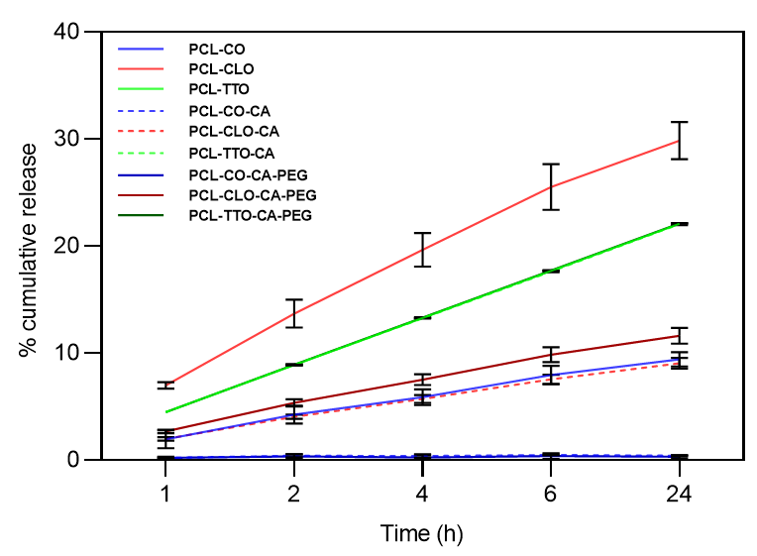
Essential oil-loaded coaxial wet-spun fibers for potential wound therapies
EOs Release Kinetics
The release kinetics of CO, CLO and TTO was mapped after 1, 2, 4, 6 and 24 h of incubation from all wet-spun fibers in PBS at 37 ºC and pH 7.4
Release rates from monolayer fibers were superior to the coaxial (the shell main function in the coaxial fibers was to work as a barrier, restricting the liberation of the EOs entrapped at the fibers’ core);
CLO-containing fibers experienced the highest release kinetics.

Slide 7
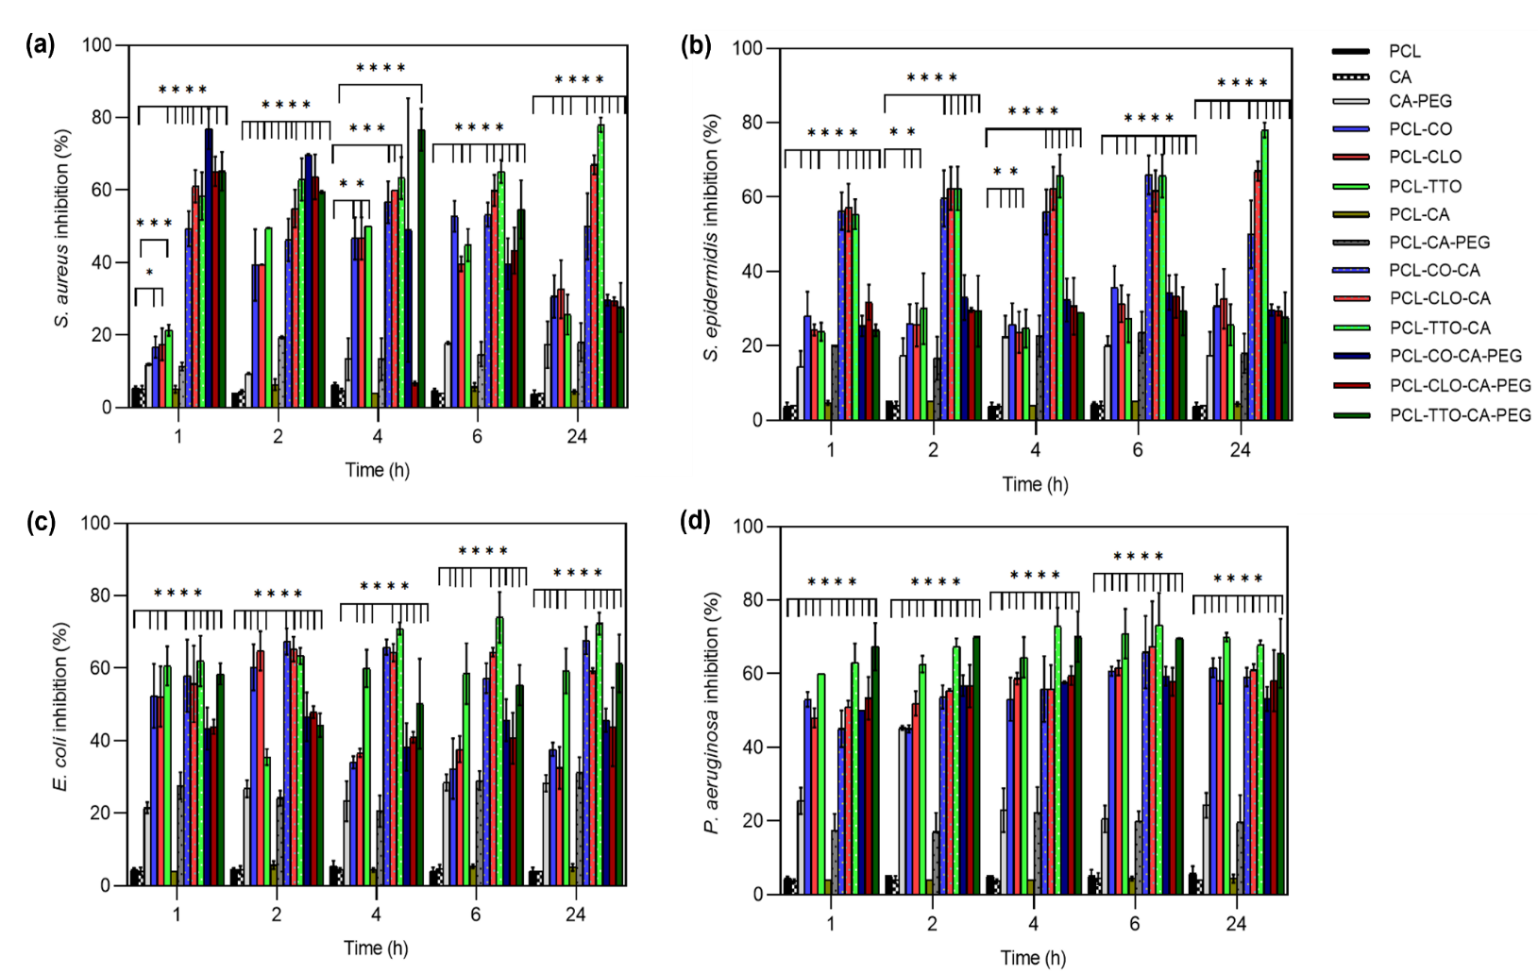
Essential oil-loaded coaxial wet-spun fibers for potential wound therapies
Bacteria Inhibition
The growth inhibition of Staphylococcus aureus, Staphylococcus epidermidis, Escherichia coli and Pseudomonas aeruginosa induced by EO-loaded and unloaded fibers was assessed after 1, 2, 4, 6 and 24 h of incubation in MHB at 37 ºC.
EOs-loaded fibers were the most antibacterial from the group.

Slide 8
Essential oil-loaded coaxial wet-spun fibers for potential wound therapies
Conclusions
The potential of the engineered coaxial fibers to serve as controlled release platforms for EOs was demonstrated.
The EOs antibacterial activities against S. aureus, S. epidermidis, E. coli and P. aeruginosa were also established.
Data confirmed the potential of this system to function as a multi-action delivery platform, suitable for prospective wound healing applications.

Slide 9
Essential oil-loaded coaxial wet-spun fibers for potential wound therapies
Acknowledgments

