Slide 1
Antimicrobial efficacy of Moringa oleifera leaf and seed extract against Candida species - An invitro study
Submission ID: sciforum-082678
Divya B *, Vasanthi V, Madhu Narayan, Dineja R, Rajkumar Krishnan

Slide 2
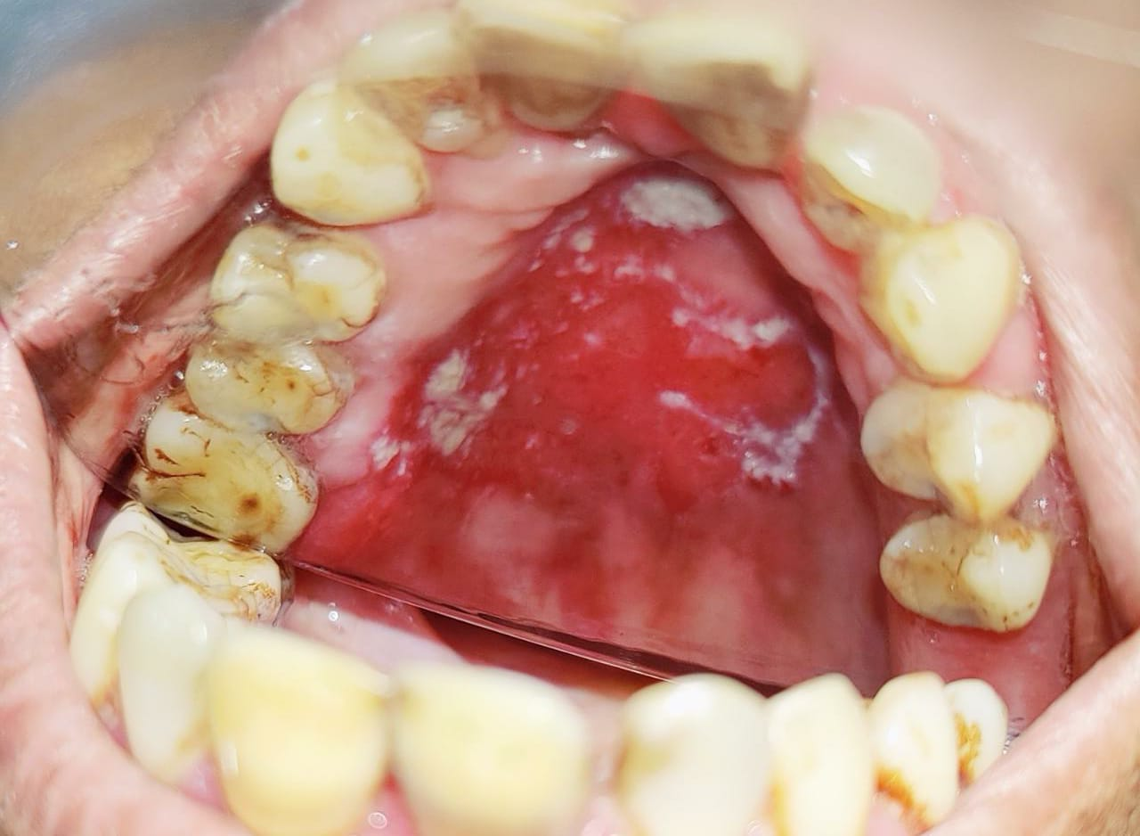
Need for new antifungals
15 to 71% of denture wearers
80 to 95% of HIV-infected individuals
CDC. Antibiotic resistance threats in the United States, 2019. Centers for Disease Control and Prevention www.cdc.gov/DrugResistance/Biggest-Threats.html (2019)
Candida infection is a significant concern for human health in vulnerable populations due to the emergence of new resistance mechanisms in the microorganisms.
World Health Organization . Antimicrobial resistance global report on surveillance. 2014.
Notes:
The increasing public health burden is now officially recognized with the listing of both of these pathogens on the urgent antimicrobial resistance (AMR) threat list published by the US CDC in 2019
Oral candidiasis (OC) is a fungal infection considered to be the most common oral mucosal infectious disease [1] and is mainly caused by Candida albicans. The detection rate of C. albicans in the general population is 20 to 75% [2,3,4,5]. It has also been reported that 15 to 71% of denture wearers [3, 6, 7] and 80 to 95% of HIV-infected individuals suffer from oral candidiasis [8,9,10]. The accepted treatment for oral candidiasis is the use of antifungal agents, such as nystatin, fluconazole, or miconazole. [11]. Because of adverse effects and side effects, such as the subsequent resistance of candida to antifungal agents, dysgeusia, and gastrointestinal discomfort, including nausea, vomiting and diarrhea, the clinical application of antifungal drugs can be limited [12]. Therefore, the exploration of new prophylaxis and therapeutic strategies for oral candidiasis is indicated.

Slide 3
Moringa oleifera
Native Indian tree
Antioxidant, anti-anti-hyperglycemic, anti-hyperlipidemic properties
Antibacterial activity against both Gram positive bacteria.
M. oleifera leaves contain β-carotene, vitamin E, and protein
M. oleifera seeds contain flavonoid, isothiocyanates, glucosinolate, and thiocarbamate
AIM
To compare the antimicrobial effectiveness of Moringa leaf and seed extracts against C.albicans and C. glabrata.

Slide 4
Materials and Methods
Culture of Candida
Antifungal activity
Well diffusion method
Isolation of Candida albicans and Candida glabrata
Preparation of aqueous and ethanolic extract of M.oleifera leaves and seeds

Slide 5
RESULTS – Efficacy against Candida albicans
S.No | Extract | Mean Zone of inhibition (mm) |  | P value
 |  | Aqueous (Aq) | Ethanolic (Et)
1 | M.oleifera seed | 13 | 22 | 0.0001
2 | M.oleifera leaf | 14 | 19 | 0.018
3 | Positive control (1% clotrimazole) | 29
4 | Negative control (saline) | 8 | -
1. Aq
1. Et
2. Aq
2. Et
3.
4.

Slide 6
RESULTS – Efficacy against Candida glabrata
S.No | Extract | Mean Zone of inhibition (mm) |  | P value
 |  | Aqueous (Aq) | Ethanolic (Et)
1 | M.oleifera seed | 14.3 | 21.3 | 0.004
2 | M.oleifera leaf | 13 | 20 | 0.001
3 | Positive control (1% clotrimazole) | 28
1. Aq
1. Et
2. Aq
2. Et
3.

Slide 7
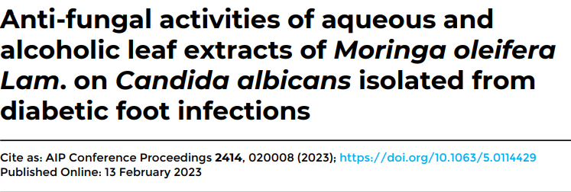
DISCUSSION
Ethanolic extract of Moringa oleifera leaf showed a higher inhibition zone than the aqueous extract
Moringa seed coat extract was more effective against Candida compared to the seed endosperm extract.

Slide 8
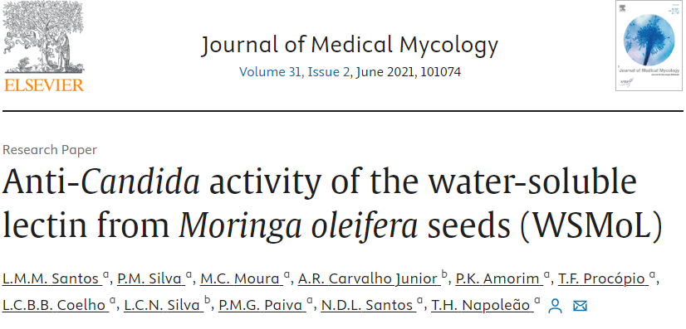
DISCUSSION
M.Oleifera seeds
Water-soluble lectins
1) Induce apoptosis
2) Alter mitochondrial membrane potential
Fungistatic & Fungicidal
Notes:
phosphate starvation response Probiotic lactobacilli such as L. rhamnosus GR-1 are able to suppress biofilm formation of C. albicans on abiotic surfaces [33]. This is presumably achieved by combining growth inhibition and repression of genes involved in biofilm formation (e.g., PHR1, ALS12

Slide 9
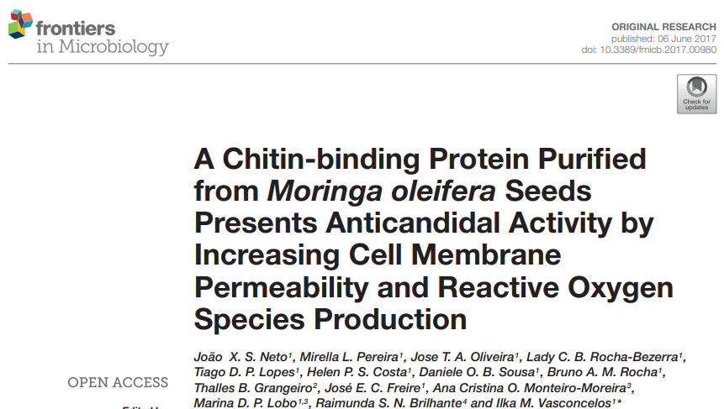
DISCUSSION
M.Oleifera seeds
Chitin binding protein
1) Increase cell membrane permeability
2) Increase ROS production
Anti-Candidal activity

Slide 10
FUTURE PERSPECTIVES
CONCLUSION
Ethanolic extract of M. oleifera seed showed the highest antifungal activity against C. albicans and C.glabrata.
Extracts can be analyzed further to identify active compounds
Different forms can be tried in vivo to determine the effective way of drug delivery system
Active compound, at its most effective dose, can be administered to patients with candidiasis

