Slide 1
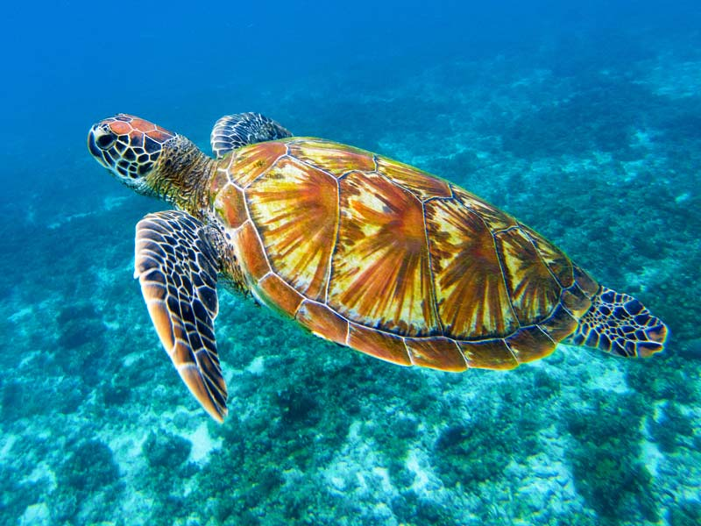
Antibiotic-Resistant in Sea Turtles
Andreia Garcês^{1,2,*}, Isabel Pires³
¹Wildlife Rehabilitation Center (CRAS) University of Trás-os-Montes e Alto Douro,
Vila Real, Portugal
²Centre for the Research and Technology of Agro-Environmental and Biological Sciences (CITAB), University of Trás-os-Montes e Alto Douro, Vila Real, Portugal
³ CECAV, University of Trás-os-Montes e Alto Douro, Vila Real, Portugal

Slide 2
INTRODUCTION
Antibiotic-resistant bacteria (AMR) are spreading in the environment at an alarming rate, becoming one of the most significant concerns in the XXI century. Currently, it is pretty common to find antibiotic-resistance genes in the environment and in animals that have never experienced antibiotic treatment. AMR is associated with the overuse and misuse of antibiotics in human and veterinary medicine, and their uncontrolled release into waste in many parts of the world. AMR may occur due to genetic mutations or horizontal transfer of resistance genes. Horizontal transfer can even occur between non-phylogenetically related bacteria.
Although in aquatic environments the bacterial concentrations are low in comparison to the soil, marine animals which are completely immersed in this environment can be bioindicators, reservoirs and spreaders of AMR. AMR can be an index of marine pollution, that can be used to detect antimicrobial pollution in marine environments. Sea turtles play a vital role in maintaining the health of marine ecosystems. These animals have been proposed as sentinel species to determine pollution levels in marine environments.
The present study aims to present antibiotic resistance and resistance genes in sea turtles and determine how they can impact the ecosystem and human health under the One health concept.

Slide 3
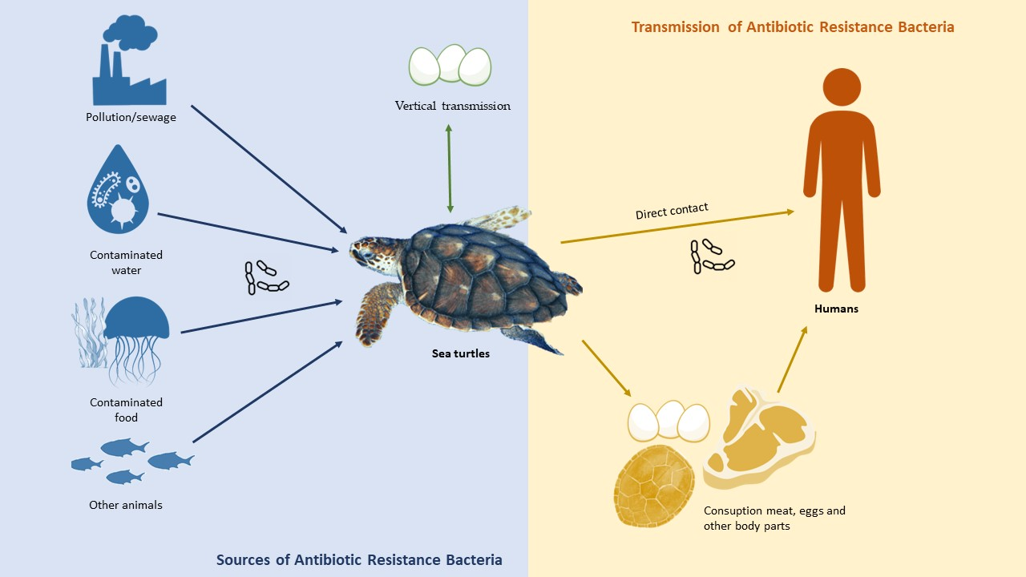
SEA TURTLE'S DISPERSION AND CONTAMINATION SOURCE OF PATHOGENIC BACTERIA
Transmission routes of antibiotic resistance bacteria in sea turtles.

Slide 4
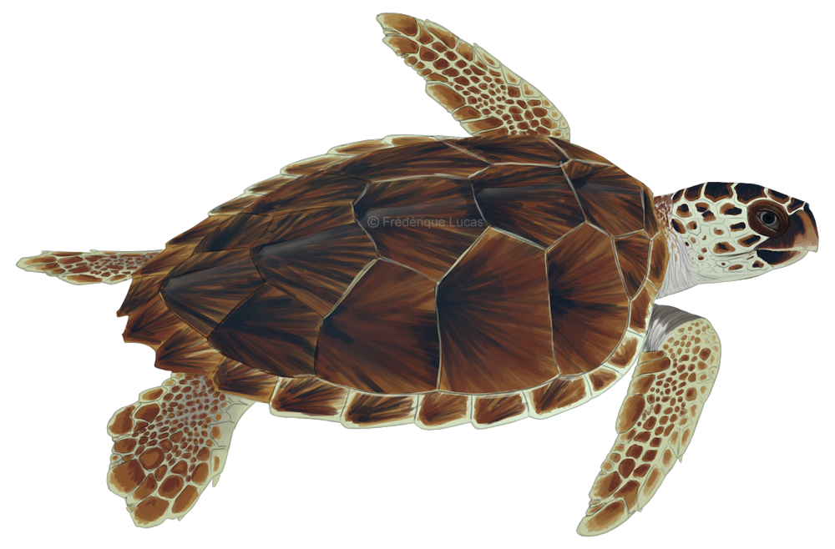
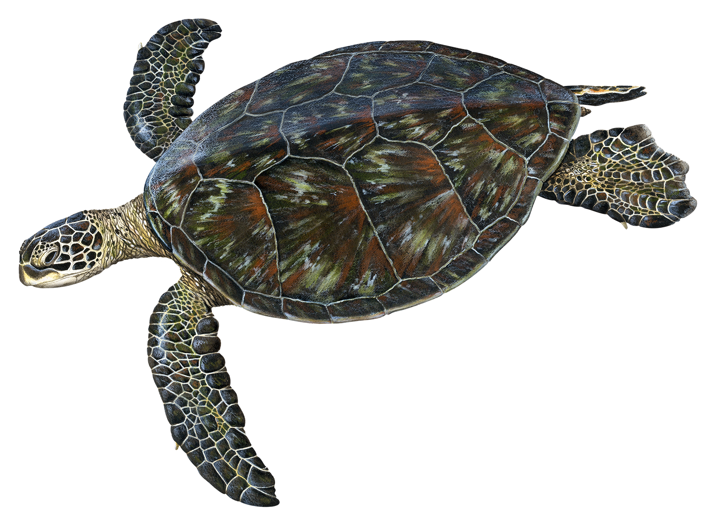
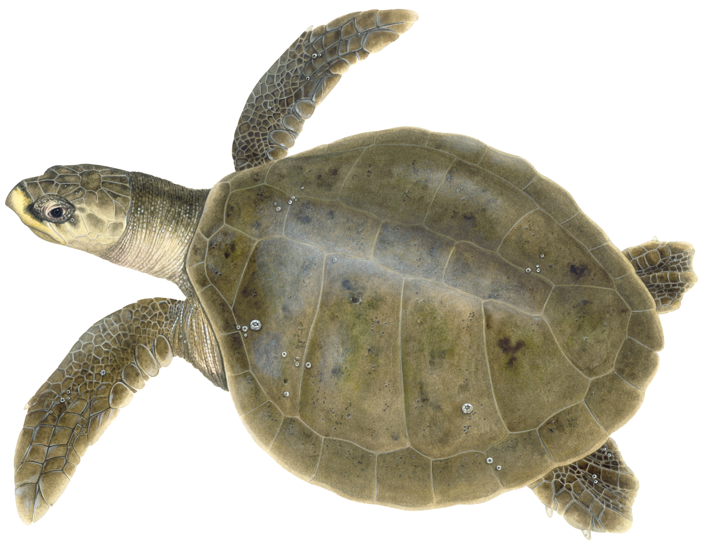
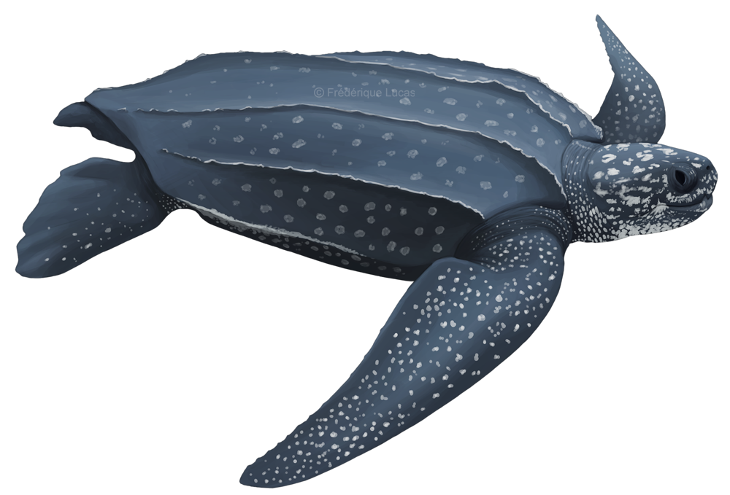
ANTIBIOTIC RESISTANCE IN SEA TURTLE
47.4 % (9/19) were performed in Caretta caretta, 21% (4/19) Chelonia mydas, 5.3 % (1/19) Lepidochelys olivacea, 5.3 % (1/18) Dermochelys coriacea.
The studies were carried out in different locations around the globe including The Gulf of Oman and the Arabian Sea, the Great Barrier Reef, Taiwan, the Gulf of California, the Pacific Ocean, the Adriatic Sea, Italy, the Mediterranean, 'Brail, the Gulf of Guinthea, St. Kitts, West Indies
Bacteria isolated were mostly Enterobacteriaceae. Regarding antibiotic resistance, the majority was observed in the classes of penicillins, tetracyclines, phenicol quinolones, and cephalosporins.

Slide 5
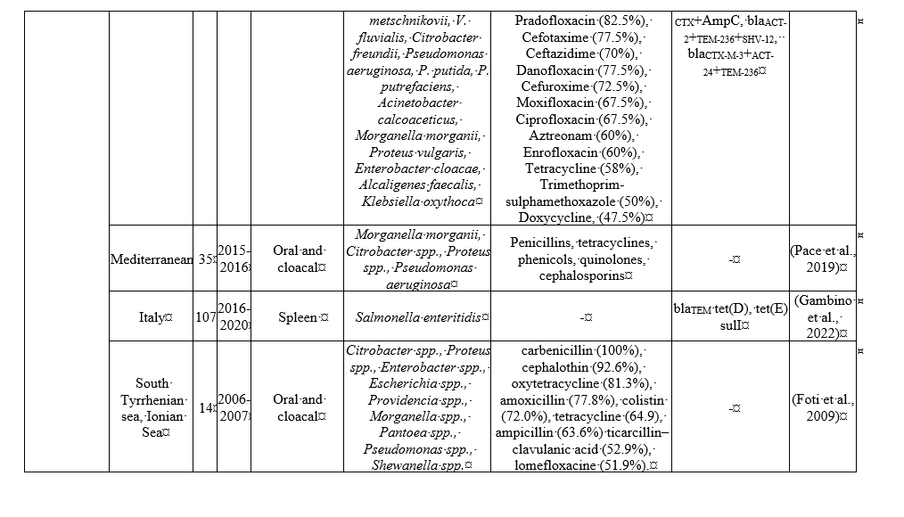
ANTIBIOTIC RESISTANCE IN SEA TURTLE

Slide 6
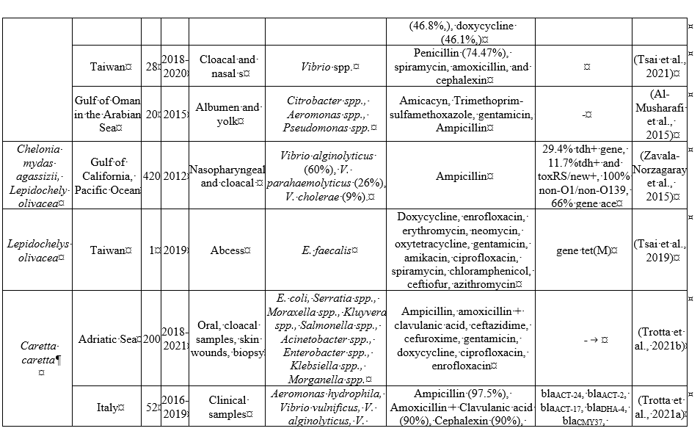
ANTIBIOTIC RESISTANCE IN SEA TURTLE

Slide 7
ANTIBIOTIC RESISTANCE IN SEA TURTLE

Slide 8
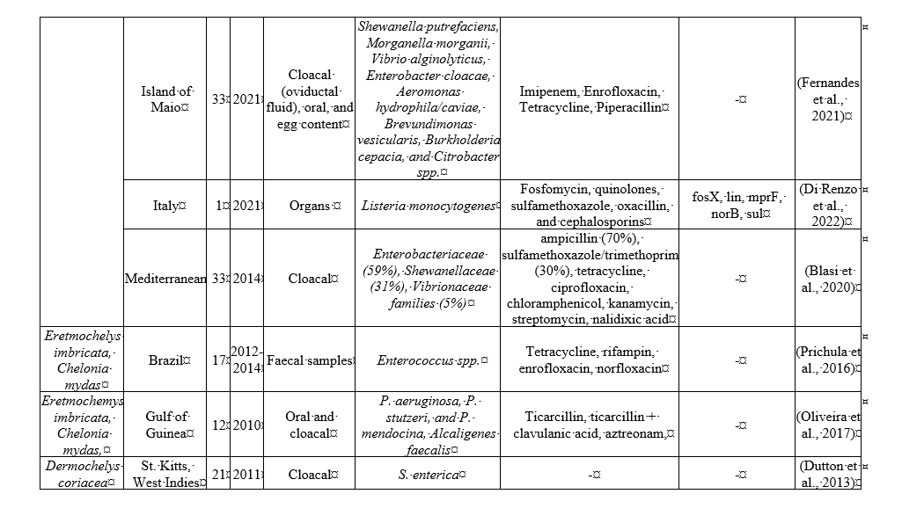
ANTIBIOTIC RESISTANCE IN SEA TURTLE

Slide 9
CONCLUSION
Based on the papers analyzed in the present study, it is possible to conclude that sea turtles are hosts of AMR. They have undoubtedly an important biological indicator of environmental health, particularly in the case of AMR in marine environments. Nevertheless, there are still gaps in knowledge about the dynamics and mechanisms routes of these agents. Wild animals such as sea turtles are often not included in epidemiological surveillance disease control. Due to their status as an endangered species, it is even more complicated to access samples. Sometimes, it is only possible in a rehabilitation centre when they are already contacted with other contaminated animals or are exposed to the antibiotic.
It is thus important to control the prevalence and diversity of antibiotic-resistant bacteria among sea turtles, as well as the sources and mechanisms of resistance. To mitigate the risks of antibiotic resistance in sea turtles, it is essential to implement strategies that promote the responsible use of antibiotics in animal and human medicine, as well as in aquaculture and other sectors. The use of antibiotics in aquaculture is a worrying situation because the regulation is rare. Such strategies can include reducing antibiotic use, strengthening hygiene and biosecurity practices, and promoting the development of alternative therapies and treatments.
Without a doubt, antibiotic resistance is a worldwide problem that impacts even the most isolated wild animals. It is important to advise the coastal populations to be careful with these animals when manipulating them or consuming their meat or eggs. Although ESBL or MRSA have not yet been reported in these animals is very likely that they are carriers of these agents but has not been performed enough investigation. In the future, further studies are needed under the One Health system to determine the role of sea turtles in disseminating and acquiring AMR in the marine ecosystem.

Slide 10
REFERENCES
Aguirre AA, Lutz PL. Marine Turtles as Sentinels of Ecosystem Health: Is Fibropapillomatosis an Indicator? EcoHealth 2004;1:275–83. https://doi.org/10.1007/s10393-004-0097-3.
Ahasan MdS, Picard J, Elliott L, Kinobe R, Owens L, Ariel E. Evidence of antibiotic resistance in Enterobacteriales isolated from green sea turtles, Chelonia mydas on the Great Barrier Reef. Marine Pollution Bulletin 2017;120:18–27. https://doi.org/10.1016/j.marpolbul.2017.04.046.
Al-Bahry SN, Al-Zadjali M, Mahmoud IY, Elshafie A. Biomonitoring marine habitats in reference to antibiotic resistant bacteria and ampicillin resistance determinants from oviductal fluid of the nesting green sea turtle, Chelonia mydas. Chemosphere 2012;87:1308–15.
Al-Bahry SN, Mahmoud IY, Al-Zadjali M, Elshafie A, Al-Harthy A, Al-Alawi W. Antibiotic resistant bacteria as bio-indicator of polluted effluent in the green turtles, Chelonia mydas in Oman. Marine Environmental Research 2011;71:139–44. https://doi.org/10.1016/j.marenvres.2010.12.005.
Alduina R, Gambino D, Presentato A, Gentile A, Sucato A, Savoca D, et al. Is Caretta Caretta a Carrier of Antibiotic Resistance in the Mediterranean Sea? Antibiotics 2020;9:116. https://doi.org/10.3390/antibiotics9030116.
Alfaro-Núñez A, Bertelsen MF, Bojesen AM, Rasmussen I, Zepeda-Mendoza L, Olsen MT, et al. Data from: Global distribution of Chelonid fibropapilloma-associated herpesvirus among clinically healthy sea turtles 2014:82241 bytes. https://doi.org/10.5061/DRYAD.8R082.
Al-Musharafi S, Mahmoud I, Al-Bahry S. Heavy metals and antibiotic resistant bacteria in green turtles are indicators of environmental pollution. International Journal of Biological, Food, Veterinary and Agricultural Engineering 2015;9:356–9.

