Slide 1


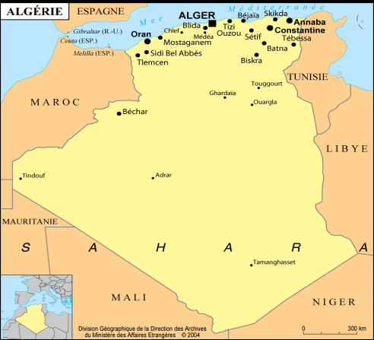
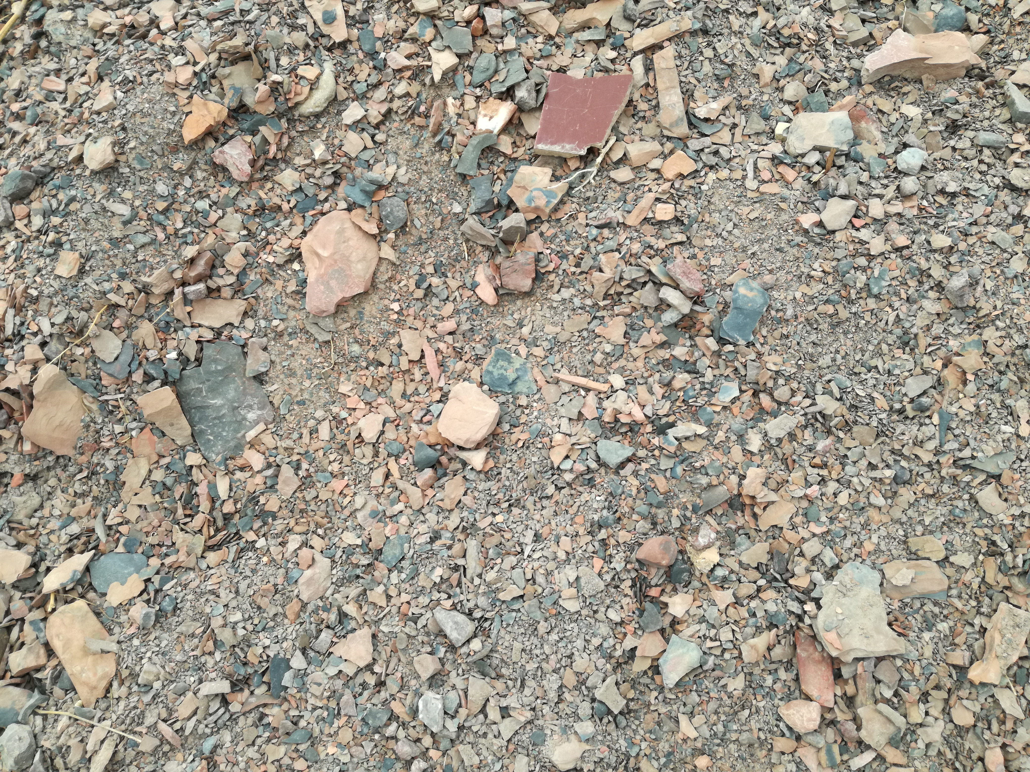
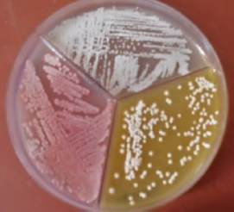
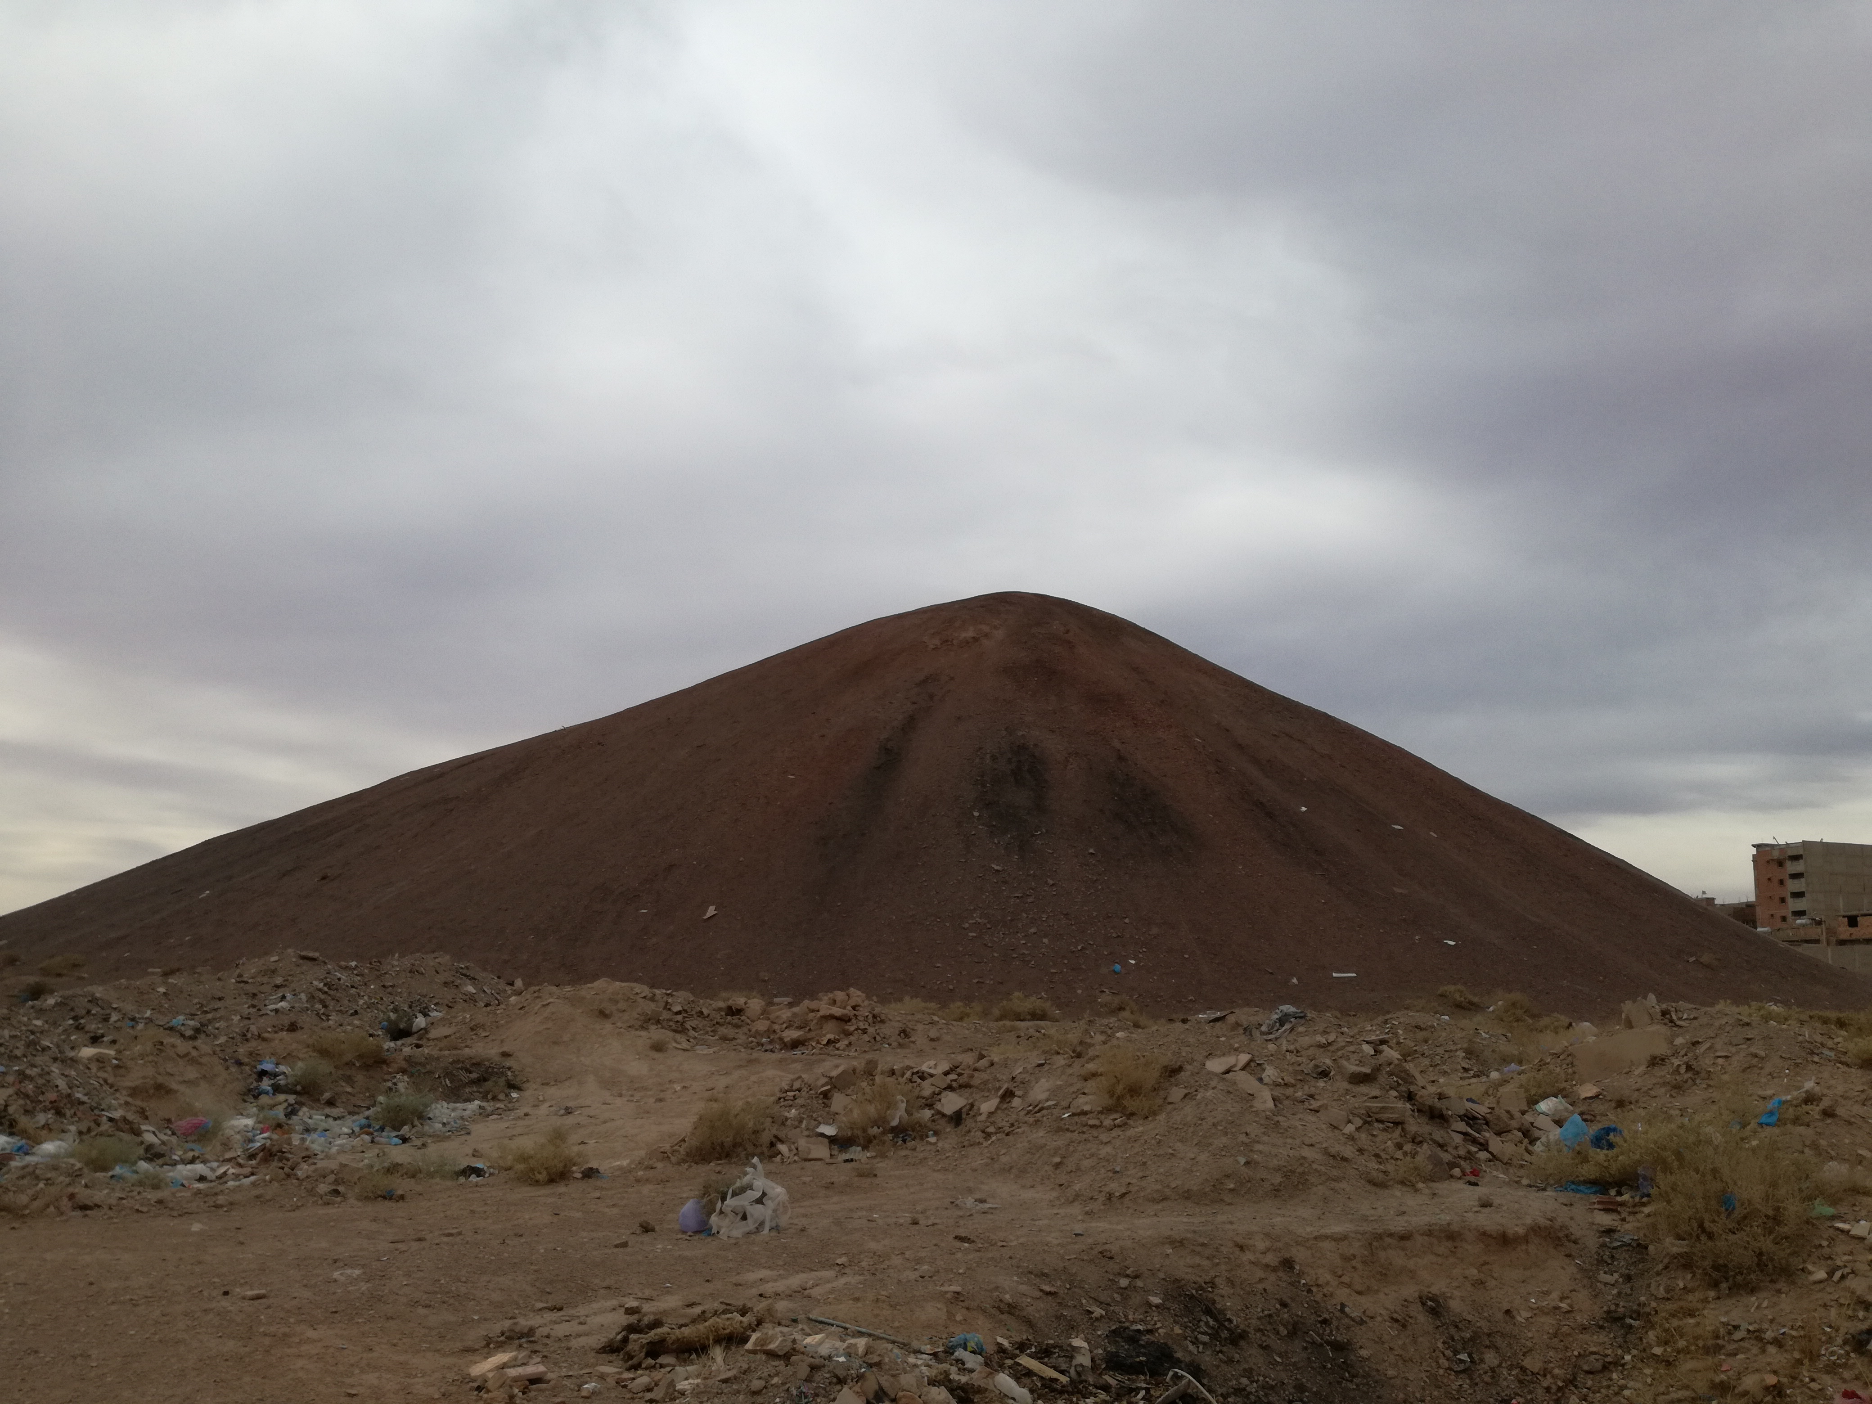
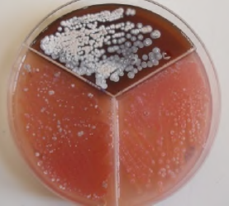
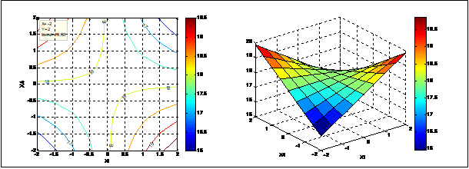
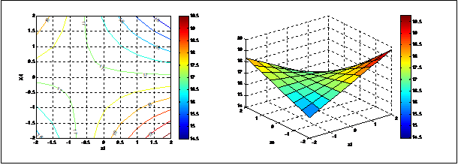
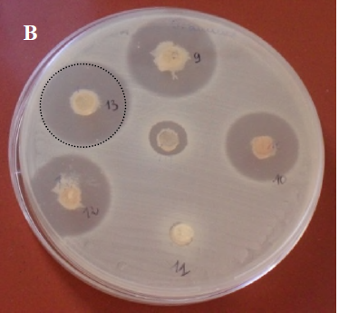
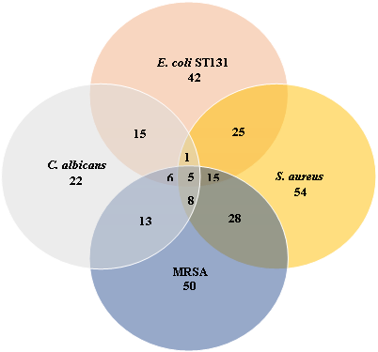
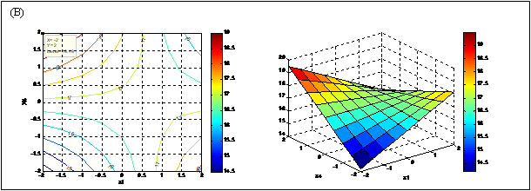
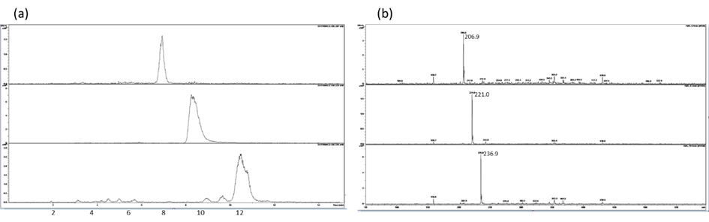
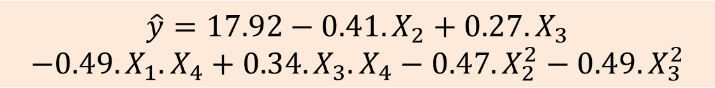
Culture medium modelisation for optimization of anti methicillin resistant Staphylococcus aureus metabolites by a coal mining soil derived Streptomyces rochei CMB47 strain
Djinni Ibtissem^{1,2}, Djoudi Warda¹, Boumezoued Chahinaz¹, Barchiche Halima¹, Souagui Samiha¹, Kecha Mouloud¹, Mancini Ines²
¹Laboratory of Applied Microbiology, Department of Microbiology, Faculty of Nature Science and Life, University of Bejaia, Bejaia, Algeria,
²Laboratory of Bioorganic chemistry, Department of Physics, University of Trento, via Sommarive 14, I-38123 Povo - Trento, Italy
ibtissem.djinni@univ-bejaia.dz
Introduction
The massive and intensive use of antibiotics, in both humans and animals, has led to the accelerated appearance of bacteria resistant to these molecules. The emergence of MRSA strains on a global scale poses a real public health problem, because they are responsible for a wide variety of infections (WHO, 2022). Therefore, the search for new active molecules with a new mechanism of action or structurally distinct from those currently used is urgently needed.
Actinobacteria has so far been the major source of new bioactive natural products. A challenge in the screening of these microorganisms lies in the search for growth conditions favorable for the production of bioactive secondary metabolites and the dereplication of known molecules.
The peculiar ecosystem of Saharan soils is abundant in rare actinobacteria that have proven to be major producers of new antimicrobial molecules.
Composite design matrix and results of anti-MRSA compounds production
Run N° | Natural values |  |  |  | Coded values
 | Starch (g/L) | NaNO₃ (g/L) | Incubation time (days) | pH | X₀ | X₁ | X₂ | X₃ | X₄ | Diameter of inhibition zones (mm) Y | ŷ
1 | 6 | 2 | 5 | 5 | 1 | -1 | -1 | -1 | -1 | 15.83±0.76 | 17.62
2 | 14 | 2 | 5 | 5 | 1 | +1 | -1 | -1 | -1 | 16.33±0.76 | 18.60
3 | 6 | 4 | 5 | 5 | 1 | -1 | +1 | -1 | -1 | 14.16±1.89 | 16.80
4 | 14 | 4 | 5 | 5 | 1 | +1 | +1 | -1 | -1 | 18.33±0.28 | 17.78
5 | 6 | 2 | 9 | 5 | 1 | -1 | -1 | +1 | -1 | 17.33±0.28 | 17.48
6 | 14 | 2 | 9 | 5 | 1 | +1 | -1 | +1 | -1 | 17.67±1.04 | 18.45
7 | 6 | 4 | 9 | 5 | 1 | -1 | +1 | +1 | -1 | 15.67±0.57 | 16.66
8 | 14 | 4 | 9 | 5 | 1 | +1 | +1 | +1 | -1 | 15±1 | 17.64
9 | 6 | 2 | 5 | 9 | 1 | -1 | -1 | -1 | +1 | 17.67±0.57 | 18.34
10 | 14 | 2 | 5 | 9 | 1 | +1 | -1 | -1 | +1 | 17±0 | 17.37
11 | 6 | 4 | 5 | 9 | 1 | -1 | +1 | -1 | +1 | 16.67±0.28 | 17.52
12 | 14 | 4 | 5 | 9 | 1 | +1 | +1 | -1 | +1 | 14.33±0.28 | 16.55
13 | 6 | 2 | 9 | 9 | 1 | -1 | -1 | +1 | +1 | 18.33±0.57 | 19.57
14 | 14 | 2 | 9 | 9 | 1 | +1 | -1 | +1 | +1 | 19.5±0 | 18.59
15 | 6 | 4 | 9 | 9 | 1 | -1 | +1 | +1 | +1 | 18±0 | 18.75
16 | 14 | 4 | 9 | 9 | 1 | +1 | +1 | +1 | +1 | 16.33±0.28 | 17.77
17 | 10 | 3 | 7 | 7 | 1 | 0 | 0 | 0 | 0 | 18±0 | 17.92
18 | 10 | 3 | 7 | 7 | 1 | 0 | 0 | 0 | 0 | 17±0 | 17.92
19 | 10 | 3 | 7 | 7 | 1 | 0 | 0 | 0 | 0 | 18±0 | 17.92
20 | 10 | 3 | 7 | 7 | 1 | 0 | 0 | 0 | 0 | 18±0 | 17.92
21 | 10 | 3 | 7 | 7 | 1 | 0 | 0 | 0 | 0 | 18±0 | 17.92
22 | 10 | 3 | 7 | 7 | 1 | 0 | 0 | 0 | 0 | 18.5±0 | 17.92
23 | 2 | 3 | 7 | 7 | 1 | -2 | 0 | 0 | 0 | 15.83±0.28 | 17.92
24 | 18 | 3 | 7 | 7 | 1 | +2 | 0 | 0 | 0 | 17.67±0.57 | 17.92
25 | 10 | 1 | 7 | 7 | 1 | 0 | -2 | 0 | 0 | 15.5±0 | 18.74
26 | 10 | 5 | 7 | 7 | 1 | 0 | +2 | 0 | 0 | 16.16±0.57 | 17.10
27 | 10 | 3 | 3 | 7 | 1 | 0 | 0 | -2 | 0 | 16±0 | 17.37
28 | 10 | 3 | 11 | 7 | 1 | 0 | 0 | +2 | 0 | 15.5±0 | 18.46
29 | 10 | 3 | 7 | 3 | 1 | 0 | 0 | 0 | -2 | 18±0 | 17.20
30 | 10 | 3 | 7 | 11 | 1 | 0 | 0 | 0 | +2 | 16.83±0.57 | 18.06
The model equation for anti-MRSA activity after discarding the insignificant coefficients is as follows:
Positive effect of incubation time
$$\hat{y}=17.92−0.41.X_{2}+0.27. X_{3}$$
$$−0.49.X_{1}.X_{4}+0.34.X_{3}.X_{4}−0.47.X_{2}^{2}−0.49.X_{3}^{2}$$
Results
Negative effect of NaNO₃
1.Isolation of actinobacteria strains and antibacterial screening
Isolation of 119 actinobacteria strains from a coal mine
sample, collected from Bechar region, Algeria.
starch (X₁) and pH (X₄) affect the response in interaction with other factors (X₁.X₄), (X₃.X₄)
Percentage of active isolates out of 119 tested strains
(a)
(c)
Screening of the antibacterial potential against E. coli ST131, S. aureus ATCC 25923, MRSA ATCC 43300, Candida albicans ATCC 10231 and P. aeruginosa ATCC 27853
Venn diagram representation of antimicrobial traits of 119 actinobacteria isolates showing four profiles representing the four tested pathogenic germs
Contour plots and response surface plots at different conditions.
(a): X₂= 0, X₃= 0,
(b): X₂= +1, X₃= +1,
(c): X₂= -1, X₃= - 1.
Selection of CMB47 strain
The anti-MRSA activity ranged from 19.5 mm to 20 mm under different parameters The best 20 mm value was selected, corresponding to : 2 g/L of starch concentration (X1 = −2), 3 g/L of NaNO3 concentration (X2 = 0), 7 days of incubation time (X3 = 0) and a media pH of 11 (X4 = +2).
Principal component analysis (PCA) of screening for antimicrobial activity of 119 actinobacteria strains.
The measured anti-MRSA activity of 18.5 mm, close to the predicted 20 mm value, indicates that the developed model has a high degree of accuracy
2.Screening the best culture medium and kinetic study on the production of anti-MRSA metabolites
Among four culture media used, the highest antibacterial activity (20.16 mm inhibition diameter) was observed in Czapeck medium against MRSA, containing per liter:
10g of soluble starch, 3g of NaNO₃, 1g of K₂HPO₄, 0.5g of MgSO₄·7H₂O, 0.5g of KCl, 10mg of FeSO₄.7H₂O.
4.Secondary metabolite profile of the bioactive fraction from CMB47 ethyl acetate extract by DAD-HPLC/ESI-MS analysis
6.9 min
m/z 207
The analysis of the bioactive fraction 11 B provided:
(a) an extracted ion chromatograms showing signals at the indicated retention time corresponding to (b) the MS spectra in positive ion mode with [M+H]⁺ ions at m/z 207, 221 and 237.
(a)
MIC evaluation of ethyl acetate and methanol crude extracts are estimated at 0. 439 and 1.95 µg/mL
Selection of Czapeck medium for further optimization study using statistical approaches
8.2 min
m/z 221
10.4 min
m/z 237
Polyphasic and molecular characterization of the selected active CMB47 Strain
The molecular structures of the three metabolites present in the bioactive fraction are related because differ by 14 units, attributable to a different number of CH2 unit, or to the presence of one/two OMe replacing OH groups or NMe replacing NH units.
(a), Anti-MRSA activity variation of CMB47 based on culture media composition,
(b), anti-MRSA compounds production kinetics on Czapeck medium of CMB47 strain
Streptomyces rochei with strain A-1T 99.47% sequence homology
Conclusions
3.Optimization of parameters for the production of anti-MRSA metabolites using experimental Central Composite Design (CCD) analysis
The novel strain, Streptomyces rochei CMB47 showed significant activity against MRSA.
The CCD analysis applied with the aim of maximizing anti-MRSA activity allowed to determine optimal fermentation process conditions reaching 20 mm in inhibition zone diameter.
DAD-HPLC/ESIMS analysis of the bioactive fraction provided preliminary structural indications on the metabolites responsible for MRSA inhibition. To the best of our knowledge, no similar data were found for antibiotic molecules isolated from S. rochei , hence the interest in further chemical investigation.
Coded and actual values of the variables for experimental CCD.
Reference
Djinni I.et al. Fermentation 2023, 9, 381.
Minitab 16.0 (Minitab Inc., Pensylvania, USA) software.

