Slide 1





Thyme (Thymus vulgaris L.) Essential Oil (TEO) as a Tool for Mastitis Control in Small Ruminants:
In vitro evaluation of antimicrobial activity and inhibition activity of
biofilm production

Slide 2
Staphylococcus aureus and coagulase-negative staphylococci (CNS) are some of the main causes of mastitis in small domestic ruminants
Biofilm production
is considered an
important
virulence
factor
that could
explain cases of
mastitis
refractory
to
antibiotic
treatments
!!!
Staph.
https://doi.org/10.1007/s11259-023-10090-5

Slide 3
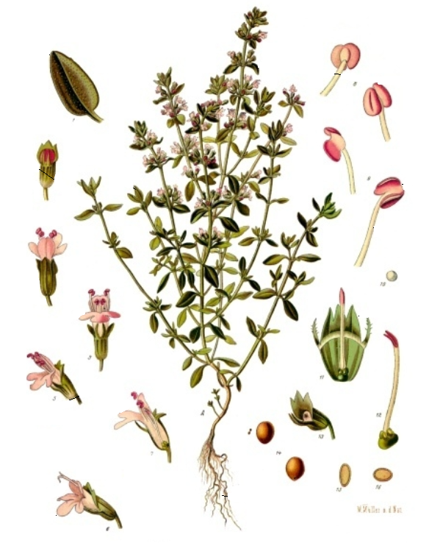
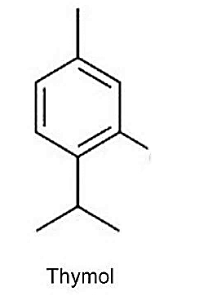
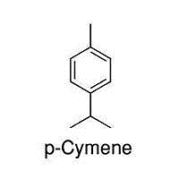

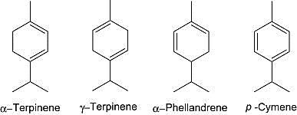
THYMUS VULGARIS L.
Major active components of TEO
Effect of TEO on bacterial cells:
- Degradation of the cell wall;
- Damage to the cytoplasmic membrane;
- Coagulation of the cytoplasm;
- Depletion of intracellular ATP;
- Inhibition of biofilm production.

Slide 4
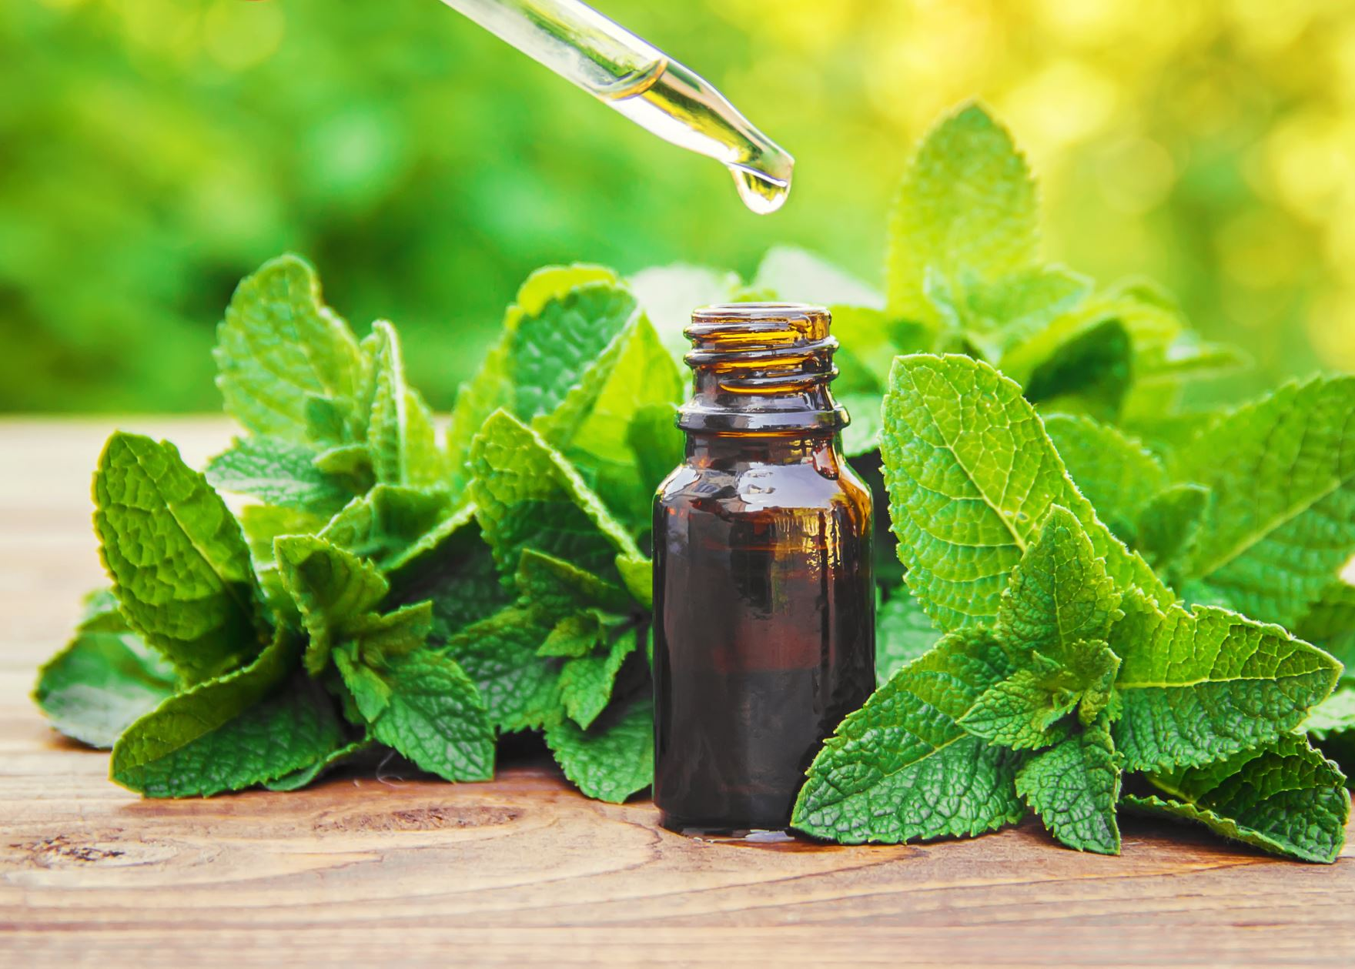
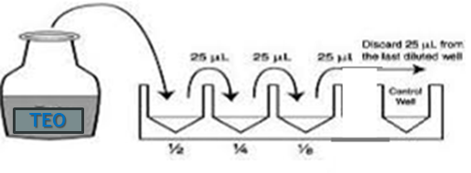
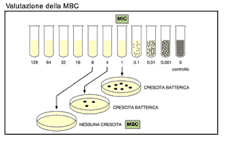
MATERIAL AND METHOD
- 2 reference strains ATCC25923
ATCC11622
- 6 S. aureus
- 6 coagulase negative staphylococci
TEO: Thyme Essential Oil (Thymus vulgaris L.)
vs
In culture broth fortified with DMSO and phosphate buffer pH 7.4 (1:5)
At concentrations of:
v/v
1:100
1:500
1:250
p/v
9,28mg/mL
4,64mg/mL
2,32mg/mL
TEO
Antibacterial activity of TEO
MIC
MBC
Biofilm formation

Slide 5
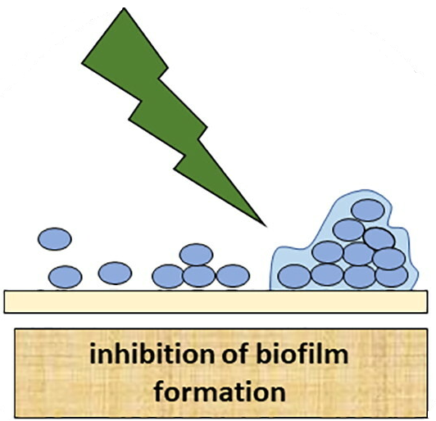
RESULTS

Slide 6
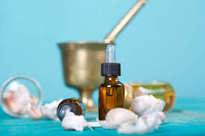

CONCLUSIONS
TEO at a concentration of 4.64 mg/mL showed a marked antibacterial activity against the tested bacteria, and at a sublethal concentration of 2.32 mg/mL TEO totally inhibited biofilm production …
… supporting the possibility that TEO could be an excellent alternative to antibacterials in the treatment and prevention of bovine mastitis
Milking attachment disinfectants
Intramammary injectable preparations and external skin applications
Pre-dipping
and post-dipping
Keeping in mind at all times
Safety for the animals;
Safety for the milk;
Safety for the consumer.

Slide 7
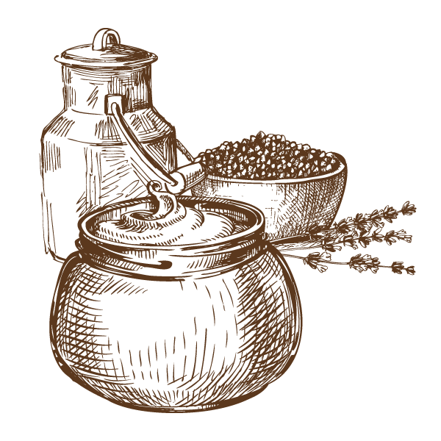
Thanks
for your attention
For any question or additional information about this study, contact
Galgano Michela ​
michela.galgano@izspb.it
www.izsfg.it

