Slide 1
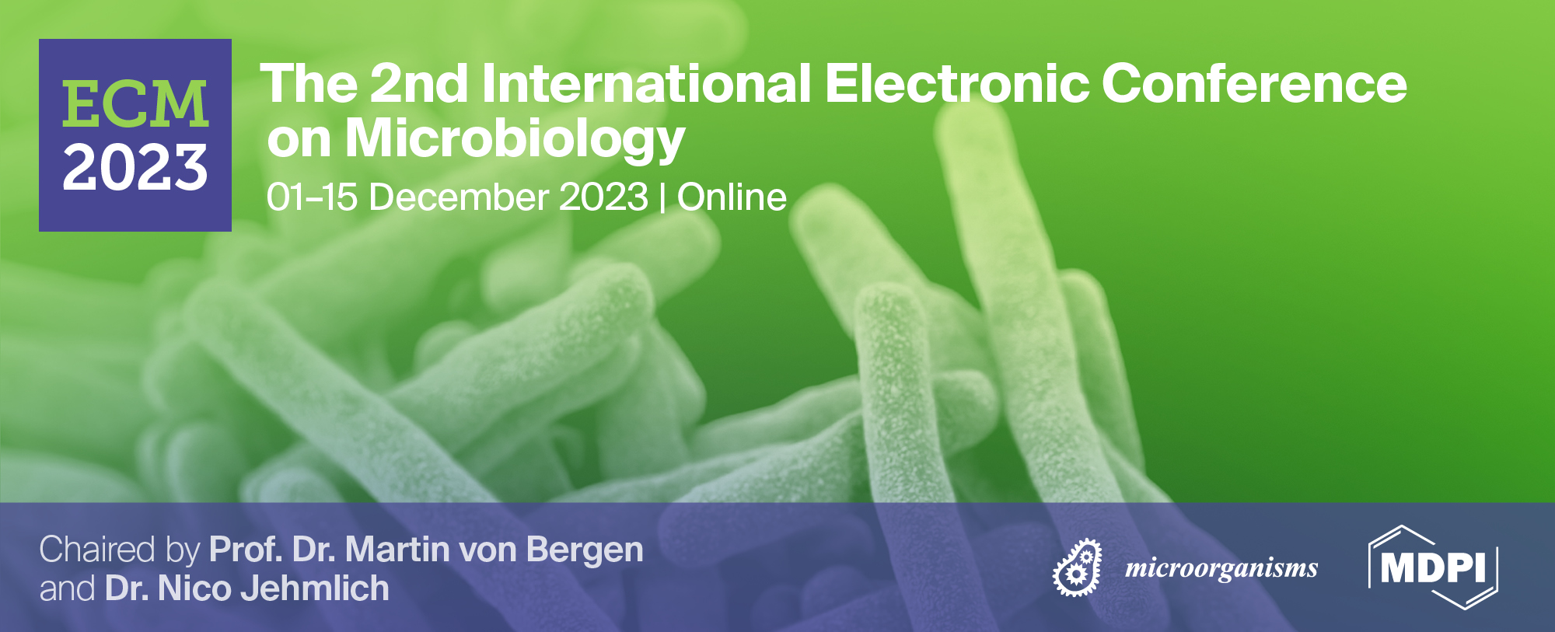
Innovative Microorganisms in Environmental Cleanup: EMO-based Bioprocesses
Hakan Çelebi ^{1*}, Tolga Bahadır ², İsmail Şimşek ³ and Şevket Tulun ⁴
Aksaray University, Department of Environmental Engineering
¹Aksaray University, Department of Environmental Engineering
²Aksaray University, Department of Environmental Engineering
³Aksaray University, Department of Environmental Engineering
⁴Aksaray University, Department of Environmental Engineering
* Corresponding author: hakancelebi@aksaray.edu.tr

Slide 2
Abstract: All over the world, environmental engineers, environmental biologists, biochemists and other scientists are concerned about environmental pollution. In particular, different treatment technologies and applications in terms of water and soil health have been investigated for years. Studies show that the bioprocess (biosorption, bioremediation, bioaccumulation, etc.) approach is more advantageous (economical, easy design, and environmentally friendly etc.) than many treatment methods. Thanks to these advantages, bioprocesses have been preferred for the removal of different pollutants in the receiving environment. Effective microorganisms (EMO) are defined as mixed cultures of advantageous and naturally occurring microorganisms that can be used as vaccine material. EMO is a natural fermentation product that is not chemically or genetically modified in the form of a concentrated solution. An EMO consists of 10 species, including photosynthetic (Rhodopseudomonas palustrus and Rhodobacter spaeroides etc.), lactic acid (Lactobacillus plantarum, Lactobacillus casei and Streptoccus lactis etc.) bacterial groups, yeasts (Saccharomyces cerevisiae and Candida utilis etc.), actinomycetes, and fermenting fungi. is coming. The main components of EMO are lactic acid bacteria, yeasts and photosynthetic bacteria. In liquid solution they are in harmony. This article aims to review the literature on 'Effective Microorganism (EMO)' from different scientific databases and discuss the effectiveness of using EMO for bioprocess
Keywords: Cleanup; Eco-friendly; EMO; Bioprocess

Slide 3
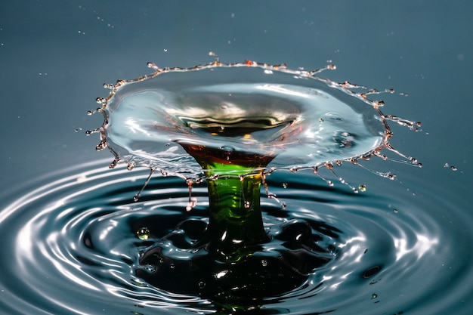
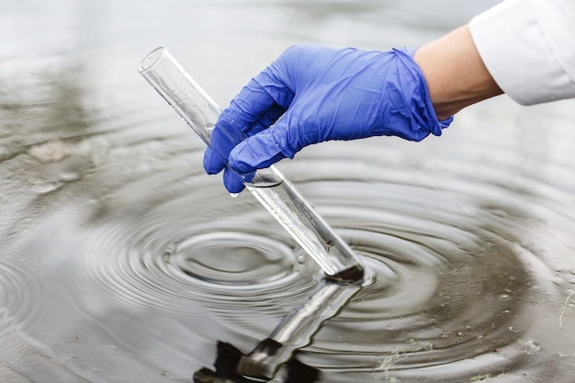
Introduction
The place of water in the ecosystem is important in terms of both pollution and quality resource potential. It has been reported that there are only 2.5% fresh water resources in the world [1]. The rapid increase in the living population and the activities related to this increase pose a great risk to water resources. With the recent COVID-19 pandemic, the damage caused by the human population to the environment has become clear. Continuous population growth heralds water scarcity on a global scale [2]. In particular, different pollutants in untreated wastewater cause dangerous effects on natural water resources [3-4]. Therefore, the availability of water in all countries has implications for wastewater recovery, water saving, etc. must be protected by applications.

Slide 4
Introduction
Wastewater treatment can be explained as the process of obtaining water suitable for different purposes such as washing and irrigation by minimizing pollutants [5-7]. In some cases, traditional wastewater treatment practices have become unfeasible due to the changing pollutant profile. It is caused by factors such as low efficiency, secondary pollution, high installation, maintenance and operating costs [8-10]. Therefore, it has become necessary to switch from traditional methods to alternative environmentally friendly technologies [4]. As an alternative method, energy-efficient and eco-friendly "Microorganism-based green technologies" (MicroRG-based GT) have come to the fore in recent years. Different groups of microorganisms (algae, bacteria, fungi, protozoa) are used in wastewater treatment. Specific microorganisms provide purification by using organic pollutants in the wastewater structure for their vital activities [11, 12]. Before EMO technology, classical microorganisms took part in treatment according to environment conditions. Aerobe and anaerobic bacteria, which are the most widely used and most intense in purification, are preferred because they are abundant in the ecosystem [13]. These bacteria take part in the following three different reactions in the activated sludge process [4].
$Organic waste+ O_{2}\underset{→}{Aerobes} {CO}_{2}+ H_{2}O+energy$ (1)
$Organic waste+ {NO}_{3}^{−}\underset{→}{Anaerobes} {CO}_{2}+ N_{2}+energy (bounded oxygen in nitrate)$ (2)
$Organic waste+ {SO}_{2}^{4−}\underset{→}{Anaerobes} {CO}_{2}+ H_{2}S+energy (bounded oxygen in sulfate)$ (3)

Slide 5
Introduction
Microalgae species are photosynthetic microorganisms used in wastewater bioremediation [4, 14, 15]. Protozoa and fungi are other microorganisms that play an active role in the treatment of wastewater with different characteristics [16]. Recent research has included green and biotechnological applications for recycling according to its type. In particular, Plant-fungus and plant-bacteria based studies are carried out. Table 1 includes green technology research (GTR) conducted with different groups of microorganisms. Both plant/soil improvement and wastewater treatment/recovery are carried out with “Effective Microorganisms (EMO)”, which is defined as the hybrid form of these microorganisms [26]. There are also commercial forms of EMOs used as green technology tools. The main purpose of this review is to search the literature on EMO from different scientific databases and discuss the effectiveness of using it for receiving environments (water, soil, and wastewater).
Table 1. Different green technologies based on microorganisms in pollutant treatment
Microorganisms Group |  | GTR | Wastewater | References
Bacteria | Acinetobacter junii NT-15 | Plant-bacteria interaction | Textile | [17]
 | Bacillus subtilis LORI66 | Plant-bacteria interaction | Oil | [18]
 | Klebsiella sp. LCRI87 | Plant-bacteria interaction | Oil | [19]
Fungi | Aspergillus flvaus CR500 | Plant-fungus interaction | Tannery | [20]
 | Trichoderma sp. | Data not available | Electroplating | [21]
Protozoa | Poteriospumella sp. | Bacteria-protozoa interaction | Industrial | [22]
 | Peranema sp. | Bacteria-protozoa interaction | Industrial | [23]
Algae | Tetraselmis suecica | Fungus-algae interaction | Swine | [24]
 | Chlorella sp. | Bacteria-algae interaction | Tannery | [25]

Slide 6
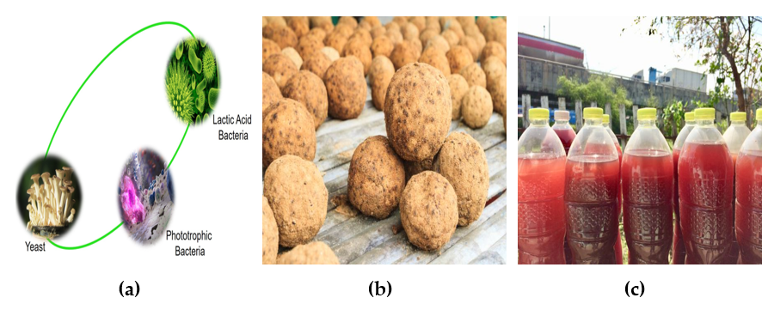
The classification and characteristics of EMO
Microorganisms form the basis of the ecological pyramid, and interacting with the microorganisms in this pyramid provides advantages for health and the environment. EMOs are defined as mixed cultures of advantageous and naturally occurring microorganisms that can be used as seed materials. EMO is a natural fermentation product that has not been chemically or genetically modified in the form of a concentrated solution. An EMO consists of 10 families from 5 families, including photosynthetic, lactic acid groups of bacteria, yeasts, actinomycetes and fermenting fungi [27]. In liquid solution, these are in harmony. On a commercial scale, there are products such as EM1TM, PRO EM1®, Bokashi, EM Compost, and EM Mudballs. Research has shown that EMOs can be used in areas such as agriculture, animal husbandry and water quality. Active EMOs consist of a group of microorganisms that increase the number of single-celled creatures and organisms in the soil. In many countries, activities such as Bokashi and mudball are carried out in natural water resources and soil. For example, in Thailand, EMO is used within the scope of environmentally friendly agriculture. A mudball event is organized in Malaysia to purify the polluted water.
Figure 2. (a) Principal Microorganism in EM1TM (adapted from https://www.integratedbioproducts.com/post/the-origin-of-effective-microorganisms ; (b) EM Mudballs; (c) EMO Solution

Slide 7
EMO Effectiveness in Wastewater Treatment
Water quality and water scarcity are common problems of all countries in the world along with climate change. The solution to these problems is bioprocesses performed with microorganisms in different forms (mudball, powder and solution), which are eco-friendly and inexpensive [30]. EMOs are commercially offered as a solution in the form of a brown microorganism cocktail. EMOs, which have recently become among the alter-native wastewater treatment technologies, are advantageous in terms of improving both cost and physicochemical properties. EMOs are an environmentally friendly product and are manifested in applications around the world, especially in water and wastewater treatment [31]. The Effective Microorganism Research Organization (EMRO) considers EMO+mudball application as an alternative technology for wastewater treatment and improvement of natural water quality. The results of the study showed that classical methods were less efficient than EMO (Figure 2).

Slide 8
EMO Effectiveness in Wastewater Treatment
Research in the literature has revealed that EMOs are effective in heavy metal removal. In a study, they added EMO+mudball to improve the physicochemical characterization of laundry wastewater [30]. In another study, EMO was used to make dairy industry wastewater compatible with irrigation water criteria [33]. Wastewater from the automotive, food and pharmaceutical industries was tried to be treated with EMO, a mixture of Acinetobacter pittii, Escherichia coli, Fictibacillus nanhaiensis, Lysinibacillus xylanilyticus and Planococcus maritimus [34]. Bioremediation of priority pollutants (drug residues, heavy metals, oil hydrocarbons) has been achieved with magic fungi [35]. In domestic wastewater treatment studies with EMO solutions obtained by different methods, Kavitha and Vani [36] and Dipali et al. [37] provided a sustainable treatment. Velmurugan and Pandian [38] investigated the effectiveness of EMOs in terms of quality in food industry ef-fluent in their study. Commercial EMO consists Rhodopseudomonas sp., Lactobacillus sp., and Saccharomyces sp. Research results showed that the removal efficiency of inorganic com-pounds in wastewater was >60%. EMO effectiveness has been tested in the production of eco-enzymes from food waste for wastewater treatment [39]. Moreover, EMO has many functions, including biostimulant, and plays an effective role in the biosorption of heavy metals from wastewater.

Slide 9
Interaction of Soil, Agriculture, Plant and EMO
EMOs are widely produced for MicroRG-based GT because they are reliable and harmless. Growth-promoting microorganisms are important as biosecurity mechanisms in both agricultural activities and plant development. Decreases in productivity and quality in agriculture are negatively affected by biotic and abiotic stress factors. As a solution to the negativities, biostimulants (EMO and different compounds) used in green technology make positive contributions with their regulating effects on plant development, product quality and soil structure [40]. EMOs offer positive results in terms of increasing the microbial diversity of soils and plants and in terms of crop rotation and management. The productivity and quality of agricultural crops are increased by spraying EMO culture as previously reported. According to studies, in agricultural soil treated with EMO, pathogenic microorganisms decrease, the degradation of organics accelerates, and the plant nutrient balance increases [27]. Additionally, it supports the growth of beneficial microorganisms such as mycorrhizae by being used instead of fertilizers and pesticides. Dos Santos et al. [41] and Abdelkhalik et al. [42] tested both the diversity and durability of Palisade grass and hot piper plants, respectively, in their seed EMO technique.

Slide 10
CONCLUSIONS
The results of the study can be listed as follows:
Active use of EMOs is key to sustainability and eco-innovation.
The most important advantage of EMOs over natural micro-organisms is that they are in optimally balanced populations.
EMOs increase the diversity of soil flora and fauna with the components they produce. They remain in the soil ecosystem long enough to provide the desired effects.
According to the United Nations Sustainable Development Goals (SDGs), Goal 12 is achieved with EMO technology.
Lactic acid bacteria, yeast and phototrophic bacteria contained in EMO have the ability to ferment organic substances and prevent decay.
EMO maximizes their natural power by activating local and indigenous microorganisms living in soil and water.
Infographics
Infographics
Infographics
Infographics

Slide 11
Innovative Microorganisms in Environmental Cleanup: EMO-based Bioprocesses
Hakan Çelebi ^{1*}, Tolga Bahadır ², İsmail Şimşek ³ and Şevket Tulun ⁴
Aksaray University, Department of Environmental Engineering
¹Aksaray University, Department of Environmental Engineering
²Aksaray University, Department of Environmental Engineering
³Aksaray University, Department of Environmental Engineering
⁴Aksaray University, Department of Environmental Engineering
* Corresponding author: hakancelebi@aksaray.edu.tr

