Slide 1
Toxicometallomics of Escherichia coli grown in the presence of silver, copper, gallium and gold metal salts at sublethal concentrations: similarities and differences at the transcriptome level
Daniel A. Salazar Alemán, Shardini Mate, Ashley McGibbon, Mai Linh Tran, Dr. Raymond J. Turner

Slide 2
What changes are induced
at the transcriptome level
for bacteria to grow in the presence of
non-lethal concentrations of
silver, copper and gallium metal salts?
DRIVING QUESTION
Notes:
This will help us to identify genes that are differentially expressed because of metal challenge, and will allow us to realistically compare findings from one experiment to another.

Slide 3
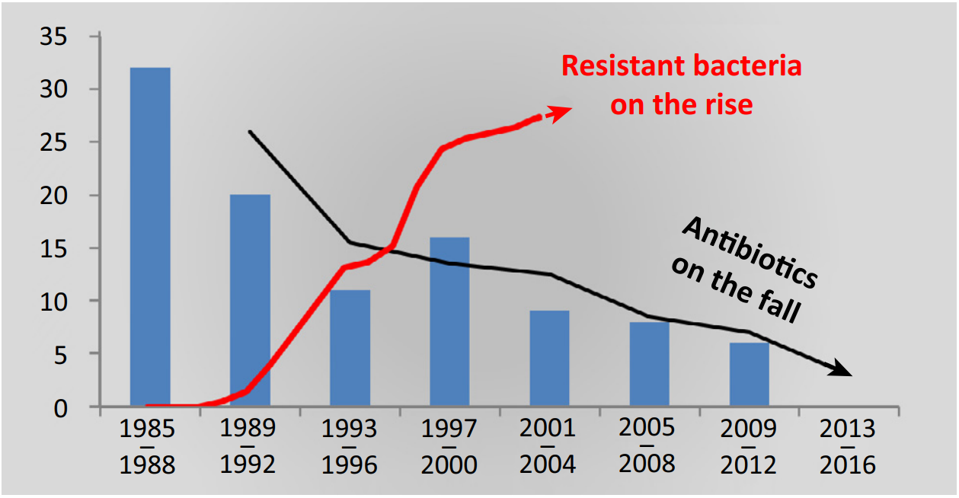
The Antimicrobial Resistance Era
Figure 1. Rise of antibiotic-resistant bacteria on the rise, while the development of novel antibiotics is declining. Adapted from Schäberle & Hack, 2014.
BACKGROUND
Notes:
We are in the antimicrobial resistance era. The incidence of antibiotic-resistant bacteria has been on an alarming rise these past decades, while the development of new antibiotics that enter the market has been declining. A study by The Lancet in 2019 revealed that almost 5 million deaths worldwide are directly related to antibiotic-resistant bacteria. These are expected to double in the following decades.

Slide 4
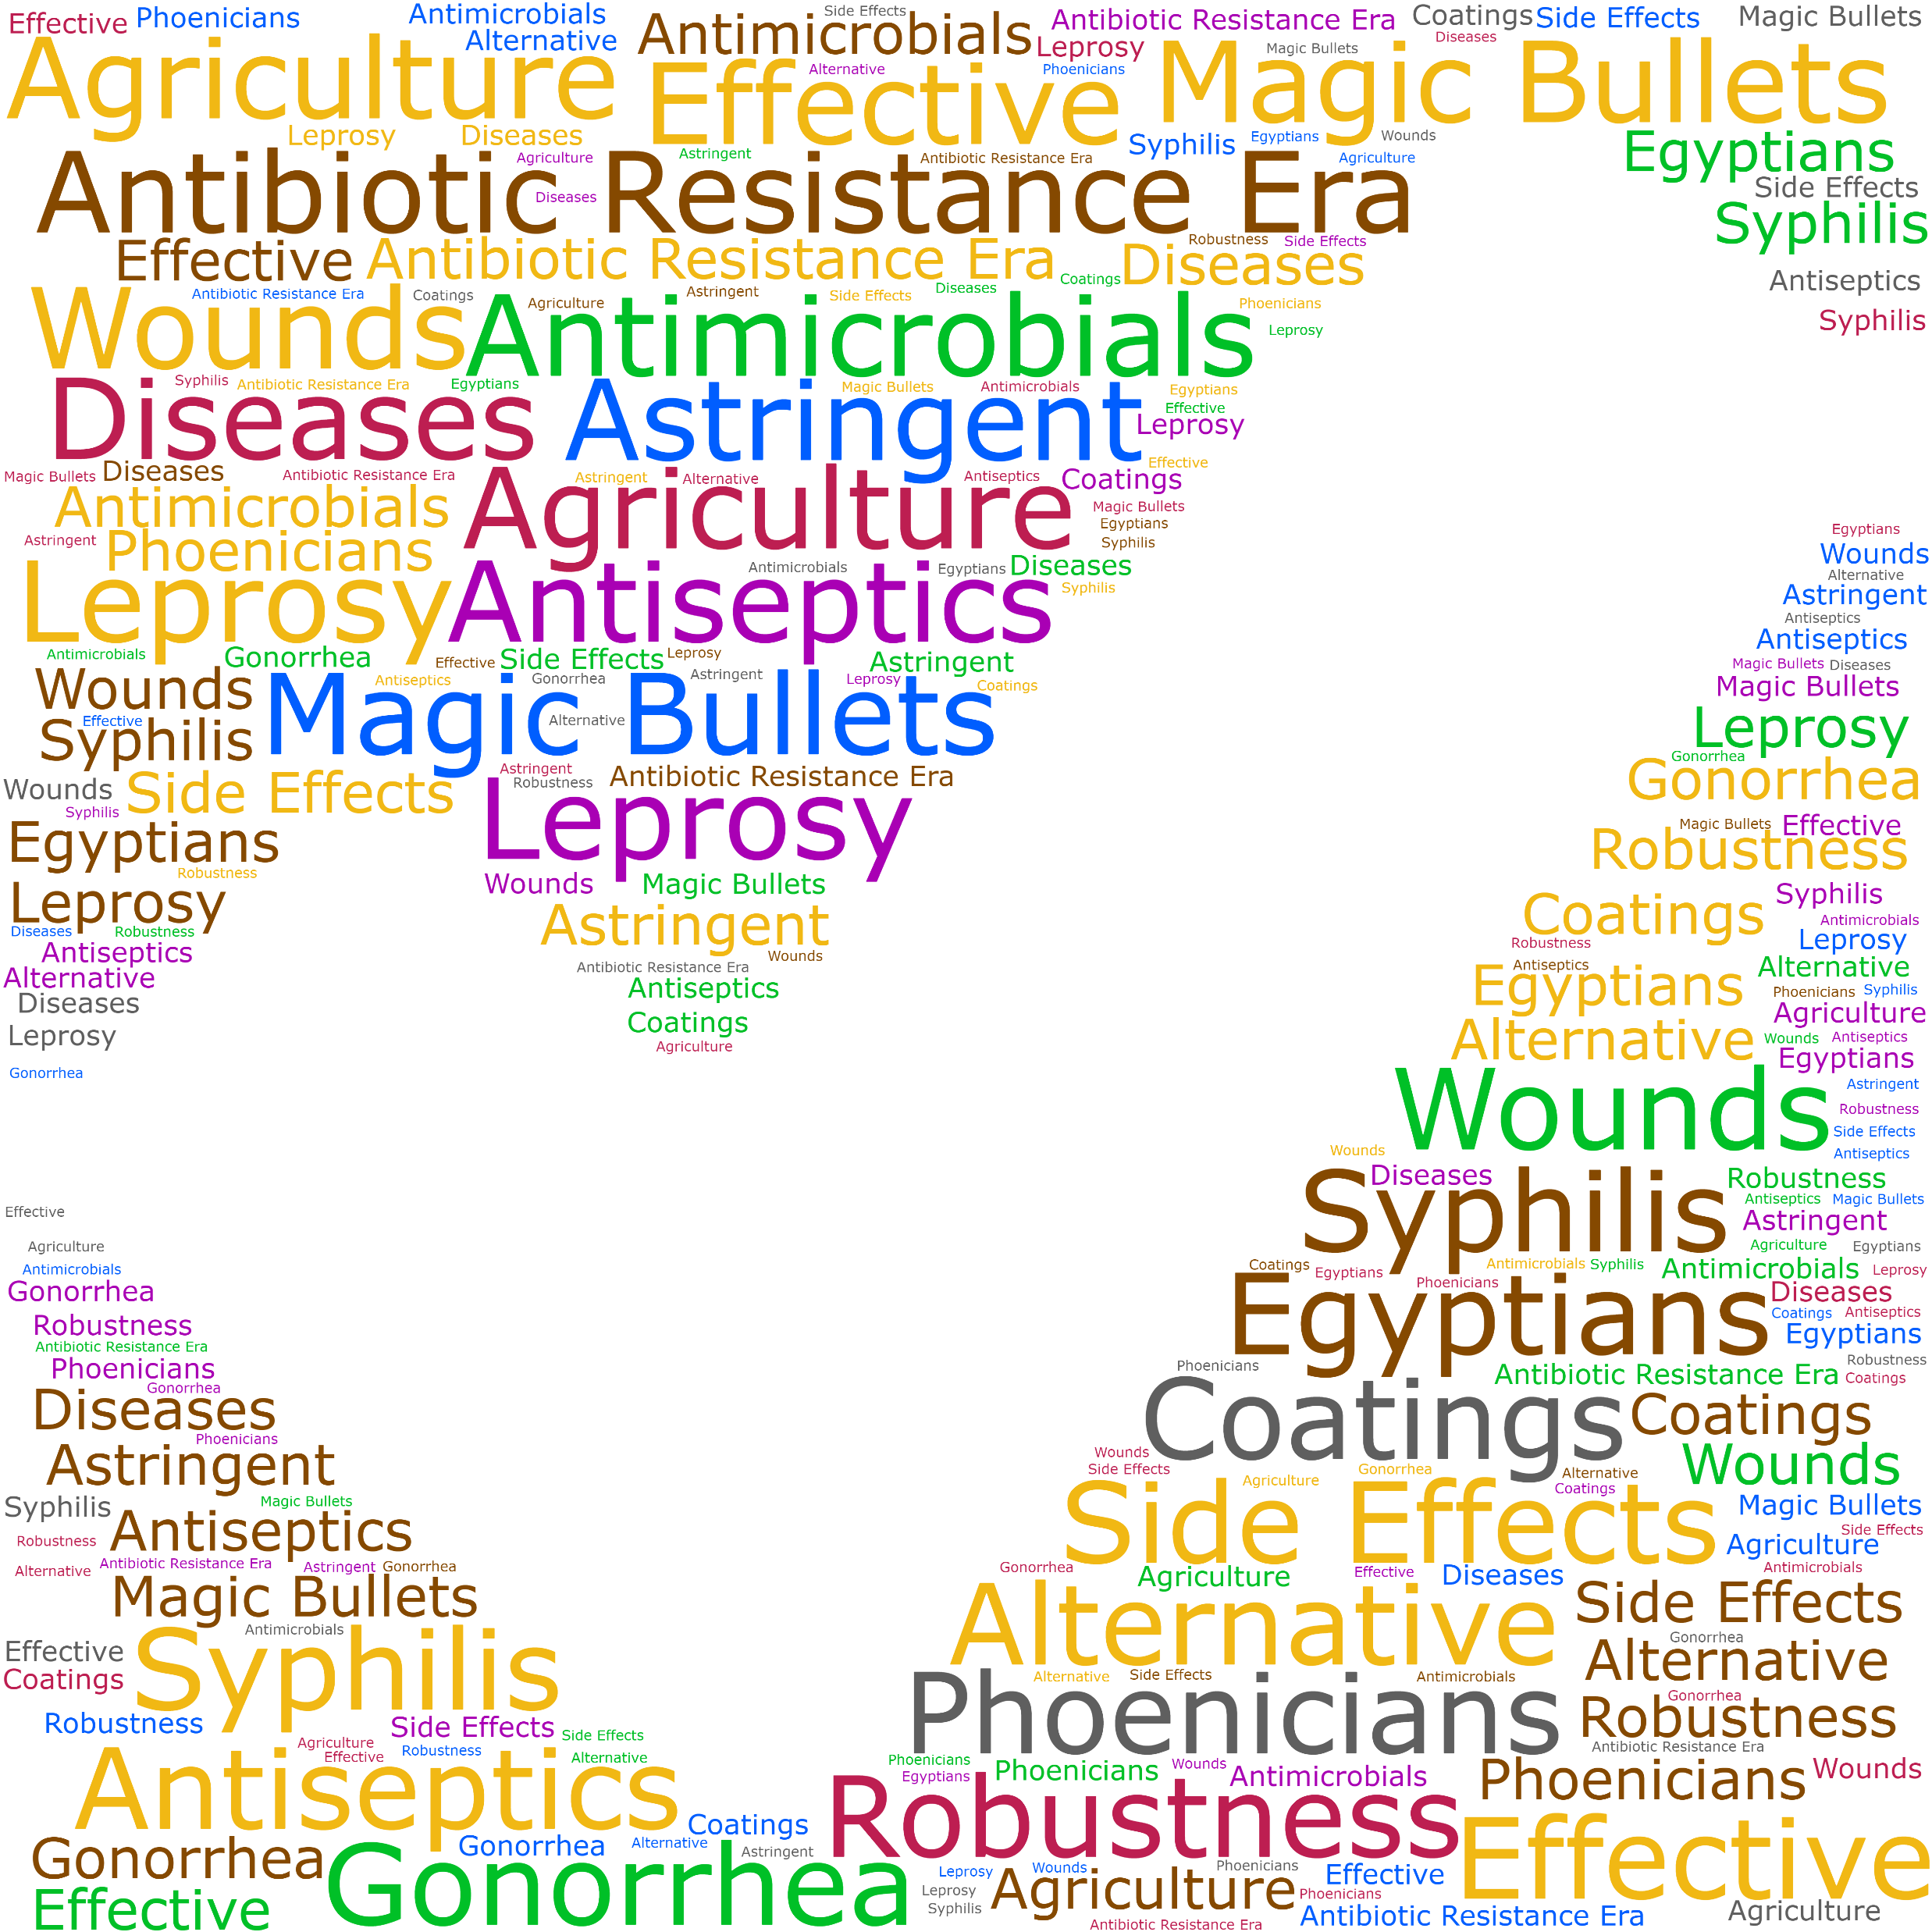
Why metals?
Effective
antimicrobials
that have a robust toxicity profile!
BACKGROUND
Notes:
Metals are effective antimicrobials that have a robust toxicity profile. Their usage dates back to the days of ancient civilizations like the Egyptians and Phoenicians in a variety of applications, all the way to present day. Some compounds were even dubbed as the “magic bullets” against infectious microorganisms due to their efficacy, but poor knowledge of human toxicity to these metals usually led to undesirable side effects. The relative convenience of antibiotics compared to MBAs has seen them relegated from their spot as the go-to antimicrobials since the 1930s, but in this antibiotic-resistance era metals are re-emerging as a possible antimicrobial alternative.
effective antimicrobials robustness Egyptians Phoenicians antiseptics agriculture coatings astringent leprosy syphilis gonorrhea diseases wounds magic-bullets side-effects antibiotic-resistance-era alternative

Slide 5
What is known about MBAs?
Toxicity of Metal-Based Antimicrobials depends heavily on type of exposure and speciation:
Zinc forms – Zn²⁺, Zn-citrate, ZnO NPs
Figure 2. Hard–soft acid base (HSAB) theory can predict the selectivity of metal ions for biological donor ligands. Adapted from Lemire et al., 2013.
BACKGROUND

Slide 6
Why Ag, Cu and Ga?
47
29
31
Ag
Cu
Ga
Silver
Copper
Gallium
107.868
63.546
69.723
Silver nitrate
Soft acid
Ag⁺¹
Copper sulfate
Borderline
Cu⁺²
Gallium nitrate Hard acid
Ga⁺³
BACKGROUND
Notes:
We are in the antimicrobial resistance era. The incidence of antibiotic-resistant bacteria has been on an alarming rise these past decades, while the development of new antibiotics that enter the market has been declining. A study by The Lancet in 2019 revealed that almost 5 million deaths worldwide are directly related to antibiotic-resistant bacteria. These are expected to double in the following decades.

Slide 7
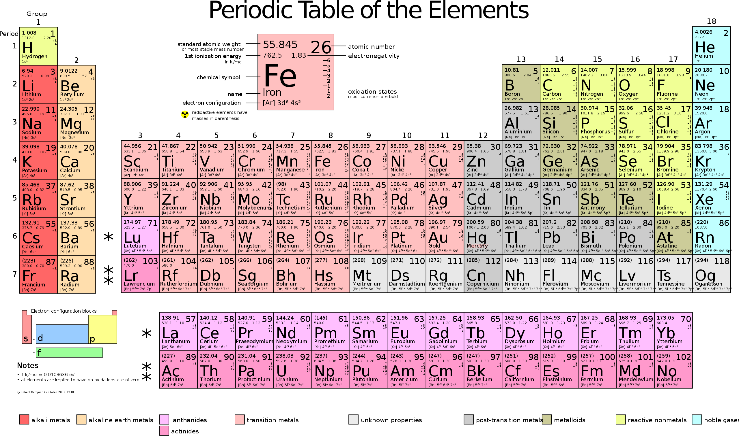
Why Au?
79
Au
Coinage metals
Group 11
Gold
196.966
Tetrachloroauric (III) acid - HAuCl₄
Au⁺³
BACKGROUND
Notes:
We are in the antimicrobial resistance era. The incidence of antibiotic-resistant bacteria has been on an alarming rise these past decades, while the development of new antibiotics that enter the market has been declining. A study by The Lancet in 2019 revealed that almost 5 million deaths worldwide are directly related to antibiotic-resistant bacteria. These are expected to double in the following decades.

Slide 8
What are the knowledge gaps?
Multiple cellular targets have been identified
Lack of equivalent conditions = different results.
Shock response vs Growth in the presence of MBAs.
Most findings are from acute-exposure type of challenges.
Some studies try to address this → omics.
Missing an overview of the full system response
BACKGROUND
Notes:
We are in the antimicrobial resistance era. The incidence of antibiotic-resistant bacteria has been on an alarming rise these past decades, while the development of new antibiotics that enter the market has been declining. A study by The Lancet in 2019 revealed that almost 5 million deaths worldwide are directly related to antibiotic-resistant bacteria. These are expected to double in the following decades.

Slide 9
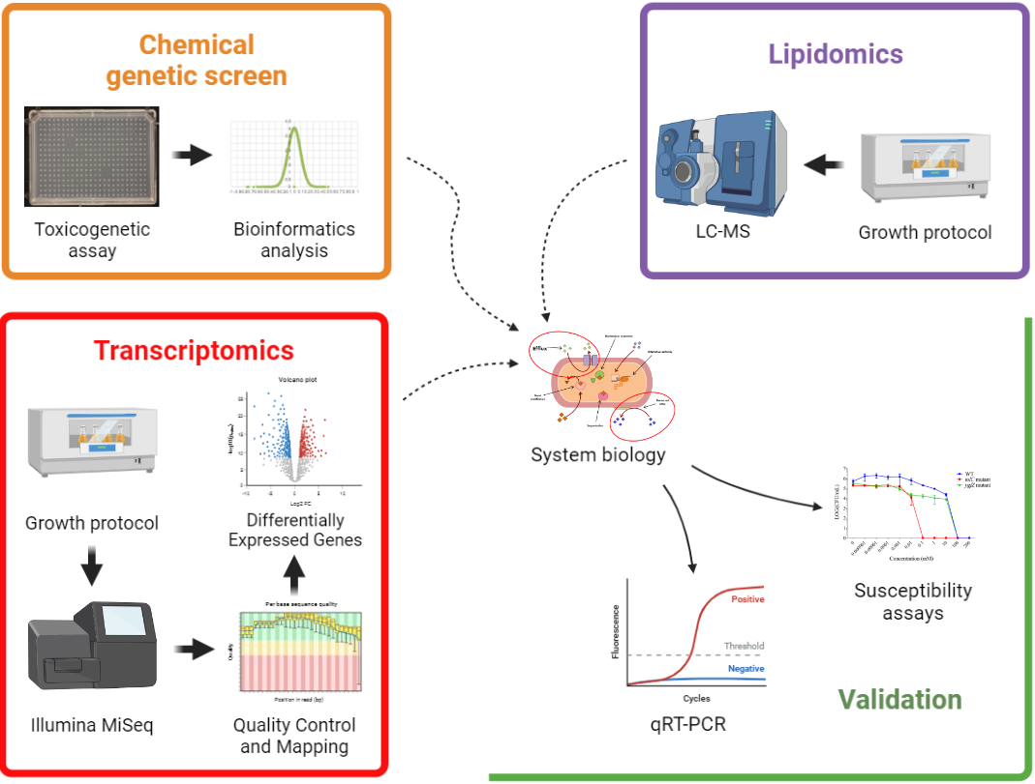
Comparative study to characterize metal-bacteria interactions when growing in the presence of non-lethal concentrations of a metal stressor.
METHODS

Slide 10
Growth curves
SIC candidates
Metal-spiked media inoculated with E. coli K12 BW25113.
Looking for partially inhibited growth → subinhibitory concentration
METHODS – Growth Protocol
Notes:
FIGURE CHANGE FOR A PRETTIER ONE

Slide 11
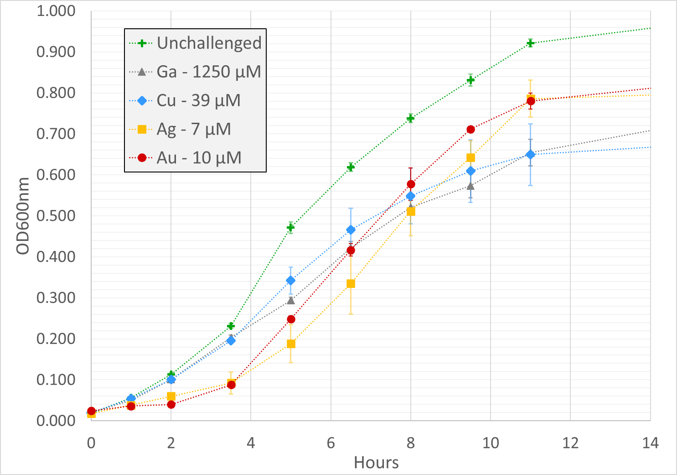
Figure 3. Comparative growth curves of Escherichia coli K12 BW25113 growing in the presence of sublethal metal concentrations.
RESULTS – Growth Protocol

Slide 12
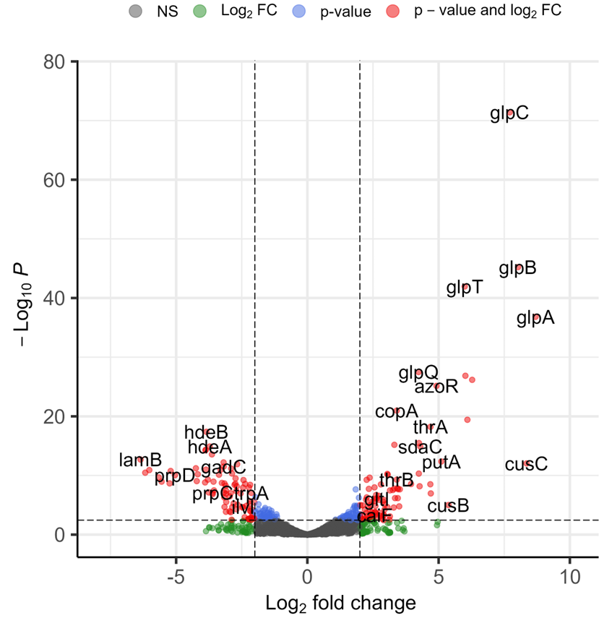
Total RNA extraction
Sampling after X hours of growth
DNA & rRNA depletion
cDNA library synthesis
Illumina sequencing
Statistical
significance
Less expressed
More expressed
METHODS – Transcriptomics: Sequencing
Notes:
NEED

Slide 13
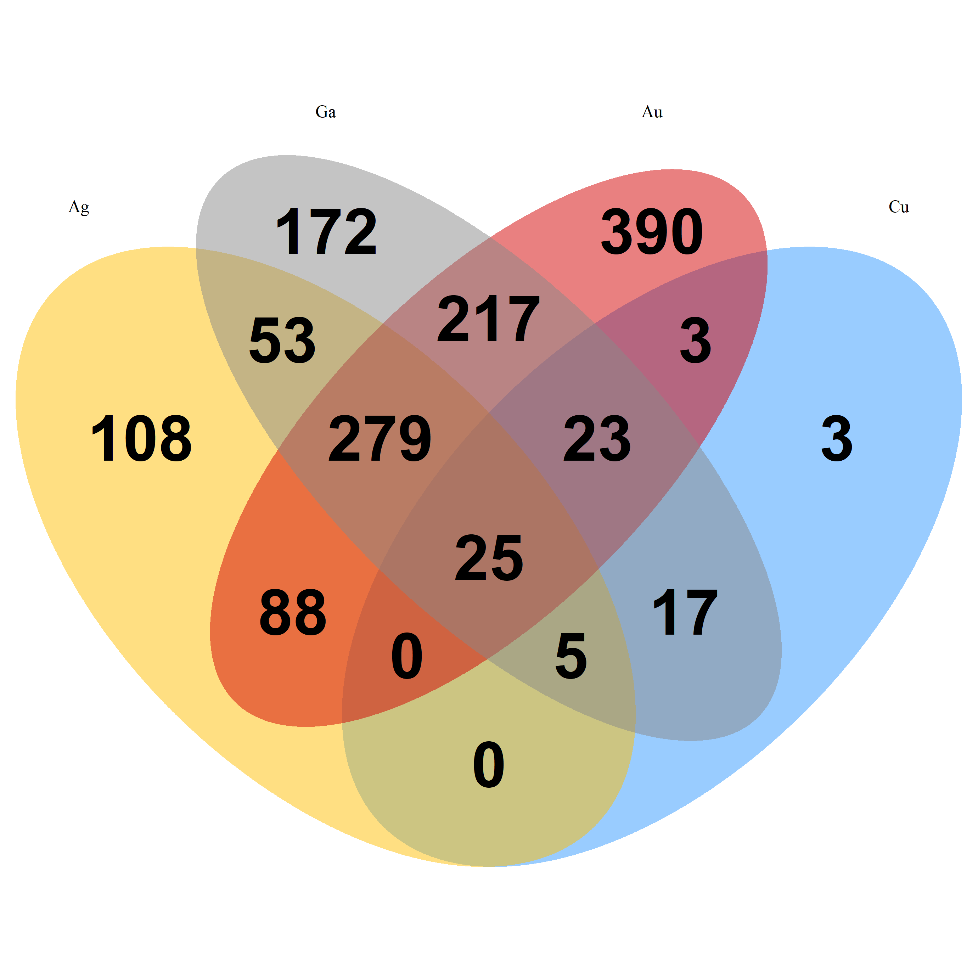
Differentially Expressed Genes
Ga
Au
Ga
Au
Ag
Cu
Ag
Cu
DOWN DEGs | Metal used | UP DEGs
558 | Ag | 131
76 | Cu | 80
791 | Ga | 581
1025 | Au | 1028
Figure 4. Shared and unique down-regulated differentially expressed genes.
Figure 5. Shared and unique up-regulated differentially expressed genes.
RESULTS – Transcriptomics: Systems Biology
Notes:
STRING

Slide 14
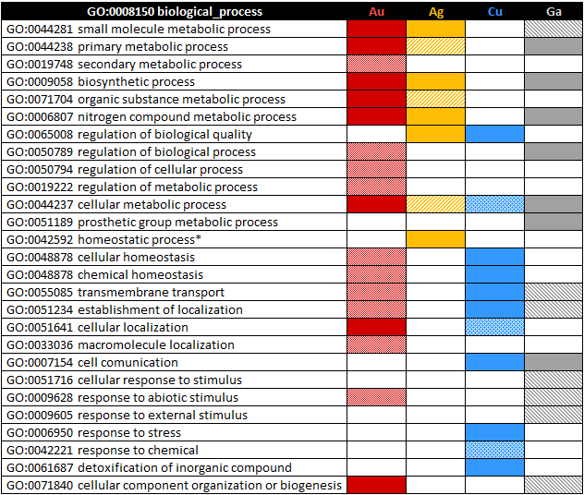
Gene Ontology Enrichment
Table 1. Gene ontology biological process enrichment for each metal’s UP DEGs. Bold colors indicate enriched terms at the second level and/or lower, while faded colors represent enrichment only at lower-level terms
Gene ontology enrichments all over the place, different patterns per treatment.
RESULTS – Transcriptomics: Systems Biology
Notes:
STRING

Slide 15
ISMARA: Transcription Factors
Ag
Cu
Ga
Au
Figure 6. Heatmap depicting the top 10 transcription factors whose target genes have high levels of expression in each dataset. Scale is relative to the maximum and minimum Z-scores of each dataset.
RESULTS – Transcriptomics: Systems Biology
Notes:
STRING

Slide 16
ISMARA: Transcription Factors
Ag
Cu
Ga
Au
Figure 7. Heatmap depicting the top 10 transcription factors whose target genes have low levels of expression in each dataset. Scale is relative to the maximum and minimum Z-scores of each dataset.
RESULTS – Transcriptomics: Systems Biology
Notes:
STRING

Slide 17
Top Differential Expression: Silver
Hydrogen sulfide metabolism.
Cysteine metabolism.
Nucleotide binding.
Ag
Cu
Ga
Au
Figure 8. Gene expression heatmap depicting the top 20 up- and down-regulated genes in the silver treatment.
RESULTS – Transcriptomics: Systems Biology

Slide 18
Top Differential Expression: Copper
Copper homeostasis.
Export
Detoxification
Iron import.
Aerobic electron transport chain.
Ag
Cu
Ga
Au
Figure 9. Gene expression heatmap depicting the top 20 up- and down-regulated genes in the copper treatment.
RESULTS – Transcriptomics: Systems Biology

Slide 19
Top Differential Expression: Gallium
Iron-sulfur cluster assembly.
Sulfate assimilation.
Cysteine biosynthesis.
Ag
Cu
Ga
Au
Figure 10. Gene expression heatmap depicting the top 20 up- and down-regulated genes in the gallium treatment.
RESULTS – Transcriptomics: Systems Biology

Slide 20
Top Differential Expression: Gold
Iron import.
Copper homeostasis?
Iron-sulfur cluster repair and assembly
Cysteine biosynthesis
Ag
Cu
Ga
Au
Figure 11. Gene expression heatmap depicting the top 20 up- and down-regulated genes in the gallium treatment.
RESULTS – Transcriptomics: Systems Biology

Slide 21
Shared upregulated STRING
Network enrichment:
Iron import into cell
Iron ion homeostasis
Ion transport
Related to fur regulation.
Figure 12. STRING functional protein association network for the 20 shared up-regulated genes across treatments.
RESULTS – Transcriptomics: Systems Biology

Slide 22
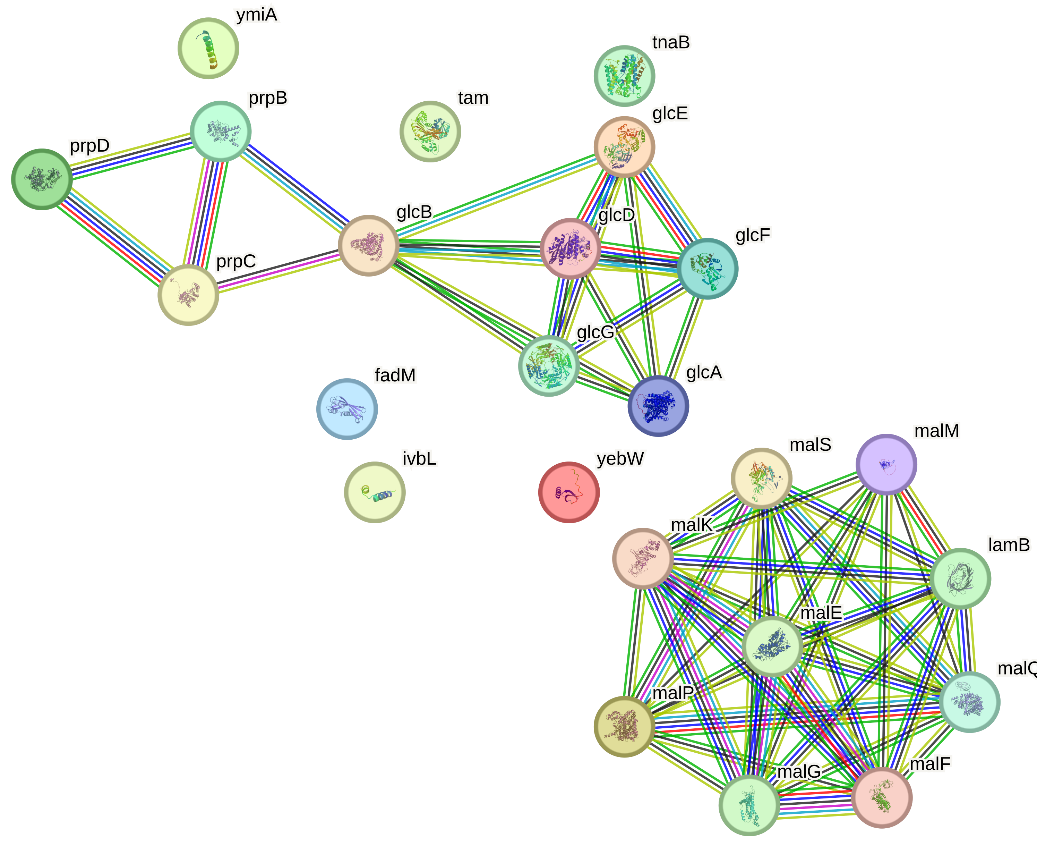
Shared downregulated STRING
Functional enrichments:
glycogen metabolism
fatty acid metabolic process
maltodextrin and maltose transport.
Related to crp regulation.
Figure 13. STRING functional protein association network for the 25 shared down-regulated genes across treatments.
RESULTS – Transcriptomics: Systems Biology

Slide 23
Main takeaways… so far
Expected results:
Copper as a redox-active metal
Targeting of thiol (-SH) groups triggering cysteine production
Iron homeostasis being affected
Poisoning of iron-sulfur centers.
Surprising results
Strong regulatory response in gallium.
Nitrogen compound metabolism being heavily affected.
Multidrug efflux pumps barely represented.
The toxicometallome varies remarkably from one metal to another
RESULTS – Transcriptomics: Systems Biology
Notes:
STRING

Slide 24
FUTURE DIRECTIONS
Compare with previous findings in our group
Which non-essential genes give enhanced sensitivity or resistance to these metals when knocked out?
Identify patterns in gene regulation
Do the DEGs regulatory patterns change on a metal-to-metal basis?
TAKEAWAYS

Slide 25
ACKNOWLEDGEMENTS
Dr. Damon Brown
Dr. Ali Pormohammad
Dr. Natalie Gugala
Arashpreet Grewal
Centre for Health Genomics and Informatics (UofC).
Current Turner lab members:
Andrii, Thomas, Charline
Supervisory committee members:
Dr. Raymond J. Turner
Dr. Gordon Chua
Dr. Joe Harrison

Slide 26
Toxicometallomics of Escherichia coli grown in the presence of silver, copper, gallium and gold metal salts at sublethal concentrations: similarities and differences at the transcriptome level
Daniel A. Salazar Alemán, Shardini Mate, Ashley McGibbon, Mai Linh Tran, Raymond J. Turner

Slide 27
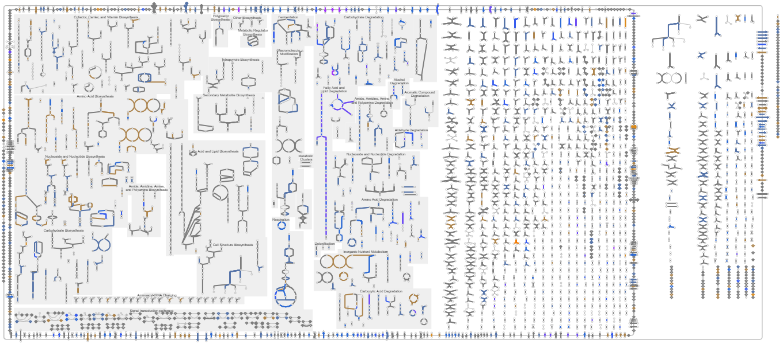
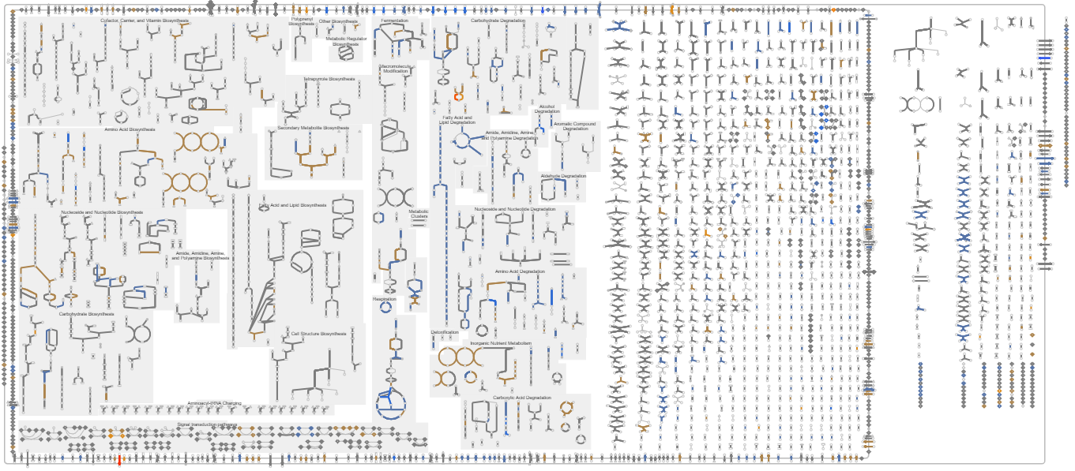
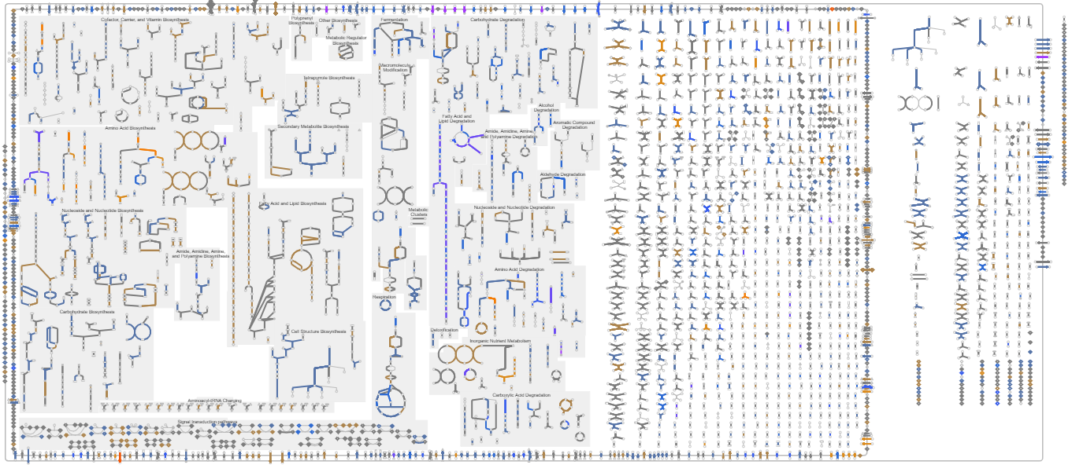
- Non-localized response.
- Multiple, different pathways being affected cell-wide.
RESULTS – Transcriptomics: Pathways View
Notes:
NEED

Slide 28
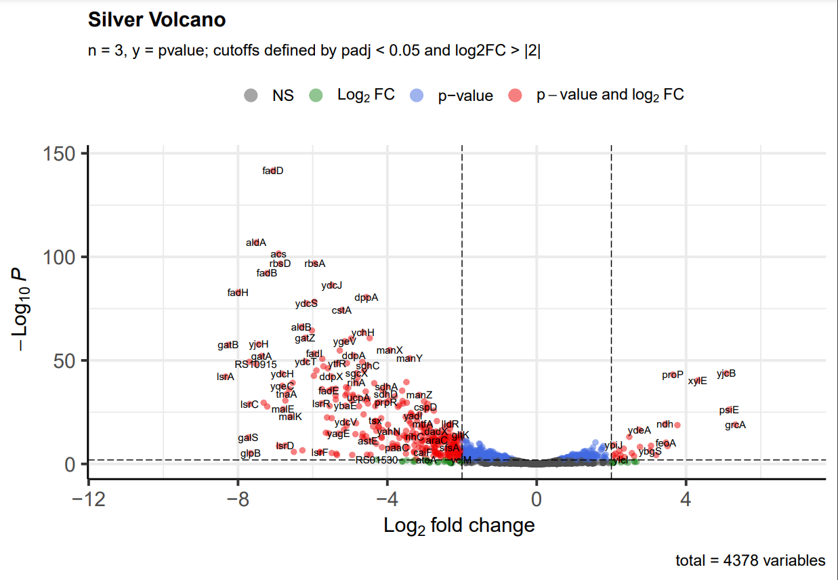
632
280
Figure 4. Volcano plot contrasting expression values from the silver treatment versus the unchallenged control. Statistical significance was determined at a p adjusted value < 0.05.
RESULTS – Transcriptomics: Silver DEGs
Notes:
NEED

Slide 29
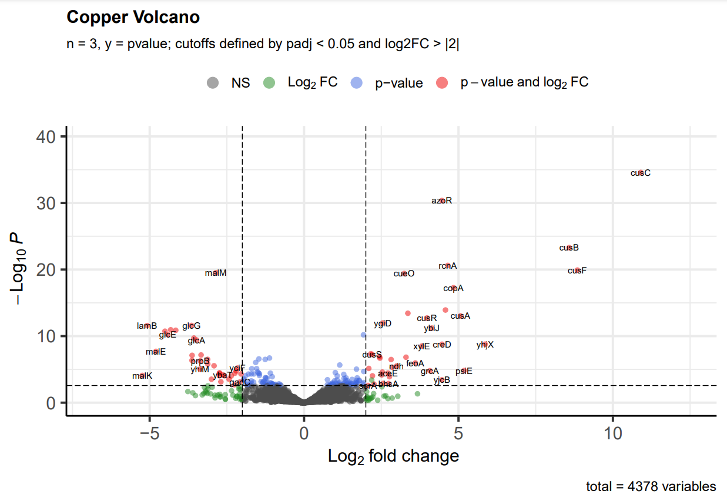
82
89
Figure 5. Volcano plot contrasting expression values from the copper treatment versus the unchallenged control. Statistical significance was determined at a p-adjusted value < 0.05.
RESULTS – Transcriptomics: Copper DEGs
Notes:
NEED

Slide 30
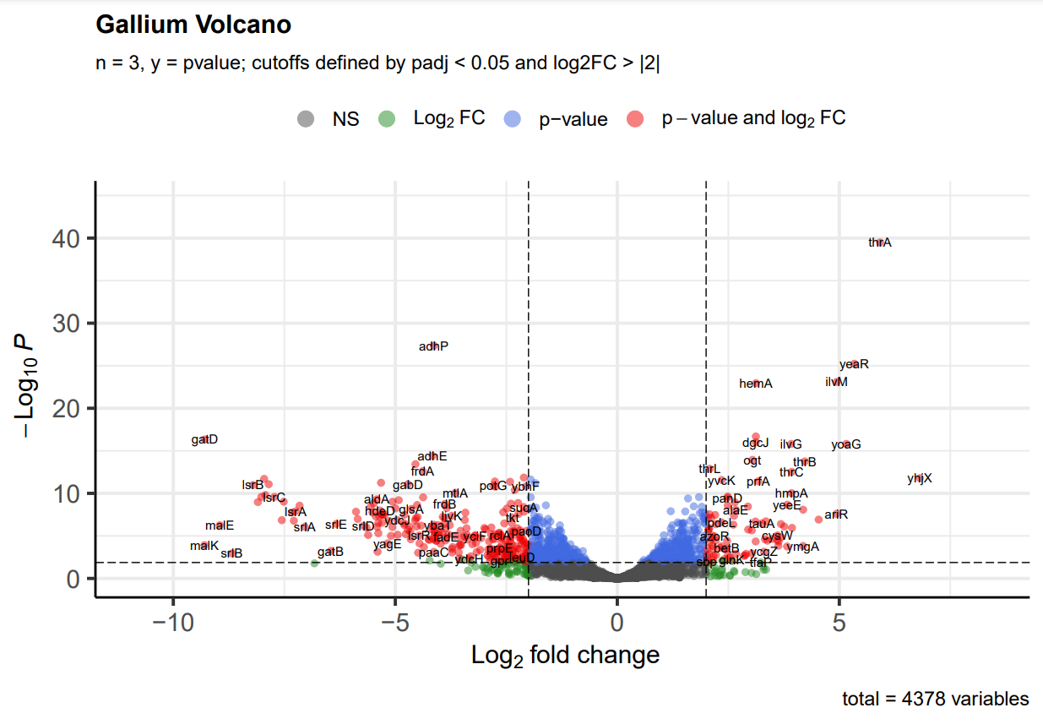
590
390
Figure 6. Volcano plot contrasting expression values from the gallium treatment versus the unchallenged control. Statistical significance was determined at a p-adjusted value < 0.05.
RESULTS – Transcriptomics: Gallium DEGs
Notes:
NEED

Slide 31
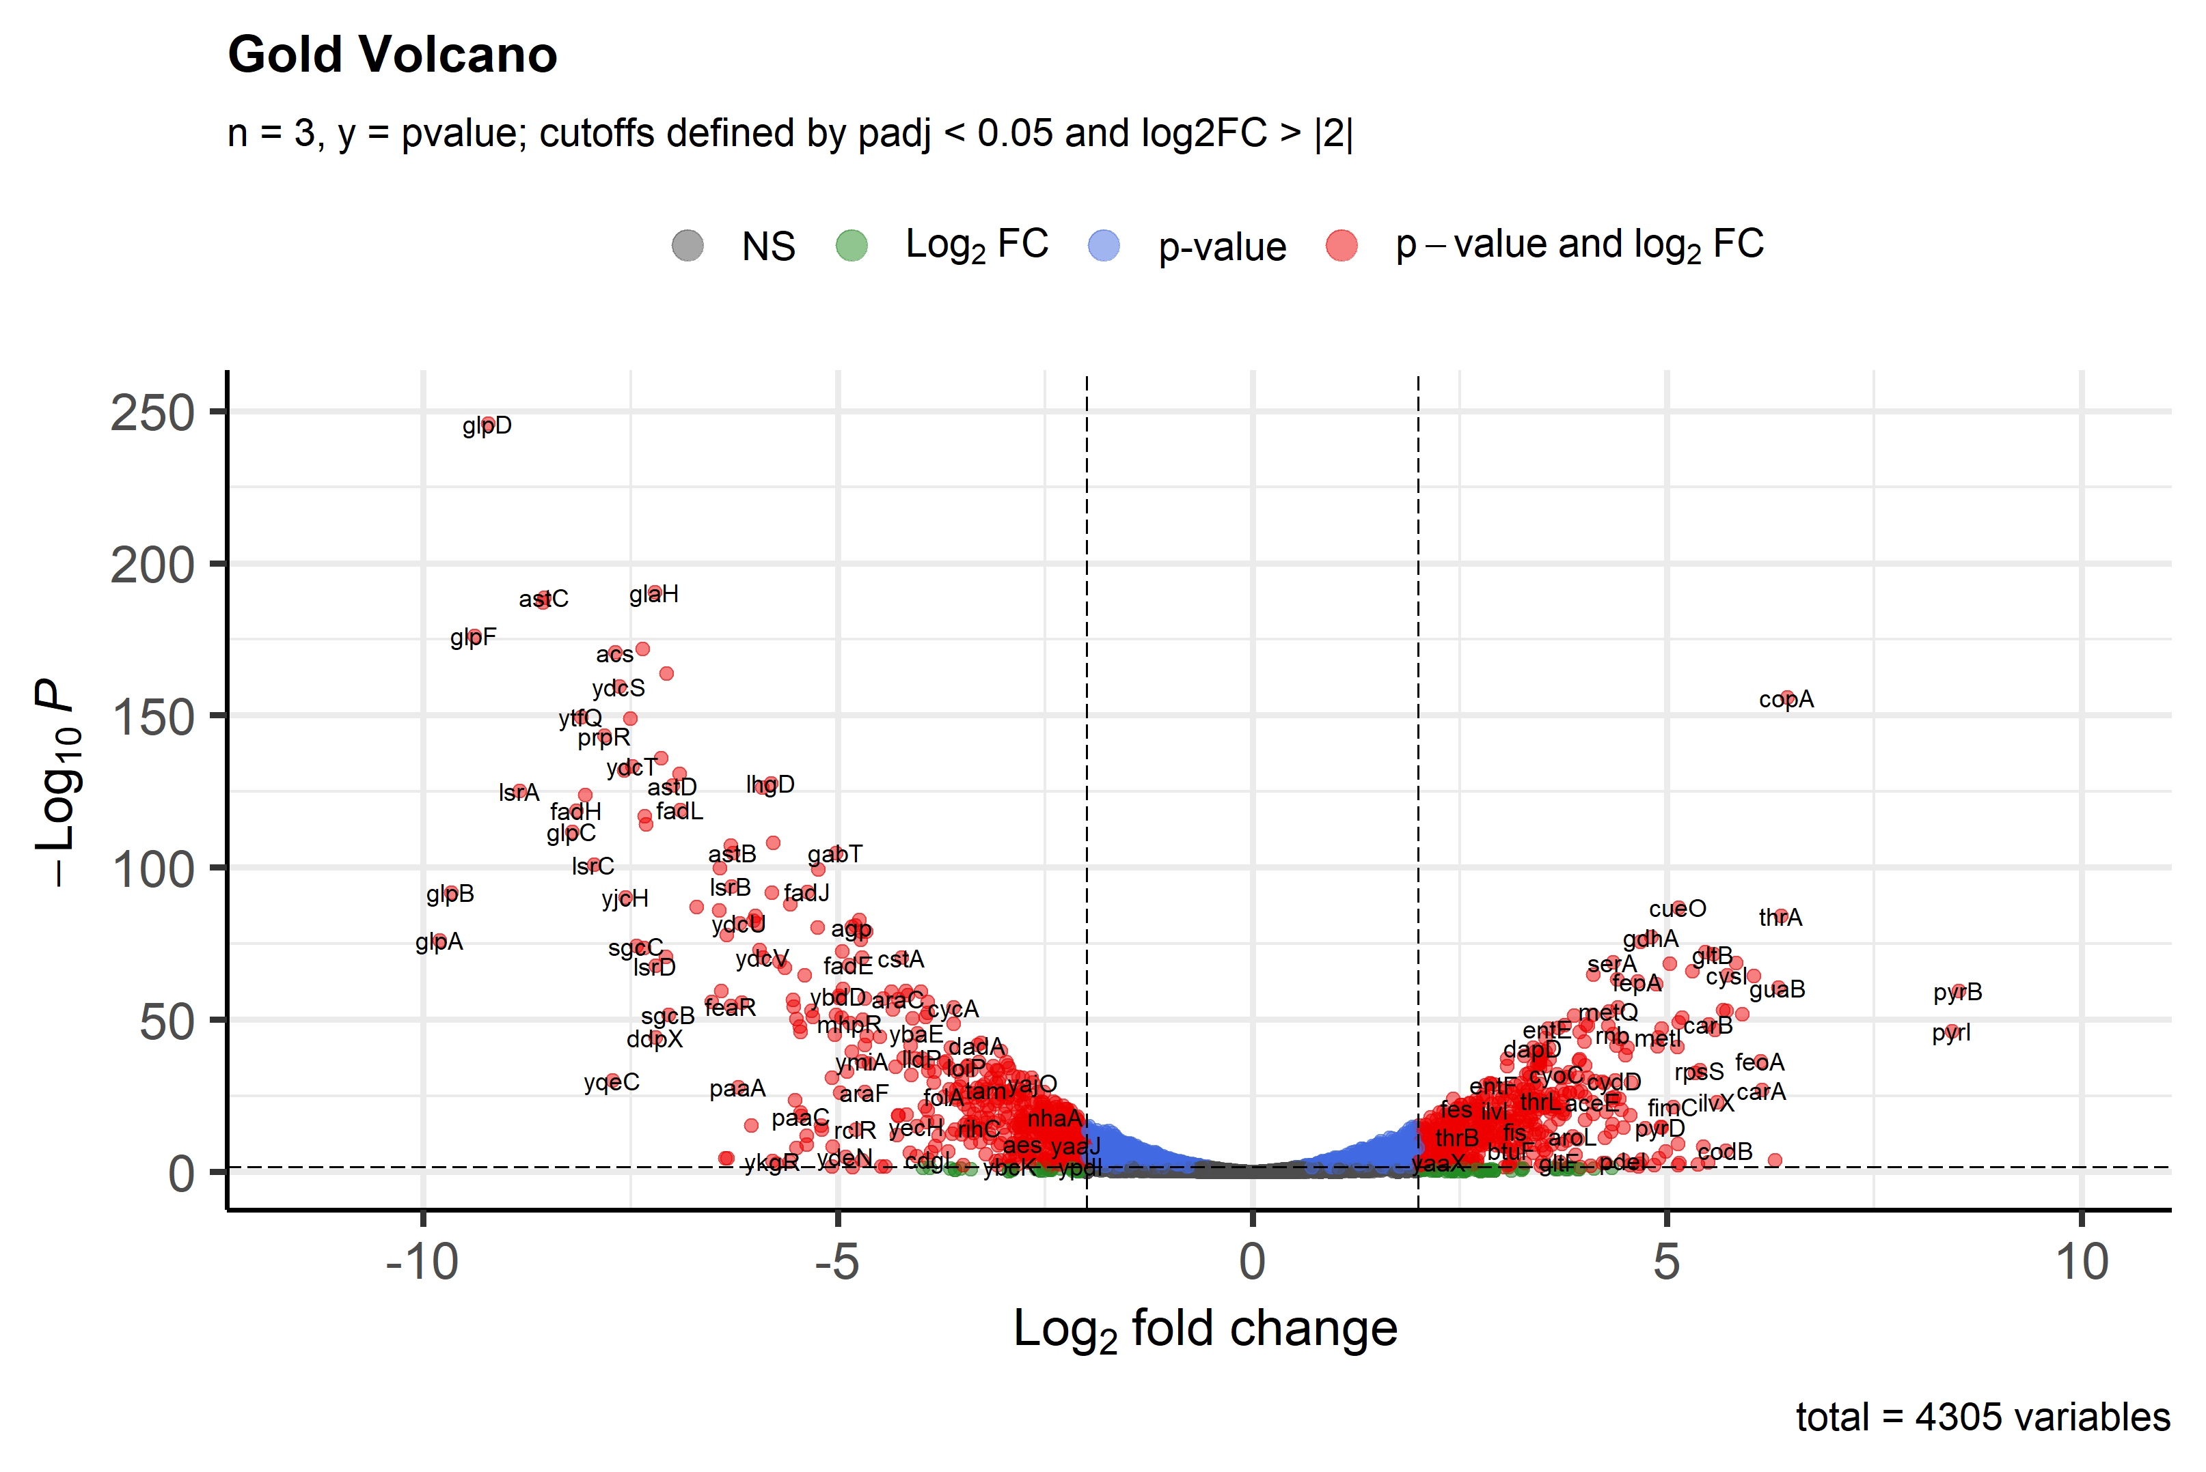
2
1144
1176
RESULTS – Transcriptomics: Gold DEGs
Notes:
NEED

