Slide 1
Bioactive peptides: biomolecules to fight antimicrobial resistance
Francesco Buonocore¹ , Esther Imperlini¹, Federica Massaro¹, Maurizio Sanguinetti², Francesca Bugli², Damiano Squitieri², Stefano Borocci¹, Fernando Porcelli¹
¹Dept. for Innovation in Biological, Agro-food and Forest systems (DIBAF), University of Tuscia, Largo dell'Università snc, 01100 Viterbo, Italy.
²Dept. of Basic Biotechnological Sciences, Intensive and Perioperative Clinics, Catholic University of the Sacred Heart, Rome, 00168, Italy.

Slide 2
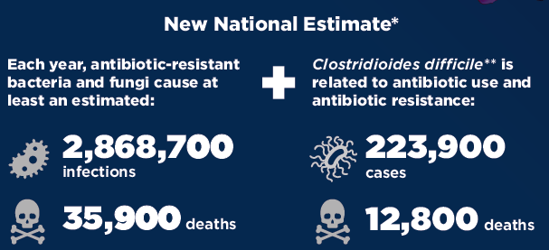
Antimicrobial resistance (AMR) occurs when germs (bacteria, fungi) change and develop the ability “to resist” to the antibiotics usually designed to kill them
The Threat of Antibiotic Resistance in the United States (CDC Report, 2019)

Slide 3
A paper on Lancet (10.1016/S0140-6736(21)02724-0) estimates
4.95 million (3.62–6.57) globally deaths associated with bacterial AMR in 2019
In particular, pathogens identified with the acronym ESKAPE (Enterococcus faecium, Staphylococcus aureus, Klebsiella pneumoniae, Acinetobacter baumannii, Pseudomonas aeruginosa, and Enterobacter spp.) are among the most common causes of life-threatening infections acquired in healthcare facilities
The development of new antibiotics, new tools, or new agents to fight resistant infections is, therefore, an urgent need

Slide 4
In this context, antimicrobial peptides (AMPs) represent a promising class of biomolecules to fight resistant infections
Source: Huan et al. 2020, 10.3389/fmicb.2020.582779

Slide 5
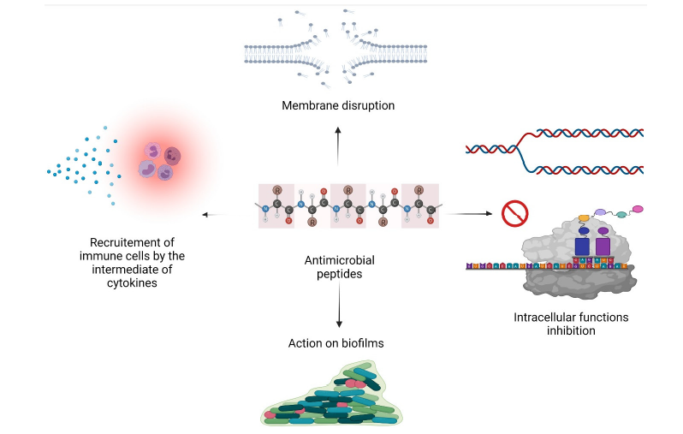
Source: Rima et al. 2021, 10.3390/antibiotics10091095

Slide 6
MECHANISMS OF BACTERIAL RESISTANCE TO AMPs
Source: Cardoso et al. 2020; 10.1007/s12551-021-00784-y

Slide 7
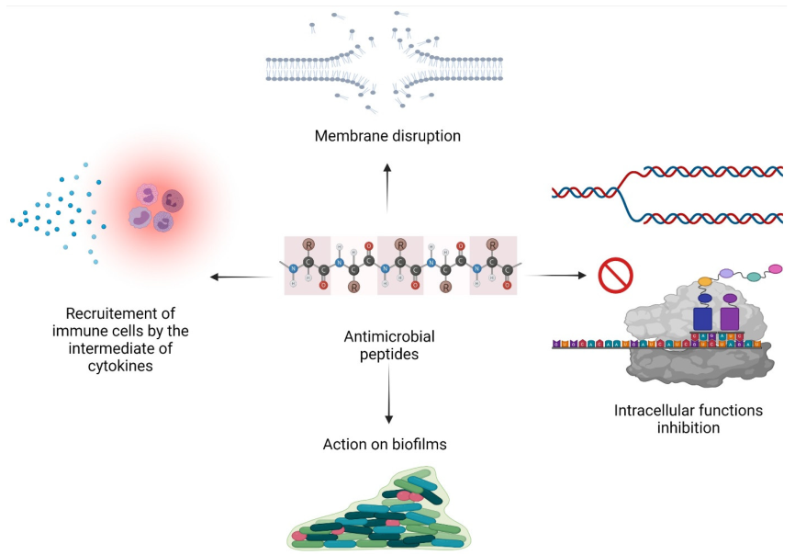
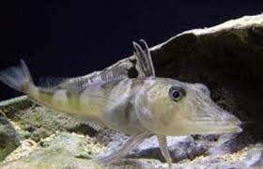
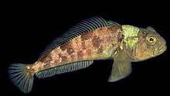
Antarctic fishes, living in an extreme environment and normally exposed to various pathogens, are a promising source for antimicrobial peptides (AMPs)
Chionodraco hamatus
chionodracine (Cnd)
Trematomus bernacchii
trematocine

Slide 8
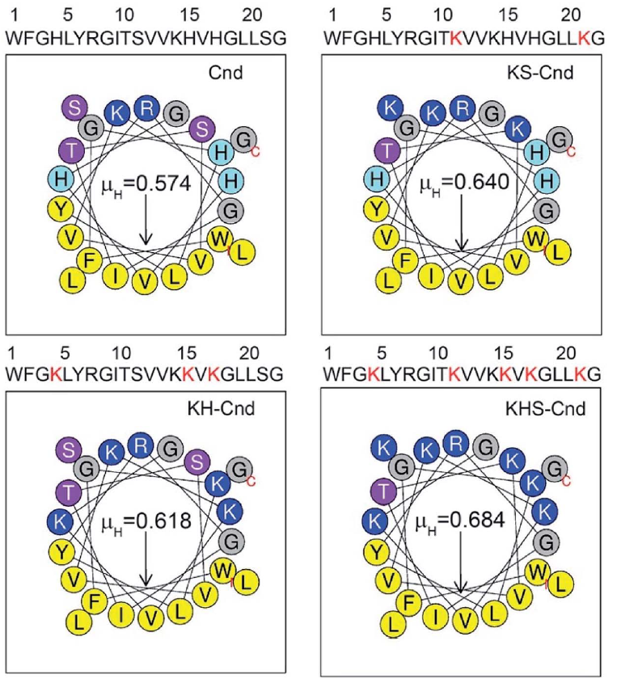
Cnd NMR structure
Mutants with introduced charged residues

Slide 9
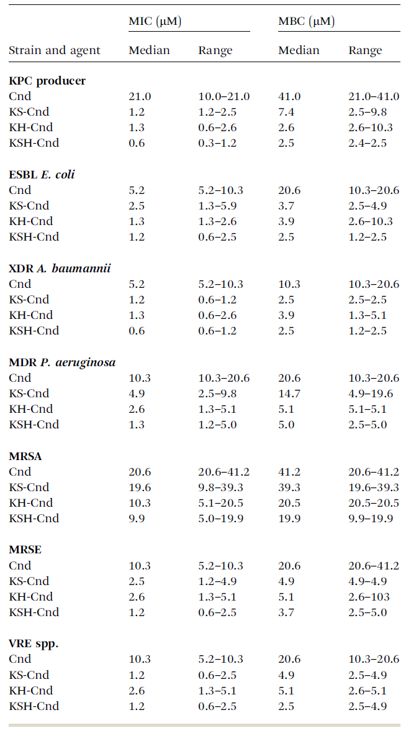
MIC and MBC against clinical pathogens isolates
KPC: Klebsiella pneumoniae carbapenemase; ESBL: Extended spectrum beta-lactamase; XDR: Extensively drug-resistant; MDR: Multidrug resistant; MRSA: Methicillin resistant Staphylococcus aureus; MRSE Methicillin resistant Staphylococcus epidermidis; VRE Vancomycin resistant Enterococcus.

Slide 10
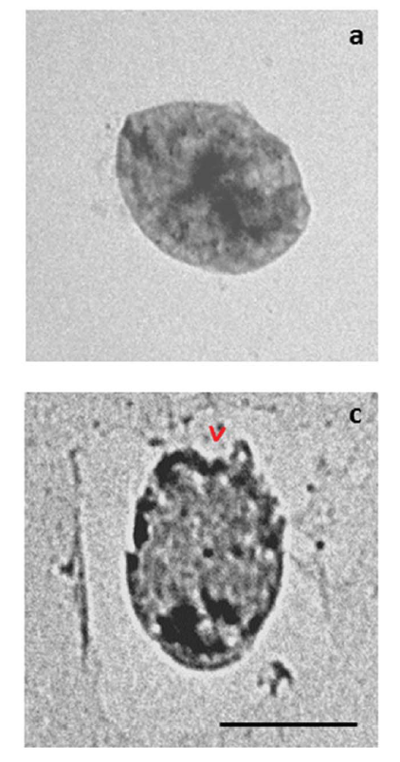
KSH-Cnd peptide for 1 h at 1XMIC on S. epidermidis
(TEM analysis)

Slide 11
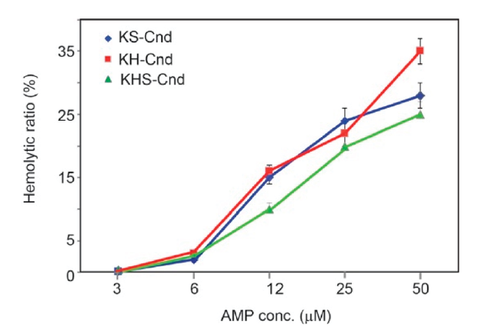
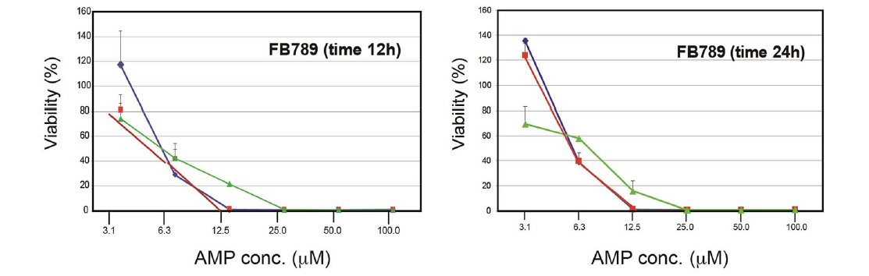
CHIONODRACINE MUTANTS TOXICITY
Hemolytic activity against rabbit erythrocytes
Cytotoxic activity against primary human fibroblast cell line

Slide 12
Mutants with introduced charged residues
Membrane permeabilization assay (ANS uptake)
Bacillus cereus (orange), Escherichia coli (green)

Slide 13
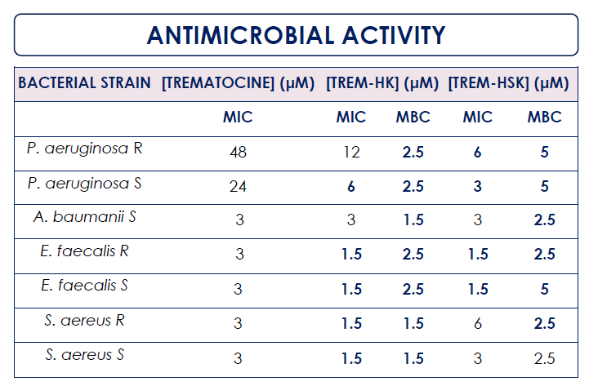
R: resistant; S: suscetible

Slide 15
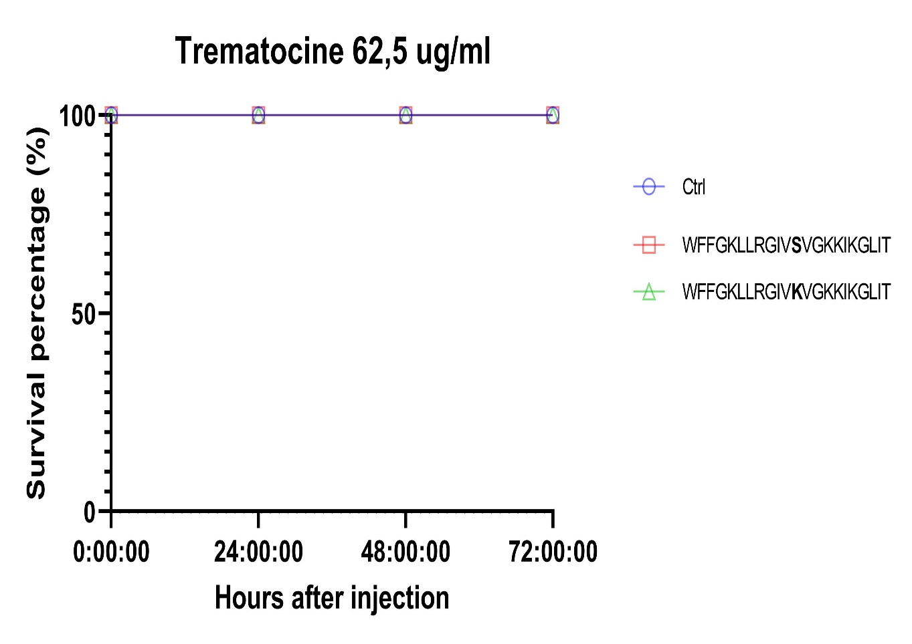
Trem-HS
Trem-HK
In vivo mutant peptides toxicity was studied using Galleria mellonella larvae. After 72 hours of treatment (at a peptide concentration of 24 μM) all larvae survived.

Slide 16
CONCLUSIONS
- A panel of AMPs based on natural scaffold with interesting antibacterial activity has been obtained;
- They have good selectivity towards bacterial cell membrane;
- To overcome the problems related to low plasma stability and in situ bioavailability for a possible in vivo administration, encapsulation of AMPs in specific drug delivery systems will be the next step
- The aim is to transfer the best candidate to pharmacological applications

