Slide 1
Synergistic antifungal activity of gold nanoparticles with Amphotericin B on sessile and persister cells of Candida tropicalis biofilms
The 3rd International Electronic Conference on Antibiotics
María Angel da Silva, Karina Fernanda Crespo Andrada, Iván Manrrique Hughes, Manuela Maldonado Torales, Paulina Laura Páez,
María Gabriela Paraje *
Faculty of exact, physical and natural sciences
National university of Córdoba
Notes:
Submission ID: sciforum-078518 Title: Synergistic antifungal activity of gold nanoparticles with Amphotericin B on sessile and persister cells of Candida tropicalis biofilms Authors: María Angel da Silva, Karina Fernanda Crespo Andrada, Iván Manrrique Hughes, Manuela Maldonado Torales, Paulina Laura Páez, María Gabriela Paraje * Event: The 3rd International Electronic Conference on Antibiotics Section: New Antimicrobial Approaches, Targets and Mechanisms of Action

Slide 2
INTRODUCTION
C. tropicalis has been included as an emergent pathogen in the “high group” of the World Health Organization Antimicrobial Resistance Division fungal priority pathogens list.
Persister cells (PCs) are phenotypic variants of a wild type and are transiently refractory to the killing, without having acquired resistance through genetic modification.
New therapies, such as the use of novel compounds alone or combined with a first-line antifungal agent, could provide an effective solution for Candida biofilm infections, thereby improving the efficacy and reducing side effects.
To date, only a few antifungal drugs are partially effective against Candida biofilm-associated infections, of which the gold standard in Candida infections is Amphotericin B (AmB).
A promising direction for future research is using metallic nanoparticles, such as gold nanoparticles (AuNPs), as well as their combination with other antifungal agents.
Notes:
Abstract
Candida tropicalis is a common member of human and animal microbiota, with invasive candidiasis having an overall mortality ranging from 55% to 60% in adults, and 26% to 40% in pediatric patients and is included as an emergent pathogen in the “high group” of the World Health Organization Antimicrobial Resistance Division fungal priority pathogens list.
We studied the antifungal activity of gold nanoparticles (AuNPs) stabilized with cetyltrimethylammonium bromide (CTAB-AuNPs) and those conjugated with cysteine, in combination with Amphotericin B (AmB), on sessile and persister cells (PCs) of Candida tropicalis biofilms.
The PC model was used and synergistic activity was tested by the checkerboard assay. Biofilms were studied by crystal violet and scanning electron microscopy. The fractional inhibitory concentration (FIC) is a widely accepted means of measuring interactions by calculating the fractional inhibitory concentration index (FICi) using the following equations: FICi = (MBIC in combination/MBIC AuNPs alone) + (MBIC in combination/MBIC AmB alone). The Bliss independence model was chosen as a theoretical approach to compare the effects of AuNPs in combination with AmB. The data interpretation was made by response surface analysis, which served to calculate a theoretical response surface of an indifferent interaction.
Mature biofilms decreased in biomass after the combination of both AuNPs and AmB. A biofilm reduction of 97.29% was obtained with CTAB-AuNPs plus AmB, corresponding to 0.05 FICi points (synergism). Meanwhile, by conjugating cys-AuNPs with AmB, a 91.66% biofilm reduction was obtained, resulting in a FICi value of 0.75 (additive). Analysis of the checkerboard data by the response surface approach led to similar results. For the combination of CTAB-AuNPs with AmB, the SUM-SYN-ANT metric ranged from 5.69 to 36.06, with a mean of 30.91.
Our improved understanding of how these AuNPs aid in the fight against biofilm-associated candidiasis and the development of new approaches to eradicate PC biofilms have great clinical relevance in the treatment of mycoses, which has seen an increasing number of at-risk patients.

Slide 3
AIM
The antifungal activity was studied on sessile and persister cells (PCs) of Candida tropicalis biofilms of gold nanoparticles (AuNPs) stabilized with cetyltrimethylammonium bromide (CTAB-AuNPs) and those conjugated with cysteine, in combination with Amphotericin B (AmB).
Notes:
We studied the antifungal activity of gold nanoparticles (AuNPs) stabilized with cetyltrimethylammonium bromide (CTAB-AuNPs) and those conjugated with cysteine, in combination with Amphotericin B (AmB), on sessile and persister cells (PCs) of Candida tropicalis biofilms.

Slide 4
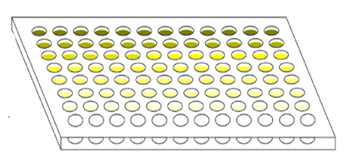
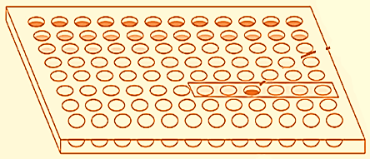
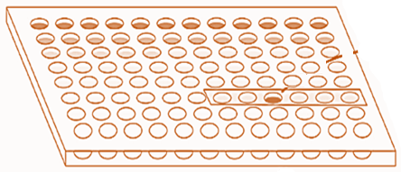
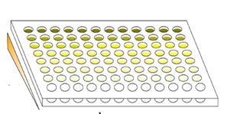
MATERIALS AND METHODS
Planktonic cells
(1 x 10⁷ CFU/mL)
MIC
MFC
3
A
1
plate “B”
plate “A”
Biofilm formation
(48 h 37 °C)
AmB or AuNPs
(48 h 37 °C)
Sonication
(40 kH, 60 s)
B
MBIC
MBEC
CFU ml-¹
MIC
PCs
AmB
C
FICi
AuNPs
Notes:
The PC model was used and synergistic activity was tested by the checkerboard assay. Biofilms were studied by crystal violet and scanning electron microscopy. The fractional inhibitory concentration (FIC) is a widely accepted means of measuring interactions by calculating the fractional inhibitory concentration index (FICi) using the following equations: FICi = (MBIC in combination/MBIC AuNPs alone) + (MBIC in combination/MBIC AmB alone). The Bliss independence model was chosen as a theoretical approach to compare the effects of AuNPs in combination with AmB. The data interpretation was made by response surface analysis, which served to calculate a theoretical response surface of an indifferent interaction.

Slide 5
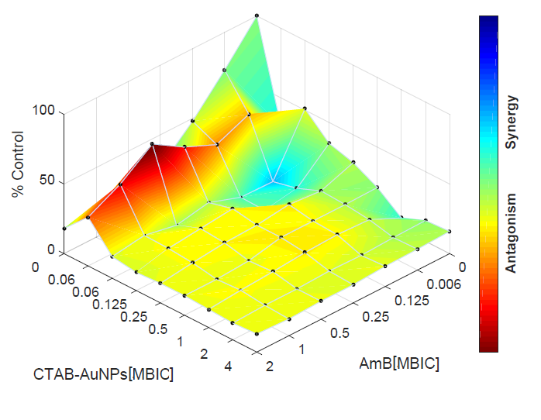
Combination dose-response based on the Bliss independence model.
Interaction between cetyltrimethylammonium bromide gold nanoparticles (CTAB-AuNPs) and Amphotericin B (AmB) on 48 h-old mature biofilms, showing different interactions depending on the combination concentrations.
0.03
0.06
Notes:
Combination dose-response based on the Bliss independence model.

Slide 6
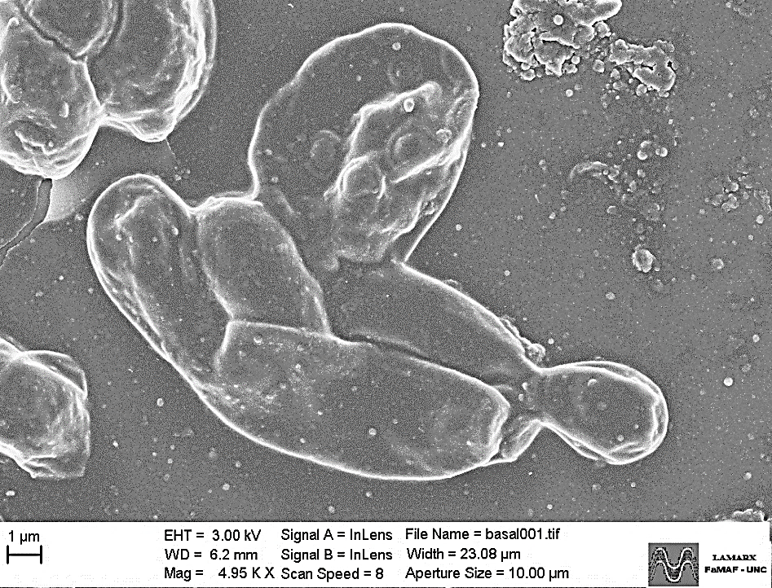
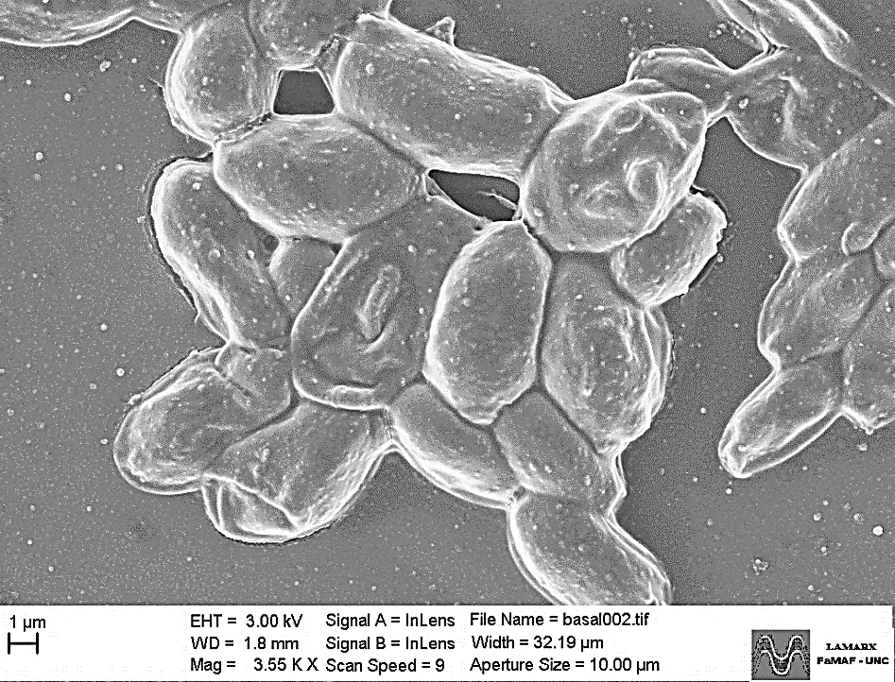
SEM images of antifungal-tolerant persister cells (PCs) after combined treatment and size distribution histogram analysis.
CTAB-AuNPs + AmB cys-AuNPs + AmB
CPs
5,000 x
3,500 x

Slide 7
CONCLUSIONS
To our knowledge, this is the first study that has attempted to correlate the PCs of Candida biofilm reduction with the action of AuNPs combined with AmB and to investigate the consequences on the surface topography and the three-dimensional architecture of the biofilms.
Our improved understanding of how these AuNPs aid in the fight against biofilm-associated candidiasis and the development of new approaches to eradicate PC biofilms could have great clinical relevance in the treatment of mycoses, which has seen an increasing number of at-risk patients.
Notes:
Mature biofilms decreased in biomass after the combination of both AuNPs and AmB. A biofilm reduction of 97.29% was obtained with CTAB-AuNPs plus AmB, corresponding to 0.05 FICi points (synergism). Meanwhile, by conjugating cys-AuNPs with AmB, a 91.66% biofilm reduction was obtained, resulting in a FICi value of 0.75 (additive). Analysis of the checkerboard data by the response surface approach led to similar results. For the combination of CTAB-AuNPs with AmB, the SUM-SYN-ANT metric ranged from 5.69 to 36.06, with a mean of 30.91.
Our improved understanding of how these AuNPs aid in the fight against biofilm-associated candidiasis and the development of new approaches to eradicate PC biofilms have great clinical relevance in the treatment of mycoses, which has seen an increasing number of at-risk patients.

Slide 8
Funding and salary resources

Slide 9
Thanks!!
questions
?
¿

