Slide 1


Global Antimicrobial Resistance and Use Surveillance System (GLASS 2022): Investigating the relationship between antimicrobial resistance and antimicrobial consumption data across the participating countries.
Samuel Ajulo¹, Babafela Awosile¹
¹Texas Tech University School of Veterinary Medicine, Amarillo, TX, USA
ECA, 2023.

Slide 2

Outline
  Background information
  Objective of the study
  Data source and statistical analysis
  Results
  Summary and Conclusion
Image source: https://www.who.int/initiatives/glass

Slide 3
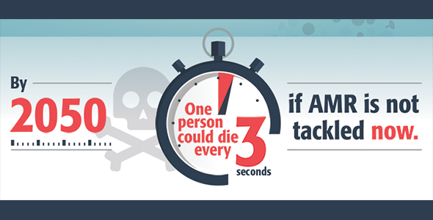
Background information 1
Antimicrobial resistance (AMR) was responsible for about 1.3 million deaths in 2019 (Murray et al., 2022)
This trend will increase and may result in about 10 million deaths annually by 2050 if nothing is done about it (Jim O.N et al., 2016)
Antimicrobial selection pressure favors the development and persistence of AMR
The misuse of antimicrobials further accelerates this selection pressure and aggravates the development and dissemination of AMR (Davies, J.et al., 2010)
Image source: bioMérieux Connection, https://www.biomerieuxconnection.com/2018/07/12/explain-antimicrobial-resistance-friends-family-infographics/

Slide 4
Background information 2
Certain antimicrobials are classified as classified as critically important by WHO to human medicine to tackle AMR.
Within the class mentioned above, a subclass considered as the highest priority to treat multi-drug resistant (MDR) bacterial infection are quinolones, third and fourth-generation cephalosporins, macrolides and ketolides, and glycopeptides (WHO, 2019)
It is alarming that there are increasing reports of resistance to these highest-priority antimicrobials too (Collignon et. al, 2016)

Slide 5
Background information 3
In 2015, as part of the global fight against AMR, the Global Antimicrobial Resistance and Use Surveillance System (GLASS) was established by the World Health Organization (WHO) (WHO, 2015).
In the 2022 report, for the first time WHO reported both AMC and AMR data from participating countries, although only a few countries participated in reporting both AMR and AMC data (WHO, 2022).
This framework was aimed to harmonize the reporting of quality and representative data of AMR and AMU on a global scale.
The GLASS has also led to improvements in surveillance systems in several countries, territories, and areas (CTAs), however, many CTAs still have poor surveillance systems and are still associated with data underreporting.

Slide 6
Study Objective
The objective of this study was to associate the reported AMR data with the AMC data in different countries and regions based on the reported GLASS data, focusing on beta-lactam/cephalosporin and quinolones AMC data and beta-lactam/cephalosporin and quinolones resistant E. coli and Klebsiella pneumoniae and also explore the relationship and differences between the AMC data reported among the participating countries.

Slide 7
Data source and statistical analysis 1
The data used in this study was extracted from the WHO GLASS report published for 2022 (WHO, 2022)
216 countries, territories, and areas (CTAs) were enrolled in the GLASS program however, data availability varied from country to country.
Only 26 CTAs presented AMC data for the data collection cycle and data were presented as both adjusted and unadjusted measurements.
AMR data were presented as percentage-resistant bacteria isolated from total bacteriologically confirmed infections.
The data collection round for this report was designated 2020 but spanned till 2021.

Slide 8
Data source and statistical analysis 2
For this study we extracted AMC data expressed as a defined daily dose (DDD) adjusted by the population size of each participating country for Beta-lactam antibacterials, penicillins group (J01C), Other beta-lactam antibacterials group (J01D), and Quinolone antibacterials group (J01M)
For the AMR data, we extracted data on bloodstream infection for beta-lactam and fluoroquinolone-resistant Escherichia coli and Klebsiella pneumoniae

Slide 9
Data source and statistical analysis 2
Datasets
AMC data expressed as a defined daily dose (DDD) adjusted by the population size of each participating country for
  Beta-lactam antibacterials, penicillins group (J01C),
  Other beta-lactam antibacterials group (J01D), and
  Quinolone antibacterials group (J01M)
AMR data on bloodstream infection for beta-lactam and fluoroquinolone-resistant Escherichia coli and Klebsiella pneumoniae
Statistical Analysis
mixed-effect regression model with the beta distribution:
  Effect of AMC on the prevalence of beta-lactam and fluoroquinolone-resistant E. coli and Klebsiella pneumoniae
multivariable linear regression model and adjustment for multiple comparisons using Tukey’s method:
  Explore the relationship and differences in the antimicrobial consumption data (DDD) reported among the participating countries
Statistical significance was set at P<0.05, and all statistical analyses were performed using R software (R version 4.1.1)

Slide 10
Table 1: Beta regression mixed models of the effect of antimicrobial consumption on the prevalence of beta-lactam and fluoroquinolone-resistant E. coli and Klebsiella spp. from bloodstream infections (the country was taken as a random effect)
Antimicrobial consumption (Variable) | Antimicrobial resistance (Outcome) | Regression estimates
 |  | Odds ratio | 95% Confidence interval | P-value
Beta-lactam/Cephalosporins Consumption | Bloodstream Ceftriaxone-R E. coli | 1.22 | 1.01-1.48 | 0.0395
Beta-lactam/Cephalosporins Consumption | Bloodstream Ceftazidime-R Klebsiella spp. | 1.20 | 0.98-1.47 | 0.0737
Beta-lactam/Cephalosporins Consumption | Bloodstream Ceftriaxone-R Klebsiella spp. | 1.11 | 0.99-1.25 | 0.0522
Quinolone Consumption | Bloodstream Ciprofloxacin-R E. coli | 1.40 | 1.17-1.67 | 0.0002
Quinolone Consumption | Bloodstream Levofloxacin-R E. coli | 1.31 | 1.15-1.50 | <0.0001
Quinolone Consumption | Bloodstream Ciprofloxacin-R Klebsiella spp. | 1.37 | 1.07-1.76 | 0.0118
Quinolone Consumption | Bloodstream Levofloxacin-R Klebsiella spp. | 1.31 | 1.02-1.68 | 0.0341

Slide 11
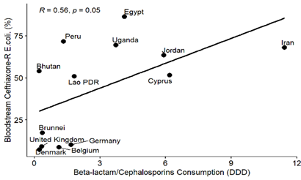
Figure 1: Linear association and Spearman correlation coefficients between selected extended-spectrum cephalosporin-resistant bacteria from bloodstream infections and beta-lactam/cephalosporin consumption among the countries.
A
B
We observed a statistically significant positive linear association between bloodstream-associated ceftriaxone-resistant E. coli or Klebsiella and bloodstream-associated ceftazidime-resistant E. coli or Klebsiella and beta-lactam drug consumption among the countries.
Clustering observed in countries based on AMC pattern
C
D

Slide 12
Figure 2: Linear association and Spearman correlation coefficients between selected fluoroquinolone-resistant bacteria from bloodstream infections and quinolone consumption among the countries.
A
B
we observed a statistically significant positive linear association between bloodstream-associated ciprofloxacin-resistant E. coli or Klebsiella, and bloodstream-associated levofloxacin-resistant E. coli or Klebsiella and quinolone consumption among the countries.
Clustering observed in countries based on AMC pattern
C
D

Slide 13
Figure 2: Linear association and Spearman correlation coefficients between selected fluoroquinolone-resistant bacteria from bloodstream infections and quinolone consumption among the countries.
Antimicrobial group comparison | DDD difference | Standard error | P-value
Beta-lactam antibacterials, penicillins (J01C) - Aminoglycoside antibacterials (J01G) | 8.13 | 0.79 | <0.0001
Other antibacterials (J01X) - Beta-lactam antibacterials, penicillins (J01C) | -7.70 | 0.78 | <0.0001
Intestinal antiinfectives (A07A) - Beta-lactam antibacterials, penicillins (J01C) | -8.26 | 0.90 | <0.0001
Sulfonamides and trimethoprim (J01E) - Beta-lactam antibacterials, penicillins (J01C) | -7.44 | 0.80 | <0.0001
Beta-lactam antibacterials, penicillins (J01C) - Agents against amoebiasis and other protozoal diseases (P01A) | 7.06 | 0.78 | <0.0001
Beta-lactam antibacterials, penicillins (J01C) - Amphenicols (J01B) | 8.32 | 0.95 | <0.0001
Tetracyclines (J01A) - Beta-lactam antibacterials, penicillins (J01C) | -6.62 | 0.79 | <0.0001
Quinolone antibacterials (J01M) - Beta-lactam antibacterials, penicillins (J01C) | -6.28 | 0.78 | <0.0001
Combinations of antibacterials (J01R) - Beta-lactam antibacterials, penicillins (J01C) | -8.70 | 1.25 | <0.0001
Macrolides, lincosamides and streptogramins (J01F) - Beta-lactam antibacterials, penicillins (J01C) | -5.23 | 0.78 | <0.0001
Other beta-lactam antibacterials (J01D) - Beta-lactam antibacterials, penicillins (J01C) | -5.13 | 0.78 | <0.0001
Other beta-lactam antibacterials (J01D) - Aminoglycoside antibacterials (J01G) | 2.99 | 0.79 | 0.010
Macrolides, lincosamides and streptogramins (J01F) - Aminoglycoside antibacterials (J01G) | 2.89 | 0.79 | 0.017
Other beta-lactam antibacterials (J01D) - Intestinal antiinfectives (A07A) | 3.14 | 0.90 | 0.028
Macrolides, lincosamides and streptogramins (J01F) - Intestinal antiinfectives (A07A) | 3.03 | 0.90 | 0.040
Other beta-lactam antibacterials (J01D) - Amphenicols (J01B) | 3.19 | 0.95 | 0.044
Other beta-lactam antibacterials (J01D) - Other antibacterials (J01X) | 2.57 | 0.78 | 0.051
Macrolides, lincosamides and streptogramins (J01F) - Amphenicols (J01B) | 3.09 | 0.95 | 0.061
Other antibacterials (J01X) - Macrolides, lincosamides and streptogramins (J01F) | -2.46 | 0.78 | 0.075

Slide 14
Summary and Conclusion
There was a consistently significant positive linear association between antimicrobial consumption and resistance in beta-lactam and fluoroquinolone-resistant E. coli and Klebsiella spp. from bloodstream infections.
These findings also emphasize the need to implement effective antimicrobial stewardship programs and policies to optimize antimicrobial use and lower the prevalence of resistant bacterial infections.
Also, this study emphasizes the importance of combined analysis of AMC and AMR data to effectively make policy decisions and take effective measures to fight the AMR menace.

Slide 15
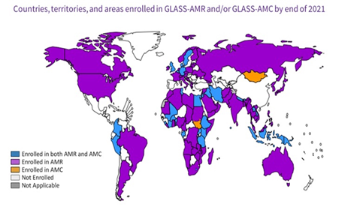
Summary and Conclusion
A key limitation of this study is based on the inconsistencies of the data from different CTAs. CTAs with robust surveillance were able to give robust reports, while CTAs with poor surveillance systems are associated with underreporting of either or both AMC and AMR data.
Although, this is the first time WHO will be reporting together both AMC and AMR data since GLASS started, with time this approach will get better and help to generate more insight to making more robust policies to fight AMR.
Image source: https://www.who.int/initiatives/glass

Slide 16
References
Murray, C.J.L., et al., Global burden of bacterial antimicrobial resistance in 2019: a systematic analysis. The Lancet, 2022. 399(10325): p. 629-655.
Jim, O.N., Tackling drug-resistant infections globally: final report and recommendations. 2016.
(WHO), W.H.O., Global Action Plan on Antimicrobial Resistance. 2015.
Collignon, P.C., et al., World Health Organization Ranking of Antimicrobials According to Their Importance in Human Medicine: A Critical Step for Developing Risk Management Strategies to Control Antimicrobial Resistance From Food Animal Production. Clinical Infectious Diseases, 2016. 63(8): p. 1087-1093.
(WHO), W.H.O., Global Antimicrobial Resistance and Use Surveillance System (GLASS) Report 2022. 2022.
Davies, J. and D. Davies, Origins and evolution of antibiotic resistance. Microbiol Mol Biol Rev, 2010. 74(3): p. 417-33.
World Health Organization (WHO), Critically important antimicrobials for human medicine: 6th revision, (AGISAR), Editor. 2019.

