Slide 1
Genomic characterization of fecal Escherichia coli isolates with reduced susceptibility to beta-lactam antimicrobials from wild hogs and Coyotes
Md. Kaisar Rahman ¹, Babafela Awosile ¹ , Jason Fritzler ¹ , Gizem Levent ¹, Samuel Ajulo ¹ , Ian Daniel ^{1,2} , Yamima Tasnim ¹ and Sumon Sarkar ¹
1 School of Veterinary Medicine, Texas Tech University, Amarillo, TX 79106, USA;
2 School of Veterinary Medicine & Biomedical Sciences, Texas A&M University, College Station, TX 77843, USA

Slide 2
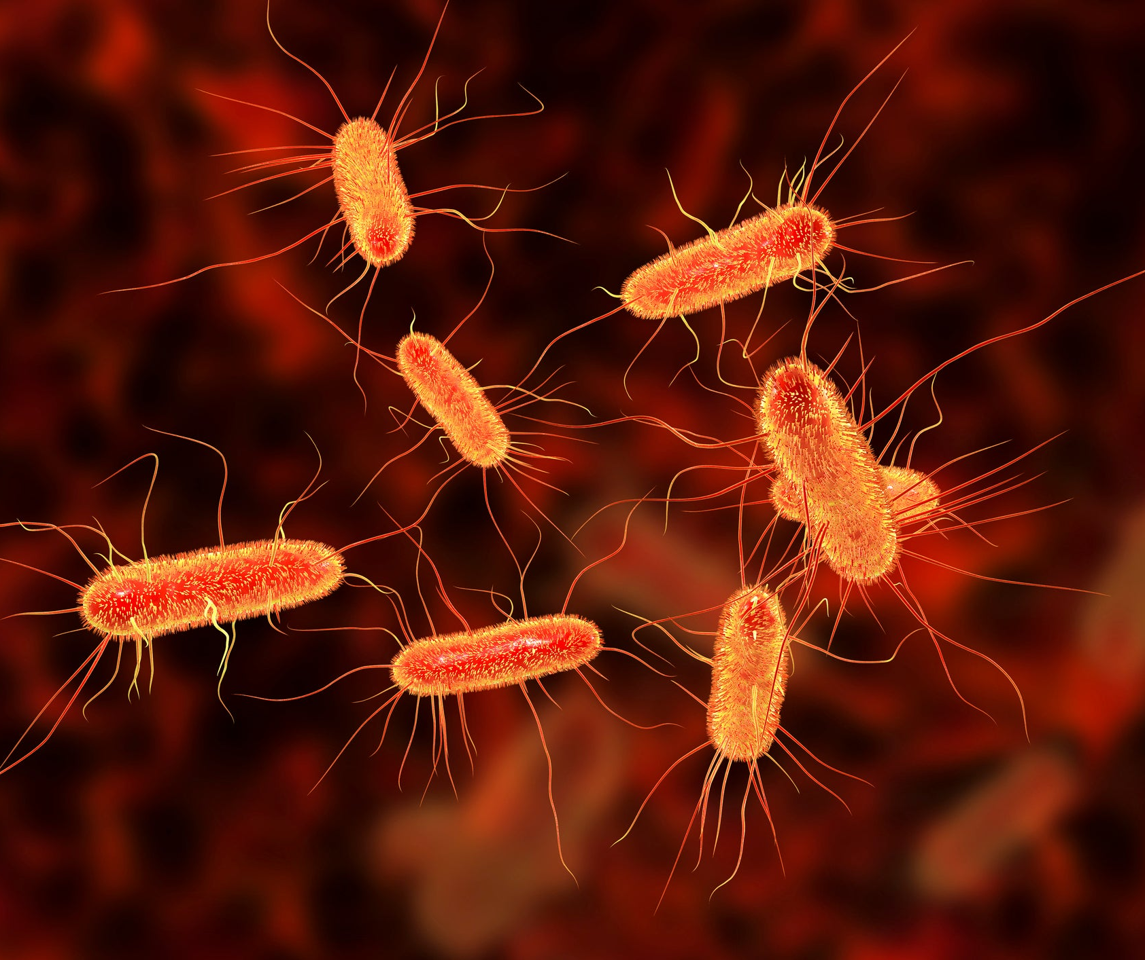
Background
Antimicrobial resistant (AMR) genes is the most significant global health threats
It could be threat in one health interface- Human, animal, industry and environment
E. coli is a commensal, colonizes the gastrointestinal tract of mammalian and avian hosts
E. coli is also a highly ubiquitous environmental microbe

Slide 3
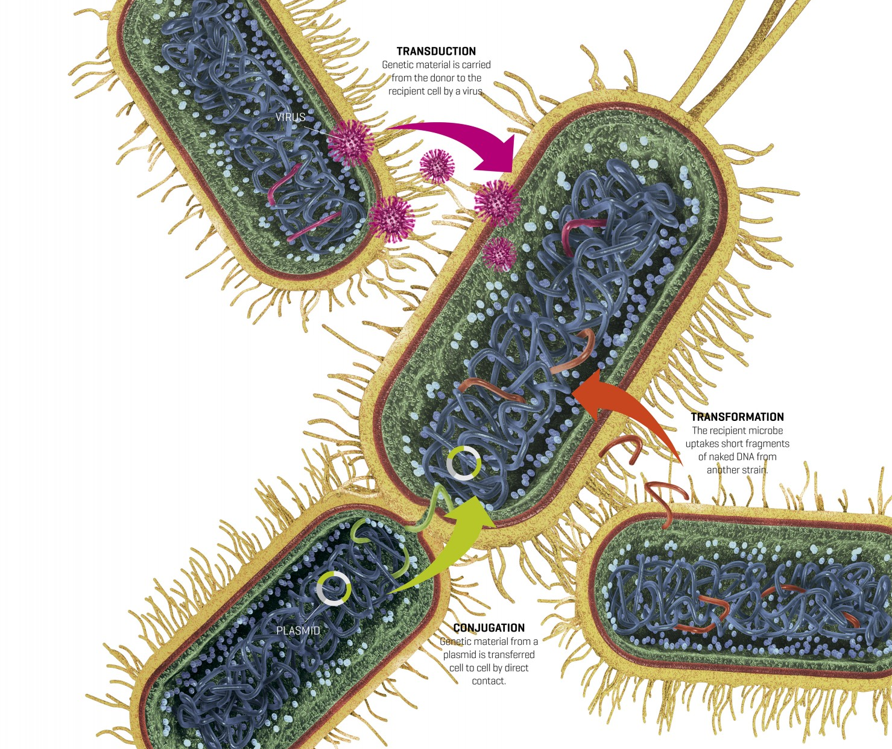
E. coli's genome adapts and thrives through mobile genetic elements like plasmids and transposons
Enhancing adaptability and survival in various hosts and environments, including horizontal gene transfer

Slide 4
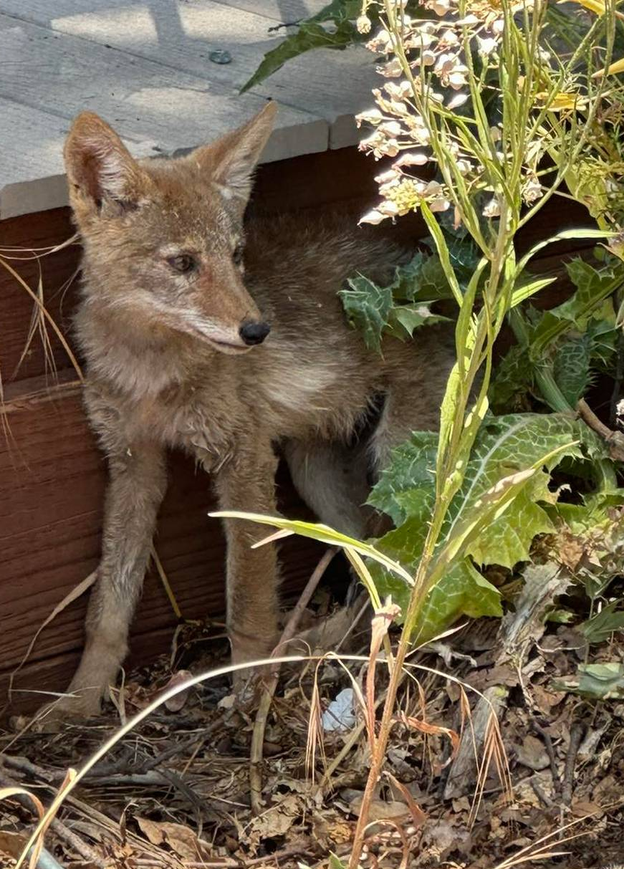
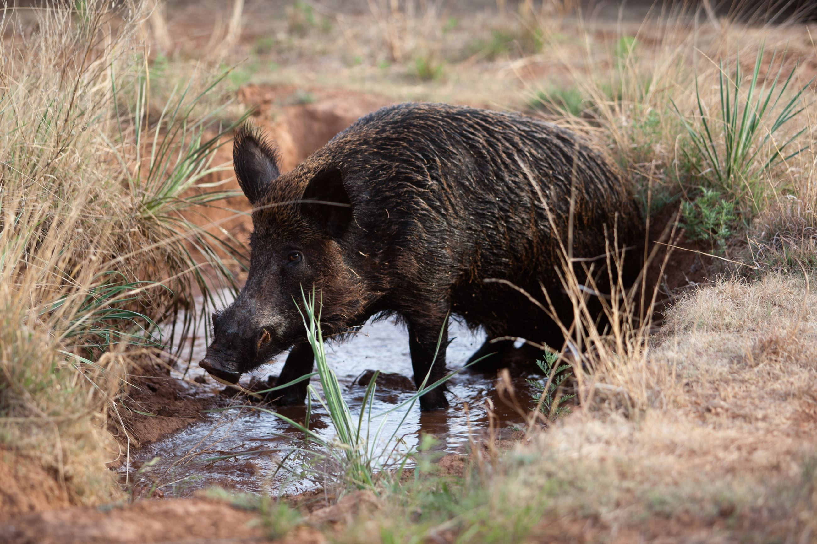
Wildlife encountering clinically employed antimicrobial treatments is an uncommon event
However, wild animals can acquire resistant bacteria by encountering humans, domesticated animals, and the environment
Coyotes and feral hogs influence AMR resistance dynamics at the wildlife-livestock interface

Slide 5
Objectives
To characterize AMR genes and Mobile genetic elements of E. coli isolates that were recovered from the fecal samples of coyotes and wild hogs from West Texas.

Slide 6
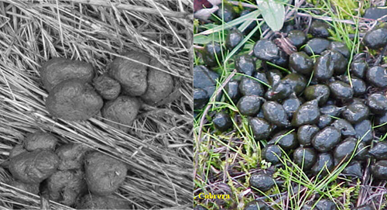
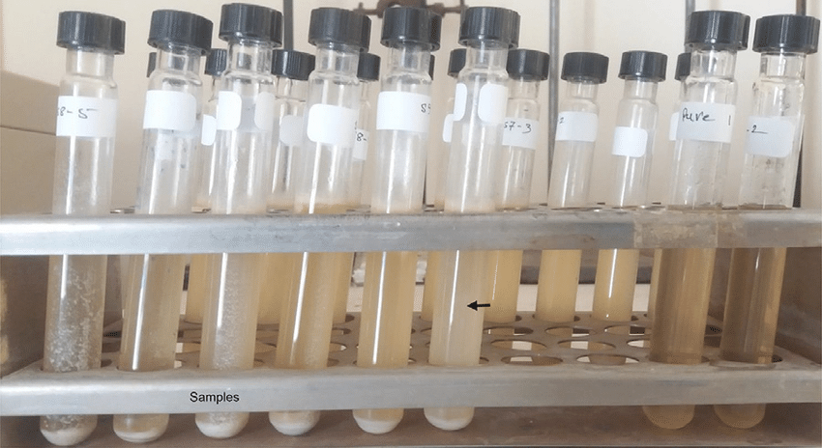
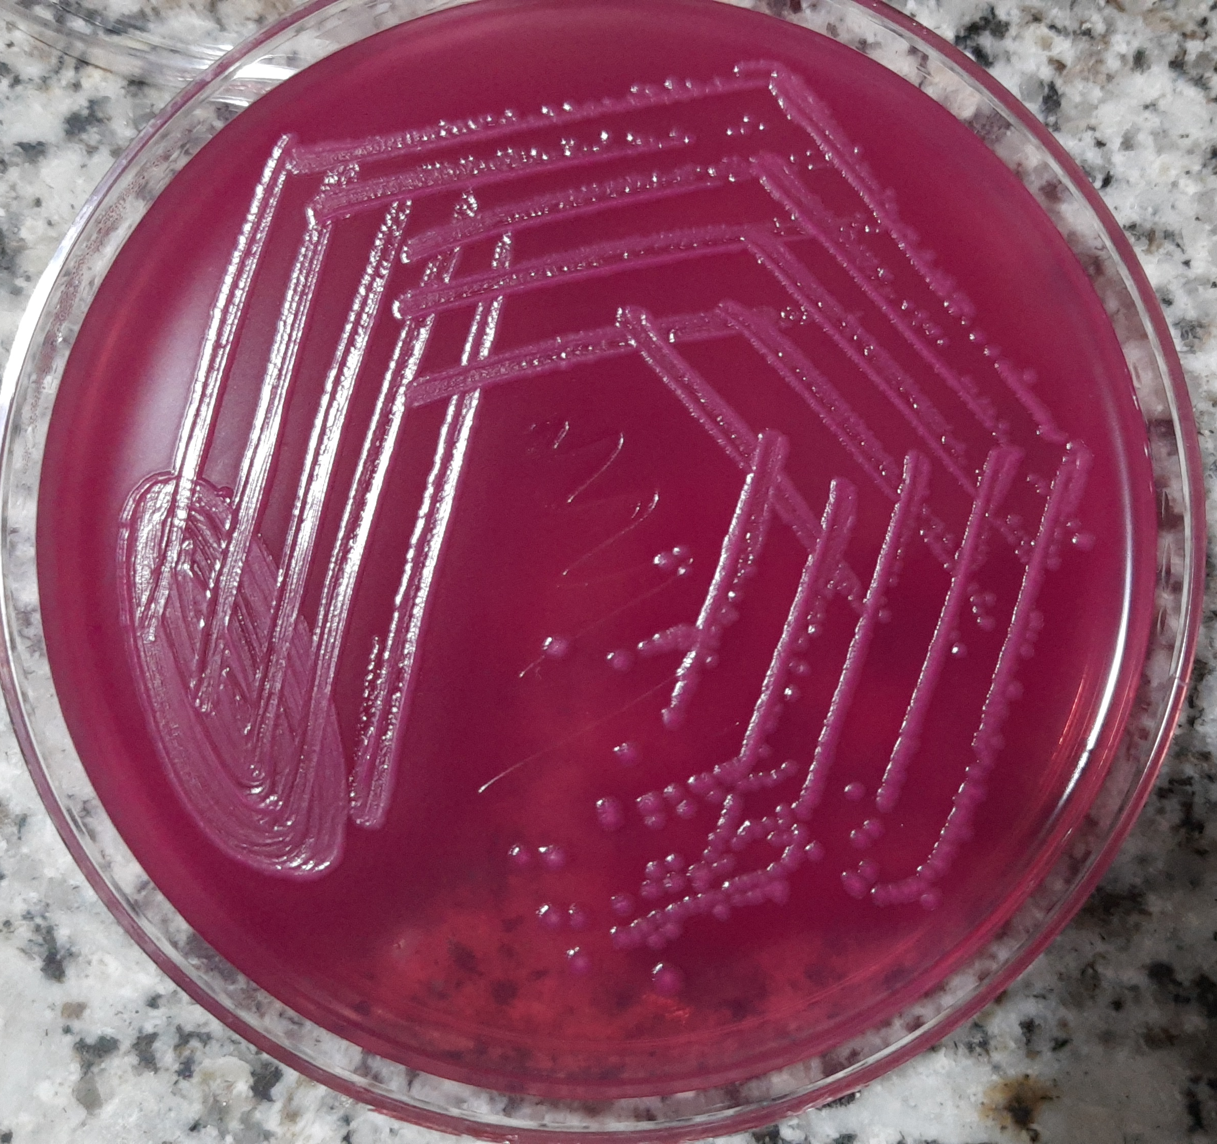
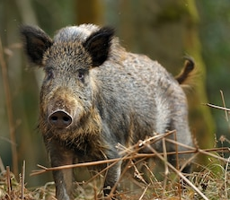
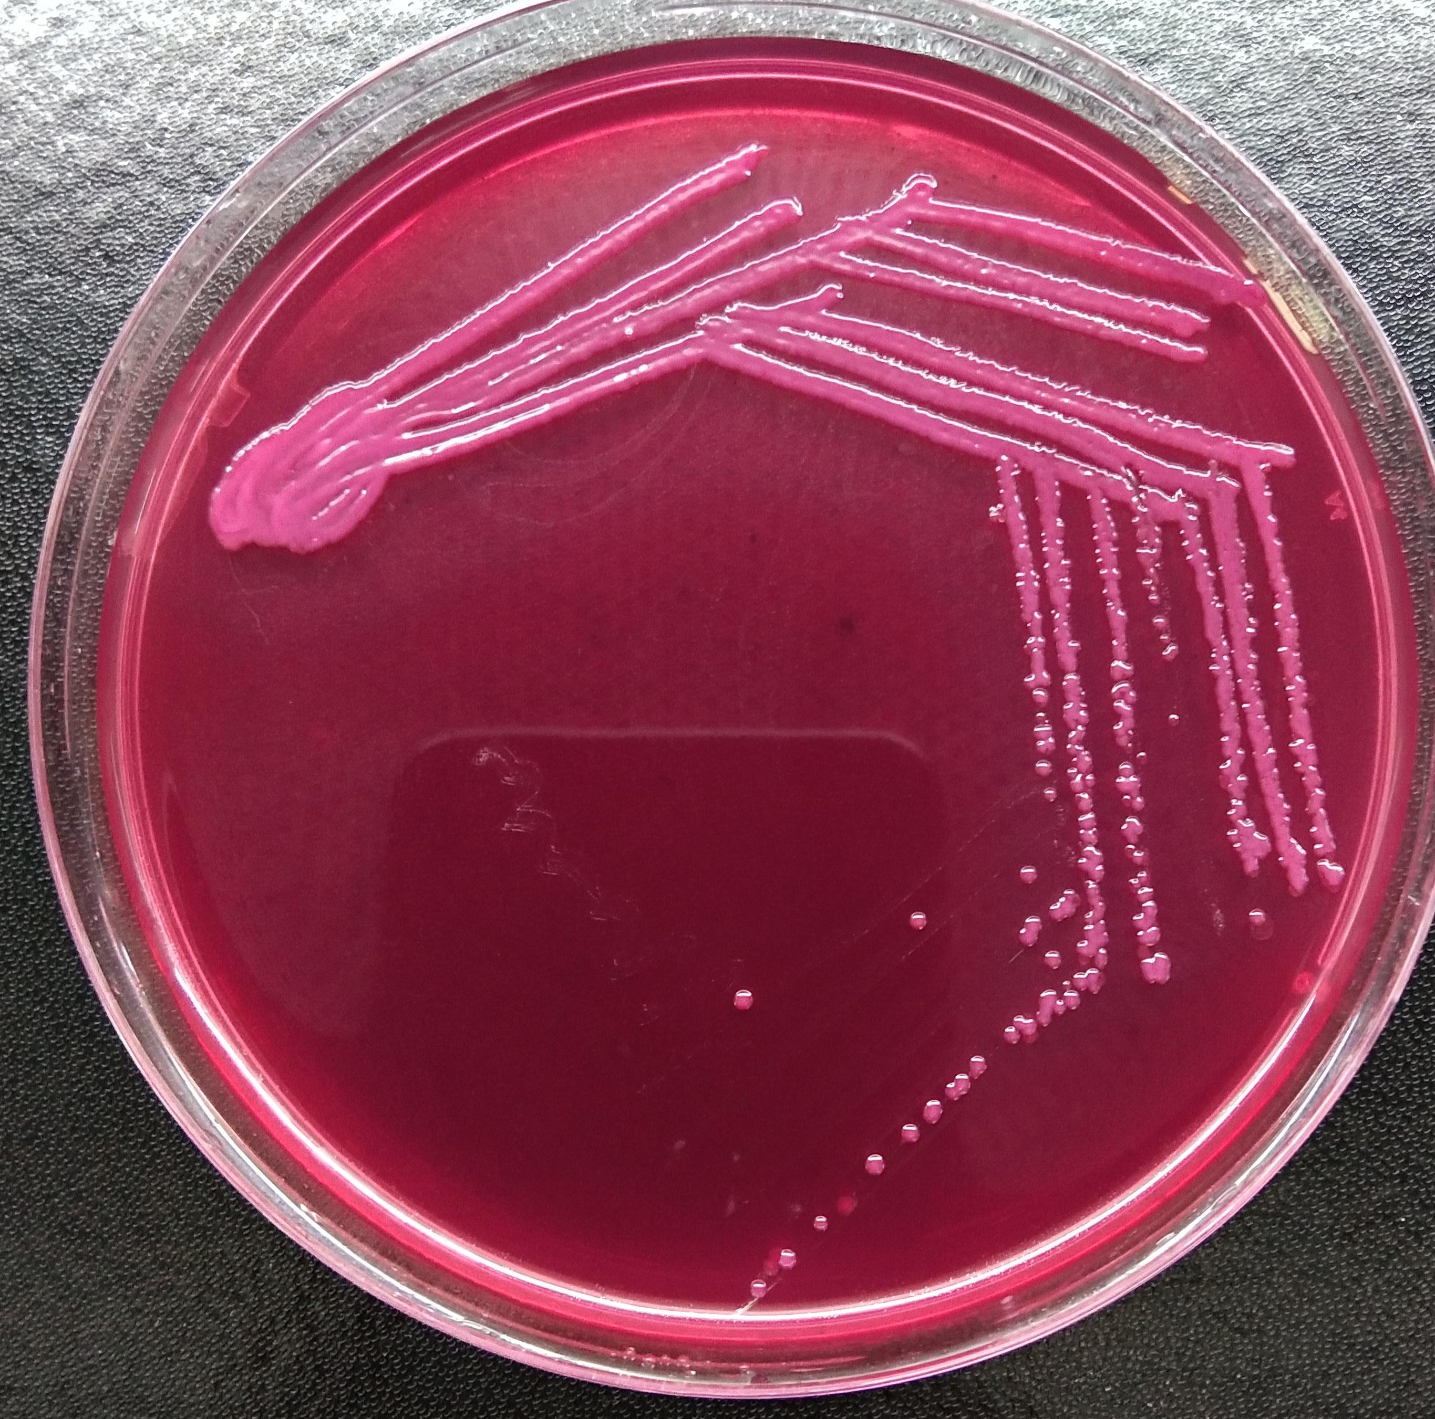
Methods
n= 9
n= 7
Feces
Pre-enrichment in buffered peptone water
MacConkey agar with 1 ug/mL of ceftazidime
E. coli isolates were further
confirmed using MALDI-TOF
Presumptive ESBL-E. coli
Further purified on Tryptic soy agar
sub-cultured on fresh MacConkey agar without ceftazidime

Slide 7
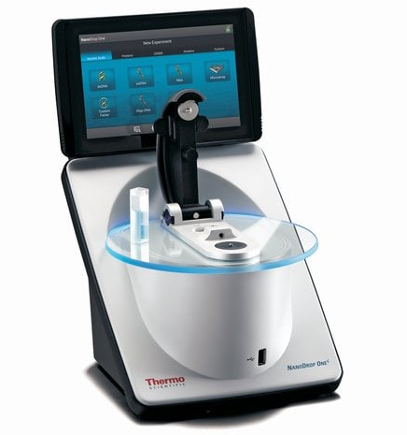
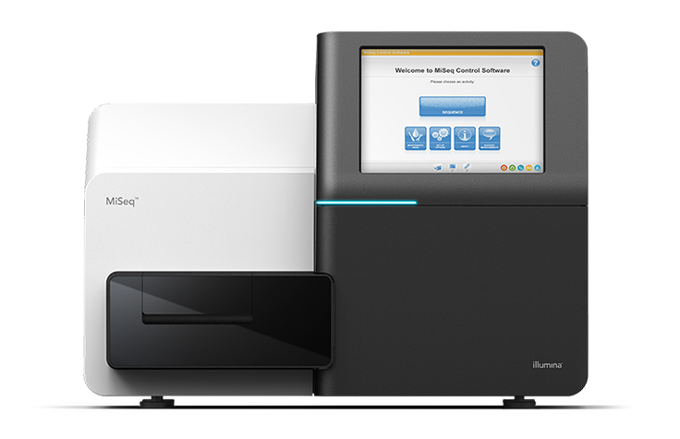
Genomic DNA of E. coli extracted using the InstaGene™ Matrix
DNA quantified
WGS on the Illumina MiSeq platform
Finally, bioinformatics analyses was done

Slide 8
Results
All the 16 E. coli isolates were carriers of the mdf(A) resistance gene
5 isolates harbored at least 1 beta-lactamase gene
bla_{CMY-2} – 1 coyote and 1 wild hog
bla_{CTX-M-55} – 2 coyotes
bla_{CTX-M-27} – 1 coyote
several isolates were carried tetracycline resistant genes
tet(A) –2 coyotes
tet(B) –1 coyotes
tet(C) –1 wild hog

Slide 9
11 isolates were positive for aminoglycoside resistance genes
aac(3)-IId (2/16)
aadA5(2/16)
ant(3″)-Ia (2/16)
aph(3′)-Ia (1/16)
aph(3″)-lb (2/16)
aph(6)-ld (2/16)
Some other resistance genes were identified
Sulfonamide resistance- sul1, sul2, and sul3
Amphenicol resistance- floR
Trimethoprim resistance- dfrA1 and dfrA17
macrolide, lincosamide, streptogramin B resistance- Inu(F), erm(B), and mph(A)

Slide 10
10 isolates showed chromosomal mutations in the promoter region G of ampC beta-lactamase, with mutation in the amino acid G > A
Additional chromosomal mutations observed in ampC beta-lactamase include promoter region P with change in amino acid C > T (7/16) and R25H cgc > cac (1/16)
Three isolates showed chromosomal mutations in gyrA (3/16), parC (2/16), and parE (1/16) quinolone resistance-determining regions
IncF (13/16) was the most common plasmid groups among the isolates

Slide 11
Various virulence genes were detected: fimH, yehA, yehB, yehC, yehD, and fdec
One bla_{CMY-2} positive E. coli isolated from a wild hog was Shiga toxin-producing stx2A virulence toxin subtype
Few isolates identified enterotoxin producing genes (astA, eltIIAB-c3, and cdt-IIB)

Slide 12
Conclusions
Coyotes and wild hogs in the Texas panhandle region harbor E. coli strains with virulence factors, antimicrobial resistance genes, and mobile genetic elements
Wildlife's role in disseminating multidrug-resistant bacteria can carry important consequences for human and animal well-being, as well as environmental health.
Environmental contamination with bodily secretions can taint water, soil, and vegetation, potentially driving the proliferation of multidrug-resistant bacteria in wildlife or vice versa.

