Slide 1



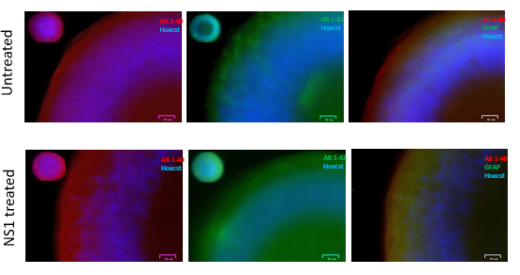
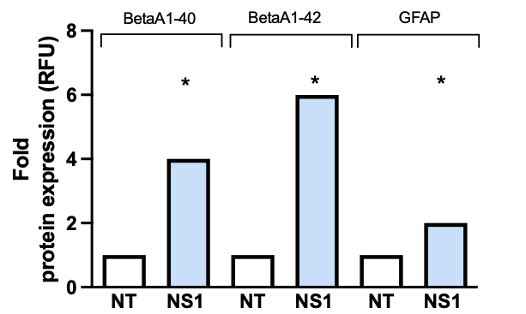
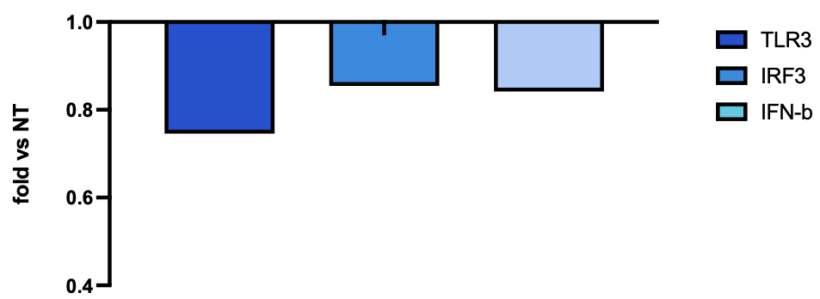
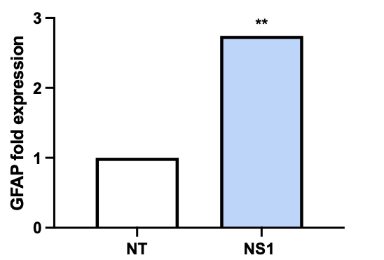

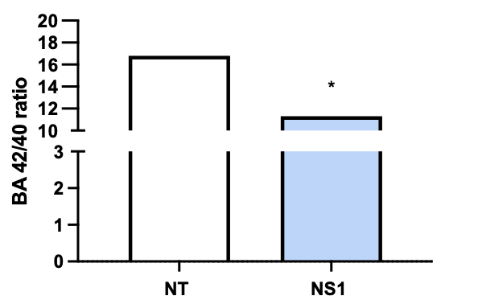
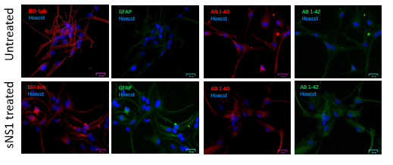
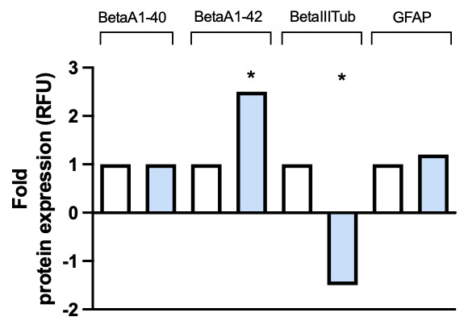
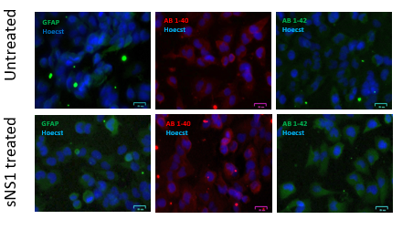
NEURODEGERATIVE ROLE OF WEST NILE VIRUS NON-STRUCTURAL PROTEIN 1: EFFECT ON TLR3 AND AMYLOID BETA EXPRESSION
SILVIA BELTRAMI¹, SABRINA RIZZO¹, VALENTINA GENTILI¹, GIOVANNA SCHIUMA¹, ROBERTA RIZZO¹, DARIA BORTOLOTTI¹
Dept. Chemical, Pharmaceutical and Agricultural Sciences - University of Ferrara, Italy;
Introduction
In the last years, the North-Est region of Italy, in particular Veneto and Emilia-Romagna [1], has been characterized by a significant increase of West Nile Virus (WNV) infection rate. Extracellular forms of non-structural protein 1 (NS1) of WNV are implicated in immune modulation and in promoting endothelial dysfunction at blood-tissue barriers, facilitating WNV dissemination to the brain and neurodegeneration. Moreover, it has been reported a possible crucial role of Toll-like Receptor 3 (TLR3), in amyloid beta (Aβ) production [2] and WNV immune evasion and entry [3].
Aim
To investigate the possible effect of soluble NS1 on neurodegenerative and dysfunctional biomarkers (e.g. amyloid beta, amyloid precursor protein (APP), glial fibrillary acidic protein (GFAP), β-III tubulin and TLR3 signaling pathway), to clarify the mechanism underlying the CNS sequelae associated to WNV infection.
Methods
sNS1 increases β amyloid expression in glial cells - 3D model
The experiment was repeated on the same line (T98G) but using three-dimensional culture systems. IF analysis confirmed what has been observed previously, reporting significantly higher levels of both isoforms of Aβ in the sNS1-treated samples, compared with untreated controls (Fig. 4), confirming higher production of Aβ 1-42 (Fig. 4A and 4B, p value < 0.05, t-Student test).
Figure 4. A) Immunofluorescence images of the spheroids, labeled for the two isoforms of β amyloid, 1-40 and 1-42, and the glial cell marker GFAP; B) Protein levels of β amyloid 1-40, 1-42 and GFAP in sNS1-treated T98G spheroids compared with untreated.
Figure 5. A) Immunofluorescence images of the spheroids, labeled for the two isoforms of amyloid β, 1-40 and 1-42, and the glial cell marker GFAP; B) Protein levels of amyloid β 1-40, 1-42 and GFAP in sNS1-treated T98G spheroids compared with untreated.
sNS1 induces neurodegeneration via Aβ 1-42 accumulation
We used IPS cell line (RenCells) differentiated in glial and neuronal populations, to assess the effect of Aβ 1-42 accumulation at neuronal level. The results confirm the induction of Aβ 1-42 expression in sNS1-treated cell samples (Fig. 6A and 6B, p value < 0.05, t-Student test), concomitant with a slight increase in GFAP expression. Moreover, sNS1-treated samples showed a significant decrease in β3-tubulin levels (marker of neuronal cells)(Fig. 6A and 6B , p value < 0.05, t-Student test) and a reduced cell viability, probably attributable to the toxic effect of Aβ 1-42 on neuronal population (Fig. 6C, 79.2%; p value < 0.05, t-Student test).
Figure 6. A) Immunofluorescence images of ReNcells, labeled for the two isoforms of amyloid β, 1-40 and 1-42, for the glial cell marker (GFAP) and for the neuron marker (β3 tubulin); B) Protein levels of β amyloid 1-40, 1-42, GFAP and β3 tubulin in sNS1-treated IPS compared with untreated. C) MTT cell viability assay conducted on sNS1-treated and untreated IPS.
2D cultures and 3D neuronal model were obtained with human glial cell (T98G cells) and iPS cells (RenCellInduced Pluripotent Stem cells), treated with purified WNV soluble NS1 (sNS1).
Gene expression (TLR3, IRF3, IFN-b, APP, GFAP) and proteomic profiles (Aβ 1-40, Aβ 1-42, GFAP, β-III tubulin) were evaluated by RT real-time PCR, ELISA and immunofluorescence (IF) analysis.
Results
a)
b)
sNS1 inhibits TLR3 signaling pathway
sNS1 reduced the expression of TLR3, IRF3 and IFN-β, compared with untreated cells, although there is no statistically significant difference (Fig. 1, p = NS). These data confirm the ability of soluble NS1 to induce the inhibition of TLR3 pathway at the level of glial populations, consistent with what has already been reported in the literature (Fig.1).
Figure 1. Relative quantitative analysis of the expression of TLR3, IRF3 and INF-β genes in T98G cells treated with soluble NS1 protein compared with control, untreated.
sNS1 increases β amyloid expression in glial cells – 2D model
sNS1-treated cells showed a significant increase of APP expression (Fig.2A, p value < 0.05, t-Student test) and in Aβ 1-42 production, compared with the untreated sample (Fig. 2B, p value < 0.05, t-Student test). In particular, the Aβ 1-42 isoform was found abundant at the cellular level (in lysates), while Aβ 1-40 isoform, was more secreted (Fig. 2, p value < 0.05, t-Student test ).
As a confirm, Aβ1-42/Aβ1-40 ratio is significantly decreased in the supernatants of sNS1-treated samples, compared with untreated controls (Figure 2C, p value < 0.05, t-Student test), indicating increased deposition of the Aβ 1-42 isoform at the cellular level and suggesting a correlation between sNS1 and neurodegenerative phenomena due to its accumulation.
Figure 2. A) Analysis of mRNA levels of APP gene. B) Levels of β amyloid 1-40 and 1-42, at extracellular and intracellular levels. C) Aβ 1-42/1-40 ratio.
These data were also confirmed by immunofluorescence analysis, showing a significant increase of both Aβ isoforms following treatment, particularly significant for 1-42 Aβ isoform (Fig. 3A and 3B, p value < 0.05, t-Student test).
Figure 3. A) IF images of T98Gs, stained for the two isoforms of β amyloid, 1-40 and 1-42, B) Protein levels of amyloid β 1-40 and 1-42 in sNS1-treated cells compared with untreated.
We also analyzed the glial activation status, in terms GFAP expression, since glial cells are the main responsible for Aβ 1-42 production.
We reported higher levels of GFAP expression were detected in sNS1-treated samples, compared with untreated controls, at both protein (Fig. 4A and 4B, p value < 0.05, t-Student) and mRNa level(Fig.5, p value < 0.05,t-Student test).
a)
b)
c)
a)
b)
Untreated
a)
b)
c)
sNS1
Conclusions
Our preliminary results suggest a possible role of soluble NS1 on CNS damage associated to WNV infection. NS1 released by WNV infected cells might participate in CNS neurodegenerative process by altering TLR3 signaling and Aβ expression[4,5], suggesting a novel pathogenetic role.
References
1, Ricco, M., et al., West Nile Virus Infection: A Cross-Sectional Study on Italian Medical Professionals during Summer Season 2022. Trop Med Infect Dis, 2022. 7(12).
2.Bortolotti, D., et al., HHV-6A infection induces amyloid-beta expression and activation of microglial cells. Alzheimers Res Ther, 2019. 11(1): p. 104.
3.Wang, T., et al., Toll-like receptor 3 mediates West Nile virus entry into the brain causing lethal encephalitis. Nat Med, 2004. 10(12): p. 1366-73.
4.Walker, D.G., T.M. Tang, and L.F. Lue, Increased expression of toll-like receptor 3, an anti-viral signaling molecule, and related genes in Alzheimer's disease brains. Exp Neurol, 2018. 309: p. 91-106.
5.Caldeira, C., et al., Key Aging-Associated Alterations in Primary Microglia Response to Beta-Amyloid Stimulation. Front Aging Neurosci, 2017. 9: p. 277.
Contact information
Beltrami Silvia, Department of Chemical, Pharmaceutical and Agricultural Sciences, University of Ferrara, 44121 Ferrara, Italy
E-mail: bltslv@unife.it

