Slide 1

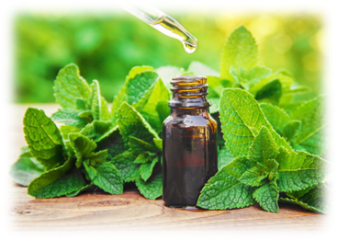

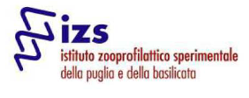



Antimicrobial effects of
Thyme Essential Oil (Thymus vulgaris) in combination with
Sodium Hypochlorite (NaOCl)
Michela Galgano, Daniela Mrenoshki, Francesco Pellegrini, Alessio Sposato, Laura del Sambro, Loredana Pozzi,
Angelica Bianco, Lisa Eramo, Giulia Schino, Elisabetta Catalano, Alessio Buonavoglia, Annamaria Pratelli, Antonio Parisi.

Slide 2
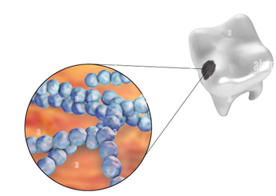


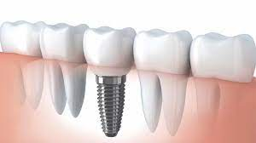

NaOCl (5%) is recommended as disinfectant solution in root canal
system during the endodontic treatments
it is caustic and may result in hypersensitivity reactions
Streptococcus mutans and Staphylococcus aureus: the most important pathogens for dental caries and medical implants
BUT
A
Several studies indicate that Essential Oils (EOs)
could be used as novel endodontic materials
(e.g. irrigants and medicaments)

Slide 3

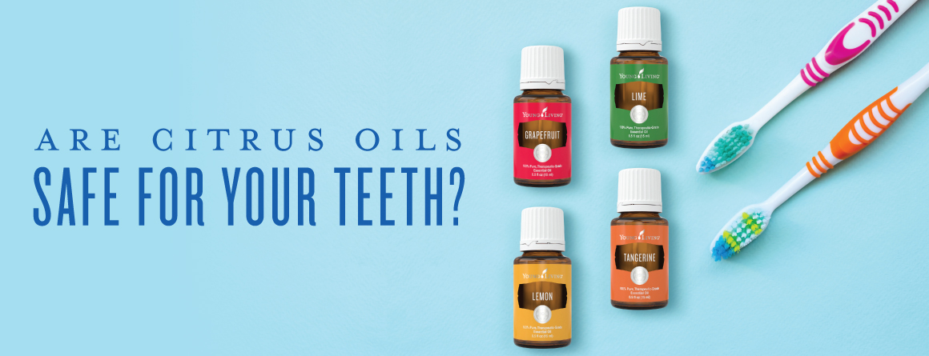
The aim of this work was to evaluate the use of Thyme Essential Oil (TEO, Thymus vulgaris) in synergistic combination with NaOCl in order to:
reduce the concentrations of NaOCl in oral therapies
improve the antiseptic efficacy
reduce side effects
Thymol
p-Cymene
γ-Terpinene

Slide 4
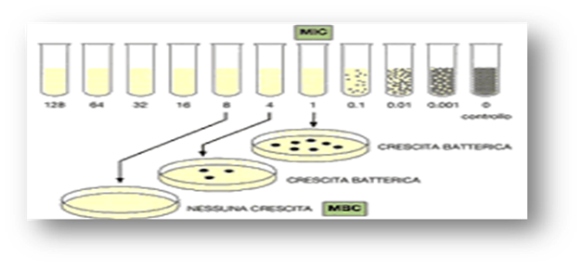
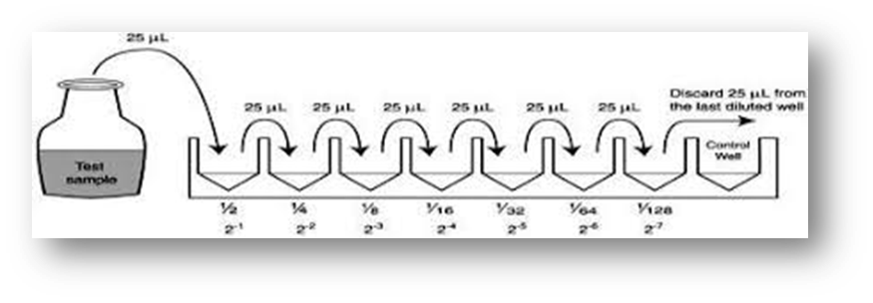
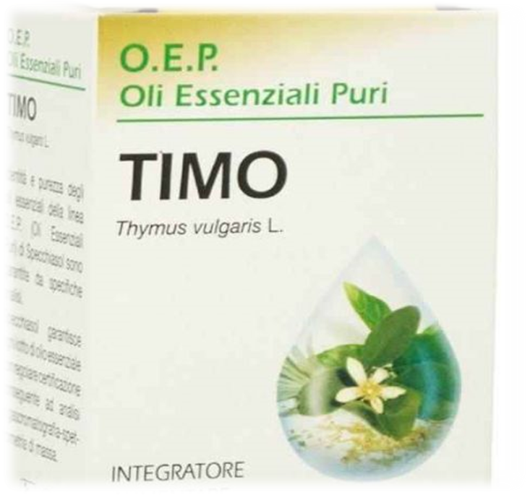
Microbroth Dilution Method
MIC & MBC
9,28mg/mL TEO and 1% NaOCl in the presence of 6% sheep blood
vs
S. mutans (ATCC70061) and S. aureus (ATCC43300)

Slide 5
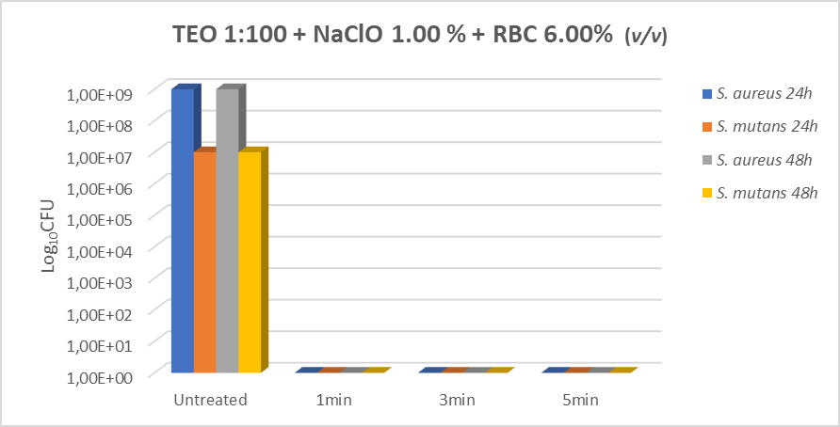
RESULTS
Antibacterial activity of TEO and NaOCl in the presence of 6% erythrocytes against ATCC bacterial strains

Slide 6
Our data confirm the efficacy of TEO as antimicrobial compound with possible applications as irrigant in endodontic treatments in association with NaOCl, reducing its concentration
"
"

Slide 7
Thanks for your attention
For any question or additional information about this study, contact.
Galgano Michela ​
michela.galgano@izspb.it
www.izsfg.it

