Slide 1
Biocontrol of Salmonella Enteritidis on fresh produce using lytic bacteriophage Christiana Dapuliga Stefan Schmidt
School of Life Sciences Discipline of Microbiology

Slide 2
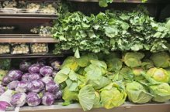
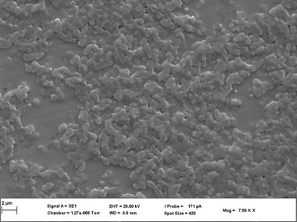
7 outbreaks (2013-2015) in SA
Salmonella Enteritidis
(8.3 × 10⁴ S.E per serving)
Produce biofilms
Multidrug-resistant
Fresh produce consumed with minimal processing
35% of outbreak cases has been linked to Salmonella Enteritidis
Novel antibacterial (MDR pathogens)
Ecofriendly
Host specific

Slide 3
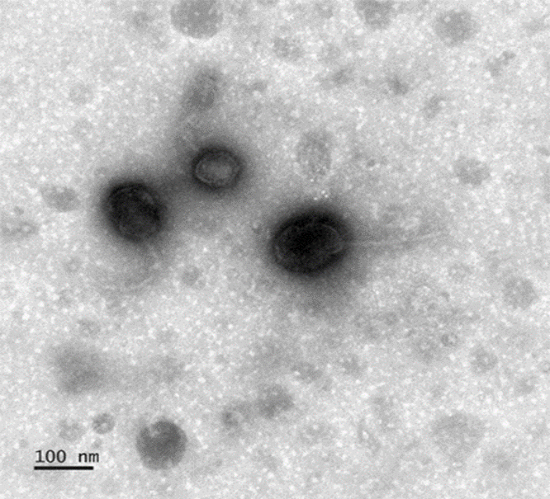
Isolation of Salmonella phage SCF
Salmonella phage SCF
Tiny plaques
Phage lysed S. Enteritidis
and S. Typhimurium​
TEM analysis
Order: Caudovirales
Genus: Tequintavirus
Flexible thin tail
Phage SCF lytic cycle
Phage attached to bacterial host SE

Slide 4
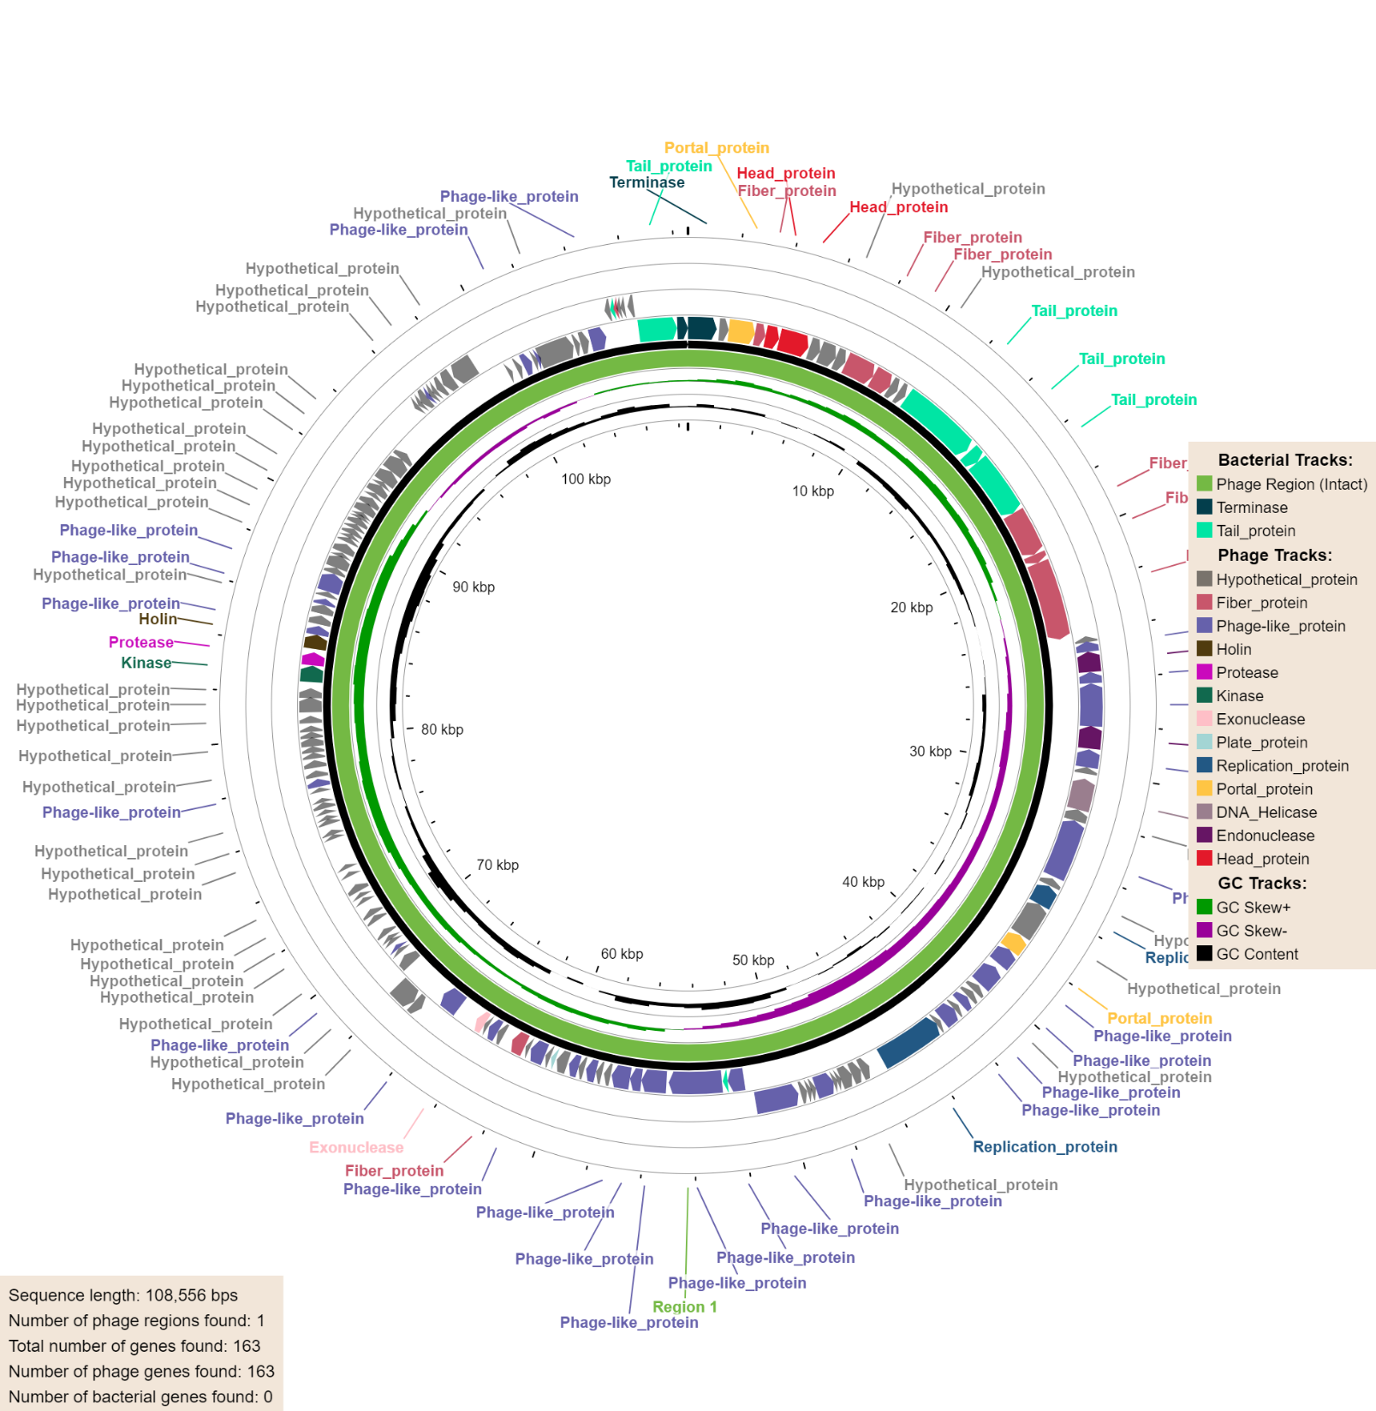
Genomic analysis of Phage SCF
Genome
108.5 kb
39.02 GC%
capsid, tail, lysin, and terminase protein coding genes identified
No lysogeny, virulence and AMR genes found

Slide 5
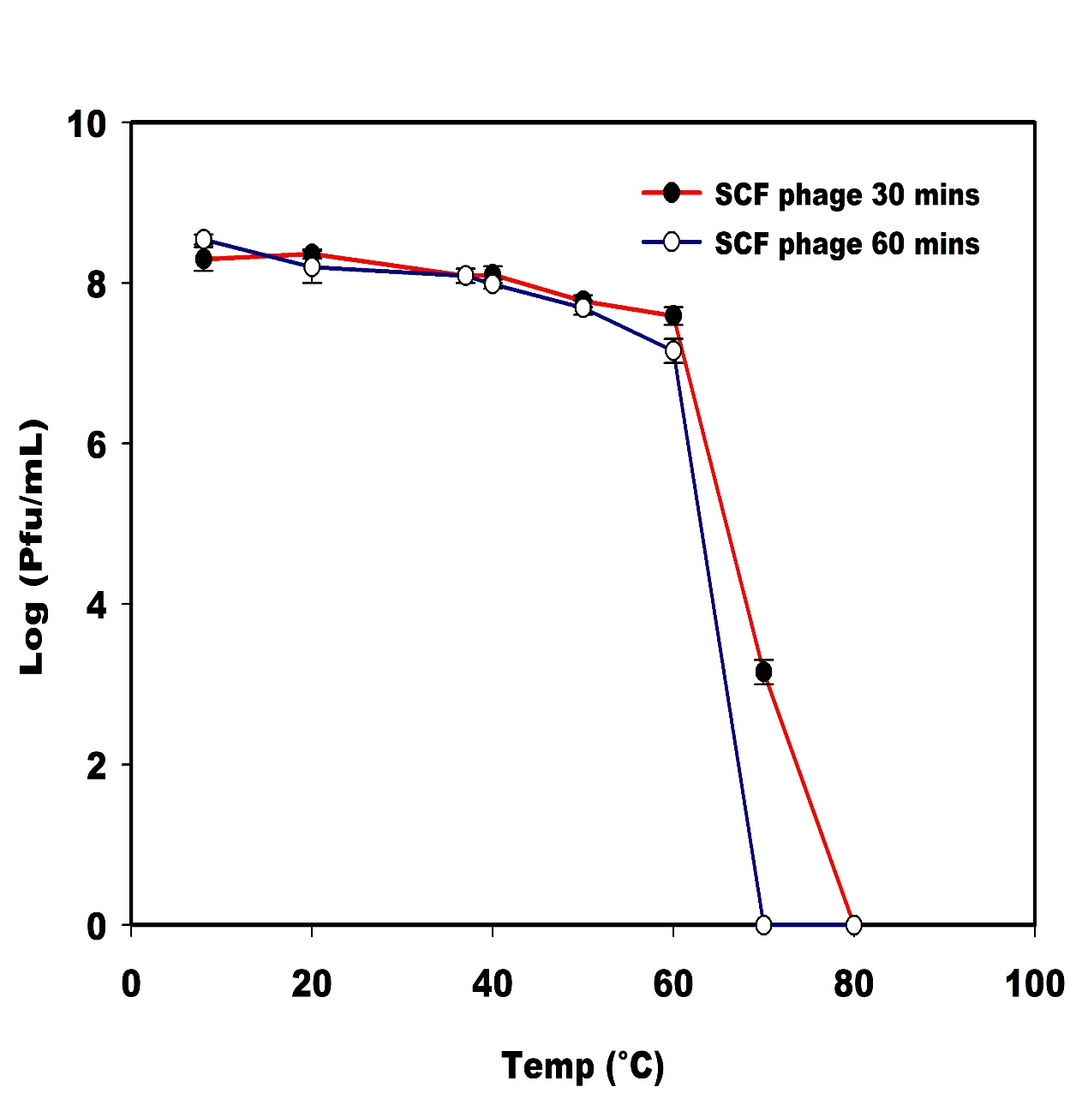
Thermal Stability
pH Stability

Slide 6
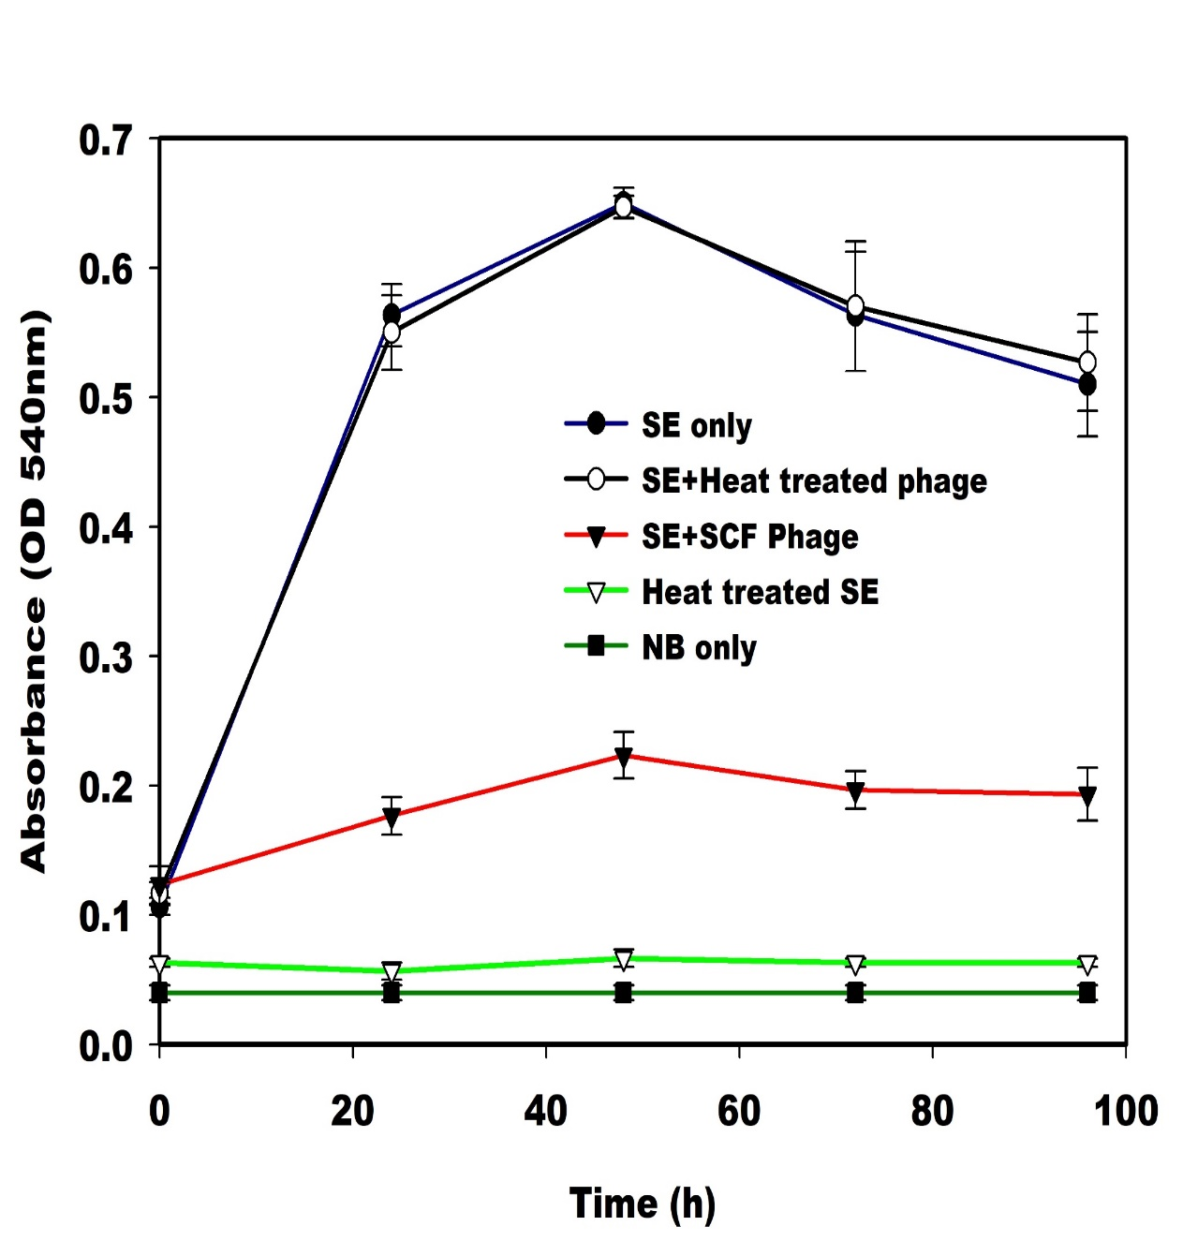
Anti-biofilm activity of Phage SCF
72 hr biofilm on stainless coupon
12 hr phage treatment (MOI= 0.01)

Slide 7
Lytic activity of phage on tomato surface
Tomato surface contaminated with S.E (10⁸) for 72 h
Contaminated tomato surface treated with phage SCF (10⁶) for 6 h
No viable SE cells were detected after 2 hrs treatment when MOI was increased (MOI=1, 10 and 100)

Slide 8
Phage SCF is a promising biocontrol tool
Phage SCF is host specific and stable
The phage does not possess any known lysogeny, virulence or antimicrobial resistance genes
≥5 log reduction (99.999%) of S. Enteritidis viable cell count achieved

Slide 9
