Slide 1
Bluetongue virus in the Campania region (southern Italy): high seroprevalence in both SBV exposed and non-exposed ruminants.
Gianmarco Ferrara
Department of Veterinary Medicine and Animal Productions, University of Naples Federico II, Via Federico Delpino n.1, 80137 Naples, Italy.

Slide 2
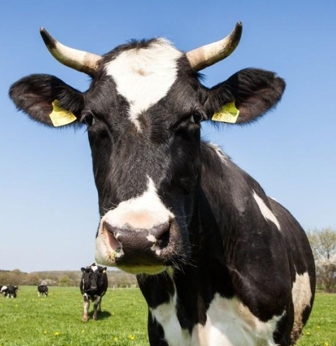
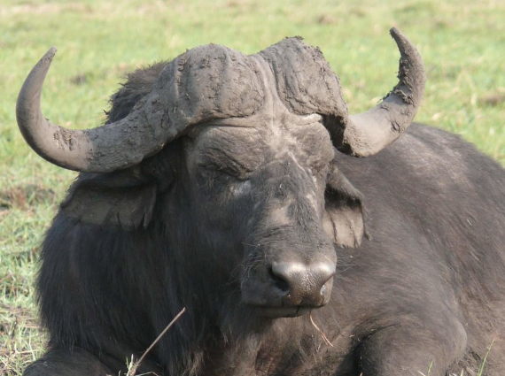
BTV outbreaks in the late 1990s and early 2000s caused economic losses and impacts the international cattle trade (estimated to be up to US$ 3 billion).
BTV is now considered an endemic and re-emerging virus throughout Europe.
Although BTV mostly results in clinical symptoms in sheep, cattle act as reservoir hosts and play an important role in BT transmission and epidemiology because they exhibit prolonged viremia
Bluetongue is endemic among ruminant populations in Italy, and repeated outbreaks are described, especially in small ruminants, while information on circulation in other species is more lacking

Slide 3
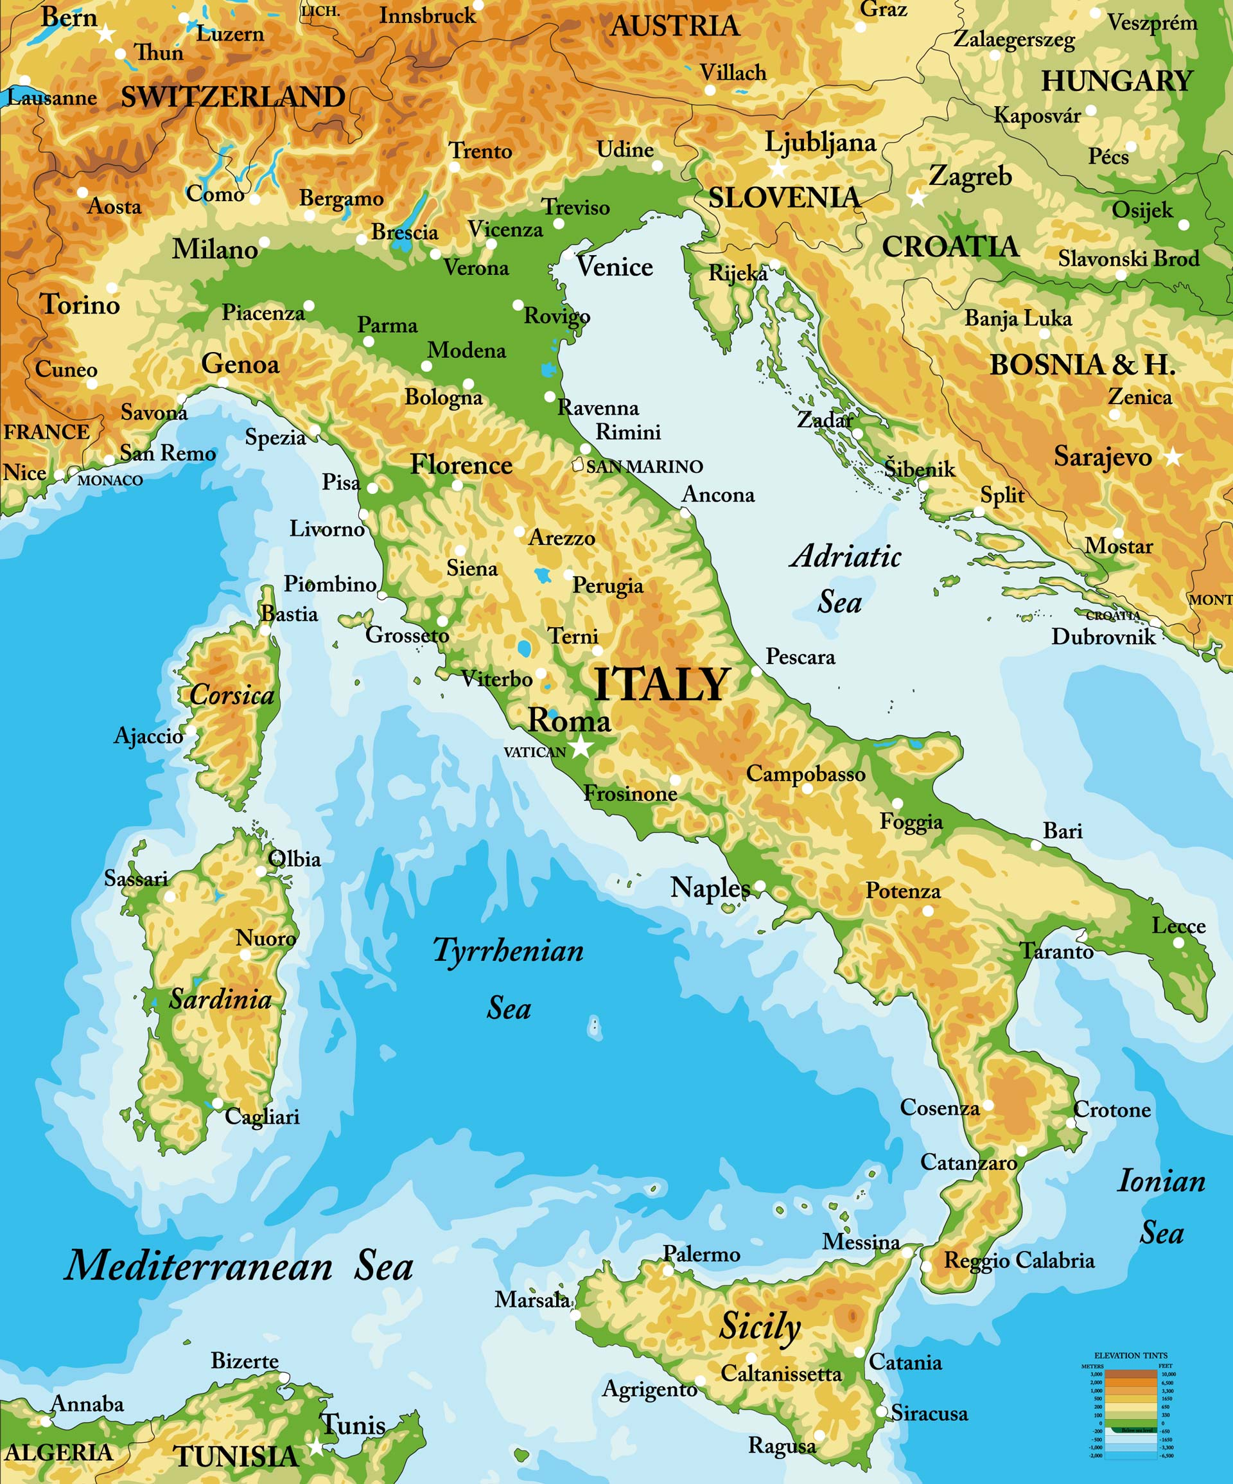
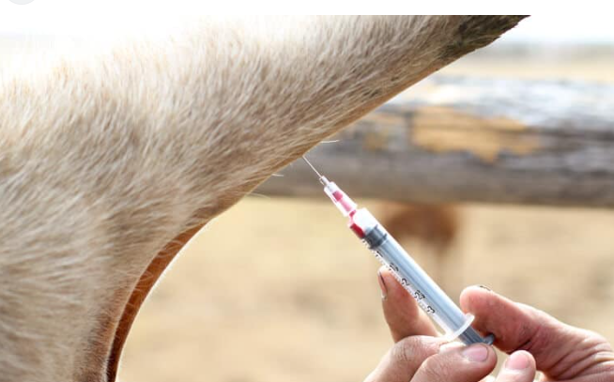
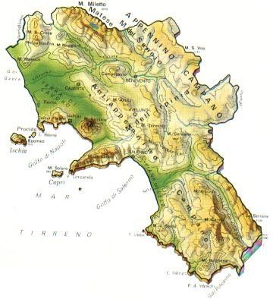
?
Materials and Methods
218 buffaloes and 250 cattle were sampled. Animals came from 31 separate districts and four provinces (21 cattle herds and 20 water buffalo herds), none of which practiced BTV immunization
?
The aim of this study was to investigate the BTV seroprevalence in the Campania region, southern Italy.

Slide 4
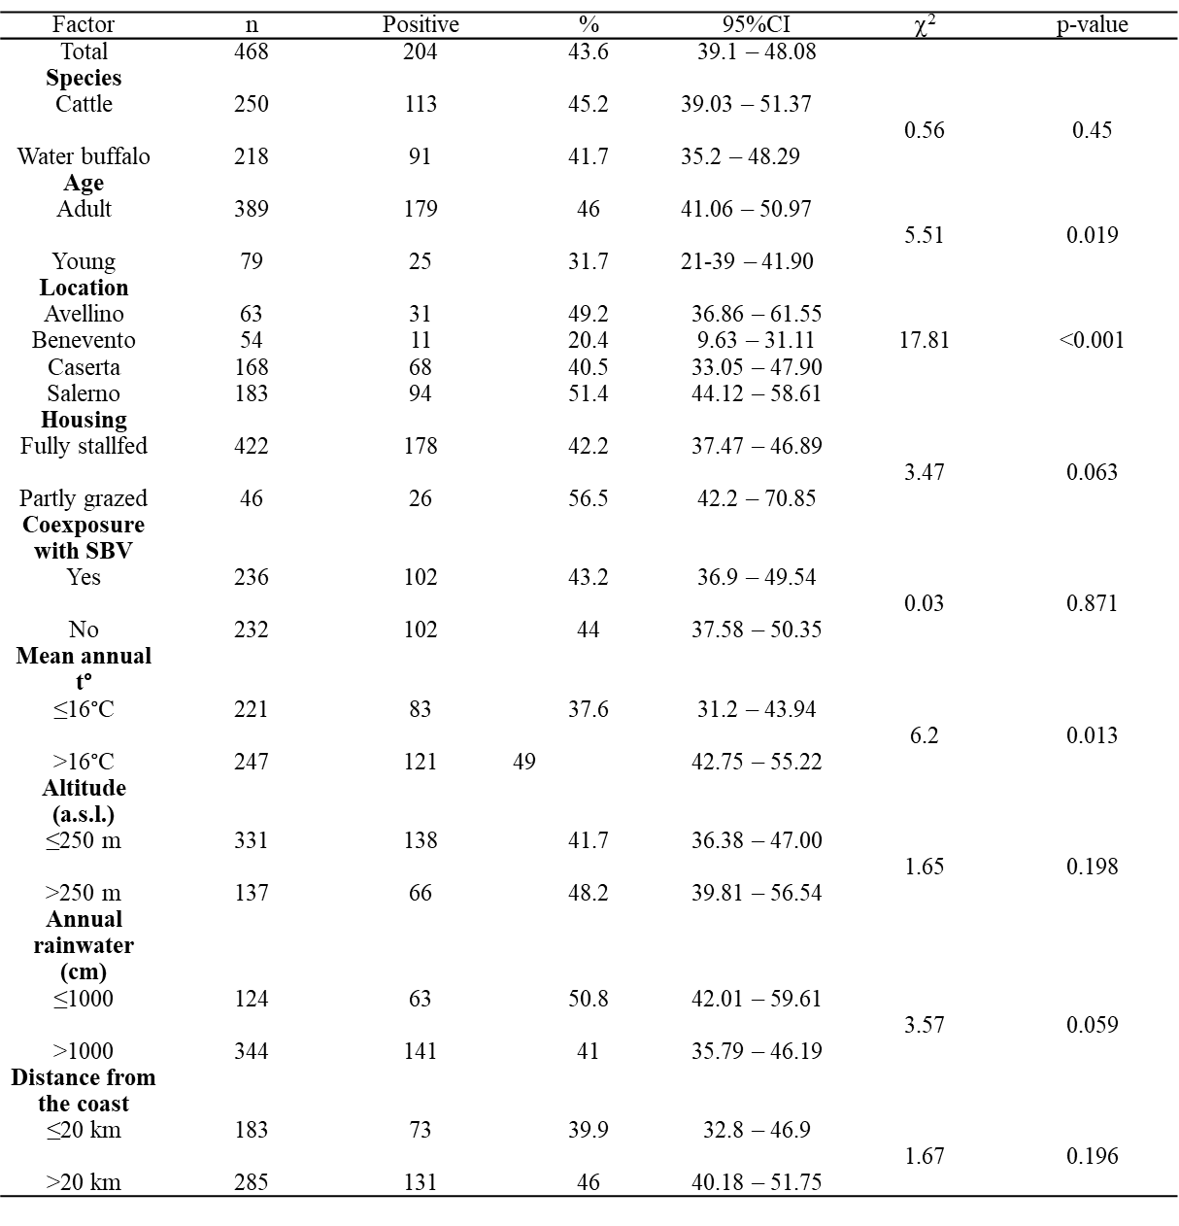
We observed an individual seroprevalence of 43.6% and a herd prevalence of 85.4%
Age and mean annual temperature were the most significant risk variables in univariate analysis.
BTV prevalence is not affected
by SBV seropositivity.

Slide 5
Conclusion
Our data, consistent with those in the literature, suggest the transversal spread of bluetongue virus in the Mediterranean area, and indicate a limited co-exposure rate between Bluetongue and Schmallenberg virus.
Cattle serve as key sentinels to anticipate outbreaks in sheep and goats, in addition to being the major res-ervoir of infection due to extensive viremia. Further studies are needed to evaluate the dura-tion of viraemia in buffalo and to establish the precise epidemiological role of this species.

