Slide 1
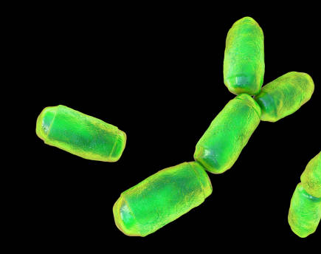
Diversity of immunoglobulin-coated archaea in human colostrum and neonatal stool from Mexican individuals
Diana Laura Rojas-Guerrero¹, Karina Corona-Cervantes¹, Carmen Josefina Juárez-Castelán¹, Alberto Piña-Escobedo¹, Bulmaro Cisneros-Vega¹, Leopoldo Santos-Argumedo², Tito Ramírez-Lozada³, Gustavo Acosta-Altamirano⁴, Mónica Sierra-Martínez⁵, Paola Berenice Zárate-Segura⁶ and Jaime García-Mena¹.
¹Departamento de Genética y Biología Molecular, Cinvestav.
²Departamento de Biomedicina Molecular, Cinvestav.
³Unidad de Ginecología y Obstetricia, Hospital Regional de Alta Especialidad de Ixtapaluca.
⁴Dirección de Planeación, Enseñanza e Investigación, Hospital Regional de Alta Especialidad de Ixtapaluca.
⁵Unidad de Investigación en Salud, Hospital Regional de Alta Especialidad de Ixtapaluca.
⁶Laboratorio de Medicina Traslacional, Escuela Superior de Medicina, Instituto Politécnico Nacional.

Slide 2
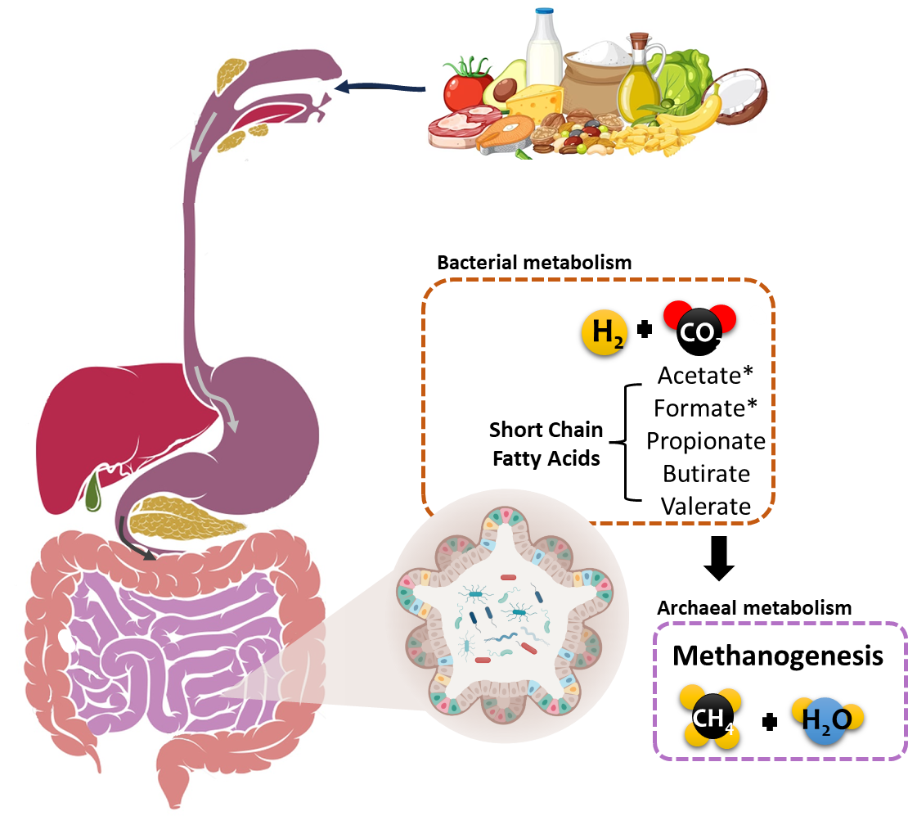
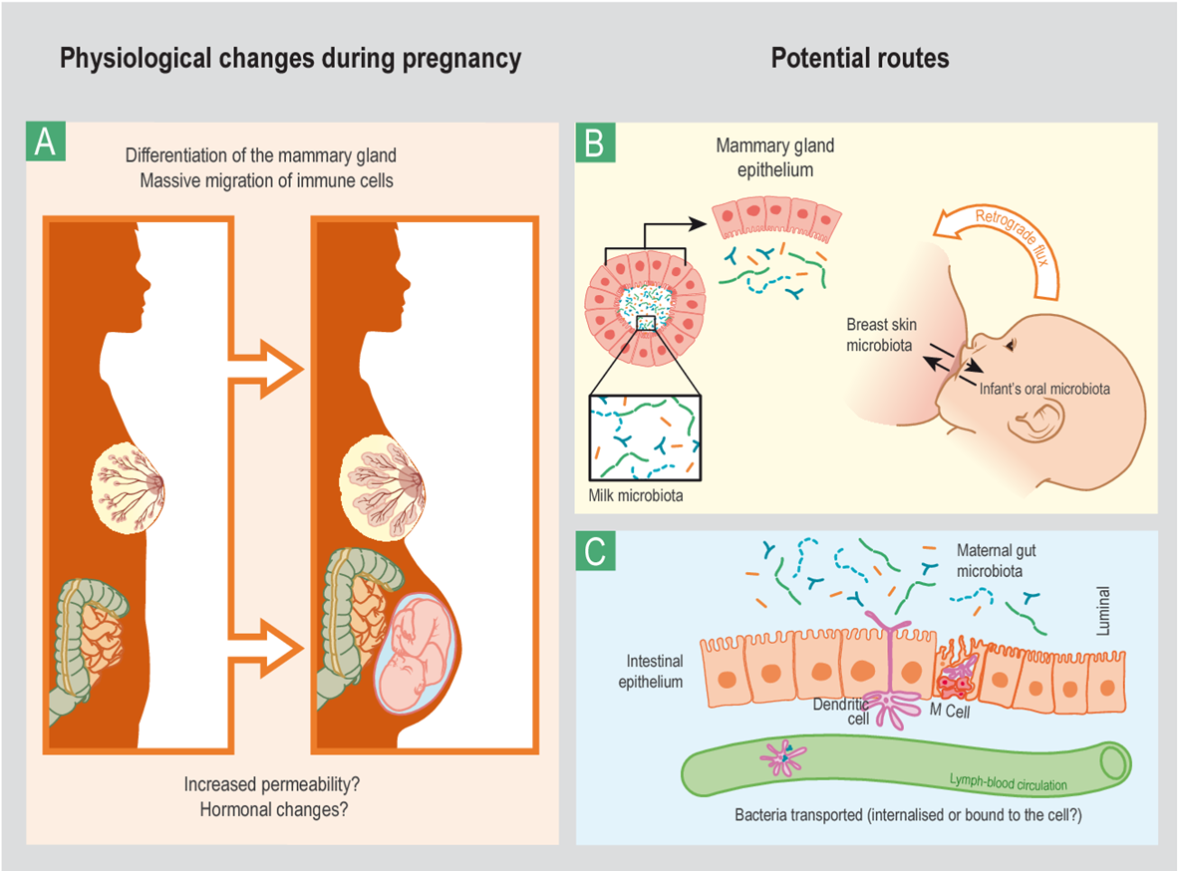
There is a syntrophic relationship between bacteria and archea in the human gut
The entero-mammary pathway
There is a potential route for the transfer of bacteria and microbial components from the maternal gut to the mammary glands (breasts) during breastfeeding.
Interactions between archaea and bacteria in the gut of healthy people:
Corona-Cervantes et al., 2020, PeerJ 8:e9205; Jeurink et al., 2013, Beneficial microbes 41:17-30.

Slide 3
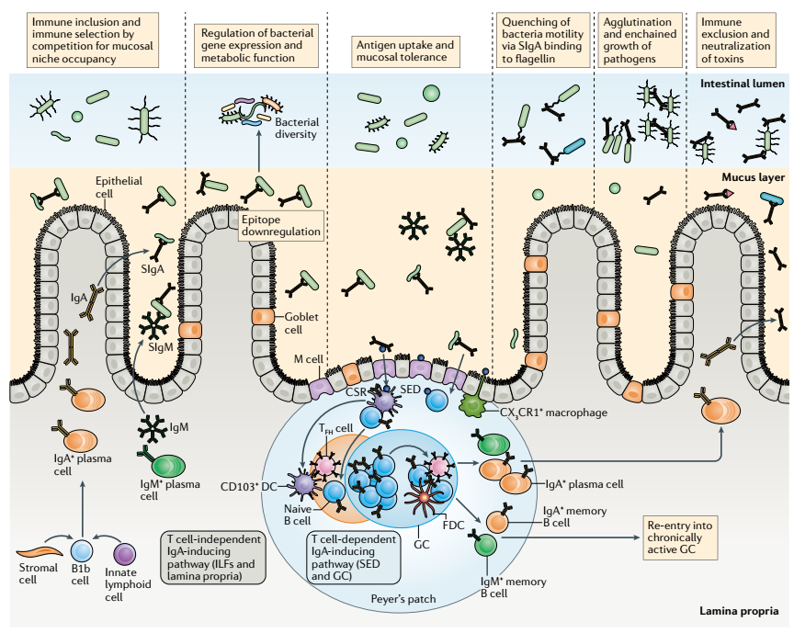
Breast milk confers passive immunization to the newborn
Colostrum/Breast milk composition:
Cells:
Bacteria / Fungi / Archaea
Immune cells
Stem cells
Nutrients:
Carbohydrates
Lipids & Fatty Acids
Proteins & Amino Acids
Minerals & Vitamins
Bioactive molecules:
Oligosaccharides
Lactoferrin
Hormones
Immunoglobulins
Microbiota-immune system interactions in the developed gut.
Selection of microorganisms
Attenuation of pro-inflammatory responses
Homeostasis
Intervention of maternal immunoglobulins during infancy
Chen et al. 2020, Nat Rev Immunol 20:427-441.

Slide 4
Methodology
MACS > isolation of immunoglobulin-bound cells
Fraction Ig-
Streptavidin+ fluorochrome
Anti-fluoroc. + microbead
Anti-Ig + biotin
MAGNET
Fraction Ig+

Slide 5
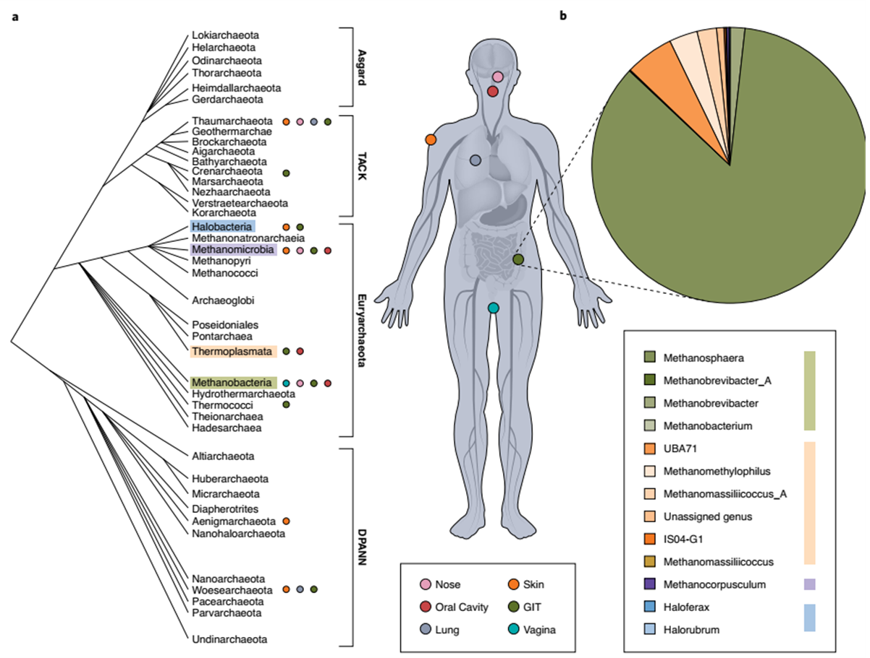
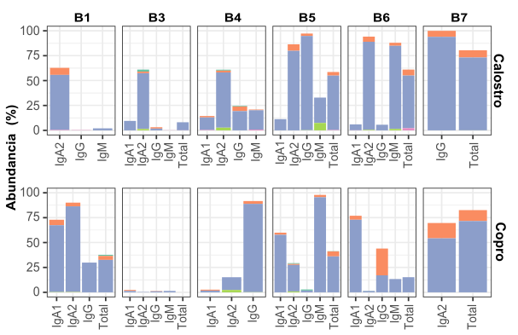
Haloarchaea and non-euryarchaea predominate in the archaeal community found in total samples and in association with immunoglobulin fractions
Abundance (%)
Colostrum Stool
Predominant phyla in the colostrum of 7 mexican women and the stool of 7 newborns – fed exclusively with human colostrum.
Geesink & Ettema, 2022, Nature Microbiology 7(1).

Slide 6
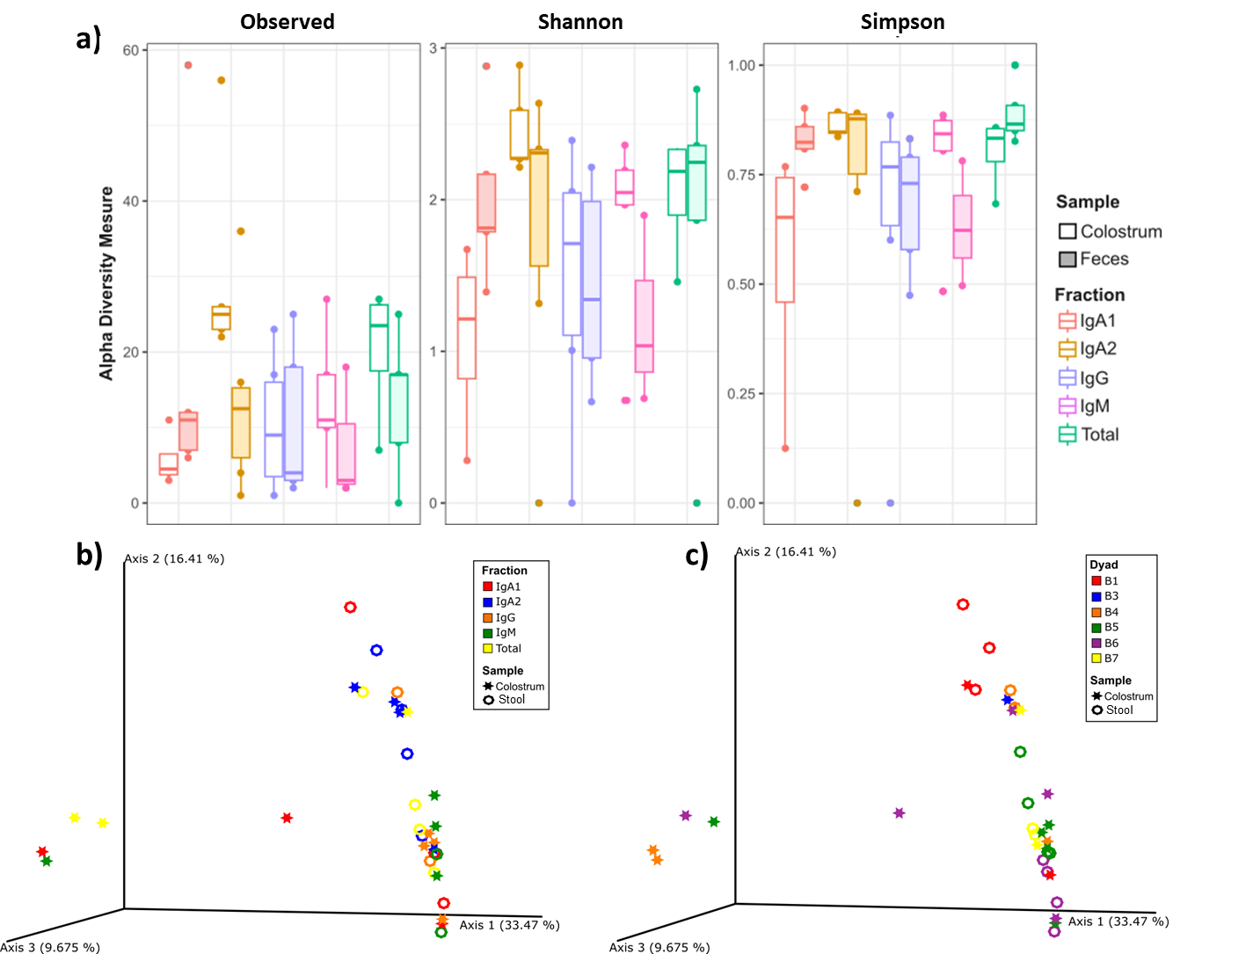
The community of archaea bound by IgA2 is the most diverse in colostrum and neonate feces
Alpha diversity
Differences among immunoglobulins and between sample type
Variable distribution of taxa
Beta diversity
Analysis parameters:
Similarities among dyads.
1,246,659 reads -> Rarefaction
12.31 % reads
72.92% samples (19 colostrum, 15 feces)

Slide 7
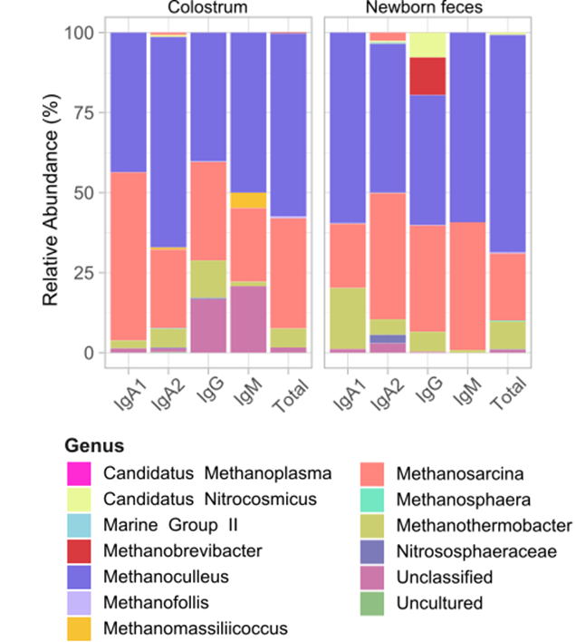
The community of archaea bound by IgA2 is the most diverse in colostrum and neonate feces
Relative abundance
Highest diversity associated to IgA2 in both sample types.
Less common genera associated to IgM in colostrum / - to IgG in newborn feces.
Possible avoidance of immunoglobulin coated.

Slide 8
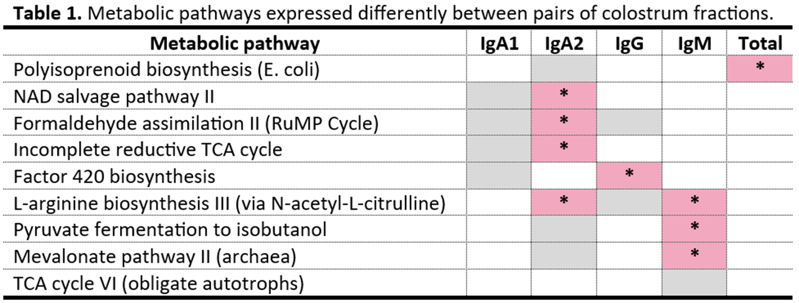
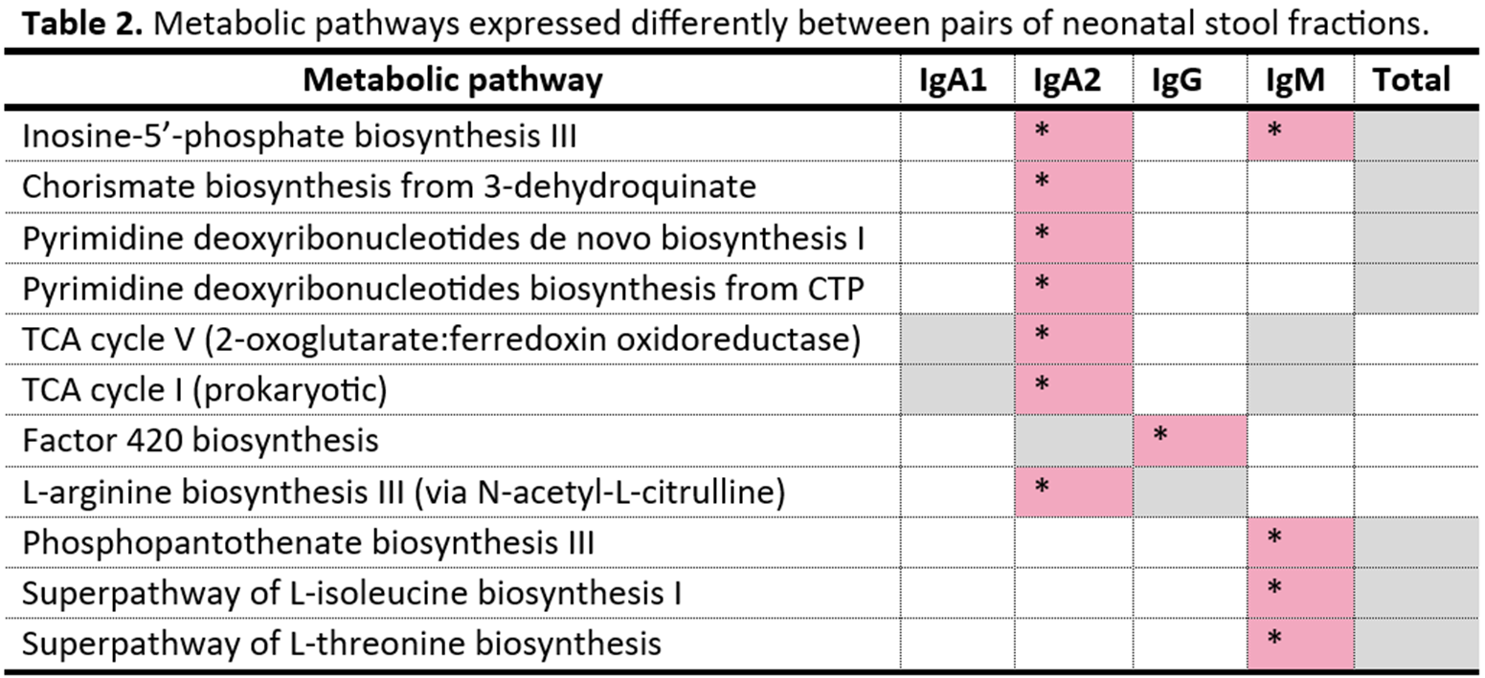
The community of archaea bound by IgA2 is the most diverse in colostrum and neonate feces
Relative abundance
Highest diversity associated to IgA2 in both sample types.
Less common genera associated to IgM in colostrum / - to IgG in newborn feces.
Possible avoidance of immunoglobulin coated.
Functional metagenome prediction
Stool Colostrum
Are archaea early colonizers of the developing infant gut?

Slide 9
Key takeaways
In summary…
Archaea are bound by maternal immunoglobulins in colostrum, and those complexes are vertically transmitted to the newborn through breastfeeding.
Based on our results, immunoglobulins A1, A2, G and M coat archaea differently.
According to the predicted metagenome functions, archaea may be early colonizers of the neonal gut shortly after birth.
We need more data regarding the diversity of archaea communities in the microbiome of healthy people –worldwide scale.
Work supported by CONACyT 163235 INFR-2011-01 and CONACyT FORDECYT-PRONACES/6669/2020_Programa Presupuestario F003-Ciencia de Frontera 2019.

