Slide 1
Perception, attitude and intention towards COVID-19 vaccination
Presenter: Nidhi Kataria
Authors: Dr. Aarti, Rosy Dhall, Jyotika Kundu, Nidhi Kataria

Slide 2
Introduction
COVID-19 (Coronavirus disease 2019) declared as a pandemic by the World Health Organization which is caused due to severe acute respiratory syndrome coronavirus-2 (SARS-CoV-2).
First COVID-19 case in India was reported on January 27, 2020, in Kerala. To tackle this situation, COVID-19 vaccination drive began on January 16, 2021, in India, and till July 15, 2021, 39,13,40,491 (According to government reports (cowin.gov.in)) first and second doses have been administered.
The general behavior of the population with respect to the acceptance of vaccine varies with the geographical location, time and the beliefs of the society (Padhi & Al-Mohaithef, 2020).
This research paper shall delve into investigation of combined effects of trust and usefulness on attitude towards COVID vaccine, intention to get vaccinated and perception of people towards COVID-19 vaccine.

Slide 3
Literature Review
The World Health Organization has reported that one of the major threats to the global health in the recent times is hesitancy of the people towards vaccination and in order to slow down the growth of the epidemic curve, vaccine coverage at a large scale is needed.
There are certain beliefs and barriers regarding vaccination among the general public. Vaccine coverage and its acceptance varies with respect to behavior of the people, geography, and time (Padhi & Al-Mohaithef, 2020)
The main causes regarding vaccine hesitancy were concerned with the vaccine use and lack of trust in vaccines (Al-Qerem & Jarab, 2020).
Other than trust and efficacy level of the vaccine; the three main reasons were people who were generally against vaccine, vaccine made available at such a short duration, and those who considered the vaccine useless (Ward et al., 2020).

Slide 4
Literature Review
The main concern of the people of the country regarding COVID-19 vaccine is potential safety, efficacy, risk perception and possible side effects of the vaccine.^{[1]} Perception and beliefs of the public about the risk and benefits associated with vaccination hampers the acceptance of vaccination (Nguyen et al.,2011).

Slide 5
Research Framework
Based on the literature on trust, usefulness, attitude, and intention discussed above, we propose the research framework which is outlined in Fig. 1.
Fig. 1 Research Framework

Slide 6
Research Methods
The data were collected from 400 respondents of Haryana. The responses were collected from April 24, 2021 to May 13, 2021.
The target study involved persons of all age groups. The sampling technique was simple random sampling.
This technique was chosen so as to get the fair idea about the population regarding vaccination rates. For analysis, SPSS and AMOS (version 24) software were used.

Slide 7
Results and Discussions
71% (284 out of 400) respondents were not vaccinated at the time of the survey, 16.5% (66 out of 400) got their first dose vaccination, and 12.5% (50 out of 400) received both doses of vaccination. 52.5% were female (210 out of 400), one hundred and fifty-eight subjects were in the age-group of 18-25.
79.75% (319 out of 400) participants gave first preference to health workers in the vaccination priority categories whereas 31.75% (127 out of 400) people responded that they came to know about the vaccine via mass media.
The Kaiser-Meyer-Olkin measure of sample adequacy was 0.823 and validates the assumption of factor analysis. Four factor trust, usefulness, intention and attitude emerged with an eigen value > 1 and these factors explained 67.35 percent variance of the total variance. Referring the threshold >.5 proposed by Hair et al. (2010), all the items have loadings >.5. Further, cronbach’s α coefficient shows the reliability of constructs and all the constructs exceeding the threshold value (Sekaran, 2000) > 0.7.

Slide 8
Table 1: Vaccine Coverage Rate
 | Not vaccinated (%) | First Dose (%) | Both doses (%) | Total
Total | 284 (71 %) | 66 (16.5) | 50 (12.5) | 400
Gender Female Male | 156 (74.28) 128 (67.37) | 32 (15.23) 34 (17.89) | 22 (10.48) 28 (14.73) | 210 190
Age Less than 18 18-25 26-35 36-45 45 and above | 4 (44.44) 141 (89.24) 96 (88.07) 26 (55.31) 17 (22.07) | 3 (33.33) 12 (7.59) 7 (6.42) 11 (23.40) 33 (42.85) | 2 (22.22) 5 (3.16) 6 (5.50) 10 (21.28) 27 (35.06) | 9 158 109 47 77
Education Below 10th 12th Undergraduate Post- graduate Other | 6 (25) 24 (51.06) 91 (78.45) 151 (75.88) 12 (85.71) | 7 (29.17) 15 (31.91) 11 (9.48) 17 (8.54) 0 (0) | 11 (45.83) 8 (17.02) 14 (12.06) 31 (15.58) 2 (14.29) | 24 47 116 199 14
Marital Status Married Unmarried Other | 114 (56.71) 166 (85.56) 4 (80) | 47 (23.38) 18 (9.27) 1 (20) | 40 (19.90) 10 (5.15) 0 (0) | 201 194 5
Income Less than 2.5 Lac 2.5-5 Lac 5-10 Lac More than 10 Lac | 78 (71.56) 73 (74.48) 91 (73.98) 42 (60) | 18 (16.51) 15 (15.30) 19 (15.45) 14 (20) | 13 (11.92) 10 (10.20) 13 (10.57) 14 (20) | 109 98 123 70
Who are supposed to be vaccinated first? General Public Health Workers Teachers and Students Others | 27 (57.44) 236 (73.98) 11 (55) 10 (71.43) | 10 (21.28) 49 (15.36) 6 (30) 1 (7.14) | 10 (21.28) 34 (10.66) 3 (15) 3 (21.42) | 47 319 20 14

Slide 9
How did you come to know about COVID-19 vaccine? Mass Media Social Media Internet Newspaper Family Members and Relatives Other | 95 (74.80) 76 (76.77) 53 (68.83) 25 (55.56) 30 (71.43) 5 (50) | 17 (13.39) 13 (13.13) 13 (16.88) 14 (31.11) 8 (19.05) 1 (10) | 15 (11.81) 10 (10.10) 11 (14.28) 6 (13.33) 4 (9.52) 4 (40) | 127 99 77 45 42 10
Vaccination preferences of respondents Everyone Newly recovered from COVID-19 People infected with COVID-19 Those who have not been infected. | 205 (74.54) 8 (32) 30 (56.60) 41 (87.23) | 44 (16) 6 (24) 11 (20.75) 5 (10.64) | 26 (9.45) 11 (44) 12 (22.64) 1 (2.13) | 275 25 53 47
Previous necessary vaccine history Yes (Received all necessary vaccines in lifetime) No | 222 (67.27) 62 (88.57) | 64 (19.40) 2 (2.86) | 44 (13.33) 6 (8.57) | 330 70

Slide 10
As the proposed relationship in hypothesized model I, SEM is used to investigate the perception towards Covid-19 vaccine (see Fig 2).
As shown in fit indices mentioned in Fig. 2, fit indices for measurement model and structural model validate goodness of models.
Researchers recommended the threshold for CMIN/DF, CFI, GFI, TLI, IFI, NFI, AGFI, RMSEA and RMR (Bentler, 1990; Baumgartner and Homburg, 1996; Hu and Bentler, 1999). Therefore, after checking the values of all indices, goodness of measurement model and structural model are satisfactory.

Slide 11
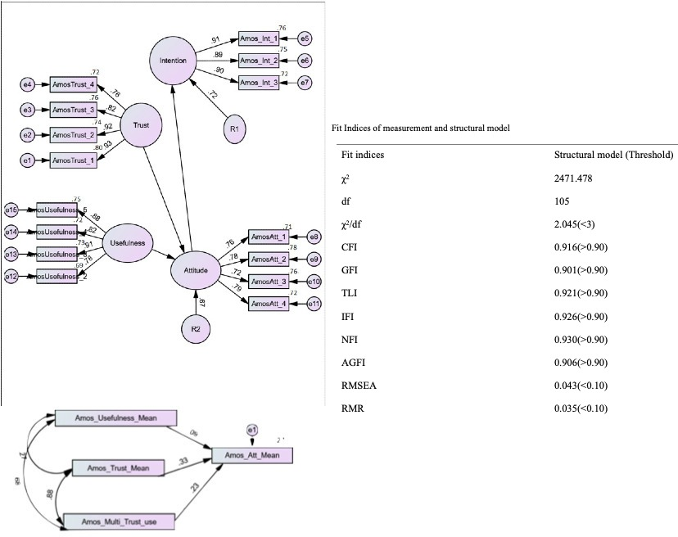

Slide 12
 |  |  | Test of Homogeneity of Variances |  | Anova
Vaccination Experience | Mean | Std. Deviation | Levene Statistic | Sig. | F | Sig.
Yes (First dose) | 3.9628 | .33714 | 2.140 | .119 | 7.998 | .000
Yes (Both dosess) | 4.0764 | .41329
No | 3.8415 | .43097
Post-Hoc Results (Group Differences)
Vaccination Experience | Mean Difference | Sig. | 95% confidence level
 |  |  | Lower Bound |  | Upper Bound
Yes (First dose)- Yes (Both dosess) | -.11355 | .311 | -.2965 |  | .0694
Yes (Both dosess)- No | .23481* | .001 | .0851 |  | .3845
Yes (First dose)-No | -.12126 | .083 | -.2546 |  | .0121

Slide 13
Conclusion and implications
The results reveal that usefulness and trust together can induce positive attitude towards the vaccine and hence, intention to get vaccinated.
Furthermore, it is observed that even those who didn’t get vaccinated had positive perception towards the vaccine which indicates that they will get vaccinated in the near future. Vaccine history plays an important role too.
Those who had received all necessary vaccines in the past are more likely to receive this vaccine too. This indicates that awareness regarding vaccination is enough in the general public.
This study provides a knowledge base for the policymakers for communication improvement and confidence-building in relation to COVID-19 vaccine and vaccination.
This study proposes that promoting a sense of community and addressing potential practical constraints will be key in designing an effective COVID-19 vaccination policy.

Slide 14
References
Al-Mohaithef, M.; Padhi, B.K. Determinants of COVID-19 Vaccine Acceptance in Saudi Arabia: A Web-Based National Survey. J Multidiscip Healthc 2020 ,13,1657-63. doi: 10.2147/JMDH.S276771.
Al-Qerem,W.A.; Jarab, A.S. COVID-19 Vaccination Acceptance and Its Associated Factors Among a Middle Eastern Population. Front Public Health 2021,9,632914. doi: 10.3389/fpubh.2021.632914.
Nguyen, T.; Henningsen, K.H.; Brehaut, J.C.; Hoe, E.; Wilson, K. Acceptance of a pandemic influenza vaccine: a systematic review of surveys of the general public. Infect Drug Resist 2011,4,197-207. doi: 10.2147/IDR.S23174.
Ward, J.K.; Alleaume, C.; Peretti-Watel, P.; COCONEL Group. The French public's attitudes to a future COVID-19 vaccine: The politicization of a public health issue. Soc Sci Med 2020, 265,113414. doi: 10.1016/j.socscimed.2020.113414.

