Slide 1
Fractional-order Predictive PI Controller-based Dead-time Compensator for Wireless Networks
P. Arun Mozhi Devan^{1,∗}, Rosdiazli Ibrahim¹, Madiah Binti Omar², Kishore Bingi¹, Hakim Abdulrab¹, Fawnizu Azmadi Hussin¹
¹Department of Electrical and Electronics Engineering, Universiti Teknologi PETRONAS, Malaysia.
²Department of Chemical Engineering, Universiti Teknologi PETRONAS, Malaysia.

Slide 2
CONTENTS
Introduction
Research background
Problem statement
Methodology
Results and Discussion
Conclusion

Slide 3
INTRODUCTION
For many years, networked control systems have been crucial to industrial processes.
Shifting from wired to wireless technology, using digitalized instruments instead of analogue-based ones, and using auto-diagnostic intelligent instruments instead of manually analysed digital equipment.
PROBLEM STATEMENT
In industrial environments, managing processes with delays can be difficult. Conventional PI controllers may not work well in closed-loop control systems due to time delays, which can significantly impact overall system performance .
One popular solution is using a Smith Predictor-based PI controller to compensate for model discrepancies with and without dead time, but this can lead to inconsistencies between the predictive controller and the processes performance. A reliable controller is required to improve dead-time process plants’ performance.
A solution for compensating prolonged dead-time processes on wired and wireless networks is proposed using a fractional-order predictive PI (FOPPI) compensator.
The FOPPI controller has been tested on various benchmark process models and has demonstrated its ability to reduce peak overshoot, thus maximizing the operating lifespan of control valve actuators
Notes:
Introduction
In most newly emerging algorithms, the primary way of finding the desired optimal value is based on exploration and exploitation phases.
The exploration phase will involve discovering the new optimal regions in the global area, while the exploitation phase will perform a deeper search on the obtained optimal region

Slide 4
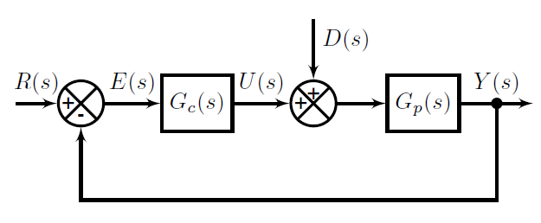
METHODOLOGY
Fig:1 General block diagram of a closed loop control system
R(s) | Input signal
E(s) | Error signal
U(s) | Control signal
D(s) | Disturbance signal
Y(s) | Output signal
Gc(s) | Controller
Gp(s) | Process

Slide 5
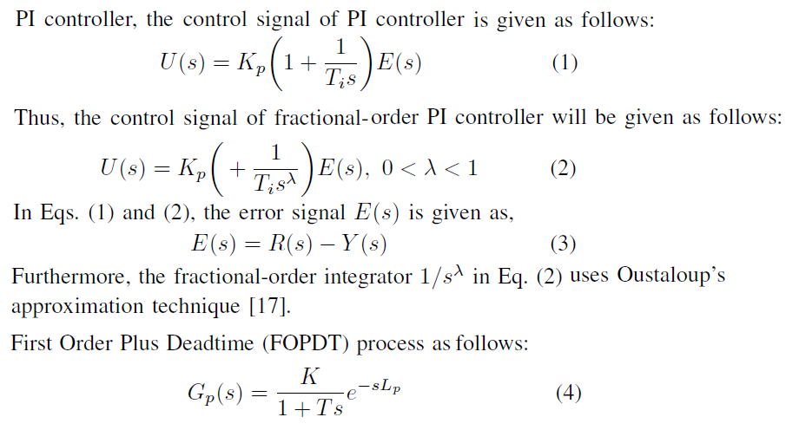
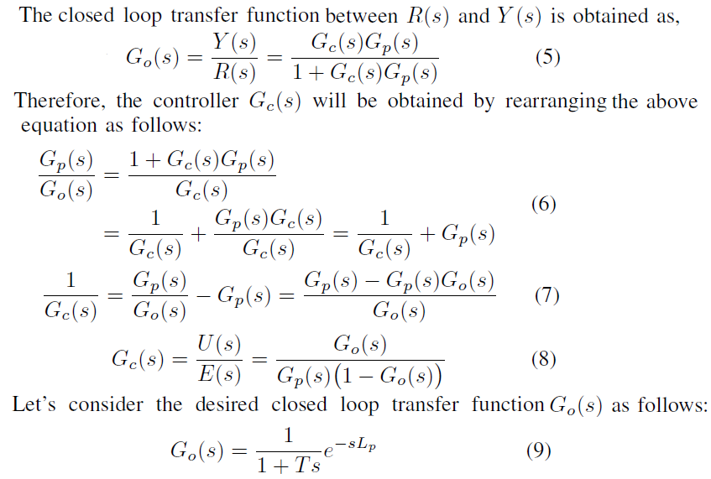
357 days
93 days
182 days
215 days
METHODOLOGY
396 days
122 days
183 days
185 days
Fractional-order Predictive PI (FOPPI) Controller
366 days
2018

Slide 6
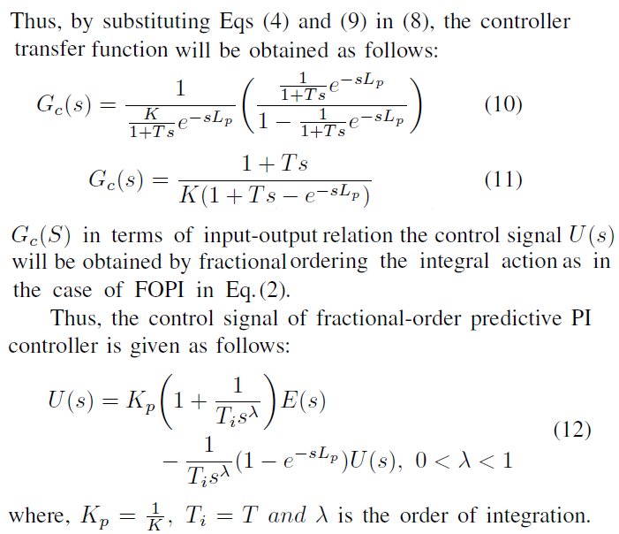
357 days
93 days
182 days
215 days
METHODOLOGY
396 days
122 days
Fractional-order Predictive PI (FOPPI) Controller (contd.,)
183 days
185 days
366 days
2018

Slide 7
RESULTS AND DISCUSSION
Fig. 2: Fractional-order dead-time compensator in the wireless network
This study used an industrial-scale pressure process model for simulation, which accurately represented the dynamic behaviour of the plant. It served as a reliable first-order process model and provided insights into the complex behaviour of industrial plants. The transfer function associated with the process model is presented below
This approximation resulted in the following transfer function for the fractional-order integrator

Slide 8
357 days
93 days
182 days
215 days
RESULTS AND DISCUSSION
396 days
122 days
183 days
185 days
Table 1 Controllers parameters and performance analysis of all the process
366 days
2018

Slide 9
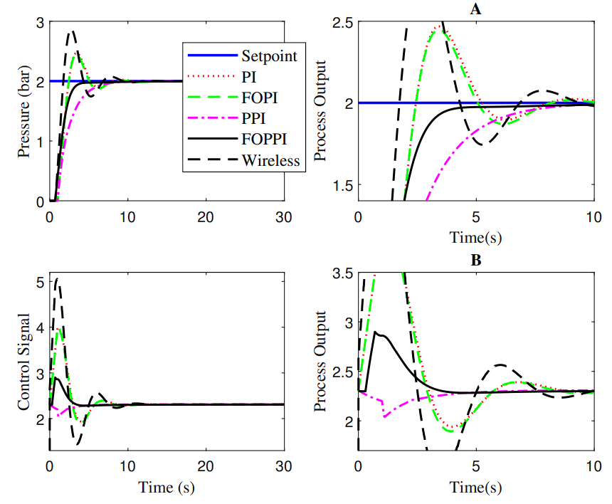
357 days
93 days
182 days
215 days
RESULTS AND DISCUSSION
396 days
122 days
183 days
185 days
366 days
2018
Fig:3 Performance of various controllers in the wired and wireless network

Slide 10
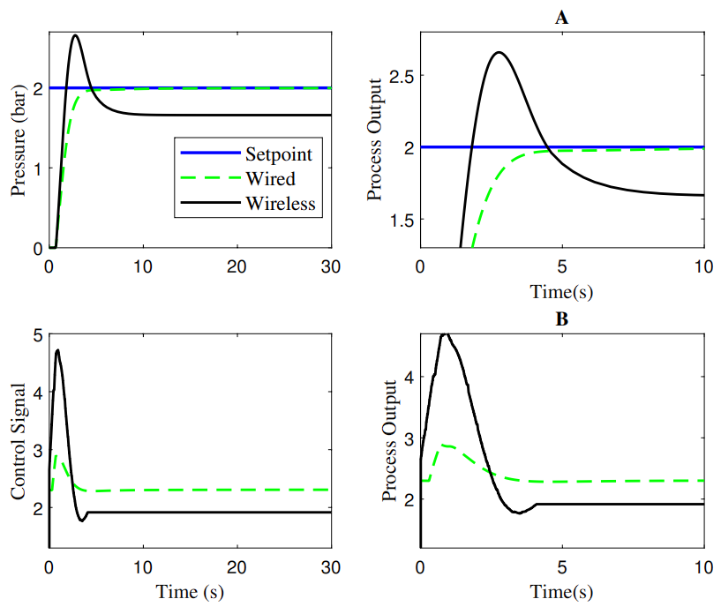
357 days
93 days
182 days
215 days
RESULTS AND DISCUSSION
396 days
122 days
183 days
185 days
366 days
2018
Fig:3 Performance of wireless FOPPI controller with packet drop

Slide 11
CONCLUSION
The study proposes a fractional-order dead-time compensator to improve the control and compensation capabilities of wireless networks.
The results shows that the controller offers optimal settling time, rise time, and peak overshoot performance compared to its wired networks.
However, due to scheduled data transfers and minimal delays, wireless networks experience longer settling times and increased overshoots.
The efficacy of the proposed compensator will be assessed on real-time wireless networks in future research.

Slide 12
REFERENCES
1. Abdulrab, H.Q.A.; Hussin, F.A.; Arun, P.S.; Awang, A.; Ismail, I. Simulation and control of industrial composition process over wired and wireless networks. In Proceedings of the
International Conference of Reliable Information and Communication Technology. Springer, 2020, pp. 685–695.
2. Devan, P.A.M.; Hussin, F.A.; Ibrahim, R.; Bingi, K.; Khanday, F.A. A survey on the application of WirelessHART for industrial process monitoring and control. Sensors 2021, 21, 4951.
3. Abdulrab, H.; Hussin, F.A.; Abd Aziz, A.; Awang, A.; Ismail, I.; Devan, P.A.M. Reliable fault tolerant-based multipath routing model for industrial wireless control systems. Applied Sciences 2022, 12, 544.
4. Selvam, A.M.D.P.; Hussin, F.A.; Ibrahim, R.; Bingi, K.; Nagarajapandian, M. Optimal Fractional-Order Predictive PI Controllers: For Process Control Applications with Additional Filtering; Springer Nature, 2022.
5. Briones, O.A.; Rojas, A.J.; Sbarbaro, D. Generalized Predictive PI Controller: Analysis and Design for Time Delay Systems. In Proceedings of the 2021 American Control Conference (ACC). IEEE, 2021, pp. 2509–2514.
6. Euzebio, T.A.; Yamashita, A.S.; Pinto, T.V.; Barros, P.R. SISO approaches for linear programming based methods for tuning decentralized PID controllers. Journal of Process Control 2020, 94, 75–96.
7. Hassan, S.M.; Ibrahim, R.; Saad, N.; Bingi, K.; Asirvadam, V.S.; Hassan, S.M.; Ibrahim, R.; Saad, N.; Bingi, K.; Asirvadam, V.S. Filtered predictive Pi controller for wirelesshart networked systems. Hybrid PID Based Predictive Control Strategies for WirelessHART Networked Control Systems 2020, pp. 27–58.
8. Peterle, F.; Rampazzo, M.; Beghi, A. Control of second order processes with dead time: the predictive PID solutions. IFAC-PapersOnLine 2018, 51, 793–798.
9. Bingi, K.; Ibrahim, R.; Karsiti, M.N.; Hassan, S.M.; Harindran, V.R. Real-time control of pressure plant using 2DOF fractional-order PID controller. Arabian Journal for Science and Engineering 2019, 44, 2091–2102.
10. Marushchak, Y.; Mazur, D.; Kwiatkowski, B.; Kopchak, B.; Kwater, T.; Koryl, M. Approximation of Fractional Order PIλDµ-Controller Transfer Function Using Chain Fractions. Energies 2022, 15, 4902.

Slide 13
THANK YOU !!!
TERIMA KASIH !!!
நன்றி !!!

