Slide 1
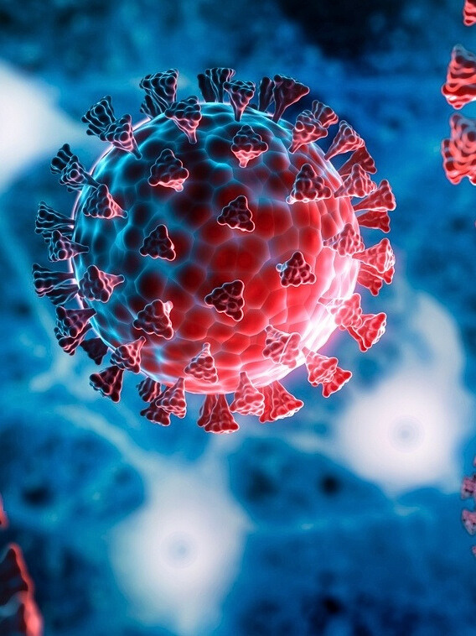
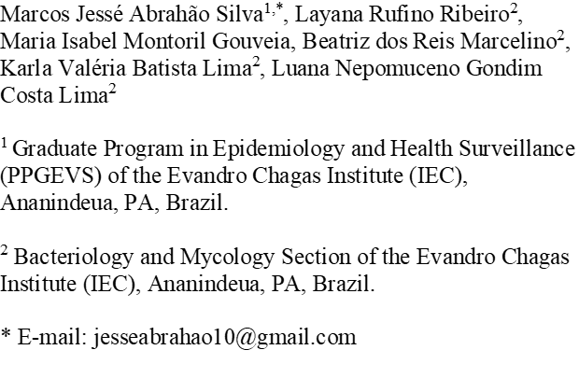
ASSERTION OF A DIDACTIC ILLUSTRATIVE SCHEME OF THE HYPERINFLAMMATORY RESPONSE IN COVID-19

Slide 2
INTRODUCTION
  COVID-19 IS AN INFECTIOUS DISEASE CAUSED BY SARS-COV-2;
  It can be asymptomatic or symptomatic:
Mild, moderate, severe or critical clinical conditions;
  It has a high transmissibility and means of escaping the host's defense system, which contributes to its high infectivity;
  It generates immune disorder

Slide 3
INTRODUCTION
HYPERINFLAMMATORY RESPONSE IN COVID-19
  EXACERBATED INITIAL RESPONSES OF INNATE IMMUNITY AND LATE UNCONTROLLED ADAPTIVE IMMUNITY IN INFECTION
HYPERINFLAMMATORY RESPONSE AND CAUSE COMPLICATIONS IN SEVERE CASES OF COVID-19.

Slide 4
OBJECTIVE
SYSTEMATIZE WHICH IMMUNOPATHOLOGICAL ASPECTS OF COVID-19 ASSOCIATED WITH THE HUMAN HOST AND SARS-COV-2 CONTRIBUTE TO THE POOR PROGNOSIS OF THE DISEASE THROUGH A HYPERINFLAMMATORY RESPONSE.

Slide 5
METHODOLOGY
Our Goals
BRIEFLY ELABORATE ON WHAT YOU WANT TO DISCUSS.
SYSTEMATIC REVIEW
  Articles were selected from the electronic databases PUBMED, MEDLINE, LILACS and SCIELO;
  Descriptors together with 'AND': "SARS-CoV-2", "COVID-19", "ARDS" and "Cytokine release syndrome".
  English or Spanish languages;
  PRISMA flowchart (Preferred Reporting Items for Systematic Reviews and Meta-Analyses) 2020.

Slide 6
METHODOLOGY
Our Goals
BRIEFLY ELABORATE ON WHAT YOU WANT TO DISCUSS.
DATA COLLECTION AND EXTRACTION
  THE DATA EXTRACTED FROM THE ARTICLES WERE: Author and year of publication, database, methodology, objectives and results.
    Inclusion criteria: articles published from February 2020 to July 2022.
    Exclusion criteria: articles with only the abstract available and with topics not pertinent to the theme.

Slide 7


METHODOLOGY
Our Goals
BRIEFLY ELABORATE ON WHAT YOU WANT TO DISCUSS.
METHODOLOGICAL QUALITY AND RISK OF BIAS ASSESSMENT
  Joanna Briggs Institute (JBI) critical review checklist.
  RoB 2.0 Tool and ROBINS-I Tool for assessment of risk of bias in randomized and non-randomized studies, respectively.

Slide 8
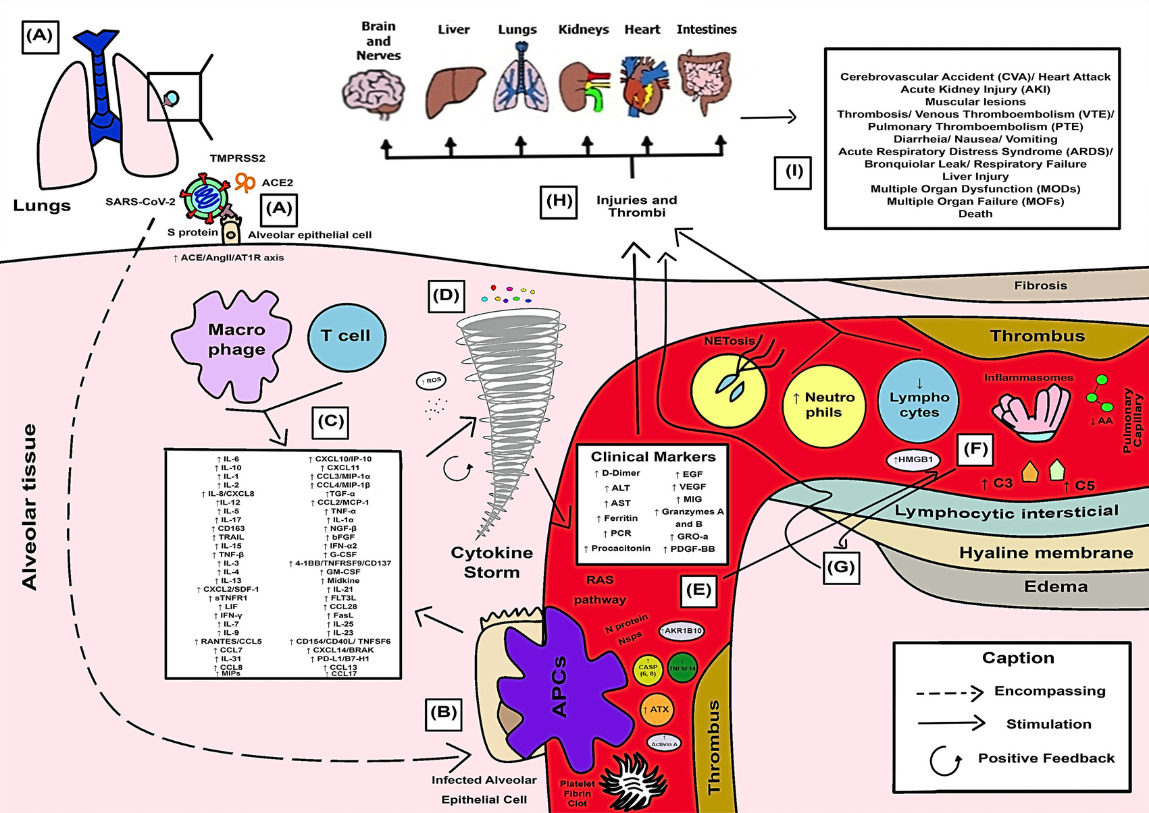
RESULTS
Our Goals
THE SEARCH RESULTED IN 39 ARTICLES.
FIGURE 1 - HYPERINFLAMMATORY RESPONSE IN PATIENTS WITH COVID-19.
Source: Authors (2023).

Slide 9
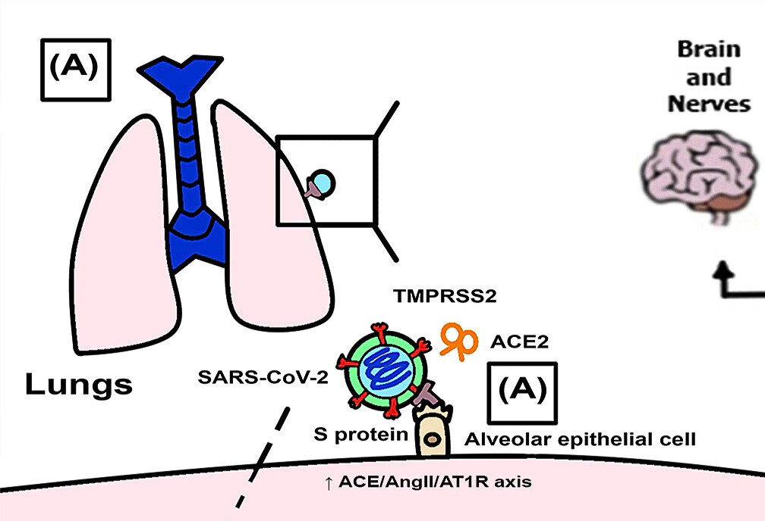

Slide 10

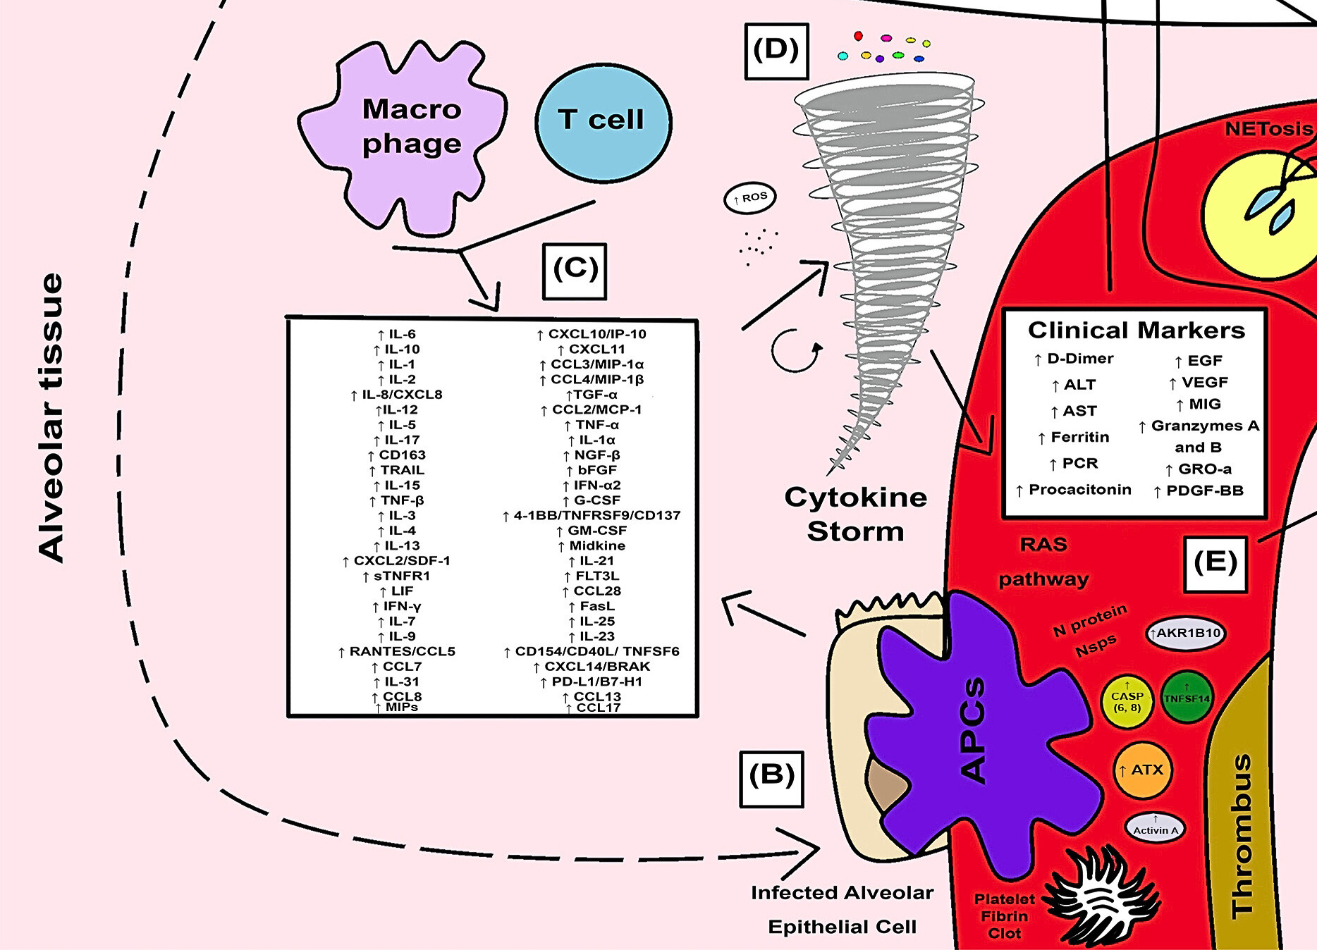

Slide 11
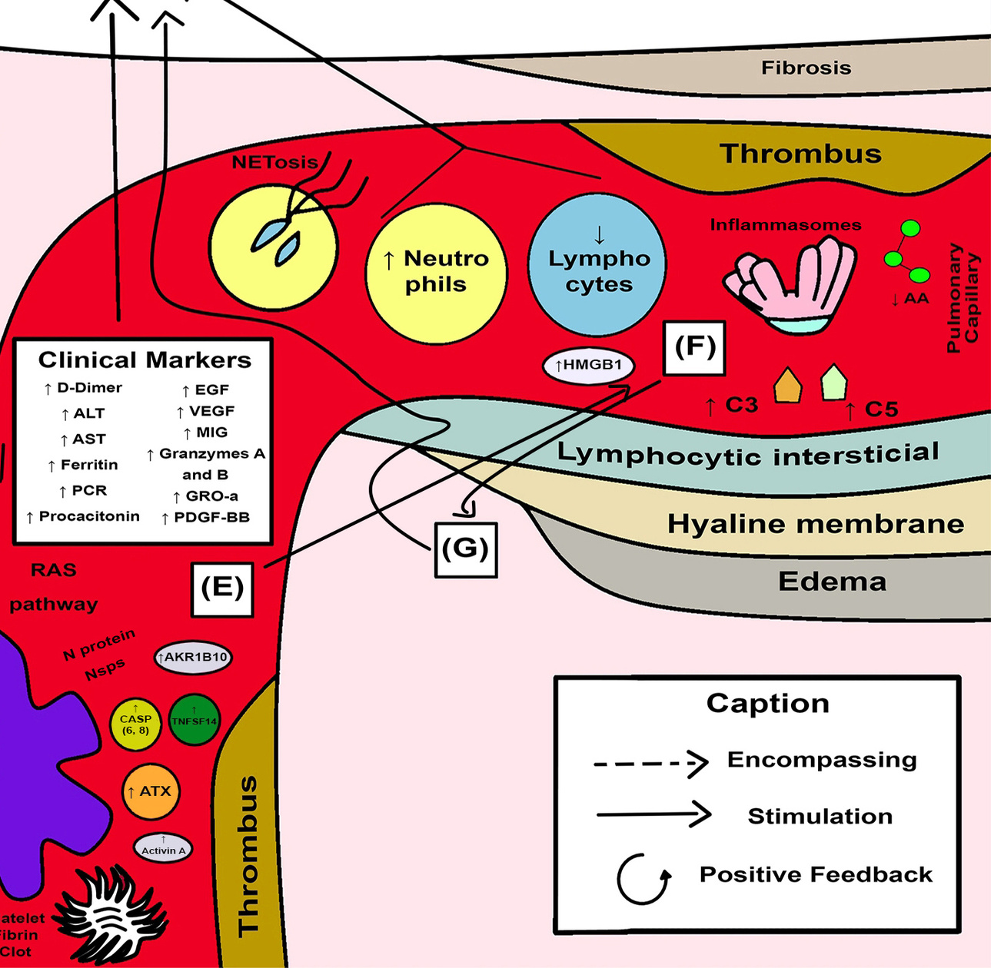

Slide 12
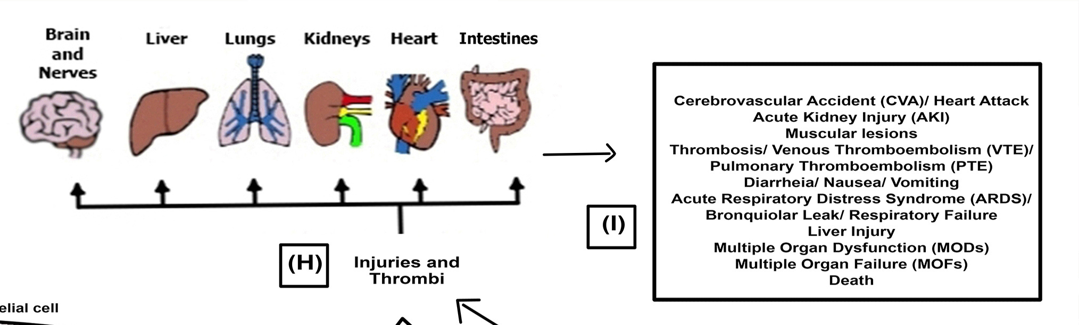

Slide 13
CONCLUSION
Our Goals
BRIEFLY ELABORATE ON WHAT YOU WANT TO DISCUSS.
  Spike protein contributes to an inflammatory response in COVID-19 patients.
  Several clinical parameters are related to disease progression.
  Dysregulated inflammation is significantly associated with the “cytokine storm”.
  Immune cells involved in the hyperinflammatory response promote generalized inflammation and blood clotting.
  There is a need for further studies involving the search for the various actors in this response and their complex interconnection to the clinical worsening of the patient.

Slide 14
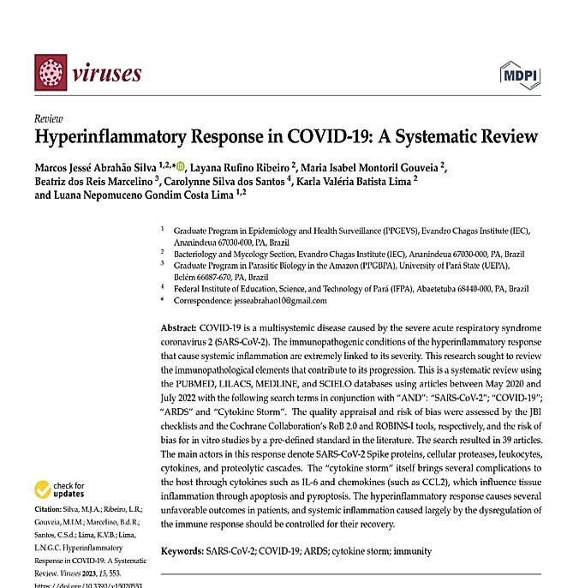
PUBLICATION OF THE ARTICLE
DOI: 10.3390/V15020553
Back to Agenda

Slide 15
REFERENCES
Our Goals
FAIST, A. et al. Virus Infection and Systemic Inflammation: Lessons Learnt from COVID-19 and
Beyond. Cells, v. 11, n. 14, p. 2198, 14 jul. 2022.
GUSEV, E. et al. SARS-CoV-2-Specific Immune Response and the Pathogenesis of COVID-19.
International Journal of Molecular Sciences, v. 23, n. 3, p. 1716, 2 fev. 2022.
LÓPEZ-COLLAZO, Eduardo et al. Immune Response and COVID-19: A mirror image of Sepsis.
International journal of biological sciences, v. 16, n. 14, p. 2479, 2020.
LOWERY, S. A.; SARIOL, A.; PERLMAN, S. Innate immune and inflammatory responses to SARSCoV-
2: Implications for COVID-19. Cell Host and Microbe, v. 29, n. 7, p. 1052–1062, 14 jul. 2021.
MAECKER HT. Immune profiling of COVID-19: preliminary findings and implications for the
pandemic. J Immunother Cancer. maio de 2021.
MOHAMED KHOSROSHAHI, L. et al. Immunology, immunopathogenesis and immunotherapeutics
of COVID-19; an overview. International immunopharmacology, v. 93, p. 107364, abr. 2021.
MORTAZ, E. et al. The Immune Response and Immunopathology of COVID-19. Frontiers in
Immunology, v. 11, n. August, p. 1–9, 2020.

