Slide 1
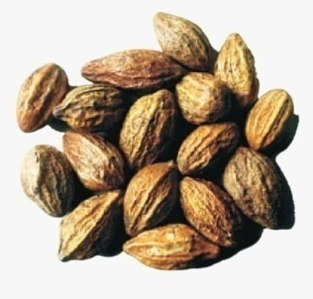
Antifungal property of Kadukkai (Terminalia chebula) - An evaluative study.
Dr. Madhu Narayan, M.D.S.,
Senior Lecturer,
Dept. of Oral Pathology,
SRM Dental College, Ramapuram

Slide 2
INTRODUCTION

Slide 3
ROLE OF GUT MICROBES IN HEALTH AND DISEASE

Slide 4
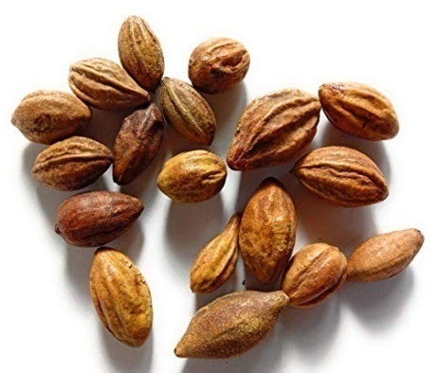
PHARMACALOGICAL PROPERTIES
Anti-carcinogenic
Anti –oxidant
Wound healing activity
Radio Protective
Anti-diabetic
Cytotoxic activity
Anti-inflammatory
TERMINALIA CHEBULA
Gupta PC. Biological and pharmacological properties of Terminalia chebula Retz.(Haritaki)-An overview. Int J pharm pharm Sci. 2012;4(3):62-8.

Slide 5
AIM & OBJECTIVES

Slide 6
•To evaluate the antifungal effect of Terminalia chebula on Candida albicans.
To evaluate the antifungal effect of Terminalia chebula
•To evaluate the antifungal effect of Terminalia chebula on Candida glabrata
AIM
OBJECTIVES

Slide 7
MATERIALS & METHODS

Slide 8
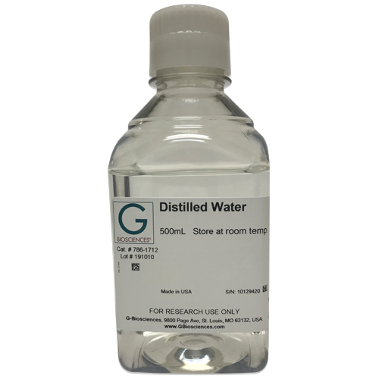
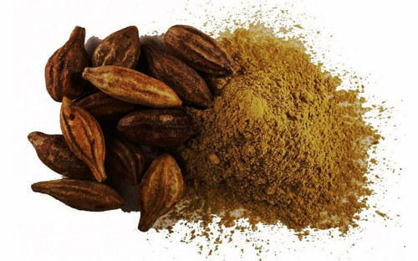
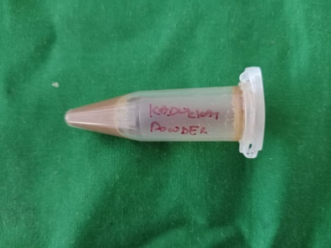
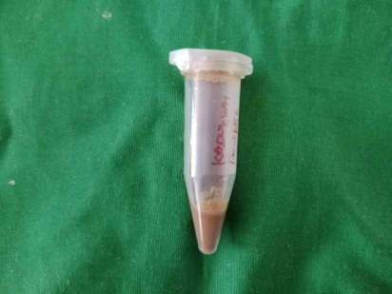
T. Chebula (Kadukkai)

Slide 9
MEDIA
For C.glabrata
For C.albicans
Saboraud’s Chloramphenicol Agar
Hichrome Candida Differential Agar Base

Slide 10
MICROBIAL STRAINS
C. albicans
C. glabrata

Slide 11
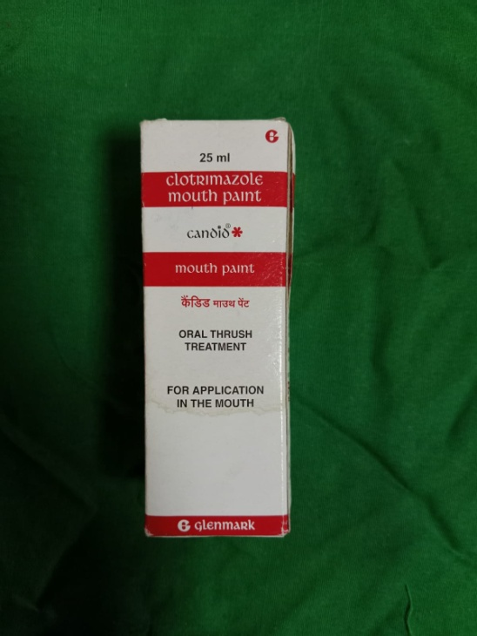
CONTROLS

Slide 12
METHODOLOGY

Slide 13
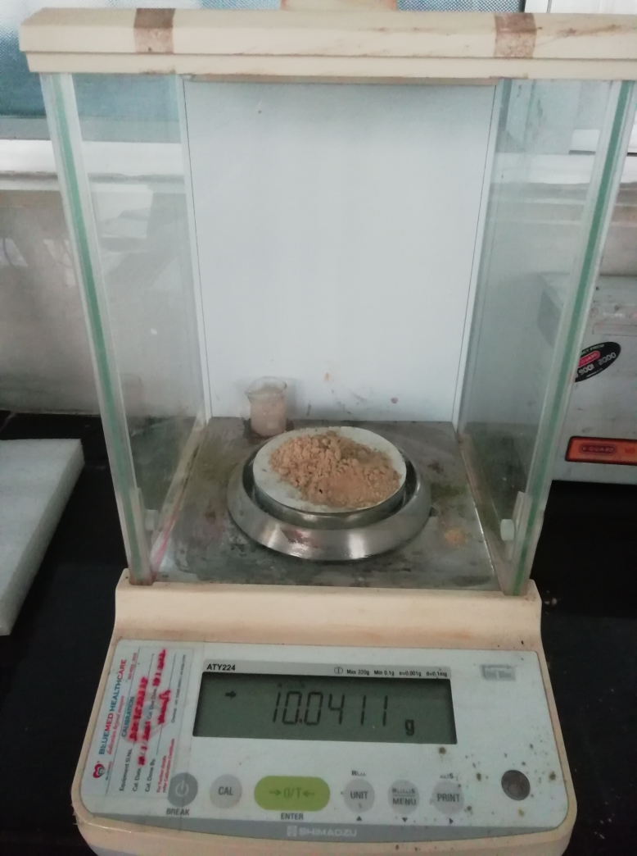
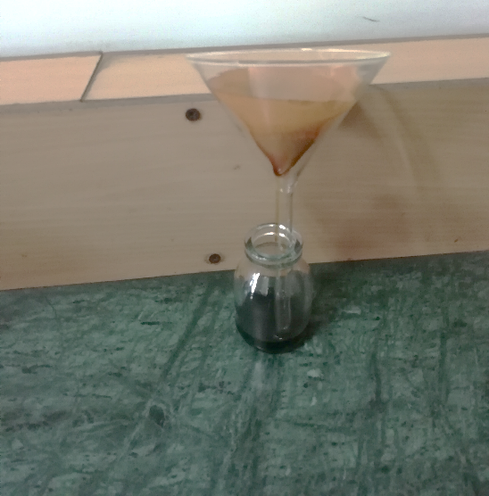
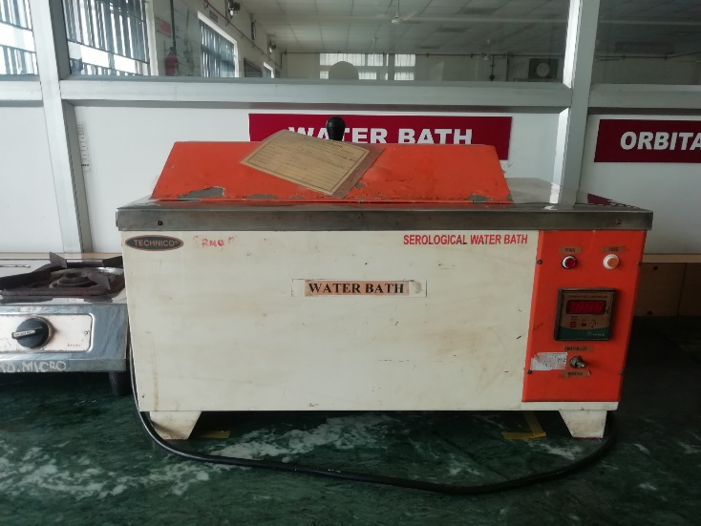
PREPARATION OF EXTRACT
10 g of Herbal powder
20 ml of distilled water
Keep it for 24 hours
Filtered in whatman’s filter paper 1
Extract –Kept in a water bath (40-50 c)
Notes:
All these equipments are provided in our lab,

Slide 14
METHODOLOGY
Procurement of fungal strains
Culturing the microbes
Inoculation of herbal extract into the strains
Assessment of the antifungal inhibitory zones

Slide 15
RESULTS

Slide 16
INHIBITORY ZONE-AGAINST C. albicans
ANTIFUNGAL – 32 mm

Slide 17
INHIBITORY ZONE-AGAINST C. glabrata
ANTIFUNGAL – 30 mm

Slide 18
INHIBITORY ZONES-CONTROLS
Positive control- 33mm
Negative control- 0mm

Slide 20
DISCUSSION
C.albicans
C.glabrata
Our study-Aqueous extract
Comparison with other studies

Slide 21
LIMITATIONS
Other spp to be analysed
Other microbes to be tested
Different concentrations to be analysed
Future prospective-In-vivo studies
Notes:
More bacteria is to be added in this study

Slide 22
CONCLUSION
Exploration of Indian herbs as therapeutic agents over allopathic ones, particularly for infectious diseases and chronic diseases like Diabetes, asthma etc.

Slide 23
REFERENCES

Slide 24
Gupta PC. Biological and pharmacological properties of Terminalia chebula Retz.(Haritaki)-An overview. Int J pharm pharm Sci. 2012;4(3):62-8.
Nam, Y. J., & Hwang, Y. S. (2021). Antibacterial and antioxidant effect of ethanol extracts of
Terminalia chebula on Streptococcus mutans. Clinical and Experimental Dental Research, 7(6),
987-994.
Saxena, S., Lakshminarayan, N., Gudli, S., & Kumar, M. (2017). Anti bacterial efficacy of
Terminalia chebula, Terminalia bellirica, Embilica officinalis and Triphala on salivary
Streptococcus mutans count–a linear randomized cross over trial. Journal of clinical and
diagnostic research: JCDR, 11(2), ZC47.
Ahuja, C., Kaur, H., & Sharma, R. (2015). Antibacterial activity of Terminalia Chebula fruit by
agar well diffusion method. Journal of Chemistry, Environmental Sciences and its Applications.
JCE, 1 (2).
Kaypetch R, Thaweboon S. Antifungal property of Piper betle leaf oil against oral Candida species. InMATEC Web of Conferences 2018 (Vol. 242, p. 01021). EDP Sciences.

