Slide 1
Trajectory of COVID-19 Vaccine Hesitancy Post-Vaccination and Public’s Intention to Take Booster Vaccines: A Cross-Sectional Analysis
Muhammad Salman¹, Yusra Habib Khan², Zia Ul Mustafa^{3,4}, Muhammad Hammad Butt⁵, Tauqeer Hussain Mallhi²
¹Institute of Pharmacy, Faculty of Pharmaceutical and Allied Health Sciences, Lahore College for Women University, Jail Road, Lahore, Pakistan
²Department of Clinical Pharmacy, College of Pharmacy, Jouf University, Sakaka 72388, Al-Jouf Province, Kingdom of Saudi Arabia
³Department of Pharmacy Services, District Headquarter Hospital, Pakpattan 57400, Pakistan
⁴Discipline of Clinical Pharmacy, School of Pharmaceutical Sciences, Universiti Sains Malaysia, Penang, Malaysia
⁵Department of Medicinal Chemistry, Faculty of Pharmacy, Uppsala University, 75123, Uppsala, Sweden

Slide 2
Introduction
Vaccine hesitancy (VH) is a significant challenge in Pakistan, as evidenced by the presence of wild polio in the country to this day [1, 2].
Published literature show substantial COVID-19 vaccine hesitancy (CVH) in Pakistan is linked with various conspiracy theories, lack of trust of the government, effectiveness and safety concerns surrounding the COVID-19 vaccines [3-5].
Above-mentioned issues can seriously hamper COVID-19 vaccination drive in Pakistan.
Amidst emergence of various variants of coronavirus, vaccinating the masses and providing booster doses to already immunized people is of great importance to keep the infection controlled in the country.
This study examined VH and its factors as well as intention to take booster doses among people who have received primary doses of COVID-19 vaccines.

Slide 3
Methods
Design
Cross-sectional study
Participants & settings
Sampling
Sample was recruited via Convenience sampling technique between March and May 2022
Inclusion criteria: (1) adults (≥ 18 years old), (2) the ability to speak Urdu, and (3) willingness to participate
Adult population of Pakistan's second largest metropolis (Lahore)
Ethical Considerations
The study approved by the Research Ethics Committee of the Department of Pharmacy Practice, Faculty of Pharmacy, The University of Lahore
Verbal informed consents were obtained from study participants
No personal information of any kind was collected to ensure the respondents' anonymity

Slide 4
Methods (Cont’d)
Data analysis
All the data was analyzed using SPSS Version 22.
The comparison of continuous data was subjected to t-test and one-way ANOVA
In addition, factors contributing to VH were also determined by Multiple regression
Study instrument
Anonymized questionnaire
The questionnaire contained 6 sections; (1) Demographics, (2) 4-items to determine COVID-19 vaccination status (3) 10-item COVID-19 vaccine hesitancy scale (4) 10-items to determine factors associated with COVID-19 vaccine uptake, (5) 3-items to assess public’s willingness to recommend vaccine to others and intention to take booster shots, and (6) Four items to record opinion about COVID-19 vaccine pre- and post-immunization
Measures of central tendencies were used to demonstrate collected data
Relative importance index (RII) was estimated to rank factors linked with VH
However, factors underlying acceptance of booster doses were measured through Ordinal logistic regression analysis

Slide 5
Results
Total number of individuals approached = 928
Consented to participate = 672
Included in the study = 650
Returned Incomplete questionnaire = 22
Excluded = 256
Reasons
1. Don't have time
2. Not interested
3. Don't want to share information
4. Believed survey was conducted by Govt.
5. Not vaccinated/Fake vaccination cards
6. No reason given
Analyzed = 650
Figure 1: Participants recruitment flowchart

Slide 6
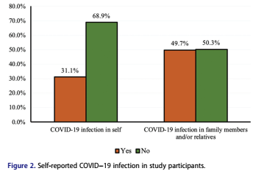
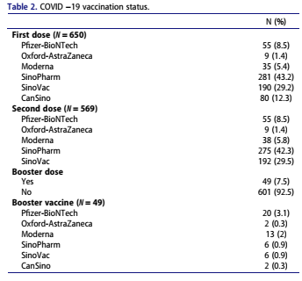

Slide 7
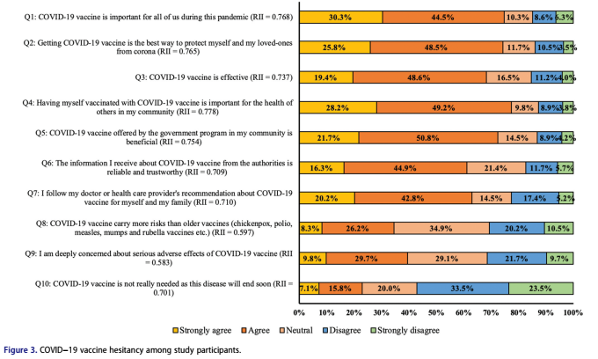

Slide 8
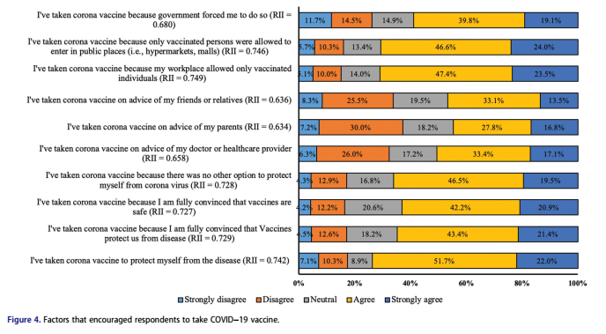

Slide 9
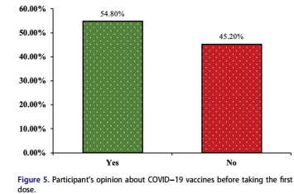
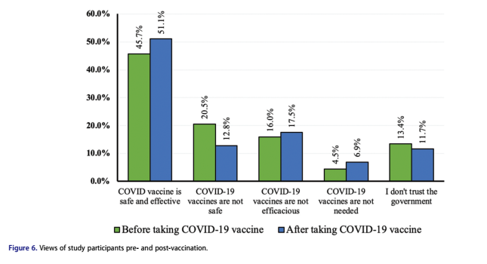
Around 55% reported they were reluctant to take COVID-19 vaccine before they received their first shot (Figure 5), with major reasons being doubts on vaccine safety, efficacy and mistrust on the government.
Though participant`s opionion changed following the COVID-19 vaccines doses (45.7% vs 51.1%), still a considerable study population have concerns over safety and efficacy of the COVID-19 vaccines (Figure 6).
Additionally, around 7% were of the opinion that COVID-19 vaccines were not really needed.

Slide 11
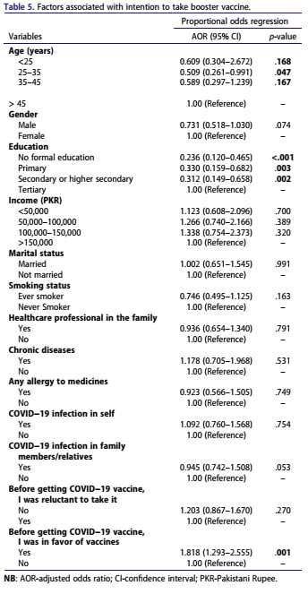
Young age and lower level of education were negatively associated with the booster vaccines’ acceptance.
Furthermore, pro-vaccine attitude prior to taking primary doses of COVID-19 vaccines was found to be associated with higher odds of booster vaccine acceptance (p = 0.001).

Slide 12
CONCLUSION
COVID-19 vaccine hesitancy is prevalent even after receiving primary doses of the vaccine
Majority of participants reported that they received COVID-19 vaccines to comply with the government`s mandates to attend office, schools, and public places.
Approximately 50% of study population was hesitant to receive primary doses of the COVID-19 vaccines. However, A slight improvement in opinions of participants were observed after receiving primary doses.
Majority of study participants were concerned about the safety and effectiveness of vaccines, which may correlate with a lack of trust in government.
People with a low socioeconomic status and a history of vaccine reluctance were significantly associated with post-vaccination VH.
Only one-third individuals were willing to receive booster doses.
Young and less educated people were less likely to receive booster doses of COVID-19 vaccines.
Our findings call for measures to control factors underlying VH.
Educational programs with positive peer influence will help to neutralize misleading narratives against COVID-19 vaccines and will to achieve the vaccination coverage.

Slide 13
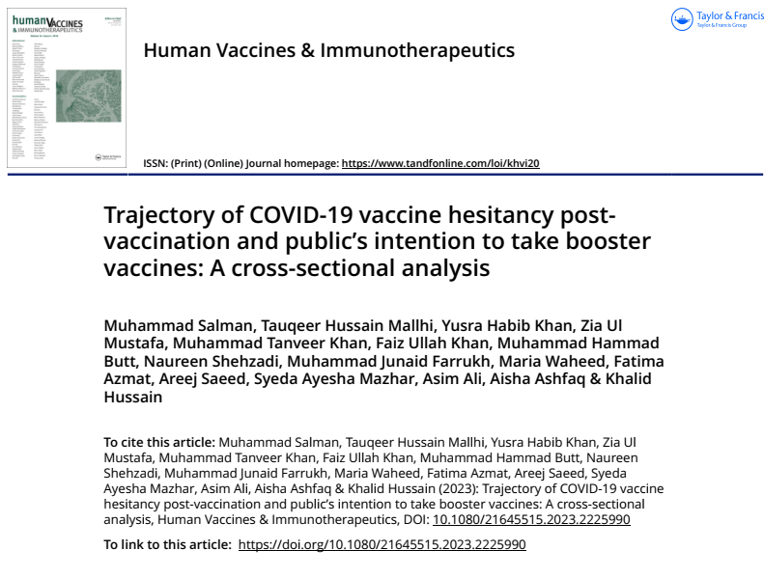
Full-text of the article can be found at https://doi.org/10.1080/21645515.2023.2225990

Slide 14
References
Asghar RJ. Why is polio still here? A perspective from Pakistan. Lancet Glob Health. 2020;8(2):e177–e8.
Shabbir H, Saeed S, Farhan M, et al. Poliomyelitis in Pakistan: challenges to polio eradication and future prospects. Ann Med Surg. 2022;80:104274.
Khalid S, Usmani BA, Siddiqi S. COVID-19 vaccine hesitancy in Pakistan: a mini review of the published discourse. Front Public Health. 2022;10.
Salman M, Mallhi TH, Tanveer N, et al. Evaluation of conspiracy beliefs, vaccine hesitancy, and willingness to pay towards COVID-19 vaccines in six countries from Asian and African Regions: a large multinational analysis. Vaccines. 2022;10(11):1866.
Khan YH, Mallhi TH, Alotaibi NH, et al. Threat of COVID-19 vaccine hesitancy in Pakistan: the need for measures to neutralize misleading narratives. Am J Trop Med Hyg. 2020;103(2):603.

