Slide 1
Enhancing Flood Resilience: Streamflow Forecasting and Inundation Modeling in Pakistan
Maham Shehzadi
2021273

Slide 2
OUTLINES
Introduction
Problem Statement
Research Gap
Datasets
Procedure
Results

Slide 3
INTRODUCTION
Frequent Natural calamities.
The Devastating Impact of Floods on Lives, and Economy.
Pakistan's Struggle: Safeguarding Against Floods.
World Bank Statistics
Floods 2022 Pakistan | People Affected | Deaths | Displaced People With health crisis
 | 33 Million | 1730 | 8 Million

Slide 4
Problem Statement
There is a need to improve Flood Forecasting and River Inundation Modeling in Pakistan through machine learning algorithms by considering various factors like meteorology, topography, hydrology, and geology.

Slide 5
RESEARCH GAP
Specific for Pakistan
Flood dataset since 1947
Main factors:
> Meteorological Data
> Streamflow Data
> Topographic Data

Slide 6
DATASETS
Rainfall _1901-2016 (Kaggle)
Temperature_1901-2016 (Kaggle)
Water level _2022-2023 (WAPDA River Flow)
Historical Flood data (Google, Different sources)
Land Cover Data (land use atlas of Pakistan , Ministry of Environment Government of Pakistan)
Weather Data (https://weatherspark.com/)
Google Earth Engine (landsat images)

Slide 7
PROCEDURE
Datasets
Collection
Data Preprocessing
Model Training
Results
Model Validation

Slide 8
RESULTS
Accuracy:
SVM: 94%
ANN: 95%
KEY WORDS:
Machine Learning
> Support Vector Machine (SVM)
> Artificial Neural Network (ANN)
Temperature
Rainfall
Key:
1 = Flood
0 = Non-Flood

Slide 9
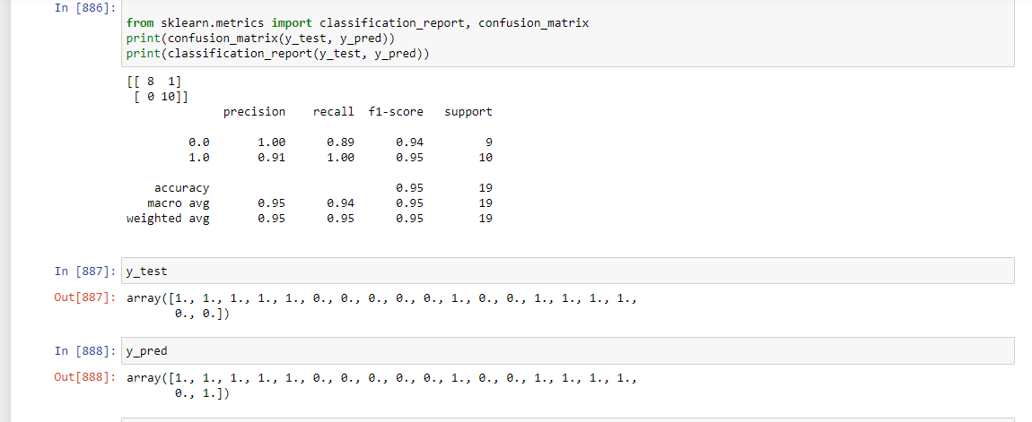
RESULTS
SVM

Slide 10
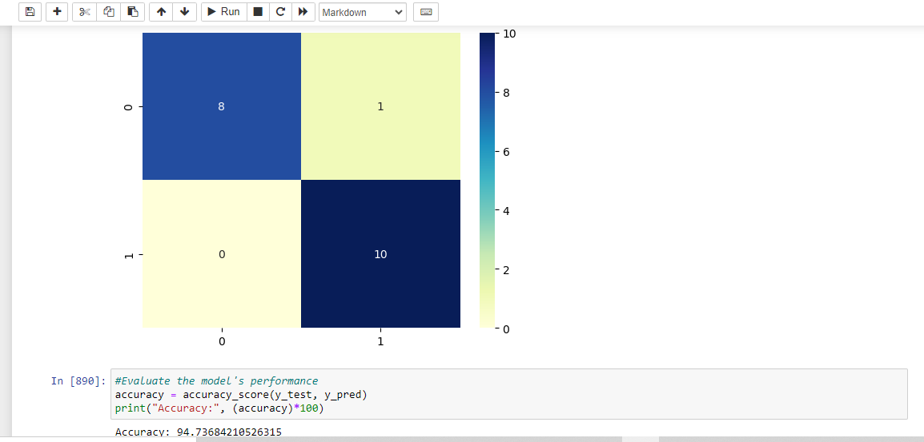
RESULTS
SVM

Slide 11
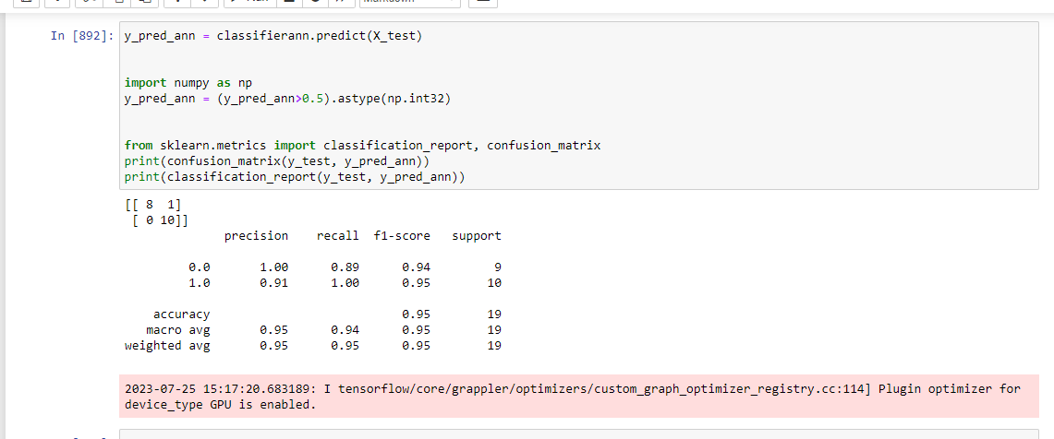
RESULTS
Artificial Neural Network

Slide 12
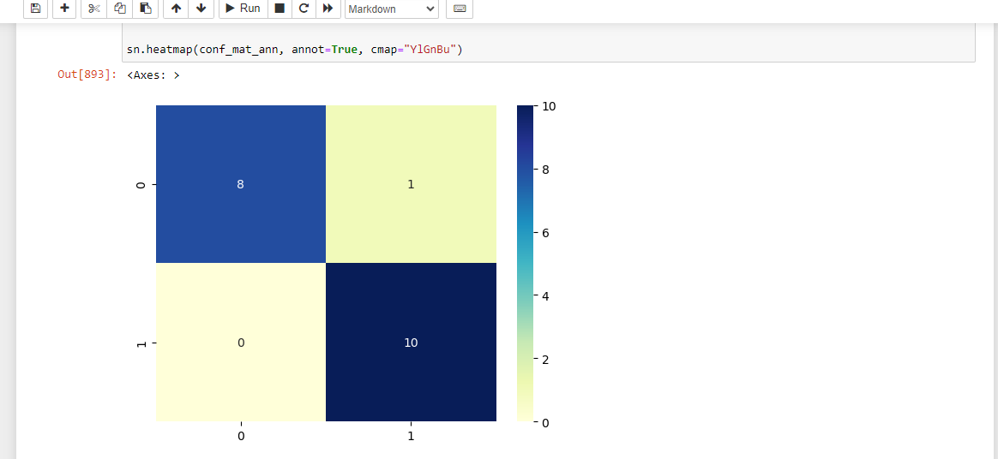
RESULTS
Artificial Neural Network

Slide 13
RESULTS
Flood Extent of 2021 and 2022
The total area of the flood extent is 11,065 square kilometers based on Landsat 8 images.

Slide 14
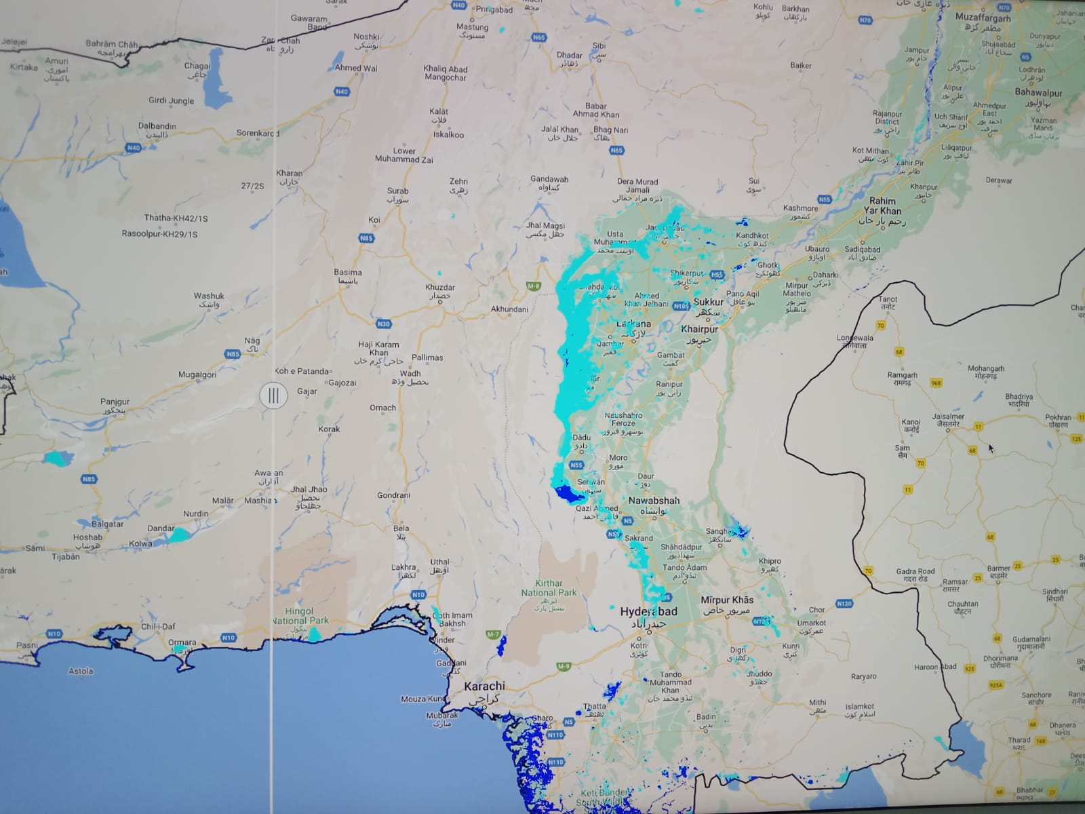
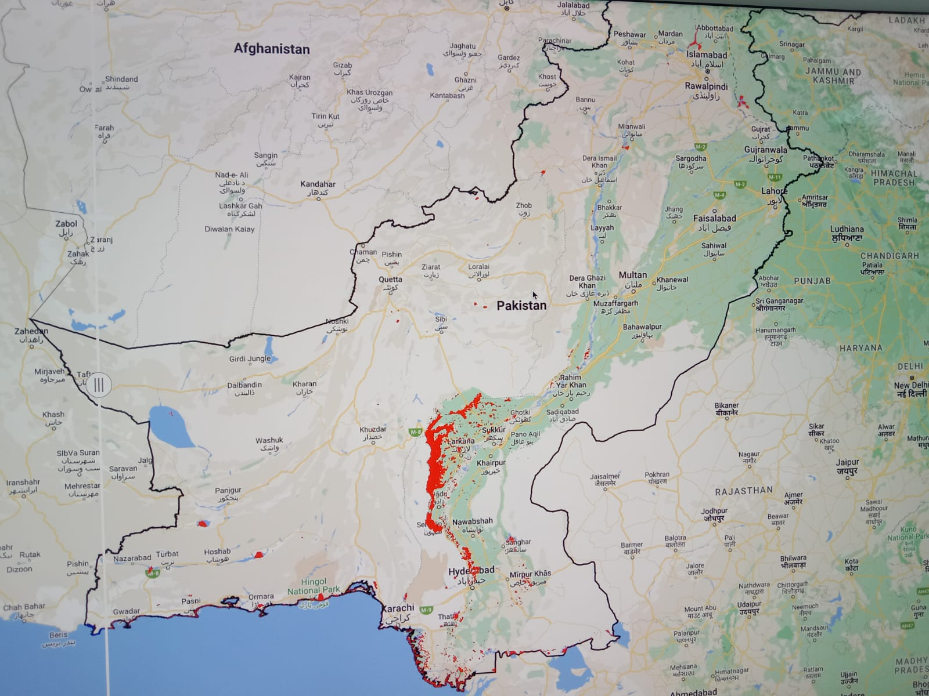
RESULTS
Flood Extent of 2021 and 2022

Slide 15
THANK YOU
Summer Internship

