Slide 1


Development and Evaluation of a New Temperature Effect Removal Algorithm for AMSR2 Satellite Soil Moisture Product using Brightness Temperature
Agampodi Deva Thisaru Nayanathara Kumarasiri, Minjiao LU and Kim Oanh Hoang
Nagaoka University of Technology, Japan
Department of Civil and Environmental Engineering

Slide 2

Content
The current methods to estimate the soil moisture
Existence of Temperature Effect (TE) in in-situ and satellite Soil Water Content (SWC) data
Objectives
Study Area and data description
Methodology
Application
Results

Slide 3
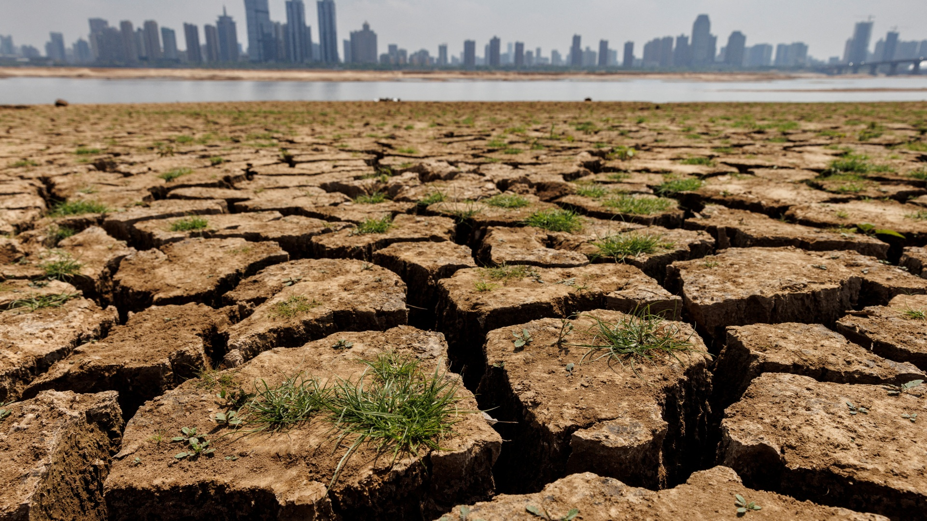
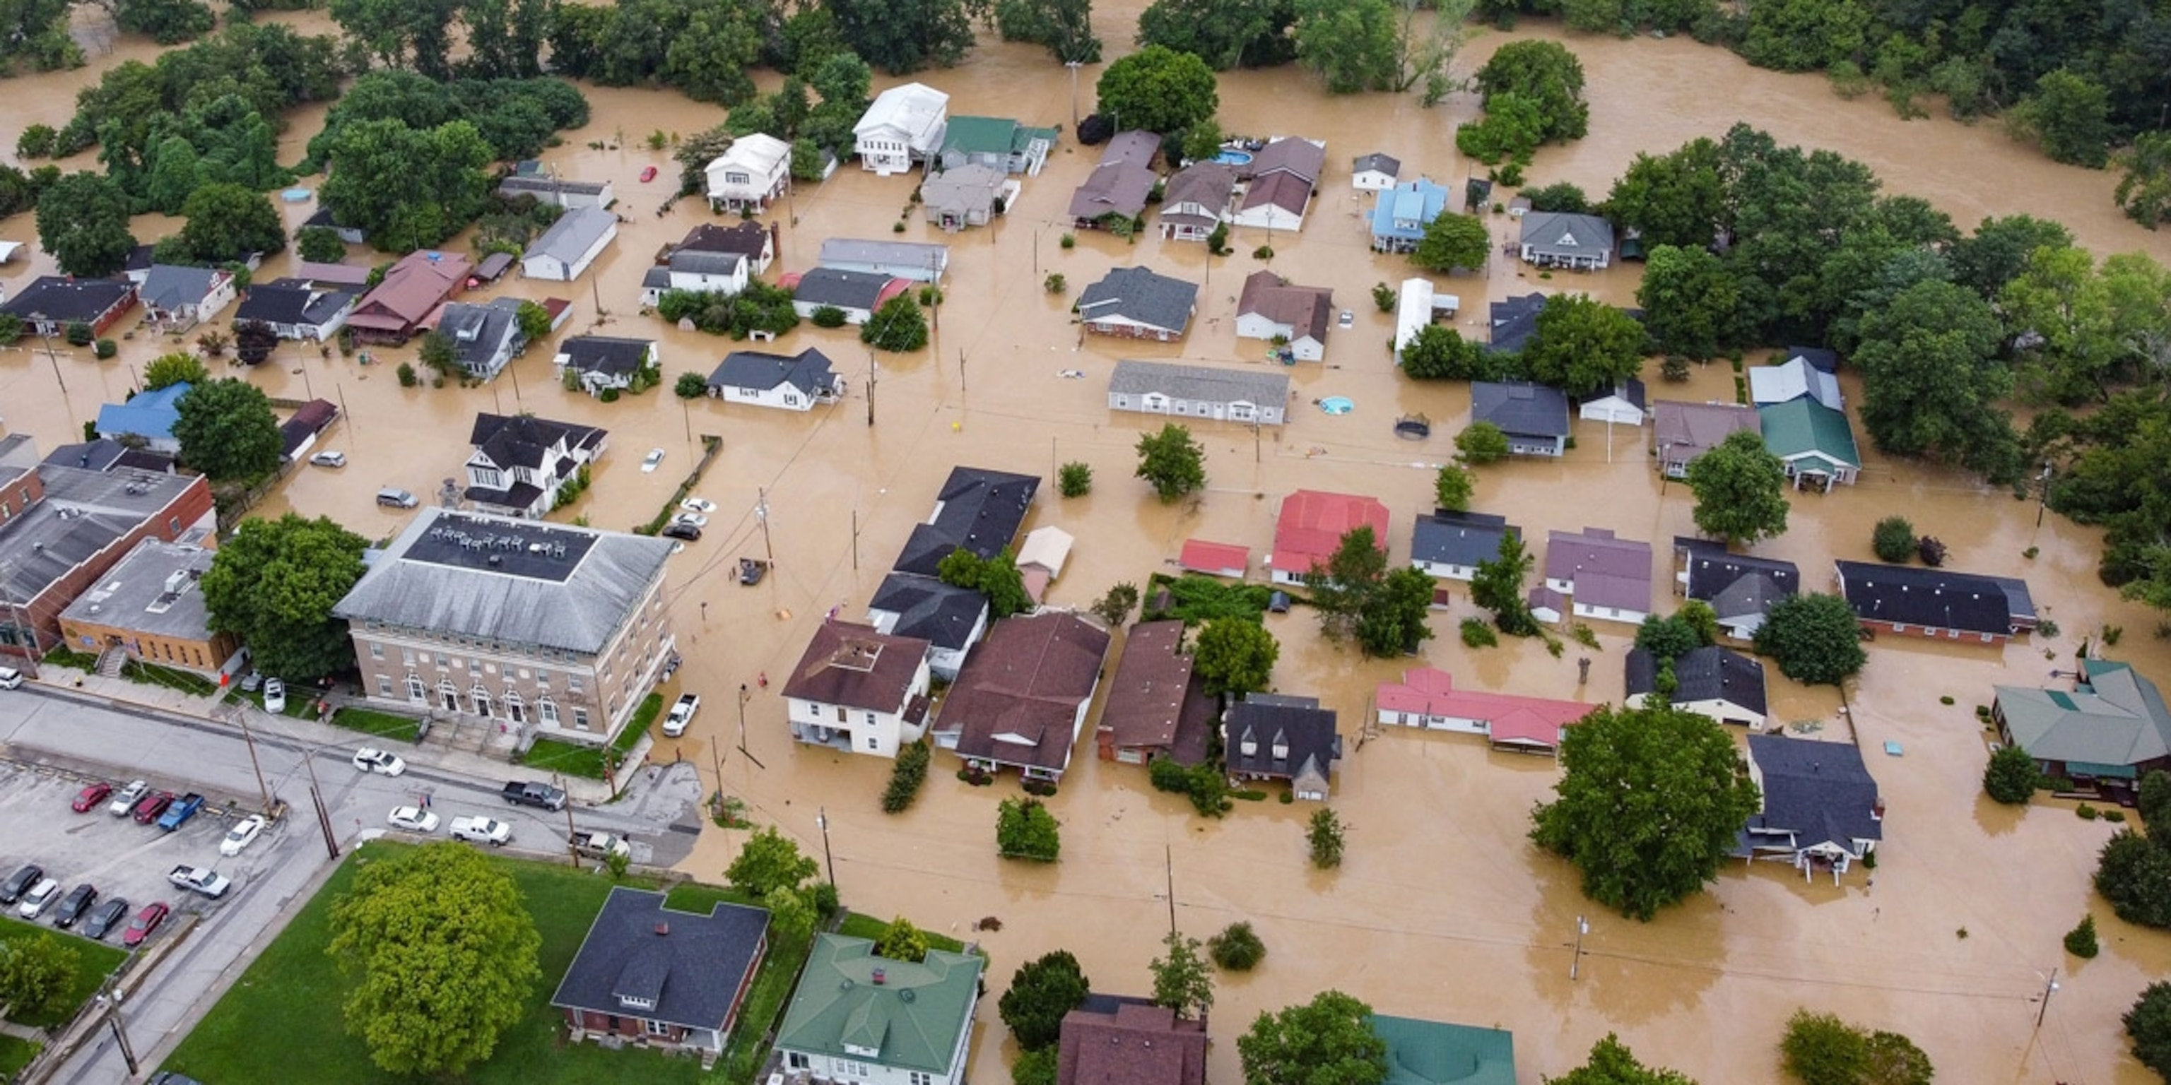


The current methods to estimate the soil water content
Soil Moisture Methods
Satellite remote sensing observation
Neutron probe technology
The gravimetric method (oven drying)
Dielectrically measured methods
Soil moisture estimating models
Time Domain Reflectometry sensors (TDR)
Capacitance and Frequency Domain Reflectometry sensors (FDR)
Ground based techniques
Examples for satellite that used to obtain soil moisture: SMMR, AMSR-E, SMOS, SMAP, AMSR2
Importance of satellite observation soil moisture
Agricultural monitoring
Drought and flood forecasting
Forest fire prediction
Water supply management

Slide 4
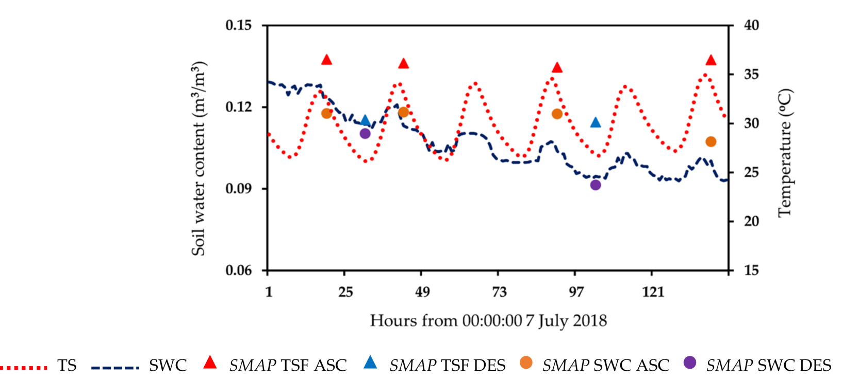
Existence of Temperature Effect (TE) in in-situ and satellite Soil Water Content (SWC) data
Satellite soil water content products
Horizontal insertion
Vertical insertion
Soil temperature
Areal mean of in-situ SWC, soil temperature, SMAP SWC at ascending and descending times and SMAP surface temperature at Oklahoma, USA (Hoang and Lu (2021))
Volumetric SWC
(Yamamato and Lu, 2022)

Slide 5
Problem Statement
Satellite data used the same physical base as in-situ data, the bulk dielectric constant;
Satellite data used in-situ soil moisture as the ground truth for calibration and validation process
The impact and removal of temperature effects on satellite soil water content (AMSR2) still need to be evaluate

Slide 6
Objectives
Confirmation of the temperature effect on AMSR2 SWC data
Develop the new temperature effect removal method which is suitable for satellite SWC data
Evaluate the impact of that correction in AMSR2 satellite soil water content data

Slide 7
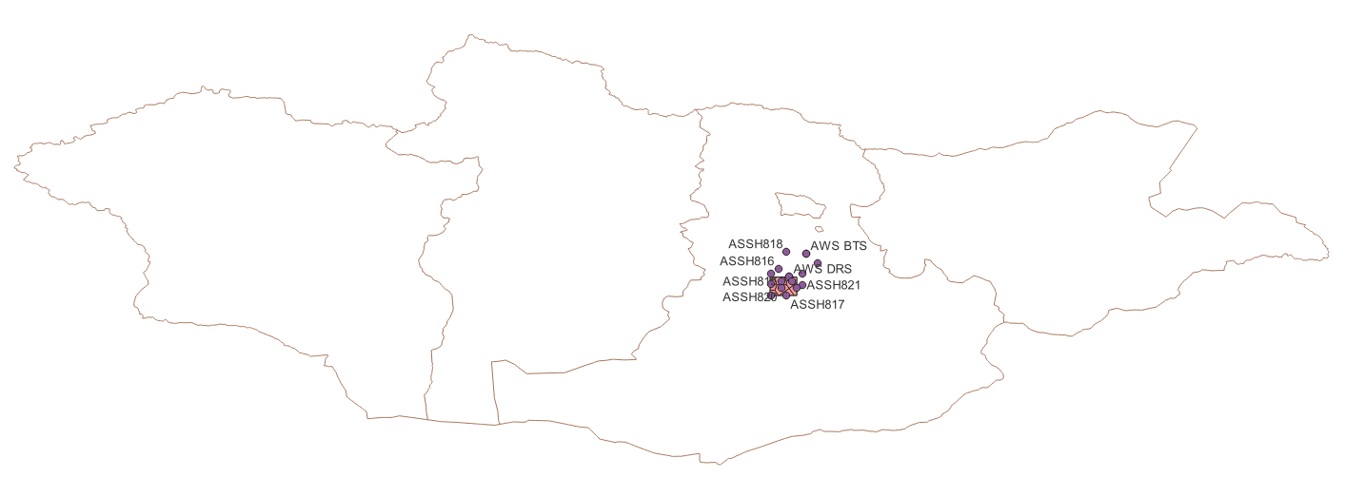
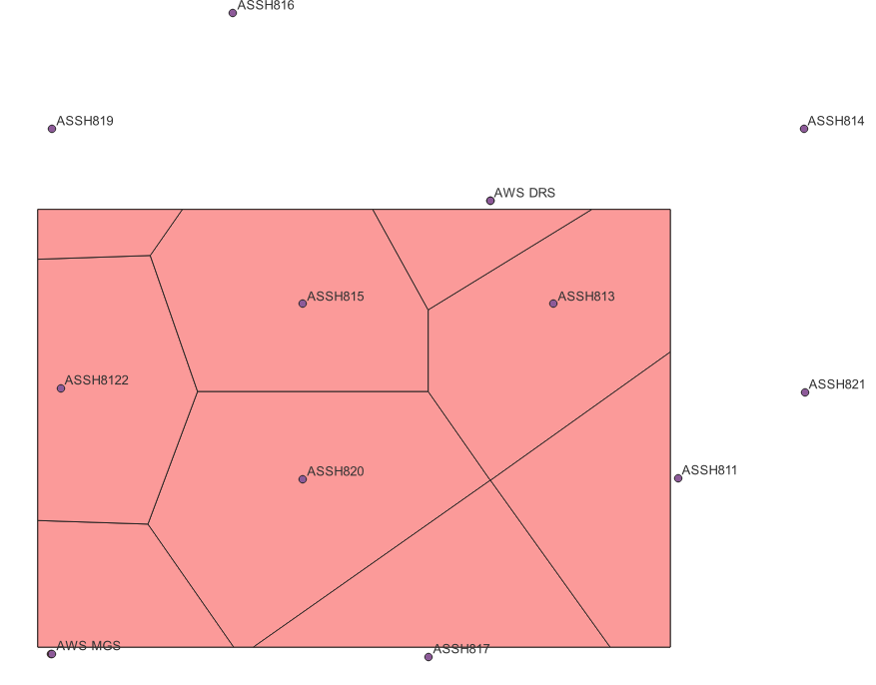
Study area and data description
Study area: Mongolia
In-situ data
3cm depth soil water content and soil temperature were selected
Accessed from the website of GCOM-W1 Research Product Distribution Service (https://suzaku.eorc.jaxa.jp/GCOM_W/research/resdist.html)
Only 9 stations have been selected from 5th Sep, 2016 to 31st Oct, 2019
The in-situ data has been weighted by using Thiessen polygon method correspond to the resolution of satellite data
Satellite data
AMSR2 level 2 soil moisture product at 50km X 50km / 0.5 x 0.5 degree spatial resolution
Obtained from the G-Portal System website (https://gportal.jaxa.jp/gpr/search?tab=0)
Local crossing times AMSR2 are around 1:30p.m. and 1:30a.m. respectively for ascending and descending over passes.
Station name | Station ID | Network | Weighing
ASSH820 | C2 | ASSH | 0.204038
ASSH815 | C4 | ASSH | 0.158021
ASSH8122 | A3E | ASSH | 0.129942
ASSH817 | D1 | ASSH | 0.107943
ASSH813 | E4 | ASSH | 0.155352
ASSH819 | A6 | ASSH | 0.022081
ASSH811 | F2 | ASSH | 0.114076
MGS |  | AWS | 0.06894
DRS |  | AWS | 0.039608

Slide 8
Methodology
Analyzing the trend of Ascending (ASC) and Descending (DES) crossing time soil water content from both satellite and in-situ observation
Analyzing and developing the temperature effect error removal method for satellite soil water content products
Applying the temperature effect removal method to confirm and evaluate the impacts of these effects on satellite SWC data

Slide 9
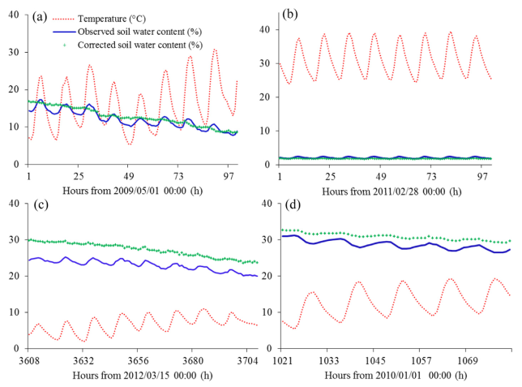
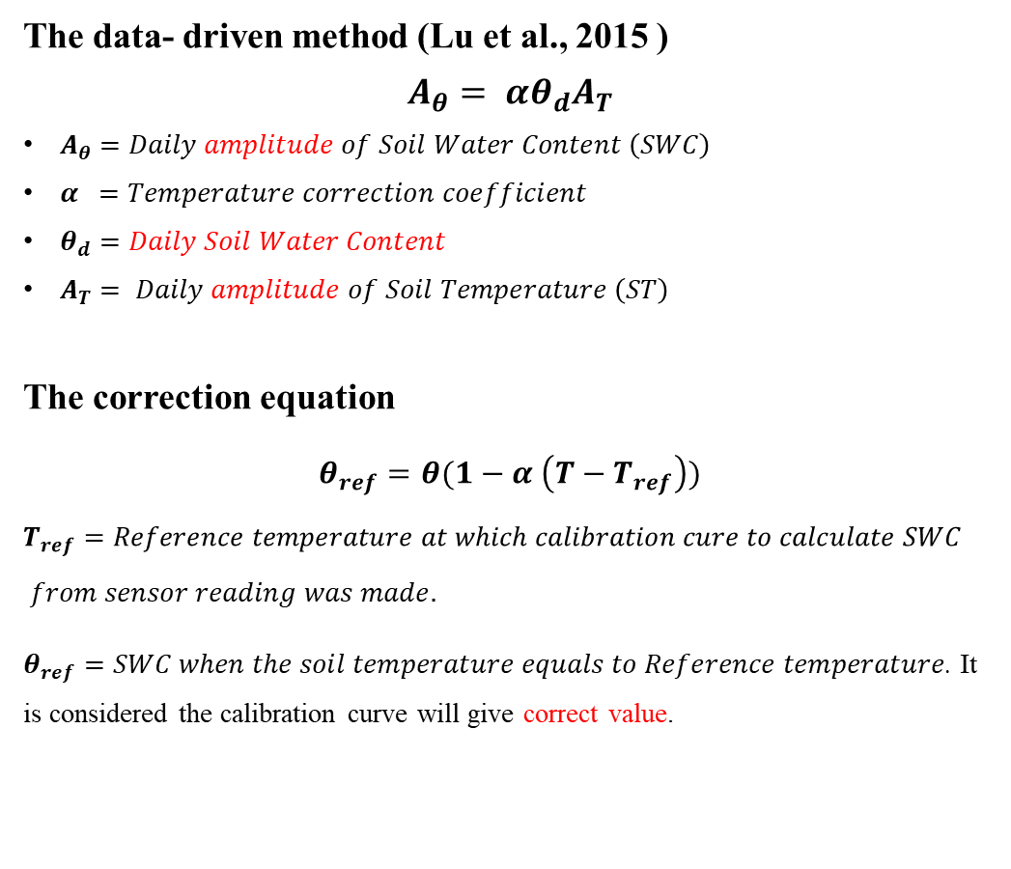
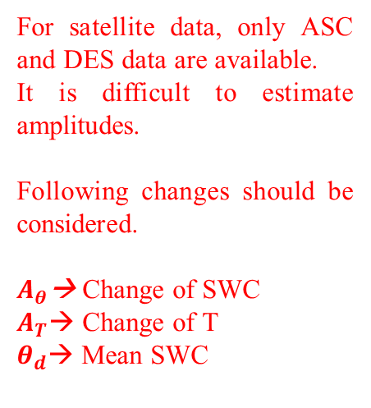
Temperature effect removal in in-situ data
The data- driven method (Lu et al., 2015 )
$$A_{θ}= αθ_{d}A_{T}$$
$A_{θ}=Daily amplitude of Soil Water Content \left(SWC\right)$
$α =Temperature correction coefficient$
$θ_{d}=Daily Soil Water Content$
$A_{T}= Daily amplitude of Soil Temperature \left(ST\right)$
The correction equation
$$θ_{ref}=θ(1−α \left(T−T_{ref}\right))$$
$$T_{ref}=Reference temperature at which calibration cure to calculate SWC$$
$$from sensor reading was made.$$
$θ_{ref}=SWC when the soil temperature equals to Reference temperature$. It is considered the calibration curve will give correct value.
Application of the automated temperature effects removal (Kapilaratne and Lu, 2017, 10.1016/j.jhydrol.2017.05.050) to in-situ data.
For satellite data, only ASC and DES data are available.
It is difficult to estimate amplitudes.
Following changes should be considered.
$A_{θ}$→ Change of SWC
$A_{T}$→ Change of T
$θ_{d}$→ Mean SWC

Slide 10
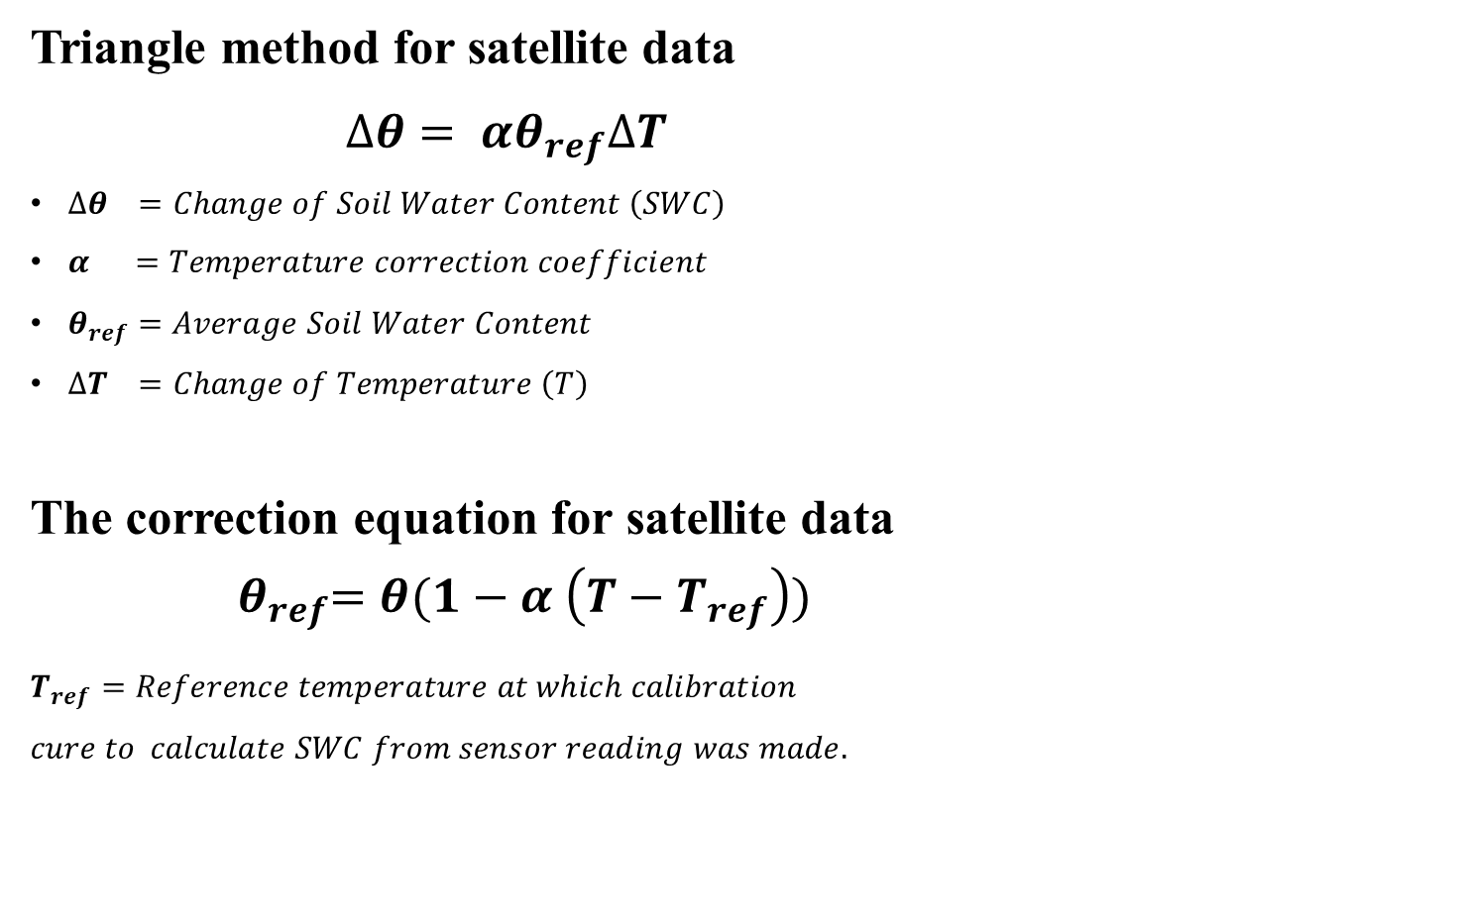

Temperature effect removal in satellite data
Triangle method for satellite data
$$∆θ= αθ_{ref}∆T$$
$∆θ =Change of Soil Water Content \left(SWC\right)$
$α =Temperature correction coefficient$
$θ_{ref}=Average Soil Water Content$
$∆T =Change of Temperature \left(T\right)$
The correction equation for satellite data
$${ θ}_{ref}=θ(1−α \left(T−T_{ref}\right))$$
$T_{ref}=Reference temperature at which calibration$ $cure to calculate SWC from sensor reading was made.$
Temperature data:
Using soil temperature as a surrogate at development stage
Using satellite surface temperature product or brightness temperature
Calculation of difference:
$$∆θ =\left(θ_{asc,p}−θ_{des}\right) or \left(θ_{asc,f}−θ_{des}\right)$$
$$∆T = (T_{asc,p}−T_{des}) or \left(T_{asc,f}−T_{des}\right)$$
$$θ_{ref}=use average as approximation$$
asc : ascending des : descending
p : previous f : following

Slide 11
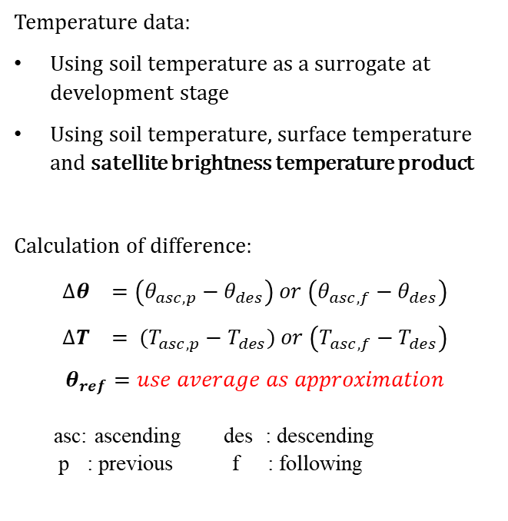
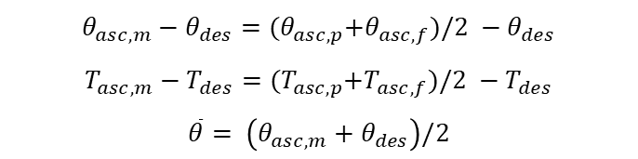

Temperature effect removal in satellite data cont.
Temperature data:
Using soil temperature as a surrogate at development stage
Using soil temperature, surface temperature and satellite brightness temperature product
Calculation of difference:
$$∆θ =\left(θ_{asc,p}−θ_{des}\right) or \left(θ_{asc,f}−θ_{des}\right)$$
$$∆T = (T_{asc,p}−T_{des}) or \left(T_{asc,f}−T_{des}\right)$$
$$θ_{ref}=use average as approximation$$
asc: ascending des : descending
p : previous f : following
TE
The summarization of the trend of normalized ASC and DES soil water content and soil temperature data of AMSR2
ASC P : Ascending Previous
D : Descending
ASC F : Ascending Following
$$θ_{asc,m}−θ_{des}={(θ}_{asc,p}+θ_{asc,f})/2 −θ_{des}$$
$$T_{asc,m}−T_{des}={(T}_{asc,p}+T_{asc,f})/2 −T_{des}$$
$$\overline{θ}= \left(θ_{asc,m}+θ_{des}\right)/2$$
$$θ_{asc,m}−θ_{des}= α\overline{θ} (T_{asc,m}−T_{des})$$
$$∆θ= αθ_{ref}∆T$$
Where m means average of previous and following ascending

Slide 12
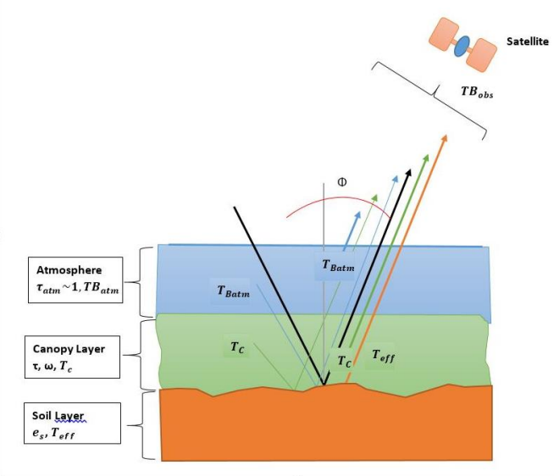
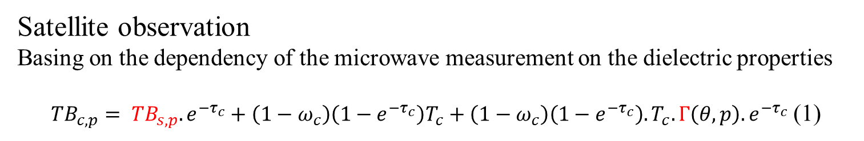
Brightness Temperature (TB)
Satellite observation
Basing on the dependency of the microwave measurement on the dielectric properties
${TB}_{c,p}= {TB}_{s,p}.e^{{−τ}_{c}}+\left(1−ω_{c}\right)\left(1−e^{{−τ}_{c}}\right)T_{c}+\left(1−ω_{c}\right)\left(1−e^{{−τ}_{c}}\right).T_{c}.Γ\left(θ,p\right).e^{{−τ}_{c}}$ (1)
${TB}_{s,p}=\left[1−\left\{\left(1−Q\right).Γ\left(θ,p\right)+Q.Γ\left(θ,q\right)\right\}.e^{−h^{′}\cos^{2}θ}\right].T_{s}$ (2)
Reasons for using Brightness Temperature (TB)
Brightness temperature is a basic observable quantity calculated from the antenna temperature of a microwave radiometer.
Can be directly measure from the satellite
Surface temperature can be obtained through the brightness temperature

Slide 13

Application: Temperature effect removal
Applying newly developed method to satellite SWC products using brightness temperature (TB)
$$θ_{asc,m}−θ_{des}= α\overline{θ} ({TB}_{asc,m}−{TB}_{des})$$
Finding the temperature effect coefficient (α)
Results and effects of temperature effect error removal for satellite data

Slide 14
Application: Temperature effect removal Cont.
Accumulation of absolute error in satellite soil moisture data

Slide 15
Results of temperature effect removal
A diagram of original and corrected AMSR2 ASC and DES SWC data
A diagram of after removing the TE on AMSR2 satellite SWC data by using brightness temperature data (TB)

Slide 16
Conclusion
Found the temperature effect also exist in the AMSR2 SWC data
Temperature effect on AMSR2 SWC data at Mongolia site was successfully removed using the brightness temperature (TB) data

Slide 17
THANK YOU

Slide 18
Data: Satellite data: Study area and data description
The study area is set to an area of 50 x 50 km that corresponding to the AMSR2 pixel of AMSR2 SWC (AMSR 2 Level 2 (L2) Soil Moisture Content (SMC) data products)..
Depending on the data quality and availability, the pixel that covers M1 area was selected for evaluation of the removal temperature effect method.
The in situ data are all averaged over the M1 area for comparison and evaluation.
The data period was chosen based on the longest data series. Since the data at C2 and A6 are not available from 1st Oct, 2015 to 4th Sep, 2016, the selected period for study ranges from 5th Sep, 2016 to 31st Oct, 2019.
Surface temperature product is also used.

Slide 19
Data Assessment
When we analyzing the data first we have to eliminate the abnormal data (data that have drops or spikes)
To avoid the effects of precipitation because of the rainfall the days that have a daily rainfall amount larger than 0.1mm have been excluded
And also the days with negative soil temperature are excluded because the TDR calibration equation is not applicable to frozen soil

Slide 20
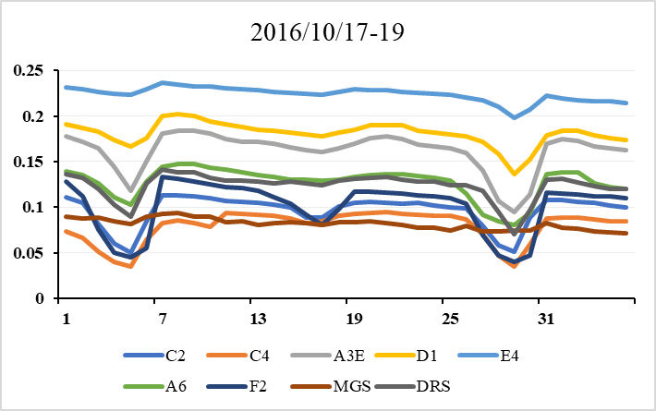
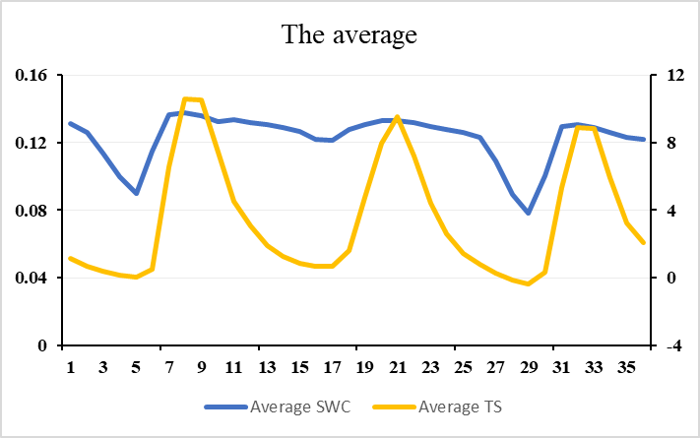
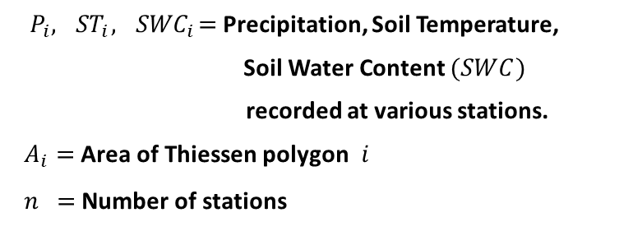

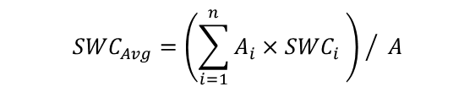

Data: In situ data averaging - Thiessen Polygon Method
$$P_{Avg}={\left(\sum_{i=1}^{n}{A_{i}×P_{i}}\right) }/ A$$
${ P}_{i},{ ST}_{i},{ SWC}_{i}=$Precipitation, Soil Temperature,
Soil Water Content $(SWC)$
recorded at various stations.
$A_{i}=$ Area of Thiessen polygon$i$
$n­­ =$ Number of stations
$${SWC}_{Avg}={\left(\sum_{i=1}^{n}{A_{i}×{SWC}_{i}} \right) }/ A$$
$${ST}_{Avg}={\left(\sum_{i=1}^{n}{A_{i}×{ST}_{i}}\right) }/ A$$
Spatially averaged data will be used.
SWC
SWC
Soil temperature

Slide 21
Experimental facts about TE in TDR SWC measurement
Horizontal insertion
Vertical insertion
Soil temperature
Volumetric SWC
Notes:
Experiments are carried out to confirm TE.
For glass beads of constant SWC, the sensor reading
Increase when temperature was raised.
Both horizontal and vertical insertion show TE.
Also our removal algorithm removed TE best.

Slide 22
Study area and data description
Weighing index
Station name | Station ID | Network | Weighing
ASSH820 | C2 | ASSH | 0.204038
ASSH815 | C4 | ASSH | 0.158021
ASSH8122 | A3E | ASSH | 0.129942
ASSH817 | D1 | ASSH | 0.107943
ASSH813 | E4 | ASSH | 0.155352
ASSH819 | A6 | ASSH | 0.022081
ASSH811 | F2 | ASSH | 0.114076
MGS |  | AWS | 0.06894
DRS |  | AWS | 0.039608

Slide 23
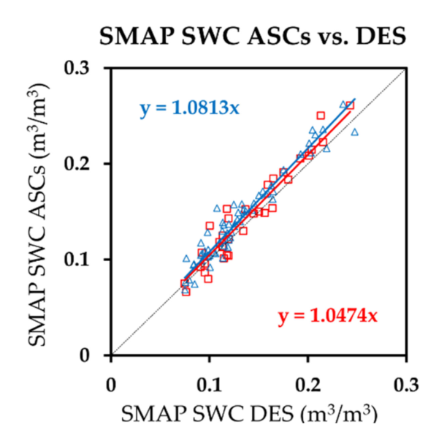
Existence of Temperature Effect (TE) in satellite Soil Water Content (SWC) data
Previous ascending
Following ascending
Areal mean of in-situ SWC, soil temperature, SMAP SWC at ascending and descending times and SMAP surface temperature at Oklahoma, USA (Hoang and Lu (2021))
Both ascending SWC are larger than descending SWC. Previous ascending SWC are larger than following ascending SWC (Hoang and Lu (2021)) .

Slide 24
Study Area
Depending on the data quality and availability, the pixel that covers M1 area was selected for evaluation of the removal temperature effect method.
Annual rainfall 300mm-400mm
Land cover : forest, meadow steppe, real steppe, desert steppe, barren, sand, desert, ice, water, cropland and built area
Time in Mongolia is officially represented by the Mongolian Standard Time (UTC+08:00) However, the far western provinces of Khovd, Uvs and Bayan-Ölgii use UTC+07:00.
This study area is located between 45.75°N, 106.9°E and 46.2°N, 106.25°E
Study area : Mongolia

Slide 25
Outliers
outlier is an extremely high or extremely low data point relative to the nearest data point and the rest of the neighboring co-existing values in a data graph or dataset
Methods of finding outliers
Sorting Datasheet to Find Outliers
Graphing Your Data to Identify Outliers (Boxplot, Histogram)
Using Z-scores to Detect Outliers
Finding Outliers with Hypothesis Tests
Studentized Residuals

Slide 26
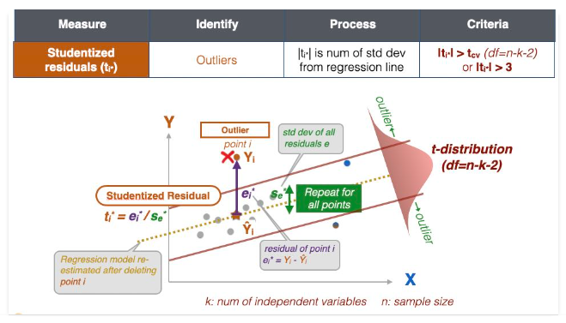
Studentized residual
To identify outliers, the preferred method is to use studentized residuals. For each data point i, the point is deleted and the regression model is re-estimated with the remaining data points. The residual of this data point is its Y-value minus the predicted Y-value from the regression. This is repeated for all the data points, and we are able to determine the standard deviation of the residuals.

Slide 27
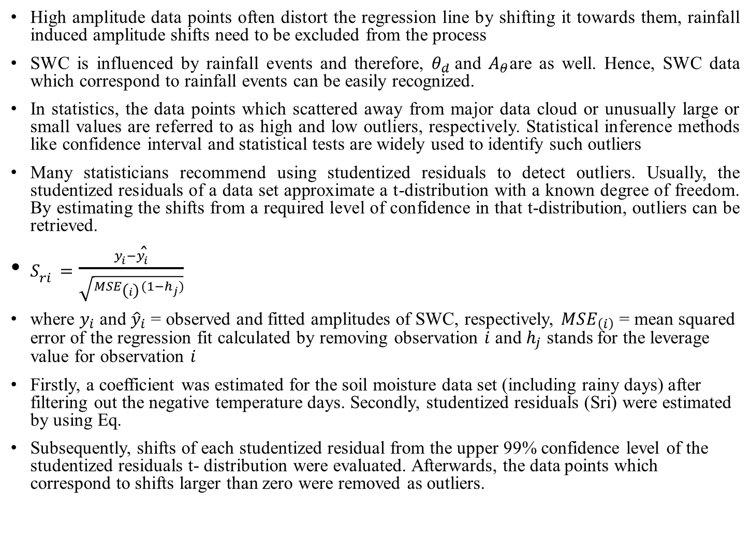
Automated temperature effects removal
High amplitude data points often distort the regression line by shifting it towards them, rainfall induced amplitude shifts need to be excluded from the process
SWC is influenced by rainfall events and therefore, $θ_{d}$and $A_{θ}$are as well. Hence, SWC data which correspond to rainfall events can be easily recognized.
In statistics, the data points which scattered away from major data cloud or unusually large or small values are referred to as high and low outliers, respectively. Statistical inference methods like confidence interval and statistical tests are widely used to identify such outliers
Many statisticians recommend using studentized residuals to detect outliers. Usually, the studentized residuals of a data set approximate a t-distribution with a known degree of freedom. By estimating the shifts from a required level of confidence in that t-distribution, outliers can be retrieved.
$S_{ri}=\frac{y_{i}−{\hat{y}}_{i}}{\sqrt{{MSE}_{\left(i\right)}(1−h_{j})}}$
where $y_{i}$ and ${\hat{y}}_{i}$ = observed and fitted amplitudes of SWC, respectively, ${MSE}_{\left(i\right)}$ = mean squared error of the regression fit calculated by removing observation $i$ and $h_{j}$ stands for the leverage value for observation $i$
Firstly, a coefficient was estimated for the soil moisture data set (including rainy days) after filtering out the negative temperature days. Secondly, studentized residuals (Sri) were estimated by using Eq.
Subsequently, shifts of each studentized residual from the upper 99% confidence level of the studentized residuals t- distribution were evaluated. Afterwards, the data points which correspond to shifts larger than zero were removed as outliers.

Slide 28
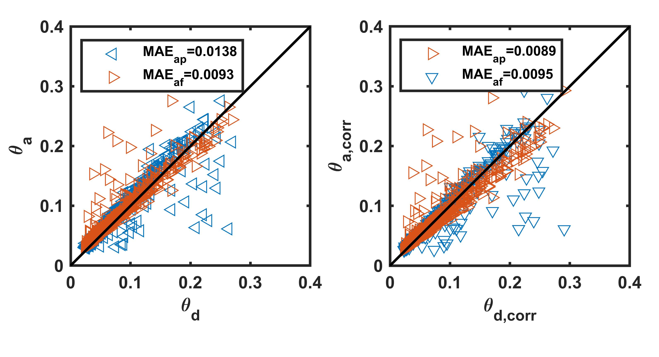
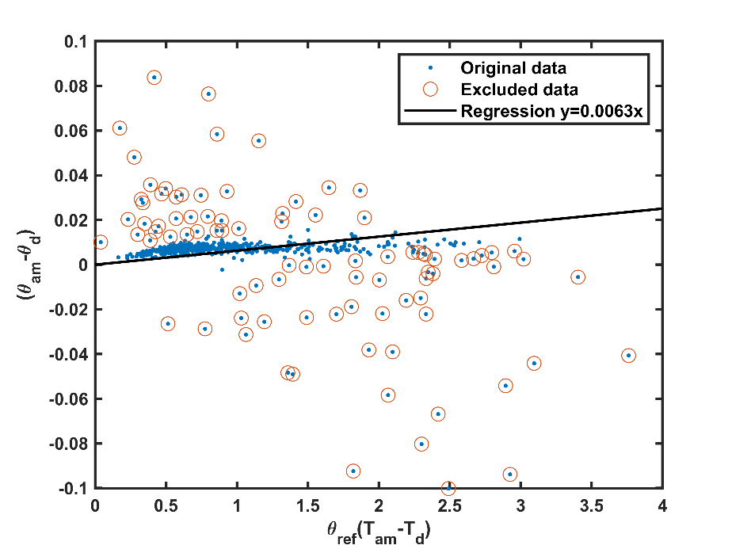
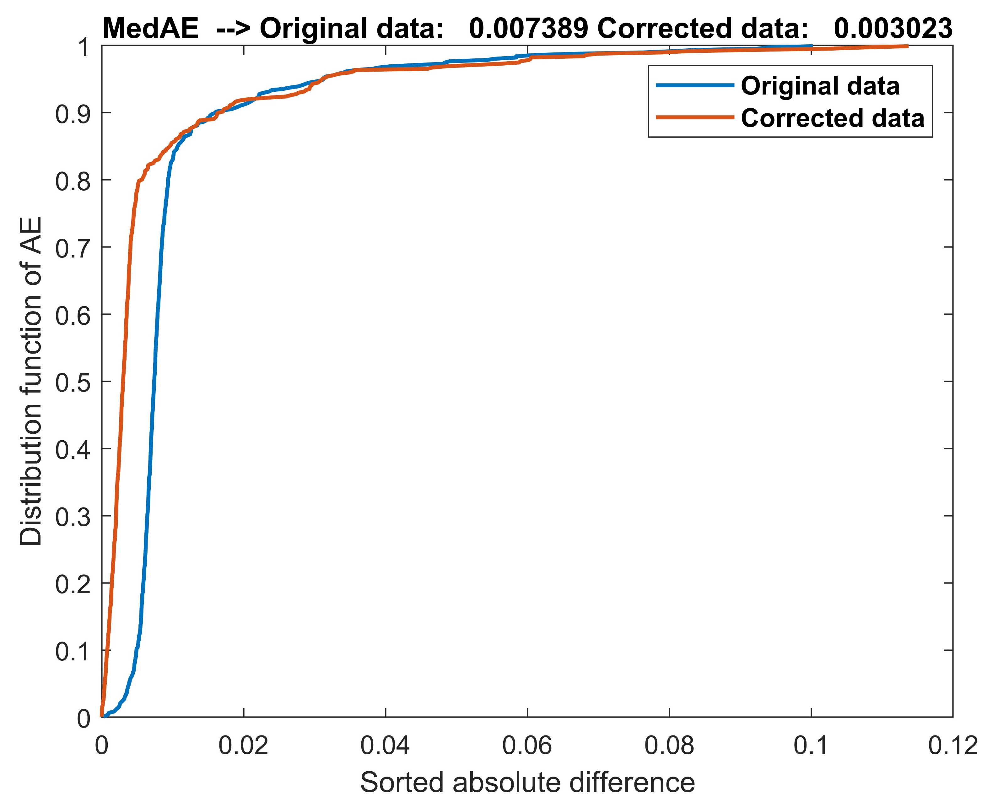
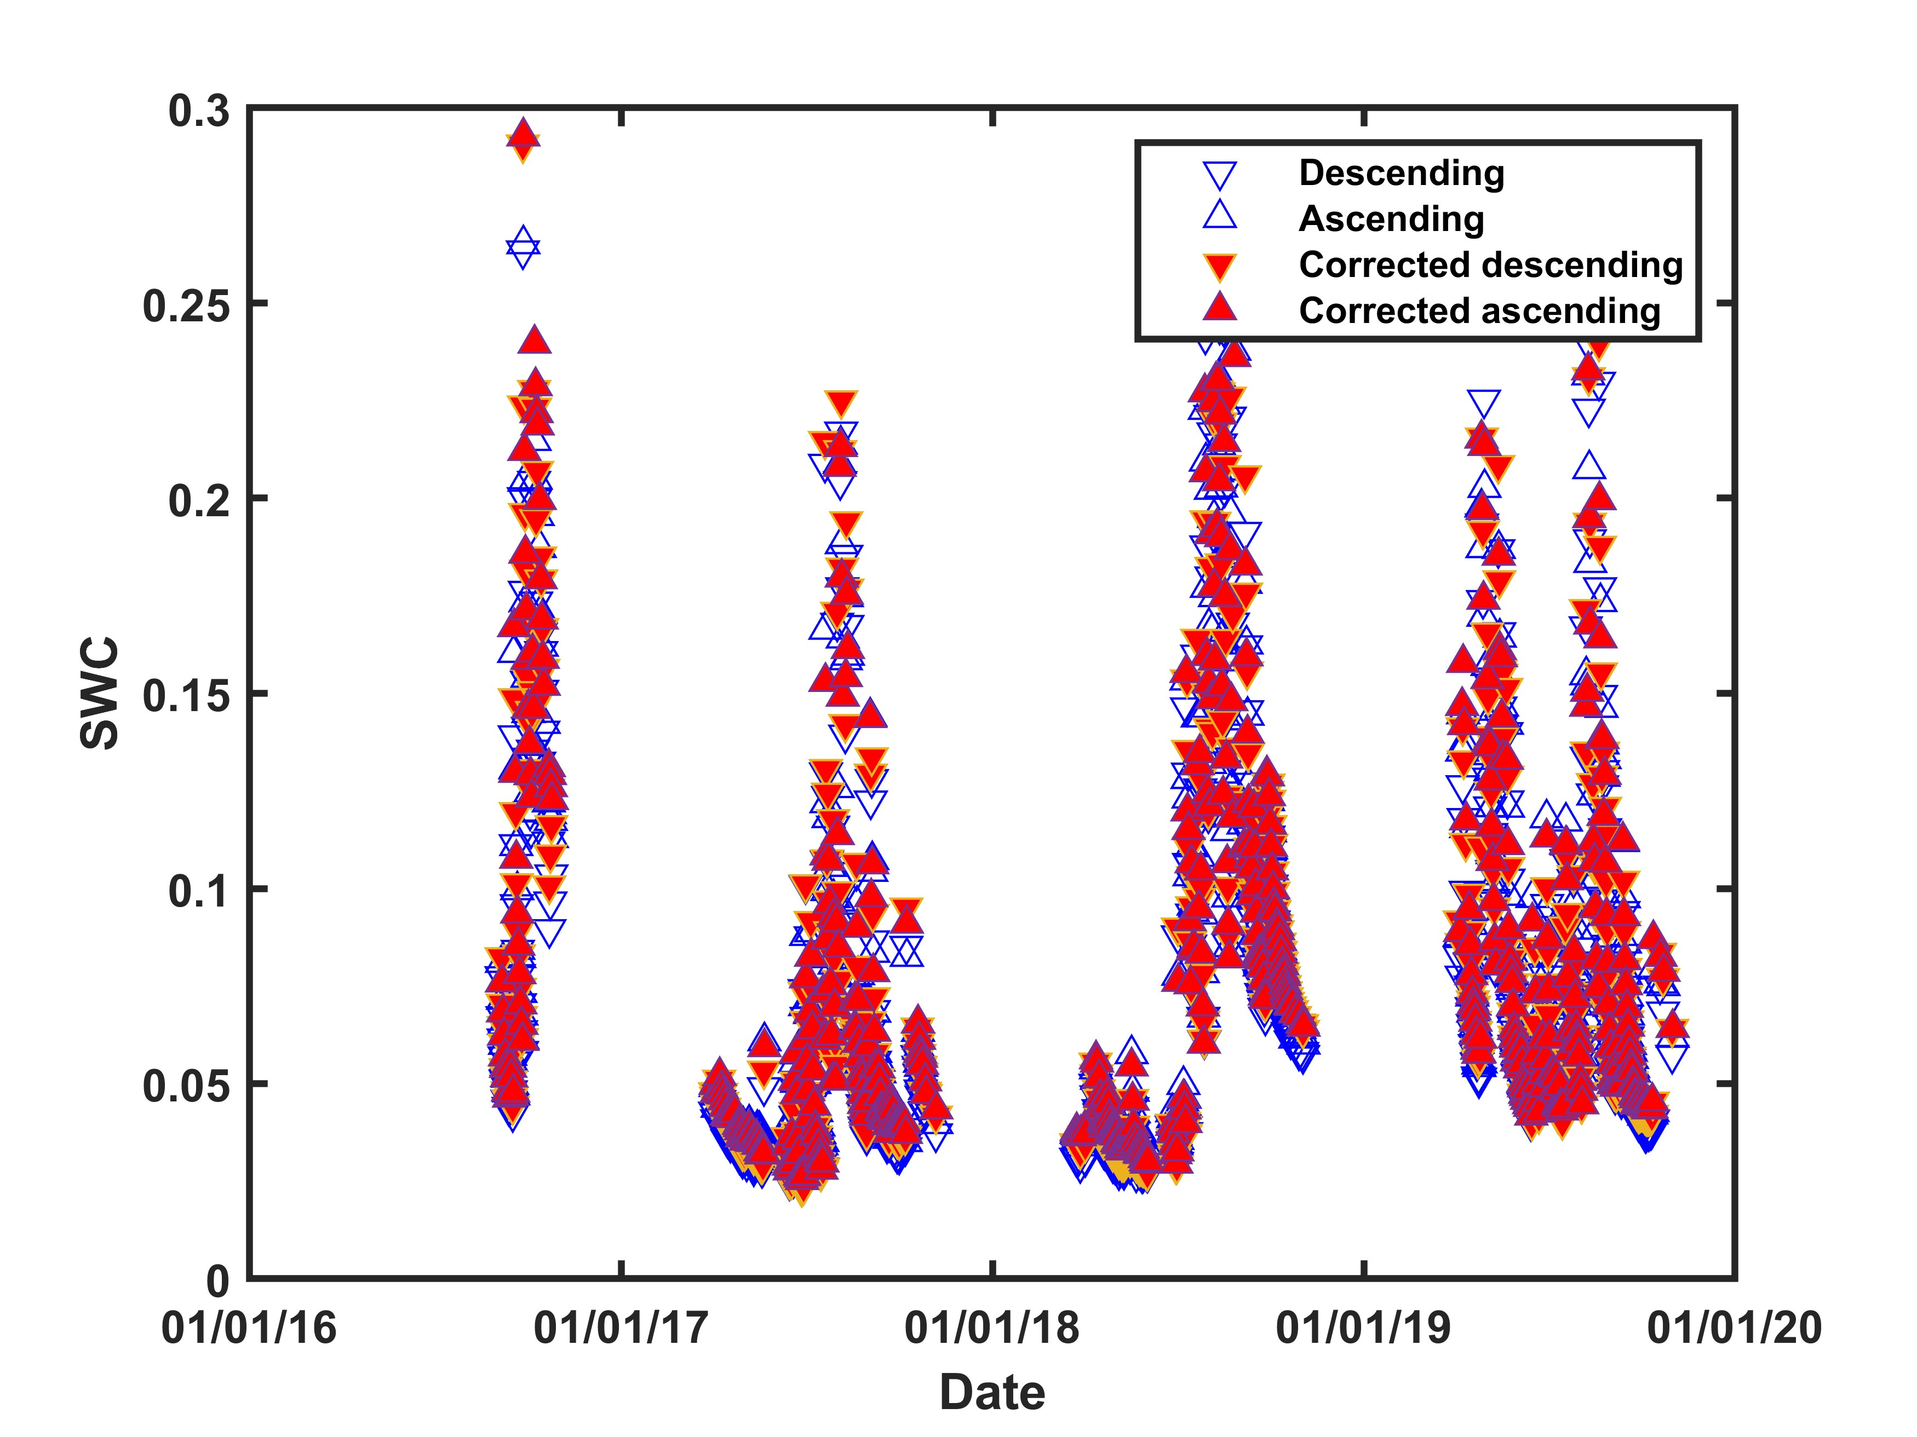
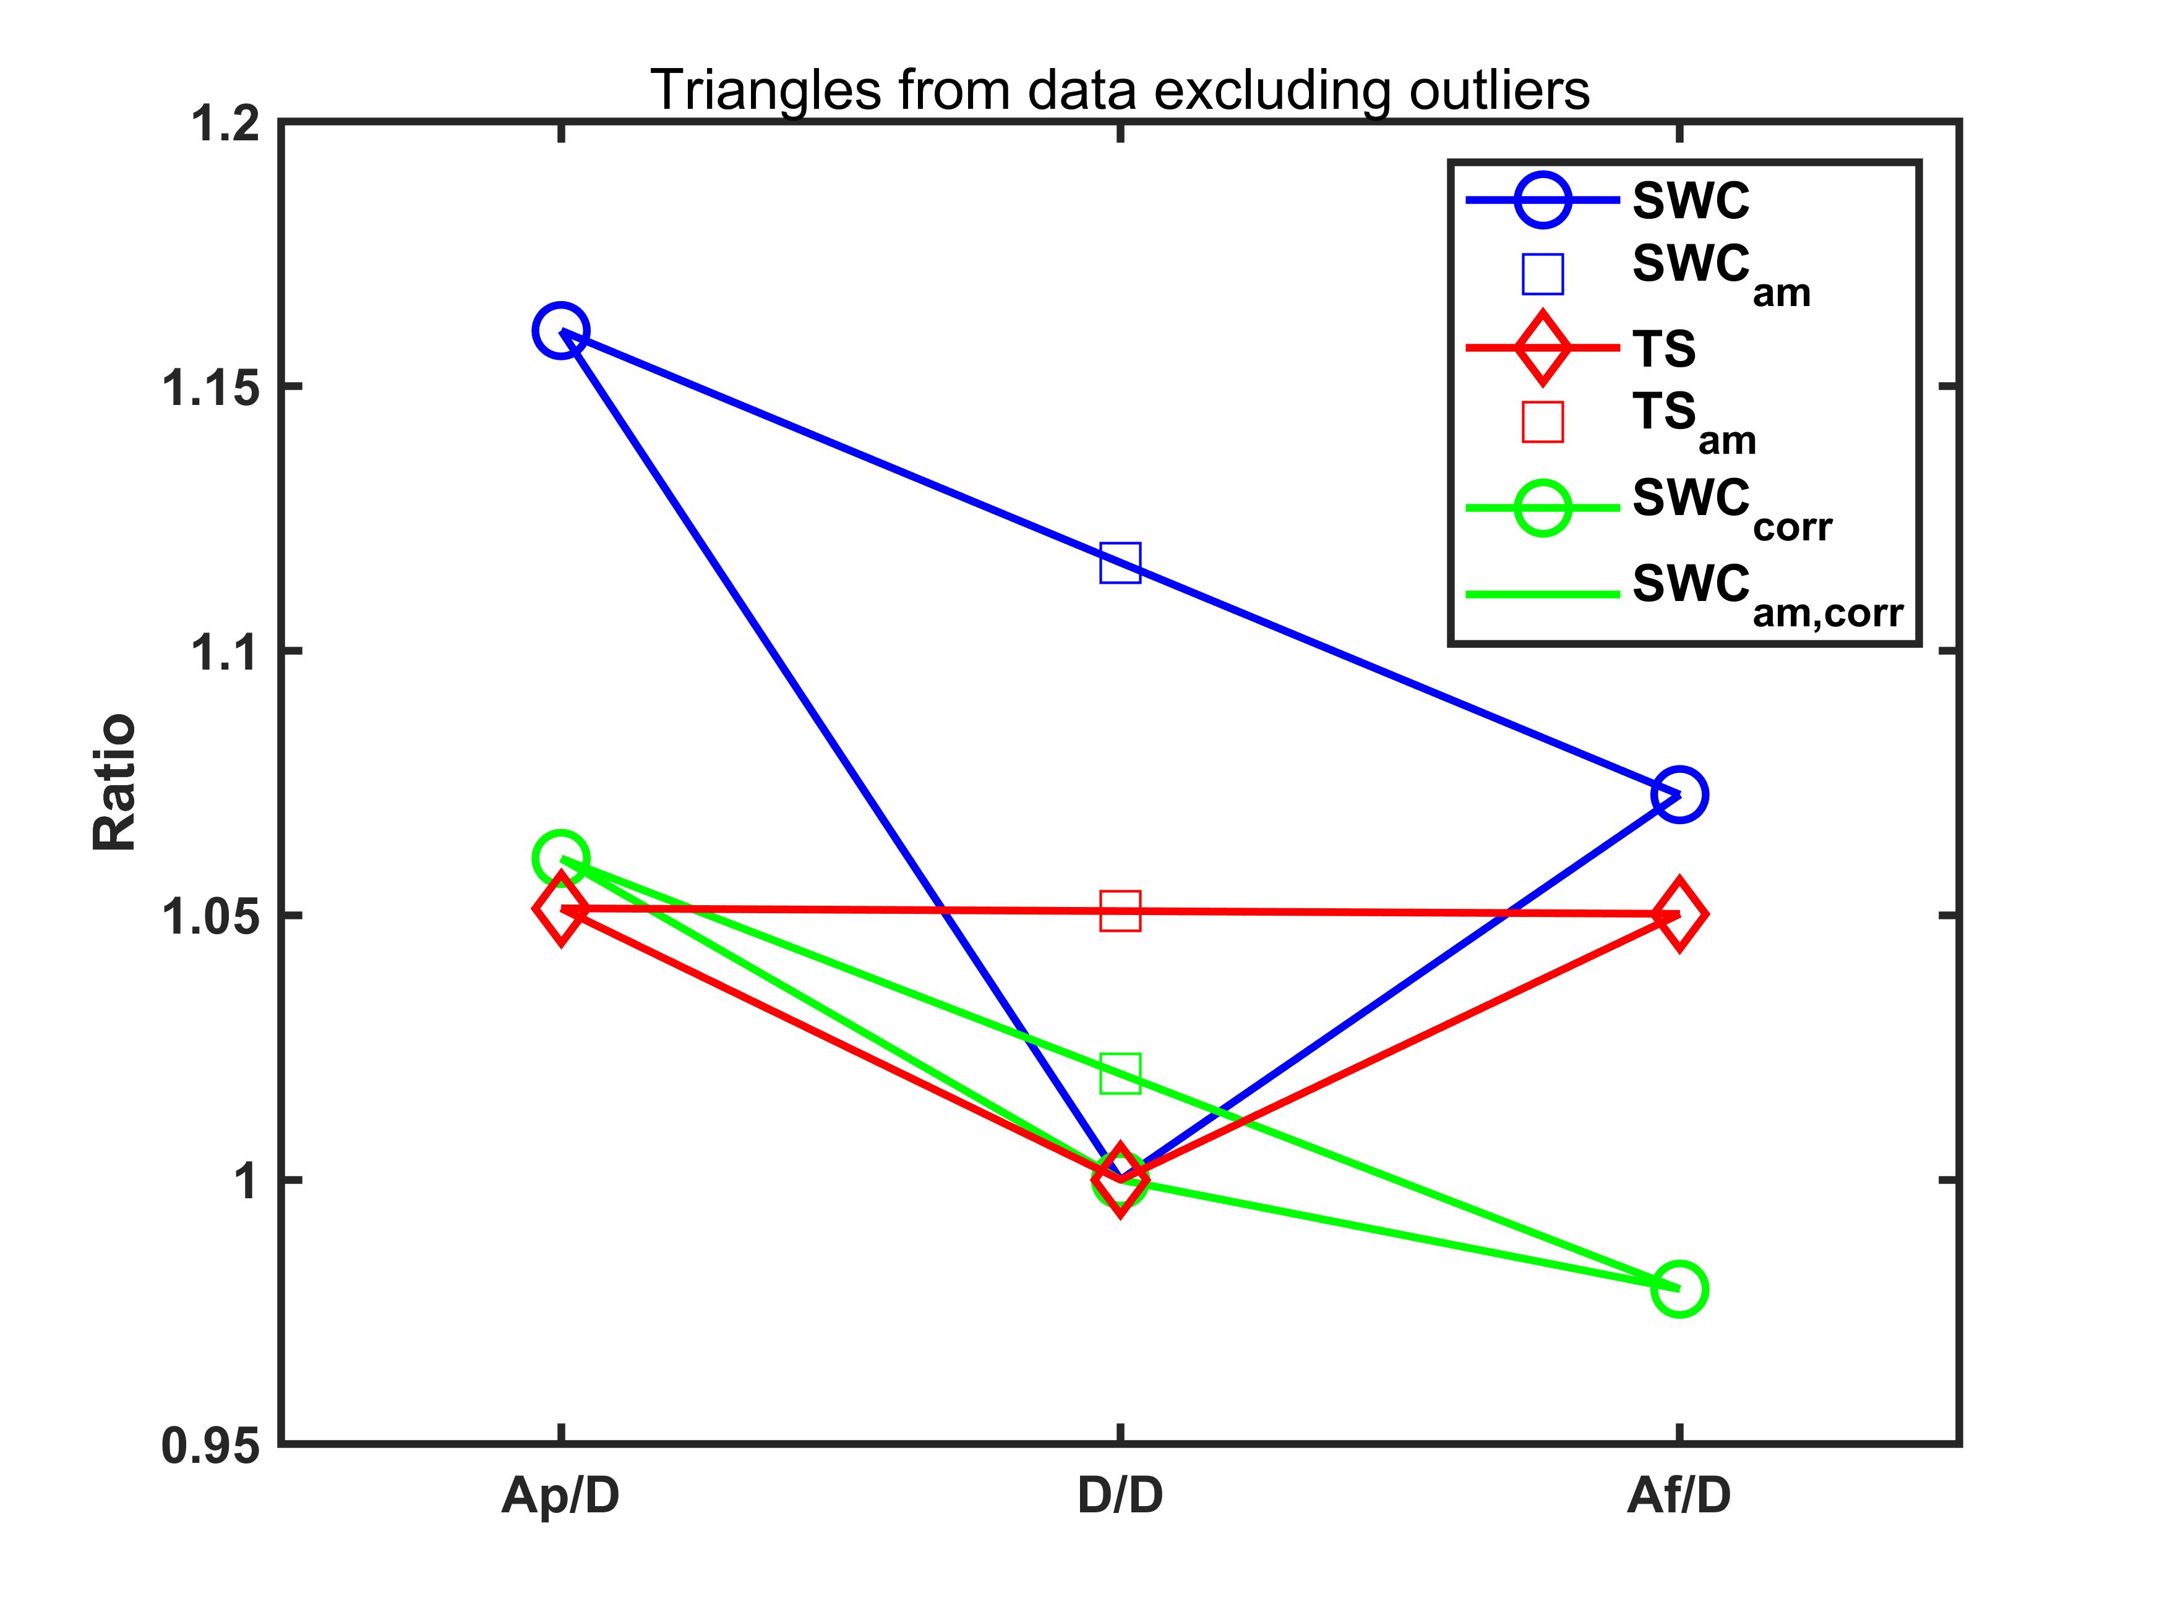

Application: Temperature effect removal
Applying newly developed method to in-situ data at ASC and DES time
$$θ_{asc,m}−θ_{des}= α\overline{θ} (T_{asc,m}−T_{des})$$
Results and effects of temperature effect error removal for in-situ mimic data
A diagram of corrected SWC ASC and DES

Slide 29
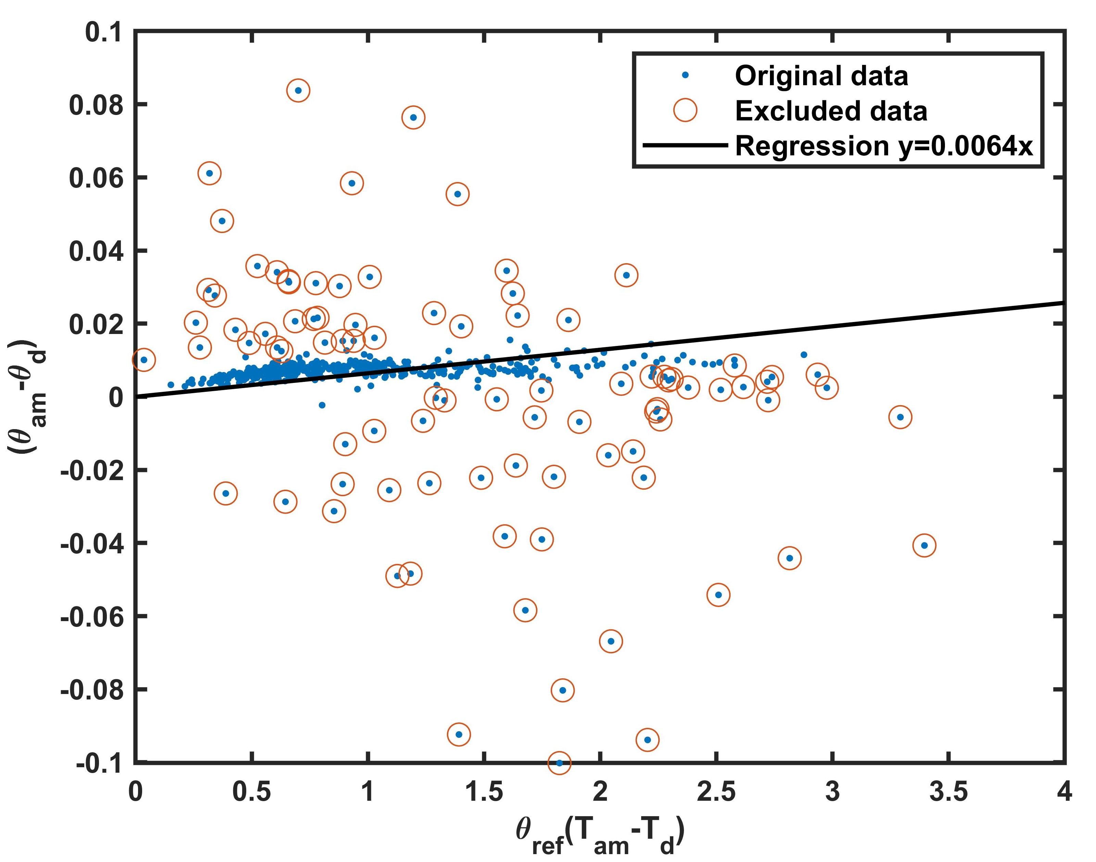
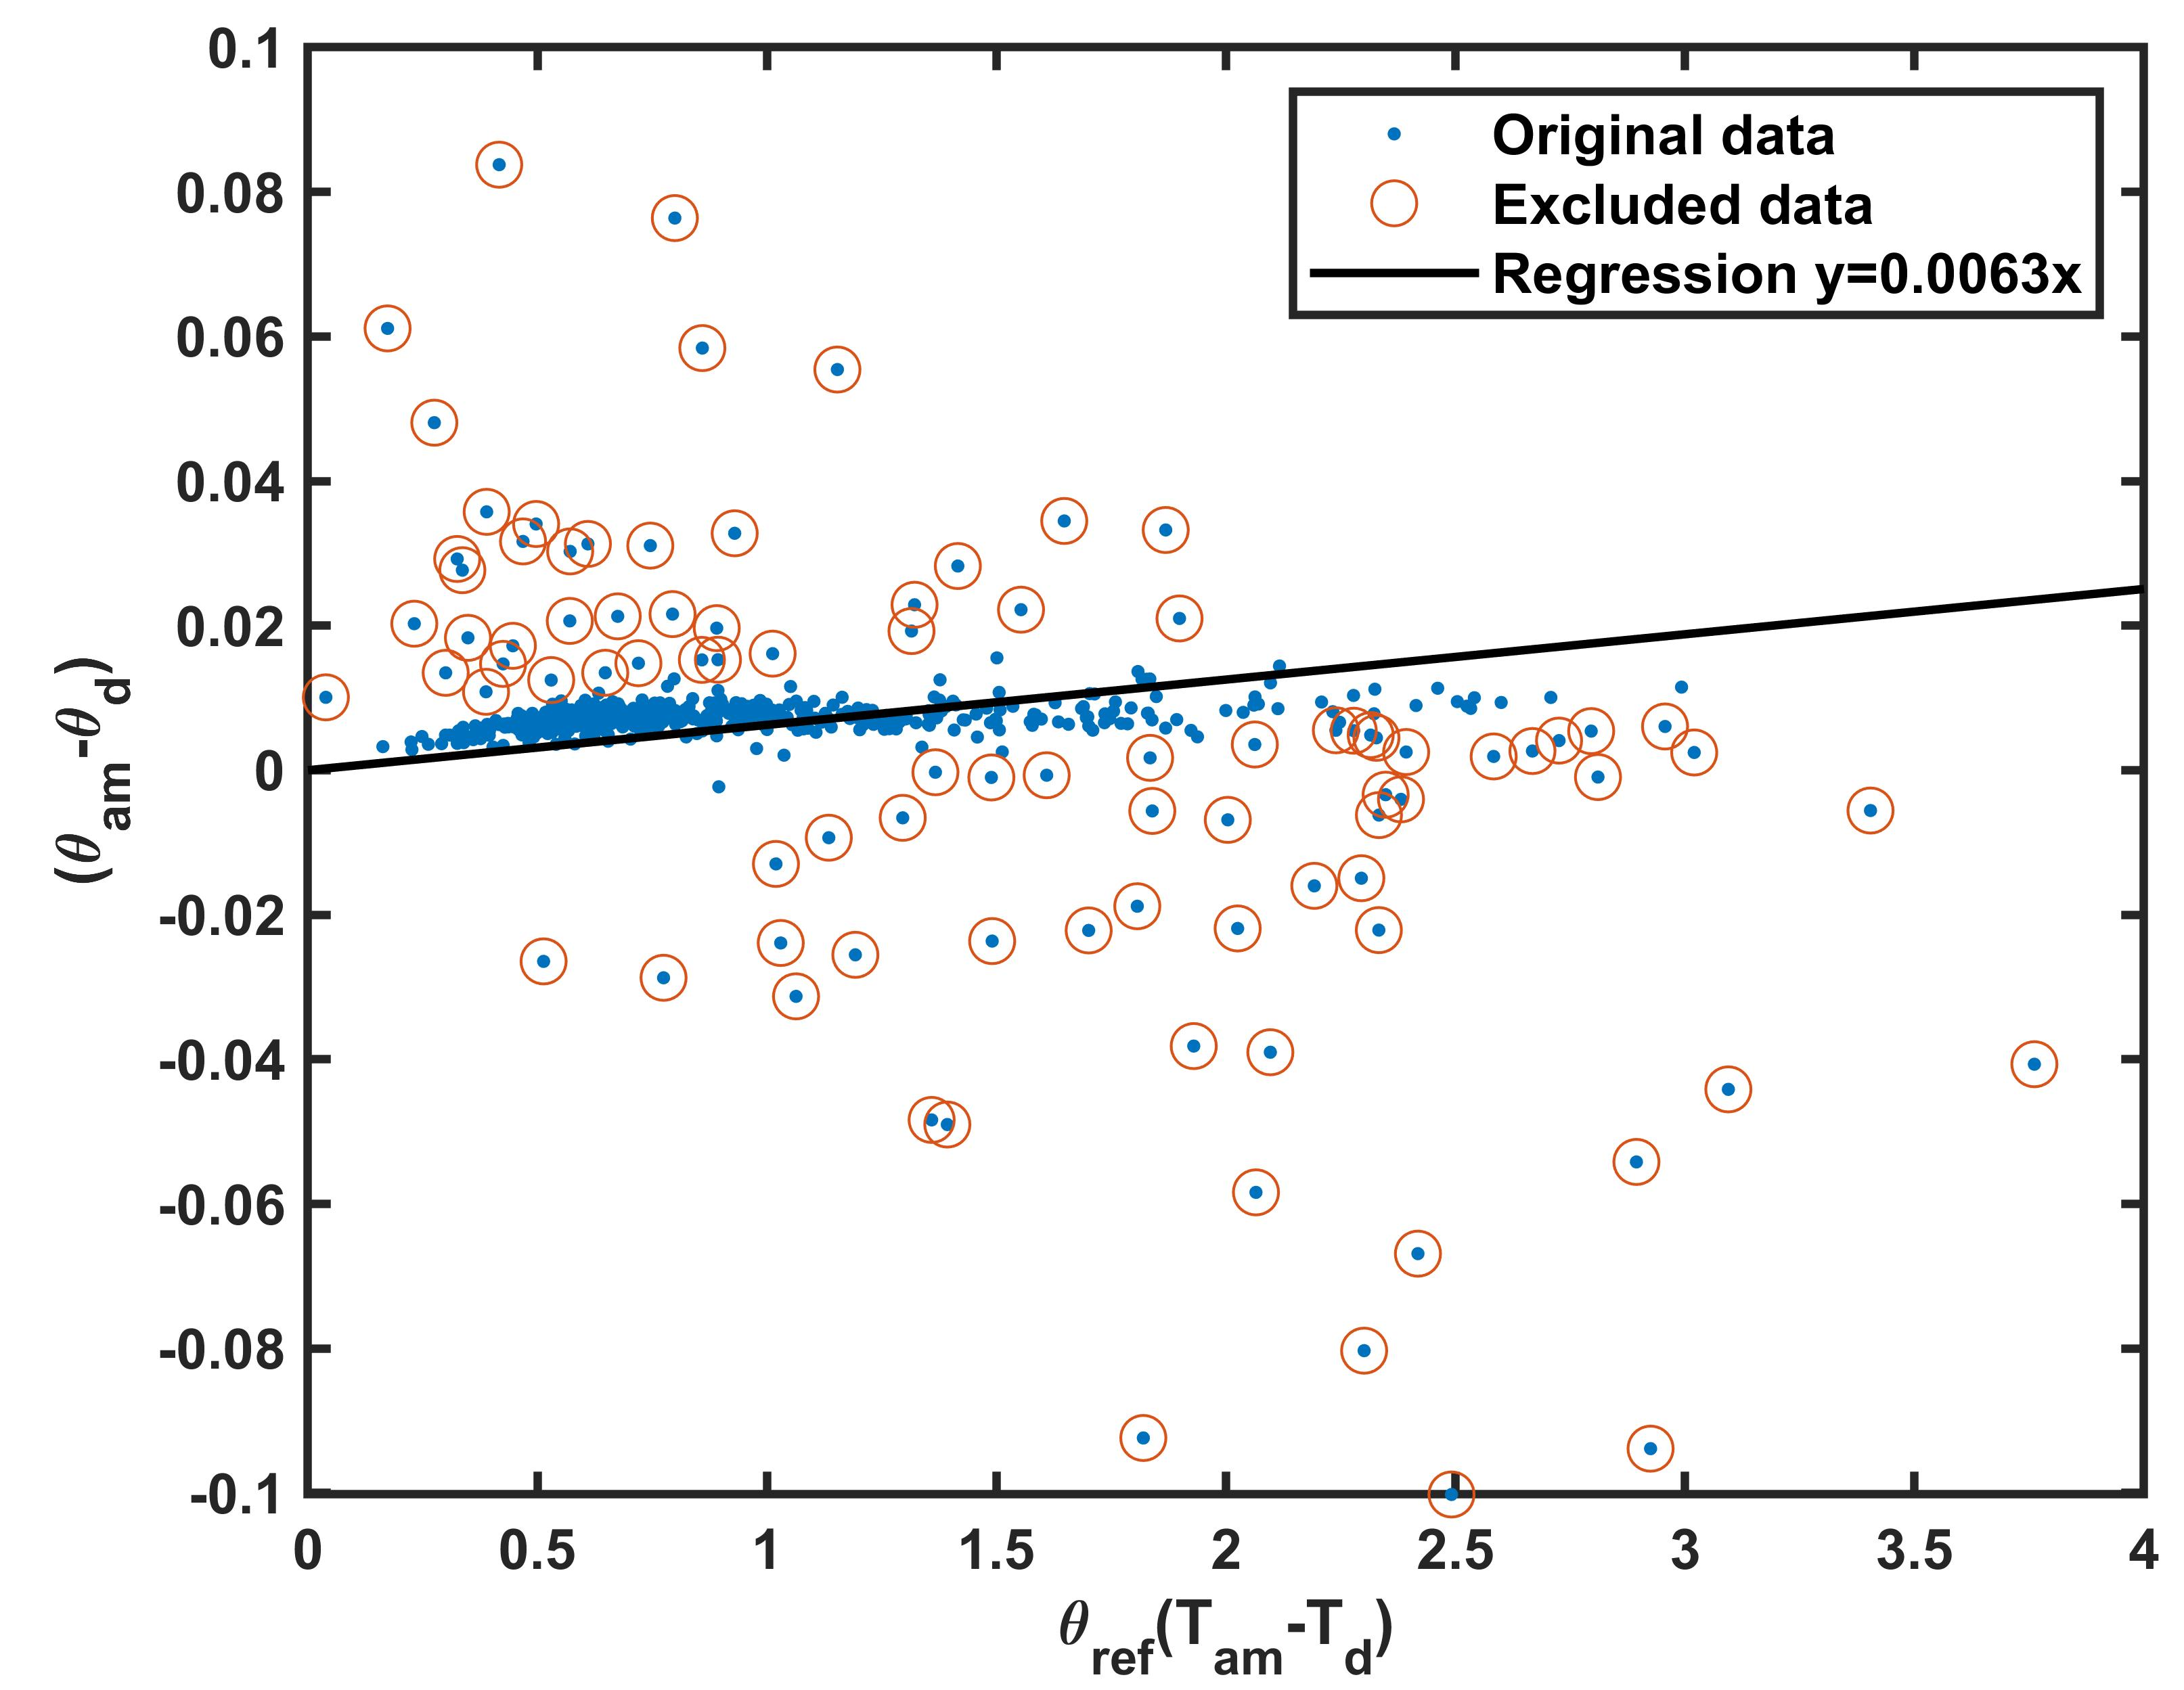
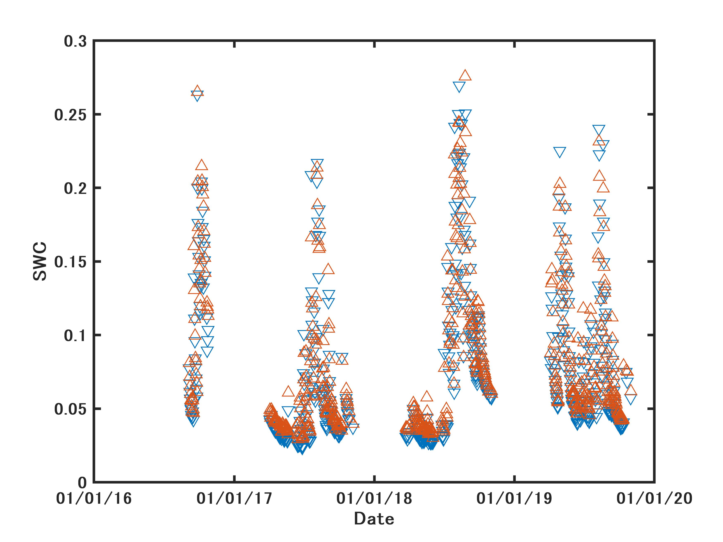
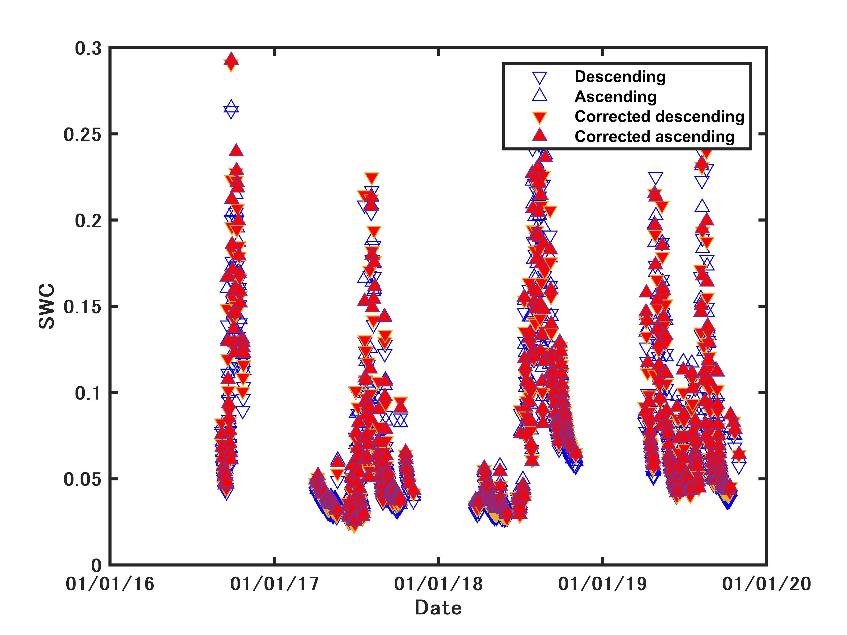
In-situ SWC data

Slide 30
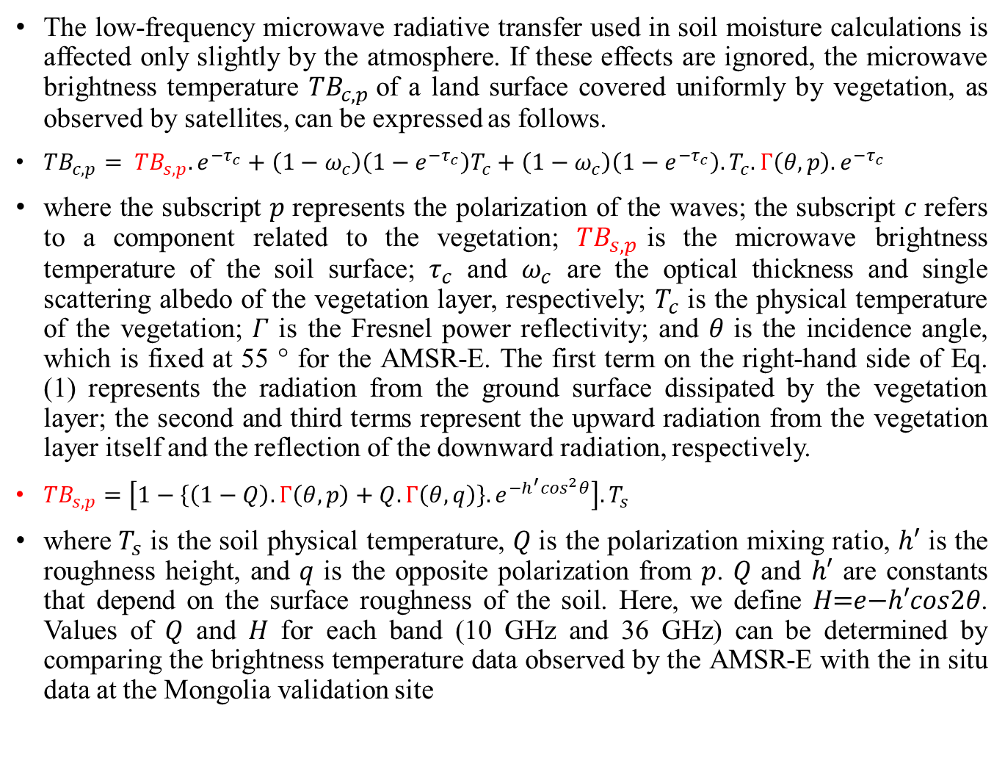
Radiative Transfer Model of the Soil Surface–Vegetation Layer
The low-frequency microwave radiative transfer used in soil moisture calculations is affected only slightly by the atmosphere. If these effects are ignored, the microwave brightness temperature ${TB}_{c,p}$of a land surface covered uniformly by vegetation, as observed by satellites, can be expressed as follows.
${TB}_{c,p}= {TB}_{s,p}.e^{{−τ}_{c}}+\left(1−ω_{c}\right)\left(1−e^{{−τ}_{c}}\right)T_{c}+\left(1−ω_{c}\right)\left(1−e^{{−τ}_{c}}\right).T_{c}.Γ\left(θ,p\right).e^{{−τ}_{c}}$
where the subscript 𝑝 represents the polarization of the waves; the subscript 𝑐 refers to a component related to the vegetation; ${TB}_{s,p}$is the microwave brightness temperature of the soil surface; $τ_{c}$ and $ω_{c}$ are the optical thickness and single scattering albedo of the vegetation layer, respectively; $T_{c}$ is the physical temperature of the vegetation; 𝛤 is the Fresnel power reflectivity; and 𝜃 is the incidence angle, which is fixed at 55 ° for the AMSR-E. The first term on the right-hand side of Eq. (1) represents the radiation from the ground surface dissipated by the vegetation layer; the second and third terms represent the upward radiation from the vegetation layer itself and the reflection of the downward radiation, respectively.
${TB}_{s,p}=\left[1−\left\{\left(1−Q\right).Γ\left(θ,p\right)+Q.Γ\left(θ,q\right)\right\}.e^{−h^{′}\cos^{2}θ}\right].T_{s}$
where $T_{s}$ is the soil physical temperature, 𝑄 is the polarization mixing ratio, ℎ′ is the roughness height, and 𝑞 is the opposite polarization from 𝑝. 𝑄 and ℎ′ are constants that depend on the surface roughness of the soil. Here, we define 𝐻=𝑒−ℎ′𝑐𝑜𝑠2𝜃. Values of 𝑄 and 𝐻 for each band (10 GHz and 36 GHz) can be determined by comparing the brightness temperature data observed by the AMSR-E with the in situ data at the Mongolia validation site

Slide 31
Satellite SM data with TB

