Slide 1

Temperature Effects in AMSR2 Soil Moisture Products and
Development of a Removal Method Using Ascending and Descending Data
Kim Oanh Hoang, Minjiao Lu and Agampodi Deva Thisaru Nayanathara Kumarasiri
Nagaoka University of Technology, Japan
Department of Civil and Environmental Engineering, Hydrology Laboratory

Slide 2

Contents
Temperature effects (TEs) in soil water content measurements
  The current methods to observe the soil water content
  The existence of TEs in in situ and satellite data
  The experimental facts
The existence of TEs in AMSR2 soil moisture products
Removing TEs in AMSR2 soil moisture products
  Methodology descriptions
  Study area and data in Mongolia site
  Results
Conclusions

Slide 3
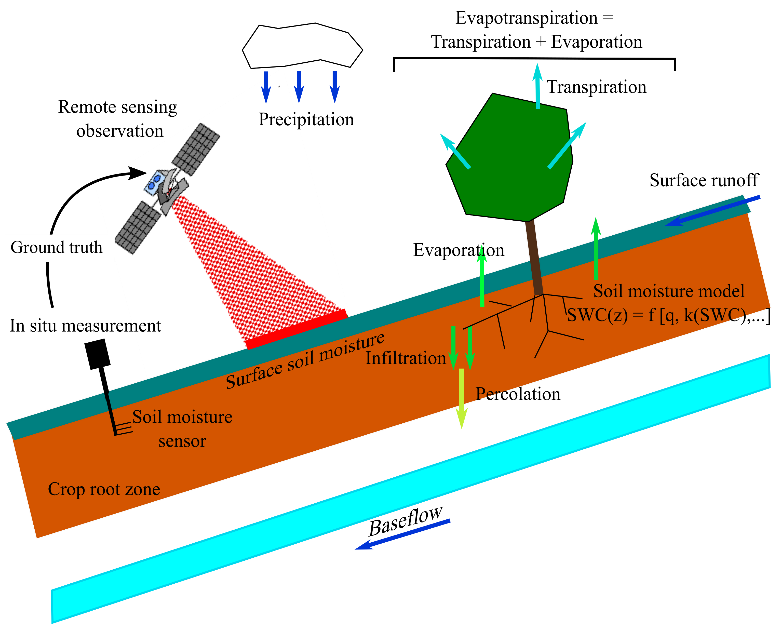
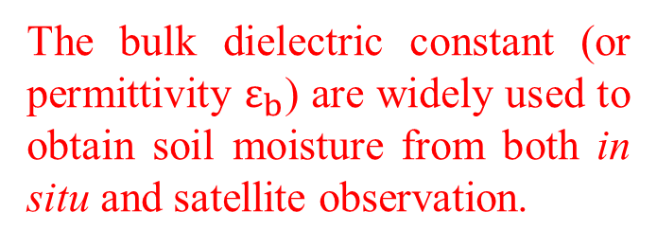
Temperature effects (TEs) in soil water content measurements
The current methods to observe the soil water content
Conventional observations
The other observations
GPS multi path
The tensiometers
Gramma-ray attenuation
The bulk dielectric constant (or permittivity $ε_{b}$) are widely used to obtain soil moisture from both in situ and satellite observation.
Dobriyal et al. (2012) : https://doi:10.1016/j.jhydrol.2012.06.021
Susha et al. (2014) : https://doi:10.1016/j.measurement.2014.04.007

Slide 4
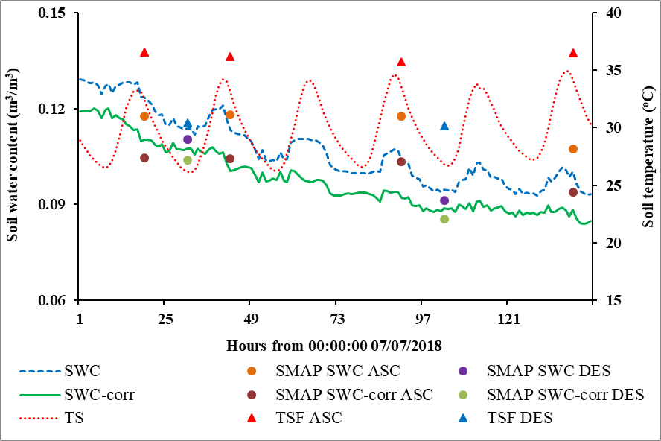
Temperature effects (TEs) in soil water content measurements
The existence of TE in in situ and satellite data (SMAP)
Average in-iitu soil water content (SWC) and soil temperature (TS), alongside SMAP SWC and surface temperature (TSF), during ascending and descending passes over Little Washita (Oklahoma, USA).
Hoang and Lu (2021): https://doi.org/10.3390/rs13204104

Slide 5
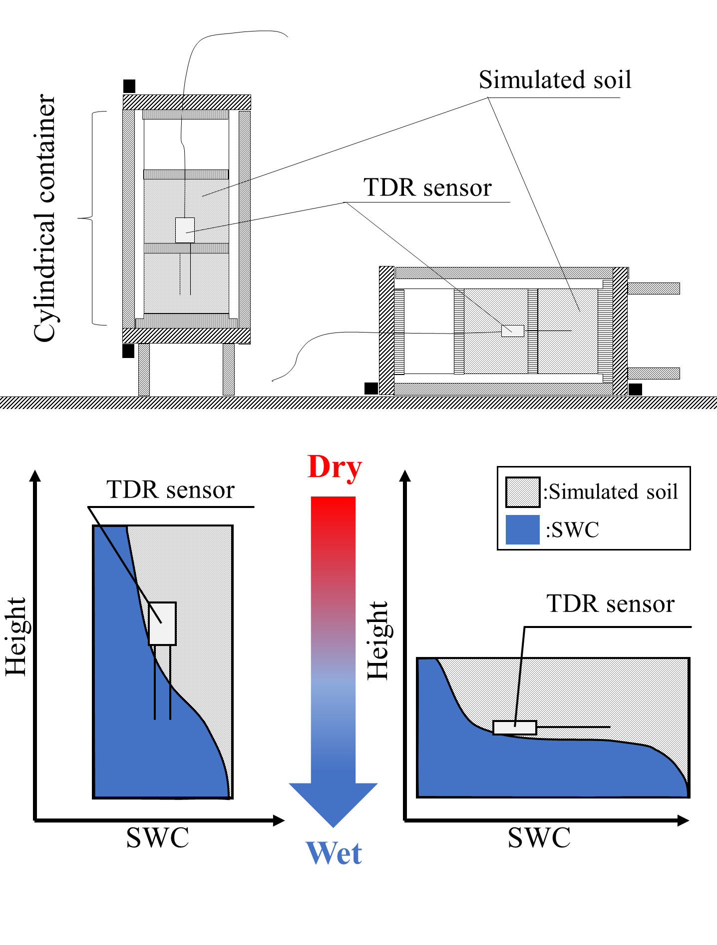
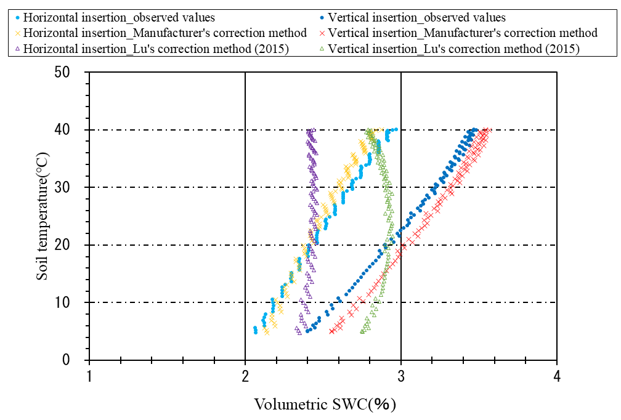
Temperature effects (TEs) in soil water content measurements
The experimental facts about TE in TDR SWC measurement
Yamamoto and Lu (2022)

Slide 6
Contents
Temperature effects (TEs) in soil water content measurements
  The current methods to observe the soil water content
  The existence of TEs in in situ and satellite data
  The experimental facts
The existence of TEs in AMSR2 soil moisture products
Removing TEs in AMSR2 soil moisture products
  Methodology descriptions
  Study area in Mongolia site
  Results
Conclusions

Slide 7
The existence of TEs in AMSR2 soil moisture products
The existence of TE in in situ and AMSR2 soil moisture data
A real mean of in-situ SWC, soil temperature, and AMSR2 SWC, and AMSR2 surface temperature at Mongolia site

Slide 8
Contents
Temperature effects (TEs) in soil water content measurements
  The current methods to observe the soil water content
  The existence of TEs in in situ and satellite data
  The experimental facts
The existence of TEs in AMSR2 soil moisture products
Removing TEs in AMSR2 soil moisture products
  Methodology descriptions
  Study area and data in Mongolia site
  Results
Conclusions

Slide 9
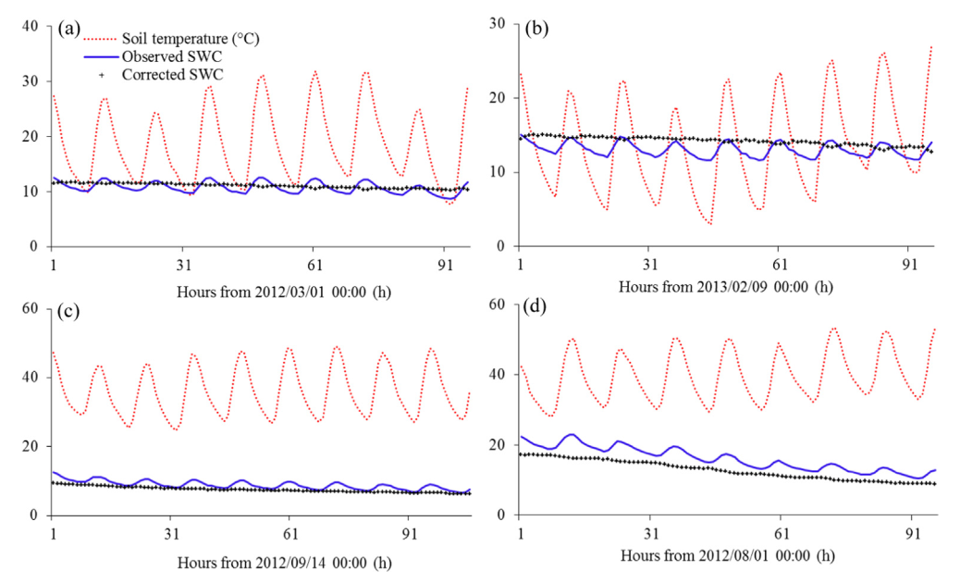
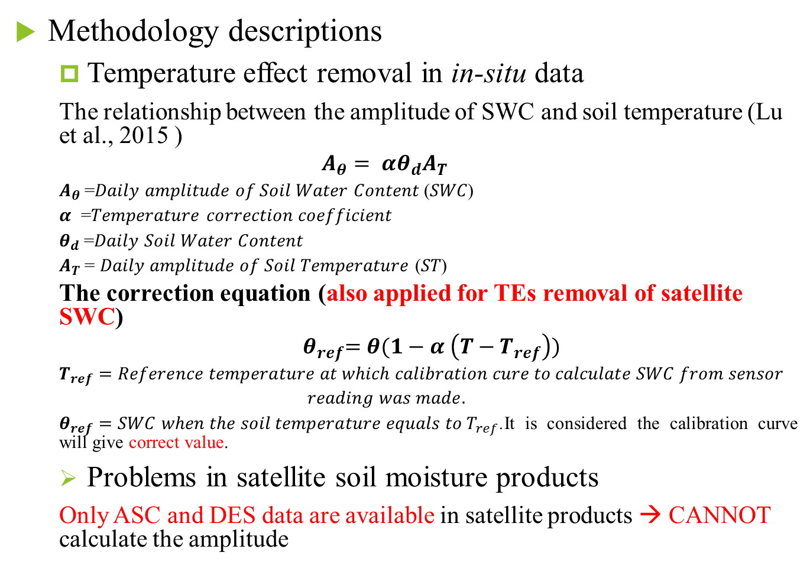
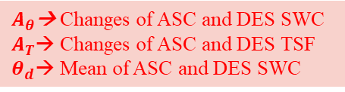
Removing TEs in AMSR2 soil moisture products
Methodology descriptions
  Temperature effect removal in in-situ data
  The relationship between the amplitude of SWC and soil temperature (Lu et al., 2015 )
  $$A_{θ}= αθ_{d}A_{T}$$
  $A_{θ}$=𝐷𝑎𝑖𝑙𝑦 𝑎𝑚𝑝𝑙𝑖𝑡𝑢𝑑𝑒 𝑜𝑓 𝑆𝑜𝑖𝑙 𝑊𝑎𝑡𝑒𝑟 𝐶𝑜𝑛𝑡𝑒𝑛𝑡 (𝑆𝑊𝐶)
  𝜶 =𝑇𝑒𝑚𝑝𝑒𝑟𝑎𝑡𝑢𝑟𝑒 𝑐𝑜𝑟𝑟𝑒𝑐𝑡𝑖𝑜𝑛 𝑐𝑜𝑒𝑓𝑓𝑖𝑐𝑖𝑒𝑛𝑡
  $θ_{d}$=𝐷𝑎𝑖𝑙𝑦 𝑆𝑜𝑖𝑙 𝑊𝑎𝑡𝑒𝑟 𝐶𝑜𝑛𝑡𝑒𝑛𝑡
  $A_{T}$= 𝐷𝑎𝑖𝑙𝑦 𝑎𝑚𝑝𝑙𝑖𝑡𝑢𝑑𝑒 𝑜𝑓 𝑆𝑜𝑖𝑙 𝑇𝑒𝑚𝑝𝑒𝑟𝑎𝑡𝑢𝑟𝑒 (𝑆𝑇)
  The correction equation (also applied for TEs removal of satellite SWC)
  $${ θ}_{ref}=θ(1−α \left(T−T_{ref}\right))$$
  $$T_{ref}=Reference temperature at which calibration cure to calculate SWC from sensor$$
  $$reading was made.$$
  $θ_{ref}=SWC when the soil temperature equals to T_{ref}$.It is considered the calibration curve will give correct value.
  Problems in satellite soil moisture products
  Only ASC and DES data are available in satellite products → CANNOT calculate the amplitude
Application of the TEs removal (Kapilaratne and Lu, 2017) to in-situ data at Yuma-27-ENE station.
Considered
$A_{θ}$→ Changes of ASC and DES SWC
$A_{T}$→ Changes of ASC and DES TSF
$θ_{d}$→ Mean of ASC and DES SWC
changes
Kapilaratne and Lu (2017): https://10.1016/j.jhydrol.2017.05.050

Slide 10
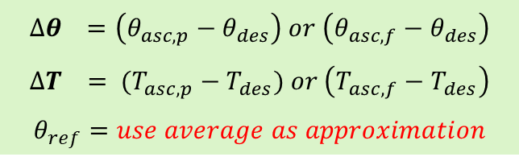
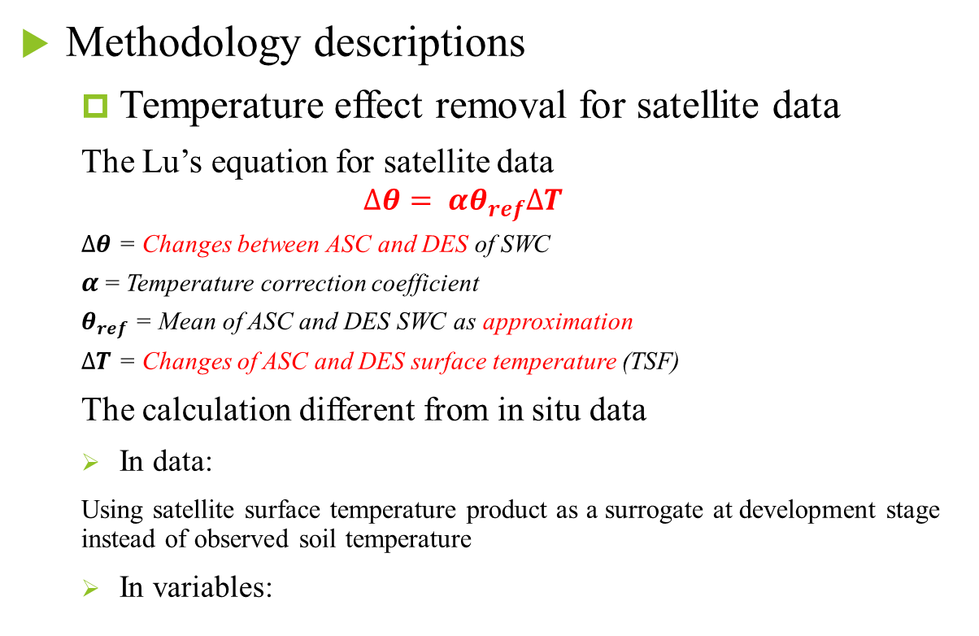
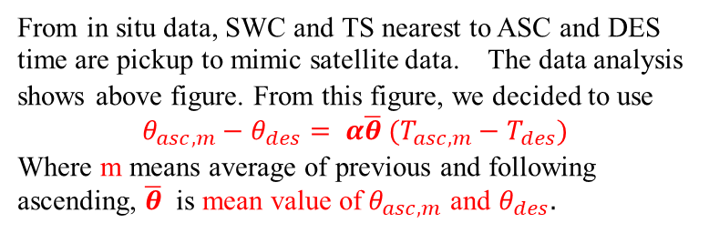
Removing TEs in AMSR2 soil moisture products
Methodology descriptions
  Temperature effect removal for satellite data
  The Lu’s equation for satellite data
  $$∆θ= αθ_{ref}∆T$$
  $∆θ$ = Changes between ASC and DES of SWC
  $α$ = Temperature correction coefficient
  $θ_{ref}$ = Mean of ASC and DES SWC as approximation
  $∆T$ = Changes of ASC and DES surface temperature (TSF)
  The calculation different from in situ data
  In data:
  Using satellite surface temperature product as a surrogate at development stage instead of observed soil temperature
  In variables:
From in situ data, SWC and TS nearest to ASC and DES time are pickup to mimic satellite data. The data analysis shows above figure. From this figure, we decided to use
$$θ_{asc,m}−θ_{des}= α\overline{θ} (T_{asc,m}−T_{des})$$
Where m means average of previous and following ascending, $\overline{θ}$ is mean value of${ θ}_{asc,m}$ and $θ_{des}.$
$$∆θ =\left(θ_{asc,p}−θ_{des}\right) or \left(θ_{asc,f}−θ_{des}\right)$$
$$∆T = (T_{asc,p}−T_{des}) or \left(T_{asc,f}−T_{des}\right)$$
$$θ_{ref}=use average as approximation$$
asc: ascending des: descending p : previous f : following

Slide 11
Contents
Temperature effects (TEs) in soil water content measurements
  The current methods to observe the soil water content
  The existence of TEs in in situ and satellite data
  The experimental facts
The existence of TEs in AMSR2 soil moisture products
Removing TEs in AMSR2 soil moisture products
  Methodology descriptions
  Study area and data in Mongolia site
  Results
Conclusions

Slide 12
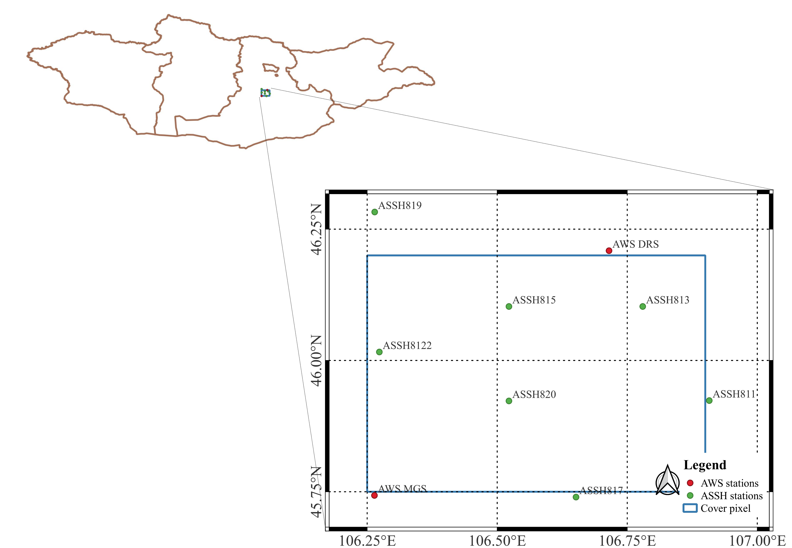
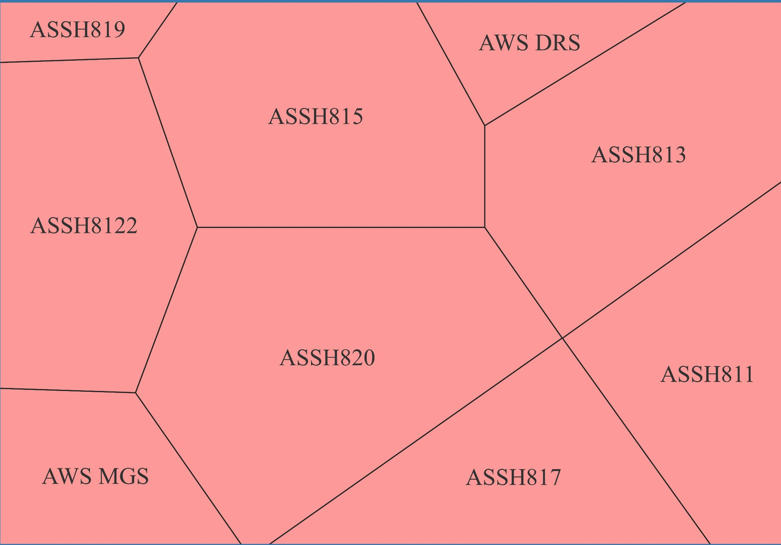
Removing TEs in AMSR2 soil moisture products
Study area in Mongolia site
  Focused on a 50×50 km specific target area (45.75°N, 106.9°E and 46.2°N, 106.25°E);
  Dominated by the cold arid climatic (BSk) area (as sorted in the Köppen–Geiger climate classification);
  Mostly flat with an elevation from 1300 m to 1500 m;
  Mainly cover by the bare soil, pasture and shrubs.
Data in Mongolia site
  In situ data
  SWC and soil temperature from 3-cm depth
  Contributed by nine station as described in the table
  Examining period from 5th Sep, 2016 to 31st Oct, 2019
  Satellite data
  Used the AMSR2 level 2 (L2) products (SGSMCLF3300300 and RGLSTLU1100100)
  Accessed through the website https://gportal.jaxa.jp/gpr/?lang=en (accessed on 31 July 2023)
Station ID | Coordinates No. | Weighed contribution | Lat. (N) | Lon. (E) | Alt. (m) | Temporal interval
MGS AWS |  | 0.080695 | 45ﾟ44'34.9'' | 106ﾟ15'52.2'' | 1393 | 30 ms
DRS AWS |  | 0.074242 | 46ﾟ12'31.2'' | 106ﾟ42'53.0'' | 1297
ASSH811/ASSH1 | F2 | 0.005092 | 45ﾟ55'22.5'' | 106ﾟ54'30.2'' | 1450 | 2 hrs
ASSH813 | E4 | 0.067831 | 46ﾟ06'10.0'' | 106ﾟ46'47.2'' | 1318
ASSH817/ASSH7 | D1 | 0.10458 | 45ﾟ44'23.4'' | 106ﾟ39'05.5'' | 1342
ASSH819/ASSH9 | A6 | 0.058915 | 46ﾟ16'57.6'' | 106ﾟ15'52.1'' | 1407
ASSH820/ASSH10 | C2 | 0.23882 | 45ﾟ55'22.5'' | 106ﾟ31'21.2'' | 1422
ASSH815/ASSH11 | C4 | 0.217732 | 46ﾟ06'10.0'' | 106ﾟ31'21.2'' | 1383
ASSH8122 | A3E | 0.152094 | 46ﾟ00'58.0'' | 106ﾟ16'24.3'' | 1502
Ascending | 13:30
Descending | 1:30

Slide 13
Contents
Temperature effects (TEs) in soil water content measurements
  The current methods to observe the soil water content
  The existence of TEs in in situ and satellite data
  The experimental facts
The existence of TEs in AMSR2 soil moisture products
Removing TEs in AMSR2 soil moisture products
  Methodology descriptions
  Study area and data in Mongolia site
  Results
Conclusions

Slide 14
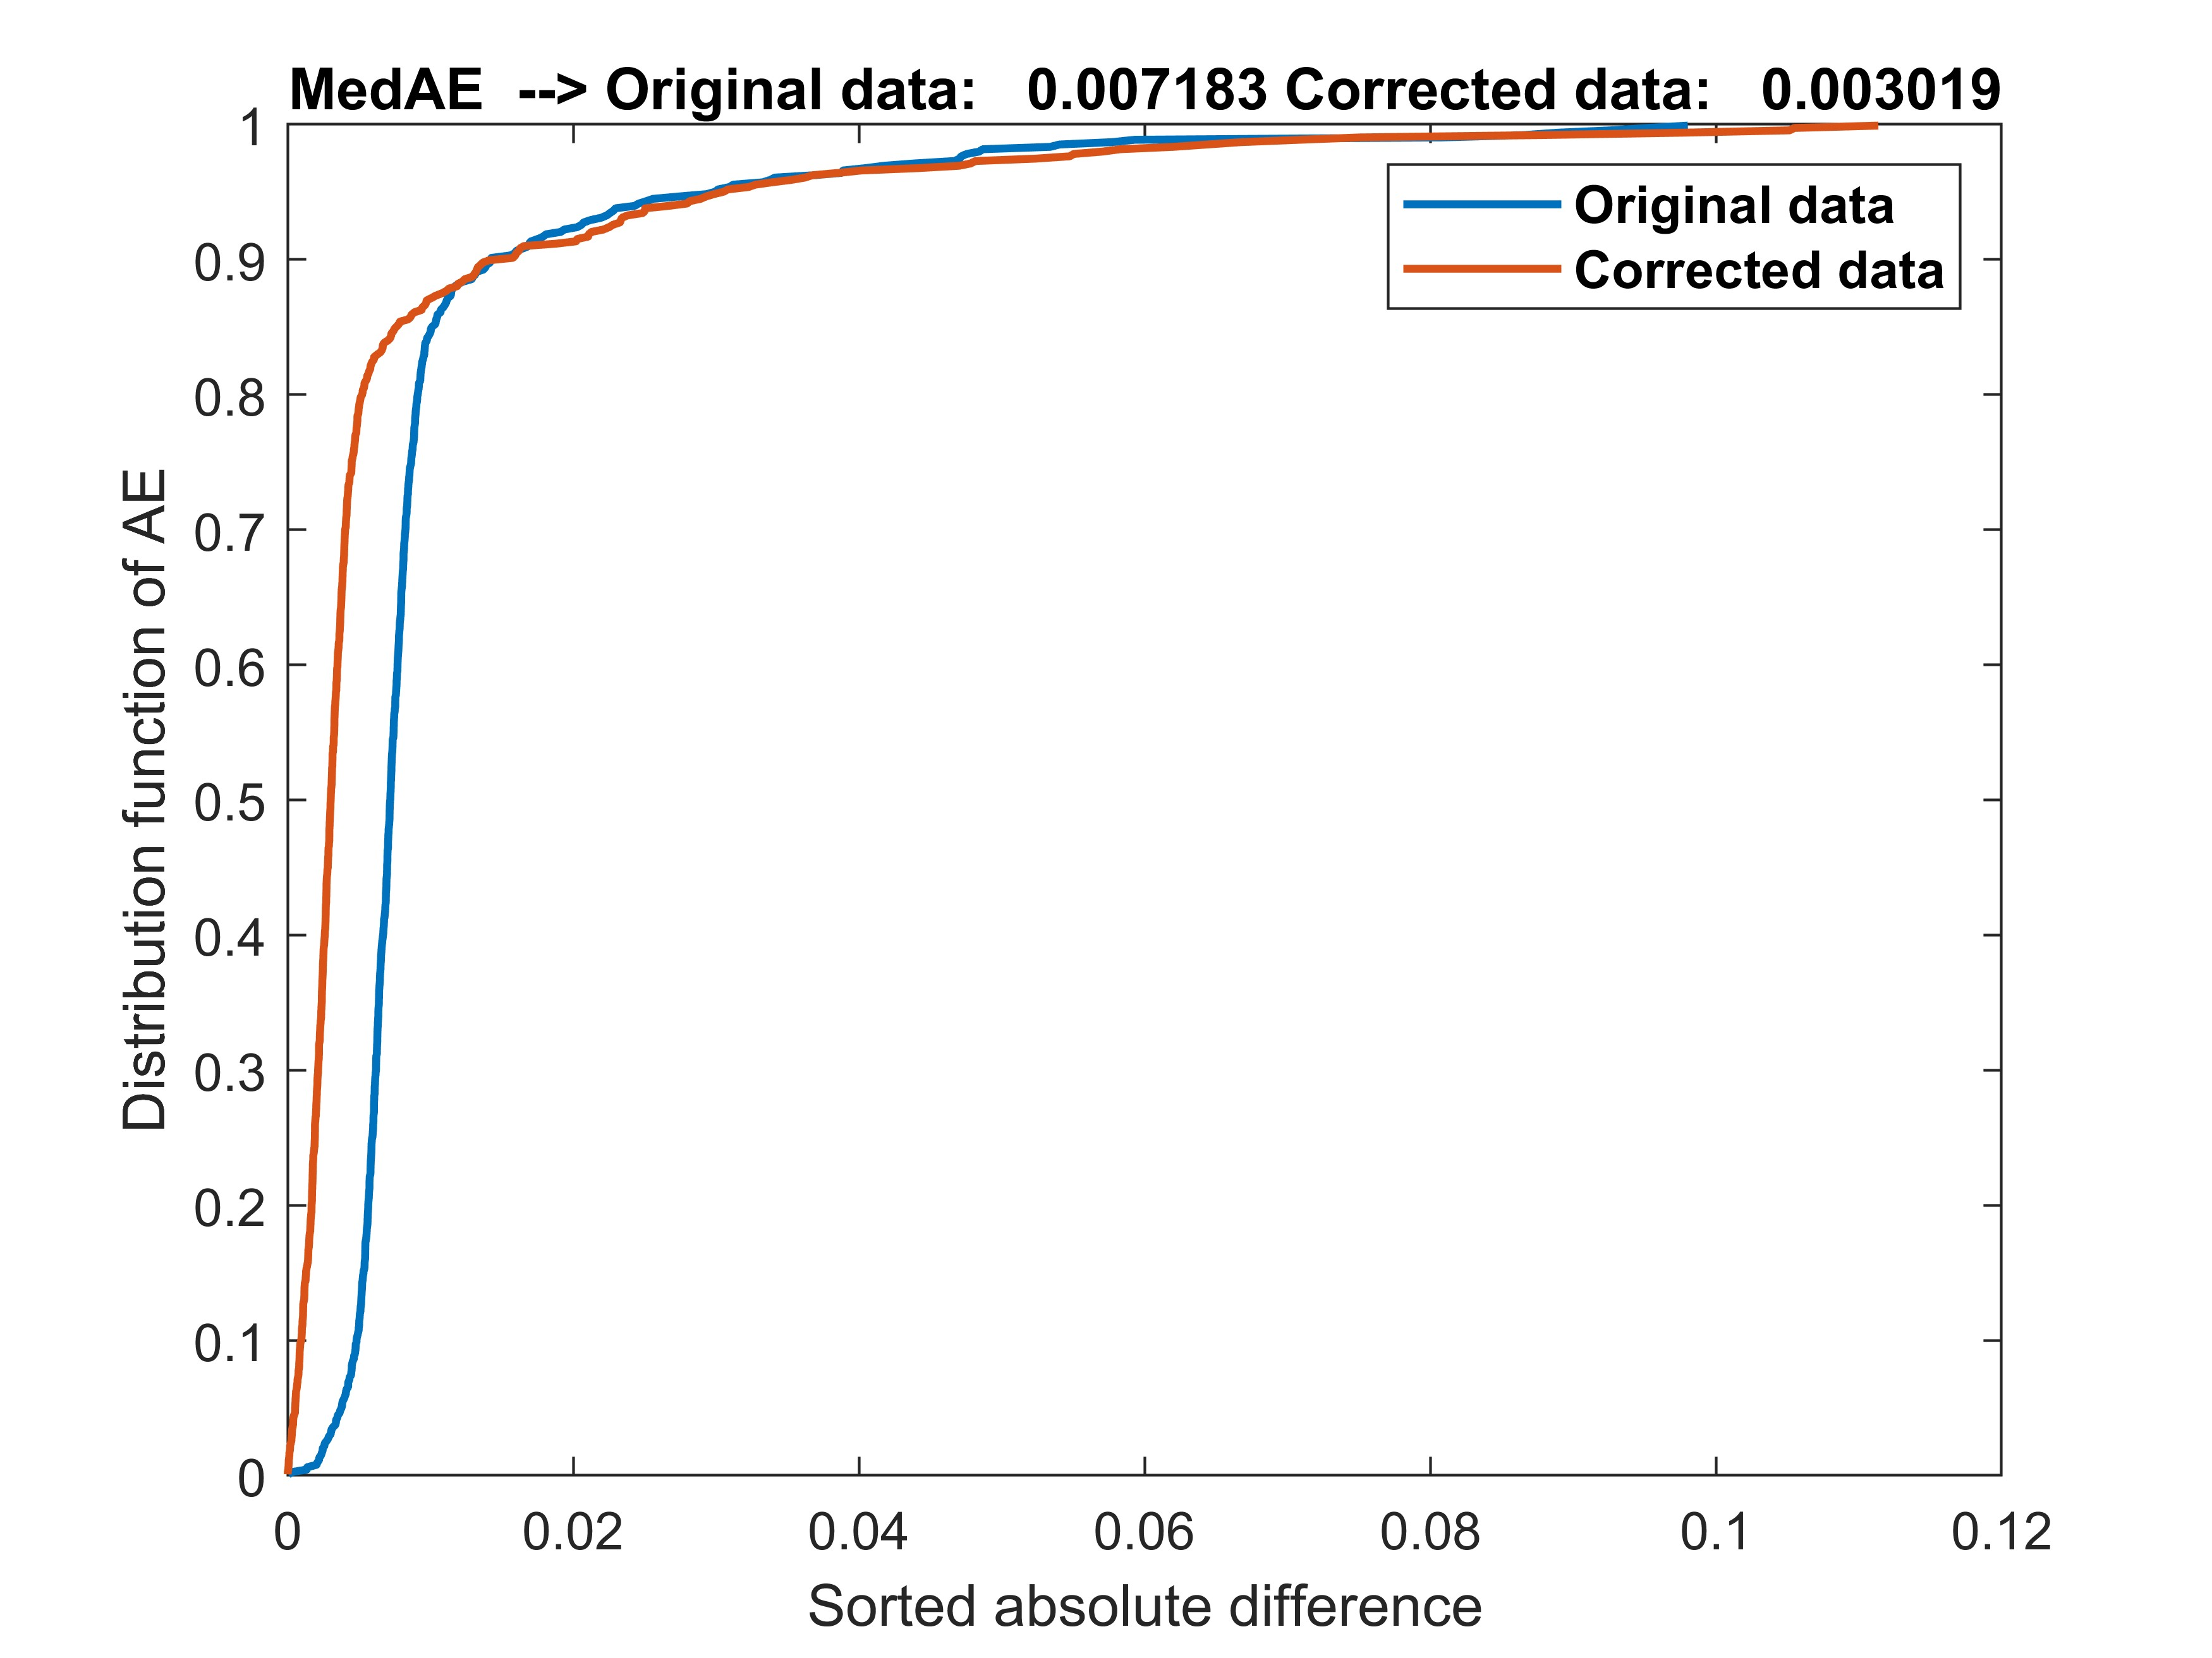
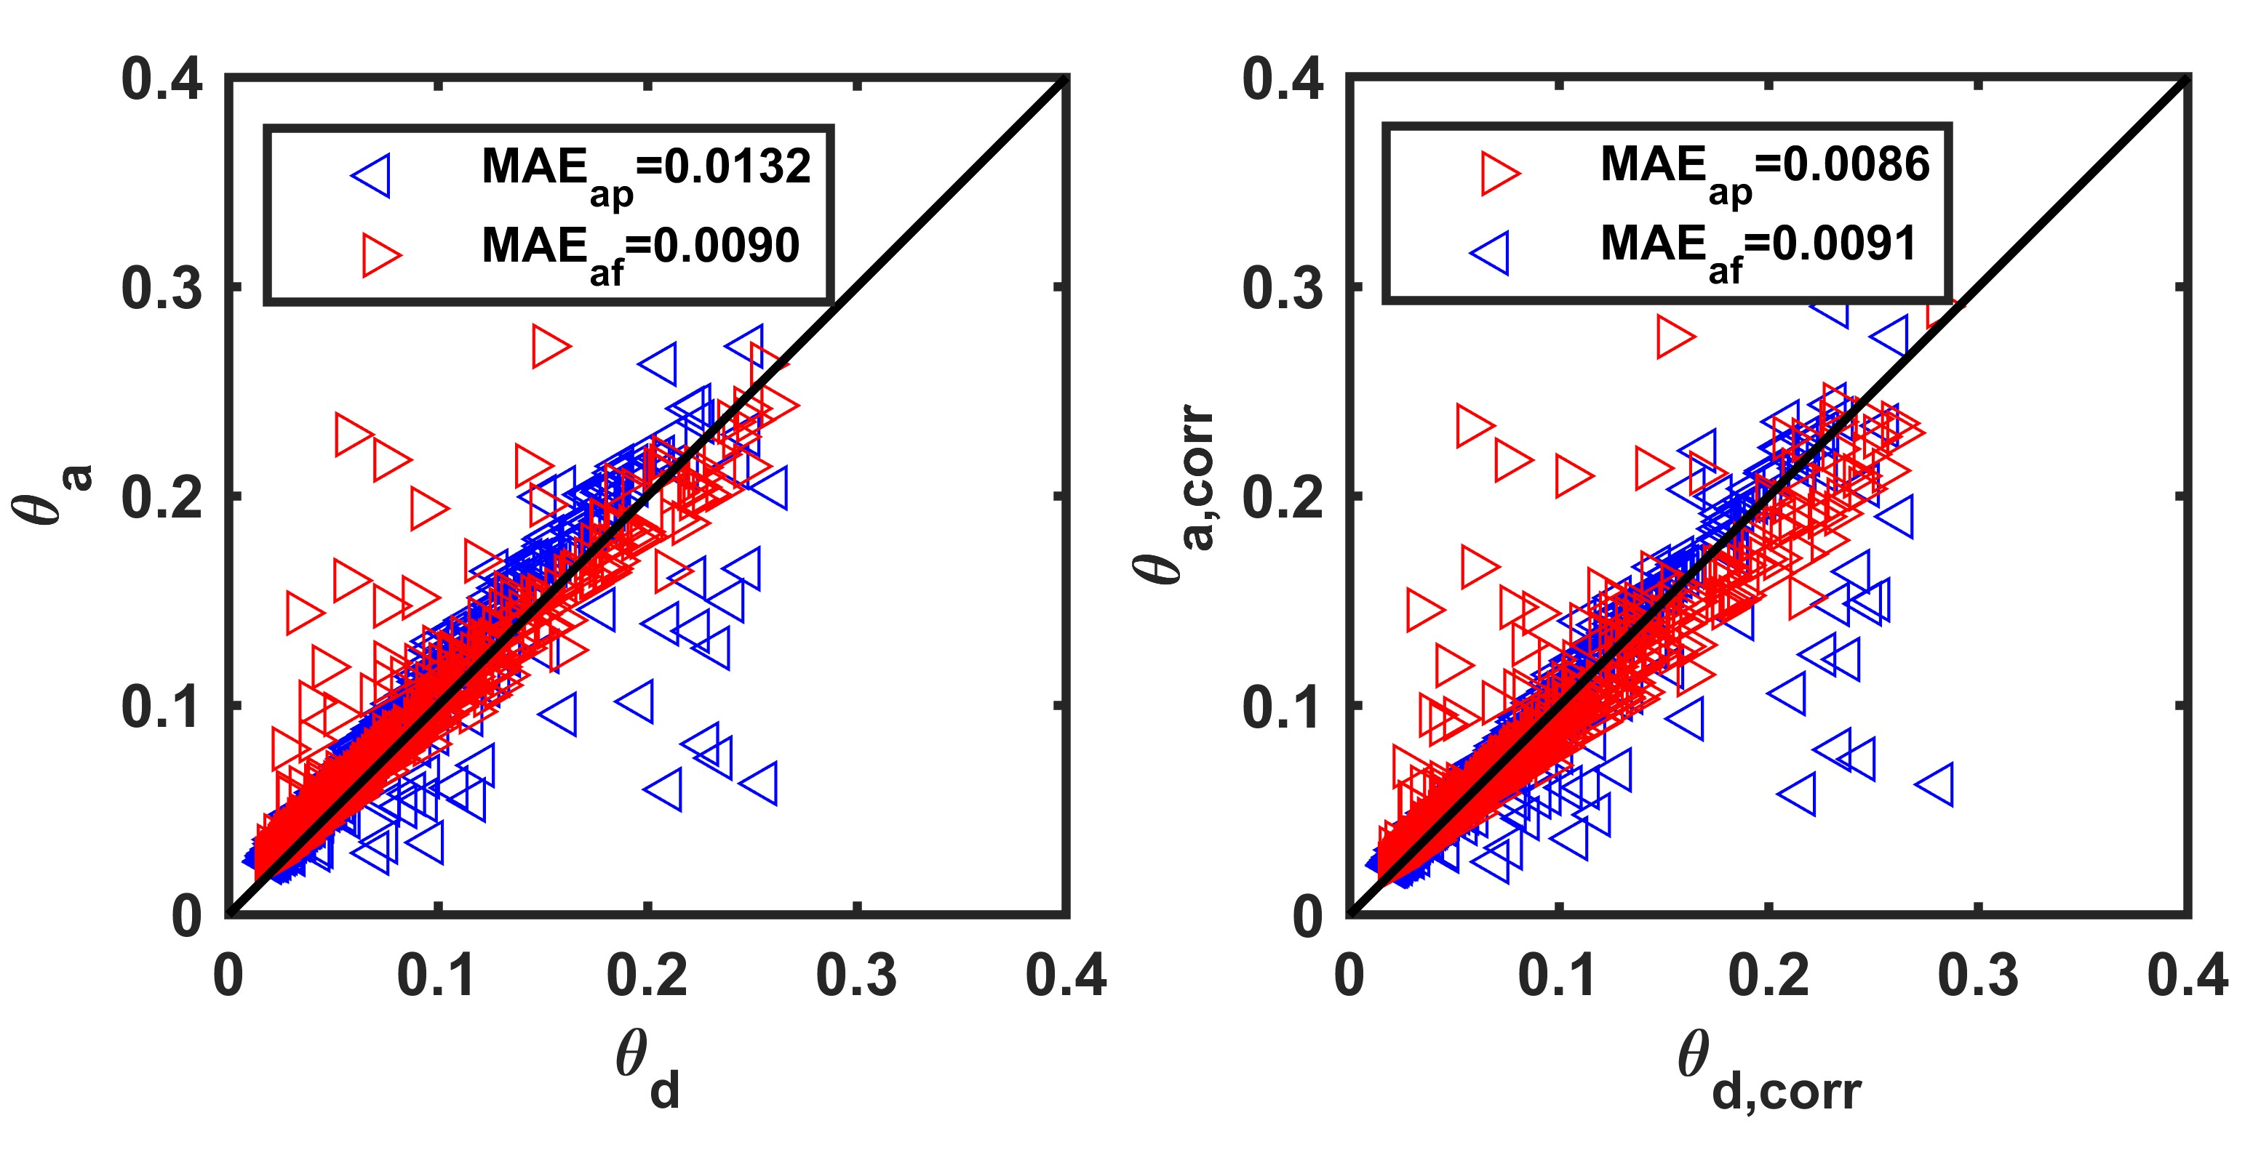
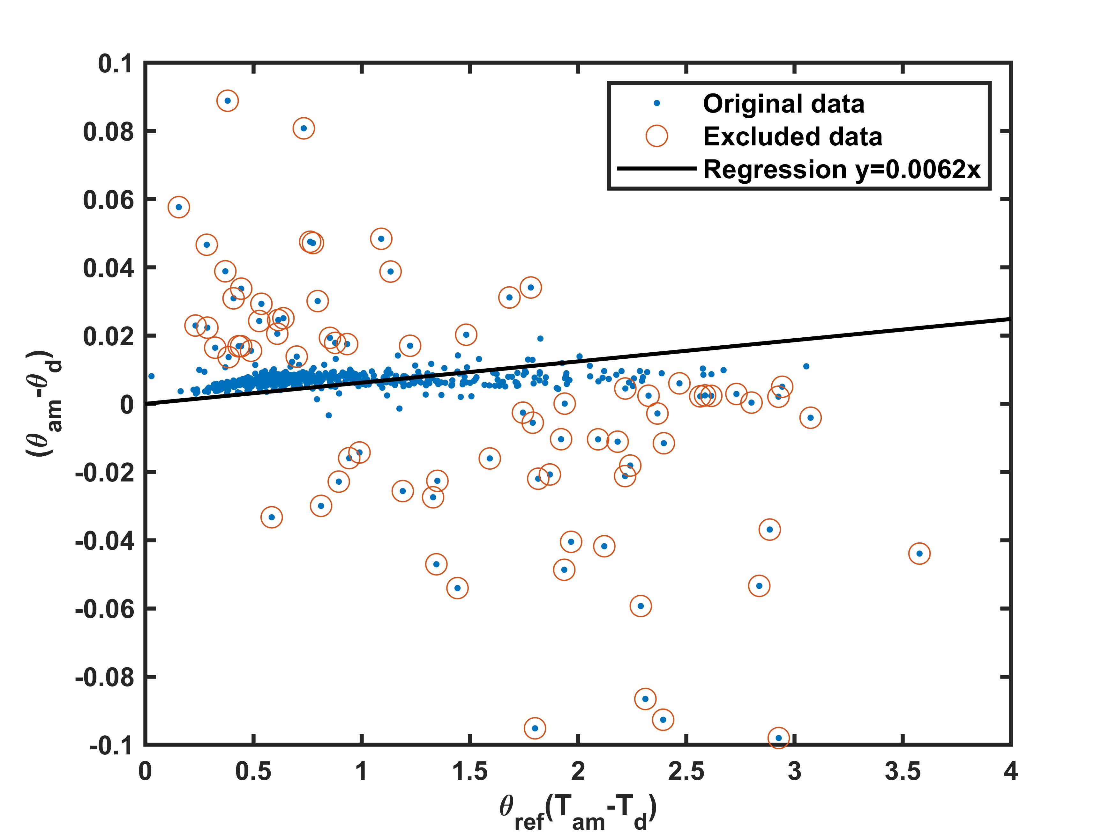
Removing TEs in AMSR2 soil moisture products
Results
  Applying newly developed method to in situ data at ASC and DES
    Using in situ SWC and soil temperature (TS) at ASC and DES times to conduct the computing
The distribution of data after applying the regression analysis
Alpha = 0.0062
The changes of the difference between ASC and DES SWC effected by TEs after the correction
Differences between DES and ASC (both previous and following) change after the correction

Slide 15
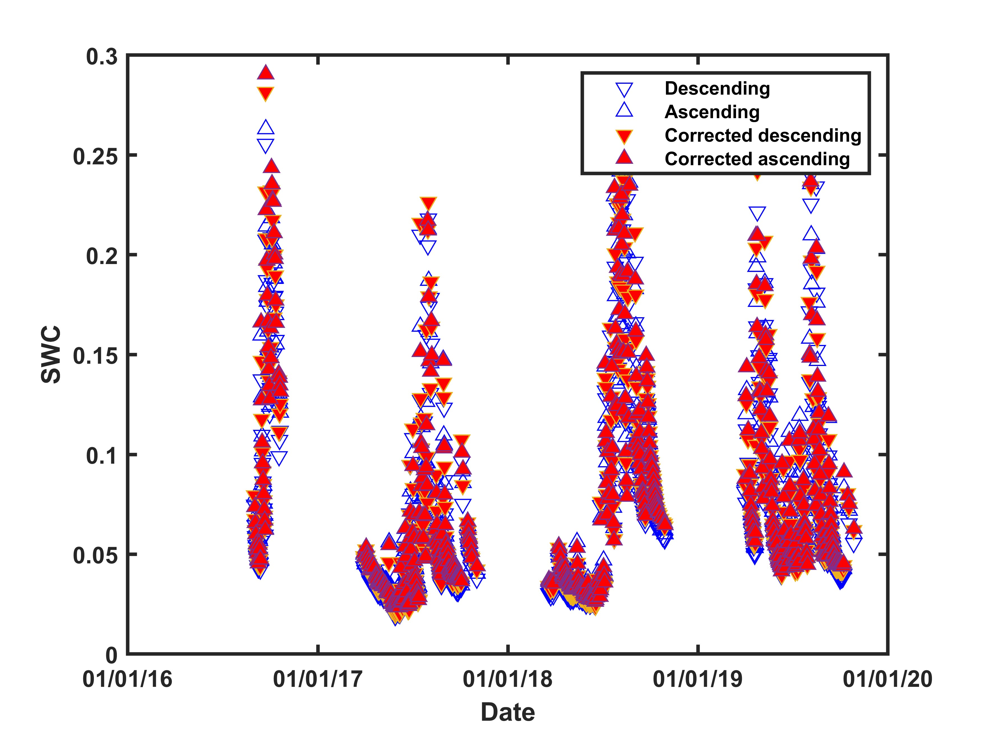
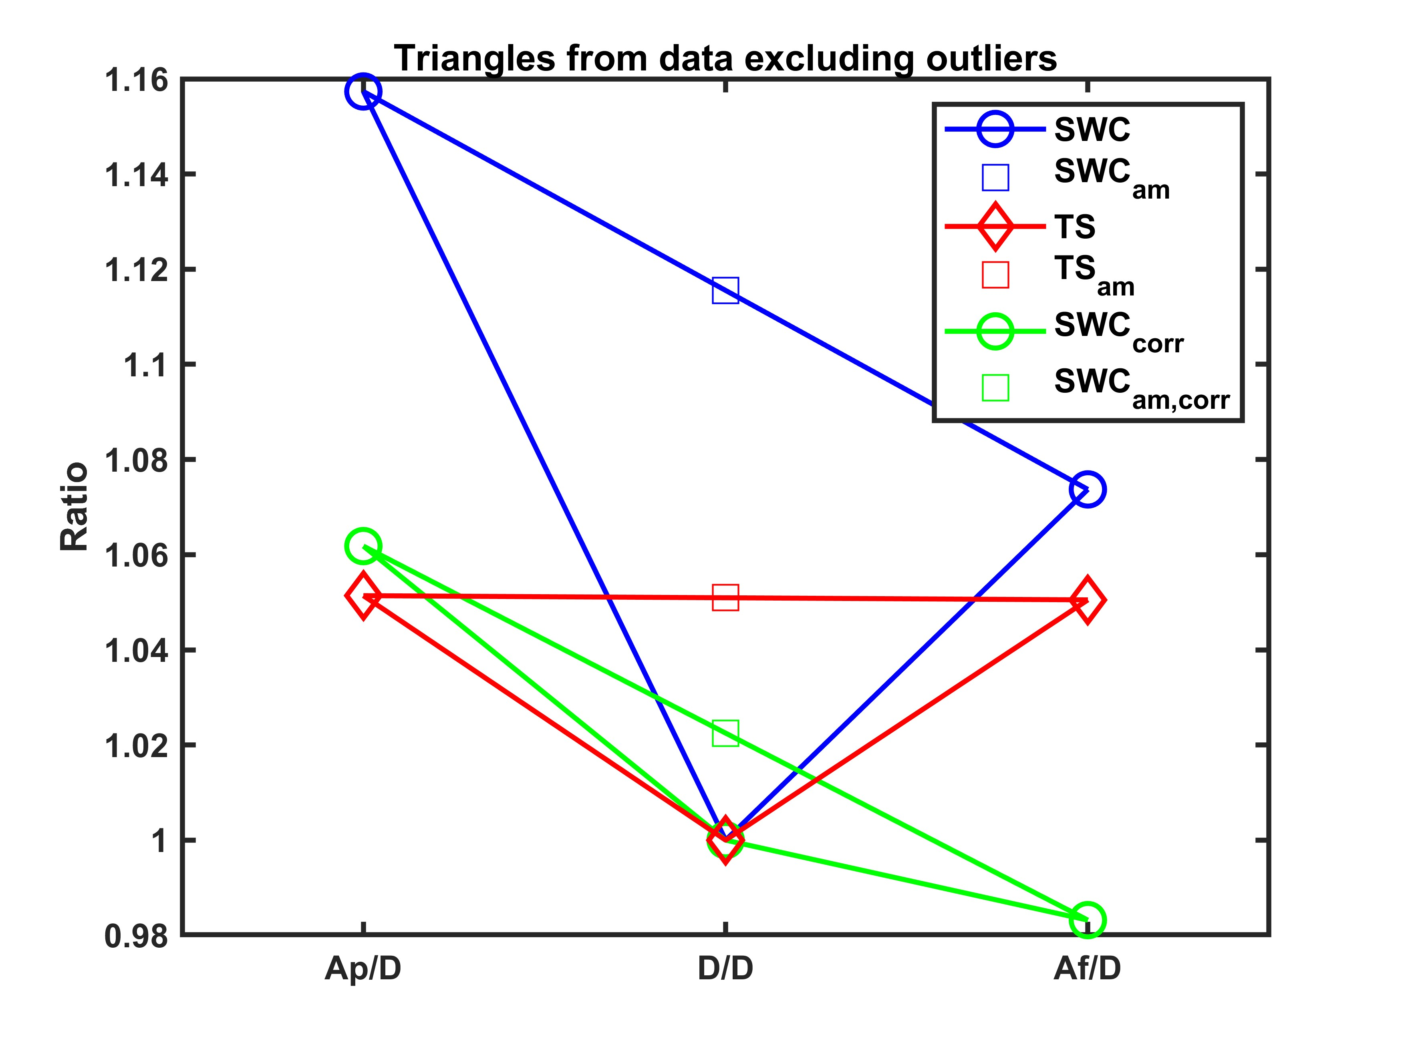
Removing TEs in AMSR2 soil moisture products
Results
  Applying newly developed method to in situ data at ASC and DES
SWC data after the correction
The triangle relationship among DES, following ASC and previous ASC data

Slide 16
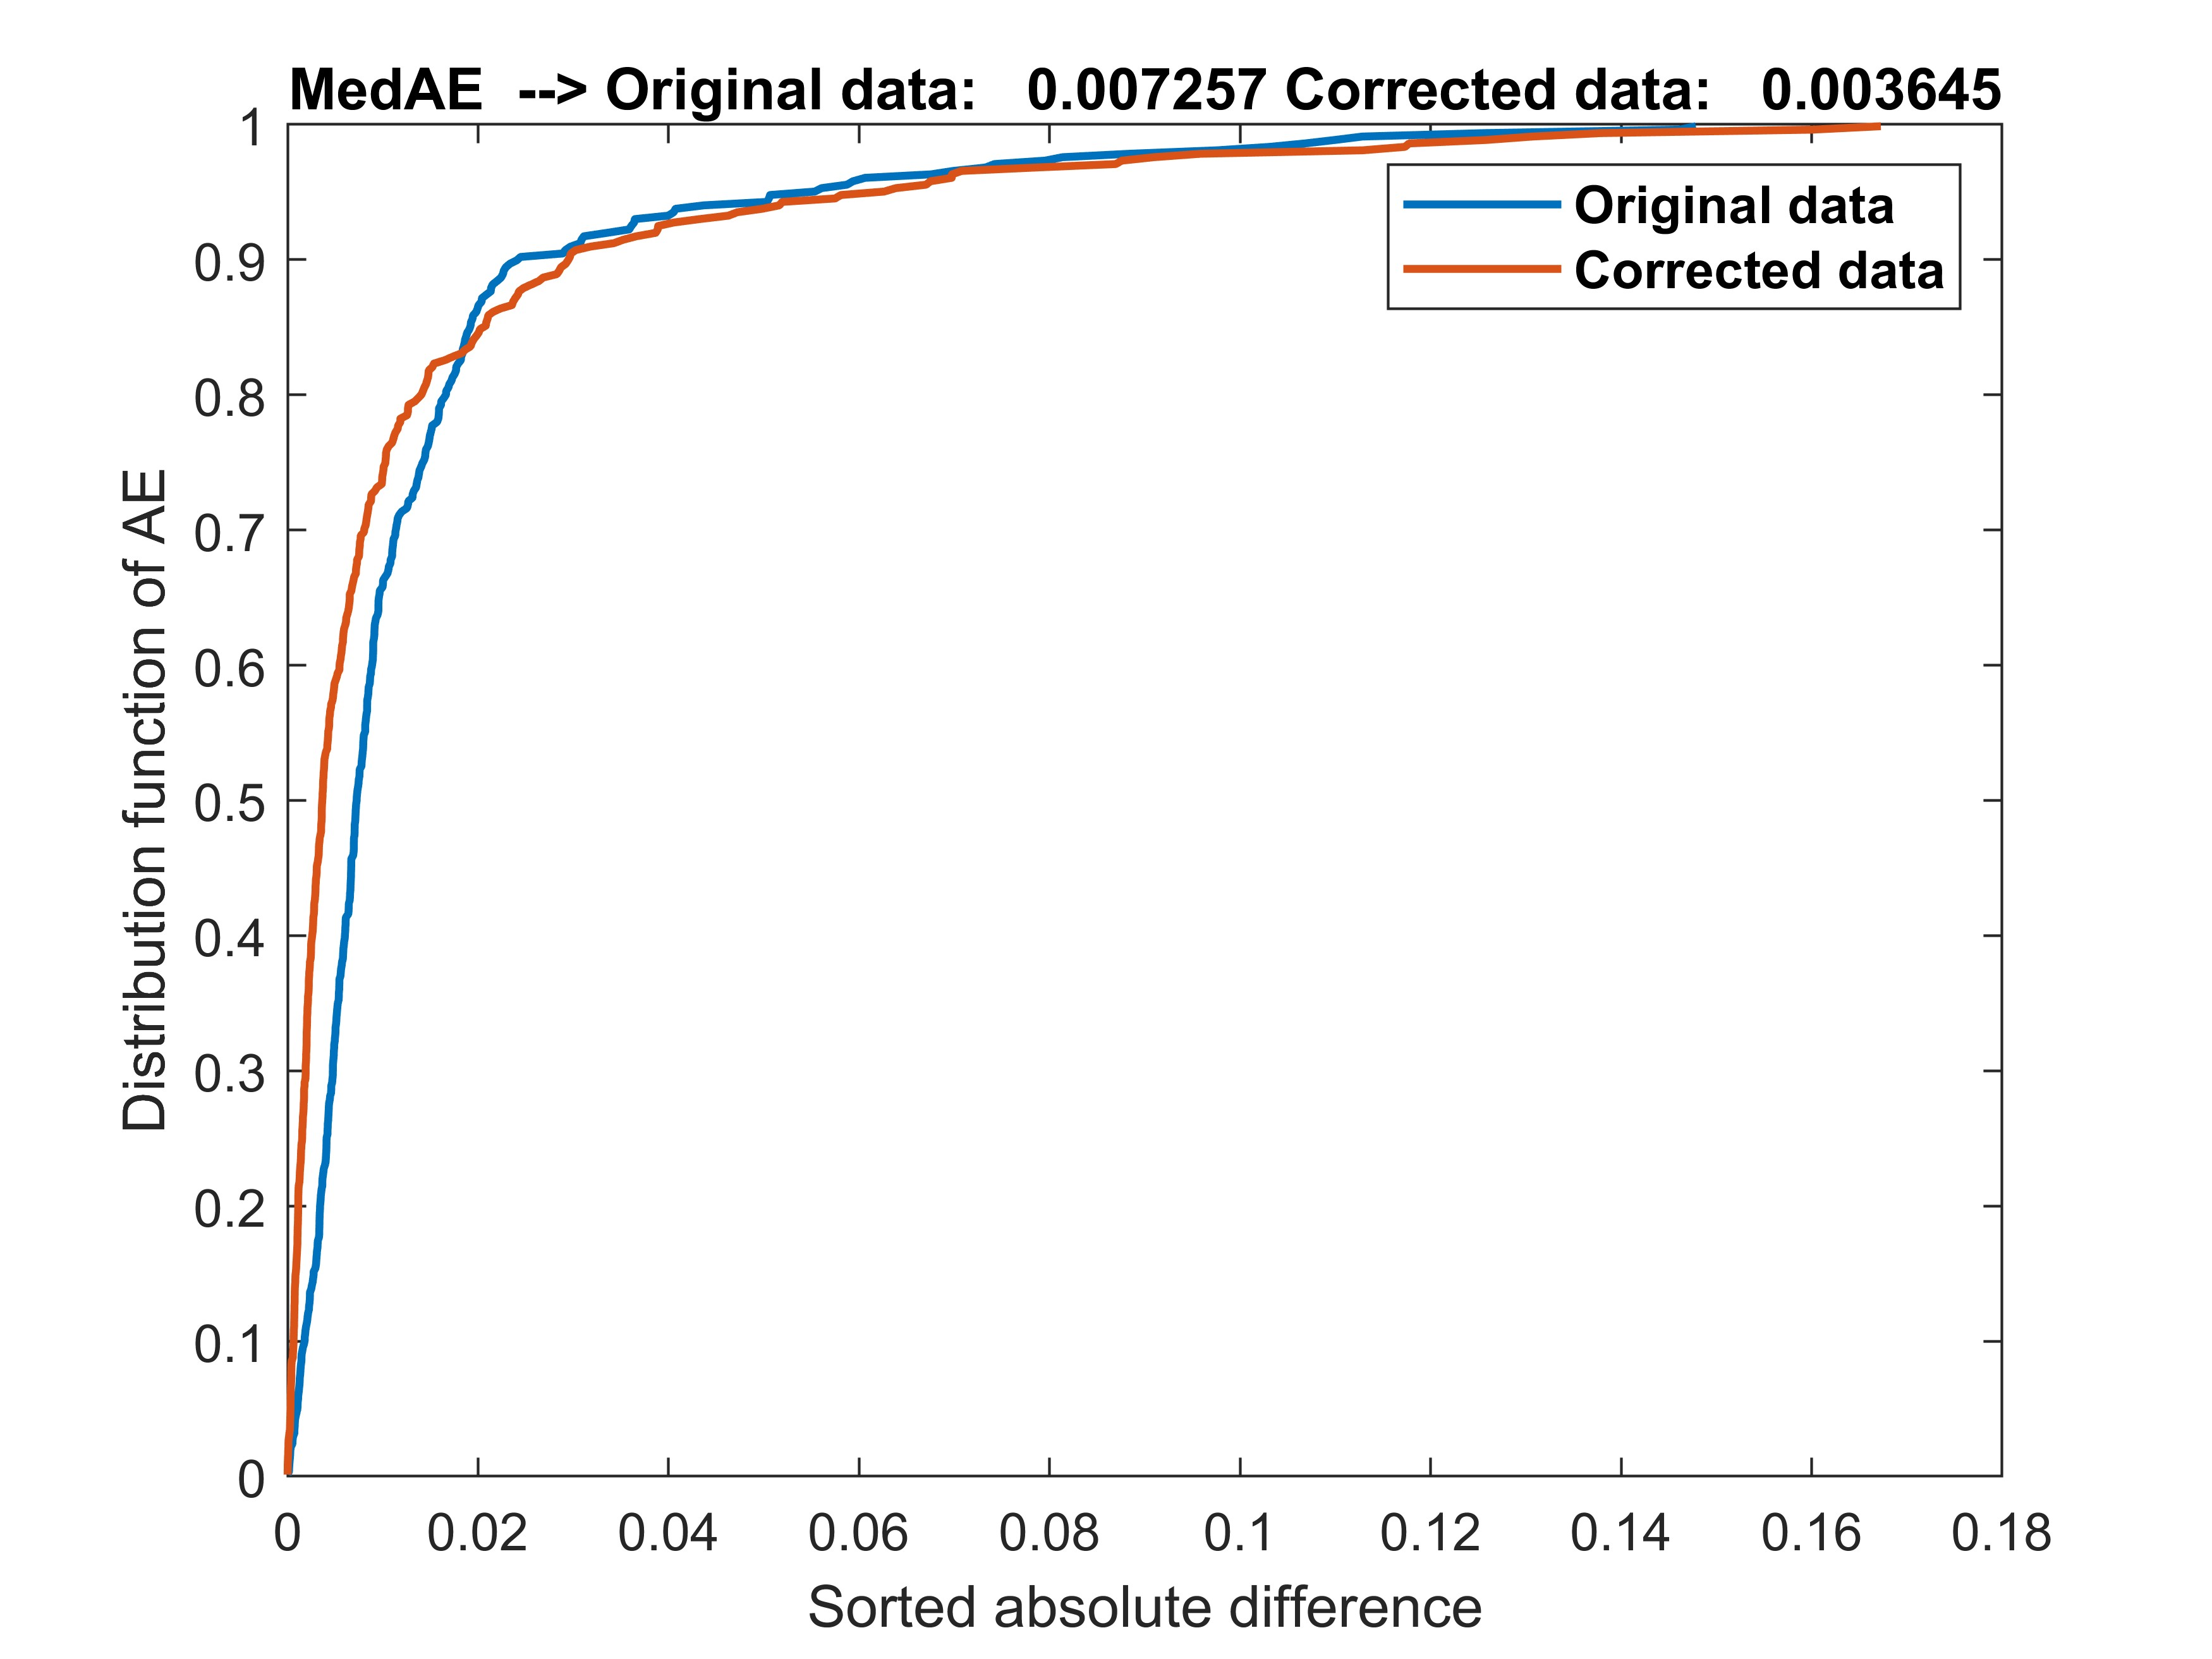
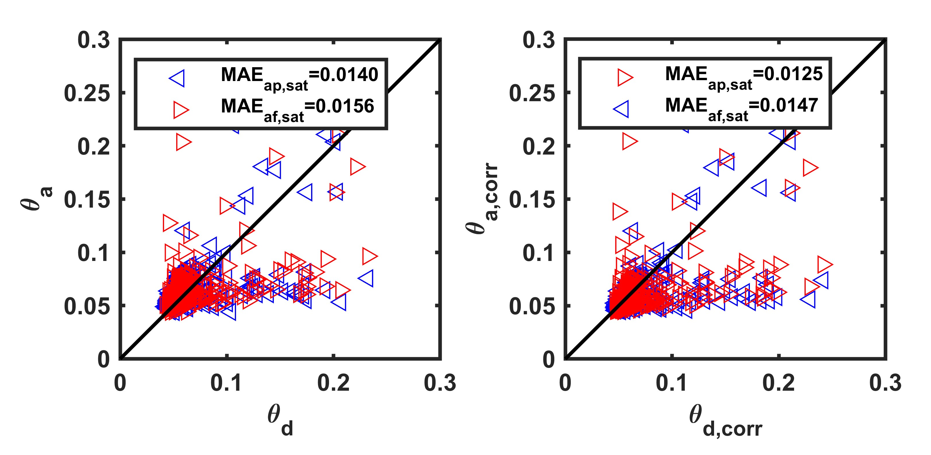
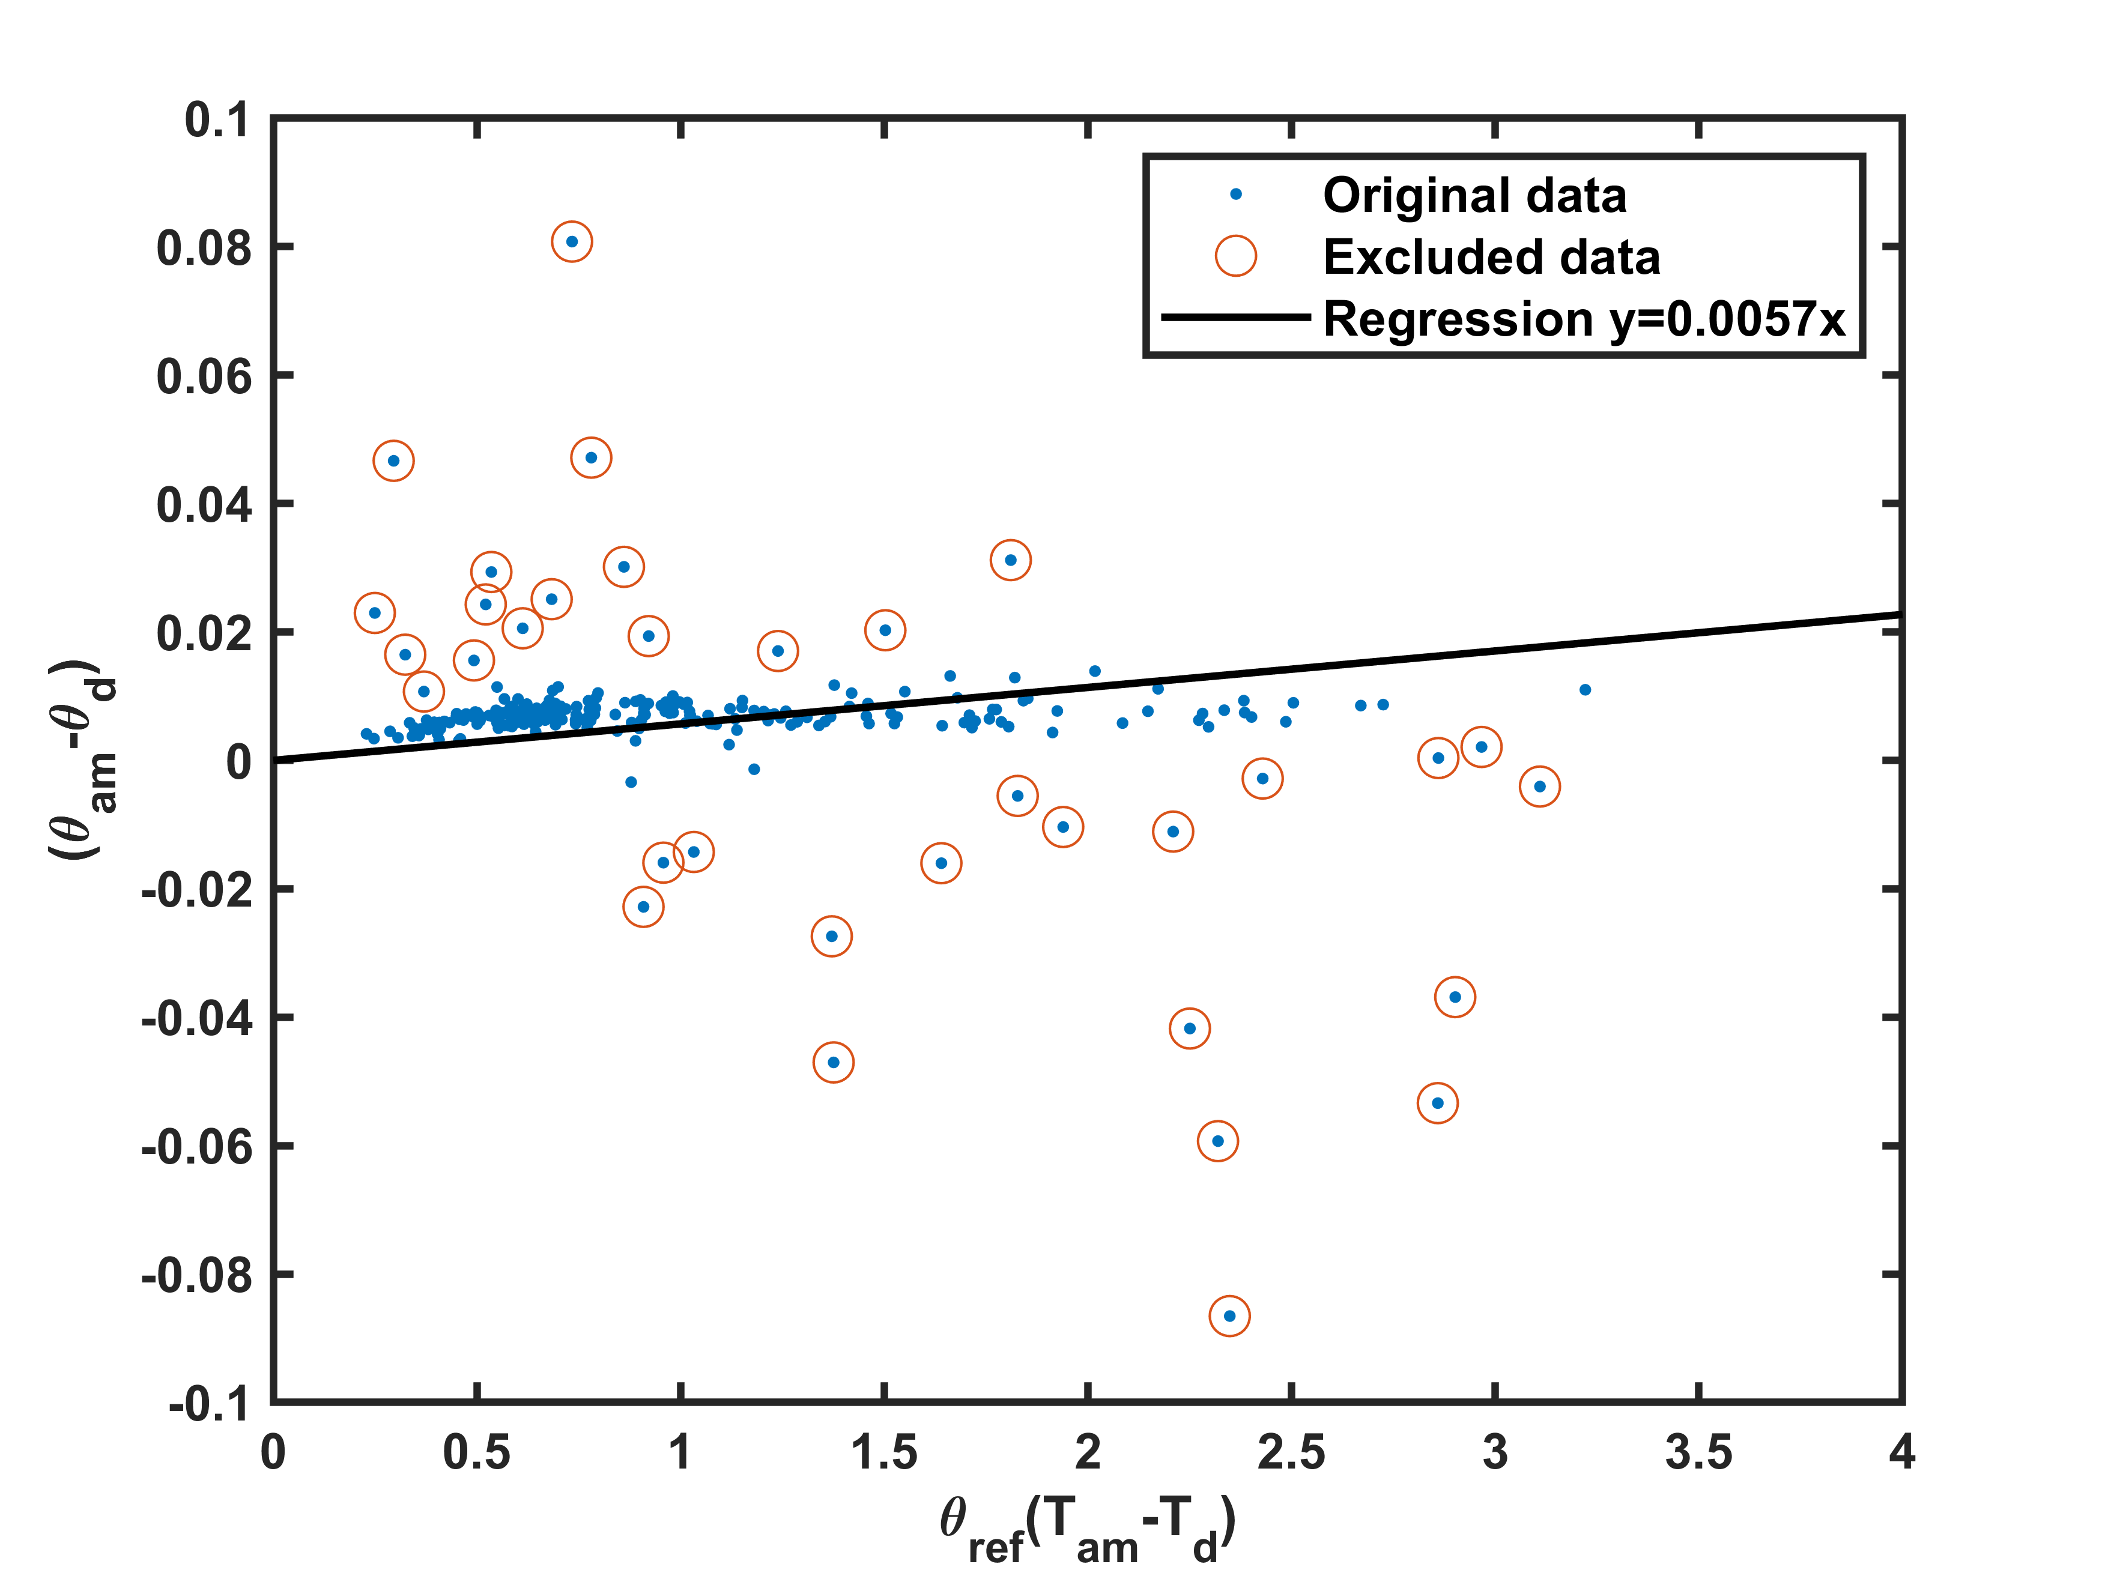
Removing TEs in AMSR2 soil moisture products
Results
  Applying newly developed method to AMSR2 data
    Using AMSR2 SWC and surface temperature to conduct the computing
The distribution of data after applying the regression analysis
Alpha = 0.0057
The changes of the difference between ASC and DES AMSR2 SWC effected by TEs after the correction
Differences between DES and ASC (both previous and following) change after the correction

Slide 17
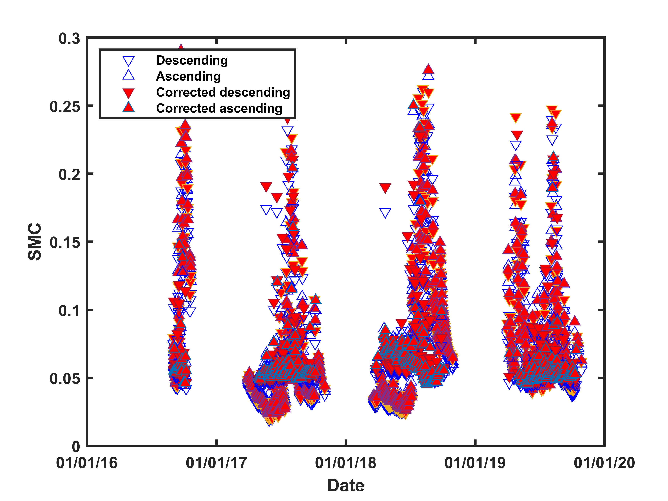
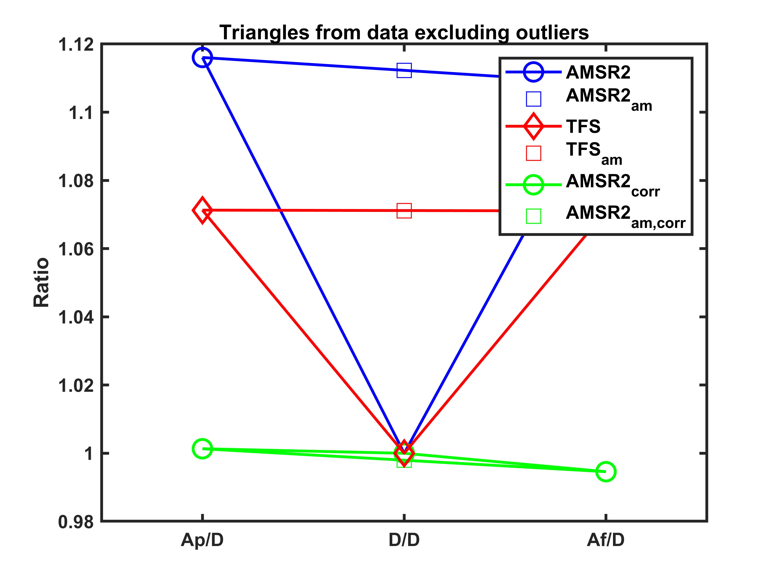
Removing TEs in AMSR2 soil moisture products
Results
  Applying newly developed method to AMSR2 data
AMSR2 SWC data after the correction
The triangle relationship among DES, following ASC and previous ASC data

Slide 18
Removing TEs in AMSR2 soil moisture products
Results
  The assessment matrix
Index | In situ vs. AMSR2 SWC |  |  |  | Corrected in situ vs. corrected AMSR2 SWC |  |  |  | %Changes
 | Ap | D | Af | Am | Ap | D | Af | Am | Ap | D | Af | Am
R | 0.3053 | 0.4809 | 0.3238 | 0.2859 | 0.3475 | 0.4696 | 0.3719 | 0.3288 | 13.82% | -2.35 | 14.85 | 15.01
RMSE | 0.0496 | 0.0486 | 0.0500 | 0.0482 | 0.0478 | 0.0509 | 0.0486 | 0.0465 | -3.63 | 4.73 | -2.8 | -3.53
ubRMSE | 0.0483 | 0.0482 | 0.0485 | 0.0467 | 0.0467 | 0.0506 | 0.0473 | 0.0452 | -3.31 | 4.98 | -2.47 | -3.21
MAE | 0.035 | 0.0335 | 0.0353 | 0.0344 | 0.0336 | 0.0353 | 0.034 | 0.0331 | -4.00 | 5.37 | -3.68 | -3.78
A: Ascending D: Descending p: previous f: following m: mean value
Red color mean increasing Blue color mean decreasing

Slide 19
Contents
Temperature effects (TEs) in soil water content measurements
  The current methods to observe the soil water content
  The existence of TEs in in situ and satellite data
  The experimental facts
The existence of TEs in AMSR2 soil moisture products
Removing TEs in AMSR2 soil moisture products
  Methodology descriptions
  Study area in Mongolia site
  Results
Conclusions

Slide 20
Conclusions
The TEs also exist in AMSR2 satellite soil moisture products → Considering to check for the other satellite products since these effects may be the existence in all satellite data.
The newly developed method can remove TEs from AMSR2 satellite soil moisture products under the case study in Mongolia site → The ASC satellite data can be used after the correction.
The correction method cannot be applied during frozen periods.

Slide 21
Thank you so much for your attention！

Slide 22
Temperature Effects in AMSR2 Soil Moisture Products and
Development of a Removal Method Using Ascending and Descending Data
Minjiao Lu, Kim Oanh Hoang and Agampodi Deva Thisaru Nayanathara Kumarasiri
Nagaoka University of Technology, Japan
Department of Civil and Environmental Engineering, Hydrology Laboratory

