Slide 2
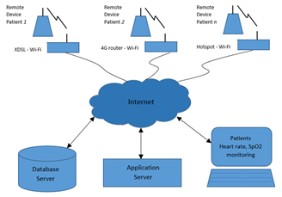
Abstract.
Τhe application of new technologies in telemedicine shows increasing interest aiming at human health. Ιn this work an integrated heart rate and SpO2 monitoring system is presented. A portable device was created with the aim of sending the measurement data, in real time, to a central information system, where the doctor will be able to monitor the measurements related to the patient's health. Low cost components were used for construction, while the entire system is based on open-source software. During the evaluation, the results of the measurements are satisfactory corresponding to the measurements from the commercial instruments that were used.

Slide 3
Introduction
Nowadays, technology has changed the way of peoples’ life
Utilizing technology for health and patient care can achieve faster diagnosis of medical issues.
Focusing on this goal, a simple heart pulse and blood oxygen monitoring device, known as an oximetry, will be the object of this work.
Research groups utilizes a combination of microcontroller and sensors to build an oximetry that sends the data through a Wi-Fi or GPRS.

Slide 4
Introduction
This work presents an integrated system for monitoring both heart rate and blood oxygen (SpO2).
The innovation of the system is based on two parts.
The first one is the measurement system, as it includes a rechargeable battery offering portability and a screen for the immediate visualization of the measurements of heart rate, SpO2 and battery status. Data transmission is conducted through a wireless network.
The second part is the information system, in which the measurements are received, using a database specifically for time-series, as well as in the web-based software for visualizing the measurements on lin.

Slide 5
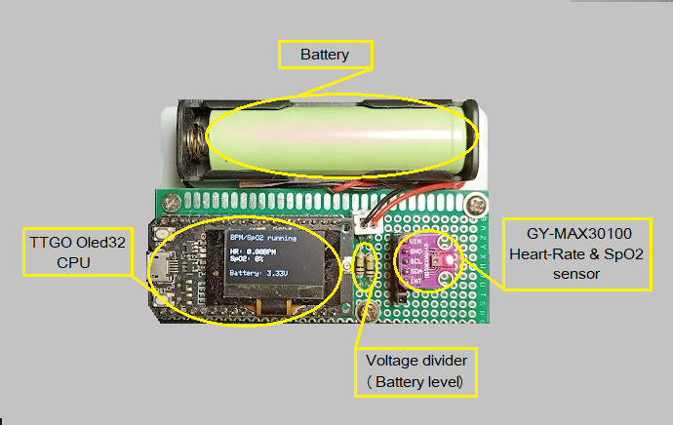
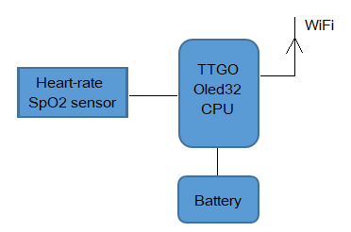
Materials and Methods
Microcontroller is the TTGO@ESP32
SpO2 sensor is the GY-MAX30100
18650 Li-Ion Lithium battery
The implementation diagram of the portable heart-rate and SpO2 device.
Final construction of the portable heart rate and SpO2 device.

Slide 6
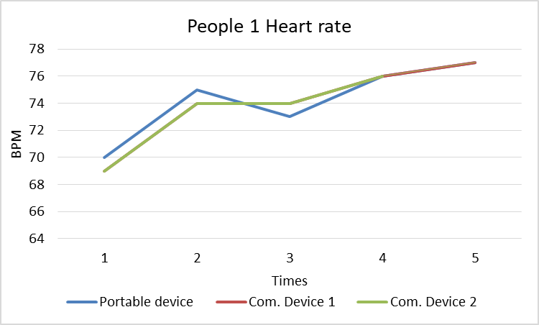
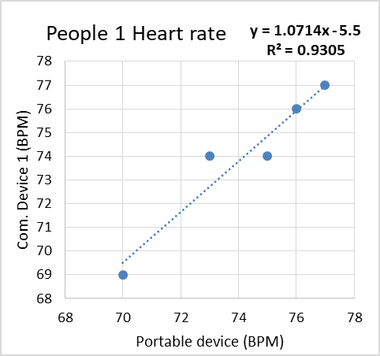
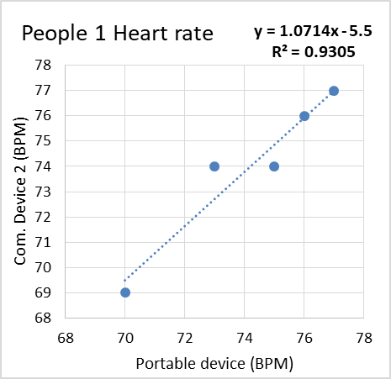
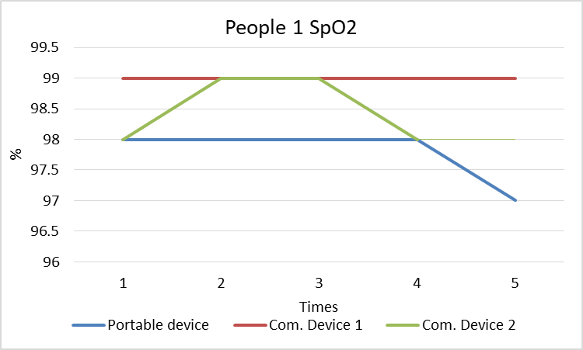
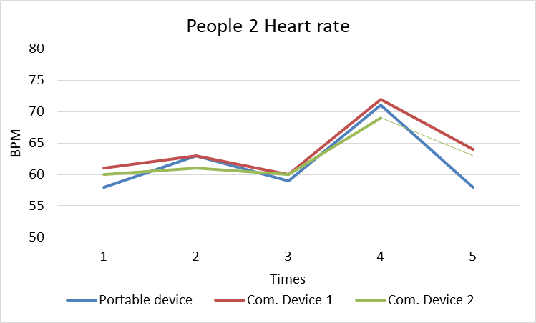
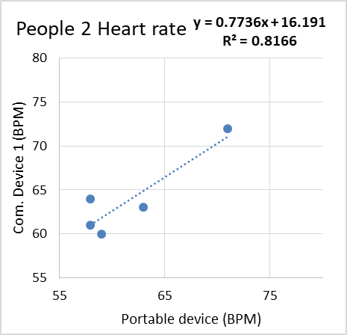
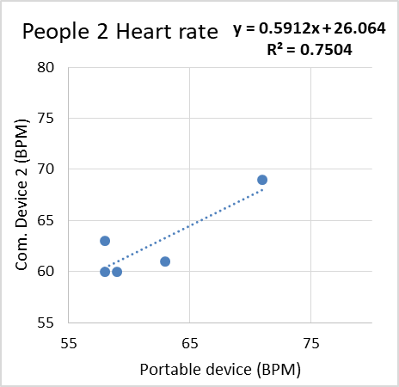
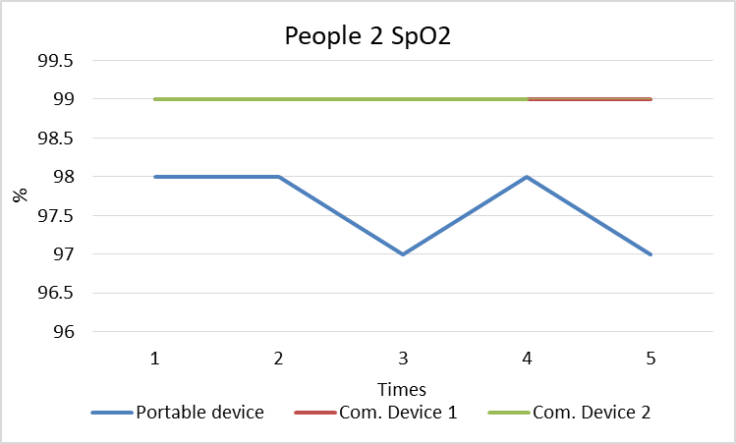
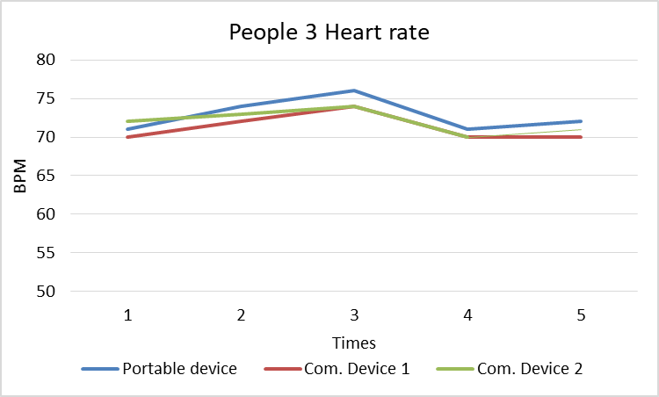
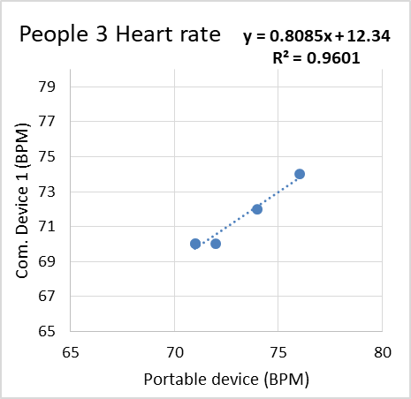
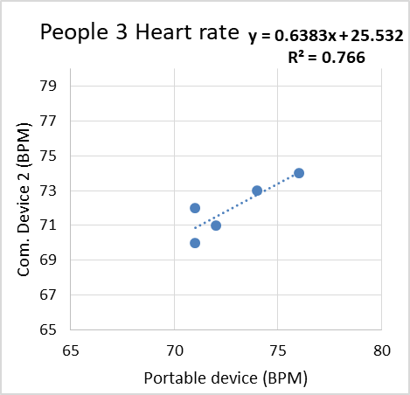
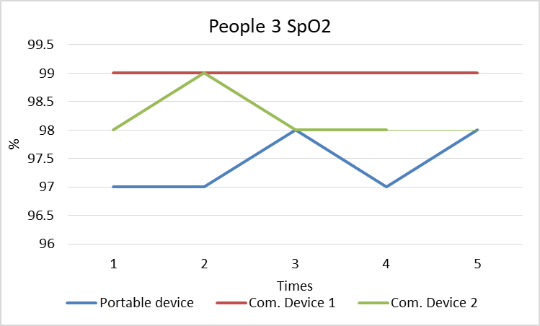
Results

Slide 7
Results
Average values of the measurements and the error of the measurements, between the portable oximetry device and each commercial device.

Slide 8
Visualization interface
Grafana, visualization of the measurements of heart rate and SpO2.

Slide 9
Conclusions
In this work, an integrated, open source, heart rate and SpO2 monitoring system was presented.
The aim of this work is to show the feasibility of implementing accessible arrangements and integrated information systems, related to health.
This application can be beneficial in a critical health situation as referenced to both the hardware and the software provided.
The evaluation of the low-cost heart rate sensor and SpO2 showed satisfactory results in respect to commercial oximeters as the correlation coefficient (R²) ranged from 0.75 to 0.93 and a maximum deviation of 3.4%, while SpO2 showed a sliding deviation of 1.4%.
This information system is based on an open-source software while it consists of an InfluxDB database and a Grafana visualization application.

