Slide 1
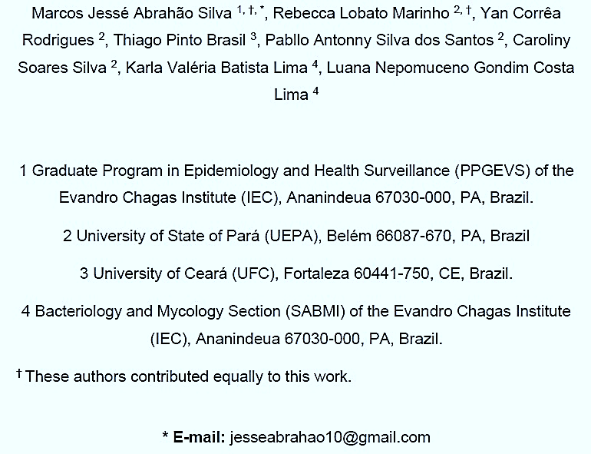
ASSERTION OF A DIDACTIC ILLUSTRATION SCHEME OF THE IMMUNOLOGICAL RELATIONSHIP BETWEEN THE
INDUCTION OF THE CCL5/CCR5 AXIS BY HIV-1 INFECTION AND NEUROAIDS

Slide 2
Neurological Illness in an HIV-positive individual can be result:
host immune response.
HIV interacts with CCR5 or CXCR4, viral co-receptors, after employing CD4+ T cells as the main receptor.
CCR5 orientates chemokines from the C-C class, such as CCL5/RANTES

Slide 3
INTRODUCTION
neuroAIDS
CO-RECEPTOR (CCR5) SIGNALING PATHWAYS
NEUROINFLAMMATION AND INDIRECT NEUROTOXICITY

Slide 4
OBJECTIVE
REVIEW AND BUILD A DIDACTIC MODEL ABOUT THE IMMUNOPATHOLOGICAL RELATIONSHIP BETWEEN THE CCL5/CCR5 AXIS AND NEUROAIDS PROGRESSION.

Slide 5
Our Goals
SYSTEMATIC REVIEW
PRISMA (Preferred Reporting Items for Systematic Reviews and Meta-Analyses) 2020 recommendations;
Articles were selected from the electronic databases PUBMED, MEDLINE, LILACS and SCIELO;
Descriptors together with 'AND’: “HIV-1", “Neurological Manifestations", “CCR5“, “CCL5” and “Immunity".
English, Portuguese or Spanish languages.

Slide 6
METHODOLOGY
Our Goals
DATA COLLECTION AND EXTRACTION
THE DATA EXTRACTED FROM THE ARTICLES WERE: Author and year of publication, database, methodology, and results.
Inclusion criteria: articles published from January 1990 to June 2023.
Exclusion criteria: articles with only the abstract available and with topics not pertinent to the theme.

Slide 7
METHODOLOGY
Our Goals
METHODOLOGICAL QUALITY ASSESSMENT
Joanna Briggs Institute (JBI) critical appraisal checklists.
ILLUSTRATIVE SCHEME CONSTRUCTION
Adobe Photoshop CS6.

Slide 8
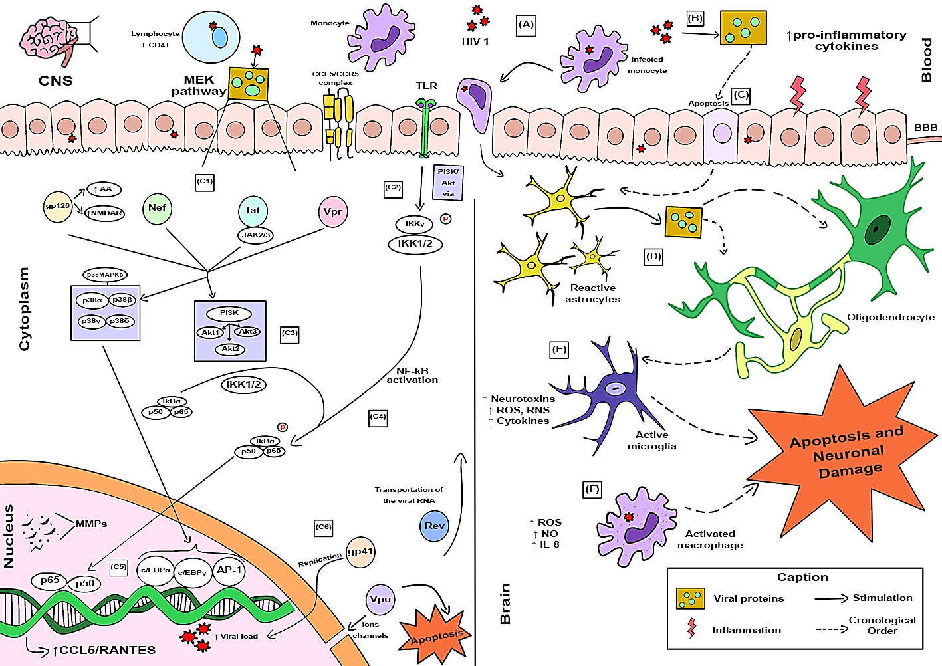
RESULTS
Our Goals
THE SEARCH RESULTED IN 36 ARTICLES.
FIGURE 1 - ILLUSTRATIVE SCHEME OF CCL5/CCR5 AXIS INDUCTION BY HIV-1 INFECTION AND ITS EFFECTS ON CENTRAL NERVOUS SYSTEM (CNS).
Source: Authors (2023).

Slide 10
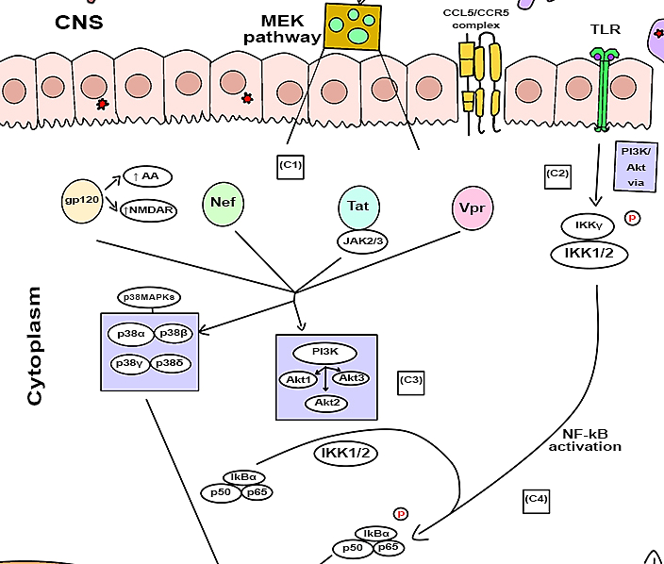

Slide 11
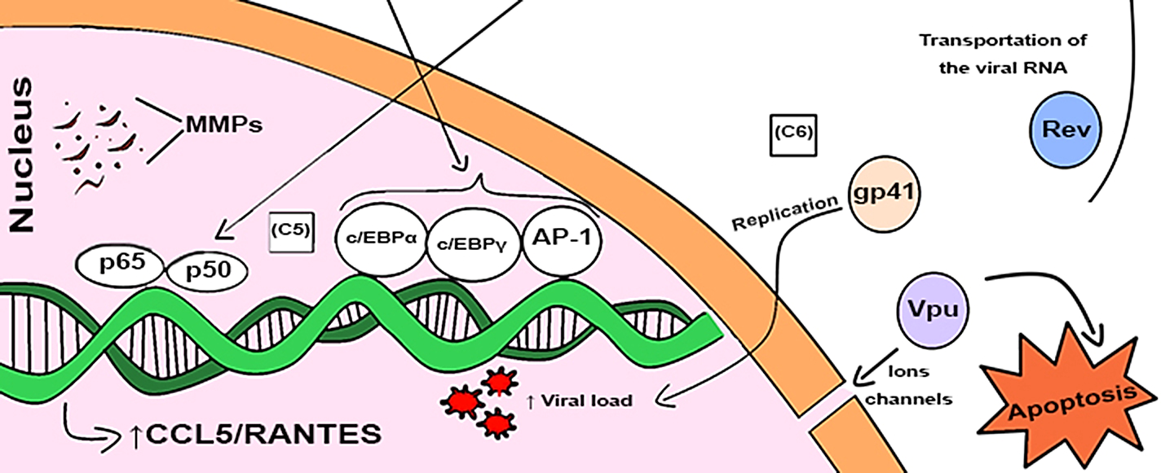

Slide 12
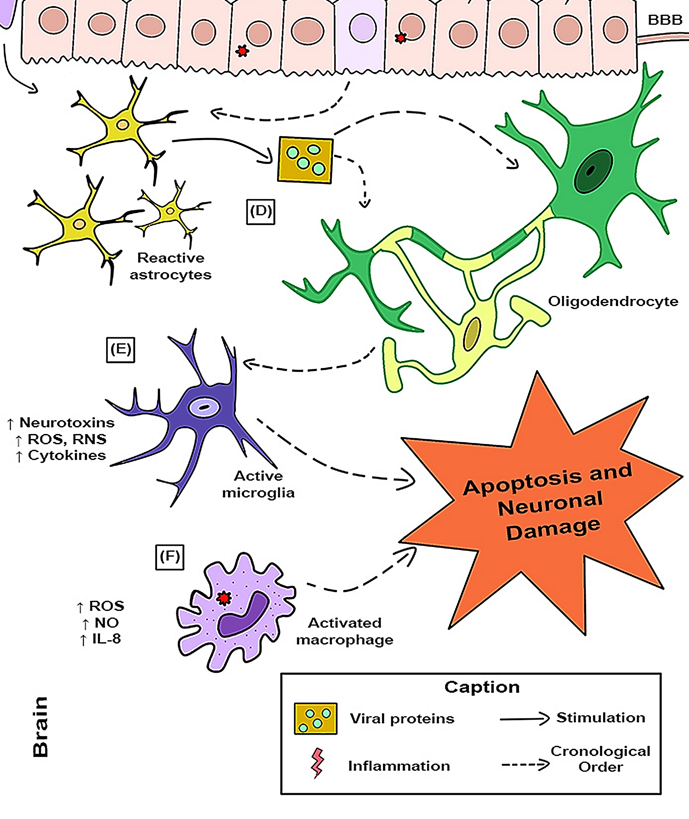

Slide 13
CONCLUSION
Our Goals
HIV IS NEUROVIRULENT, NEUROTROPHIC, AND NEUROINVASIVE.
CCR5 IS THE PRIMARY RECEPTOR FOR HIV-1 ENTRY IN CELLS WHEN COMBINED WITH THE VIRAL GLYCOPROTEIN 120 (gp120).
CO-RECEPTOR SIGNALING MAY ALSO CONTRIBUTE TO ONGOING NEUROINFLAMMATION AND INDIRECT NEUROTOXICITY.
WHEN HIGH CONCENTRATIONS OF CCL5/RANTES ARE PRESENT IN THE BODY OF HIV-1 INFECTED ONES, THERE IS PRODUCTION OF MORE INTENSE INFLAMMATORY RESPONSES, CULMINATING, FOR EXAMPLE, IN DEMENTIA IN THESE PATIENTS.
THE CCR5-CCL5 IMMUNE AXIS CONTRIBUTE TO THE NEUROAIDS PROGRESSION.

Slide 14
REERENCES
Our Goals
Liu, X.; Shah, A.; Gangwani, M.R.; Silverstein, P.S.; Fu, M.; Kumar, A. HIV-1 Nef Induces CCL5 Production in Astrocytes through P38-MAPK and PI3K/Akt Pathway and Utilizes NF-KB, CEBP and AP-1 Transcription Factors. Sci Rep 2014, 4, 4450, doi:10.1038/srep04450.
Ma, M.; Nath, A. Molecular Determinants for Cellular Uptake of Tat Protein of Human Immunodeficiency Virus Type 1 in Brain Cells. J Virol 1997, 71, 2495–2499.
Rojas-Celis, V.; Valiente-Echeverría, F.; Soto-Rifo, R.; Toro-Ascuy, D. New Challenges of HIV-1 Infection: How HIV-1 Attacks 34 and Resides in the Central Nervous System. Cells 2019, 8, 1245, doi:10.3390/cells8101245.
Shah, A.; Singh, D.P.; Buch, S.; Kumar, A. HIV-1 Envelope Protein Gp120 up Regulates CCL5 Production in Astrocytes Which Can Be Circumvented by Inhibitors of NF-ΚB Pathway. Biochemical and Biophysical Research Communications 2011, 414, 112–117, doi:10.1016/j.bbrc.2011.09.033.
Si, Q.; Kim, M.-O.; Zhao, M.-L.; Landau, N.R.; Goldstein, H.; Lee, S.C. Vpr- and Nef-Dependent Induction of RANTES/CCL5 in Microglial Cells. Virology 2002, 301, 342–353, doi:10.1006/viro.2002.1613.

