Slide 1
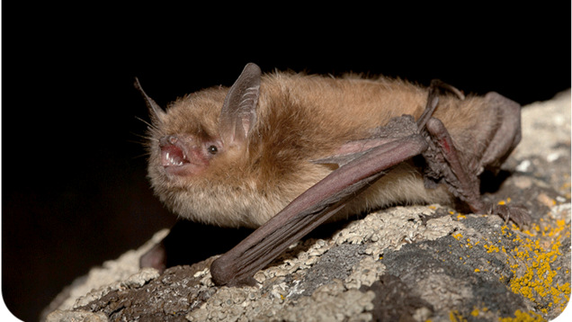
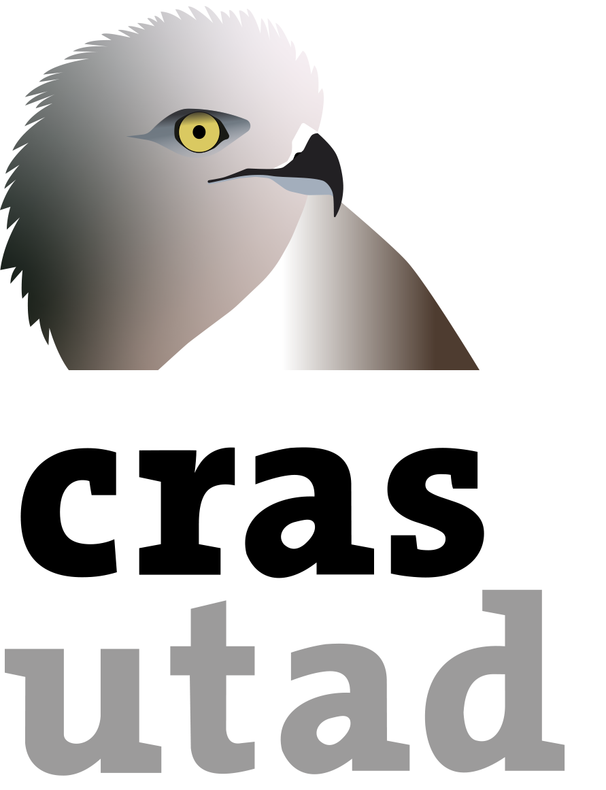
Pseudogymnoascus destructans as the agent of white-nose syndrome (WNS) in bat populations
Andreia Garcês^{1,2}, Isabel Pires³
¹Exotic and wildlife Service (CRAS) from Unvicersity of Tras-os-Montes and Alto Douro
²CITAB, University of Trás-os-Montes and Alto Douro, Vila Real, Portugal
³CECAV, University of Trás-os-Montes and Alto Douro, Vila Real, Portugal
*andreiamvg@gmail.com

Slide 2
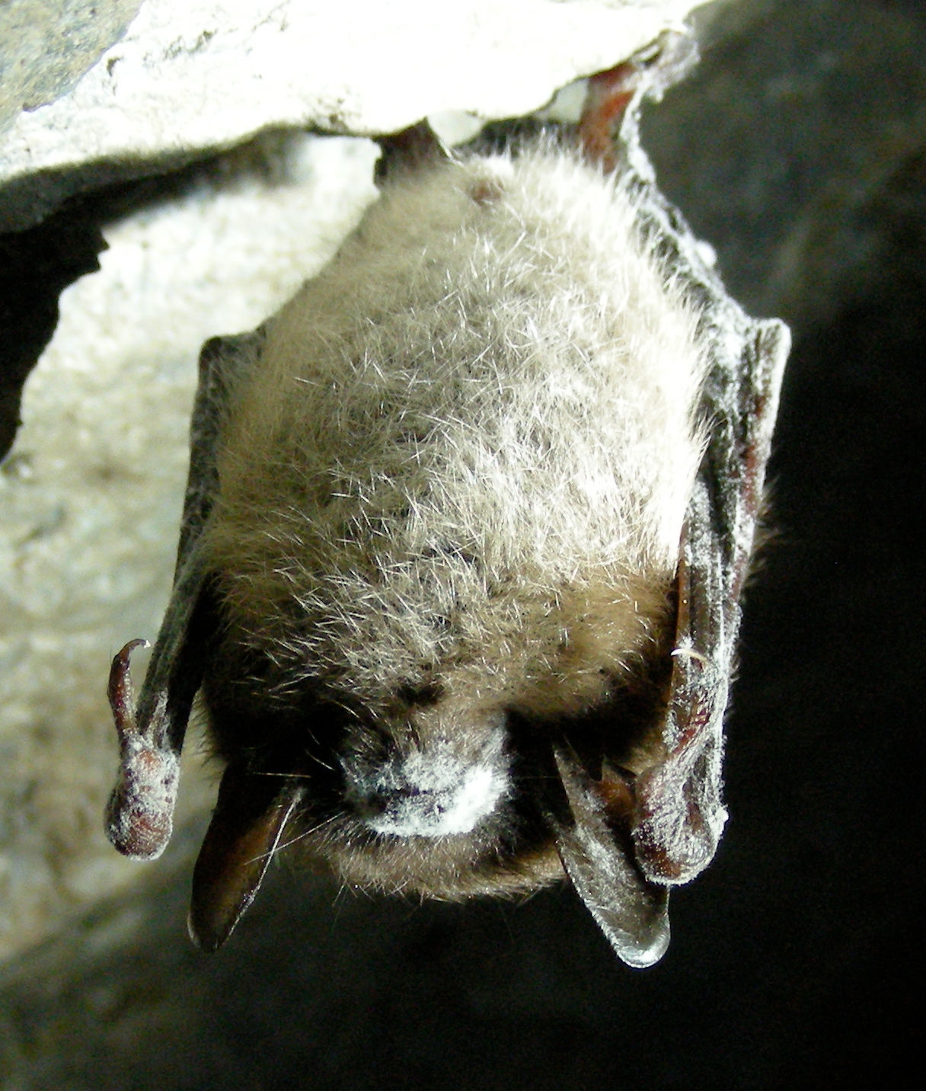
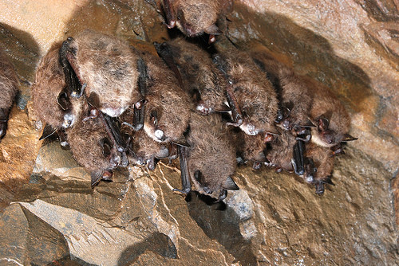
Introduction
Pseudogymnoascus destructans (formerly known as Geomyces destructans) is a psychrophilic fungus that is the etiologic agent of white-nose syndrome (WNS) in bats. A fatal fungal disease that has devastated bat populations in North Hemisphere, particularly in North America.
The first report of P. destructans (WNS) was in North America in a photograph of a hibernating bat taken in the winter of 2005-2006 in a hibernaculum near Albany, New York (USA). In New York, the specie affected was little brown bats (Myotis lucifugus) were the first to be infected and had the higher mortality, resulting in population declines of 90-100% in caves.

Slide 3
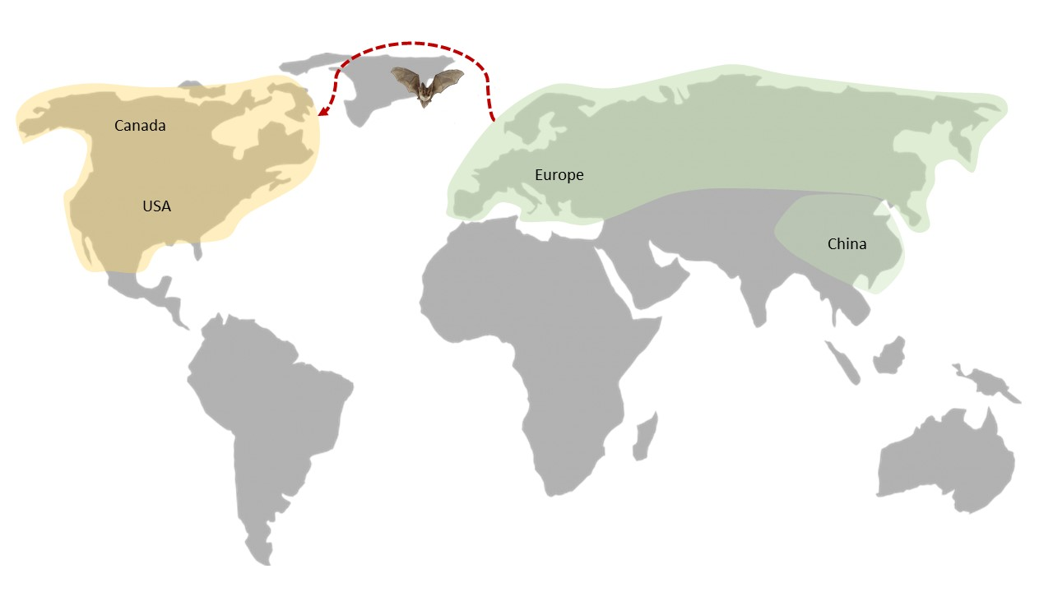
Distribution and dispersion
It is hypothesized that these fungi have been introduced to North America from Europe or Asia where are native. The route of introduction is still unknown, but the subsequent spread throughout North America probably occurred due to the natural movement of bats, contact with contaminated substrates and human clothing/equipment (particularly cave equipment) and host and vector organisms (pathway vector).
Figure 1. Distribution of P. destructans. (Yellow – Invasive, Green – Native).

Slide 4
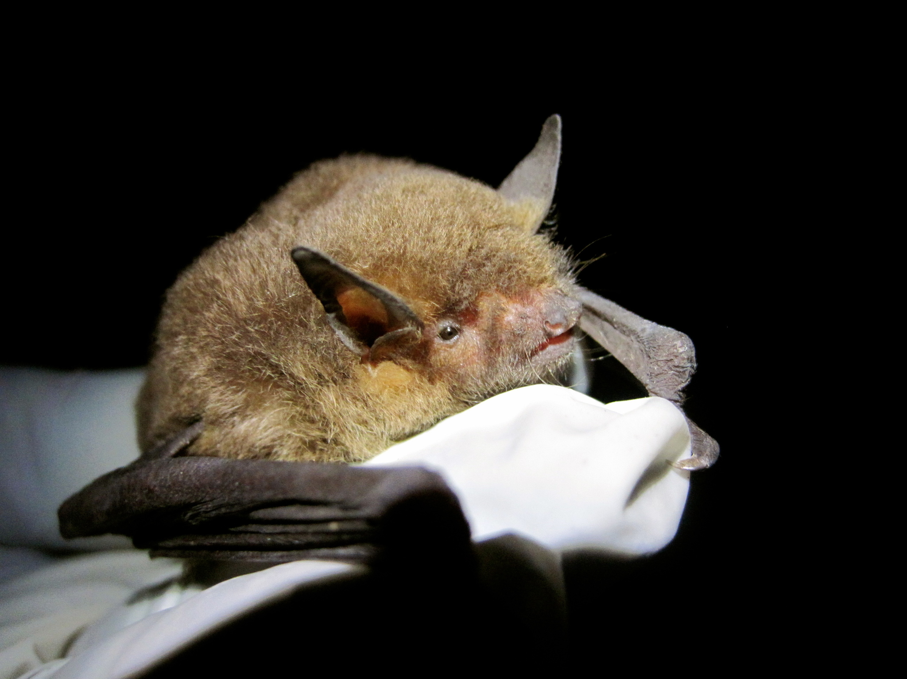
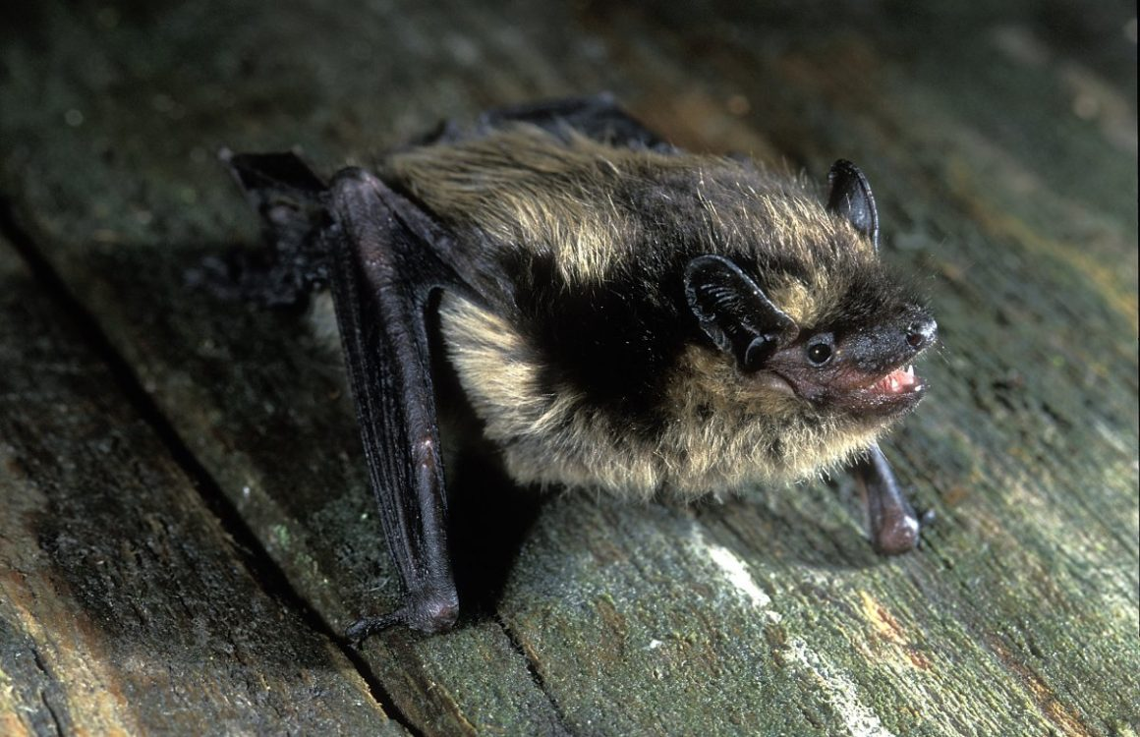
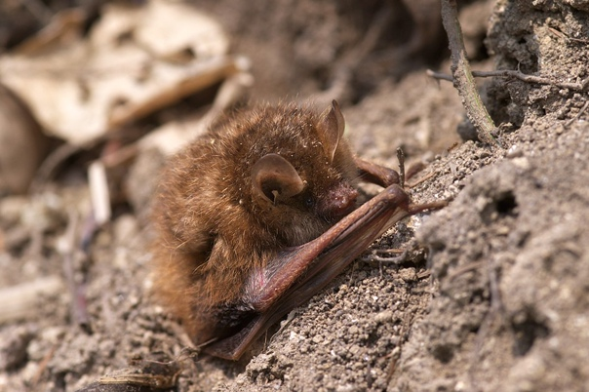
Affected species
North America: Myotis sodalist, Myotis grisescens, Myotis lucifugus, Myotis septentrionalis, Eptesicus fuscus, Perimyotis subflavus, Myotis leibii, Corynorhinus townsendii virginianus, Myotis velifer, Lasionycteris noctivagans, Myotis austroriparius.
Europe: Myotis bechsteinii, Myotis blythii oxygnathus, Myotis dasycneme, Myotis daubentoniid, Myotis myotis, Myotis mystacinus, Myotis emarginatu, Eptesicus nilssonii, Rhinolophus hipposideros, Barbastella barbastellus, Plecotus auratus.
Asia: Rhinolophus ferrumequinum, (Rhinolophus pusillus, Myotis adversus, Myotis macrodactylus, Myotis pilosus, Myotis chinensis, Murina usseriensis, Murina leucogaster, Myotis petax.

Slide 5
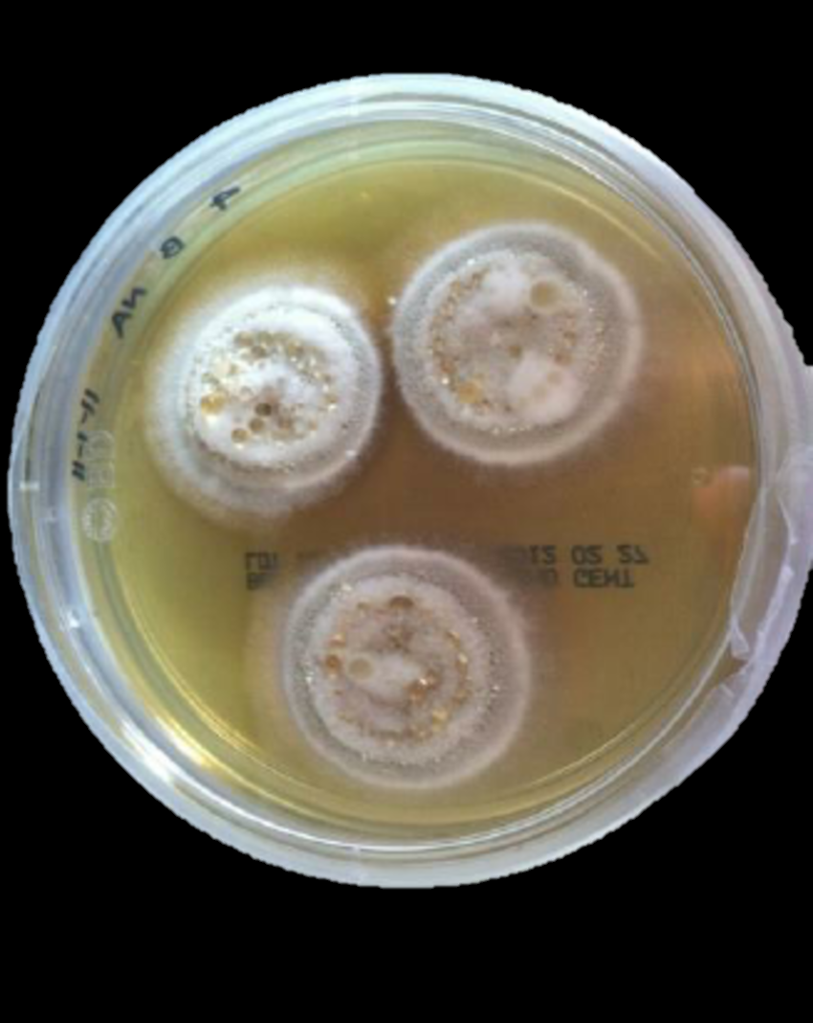
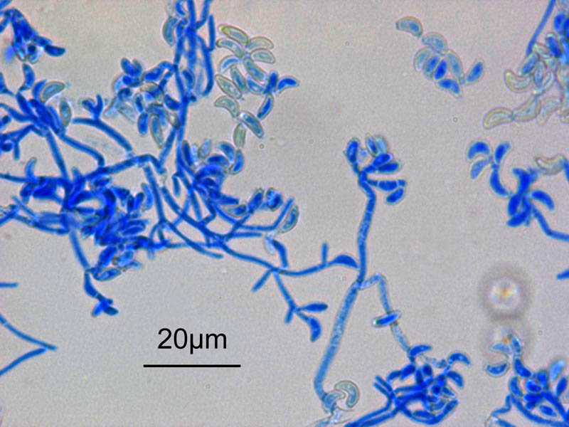
Pathogen Characteristics
It is psychrophilic fungi that grow at temperatures around 4 °C to 20 °C (the same temperatures that can be found in winter bat hibernacula). It belongs to the genus Pseudogymnoascus, family Pseudeurotiaceae.
In laboratory is incubated at 5 to 15°C for 16 days. Colonies have a 1.0 mm diameter and are white marginally with grey to green powdery centres. The reverse side is uncoloured on cornmeal agar or brown in Sabouraud dextrose agar. Microscopically has moderately thick-walled, curved conidia and erect, hyaline, smooth, narrow and thin-walled conidiophores. Some virulence factors have also been identified in P. destructans that may contribute to skin invasion.
https://www.cabidigitallibrary.org/doi/10.1079/cabicompendium.119002

Slide 6
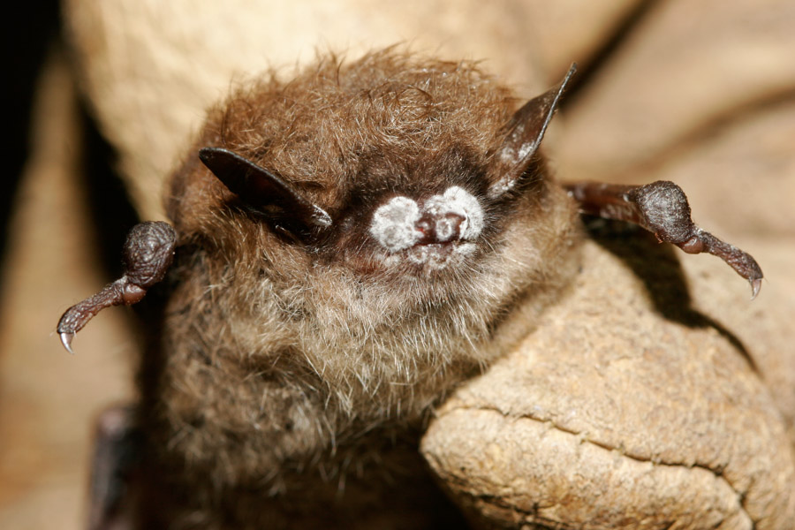
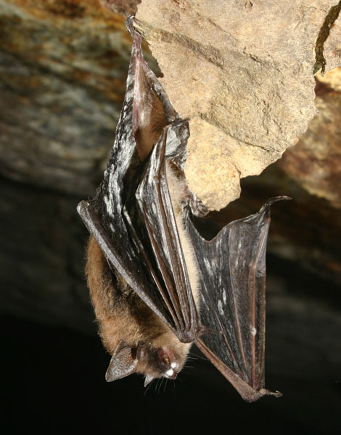
Clinical presentation
This fungi almost exclusively affects hibernating bats.
Gross clinical signals are fungal growth with 1 to 3 mm diameter, multifocal to coalescing white foci with a pinpoint black centre on the ears, ears, and wing membranes of hibernating bats. In the wings is also possible to observe areas of depigmentation, splitting, and dryness of the patagia. The animals infected also present behaviours alterations such as premature emergence from hibernation during the winter period.
Other systemic alterations that can be present are increasing evaporative water loss through the damaged skin, hypovolemia, hyperkalemia, acidosis, and hypotonic dehydration.
https://www.cabidigitallibrary.org/doi/10.1079/cabicompendium.119002

Slide 7
Impacts of Pseudogymnoascus destructans
Social impacts
Some insectivorous bat species consume large quantities of mosquitoes each night, many carriers of many diseases that can affect humans. With the decline of bats there is a reduction in the elimination of these vectors and a higher risk for transmission of vector-borne diseases
Environmental impact
Populations that have been affected by P. destructans have a slow recovery due to already low annual fecundity (one juvenile a year) and other causes of mortality such as wind-turbine collisions. Some may never recover to the number before the infection. The alteration in bat populations can lead to alterations at the trophic level, damaged ecosystem services, negative impacts on agriculture, forestry, human and animal health and reduction of native biodiversity and threatened species.
Economic impacts
Insectivorous bats offer pest control services, by consuming insects that damage crops and forests, or vectors that carry diseases. Bat species also are important pollinators and dispersers of seeds in tropical and subtropical regions. These services save farmers millions of dollars every year. The mortality of bats due to these fungi is estimated to reduce these valuable and irreplaceable ecosystem services.

Slide 8
Conclusions
P. destructans has an enormous impact on the bat population, especially in North America, with so high levels of mortality that previously common bat species have become almost extinct.
There is limited understanding of both fungal pathogens and wildlife hosts, since fungal species, in general, are very poorly investigated compared to other taxa of pathogens. Antifungal medications existing are limited and those in use often have considerable side effects on the animals, and anti-fungal vaccines at still not available. There is also inadequate knowledge about the immunology, physiology, and ecology of P. destructans on the multiple species of bats infected. This has led to many challenges in the control and prevention of this disease.
Efforts to attend to this devastating disease have already been made, but in the future, more research and development of new drugs will be necessary to combat this disease.

Slide 9
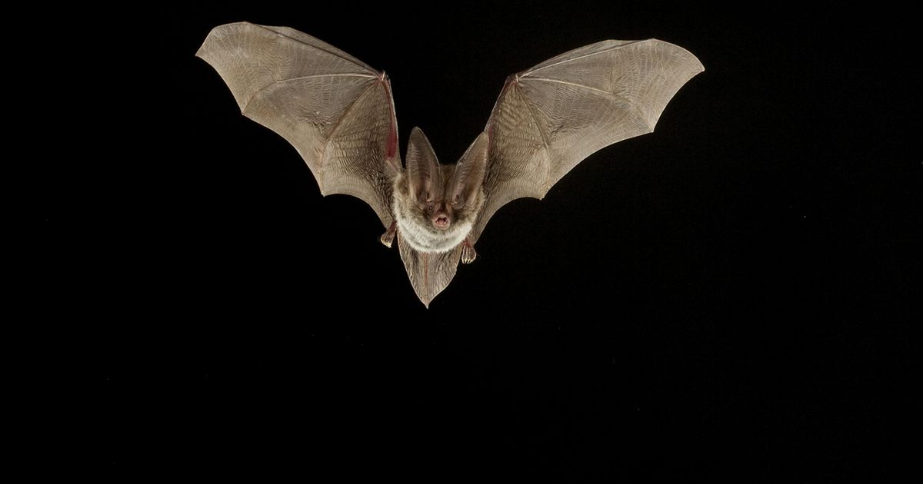
References
1. Lorch, J.M.; Meteyer, C.U.; Behr, M.J.; Boyles, J.G.; Cryan, P.M.; Hicks, A.C.; Ballmann, A.E.; Coleman, J.T.H.; Redell, D.N.; Reeder, D.M.; et al. Experimental Infection of Bats with Geomyces Destructans Causes White-Nose Syndrome. Nature 2011, 480, 376–378, doi:10.1038/nature10590.
2. Gargas, A.; Trest, M.; Christensen, M.; Volk, T.; Blehert, D. Geomyces Destructans Sp. Nov. Associated with Bat White-Nose Syndrome. Mycotaxon 209AD, 108, 147-154(8), doi:https://doi.org/10.5248/108.147.
3. Lindner, D.L.; Gargas, A.; Lorch, J.M.; Banik, M.T.; Glaeser, J.; Kunz, T.H.; Blehert, D.S. DNA-Based Detection of the Fungal Pathogen Geomyces Destructans in Soils from Bat Hibernacula. Mycologia 2011, 103, 241–246, doi:10.3852/10-262.
4. White-Nose Syndrome Available online: https://www.whitenosesyndrome.org/where-is-wns (accessed on 4 July 2023).
5. Blehert, D.S.; Hicks, A.C.; Behr, M.; Meteyer, C.U.; Berlowski-Zier, B.M.; Buckles, E.L.; Coleman, J.T.H.; Darling, S.R.; Gargas, A.; Niver, R.; et al. Bat White-Nose Syndrome: An Emerging Fungal Pathogen? Science 2009, 323, 227, doi:10.1126/science.1163874.
6. Minnis, A.M.; Lindner, D.L. Phylogenetic Evaluation of Geomyces and Allies Reveals No Close Relatives of Pseudogymnoascus Destructans, Comb. Nov., in Bat Hibernacula of Eastern North America. Fungal Biol 2013, 117, 638–649, doi:10.1016/j.funbio.2013.07.001.
7. Meteyer, C.U.; Verant, M.L. 72 - White-Nose Syndrome: Cutaneous Invasive Ascomycosis in Hibernating Bats. In Fowler’s Zoo and Wild Animal Medicine Current Therapy, Volume 9; Miller, R.E., Lamberski, N., Calle, P.P., Eds.; W.B. Saunders, 2019; pp. 508–513 ISBN 978-0-323-55228-8.
8. Johnson, J.R. Virulence Factors in Escherichia Coli Urinary Tract Infection. CLIN. MICROBIOL. REV. 1991, 4, 49.
9. Puechmaille, S.J.; Wibbelt, G.; Korn, V.; Fuller, H.; Forget, F.; Mühldorfer, K.; Kurth, A.; Bogdanowicz, W.; Borel, C.; Bosch, T.; et al. Pan-European Distribution of White-Nose Syndrome Fungus (Geomyces Destructans) Not Associated with Mass Mortality. PLOS ONE 2011, 6, e19167, doi:10.1371/journal.pone.0019167.
10. Igor, P.; Đaković, M. Identification of Four Plecotus Species (Chiroptera, Vespertilionidae) in Croatia Based on Cranial Characters. Mammalia 2015, 80, doi:10.1515/mammalia-2014-0031.
11. Pikula, J.; Bandouchova, H.; Novotny, L.; Meteyer, C.U.; Zukal, J.; Irwin, N.R.; Zima, J.; Martínková, N. Histopathology Confirms White-Nose Syndrome in Bats in Europe. J Wildl Dis 2012, 48, 207–211, doi:10.7589/0090-3558-48.1.207.
12. Puechmaille, S.J.; Frick, W.F.; Kunz, T.H.; Racey, P.A.; Voigt, C.C.; Wibbelt, G.; Teeling, E.C. White-Nose Syndrome: Is This Emerging Disease a Threat to European Bats? Trends Ecol Evol 2011, 26, 570–576, doi:10.1016/j.tree.2011.06.013.
13. Puechmaille, S.J.; Verdeyroux, P.; Fuller, H.; Gouilh, M.A.; Bekaert, M.; Teeling, E.C. White-Nose Syndrome Fungus ( Geomyces Destructans ) in Bat, France. Emerg. Infect. Dis. 2010, 16, 290–293, doi:10.3201/eid1602.091391.
14. Wibbelt, G.; Kurth, A.; Hellmann, D.; Weishaar, M.; Barlow, A.; Veith, M.; Prüger, J.; Görföl, T.; Grosche, L.; Bontadina, F.; et al. White-Nose Syndrome Fungus (Geomyces Destructans) in Bats, Europe. Emerg Infect Dis 2010, 16, 1237–1243, doi:10.3201/eid1608.100002.
15. Zukal, J.; Bandouchova, H.; Brichta, J.; Cmokova, A.; Jaron, K.S.; Kolarik, M.; Kovacova, V.; Kubátová, A.; Nováková, A.; Orlov, O.; et al. White-Nose Syndrome without Borders: Pseudogymnoascus Destructans Infection Tolerated in Europe and Palearctic Asia but Not in North America. Sci Rep 2016, 6, 19829, doi:10.1038/srep19829.
16. Leopardi, S.; Blake, D.; Puechmaille, S.J. White-Nose Syndrome Fungus Introduced from Europe to North America. Curr Biol 2015, 25, R217–R219, doi:10.1016/j.cub.2015.01.047.
17. Paiva-Cardoso, M.D.N.; Morinha, F.; Barros, P.; Vale-Gonçalves, H.; Coelho, A.C.; Fernandes, L.; Travassos, P.; Press: United States, 2006; ISBN 0-226-46207-2.
Blehert, D.; Lankau, E. Pseudogymnoascus Destructans (White-Nose Syndrome Fungus). CABI Compendium 2017, CABI Compendium, 119002, doi:10.1079/cabicompendium.119002

