Slide 1
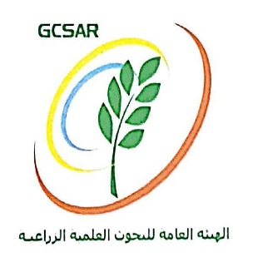
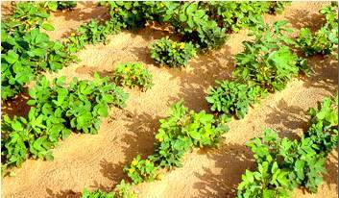
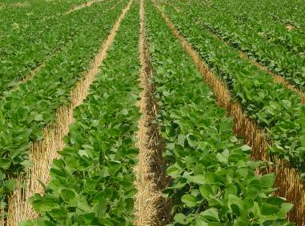
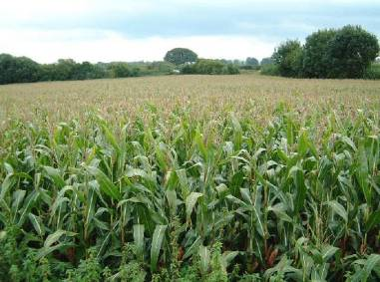
Studying correlation between precipitation and NDVI/MODIS for Time Series (2012 - 2022) in arid region in Syria
Dr.Rukea Al-hasn
General Commission for Scientific Agricultural Research (GCSAR)

Slide 2
Introduction
Many difficult climatic factors have dominated the Middle East region recently, most notably drought, Syria in particular is considered one of the most economically sensitive regions to drought. Which negatively affected agricultural areas and their productivity, which led to the exit of a large portion of agricultural areas from the production process, especially rain-fed agriculture.
Low rainfall negatively affects the agricultural and livestock sectors, requiring limited quantitative and qualitative use of available water. The sensitivity to drought is also increasing in the eastern region of Syria as a result of the growing population and the subsequent increase in demand for water resources and the deterioration of natural pastures.
On the other hand; Remote sensing technologies play a major role in the agricultural and climatic fields, such as monitoring climate changes, the growth of agricultural crops, and studying different patterns of drought, which has prompted an attempt to employ this data in the drought monitoring process.

Slide 3
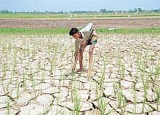
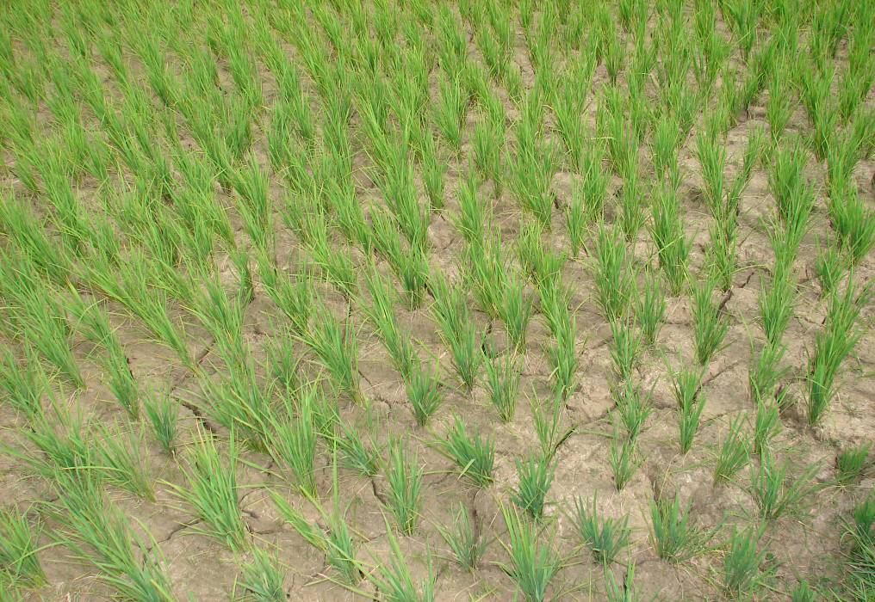
Objectives of the study
This study aimed to evaluate the relationship between rainfall amounts and changes in vegetation areas in conditions of arid and semi-arid regions represented by Deir ez-Zor Governorate.

Slide 4
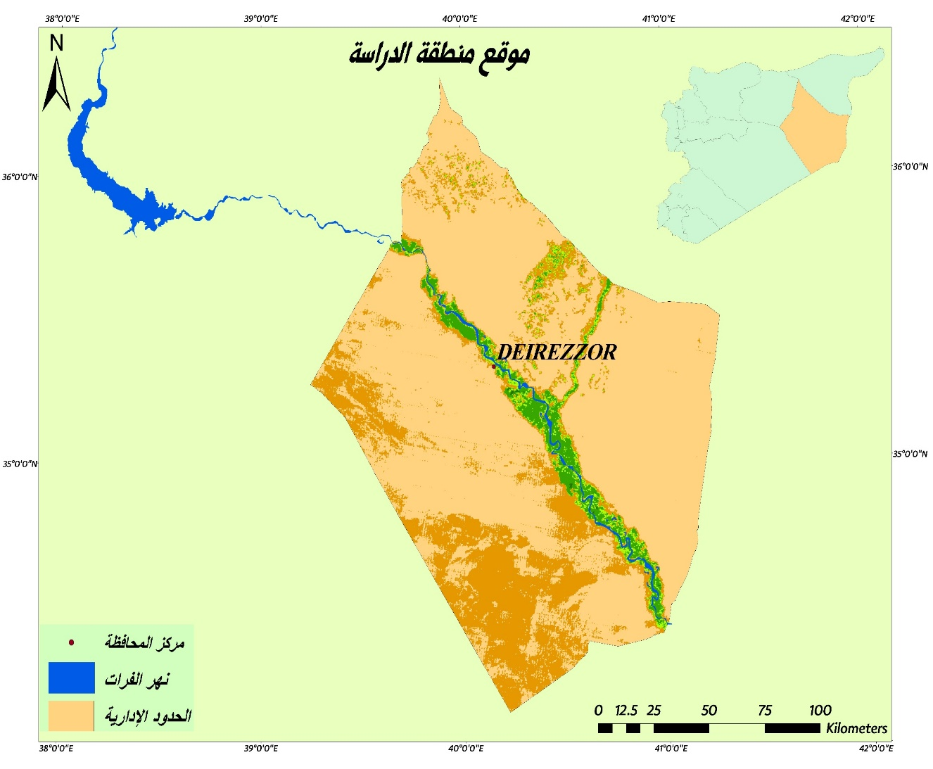
Study area
The total area of the governorate is 33.06 thousand km², occupying 17.9% of the country's area.
It is extends between the longitudes of (39˚˚ 14' 36" - 41º 13' 7") east.
And latitudes of (36˚ 20' 23" - 33º 7' 29") north.
Its average height is 220 meters above sea level.
Location of the study area
Climate of the study area:
The climate of the study area is Mediterranean with a continental influence, and climatically it is classified into semi-arid, arid and extremely dry regions according to the Amberger classification. It is characterized by a long dry season extending from June to October, and a cold winter with an average rainfall of 160-200 mm annually.

Slide 5
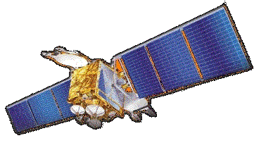
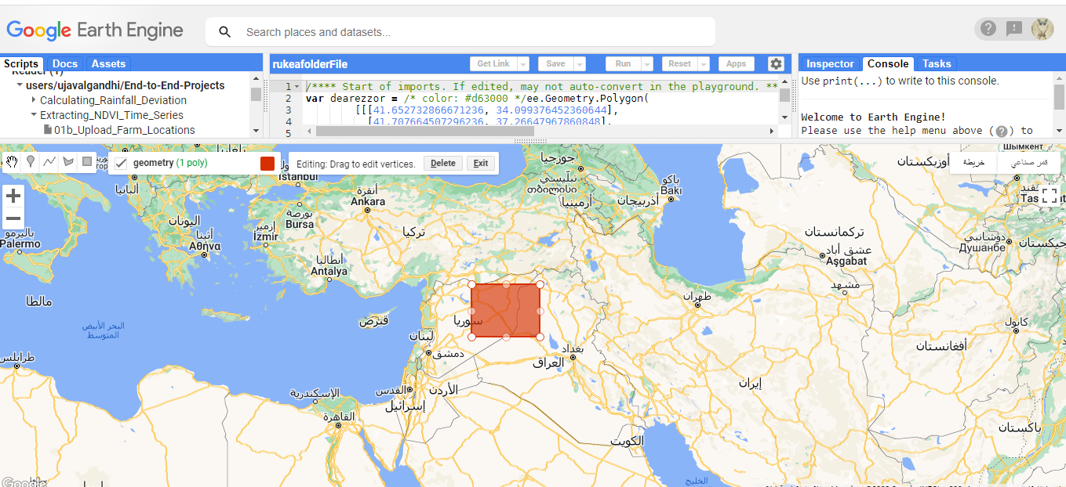
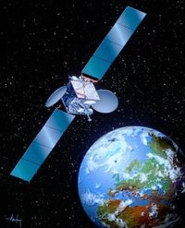
Data
Satellite images:
NDVI images from MODIS (Terra/Aqua) satellite data were used for the time series from 2012 to 2022 (11 years) for April of each year. Which is characterized by great temporal accuracy compared to other satellites (time period of 16 days), and its spatial resolution is 250 m. The processing level is the third level.
Data were extracted and processed using a JavaScript code editor in the GEE (Google Earth Engine) platform https://earthengine.google.com/, which provides big data processing capabilities for even very large study areas.

Slide 6
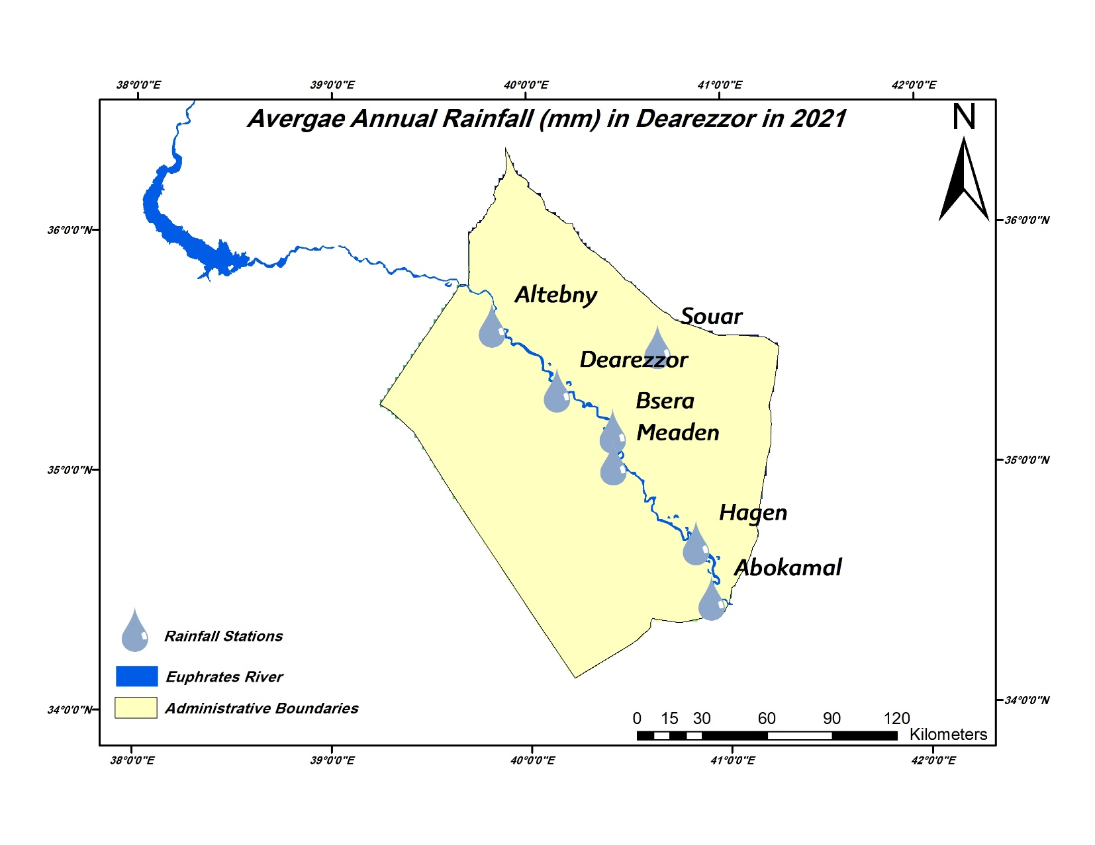
Rainfall data:
Annual rainfall data for the period 2012-2022, obtained from the Agricultural Rainfall Enhancement Project, were used to determine the average rainfall for the study area for five rain stations: Deir ez-Zor, Al-Tebny, Souar. Meaden, Abu Kamal.

Slide 7
Methodology
Rainfall maps:
Rainfall maps for the study area were prepared using the annual Rainfall rates for the five climate stations within the ArcGIS 10.8.2 environment using the Kriging tool from Spatial Analyst.

Slide 8
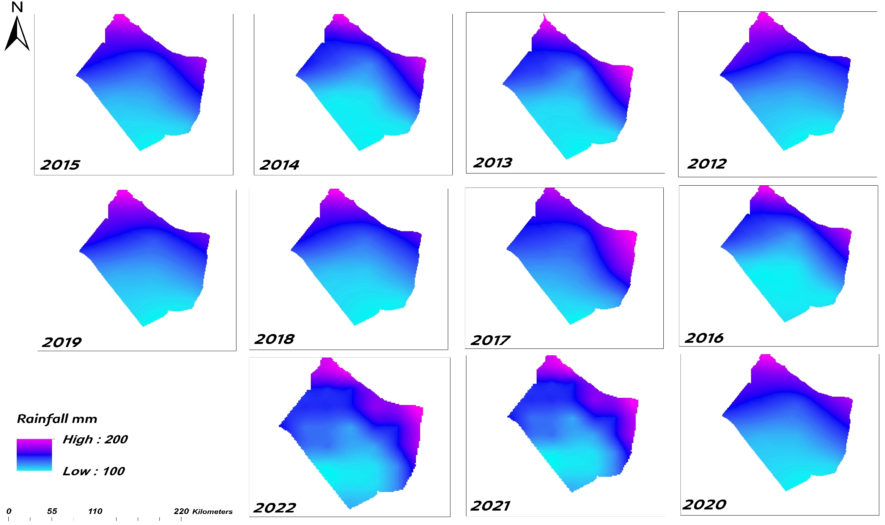
Rainfall maps for the study area for the time series 2012-2022

Slide 9
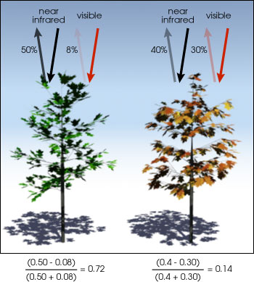
Normalized difference vegetation (NDVI) maps
It is considered the most widespread indicator, it is the ratio between the reflectance difference in the red and near infrared (NIR) spectral bands relative to their sum, it is calculated from the following equation:
$$NDVI=\frac{NIR−R}{NIR+R}$$
The area of Deir ez-Zor Governorate was cliped from the satellite images according to the administrative boundaries approved by the Ministry of Local Administration, and the satellite images representing the NDVI index were classified into rows using ArcGIS 10.8.2.
As Table 1 shows:
Classification | NDVI
water | -0.8
 | -0.5
 | 0
Barren lands | 0.1
Pastures, grass, shrubs | 0.2
Medium plant cover and field crops | 0.3
 | 0.4
 | 0.5
forests | 0.6
 | 0.76
 | 0.82

Slide 10
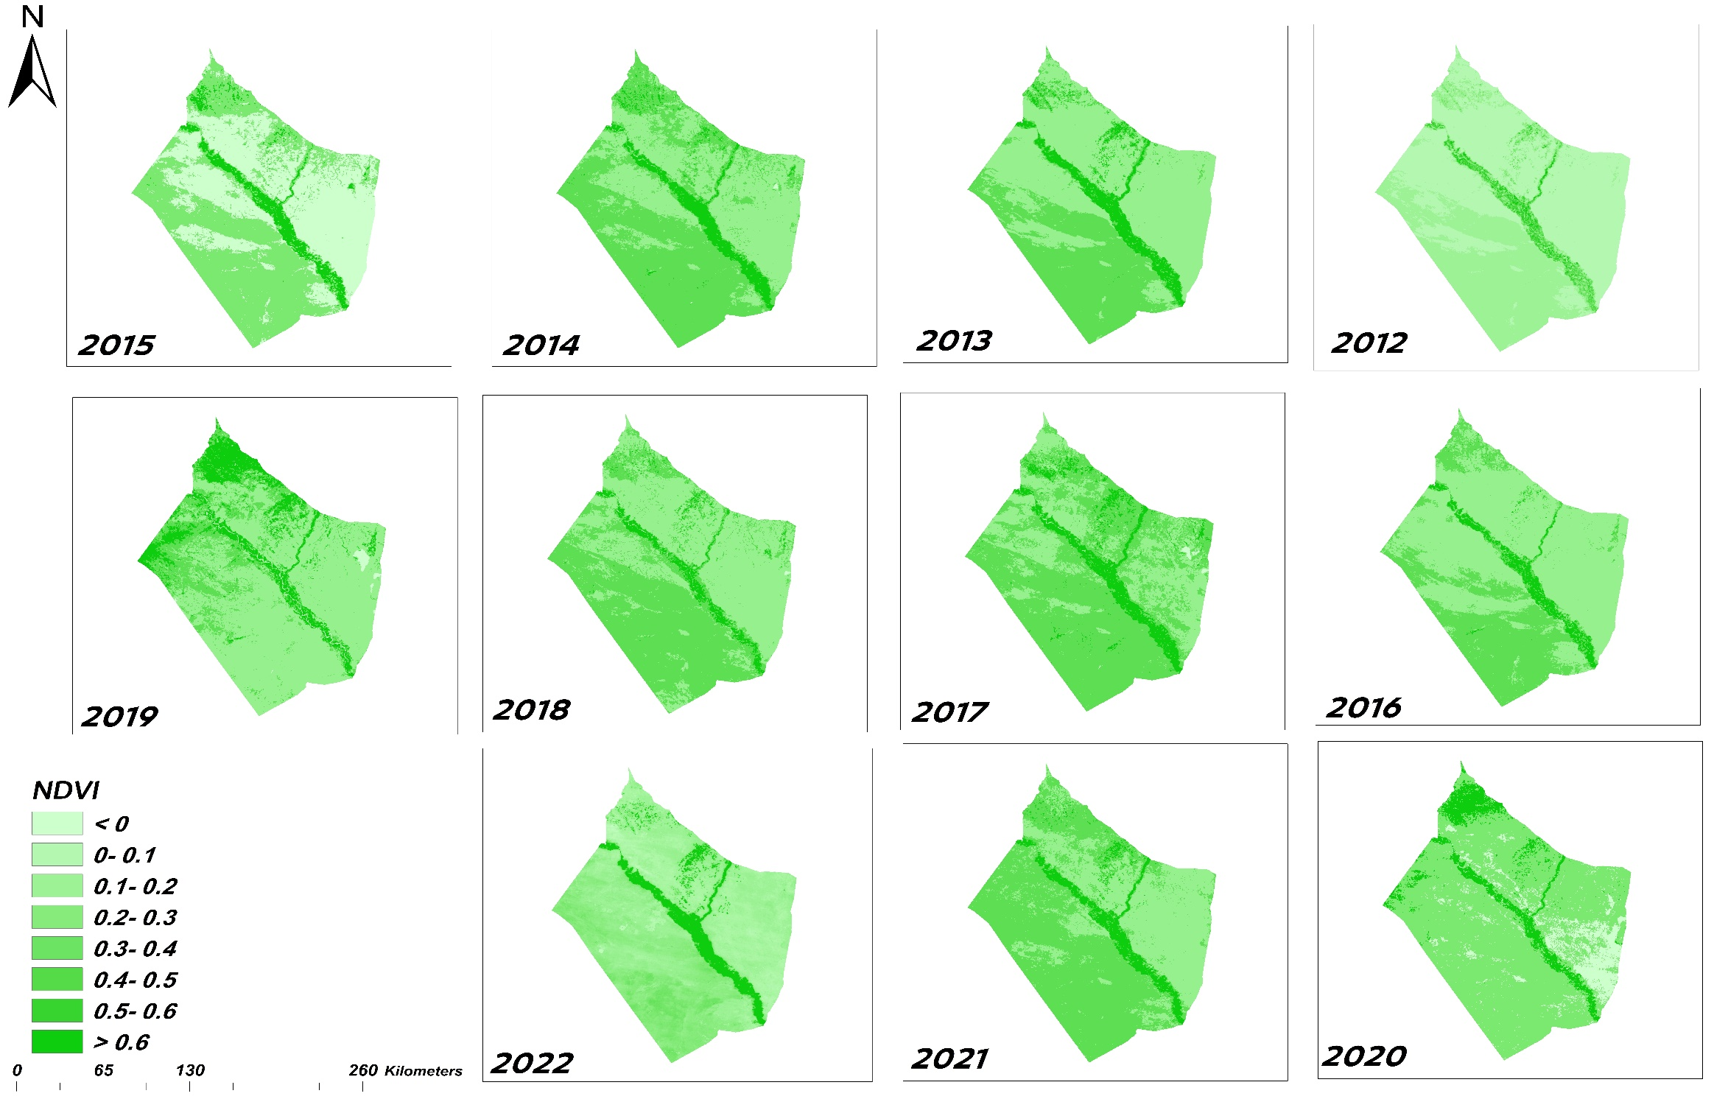
NDVI maps in April of each year for the study area during the time series (2012-2022)

Slide 11
Results and Discussion

Slide 12
Correlation of rainfall with NDVI index
The results showed that the lowest value of the NDVI vegetation index was in (2016) with an average of 0.098, which represents the driest years during the studied series, corresponds the lowest rainfall rate in the studied series (131 mm), while the highest value was in 2019 with an average of 2.4. This corresponds to the highest mean rainfall of 206.67 mm, thus represents the least dry years during the same series. There was also a strong correlation (R = 0.7) between the general mean rainfall amount for the studied time series and the general mean values of the NDVI vegetation index. We also observe relatively average values of the NDVI index during the rest of the years, accompanied by rainfall values as well.

Slide 13
the NDVI vegetation index maps , which were classified into rows from (-0.2 to 0.8) using the (ArcGIS 10.8.2) program, also showed: The barren lands with simple grass coverage (0-0.1) occupied an area estimated at 90% of the total area of the studied region, with the exception of the year 2019, where pastures and rain-fed crops (0.3-0.4) occupied 85.45% of the total area of the studied region

Slide 14
Conclusion
The study concluded several results, the most important of which are:
-The effectiveness of using MODIS satellite images to derive drought indicators for any region in the world. Using these indicators, the development and severity of drought in a country or region where ground observations are absent or limited can be monitored and estimated (such as Syria and the Arab region).
-The study showed that changes in the vegetation index (NDVI) are related to changes in rainfall, which indicates the possibility of using it to estimate, and study drought as a simple method derived from satellite data in isolation from ground data.

